Slide 1
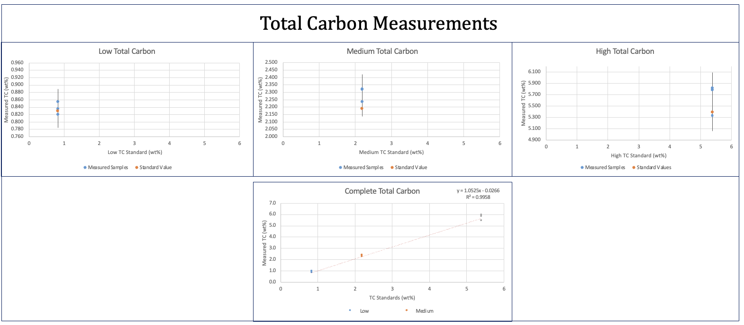
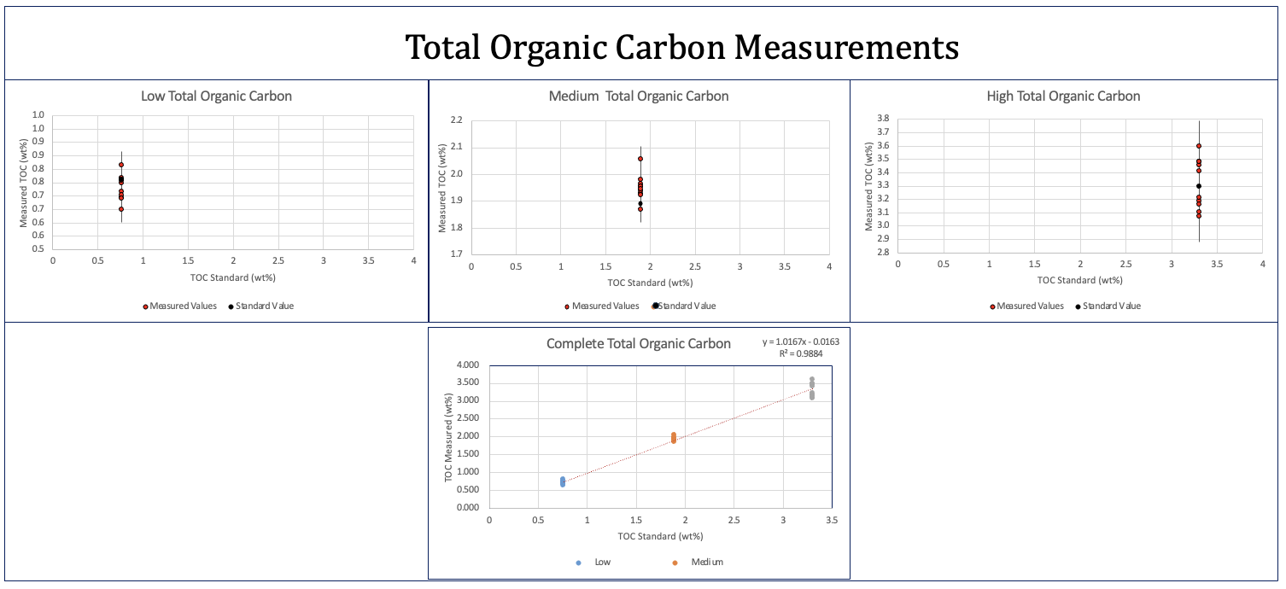
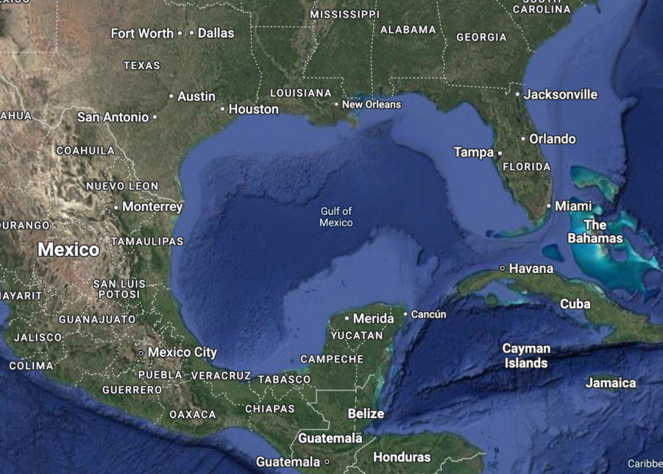
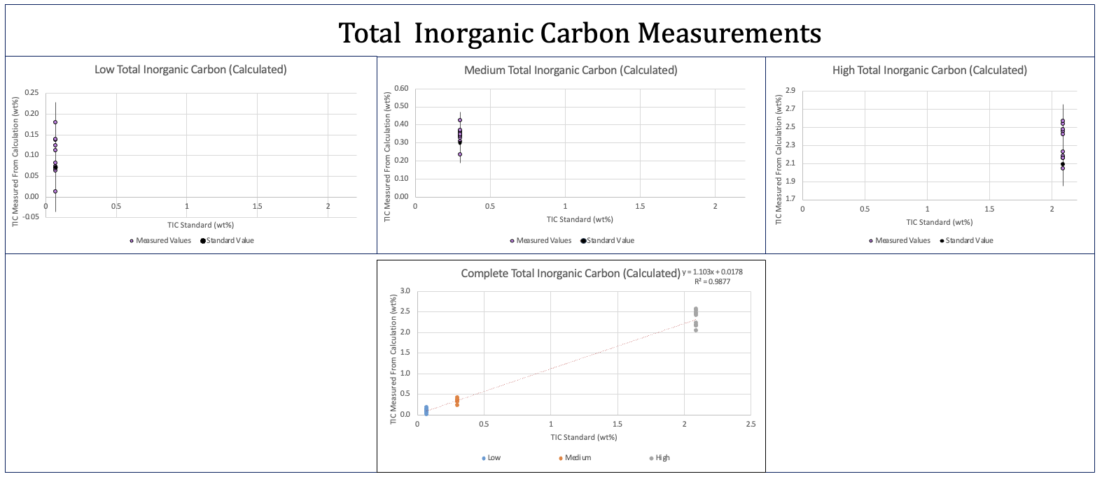
Isolating Charcoal in Synthetic Marine Sediments: Refining Carbon Removal Techniques Amelea Hauer Advisor: Professor Joel Johnson Department of Earth Sciences, University of New Hampshire, Durham, NH
Research Questions
Results
What is the most accurate method to isolate charcoal in a marine sediments?
How do carbon components in the sediments respond to variable acid and peroxide treatments?
Ultimate Question: Will charcoal found in marine sediments from the Gulf of Mexico reflect paleoclimate and/or paleofire events from the past?
Soil Standard Type | Label | Soil Composition | Total Carbon (TC) = wt% | Total Inorganic + Carbon (TIC) wt% | Total Organic Carbon
 |  |  |  |  | (TOC) wt%
Low | B2180 | sandy | 0.83+/-0.05 | 0.07 | 0.76
Medium | B2182 | silty | 2.19+/-0.05 | 0.3 | 1.89
High | B2188 | chalky | 5.39+/-0.09 | 2.09 | 3.3
Low, Medium, High are characterized by the increasing weight percent (wt%) of carbon types (TC, TIC, TOC) in the soil standards.
These standardized amounts are valuable for ground truthing the accuracy of the TC, TIC, and TOC measurements taken by CHNS analysis at the University of Washington- Stable Isotope Core Laboratory.
Information from Elemental Analysis and the Certificate of Analysis for each soil standard type.
Study Site: Gulf of Mexico
Sample Prep:
Avg: 0.84
Std: 0.83
Avg: 2.29
Std: 2.19
Avg: 5.64
Std: 5.39
Avg: 0.73
Std: 0.76
Avg: 1.95
Std: 1.89
Avg: 3.32
Std: 3.3
TC is the summed amount of Total Carbon in the soil standard, including TIC & TOC.
TC= TIC + TOC
No 6% Sulfurous acid treatment
Measured total amount of carbon in the standard.
No outliers within 2σ range
With increasing TC content, the measurement ranges get larger, the more TC the less accurate the measurement.
TOC is the measure of how much organic carbon is in the standard.
Organic carbon: decomposed organisms, plant matter, decomposition products, charcoal
TOC= TC-TIC
6% Sulfurous Acid Treatment (TIC)
No outliers within 2σ range
No outliers within 2σ range
With increasing TOC content, the measurement ranges get larger, the more TOC the less accurate the measurement.
High
High
Picture: Adding Nitric Acid to samples with glass microsyringe
High
Methodology
Peroxide Treatments on Charcoal
Charcoal & Nitric Treatments
Purpose: To create a method of acidification to isolate charcoal in marine sediments.
Approach:
-Soil Standards: silver capsules, 10mg of standard, 6% sulfurous acid treatment.
-Charcoal Samples: silver capsules, 10mg of sieved (45-63 micron) lab grade charcoal, 33% Peroxide treatments, 68% Nitric Acid treatments.
Analyses:
- CHNS analysis on standards for TC, TIC, TOC wt% & δ¹³C isotopes
- Measured weight changes in charcoal samples & blanks
Failed & Incomplete
Method: 10mg of sieved charcoal treated with 30 µL of 68% Nitric Acid every 4 hours.
No visible reaction
Findings: Upward trend in weights after Nitric treatments
Hypothesis: Nitric acid did not fully dry in between treatments and/or a chemical reaction happened causing a precipitate to form.
Nitric & Peroxide alternating treatments terminated due to corrosion.
6% Sulfurous Acid | Removing CaCO3 (TIC) | Variable additions | 780 µL total
68% Nitric Acid | Bleaching/removing organic matter (TOC) | 30 µL | 120 µL total
33% Peroxide | Bleaching/removing organic matter (TOC) | 10 µL | 80 µL total
Avg: 0.099
Std: 0.07
Avg: 0.34
Std: 0.3
Avg: 2.32
Std: 2.09
10mg of sieved charcoal treated with 10 µL of 33% Peroxide every 4 hours.
Visible reaction
Findings: Downward trend in weight from treatments due to charcoal overspilling from reaction and contamination on microsyringe.
TIC is the measure of how much calcium carbonate (CaCO3) is in the standard.
TIC= TC-TOC
TIC (Calculated)= (mean TC wt%) – (TOC wt% sample)
*ex: low mean TC wt% – low TOC wt% sample
No outliers within 2σ range
With increasing TIC content, the measurement ranges get larger, the more TIC the less accurate the measurement.
Empty silver capsule (blank) treated with 10 µL of 33% Peroxide every 4 hours.
Visible reaction
Findings: Slight upward trend in weight throughout treatments.
Conclusions & Future Work
of TC
Conclusions:
With increasing amount of carbon components in soil standards there is a larger range of error in the analyses, carbon is hard to remove.
The 6% Sulfurous Acid treatments on the soil standards successfully dissolved the CaCO3 yielding a marginally homogenous result of δ¹³C ~-26 to -27‰ isotopes.
Use of Nitric Acid treatments on charcoal resulted in abnormally large weights.
Use of Peroxide on charcoal was highly reactive and caused charcoal to spill out of the silver capsule and to contaminate the micropipette resulting in mass lost shown in the weight measurements.
Future Work:
This senior thesis work will be applied to my Master’s project at UNH with Joel Johnson involving real marine samples taken from a sediment core from the Gulf of Mexico. I will be analyzing those sediments for charcoal to try and traceback where the charcoal came from, and if there are recognizable patterns, such as glacial meltwater pulse periods, large forest fires, and possibly the origin of the charcoal.
Avg: -26.7
Avg: -23.0
Avg: -17.0
Avg: -26.3
Avg: -27.8
Avg: -26.9
Avg:-27.8
Low (No Acid), δ¹³C ~-26‰ -> C3 terrestrial organic carbon
Med (No Acid), δ¹³C ~-23‰ ->mixed signal between C3 terrestrial and aquatic carbon
High (No Acid), δ¹³C ~-17‰ -> soil carbonate
Low, Med, High (Acid Treated), δ¹³C ~-26 to -27‰ -> C3 terrestrial organic carbon
Findings: Shift in δ¹³C isotopes when treated with 6% Sulfurous Acid, this shift was due to dissolving the CaCO3 from the soil standards (getting rid of the inorganic carbon) and leaving the organic carbon to be reflected in the measurements.
No outliers within 2σ range
The higher the amount of CaCO3 the larger the discrepancy between the standards of the same value (ex: high (no acid) & high (acid treated)).
References & Acknowledgments
-Professor Johnson for being my advisor on this project and guiding me through this process.
-Professor Florencia for lab safety and questions on the acids used.
-UT-GOM2-2 Expedition and Crew for the funding.
-David Aawiller & Lory Summa for guidance and advice on the charcoal experiment.
-University of Washington- Stable Isotope Core Laboratory for doing the wt% and δ¹³C measurements.

