Slide 1
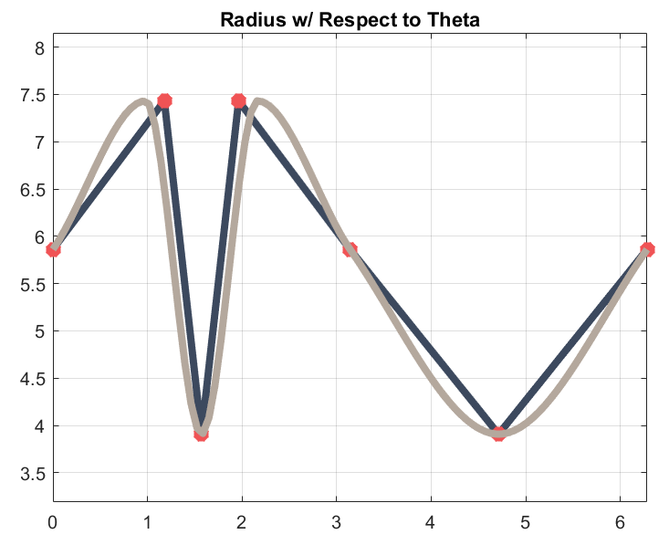
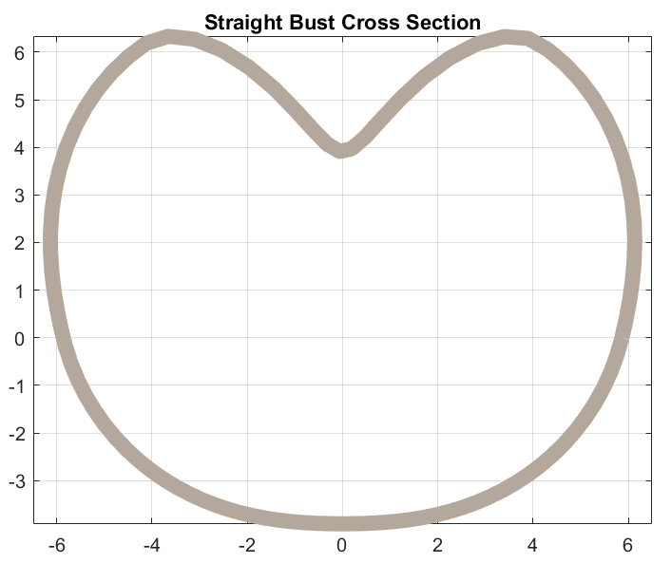
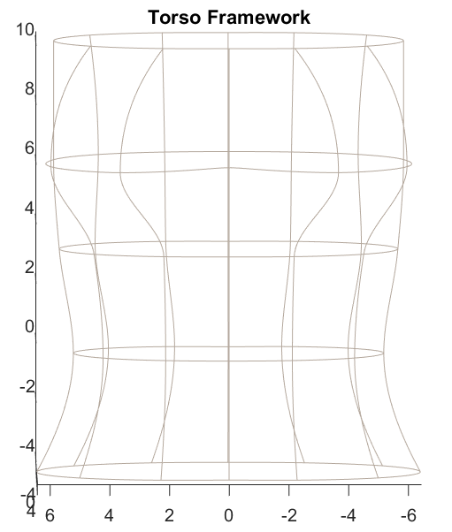
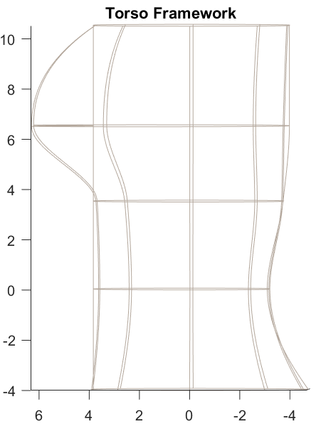
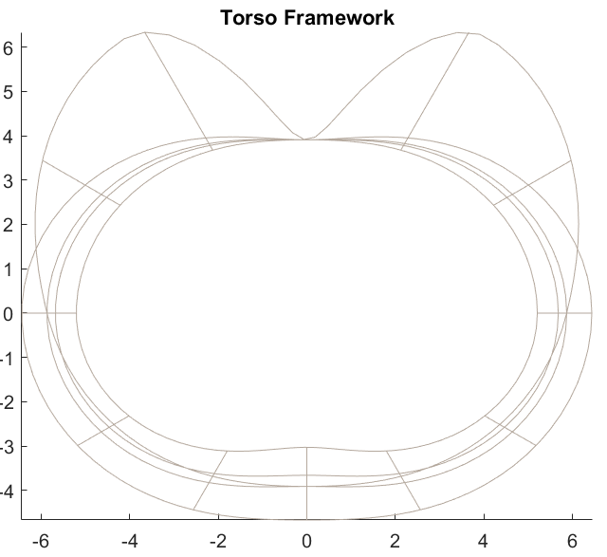
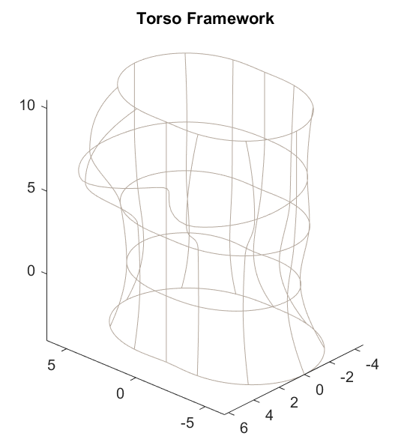
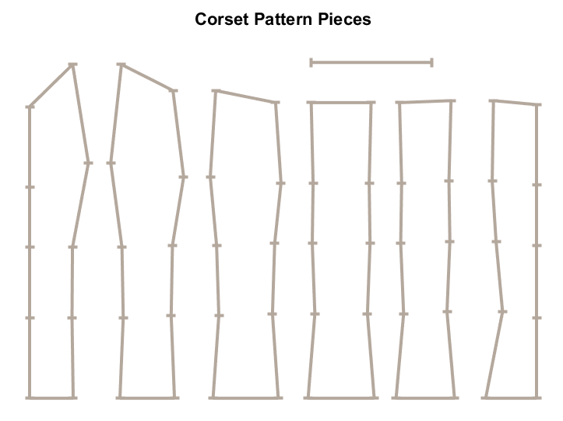
Measurement-Based 3D Torso Modeling for Corsetry
Lily Grymko, Innovation Scholars: Patterns and Symmetry - Advisor: John Gibson, Ph.D.
Introduction
Methodology
Results
In corsetry, a precise fit is essential because a small inaccuracy can make a difference to comfort, structure, and appearance. A common way to make a corset is to create a cast of one’s body and then split it into pattern pieces. The goal of this project was to mimic this process by creating a mathematical 3D body model which can then be used to create the corset pattern.
Traditional 3D body modeling is typically a result of scans or photographs of one's body, which is usually uneconomical, invasive, or simply impractical. However, I developed an innovative technique to create accurate standardized 3D torso models from a handful of simple measurements. The models are constructed with polar-coordinate cross sections and basic mathematical interpolation.
My process uses these digital torsos to successfully complete custom design and pattern drafting in a precise manner. For designers and makers, I am providing a creative tool that reduces material waste during prototyping, and that also increases accessibility for independent or beginner hobbyists to create structured garments without a physical studio.
To the left: A graph of the radius of the cross section of a straight bust with respect to theta. This can also be written at r(θ). When on a polar coordinate system it would look like the shape on the right.
To the right: In order to create the 3d framework, coordinates must be converted to the Cartesian coordinate system.
The results of the project were very successful. Using a pattern that was generated based directly on measurements put into the program, the desired applications of this project were produced.
A corset that directly mimics the dimensions of the body. This is the red and green flowered corset. When comparing the measurements of the corset with the measurements of the model, they align mostly accurately. With one exception being the chest, which is tight.
A planned second corset is based off the measurements one would use for a wearable shapley corset. This means the true body measurements had margins added to them so they would be able to fit around a body instead of directly mimicking the body.
One mistake to note is that while the pattern came out accurately, there is a mistake in the code when finding the arc lengths of the cross sections. This lead to the chest of the pattern being flatter. While for a typical corset this is desired, this would need to be fixed for applications in other disciplines. Additionally, the patterns produced do not create a desirable neckline. Necklines would need to be adjusted after the corset is mostly constructed.
Background
Corsetry is a precise craft. A properly fitted corset takes into consideration body measurements, such as bust, underbust, waist, hip, and torso length, across a series of panels drafted and sewn with curved seams and boning to form the shape of the torso. Measurement accuracy shows up in body comfort, function, and appearance of a garment’s final product.
Corsets have suffered from an inaccurate historical view as tools for constricting or warping the body. This is a misconception brought on by people wearing ill-fitted corsets. Both historical and modern corsetry is focused on support, comfort and body diversity using anatomical shaping rather than compression.
Many corset makers today prioritize precision and dependability, but traditional body drafting is both time consuming and inconsistent; while 3D scanning is expensive and possible invasive.
This project seeks to present a measurement-oriented solution that produces anatomically accurate 3D torso models, using mathematical (not scanned) modeling. Torso segments are represented in polar coordinates (r, θ) based on circumferential measurements. Using trigonometric ratios these coordinates can be converted to the Cartesian coordinate system (x,y). The cross sections are stacked along the vertical axis (z) and their surfaces are then interpolated to produce a smooth and continuous mesh. This creates a framework of the torso. By finding the arc length of pieces of the framework, the sewing pattern can be generated. By using the front/back and waist of the corset as anchors, the arc lengths create the proper curves between pattern pieces.
Possible Future Applications
Despite the focus on corsetry for this project, there are many possible applications for this research. Such uses include:
Fashion and Apparel: Virtual try-ons, mass customization, reduced returns
Telemedicine: Remote diagnostics, posture correction, prosthetic fitting
Gaming and VR: Fast avatar generation, body diversity, realism
Ergonomic Product Design: Custom-fit chairs, body supports, wearable tech, designing around real human form factors
Forensics and Anthropology: Reconstructing bodies from measurements or skeletal data
Fitness: Body tracking over time, precise graduated compression clothing
Privacy-Preserving Modeling: Generates accurate 3D torso models without requiring scans or photos, protecting user identity and body data.
The torso framework is composed of several cross sections of the body stacked on top of eachother. These distances are defined in the z-axis, and are obtained through measurements of the real person’s body. The model is also able to account for the curves of somebody’s spine and butt. It does this by assuming that the points along your sternum and belly button are all perpendicular to the ground. This isnt always true for everyone, but if use for corsetry, the goal is to create a flat stomach. The seams of the pattern are the interpolated sides. The seams allow for boning since they are straight when viewed radially.
The line at the top of the corset pattern is the scale. This is used to print the pattern out at the proper dimensions. If this pattern was printed, the scale would need to measure 6 inches to guarantee the right fit.
Contact Information
If you have any questions or would like to talk more about this project, feel free to reach out through email. I am available at lily.grymko@unh.edu.

