Slide 1


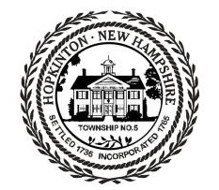
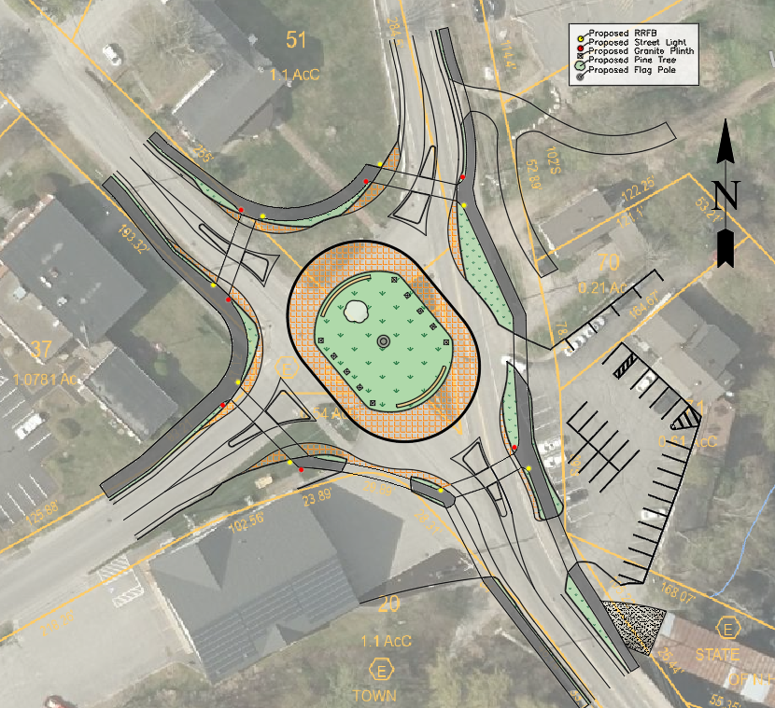
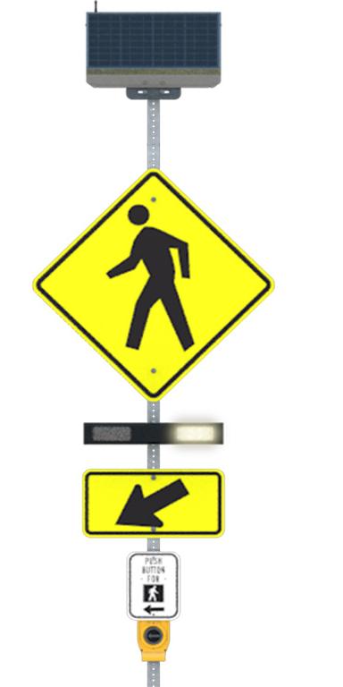
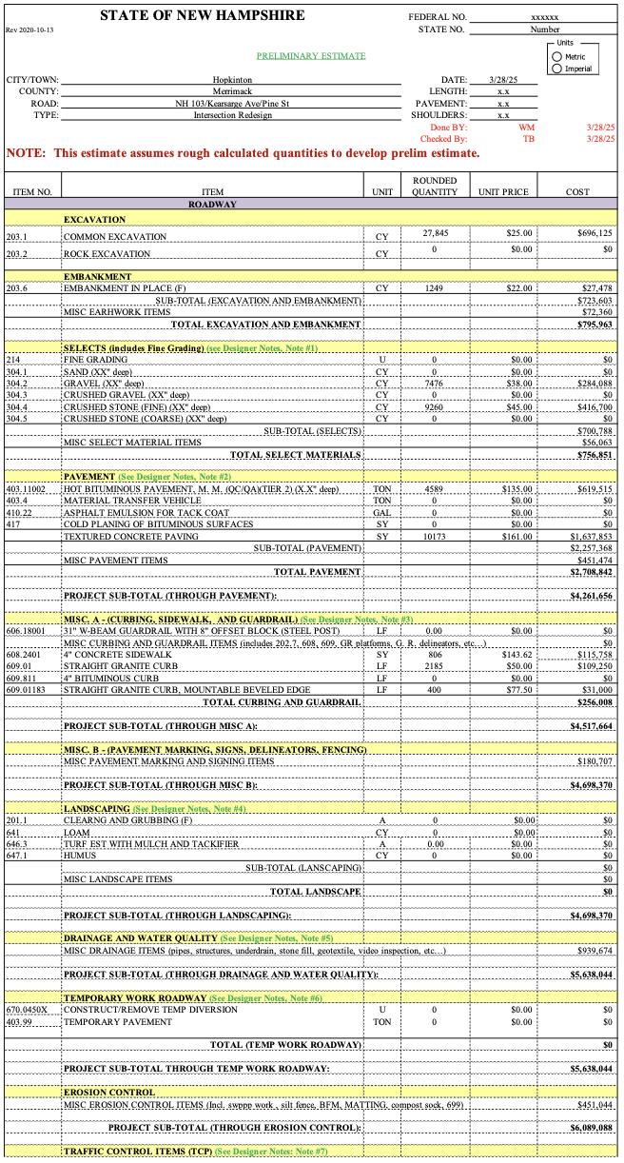
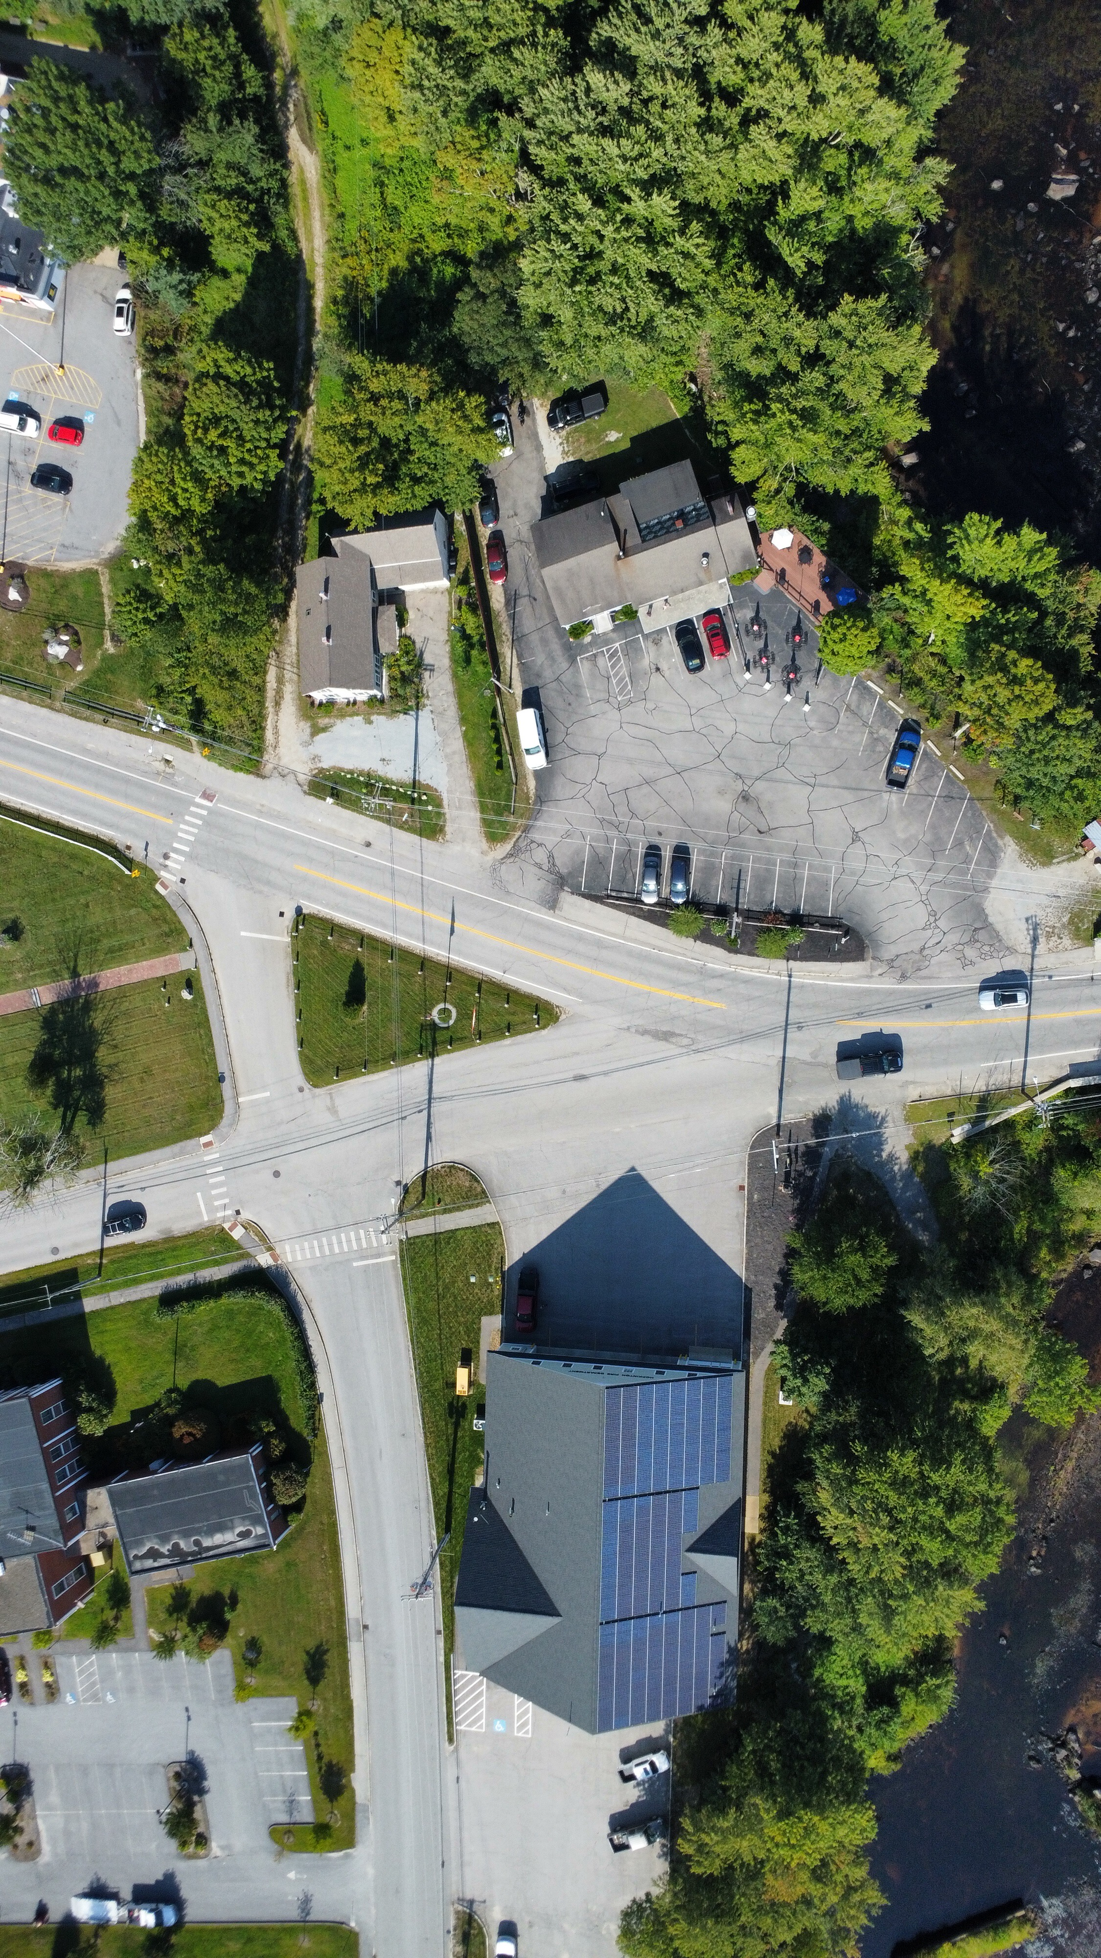
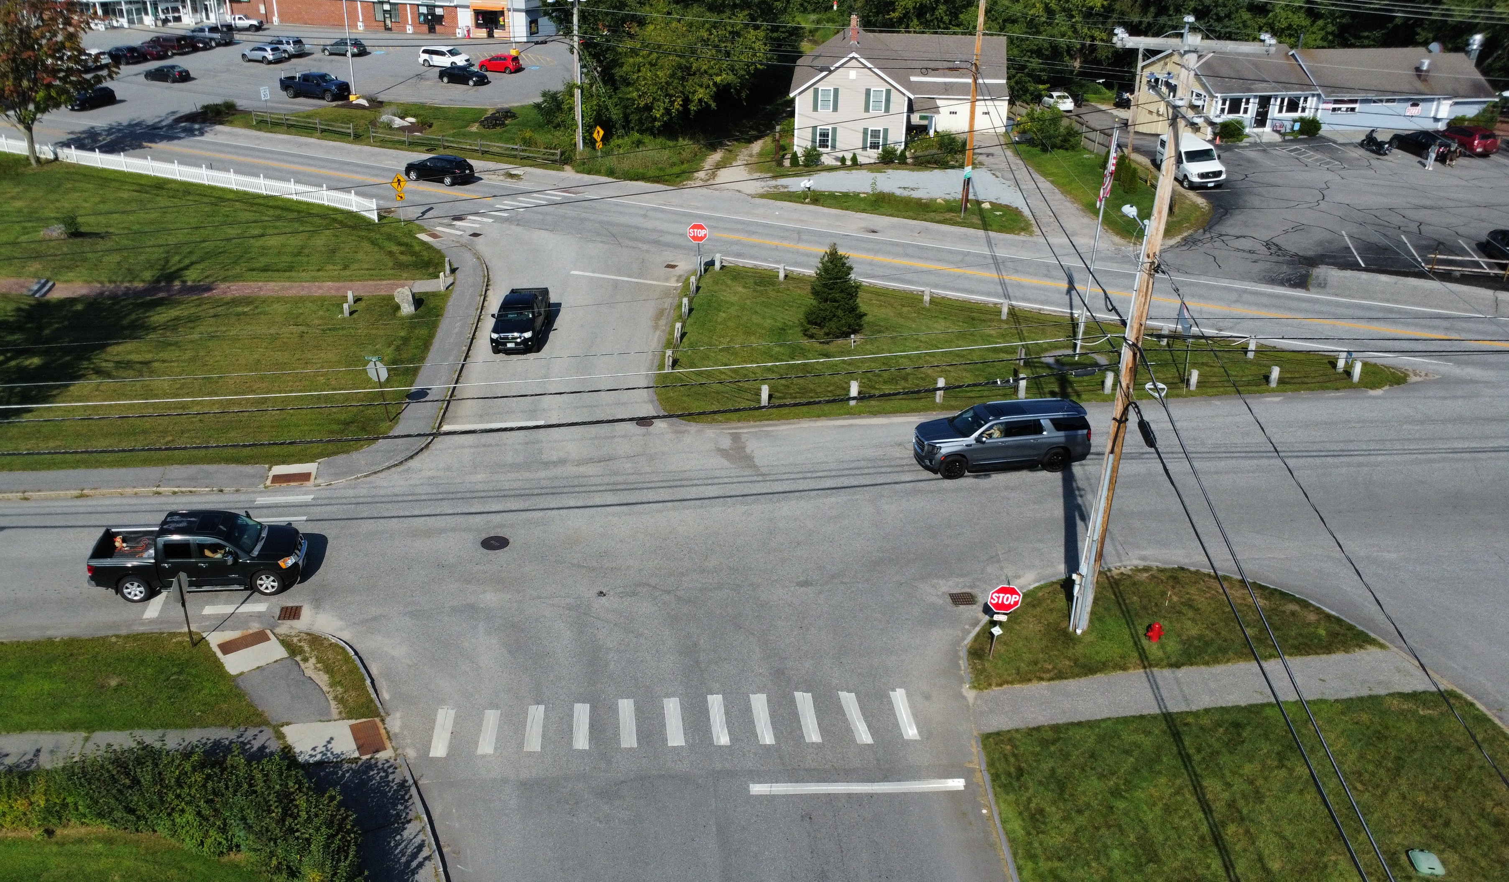
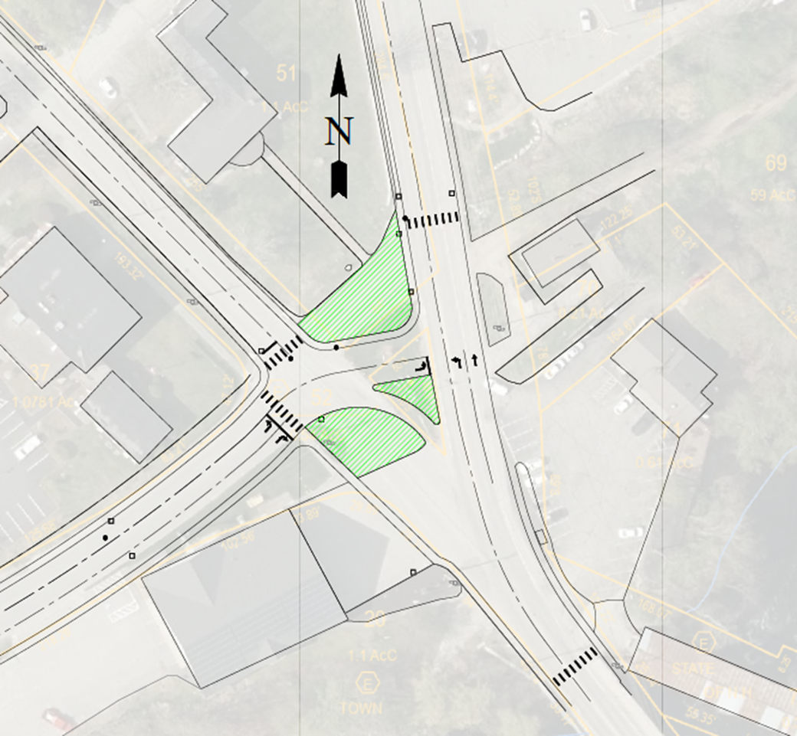
Hopkinton Intersection Redesign
Tyler Beresford, Cole Cronin, David Fisk, Will Mollo
Department of Civil and Environmental Engineering, University of New Hampshire, Durham, NH
Introduction
Proposed Redesigned Intersection
Pedestrian Safety
This five-way intersection in Contoocook, New Hampshire, serves as a vital hub for the Village of Contoocook and the Town of Hopkinton. It connects residential neighborhoods with key community amenities including schools, businesses, recreational facilities, and public services. This intersection, formed by Pine Street, Kearsarge Avenue, and NH Route 103 (Park Avenue/Main Street), suffers from confusing alignment, poor sightlines, and moderate traffic, including commercial trucks, farm equipment, pedestrians, bicyclists, and ATVs. Due to these factors, the intersection has safety concerns and inefficient traffic flow. With approximately 6,971 vehicles using NH 103 daily (and additional non-motorized traffic), the Town has prioritized improvements to this area. In collaboration with the town and VHB, the project team will explore design alternatives to enhance safety, improve traffic flow, and visual aesthetics of the intersection.
The team identified pedestrian safety as a top area of focus with our new design. To better protect pedestrians in our intersection, we utilized Rectangular Rapid Flashing Beacons (RRFBs), built up pedestrian refuges, and grade separated sidewalks.
Project Estimate
Key Design Considerations
The team utilized a New Hampshire Department of Transportation to estimate the total project cost. Using this process, the team estimates the project will cost:
$5,600,000
Street View
User Safety
Overall Project Cost
Abutter Impacts and Access
Multimodal Accommodation
Green Space and Landscape Design
Chart #2 Sub-Title Here
Methodology And Existing Conditions
The team utilized a decision matrix to analyze the existing deficiencies at the intersection and rate proposed design alternatives. These alternatives included various roundabout sizes and locations, realignment of Pine Street and Kearsarge Avenue, and upgrading this intersection to a signalized intersection. Through research and trial and error, the team found a non-circular roundabout to be the best design option for our project. The team utilized all relevant NHDOT and FHWA standards and specifications for this design.
Conclusions
sTAMD Simulations
Our proposed redesign of this intersection addresses all of our key considerations while limiting adverse impacts to local stakeholders. This design improves mobility and safety for all users, without sacrificing the existing character of the area. Additionally, this design addresses the operational needs of the fire station and Riverside Pizza, while simultaneously minimizing impacts to abutter properties. The large center island and improved landscaping provides an attractive focal point for local community events while maintaining the look of the existing island.
Site Photos
Acknowledgements and References
Example of Proposed Realignment
Town of Hopkinton
Chuck Gregory, PE – VHB NH Highway Team Leader
Anna Wells - PlanNH
Tony Puntin, PE – UNH Capstone Coordinator/Faculty Advisor
Federal Highway Administration (FHWA) – Roundabouts: An Informational Guide
NHDOT

