Slide 1
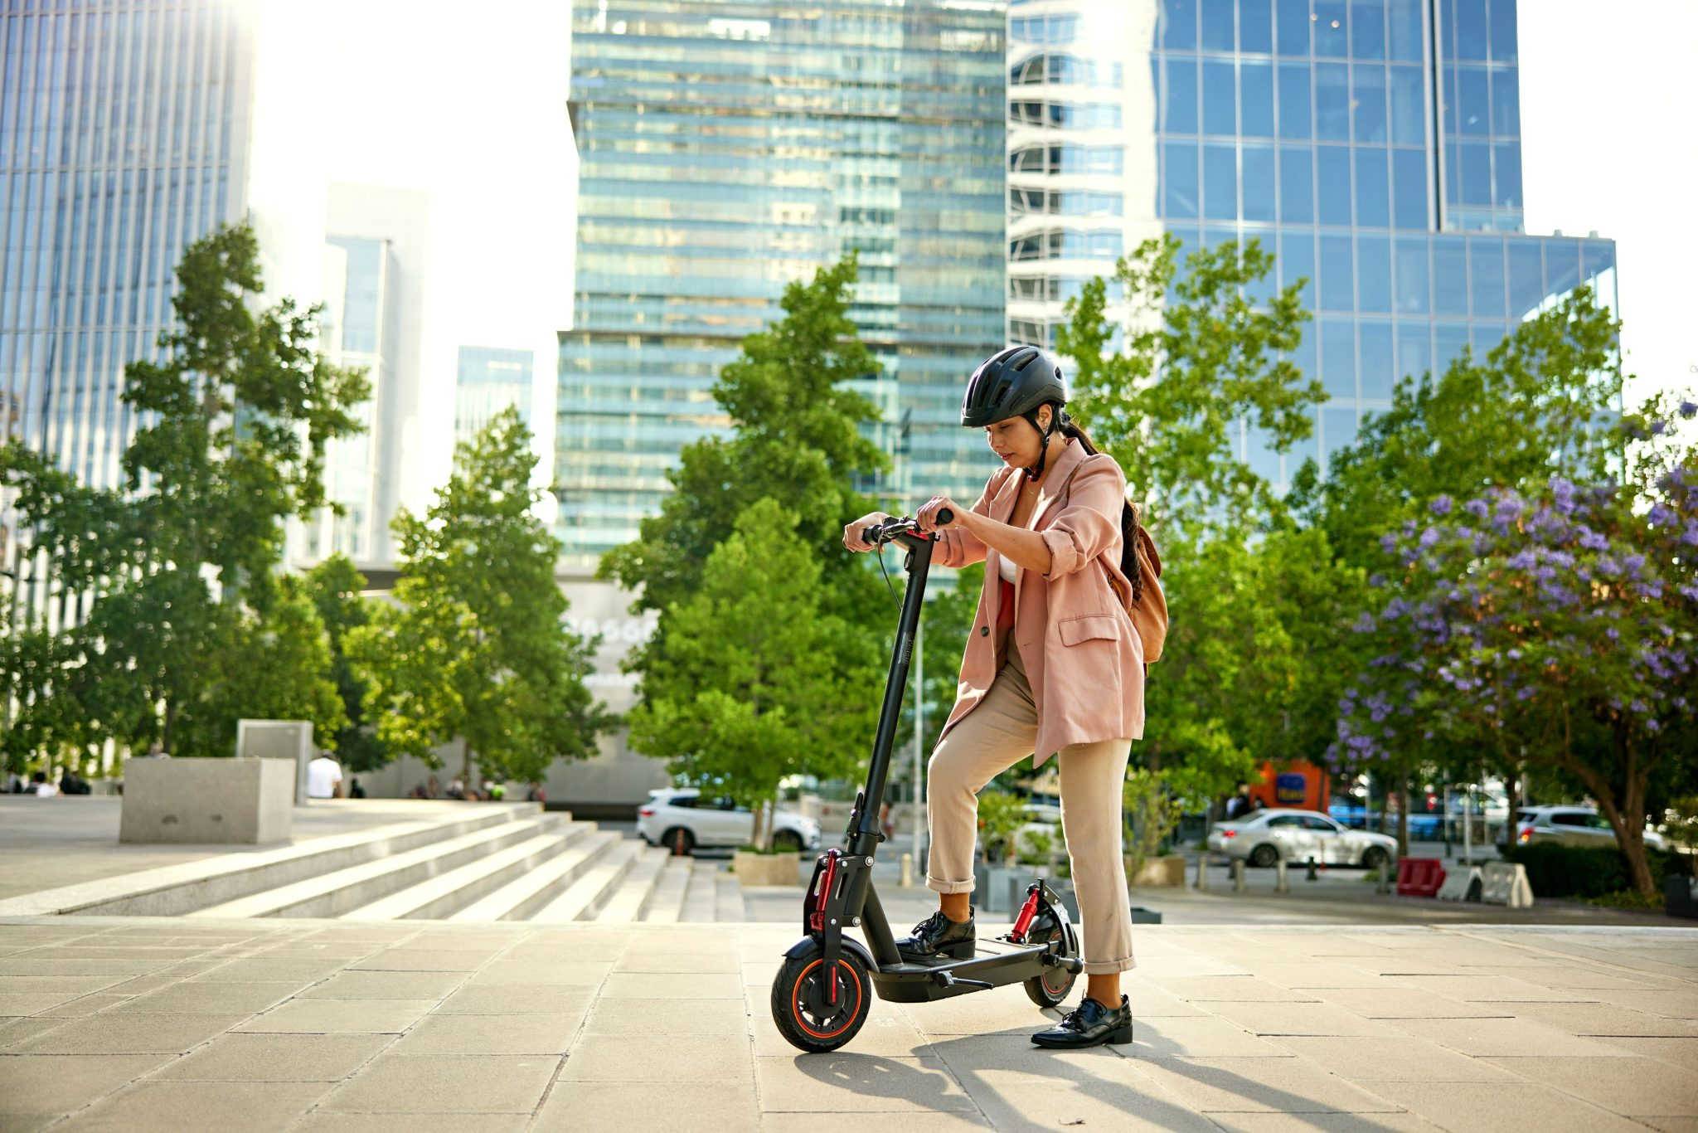
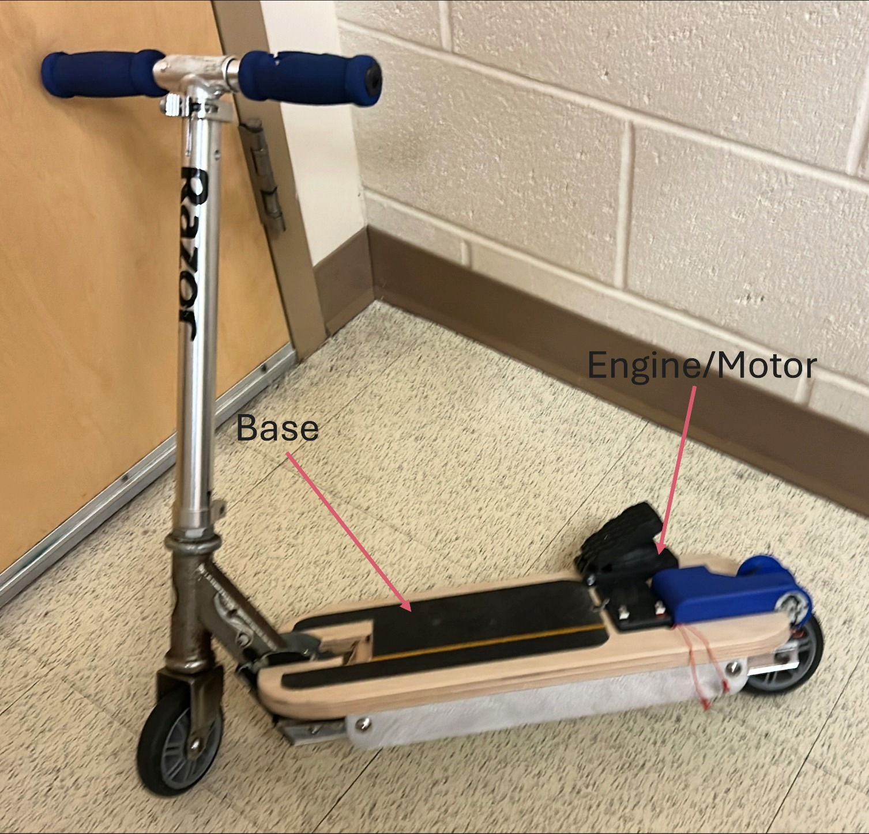
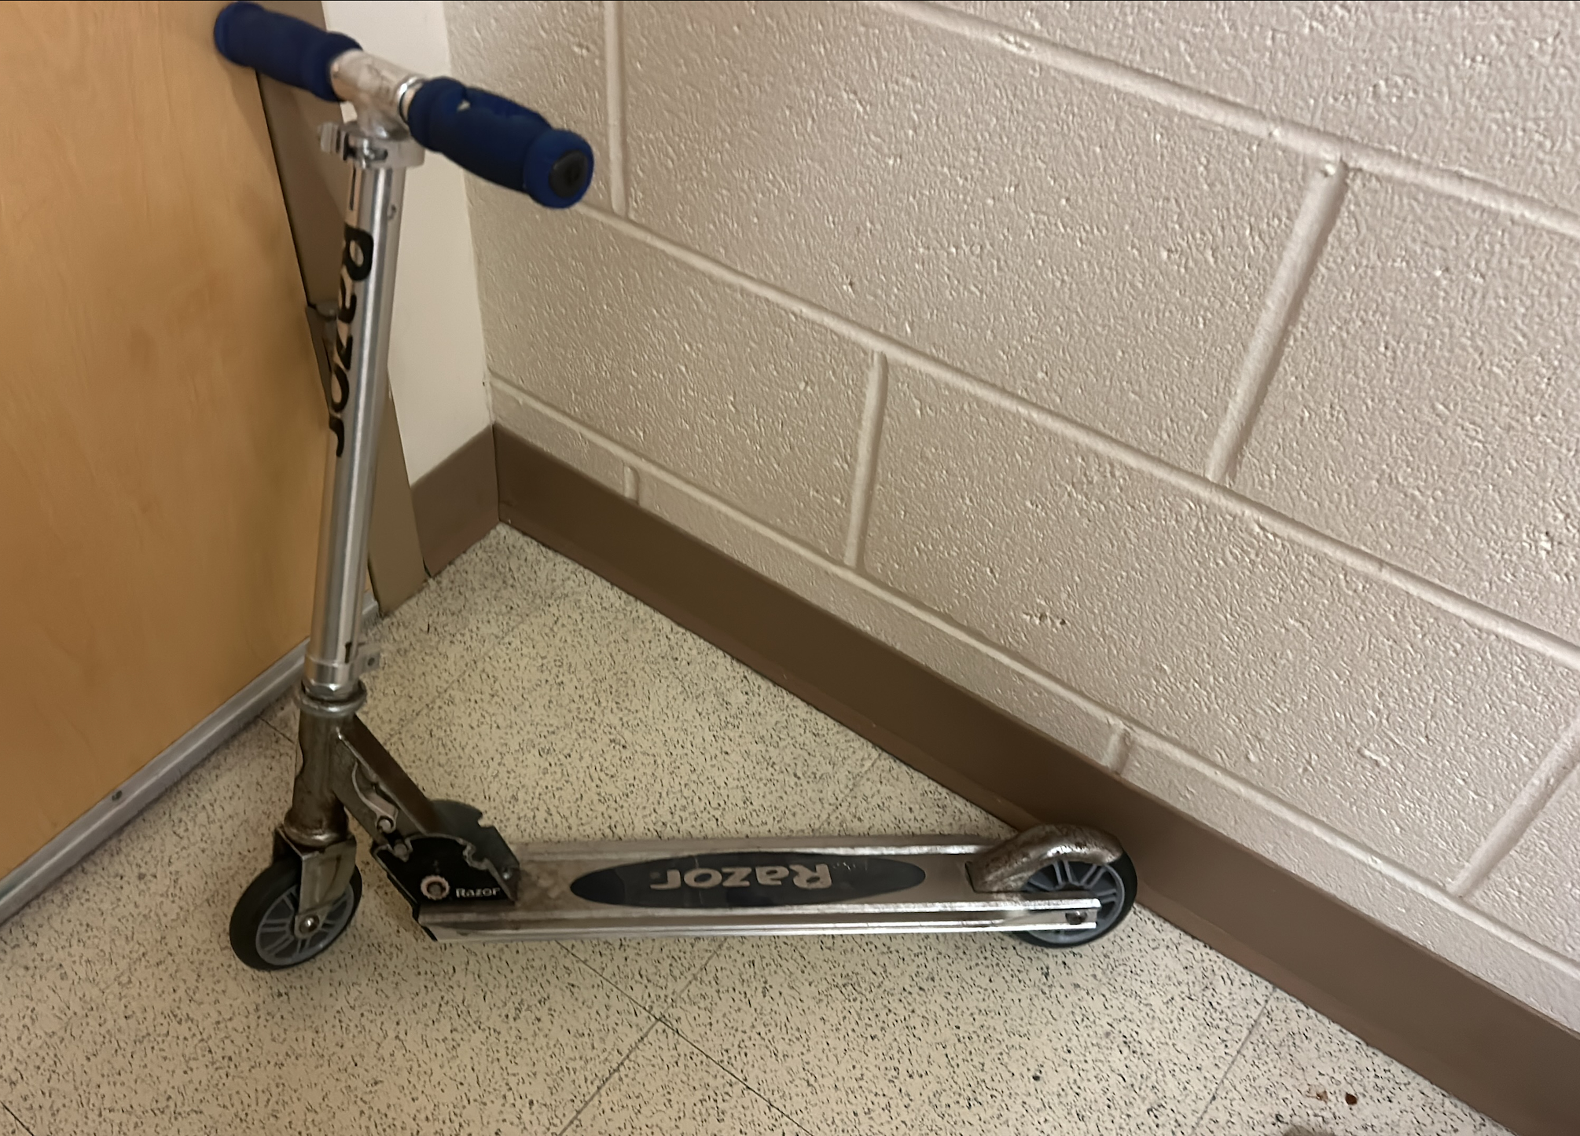
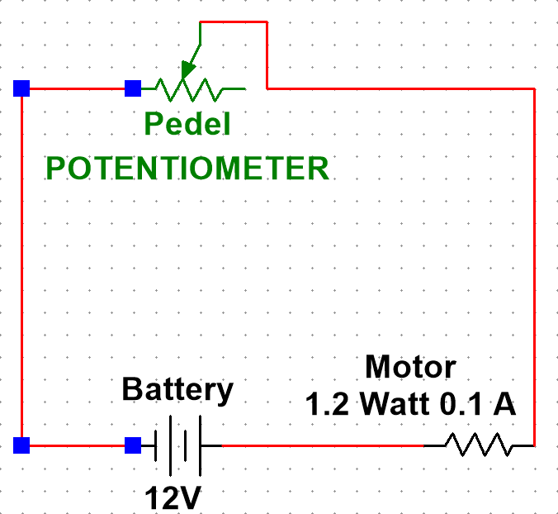
Turning a Razor scooter Electric
Upcycling an old scooter into an electric vehical.
Adam Vachon and Eddie Hall, Department of Electrical Engineering, University of New Hampshire
Background
Methods/Process
Price/Allowance: $200
($100 per participant)
Results
Electric scooters normally cost around $320 when looking for one just under $400 dollars.
It is very popular for college students for travelling on campus, but the price can be off-putting.
The goal was to see if it is feasible to make our a electric scooter for less than the normal price of what they usually cost.
Successfully converted Razor Scooter to an electric scooter for only $98.58
With a max speed of 10.4 mph
Access to an old razor scooter laying around.
Next was finding the supplies that were needed like motors to power it and a base to put everything on.
This included our final motor, being a 2.4 W, 3500 rpm, 3.2 mNm.
When supplies arrived, parts were 3D printed at the Makerspace in Kingsbury to help stabilize the items before they were put onto the scooter.
Quantity | Price/ unit | Vendor | Item description | Total price
1 | 9.99 | Amazon | Motor pinion | 9.99
1 | 19.99 | Amazon | Pedal variable resistor | 19.99
1 | 23.48 | Digikey | Battery | 23.48
1 | 27.6 | Transmotec | Motor | 27.6
2 | 5.77 | mcmaster | T-slot connectors | 11.54
1 | 5.98 | Lowes | Angle Aluminum | 5.98
Total |  |  |  | 98.58
Figure 1: A photo of a generic electric scooter
Figure 4: A photo of the completed device, mounted to the scooter with small labels of the largest parts.
Conclusions
The small base/bottom is too small for both of us, possibly a longer board would have worked.
It requires a bit of a run before you can the motor works, a stronger one would be required to get better results.
Objectives
What we learned
Converting a normal scooter to an electric one with a limited budget.
Would the engine that was bought be powerful enough to work.
Produce an item that can upcycle a common scooter into the modern day
Figure 2: A photo of the scooter prior to modification
3D printing
Hole drilling
Tapping
Electronics and controls design (controlling an electric motor)
Woodworking skills (Table saw, chop saw, disk and RO sanders, routing, clear coat, ect. )
Circuit Diagram
Future Steps
Contacts
Get a stronger motor/power source.
Find a better base model to use instead of a scooter that is more so for younger kids.
Eddie: Eddie.Hall@unh.edu
Adam: Adam.Vachon@unh.edu
Figure 3: A diagram representing the main circuitry of the device accurately represented in structural configuration, here around the wheel well.

