Slide 1
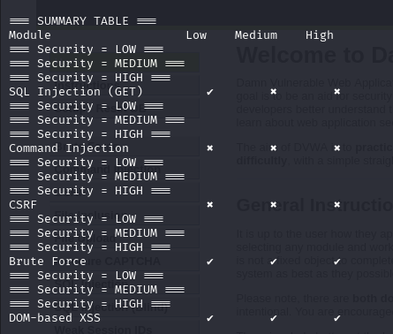
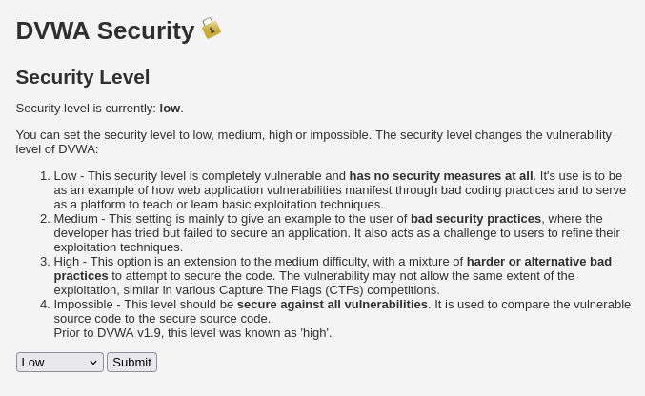
Vulnerability Scanner using DVWA Testing Command Injection, SQL Injection, CSRF, XSS, and Brute Force Jameson Dunsford Department of Computer Science, University of New Hampshire
Introduction
Discussion
Modern web applications are frequently targeted by malicious actors seeking to exploit security vulnerabilities. Testing for such vulnerabilities is a critical component of web development and cybersecurity defense.
This project focuses on building a Python-based automated scanner to detect five common types of web application vulnerabilities:
Command Injection
SQL Injection
Cross-Site Request Forgery (CSRF)
Brute Force
Cross-Site Scripting (DOM-based XSS)
To test this scanner in a controlled environment, I used DVWA (Damn Vulnerable Web Application), a deliberately insecure PHP/MySQL web app commonly used for security training and research. This environment allows me to evaluate how the scanner handles various attack surfaces without the risk of affecting live systems.
This project highlights the difference in behavior of web application vulnerabilities when put under various security configurations. Through scripting direct communication with DVWA, the scanner shows how changes like token checking, input sanitizing, or login throttling affect exploitability.
Comparison of responses were valuable in detecting server-side vulnerabilities like command injection and SQL Injection. These tests reliably reported when input was processed or filtered differently depending on the security level established.
Vulnerabilities like CSRF and brute force were more session behavior and form control dependent. For example, in DVWA's low security mode, the absence of CSRF token checks allowed requests to be posted directly. Brute force logins were successful without any rate-throttling and lockout.
DOM-based XSS is client-side scripting-based rather than server feedback, this test operated differently it was testing for the occurrence of unsafe patterns in JavaScript in page source, rather than response variance monitoring. This is shows how knowing not only if a defect exists but also where it lies in the request/response life cycle is important.
Overall, the scanner is an demonstrates the way in which web applications will respond differently to the same input depending on how they have defended themselves. It is a representation of the vulnerability presence and remediation in a controlled form.
Methods
The scanner is implemented in Python and executed in a Kali Linux virtual machine. DVWA is installed and running locally on the same VM. Each vulnerability is tested using unique logic tailored to how that vulnerability operates in DVWA:
Command Injection:
Targeted DVWA’s vulnerable OS command input field.
Sent payloads such as ; ls and checked for directory listing output in the response.
SQL Injection:
Tested DVWA’s login form using payloads like ' OR 1=1--.
Successful SQLi was detected if the script bypassed login or extracted sensitive database information.
Cross-Site Request Forgery (CSRF):
Crafted POST requests without valid CSRF tokens.
Observed whether unauthorized actions succeeded.
Brute Force:
Developed a loop to submit multiple username-password combinations from a dictionary file.
Valid credentials were confirmed when a successful login message appeared in the response.
DOM-based XSS:
Injected payloads like <script>alert('XSS')</script> into fields that modify the DOM.
Used a browser-based listener to confirm if the alert script executed.
Tools used:
requests for sending HTTP requests
BeautifulSoup for parsing HTML
time, re, and json modules for delay, pattern-matching, and response processing
References
DVWA – Damn Vulnerable Web Application. github.com/digininja/DVWA
OWASP Top 10 – Critical Web App Risks. owasp.org/Top10
Beautiful Soup 4 Docs. crummy.com/software/BeautifulSoup
OWASP: CSRF Attacks. owasp.org/www-community/attacks/csrf
PortSwigger: SQL Injection Guide. portswigger.net/sql-injection
Cloudflare: Brute Force Attacks. cloudflare.com/brute-force
Contacts
EMAIL: jsd1088@usnh.edu PHONE: (603)-903-7893

