Slide 1

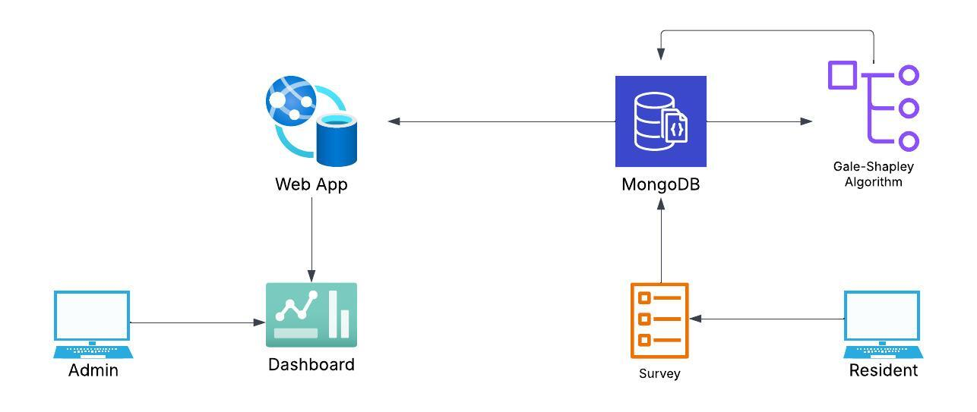
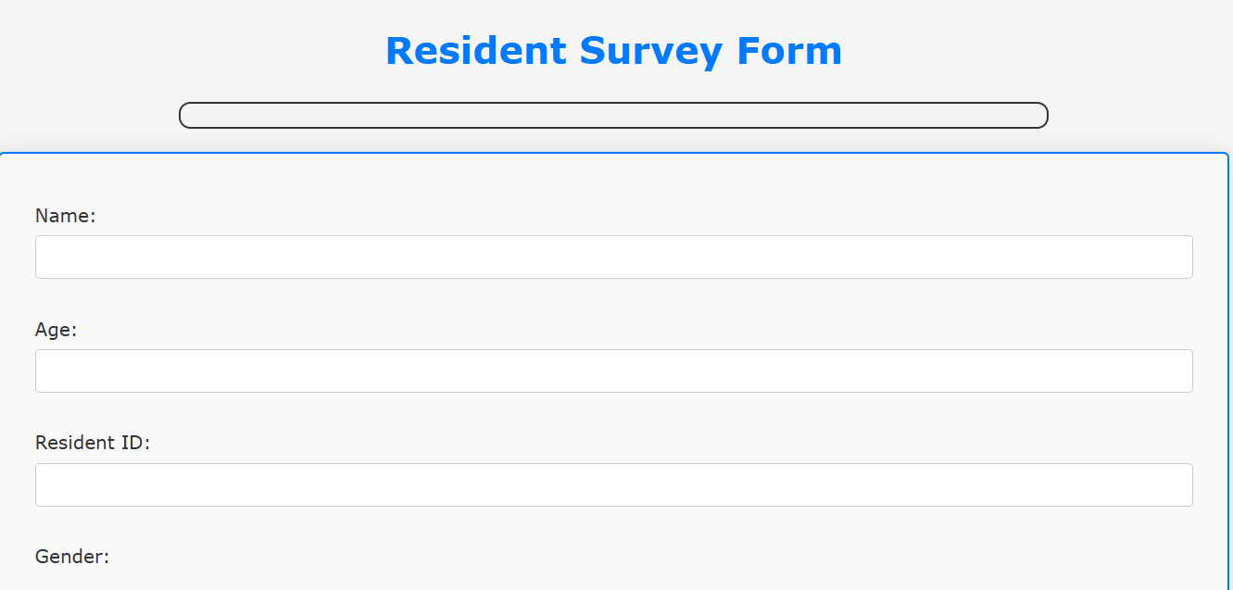
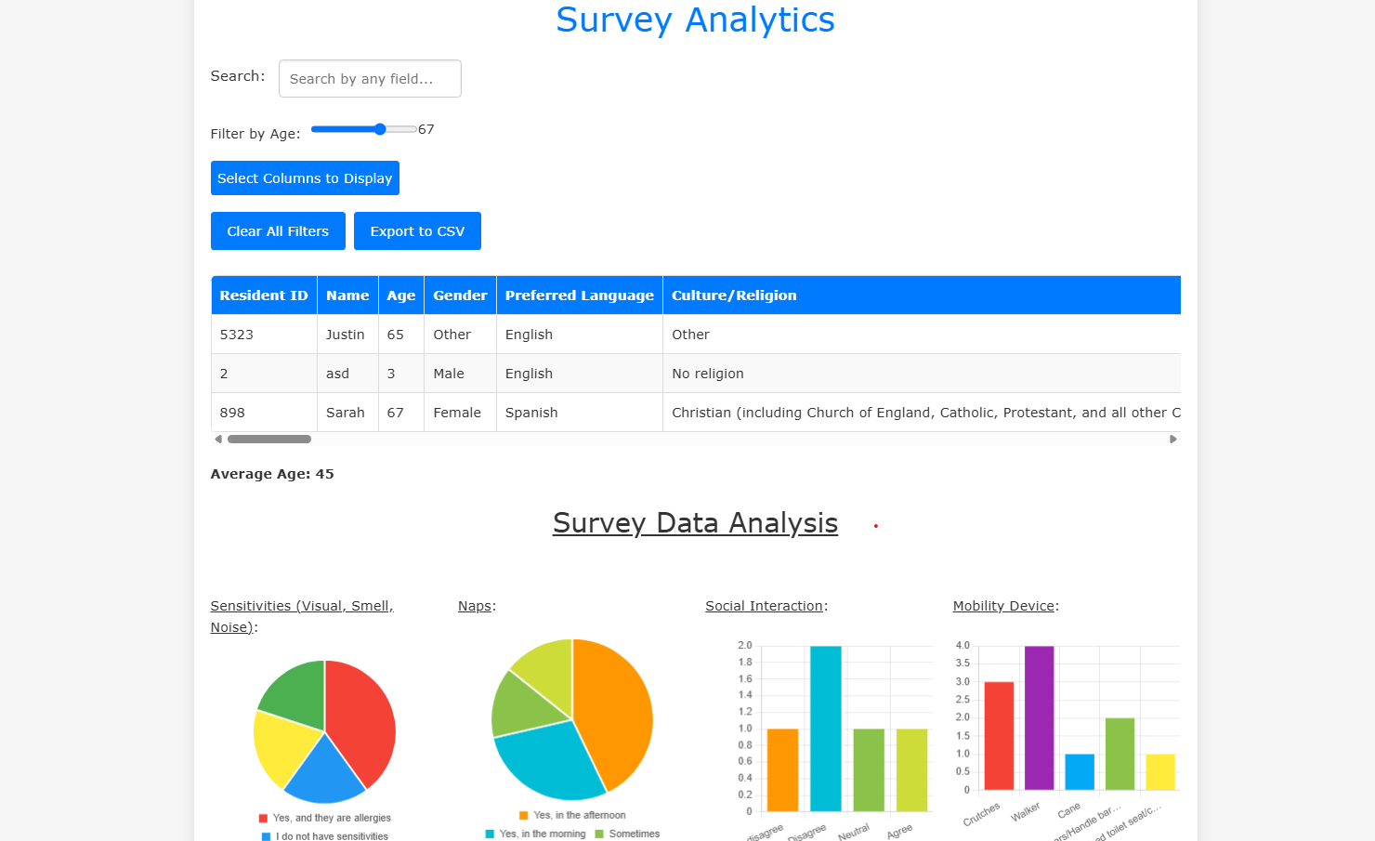
Nursing Home Resident Matching
Spencer Whiting, Lillian Van Rees, Charlie Bischoff, Dongho Lee, Emma Cheney, Austin KC
Department of Computer Science, University of New Hampshire, Durham, NH 03824
Introduction
Design
Testing
The Sullivan County Nursing Home wanted a new way to match roommates in preparation for moving to a new facility. We made the nursing home resident matching system to help nursing homes pair residents based on personality and medical needs. We worked alongside a nursing team to create a survey and designed a webapp to take the survey, store the information, create the matches, and display analytics along with results for the staff.
Fig 3: Workflow
Unit testing: CRUD operations function without error, the web application can access and manage the database successfully.
User testing: 10 UNH students were asked to rate the usability of our web application from 1-10. The average of those answers was 8.6/10
System testing: Navigation, authorization, and authentication all run smoothly together.
Integration testing: Our web application successfully interacts with the database through our middleware Node.js and can retrieve data from the database the same way.
Requirements
Functional Requirements:
Maximizes the number of residents matched with their most preferred roommate
Staff can view roommate matches and analyze survey results.
Residents can only complete the survey.
Algorithm and platform are designed to be dynamic and allow staff to add new survey questions directly through the web app.
Information has to be stored in database
Non-Functional Requirements:
Easy to use for both the staff and residents.
Easily readable for survey takers.
Secure data to avoid HIPPA violations.
The survey was created along side a nursing team, which is taken by the resident on the web app. The survey data is then put into the database where it is then run through the algorithm. To make the matches we used a modified Gale-Shapley algorithm. First, To generate roommate preferences we calculate the Euclidean distance, ranking the most preferred roommate first and themselves last to accommodate odd numbers. The algorithm then iterates through each list, with each person “proposing” to their top choice. The recipient either accepts or rejects the proposal based on their own preference list. This process continues until all residents are matched with either a roommate or themselves.
Once the algorithm determines the matches, they are displayed on the web app's dashboard for staff review. Staff can search for specific residents using their resident ID or analyze survey responses through various charts and graphs, as shown in Figure 2. Additionally, the web app allows staff to add new survey questions, enabling customization based on the specific needs of each nursing home.
Evaluations and Conclusions
We wanted the staff to rate matches on an average ⅔, with 3 being a perfect match and 0 the worst. The staff gave reviews on the matching so we could adjust weights to produce more accurate matches. Also, through our testing we were able to get a good rating for our website
The project will be continued by a new team next year, but we were able to set up a functional prototype and a strong foundation for future development
Survey
Analytics Dashboard
References
Gale, D., & Shapley, L. S. (1962). College admissions and the stability of marriage. The American Mathematical Monthly, 69(1), 9–15.
Technology
Python was used for creating algorithm
  Original encoder from Scit-kit Learn for encoding
  Pymongo for interacting with database
  Numpy for dataframes
The data is stored on MongoDB
Express and JavaScript to create web app
Acknowledgments
Thank you to our sponsors Marguerite Corvini and Nagaraj Bukkapatnam for supporting us during this project.
Fig 1: Resident survey
Fig. 2: Staff dashboard on web app

