Slide 1
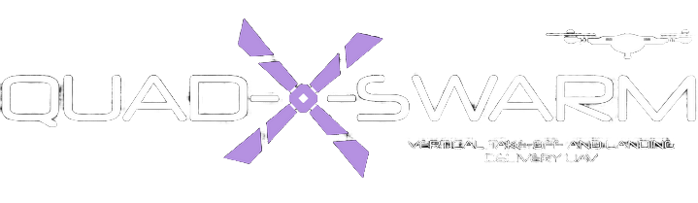
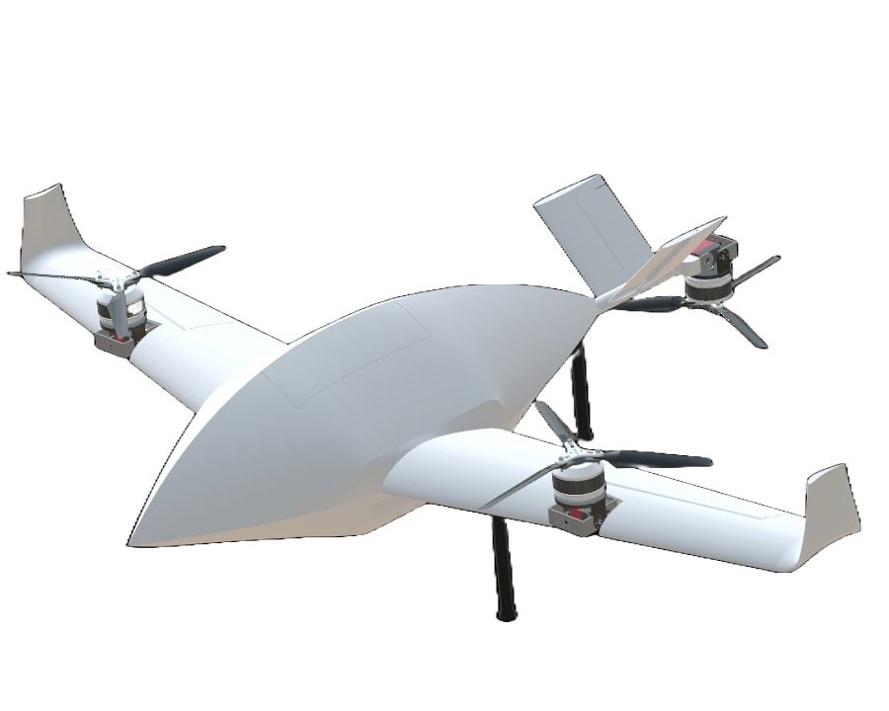
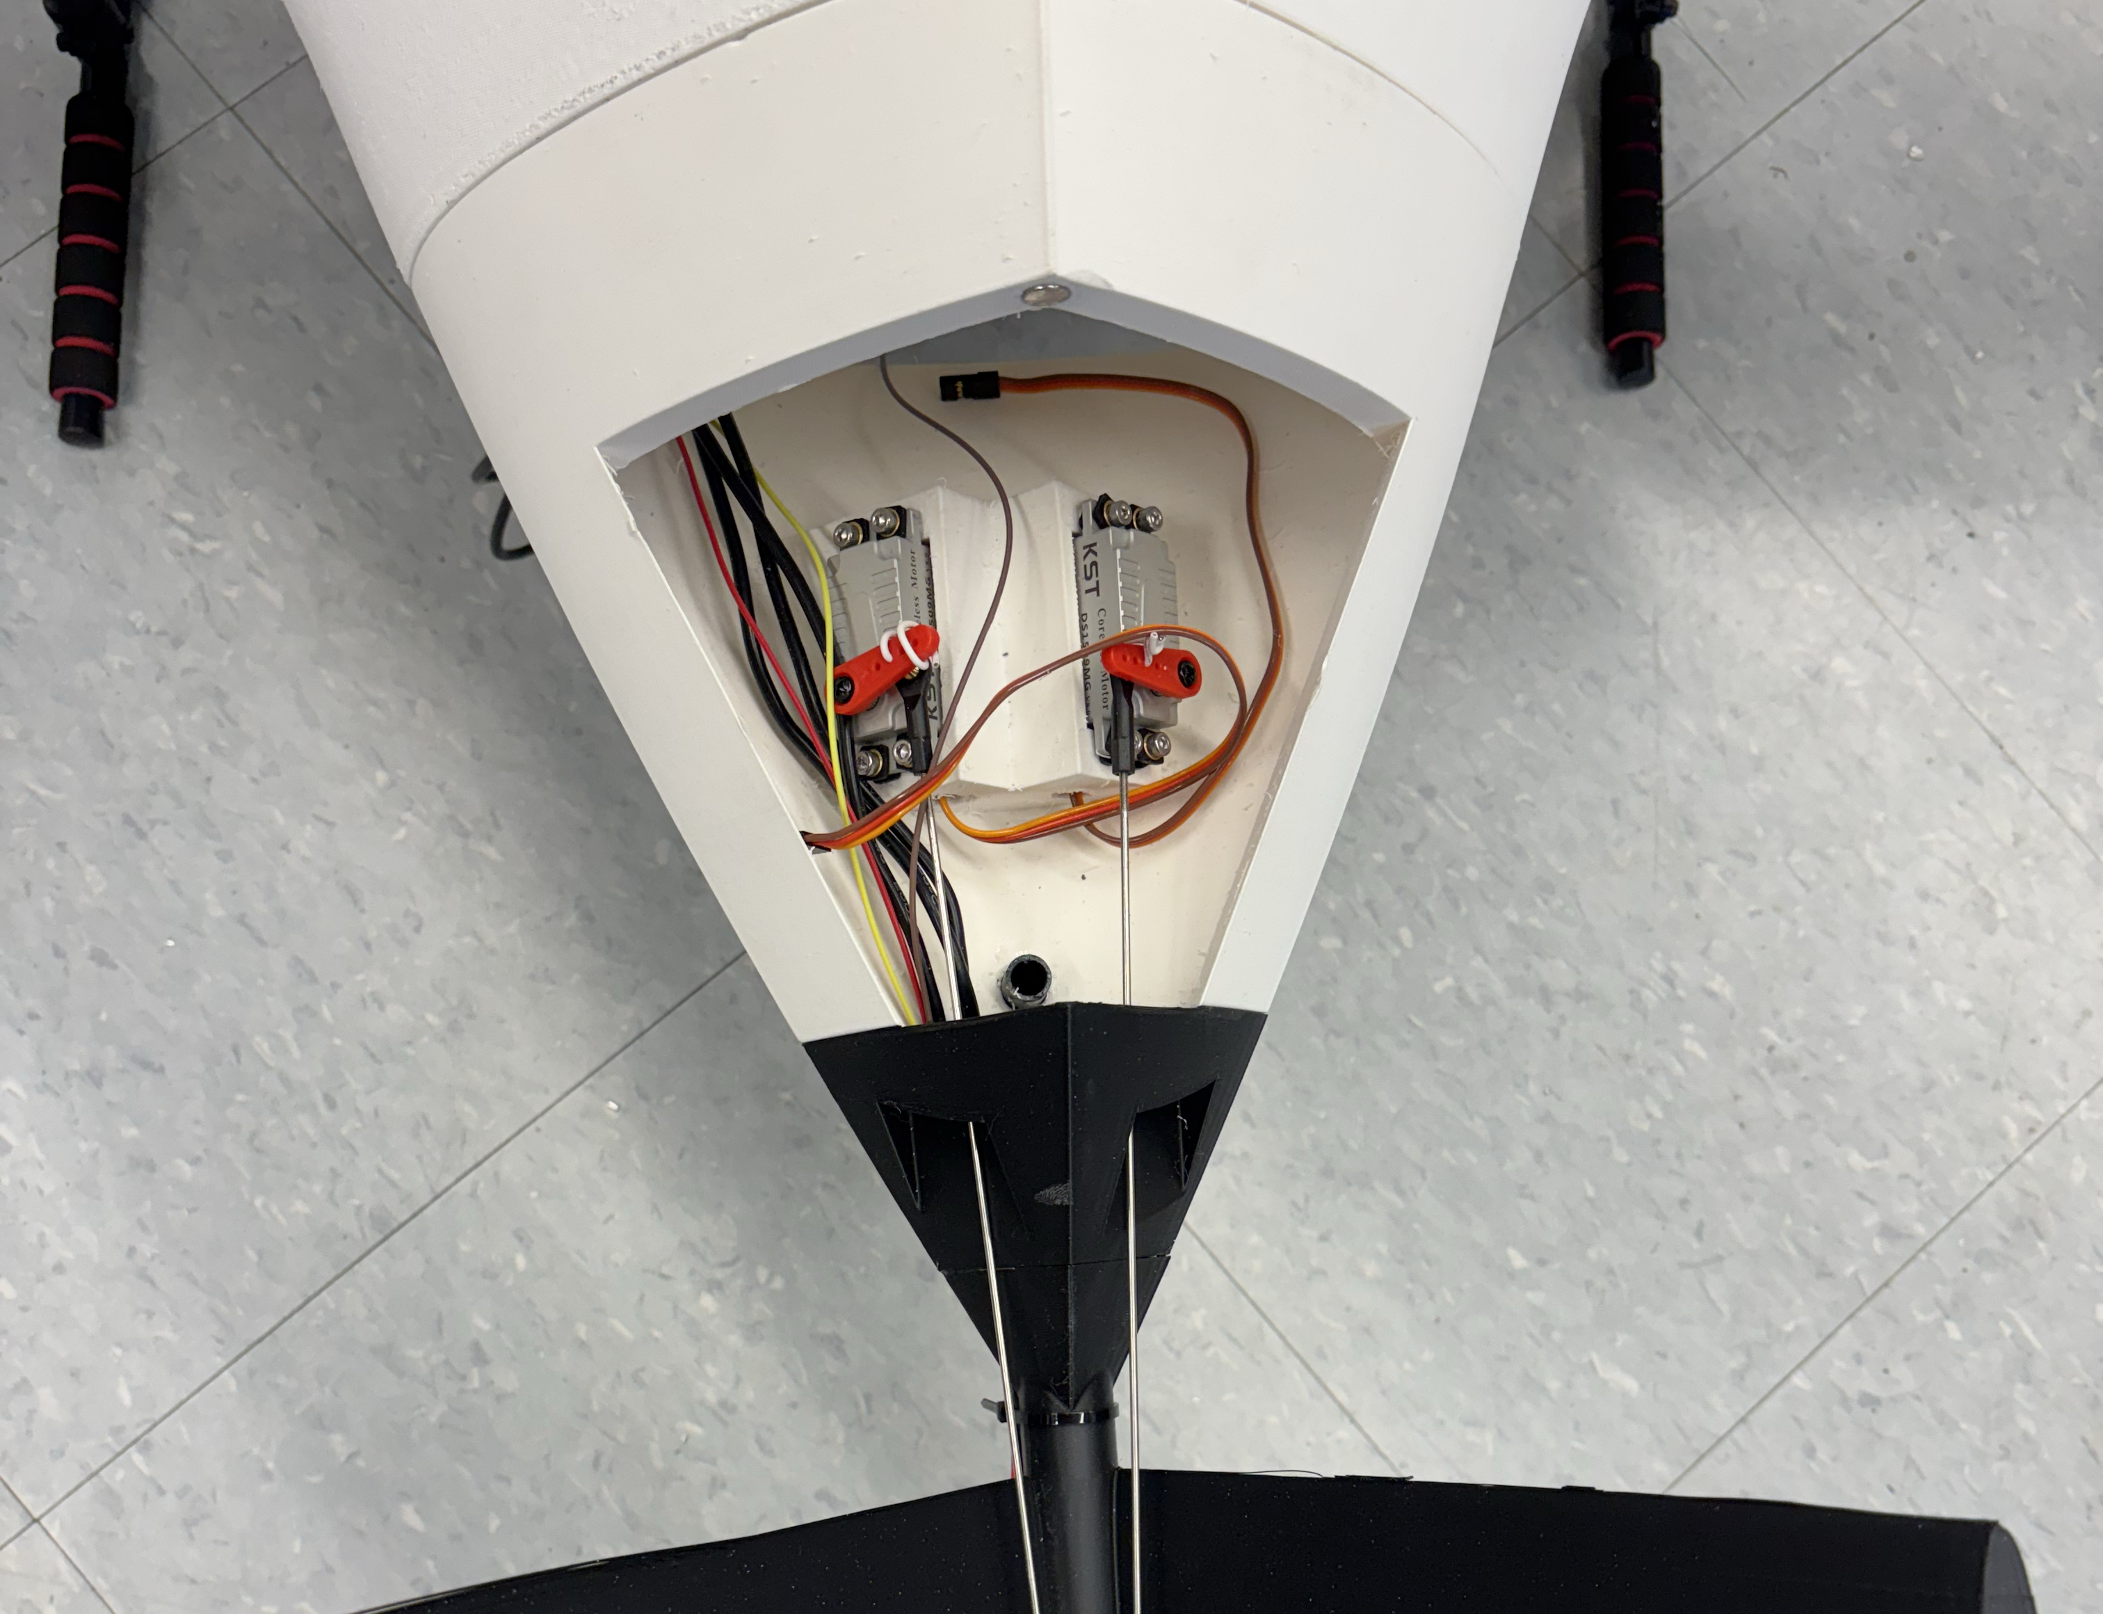
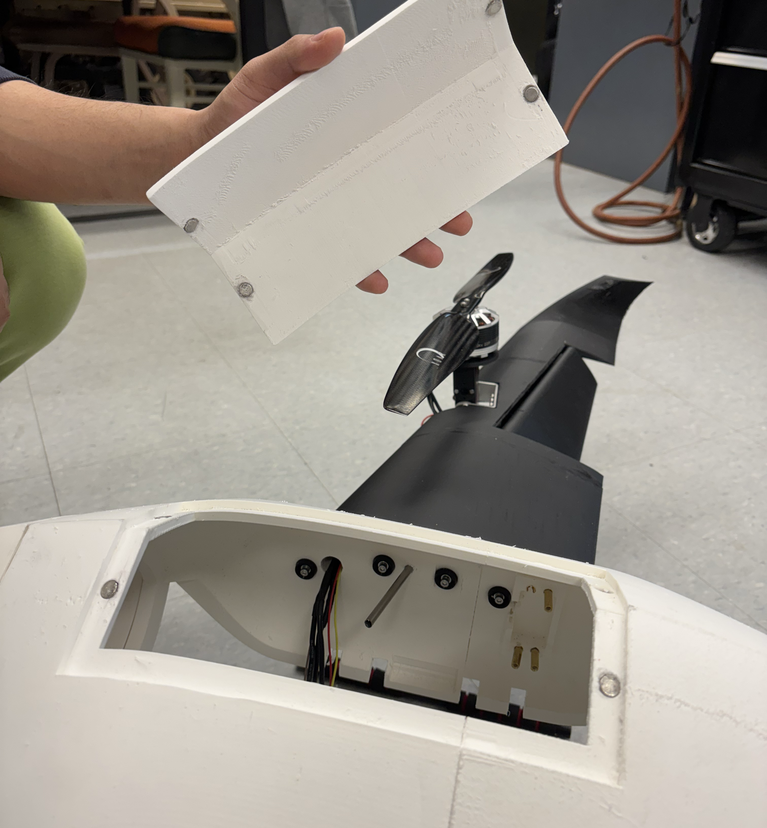
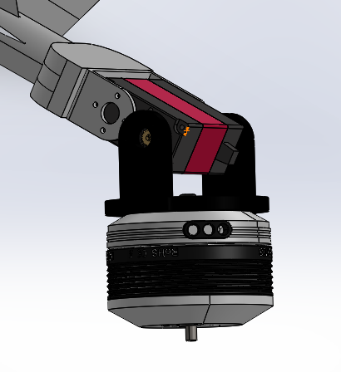
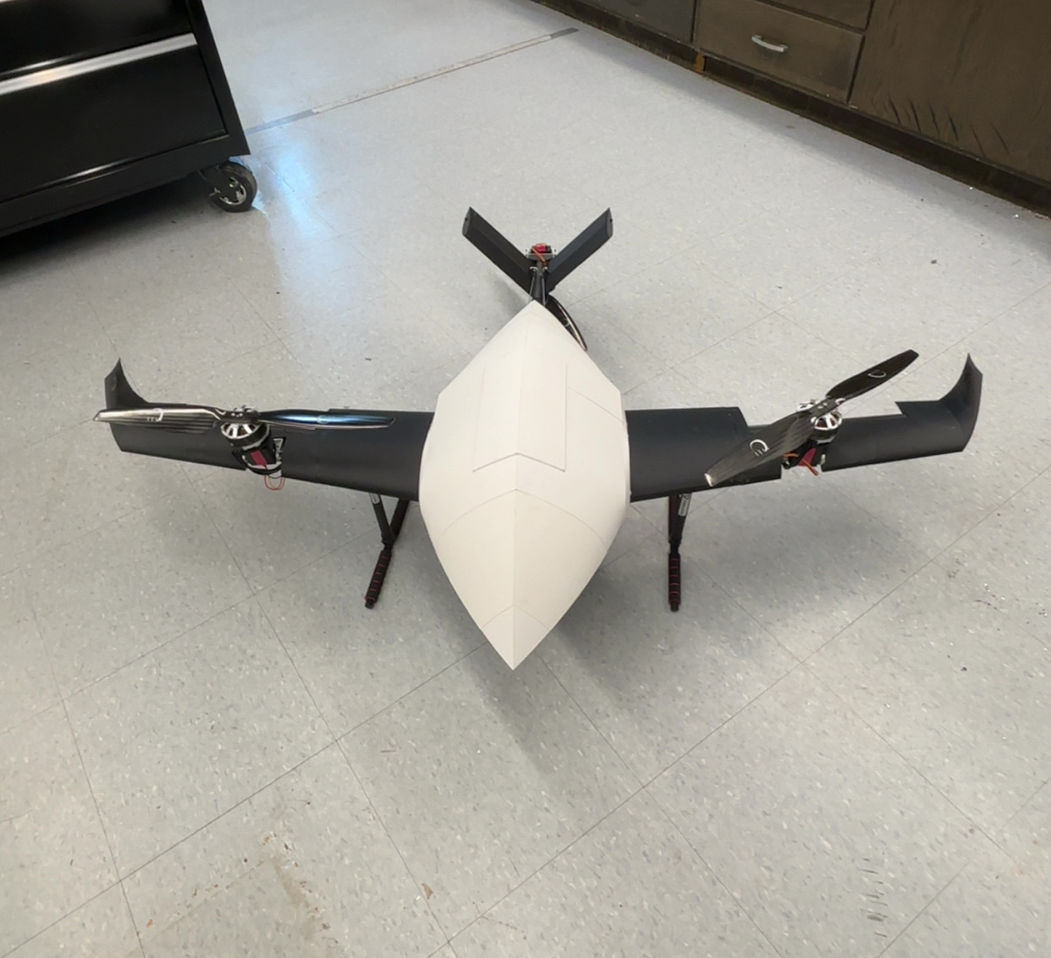
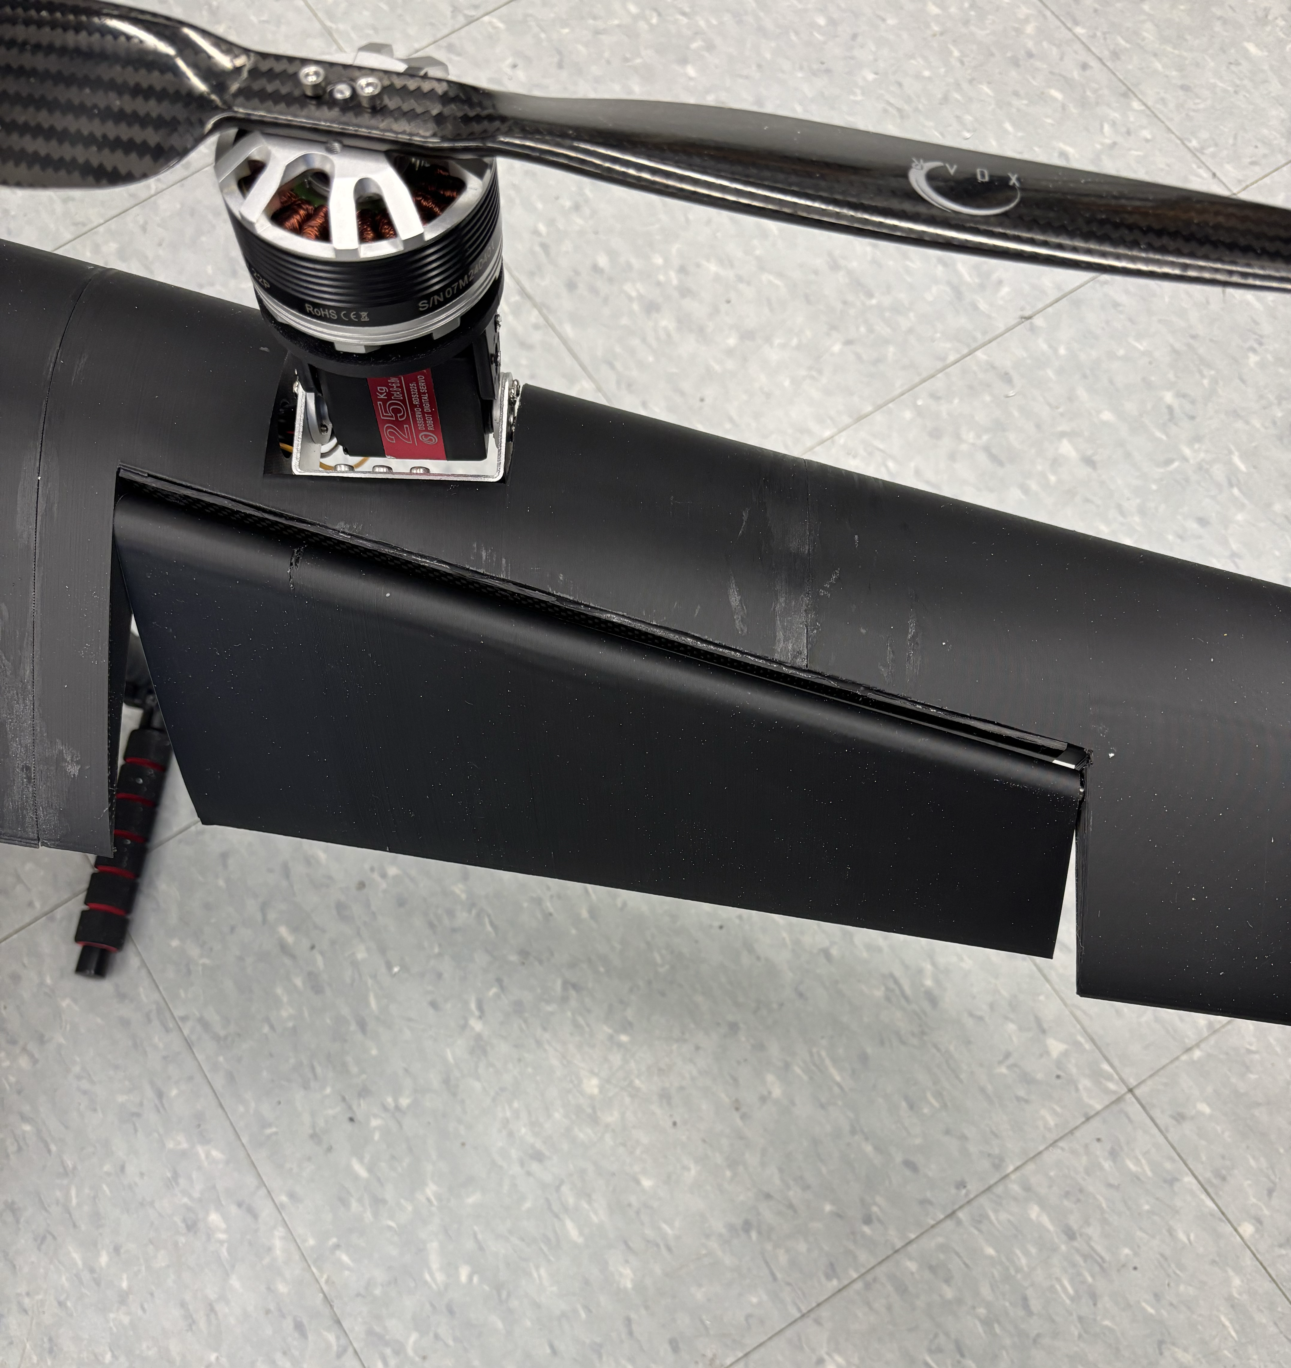
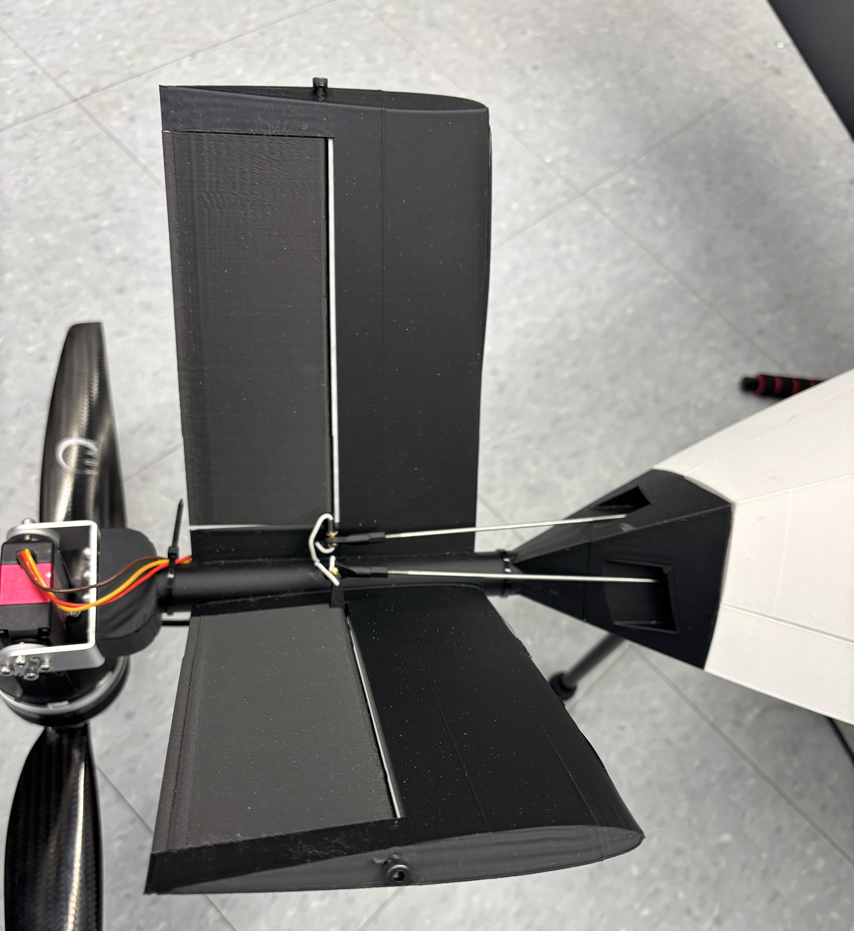
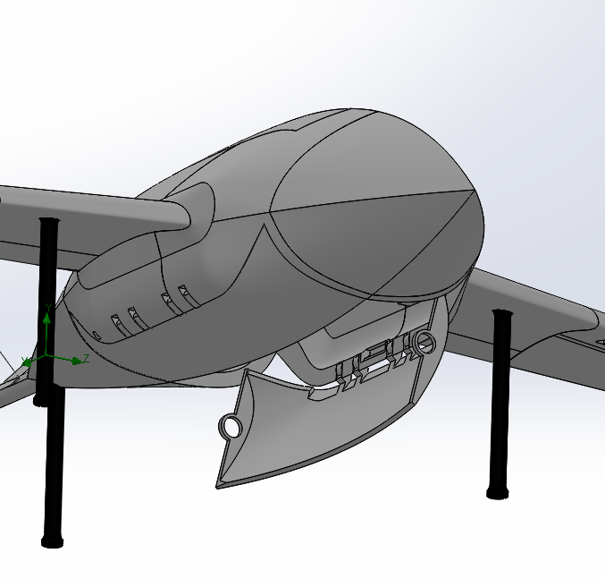
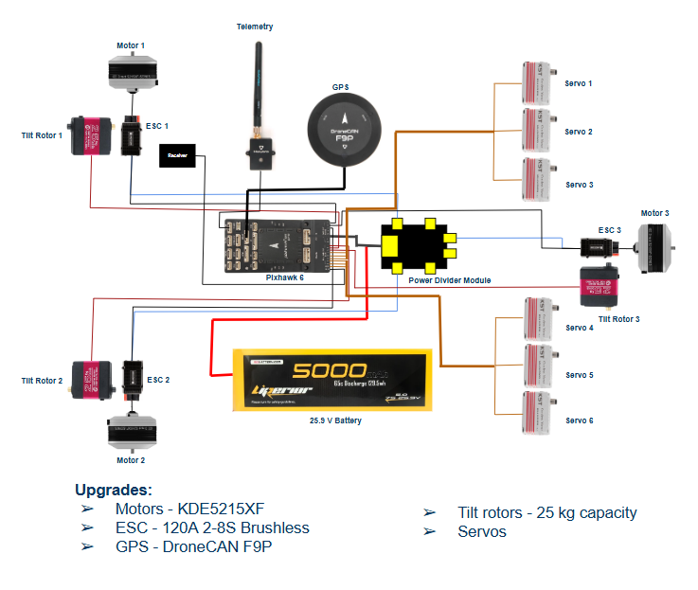
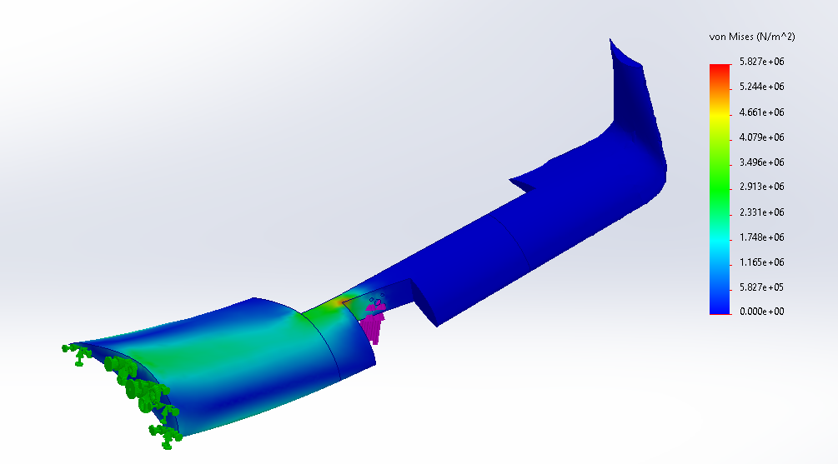
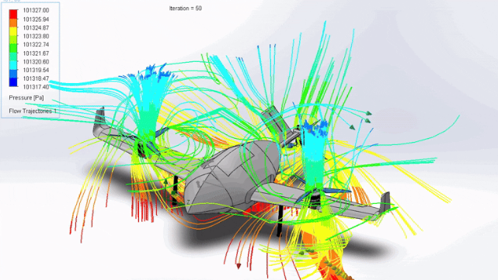
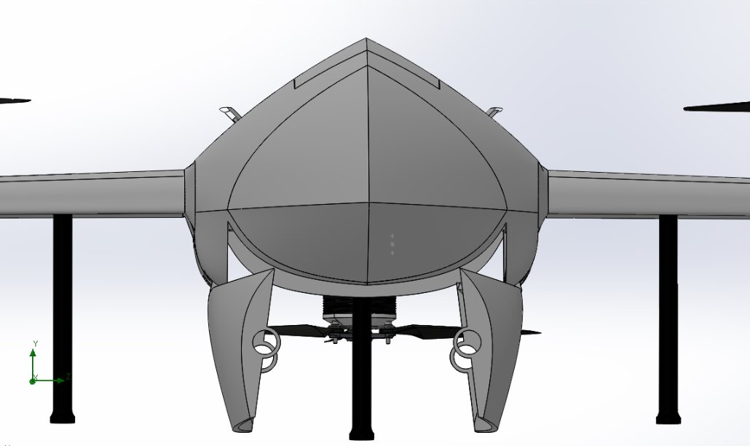
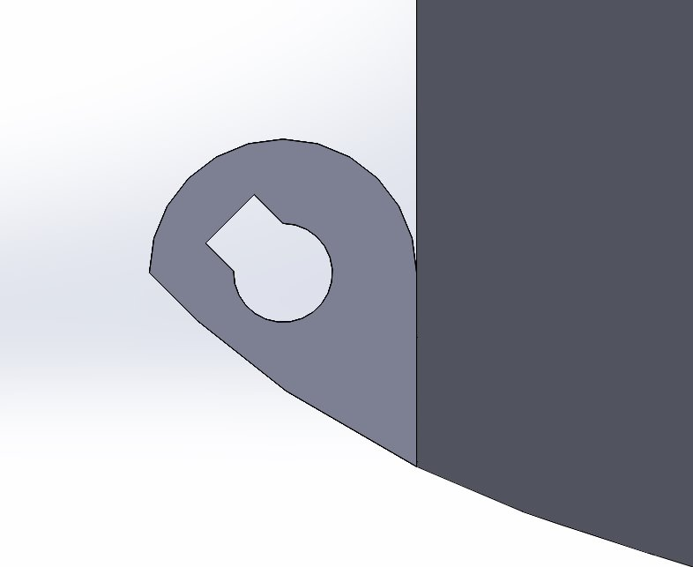
UNH Quad-X-Swarm | V.T.O.L. Team Dhiren Timsina, Evan Piette, Max Young, Lekha Poudyal Advisor: Professor May-Win Thein University of New Hampshire Department of Mechanical Engineering
Project Statement
The nose, tail linkage, and electronics housing are removable for easy maintenance.
The Tilt rotors are connected to the motors using a purpose-built motor mount. The servos are connected to the body through heat set inserts and socket cap screws.
Flight Control & Operation
This project aims to design and build an autonomous Vertical Takeoff and Landing (VTOL) Unmanned Aerial Vehicle (UAV) capable of semi‑autonomously delivering a five‑pound package anywhere within a five‑mile radius, revolutionizing package delivery.
Ground control software: Mission Planner
Knows location, velocity, and rotation of UAV
Enables autonomous flight function and tunability
Generates flight logs for tuning and troubleshooting
Flight Control Software: Ardupilot
Open-source software for a wide variety of unmanned systems
Enables tunability of parameters based on airframe characteristics (ex. maximum tilt of ailerons)
Calibrates all sensors required for flight (accelerometer, airspeed sensor, compass, GPS, and gyroscope)
PID tuning for motors and servos
Remote controller: FlySky FS-i6X
Used for manual flight control
Crucial for testing and troubleshooting
Communicates with flight controller through a telemetry device
Objective
The detachable parts are fastened to the fuselage and empennage with high-powered magnets.
Easily Manufacturable & Repairable
3D-printed parts simplify assembly and maintenance
Any part can be printed and assembled in under 24 hours
Fast & Reliable Delivery
Remove hazards and waiting associated with truck delivery
Cost-Effective
Each UAV costs around $2,500
No specialized tools required for assembling
VTOL Material Composition
The ailerons and V-tail are actuated by servos. The ailerons' role is to control the roll of the UAV, while the V-tail influences the yaw and pitch during horizontal flight.
Real-World Applications
Regular PLA
Left & Right Wings
Aileron
V-tail
Elevator
Legs
Medical Supply Transport: Rapid deliveries for medicine or organs
Remote Delivery: Reach isolated locations where ground transport is impractical or the terrain is too danegrous
Neighborhood Deliveries: Multiple UAVs deliver packages to a community faster and safer than a traditional delivery truck
Eco-Friendly Delivery: Reducing carbon footprint compared to traditional transport
PLA Aero
Fuselage
Nose cone
Door Mechanism to deploy package. Works with inserted key rods, and servos
Electrical Components
Analysis
Door Mechanism
Conclusion
FEA & CFD
The VTOL drone uses a hinge and key mechanism to secure the delivery compartment's door during flight and release it precisely when needed.
Door opening is controlled servo and pulley
The key rod is designed to distribute the load evenly to prevent failure and ensure that the force exerted by the package is handled without damaging the mechanism.
A belt mechanism rotates over the key rod, controlling the release of the door. As the belt rotates, it moves the key rod, unlocking and releasing the door.
The autonomous VTOL Unmanned Aerial Vehicle delivers a cost‑effective, reliable, and rapid package‑delivery platform by combining an optimized airframe, strategic use of 3D‑printed components, and a robust flight‑control system. With real‑world applications such as medical supply runs to carbon‑neutral —the design illustrates how UAVs can reshape warehouse‑to‑consumer transport.deliveries Future improvements will expand the operational radius, boost payload capacity, and advance full autonomy to support scalable, high‑volume delivery networks.
Performed static analysis on the shelled-wing models for both PLA and lightweight-PLA
Concluded lightweight PLA was not strong or rigid enough for wings
Flow simulation estimated the relative torque produced by each motor and was used for FEA on the entire UAV
Acknowledgments
Professor May-Win Thein Project Advisor
CEPS and ME Dept Grant & Funding

