Slide 1


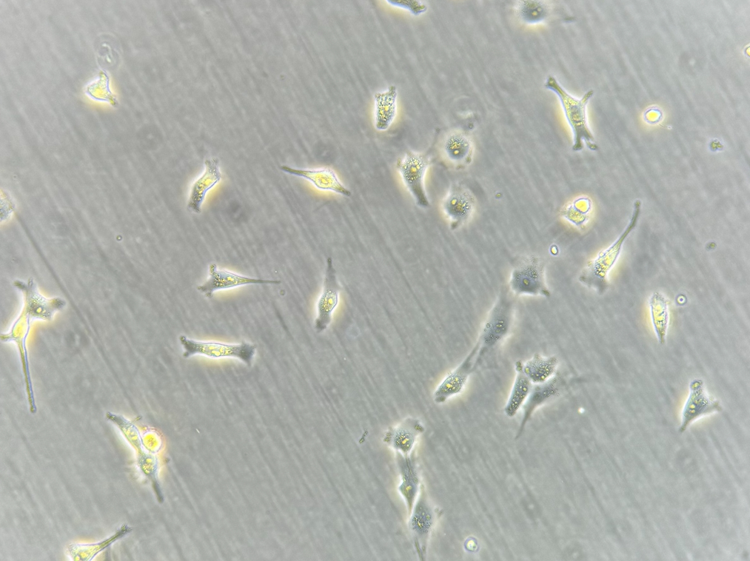
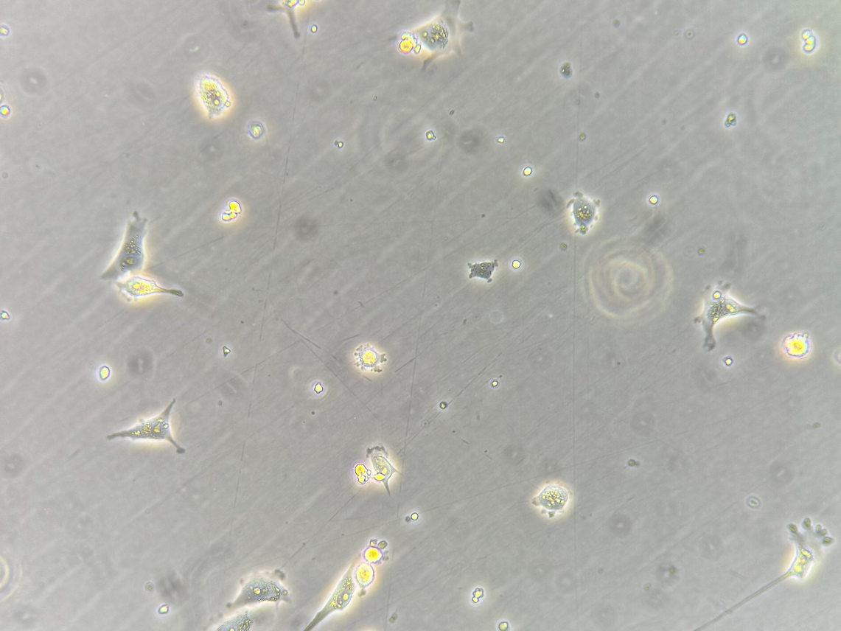
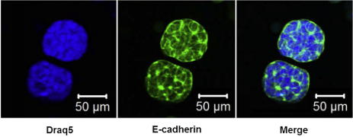
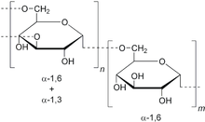
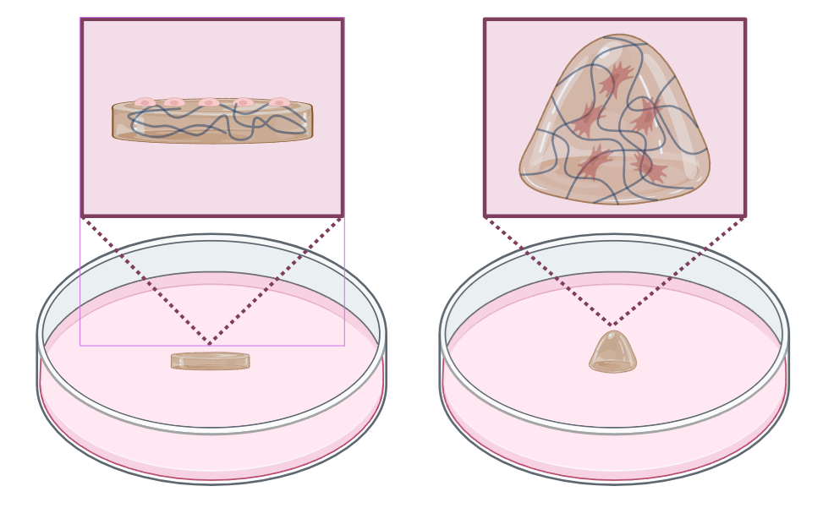
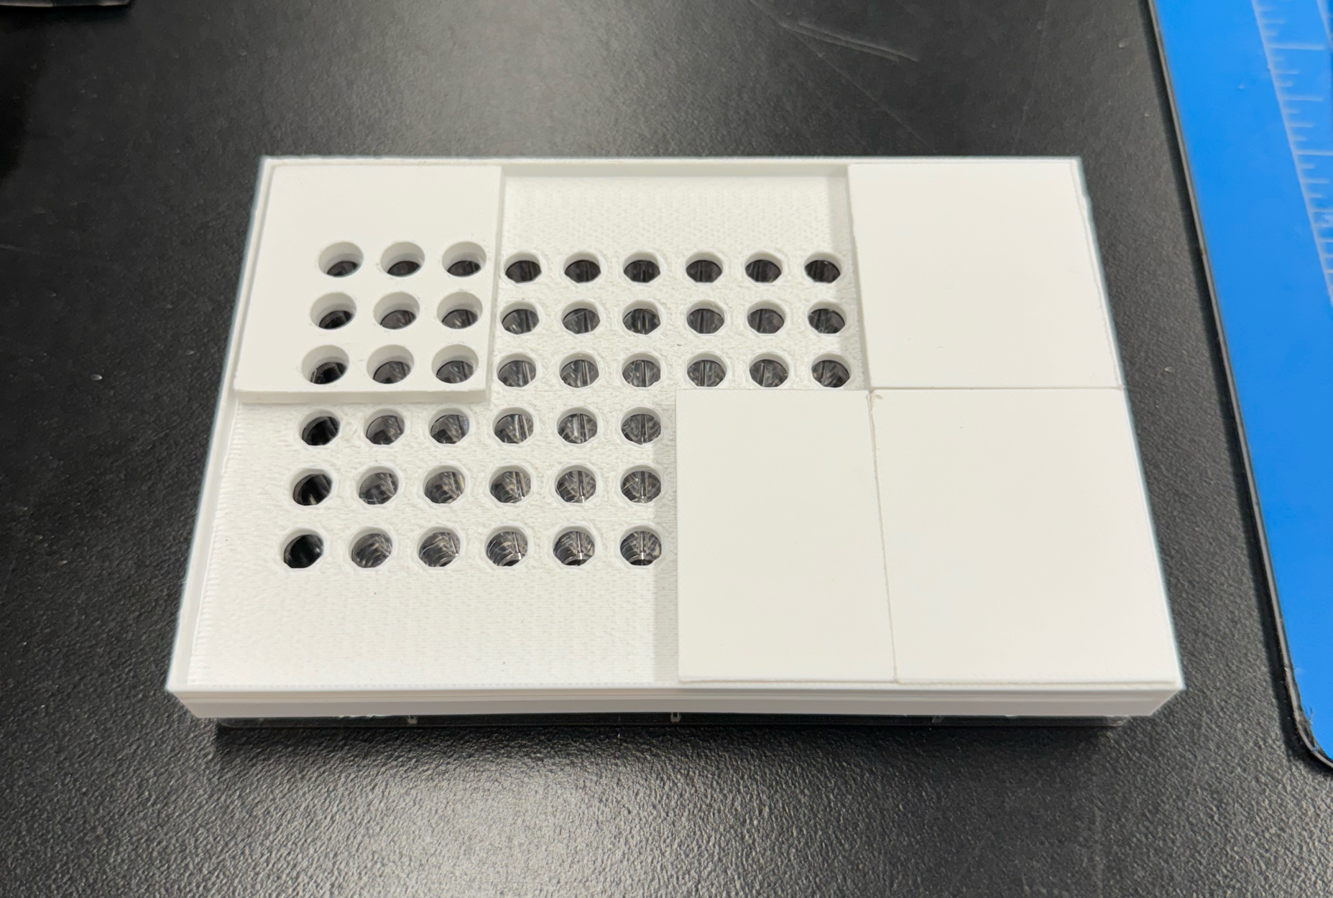

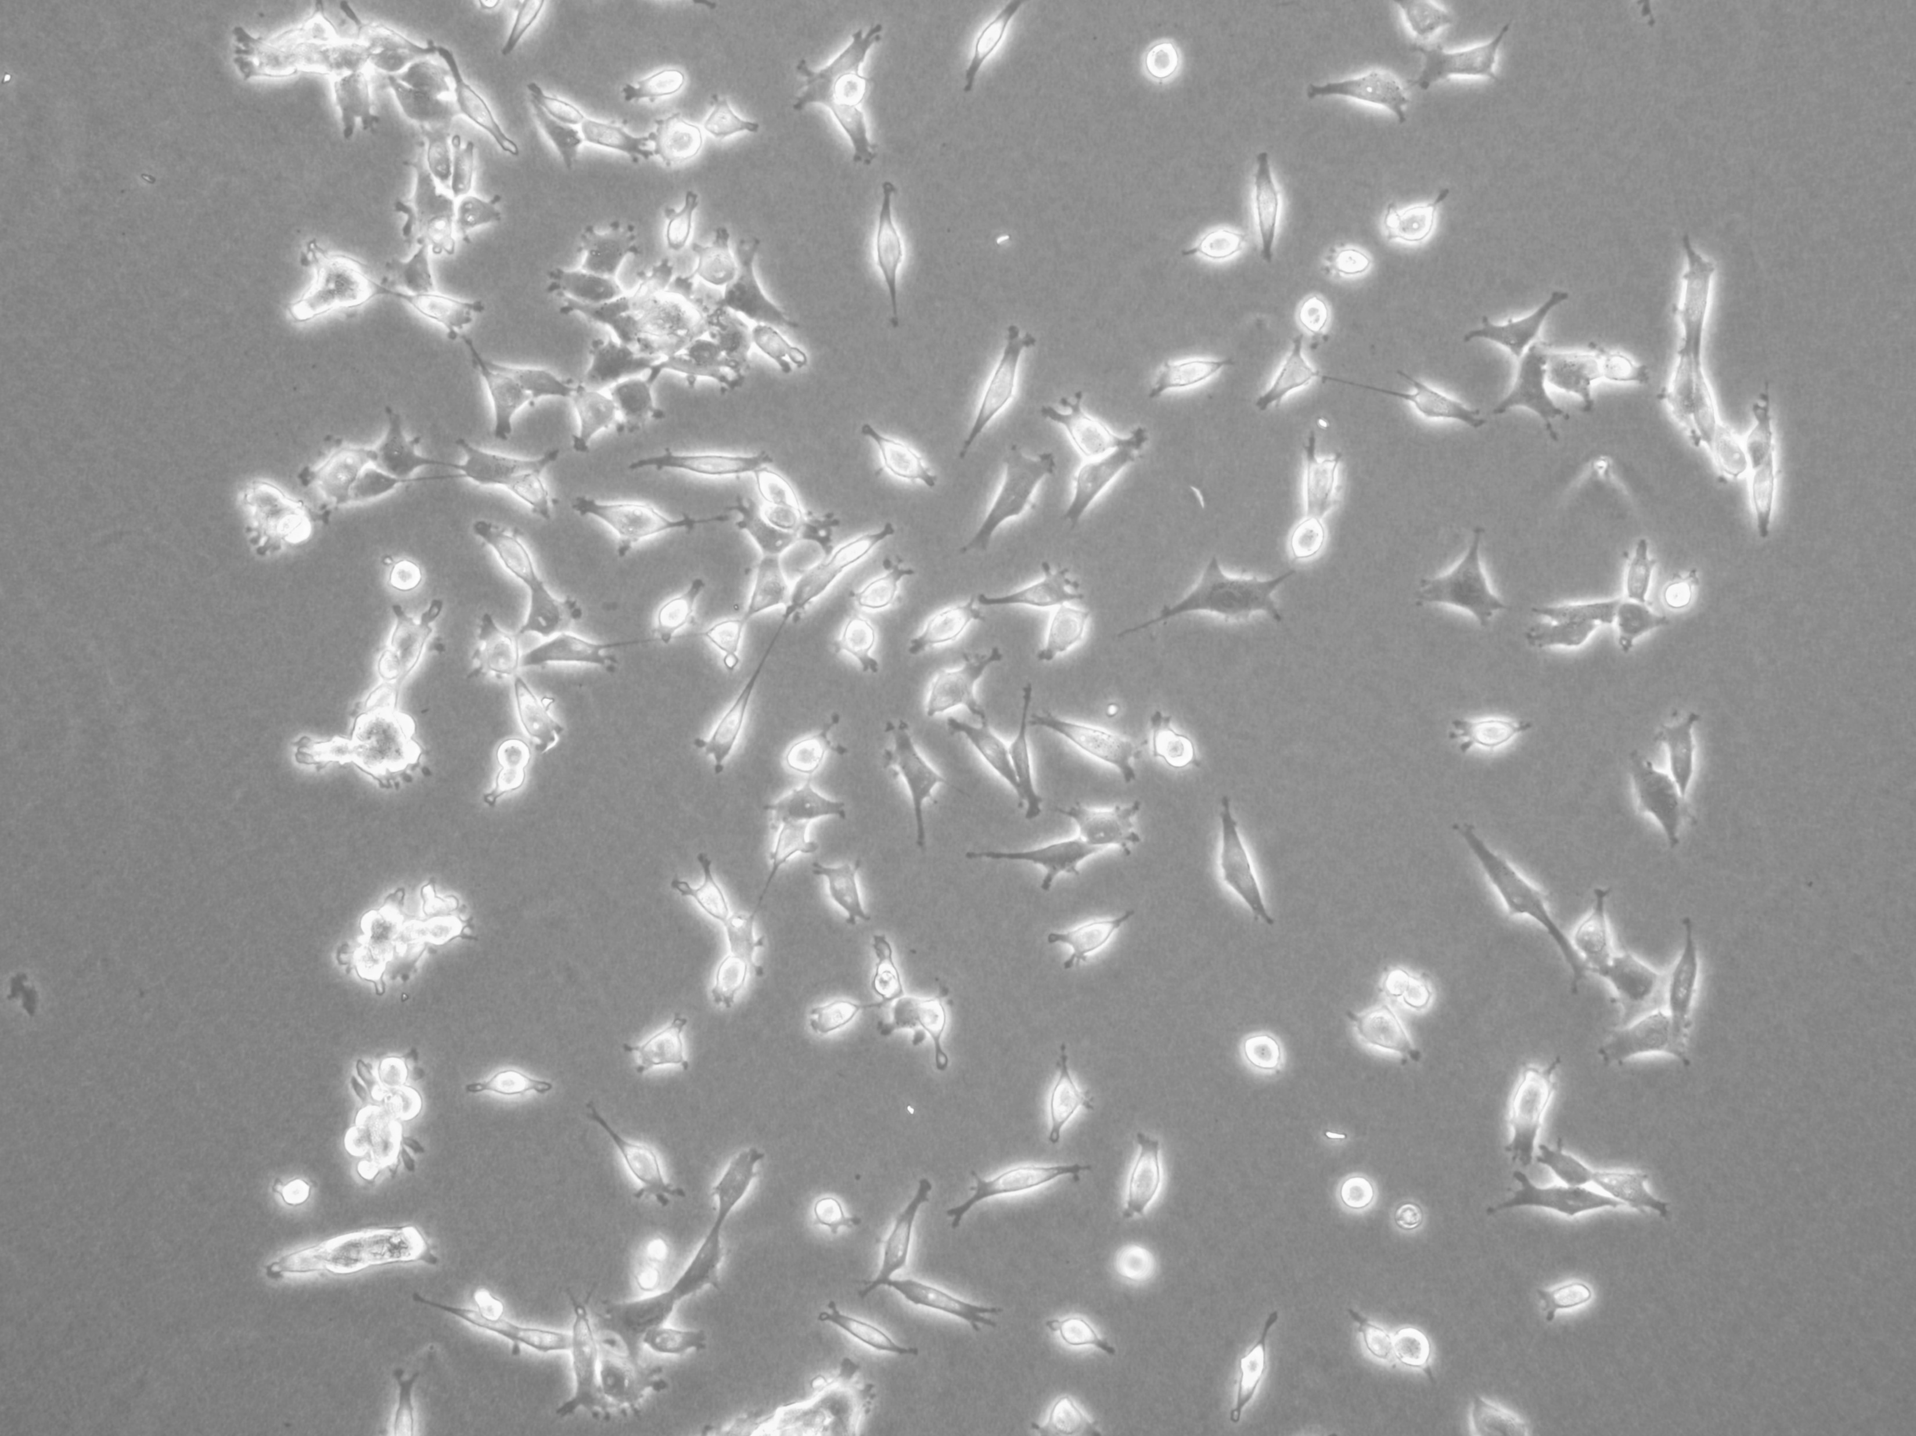
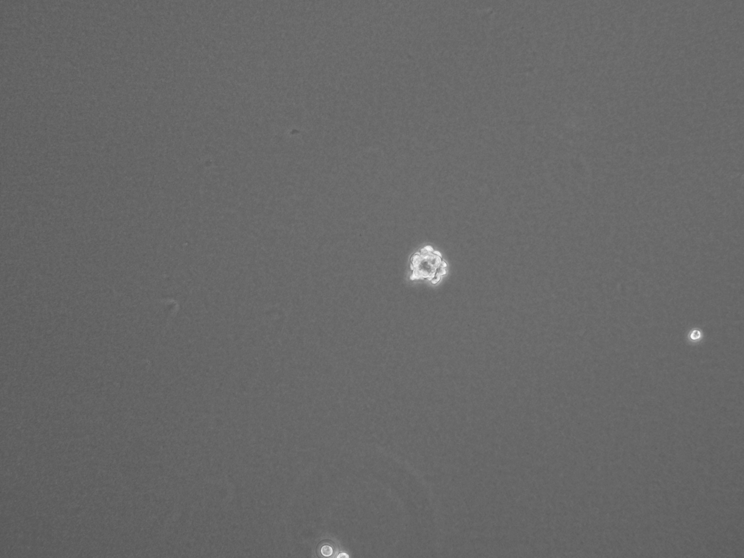
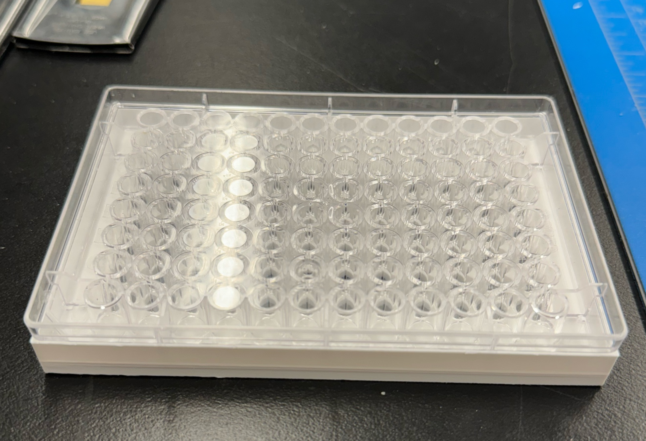
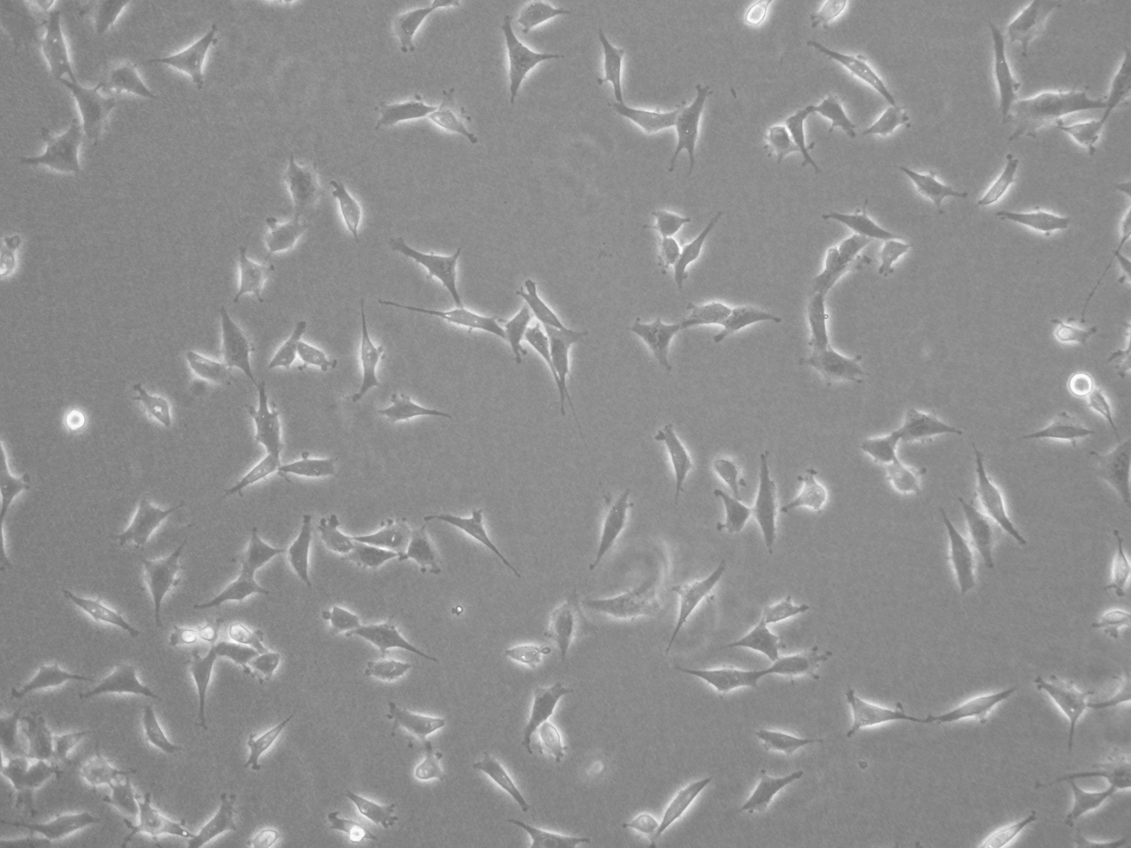
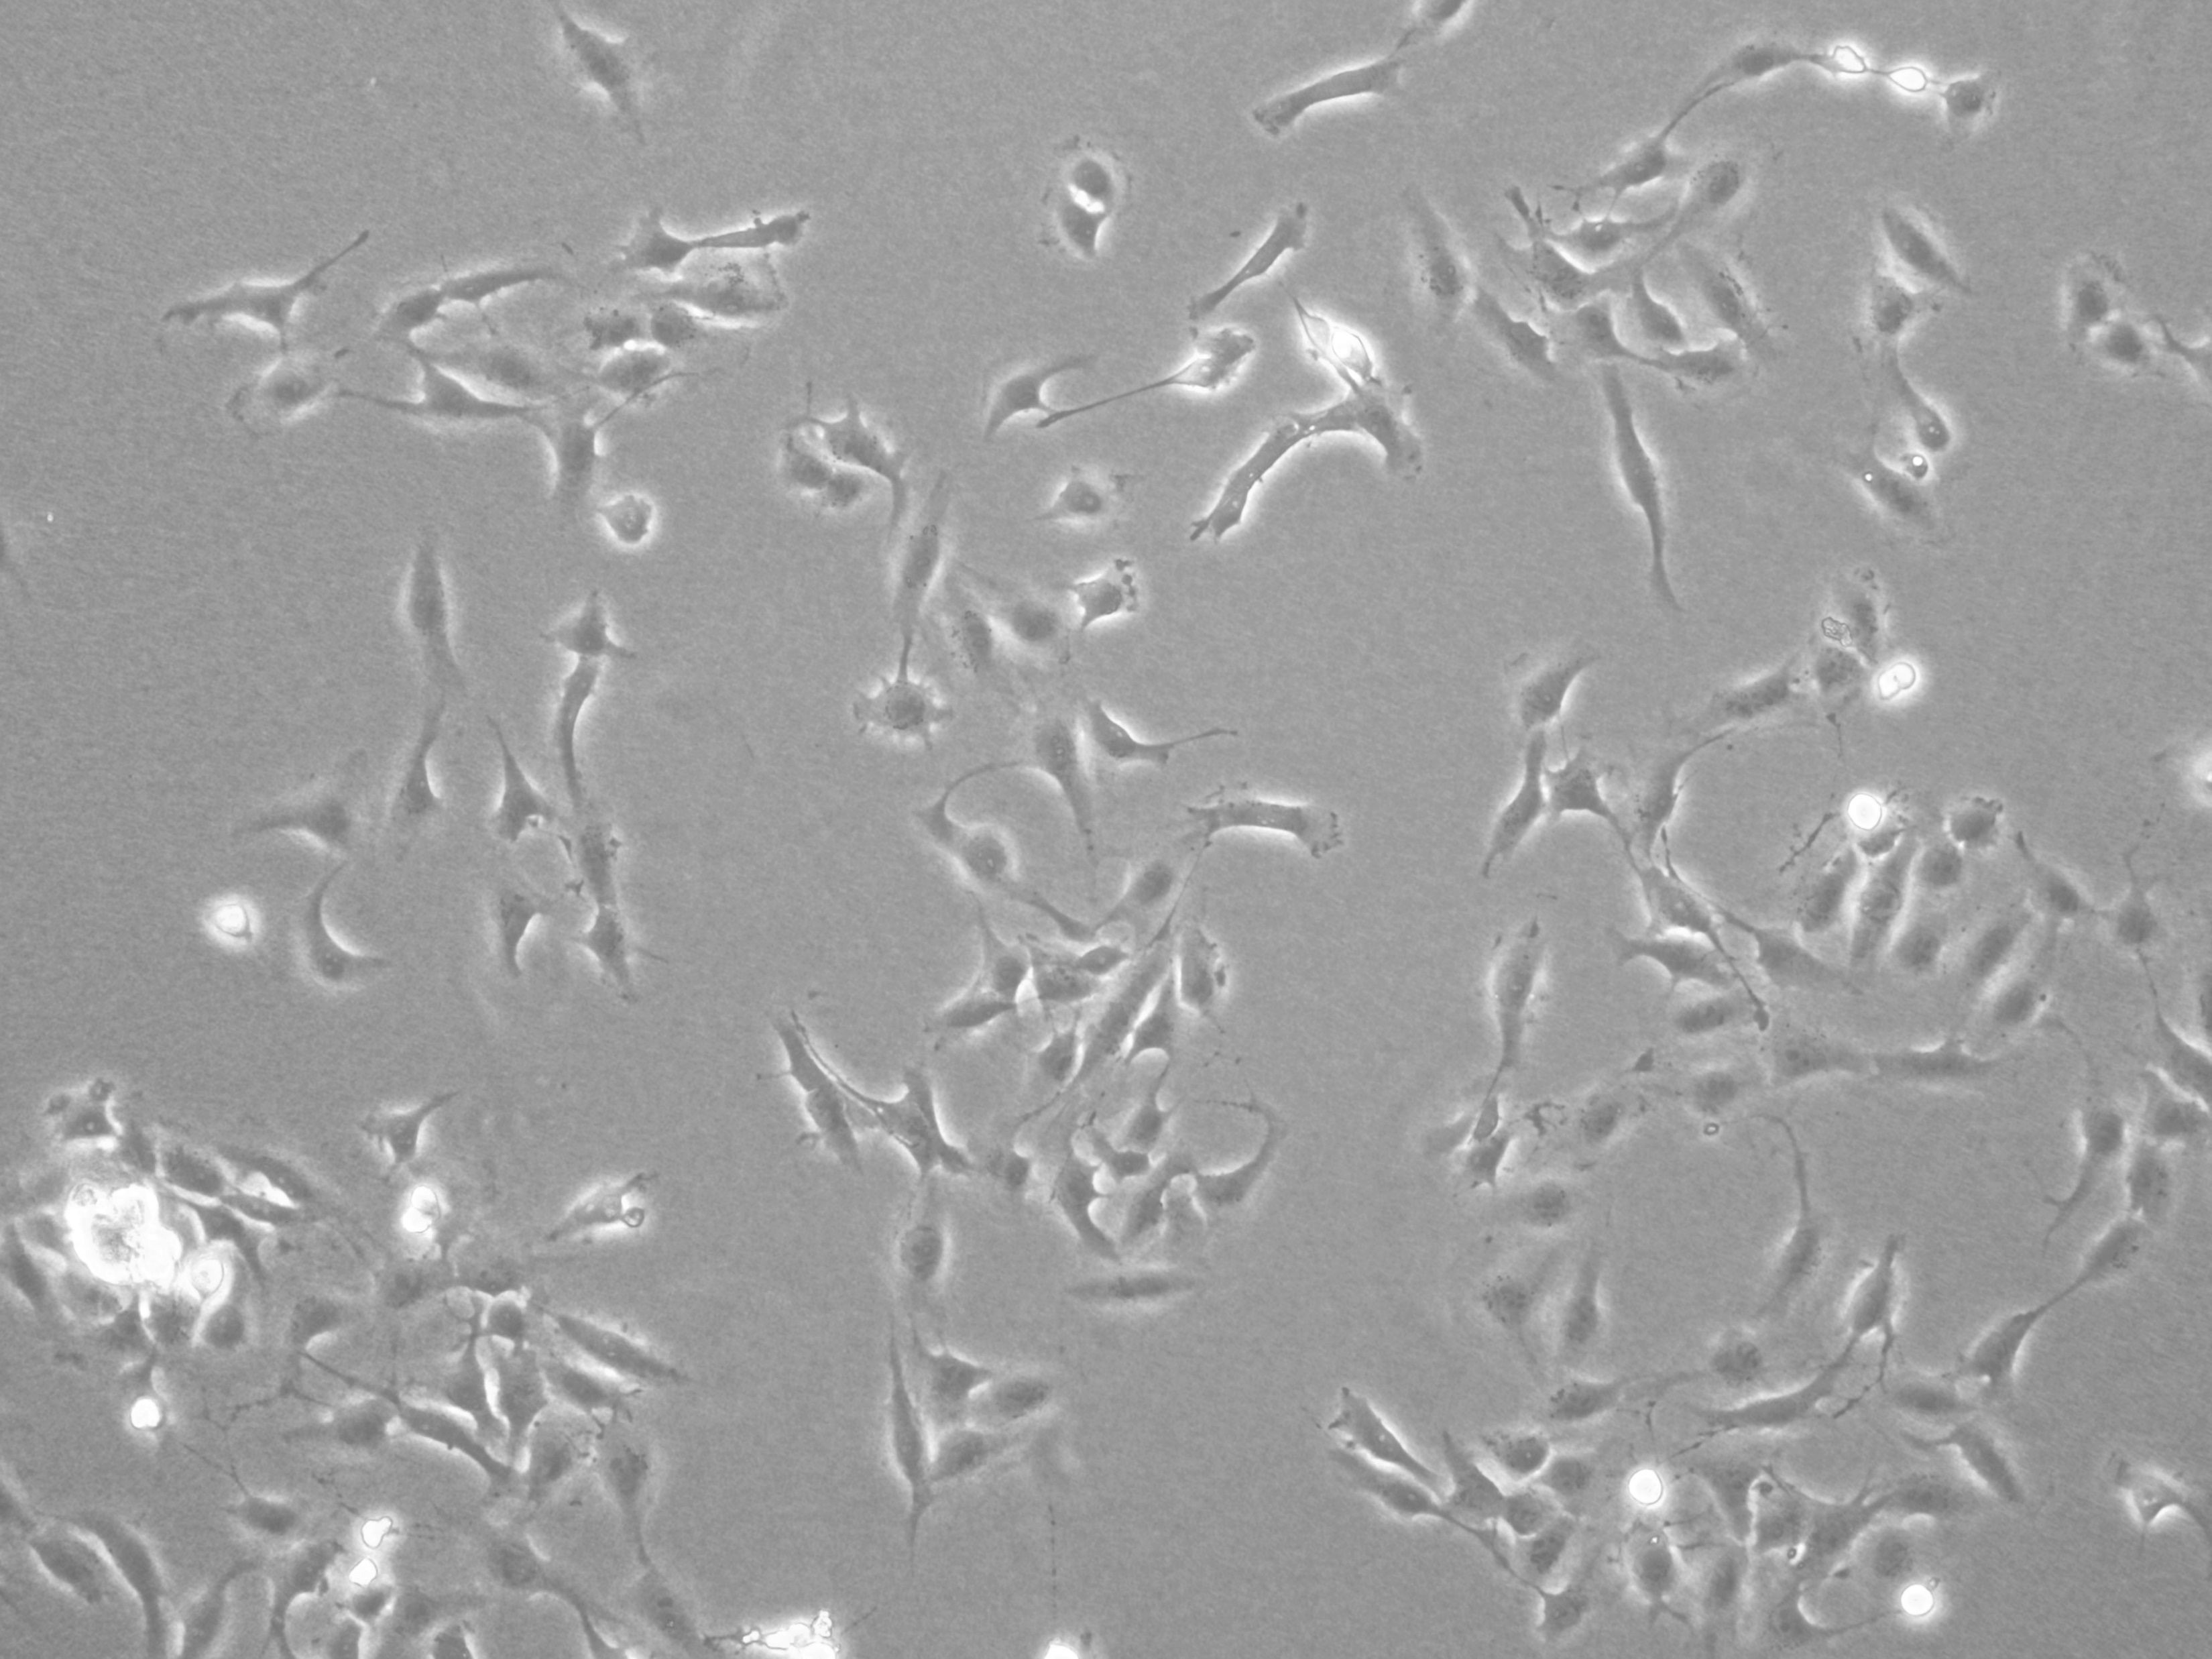
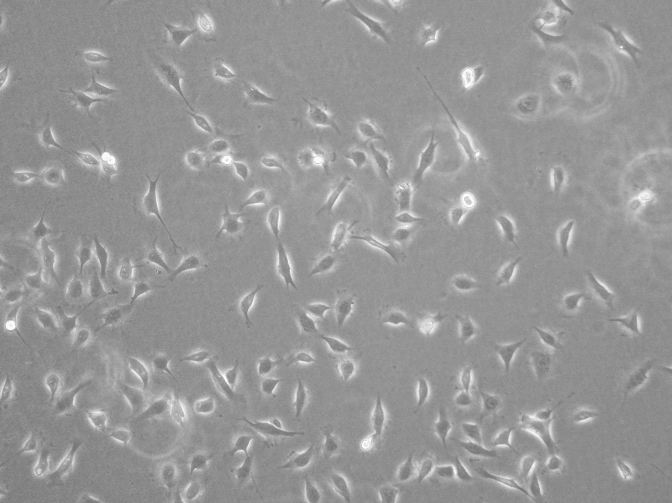
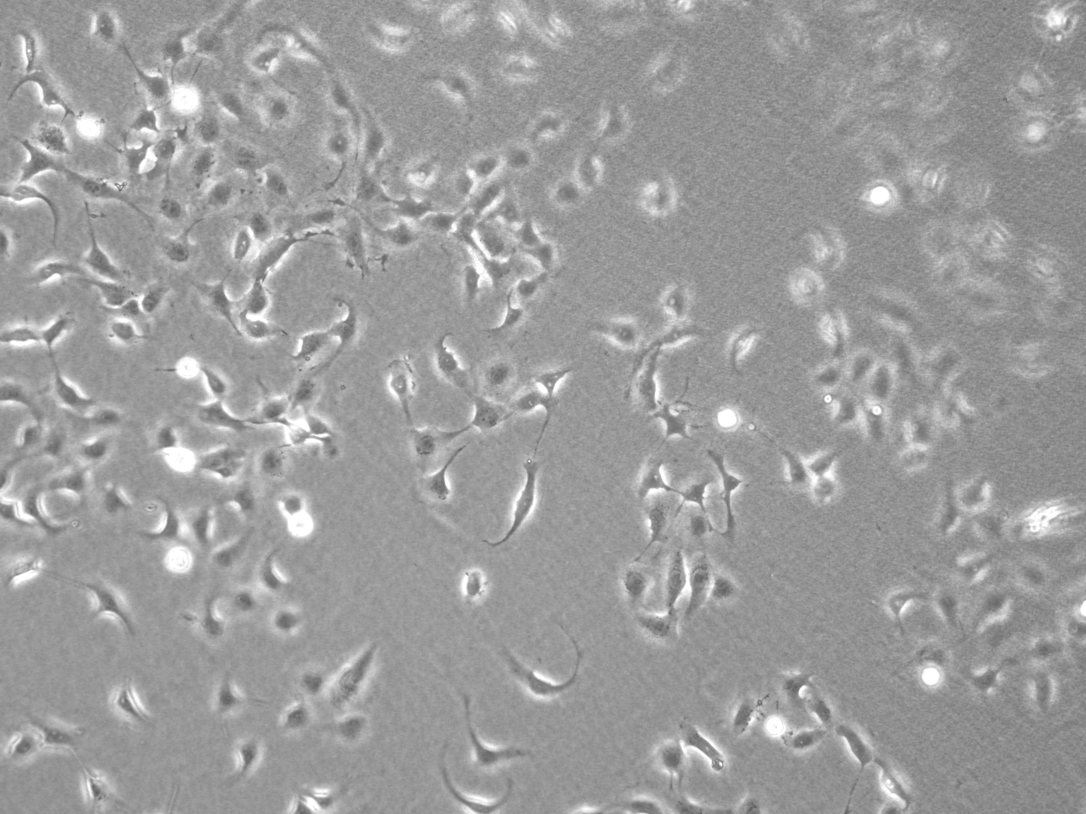
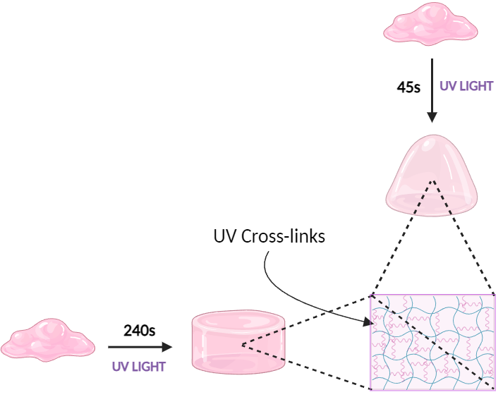
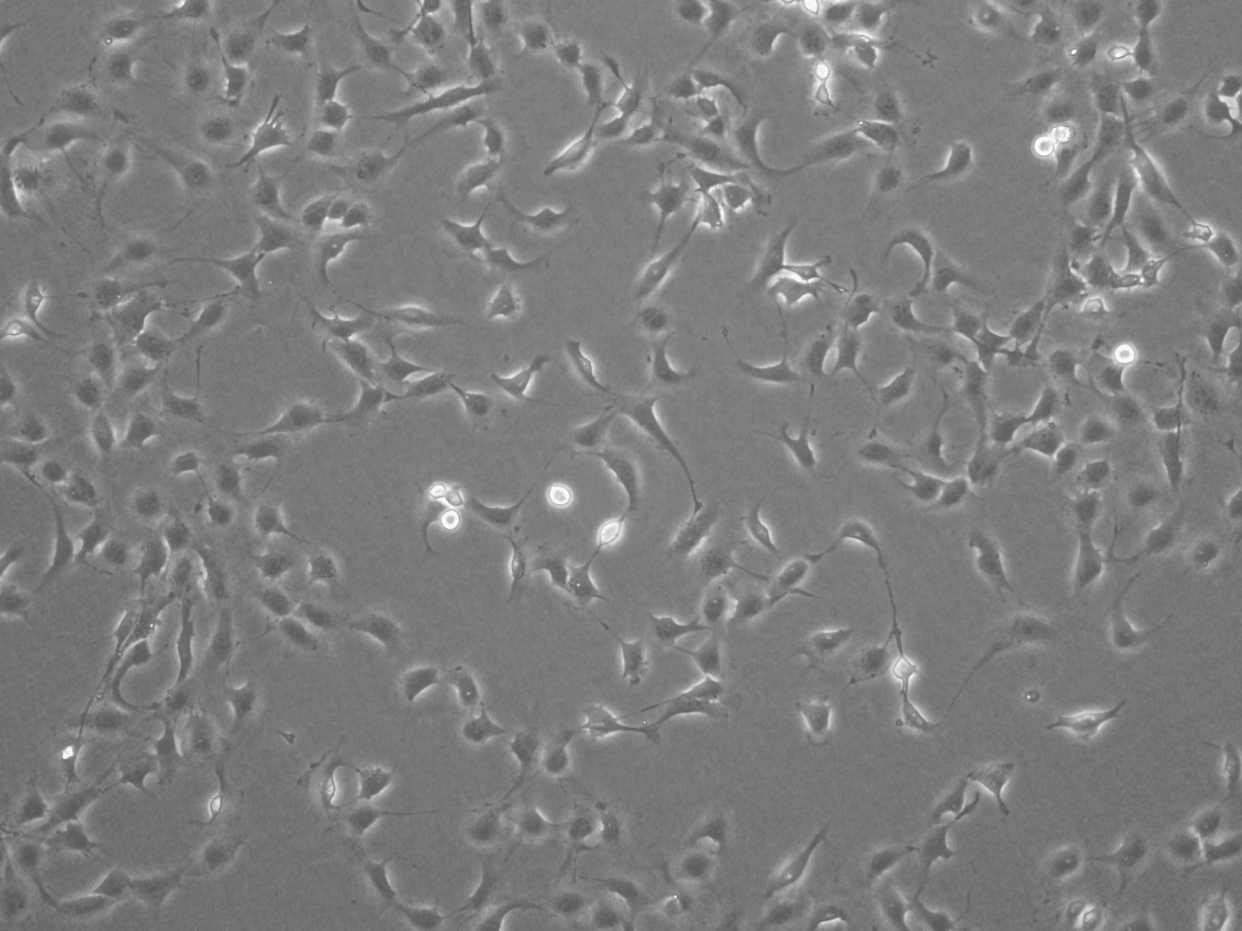

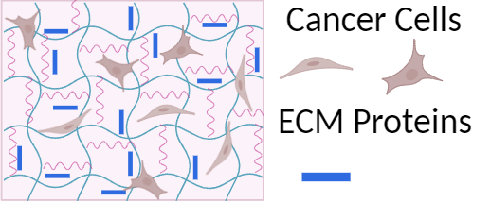
Regulating Ovarian Cancer Growth; Tuning 2D Hydrogel
Mechanical and Biochemical Properties
James Brackett, Jaxson Libby, and Linqing Li
Department of Chemical Engineering and Bioengineering
Introduction
Cell Culture
Staining/Problems
1 in 130 women will die of ovarian cancer
The United States Drug Administration fails 95% of ovarian cancer drugs
ECM infused Dex-Ma Hydrogels could provide a novel drug testing platform
2D gels is representative of preliminary tests whereas 3D would be the ultimate aim
ECM known to cause changes in cell behavior in body
Dex-Ma hydrogels allow for mechanical tuneability to a staggering degree
  Materials and Methods:
  Cells cultured using RPMI 1640
  Cells split using Trypsin 0.05%
  Cells washed with Phosphate
  Buffered Saline (PBS)
  Cell Seeding Density 150,000 cells
Cells de-adhering from plate when fixed
Cells not adhering to plate when live stained
OVCAR8
Stain Types:
DAPI ~ 461nm (Nuclear)
Hoechst ~ 461nm (Nuclear)
Phalloidin ~ 488nm (Actin)
B)
C)
HEYA8
Dextran Chemical Structure
2D vs. 3D
Preliminary Morphological Data
Troubleshooting
New Way of Testing Gels:
96 well plate
  Many more highly reproducible tests & lowers time required
Adjustable cover to limit excess UV exposure
Reduces material waste
Heya
Fibronectin
45s
Medium spreading out
OVCAR
Fibronectin
45s
Only grouping that formed aggregates
Dextran is a polysaccharide comprised of 1:6 glucoside links. This differs from main glucose chains which are joint by 1:3 or 1:4 polymer links³
Cells Seeded on top of gel rather then inside, give less biomimetic response; however, can still give relevant data when relating stiffness and ECM
Heya
Fibronectin
240s
More noticeable spreading out
OVCAR
Fibronectin
240s
Difference hard to see
Objective
Observe the Morphological differences resulting from varying 2D hydrogel stiffness as well as application of ECM proteins such as RGD, Laminin, and Fibronectin
Future Work
Heya
Laminin
240s
Noticeably more spherical
OVCAR
Laminin
240s
Difference hard to see
Move toward more expensive and harder to use, but more biomimetic 3D Dex-Ma ECM infused hydrogels
Observe different combinations of ECM protein
2D Dextran-Methacrylate Hydrogels
Materials and Methods:
86kDa, 70% substituted, Dex-Ma
M199 (Medium)
Irgacure (photo-initiator)
Cross-linked via UV light
  Highly Tunable
Acknowledgements
OVCAR
Laminin
45s
Difference hard to see
This research is supported by the Li Lab from the Dept. of Chemical
Engineering. The authors would like to acknowledge the financial
support from the New Hampshire BioMade provided by the National
Science Foundation through EPSCoR Research Infrastructure
Improvement Award IIA 1757371 (LL), the National Institute of
General Medical Sciences of the National Institute of Health,
P20GM113131 (LL) and R35GM155450 (LL).
ECM Protein Types:
Laminin
Fibronectin
ECM type influences the growth of
cancer cells
References
American Cancer Society. Ovarian Cancer Statistics | How Common is Ovarian Cancer. www.cancer.org. https://www.cA ancer.org/cancer/types/ovarian-cancer/about/key-statistics.html#:~:text=A%20woman.
Hynes, R. O. The Extracellular Matrix: Not Just Pretty Fibrils. Science 2009, 326 (5957), 1216–1219. https://doi.org/10.1126/science.1176009.
Popova, N. V.; Jücker, M. The Functional Role of Extracellular Matrix Proteins in Cancer. Cancers 2022, 14 (1), 238. https://doi.org/10.3390/cancers14010238.
Xu, X., Gurski, L. A., Zhang, C., Harrington, D. A., Farach-Carson, M. C., & Jia, X. (2012). Recreating the tumor microenvironment in a bilayer, hyaluronic acid hydrogel construct for the growth of prostate cancer spheroids. Biomaterials, 33(35), 9049–9060. https://doi.org/10.1016/j.biomaterials.2012.08.061

