Slide 1
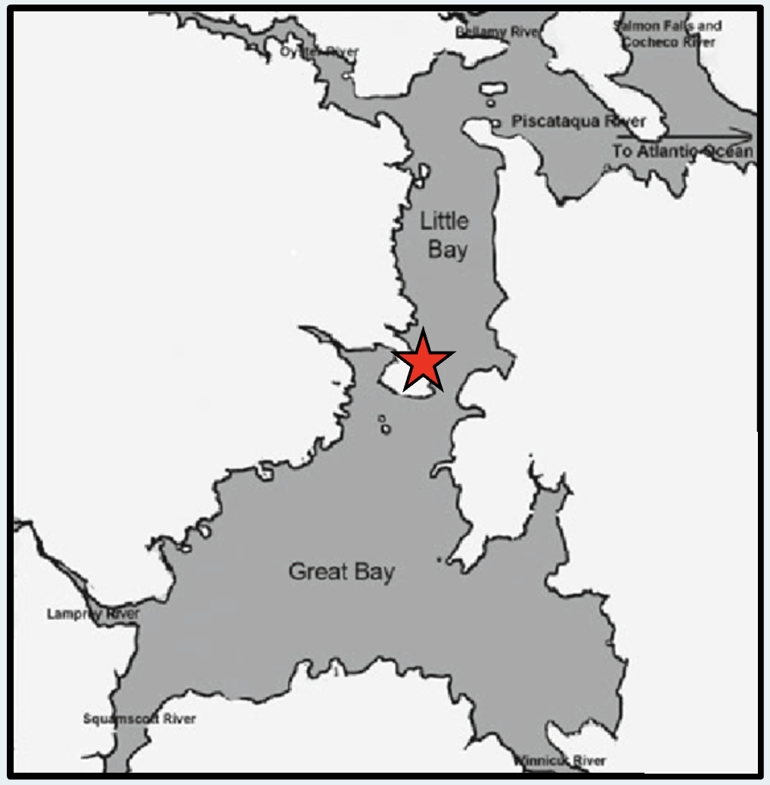
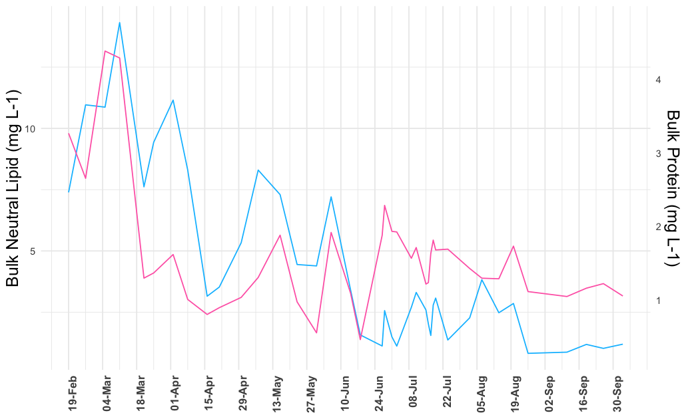
Characterizing the Lipid and Protein Concentrations in Phytoplankton
Alicia Veronneau¹, Marley Gonsalves¹, Elizabeth Harvey¹
¹Department of Biological Sciences, University of New Hampshire
Introduction
Lab Data
Phytoplankton are single-cell algae that play a key role in modulating atmospheric CO₂ and ocean carbon sequestration. In addition, phytoplankton are the base of marine food webs.
Great Bay Estuary is the largest in New Hampshire, and the site of ongoing aquaculture efforts that are important both ecologically, but also economically. One outstanding question is how well are phytoplankton communities nutritionally supporting important these important fisheries efforts?
The goal of this work was to better understand phytoplankton nutritional quality by screening phytoplankton in the lab to investigate the distribution of per cell lipid and protein concentrations and then relate those findings to field samples.
Both lipid and protein concentrations scaled with cell size on a per cell basis
Cell size 3 – 6 µm
Cell size 15 – 40 µm
Figure 2. Protein and lipid concentrations per species scaled with cell size on a per cell basis.
Methods
Field Sampling
In the Field:
Whole seawater was sampled at high and low tide from early spring to late fall.
Particulates in each sample were gently condensed into a smaller volume using a 1.2 µm polycarbonate filter
Samples were then frozen at –80°C until analysis.
In the Lab:
Spectrophotometric methods were used for both lipid and protein measurements.
A standard curve was created for both lipid and proteins using commercially purchased mixtures.
For Lipids:
Small aliquots of the condensed sample were added to a 96 well plate, stained with Nile Red and read on a spectrophotometer
For Proteins:
A Micro BCA Protein Assay kit was used
Reagents from the kit were added to each sample and incubated at 37°C for 30 mins in a 96 well plate which was then read on a spectrophotometer
Seasonal signals in lipid and protein concentrations
Figure 2. Bulk neutral lipids and proteins over the course of the year (2024) sampled from Adams Point in Great Bay, NH.
Conclusions & Future Work
Figure 1. shows the location in Great Bay that field samples were collected. Specifically, the samples were collected from a dock off Adam’s point.
Implement our knowledge of individual phytoplankton species nutritional quality to better understand trends in lipids and proteins in Great Bay.
Evaluate the nutritional quality of phytoplankton in Great Bay for important aquacultured organisms such as oysters.
Acknowledgements
Thank you to Dr. Elizabeth Harvey and Marley Gonsalves for their support and guidance on this project.
Notes:
Introduction: talk about phytoplankton and the interest of knowing more about and understand nutritional availability in Great Bay. First need to understand the nutritional contents and requirements of specific phytoplankton in the lab.
Methods: describe both lab and field methods.

