Slide 1
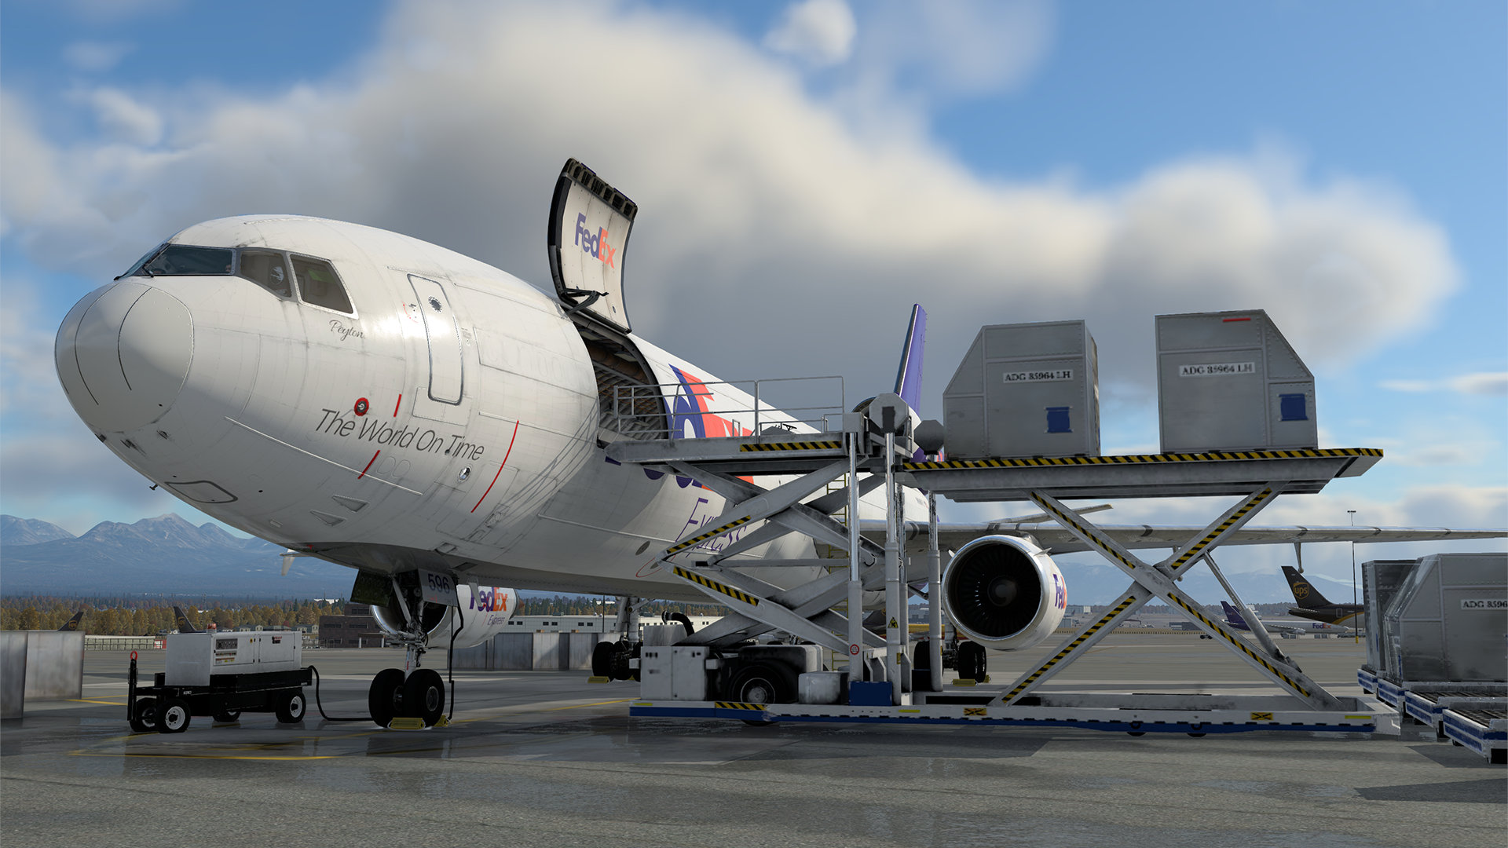
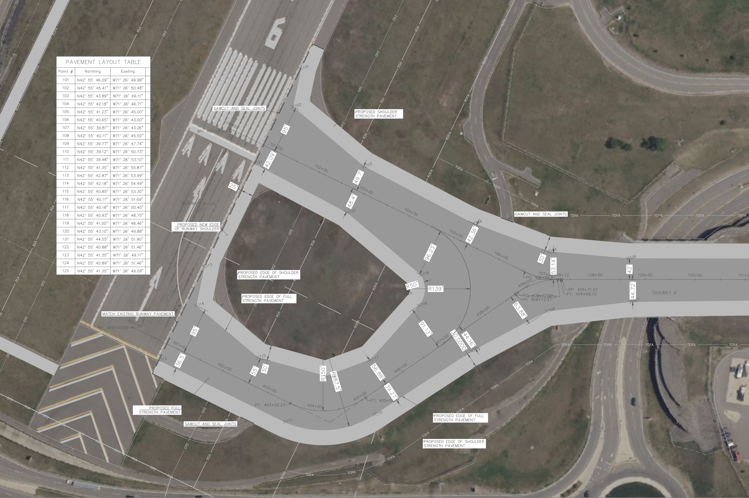
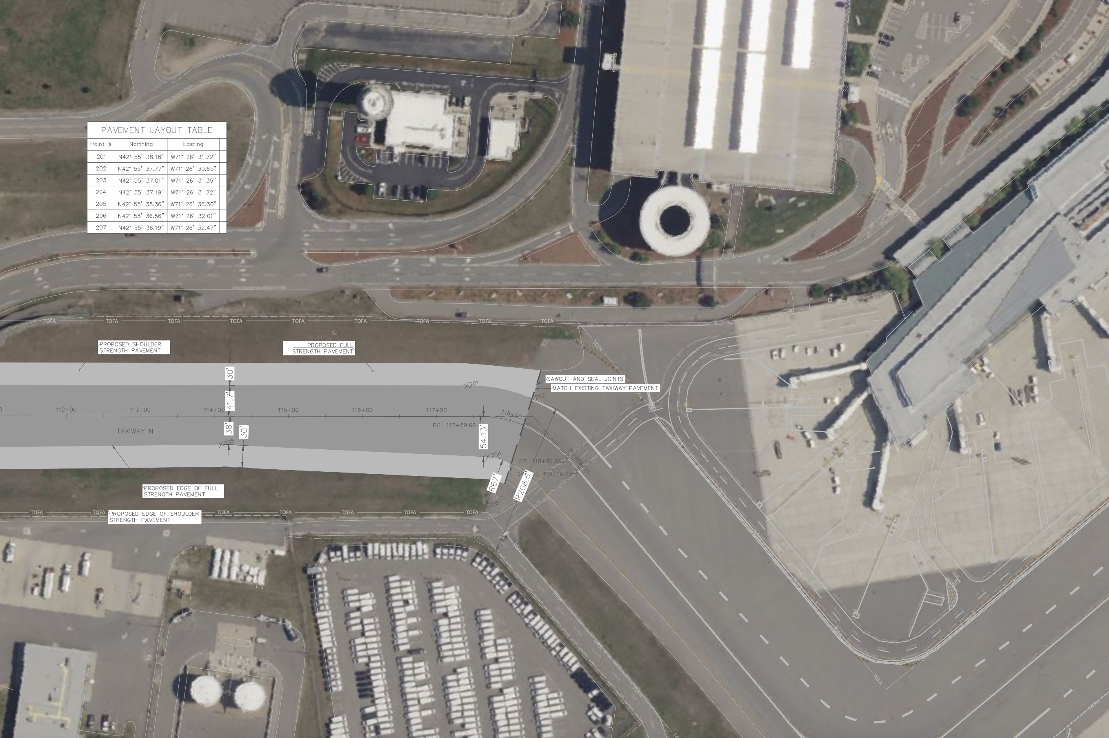
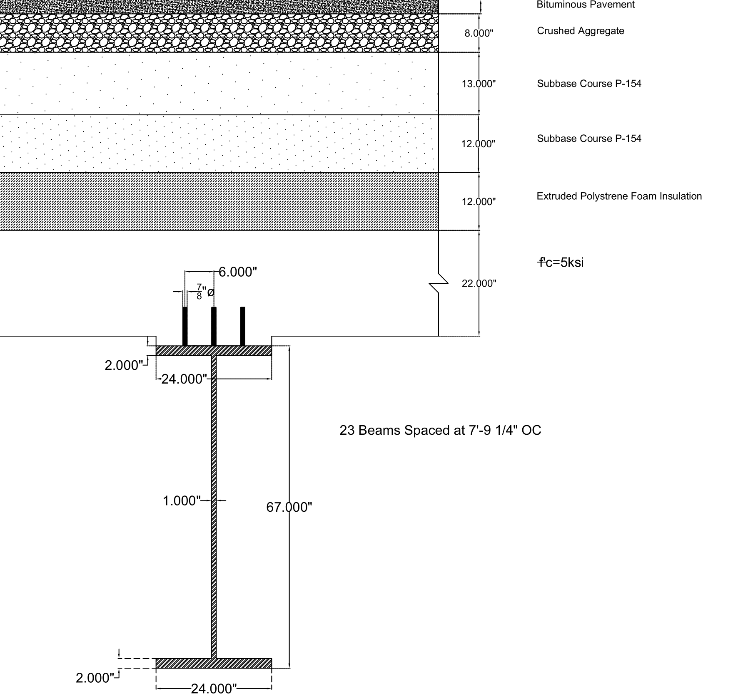
MHT Boston Taxiway-N Bridge Bridge Redesign and Reconstruction Cole Arcieri-Rowe, Cole Smith, Cormac Lynch-Greenberg, Jack Lambert, Tim Clark Department of Civil Engineering, University of New Hampshire
Introduction
MD-11 Aircraft
Proposed MSE Mural
Methods
Manchester International Airport's 2009 taxiway bridge features pavement with a standard 20-year lifespan, requiring future reconstruction. Redesigned to FAA Advisory Circular (AC) standards - which mandated expansion of the Taxiway Safety Area (TSA) to 171 feet - this project faced unique challenges. As taxiway bridges are rare, no existing standards addressed aircraft loading requirements. The solution needed to support an MD-11's maximum weight (652,000 lbs.) while enabling rapid construction to minimize operational disruptions.
Accelerated Bridge Construction (ABC) approach utilizes PCI-Northeast Guidelines for the Bridge Deck, Retrofitted Footings, and Parapet Walls, delivering three client-aligned benefits:
Rapid on-site assembly minimizing airport disruptions
Durable design reduces future Rehabilitation needs
Modular system simplifies maintenance
This package includes a full Taxiway-N replacement with an additive alternative included for the MSE façade for an aesthetic enhancement.
Footing Design
New Taxiway Geometry
Super Structure Design
Construction Safety & Phasing Plan (CSPP)
Construction Cost
Acknowledgements
References
Sydney Graveson & Samuel White
McFarland Johnson Inc.
Eshan Dave
Department of Civil Engineering, University of New Hampshire
-AASHTO LRFD Bridge Design Specifications. American Association of State Highway and Transportation Officials, 2010.
-Steel Construction Manual. American Institute of Steel Construction, 2023.
-Moulds, Bruce A. “Design considerations for Aircraft Bridges.” Journal of Bridge Engineering, vol. 6, no. 6, Dec. 2001, pp. 498–505
-Building Code Requirements for Structural Concrete (ACI 318M-08) and Commentary (ACI 318R-08). American Concrete Institute, 2008.
-“MassDOT Bridge Manual - Hundredth Anniversary Edition.” Mass.Gov
-Advisory Circulars. Federal Aviation Administration.
-PCI, www.pci.org/PCI_Docs/PCI_Northeast/Technical_Resources/Bridge

