Slide 1

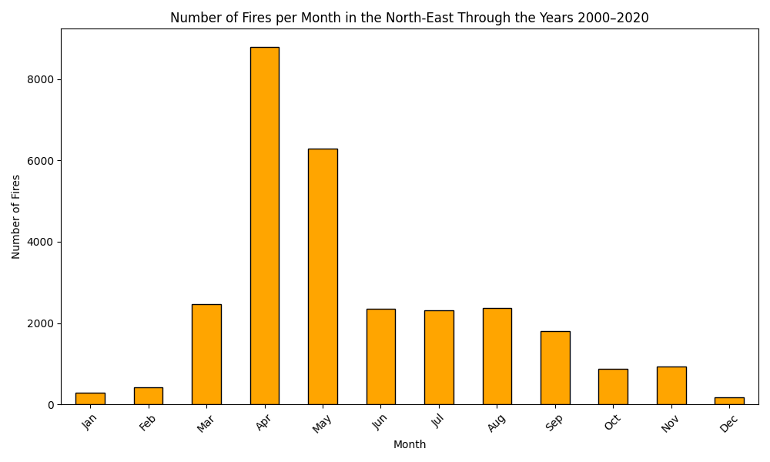
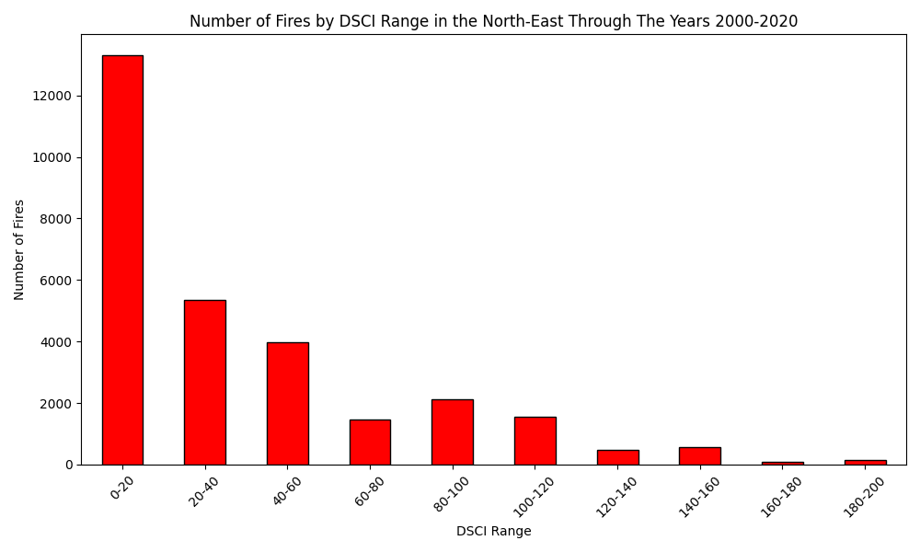
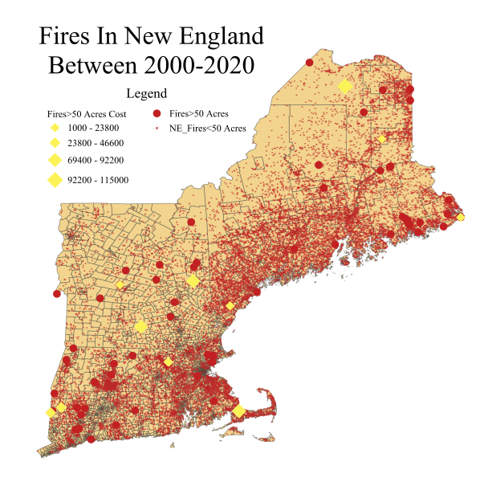
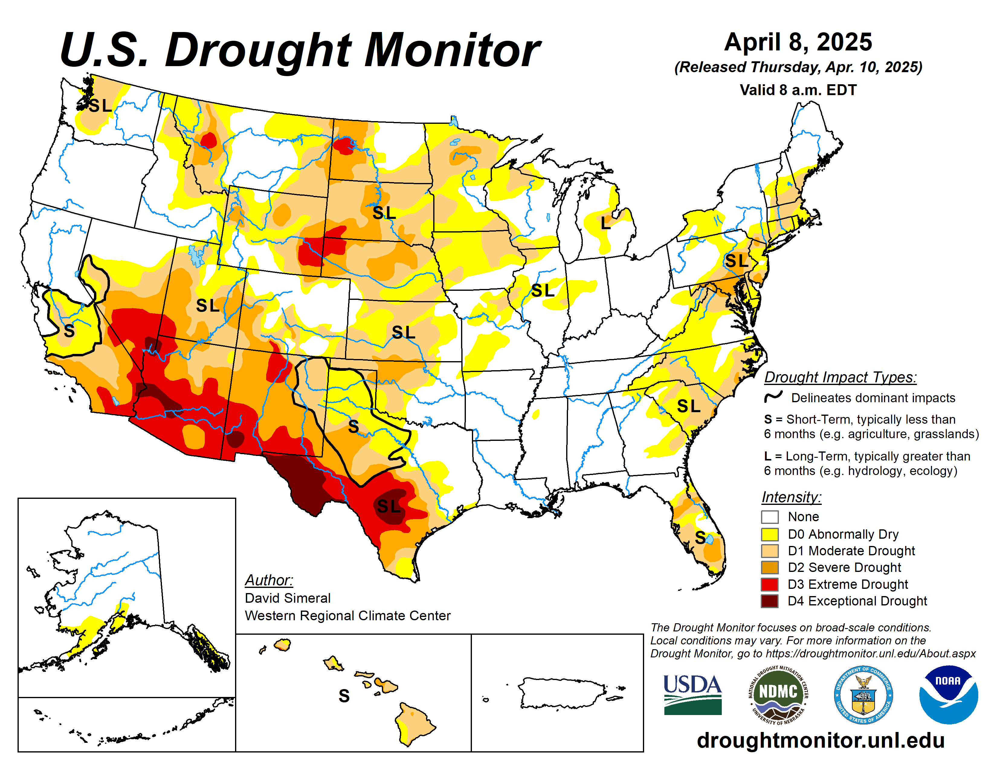
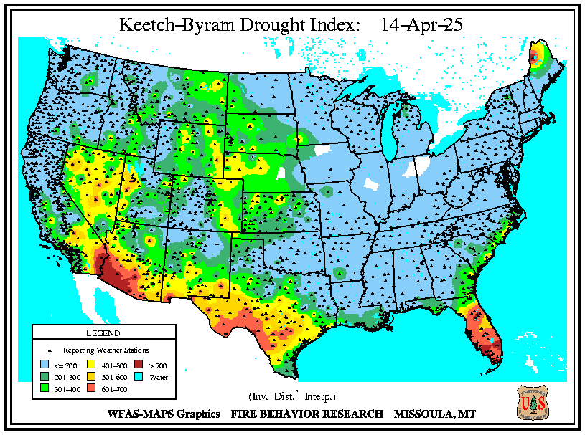
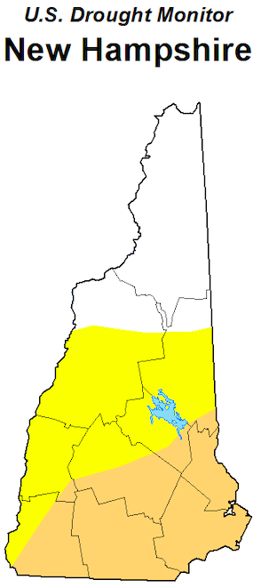
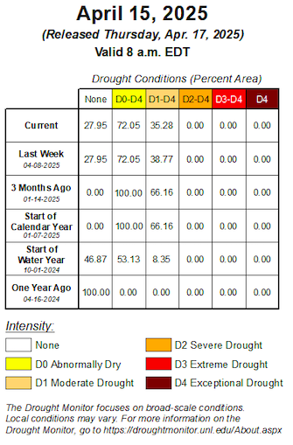
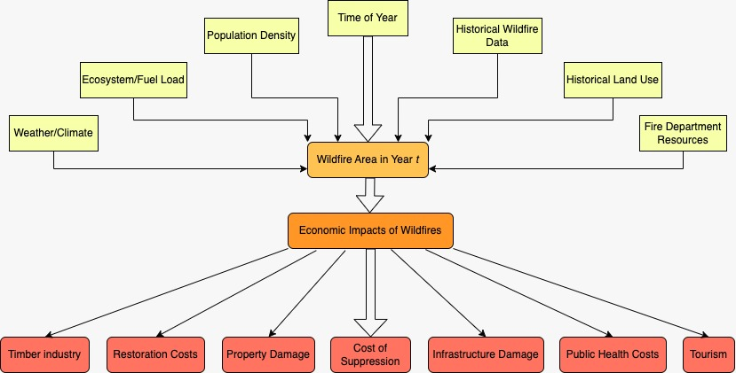
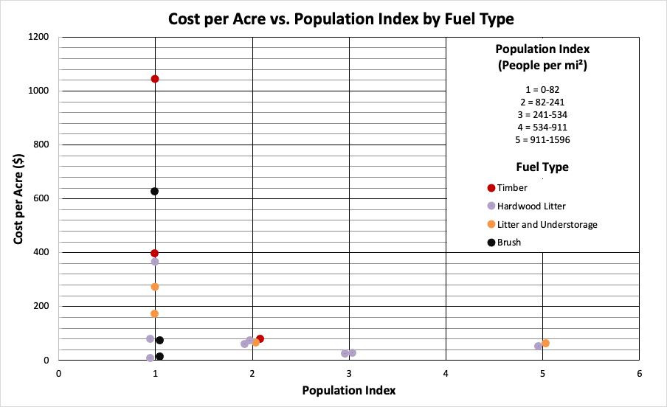
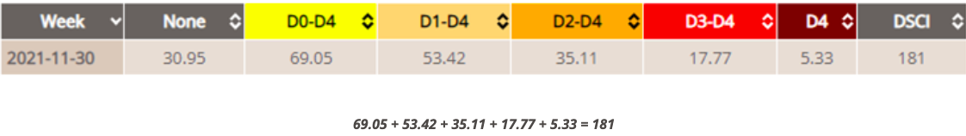
Analyzing Forest Fires in New England: GIS-Based Assessment of Causes, Impacts, and Economic Challenges
Danielle Ford, Allison Lessard, William de Constant
Advisor: Matt Davis
Department of Earth Sciences, University of New Hampshire
Introduction
Results
Discussion
Number of Fires per Month in NE Through the Years
2000-2020
Number of Fires by DSCI Range in NE Through the Years 2000-2020
Fire season is primarily in the spring.
Some drought indicators for the U.S. drought monitor are precipitation, streamflow, reservoir levels, temperature and evaporative demand, soil moisture and vegetation health. More of a measure over longer time periods.
Based on the U.S. Drought Monitor DSCI values for the fires that occurred according to the FPA and FOD data, there seems to not be a correlation between intense drought and fires in New England.
Infact, most of the recorded fires that happened in New England occurred during minimal drought.
There is a difference between meteorological drought and hydrological drought.
Meteorological drought refers to a lack of precipitation over a period of time. It is usually the first sign of drought and is measured using indicators like rainfall deficits, temperature, or drought indices (e.g., DSCI).
Hydrological drought develops more slowly and refers to low water levels in streams, rivers, reservoirs, or groundwater. It often lags behind meteorological drought because it takes time for reduced precipitation to impact water systems.
A method that is primarily based on meteorological drought is the KDBI (Keetch-Byram Drought Index), which uses daily precipitation and temperature data to estimate soil moisture deficits and fire danger.
Droughts in New England:
  No records of prolonged extreme droughts like with what you see out in Western U.S.
  Using the U.S. Drought Monitor, we were able to interpret the DCSI (Drought Severity and Coverage Index) value for each county the fire took place in from the years 2000 to 2020
Climate Change and its impact on New England:
  Warmer earlier springs: Rising temperatures lead to earlier springs, which extend the growing season but also increase evaporation rates.
  Longer, drier summers: Higher temperatures result in more intense, prolonged dry spells, reducing available moisture
  Less snowmelt, lower soil moisture: Warmer temperatures reduce snow accumulation, leading to lower soil moisture, which worsens drought conditions.
  Higher population density: Growing populations in vulnerable areas increase demand for water and heighten exposure to wildfire and drought risks
Questions:
  How might climate change affect wildfires and what are some economic impacts?
  Droughts could be connected to fires?
Figure 3: Number of wildfires per month in the Northeast U.S. (2000–2020). Fire activity peaks in spring, particularly in April, which may reflect a combination of dry vegetation, increased wind, and human ignition sources before full green-up.
Figure 4: Frequency of wildfires in the Northeast U.S. from 2000 to 2020, grouped by weekly DSCI values. Most fires occurred under lower drought severity (DSCI 0–20), suggesting ignition factors may be influenced more by non-drought conditions or human activity.
Methods
Historical records of fires, droughts, and costs:
  Fires:
    Fire program analysis (FPA)
    Fire Occurrence Database (FOD)
    Fires bigger than 50 acres from the datasets.
  Drought:
    US Drought Monitor
    DSCI
  Costs:
    National Interagency
    Fire Center
  Population:
    US Census
Calculations:
  Using cumulative Drought Monitor data, the percentage of land area in each drought category (D0 through D4) for a given week was used to calculate the Drought Severity and Coverage Index (DSCI) for that week.
    DSCI = D0 + D1 + D2 + D3 + D4
    Example:
    High DSCI value indicates a stronger drought for that area.
Software and tools used:
  Excel
    For FPA, FOD, and U.S. Drought Monitor data organization
  QGIS
    Used to create a map of where fires were, the population in those areas, and the difference in cost of a few fires
  Python
    To make the fires by month and fires by DSCI histograms
Figure 2: Drought conditions in New Hampshire as of April 15, 2025. Southern and central regions show Abnormally Dry (D0) and Moderate Drought (D1) conditions. The table tracks drought coverage over time, showing a recent decline in Moderate Drought areas
Figure 5: Illustrates the factors that impact wildfire size and its resulting effects on the economy. This model is tuned for Northeast parameters and is influenced by a combination of these factors.
Figure 6: Cost per acre ($) in relation to the population index assigned to each fire over 50 acres from 2015-2020 in New England. Colors represent the main fuel type of each fire.
.
Figure 1: This figure shows the number and location of wildfires in New England from 2000-2020. The larger red dots show fires larger than 50 acres while the smaller red dots show fires smaller than 50 acres. The yellow symbols show fires that have been evaluated for the amount of money they lost in US dollars.
References
Acknowledgements
U.S. Drought Monitor. (n.d.). Drought Severity and Coverage Index (DSCI). National Drought Mitigation Center, University of Nebraska–Lincoln. Retrieved from https://droughtmonitor.unl.edu
U.S. Forest Service. (n.d.). Metrics. Forest Service Research Data Archive. Retrieved from https://www.fs.usda.gov/rds/archive/catalog/metrics
Pyun, Y. (2017). Gardner Wildfire History. The Gardner News. https://data.thegardnernews.com/wildfire-history/
Mercer, D., Pye, J., Prestemon, J., Butry, D., & Holmes, T. (2000). Economic Effects of Catastrophic Wildfires: Assessing the Effectiveness of Fuel Reduction Programs for Reducing the Economic Impacts of Catastrophic Forest Fire Events. https://www.srs.fs.usda.gov/econ/pubs/misc/fl-fire-report2000-lores.pdf
We would like to thank Matt Davis for his continual support and guidance throughout this process. Thank you to the URC for allowing us to share our knowledge.

