Slide 1


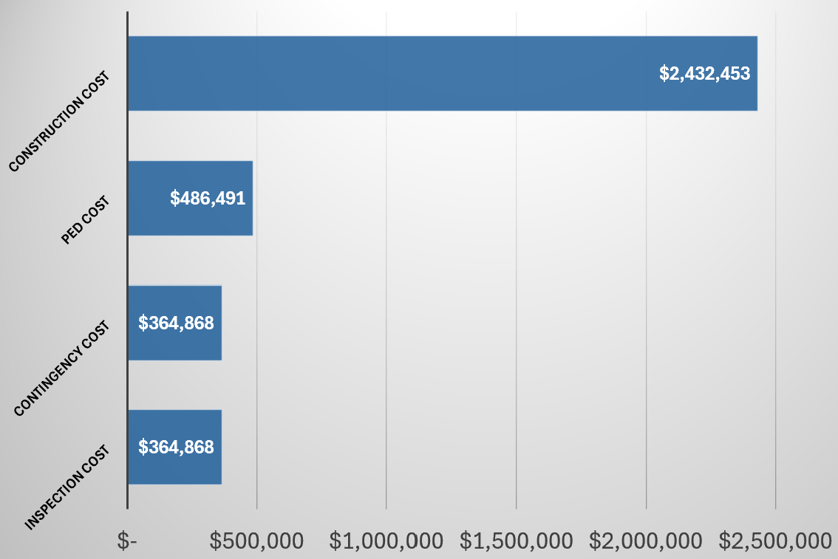
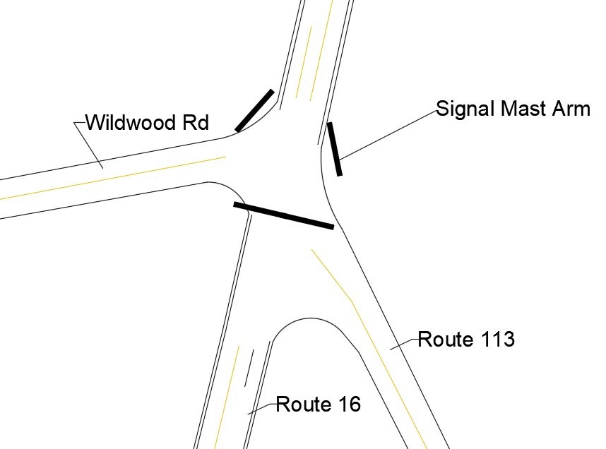
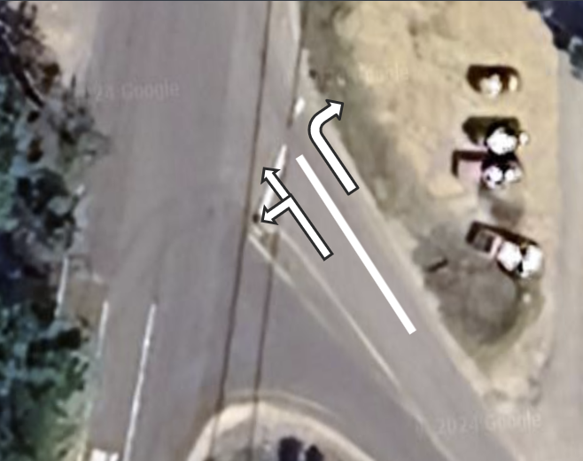
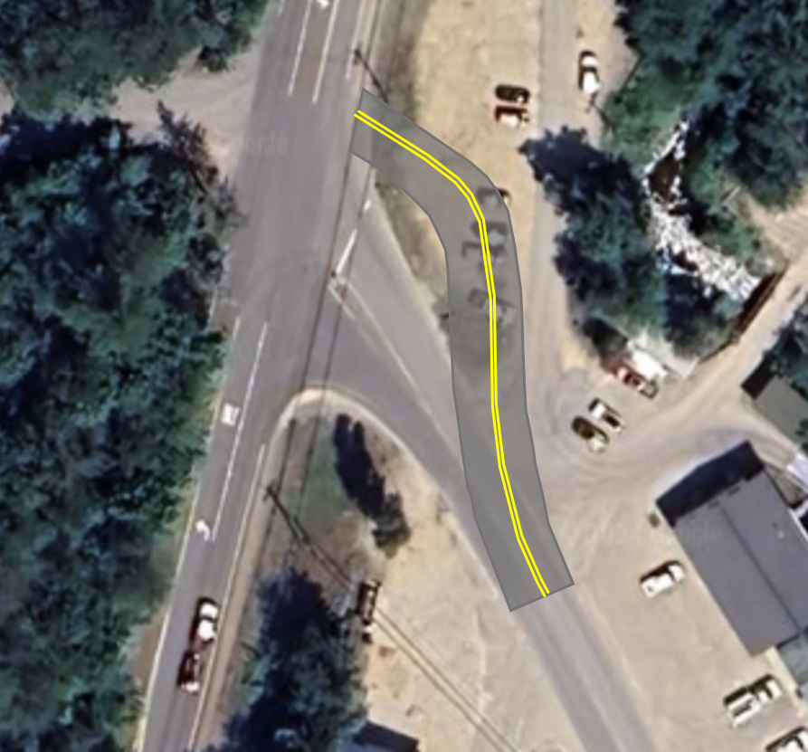
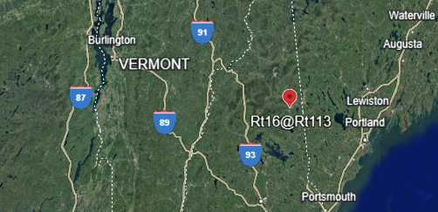
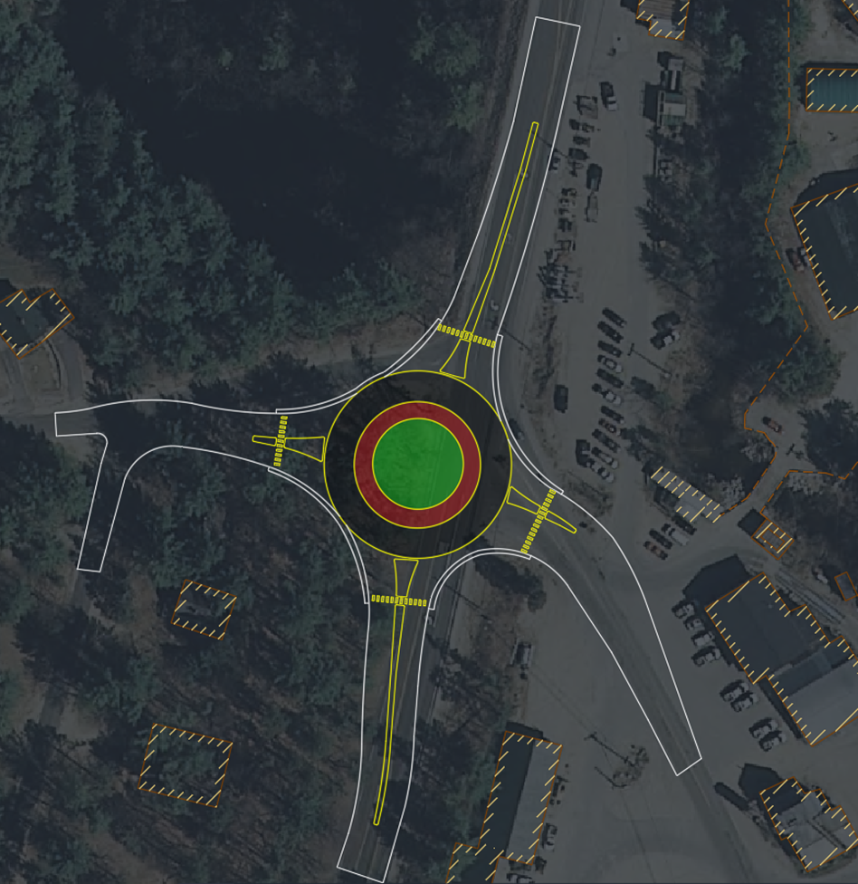

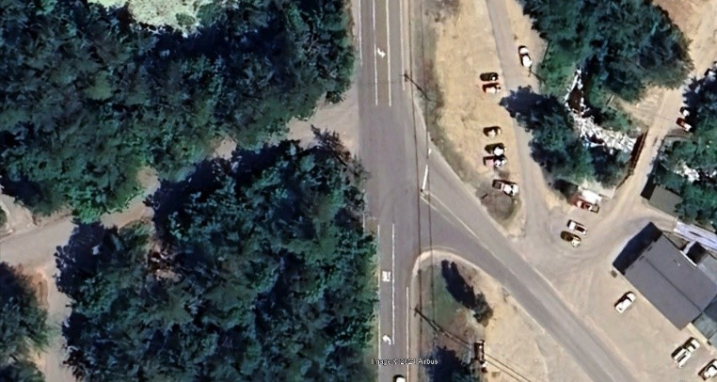

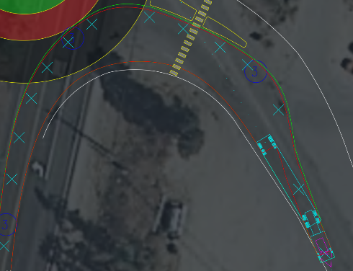
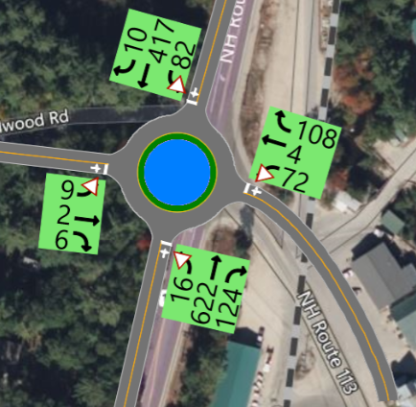
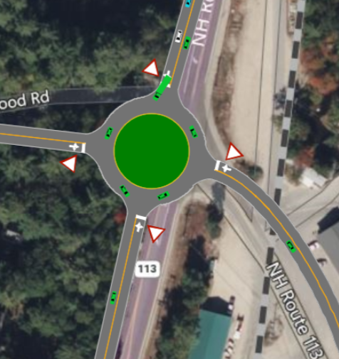
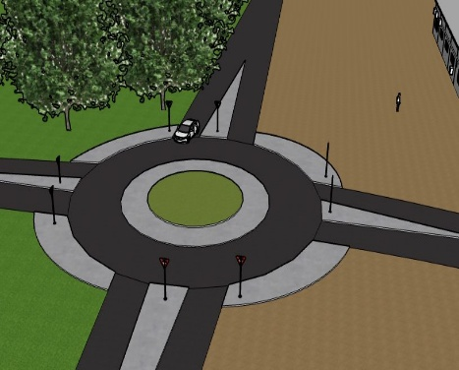
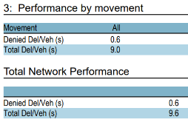
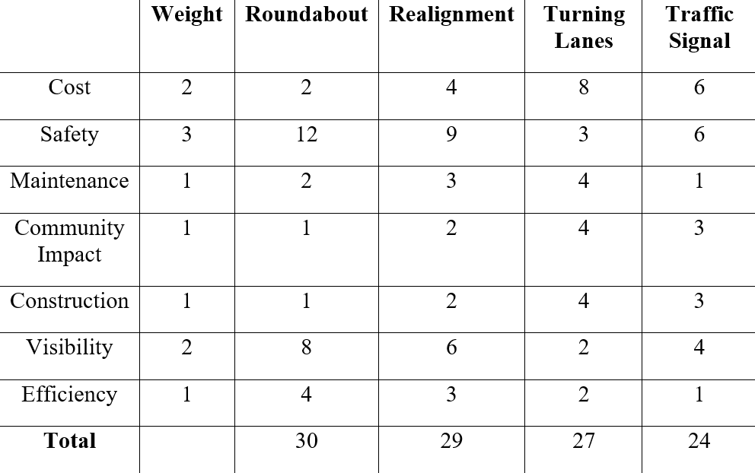
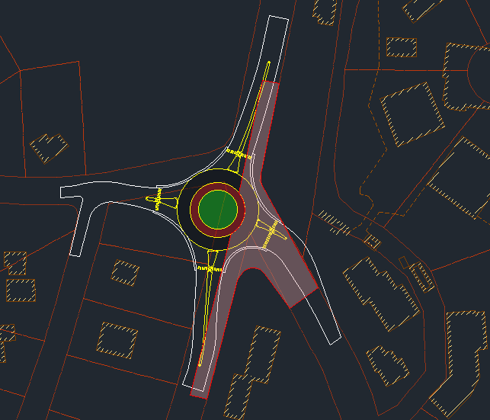
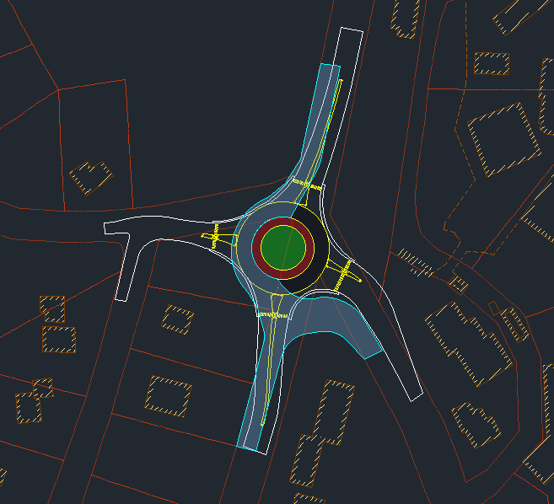
NH Route 16 at NH Route 113 Roundabout: Albany, NH
Samuel Bibeau (PM), Reed Abry, Luke Adams, Jackson DiMartino, Nicholas Lucas
Department of Civil Engineering, University of New Hampshire, Durham, NH 03824
Introduction
Design Alternatives
Cost Estimate
Overview:
The primary goal was to design a safer, more accessible intersection without disrupting traffic flow or causing backups on NH Route 16 at NH Route 113.
Scope:
Fall 2024: Dedicated to analyzing traffic flow, crash data, and researching potential alternative designs.
Spring 2025: Dedicated to finalized conceptual design, developing a construction phasing plan, and calculating a cost estimate for the preferred alternative.
Alternative: Traffic Signal
Alternative: Turning Lane with Geometric Improvements
Controlling the right turns from Route 113 onto Route 16 with a traffic signal would decrease the most common crashes currently seen at the intersection though it would likely cause rear-ends on Route 16.
Striping in turning lanes and realigning Route 113 could clarify the order of traffic and would also fix the skew between Route 113 and Wildwood Rd.
Location
Preferred Alternative
Expenses
Inspection | $ 364,868
Contingency | $ 364,868
PED | $ 486,491
Construction | $ 2,432, 453
Total Project | $ 3,648,679
Final Roundabout Concept
A roundabout with an inscribed circle diameter of 140 feet was chosen as it meets the speed recommendations from the Roundabout Guide and minimizes impact on the surrounding area. Large vehicles can safely use the roundabout by utilizing the truck apron and extended shoulder, as tested within the Vehicle Tracking Program in AutoCAD. There are 4 crosswalks, each connected with sidewalks to accommodate pedestrians. On the Route 16 approaches, longer splitter islands were utilized for speed control.
Dimensions:
140’ Inscribed Circle Diameter
68’ Center Island Diameter
13’ Truck Apron Width
6’ Sidewalk Width
25’ Crosswalk Setback
50’ Long Splitter Islands on Rt 113 and Wildwood Rd
200’ Long Splitter Islands on Rt 16
The estimated construction cost was calculated at $2.4 million. Adding 15%, 20%, and 15% for Inspection, Preliminary Engineering Design (PED), and Contingency respectively resulted in the Total Project Cost.
N
N
Synchro Modeling
Using the traffic volumes provided, engineering mathematics, and the trip generation manual as well as collected field data on the road and its geometry, a synchro analysis of the intersections pm peak hour was performed. This showed an average Level of Service (LoS) of A with only the northbound approach from Route 16 being a LoS of B for the intersection.
Decision Matrix
Construction Phasing
Detours were not feasible at this location. Construction of the roundabout will be done in two phases while two-way temporary roads run on the opposite side. Traffic will be controlled by a stop sign on the intersection of Rt 113 and Rt 16. Lower-level access will be maintained to Wildwood Rd. throughout construction.
Acknowledgements
Project Sponsor:
Jordan Pike, PE & Claudia Damboise
– HEB Engineers
Faculty Advisor:
Dr. Jo Sias
–University of New Hampshire
References
Temporary Road First Phase
Temporary Road Second Phase
AASHTO Green Book
USDOTFHA Roundabout Guide
NHCRP Guide for Roundabouts

Slide 2

This poster template provided courtesy of
UNH ESRC Poster Printing Services
Trust us to make your poster look GREAT!
Website: http://posters.unh.edu
Poster Guide: http://goo.gl/1E7TJY
DELETE THIS SLIDE BEFORE PRINTING

