Slide 1
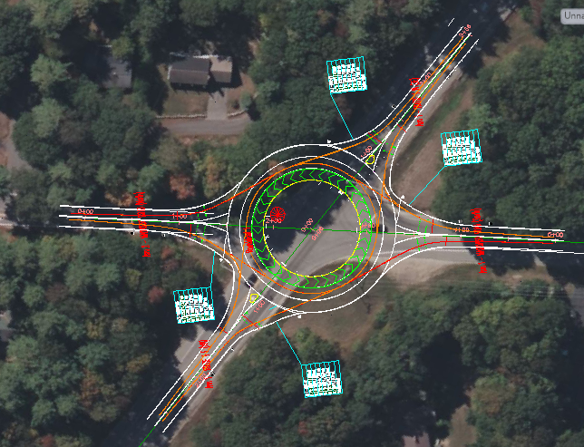
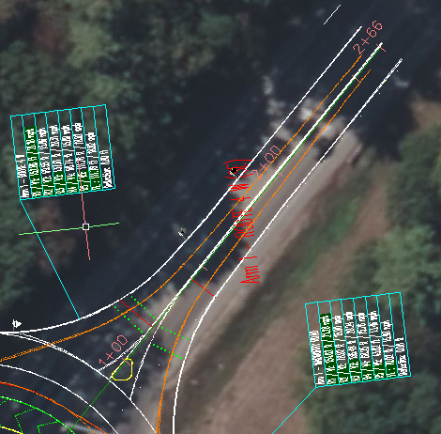
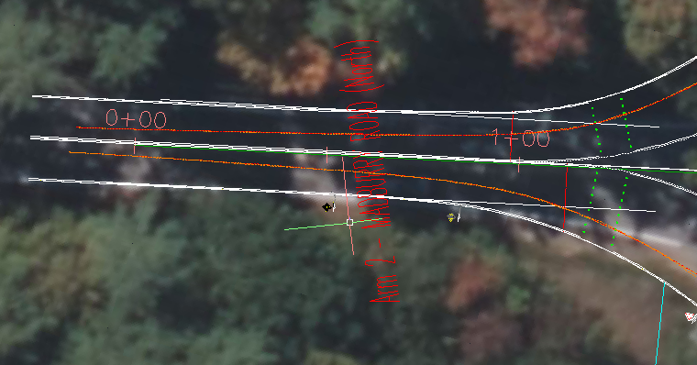
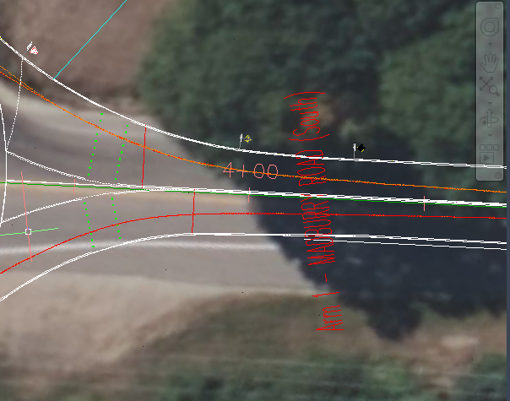
DURHAM – US RT 4 & MADBURY ROAD Isabel Gillam, Quinn Connors, Thomas Leahy, and Octavia Edwards Civil Engineering, University of New Hampshire, Durham, NH 03824
Introduction
Design Elements
Cost
sTAMD Simulations
The intersection of Route 4 and Madbury Road in Durham, NH has become a growing concern due to its high crash frequency, recurring congestion, and inefficient traffic flow. Over the past decade, the intersection has experienced 40 crashes—32 of which were rear-end or angle collisions. In response to these safety concerns, our team evaluated three potential design alternatives. The first involved adding dedicated left-turn lanes onto Madbury Road to improve vehicle movement and reduce conflict points. The second proposed an overpass, allowing Route 4 to pass over Madbury Road to fully separate traffic streams. The third alternative was the implementation of a two-lane roundabout. After thorough analysis, our team selected the roundabout design for further development and evaluation.
The projected total cost for the roundabout construction is approximately $3.4 million. This estimate accounts for materials, labor, equipment, and long-term maintenance. Paving costs are among the largest components, with asphalt covering approximately 28,700 square feet at a combined material and labor cost of $602,700. Concrete will be used for curbing, the center island, and traffic separation features, totaling $27,877. Excavation and filling, required due to site grading and soil conditions, will contribute $1,838,825 to the overall cost, factoring in both crew work and truck deliveries.
Landscaping and signage around the roundabout, including a 12,668-square-foot center island, will cost approximately $320,900. Tree removal and trimming in the construction area is expected to total $23,700. Long-term maintenance over the roundabout’s 25-year service life is estimated at $125,000. Contractor fees—including general and subcontractor markups, as well as costs related to traffic control, construction management, and safety—are projected to comprise $461,000 of the total. These combined figures bring the final estimated project cost to $3.4 million.
Requirements
Figure 1: Overview of Roundabout
Figure 2: RT 4 heading west entering Roundabout
Conclusion
Our project focused on developing three alternative designs for the potential reconstruction of the intersection. The first concept proposed adding dedicated left-turn lanes onto Madbury Road, aimed at reducing confusion and improving traffic flow. The second option introduced an overpass, allowing Route 4 to pass over Madbury Road—this design would virtually eliminate the risk of collisions and confusion by fully separating traffic streams. The final alternative was a roundabout, featuring dedicated entry and exit lanes for both roads. This option would promote a continuous flow of traffic while significantly reducing the likelihood of head-on collisions.
We evaluated each design using a variety of criteria to determine the most suitable solution. First, we developed a design matrix to assess each option based on traffic and pedestrian safety, emergency vehicle access, and other key constraints. Next, we created a detailed cost estimate for each design, accounting for materials, long-term maintenance, and associated expenses. Finally, we examined similar intersections throughout Durham and the wider New Hampshire area to identify the solution most aligned with local needs and expectations.
After careful consideration, our team selected the roundabout design. It proved to be the most cost-effective, required minimal disruption to the surrounding area, aligned well with nearby intersections, and received the highest overall rating in our design matrix.
Design Elements
The goal of this project was to identify the design alternative that best improved overall safety for motorists, enhanced intersection efficiency, and remained cost-effective. After careful evaluation, the roundabout design was determined to be the most suitable solution. By gradually reducing vehicle speeds upon entry, the roundabout minimizes the risk of abrupt stops and high-speed collisions. Its geometric design eliminates the possibility of T-bone crashes through continuous, unidirectional flow. Additionally, the roundabout significantly improves traffic efficiency by removing the need for signalized control.
While the overpass alternative offered strong benefits in terms of safety and traffic flow, the associated construction and maintenance costs rendered it unfeasible. The addition of dedicated left-turn lanes onto Madbury Road was a cost-effective solution for reducing crash risk; however, it did not adequately address traffic flow concerns. The presence of traffic signals and high approach speeds continued to pose challenges, potentially leading to sudden stops and increased crash risk. Based on this criteria, the left turn lanes and overpass were ruled out as potential options.
Figure 3: Madbury heading North past Roundabout
Figure 4: Madbury heading South past Roundabout
Design Criteria
Existing Conditions
The proposed roundabout features a two-lane approach from both directions along Route 4 and a single-lane approach from each direction on Madbury Road. Each approach lane will transition into a circulating lane—two lanes from Route 4 and one from Madbury Road—ensuring smooth traffic flow within the roundabout. The central island will have a diameter of 103 feet, with a 12-foot-wide mountable apron surrounding it, bringing the total diameter to 127 feet. Located at each entrance to the roundabout are unsignalized pedestrian/cycle crossings, that have a crossing width of 7.87 feet, and are located 24.61 feet from each entrance,
To facilitate efficient traffic movement, all approach lanes will incorporate a tapered design. This geometry is intended to minimize congestion and promote continuous vehicle flow. Vehicles entering from Route 4 will use the outer circulating lane as an exit-only lane for through movements, while vehicles entering from Madbury Road will have the ability to merge into the inner circulating lane to complete left turns or continue around the roundabout.
The Route 4 approaches will consist of lanes 10.83 feet wide, expanding to 14.78 feet at entry and exit points, with an overall nominal road width of 25.59 feet. Key design features include a curb taper offset of 16.4 feet, entry and exit radii of 78 feet and 131.23 feet respectively, and various inner and outer curb offsets to optimize turning paths and lane separation.
Approaches from Madbury Road will include 11-foot-wide lanes, which widen to 14.76 feet at the entry and exit points. These entries will have a nominal road width of 14.76 feet, with an entry radius of 98.43 feet and an exit radius matching that of Route 4 at 131.23 feet.
The intersection serves as a critical link for commuter, residents, and UNH students, experiencing high traffic volumes and notable safety concerns. Currently signalized, the intersection suffers from frequent congestion, prevalent speeding -particularly on Route 4- and a lack of dedicated turn lanes on Madbury Road. Limited pedestrian and cyclist infrastructure, combined with inefficient traffic flow, further underscore the need for improvement.
The roundabout addresses these issues by eliminated signal-related delays and reducing vehicle speeds through its circular geometry. It removed direct left turn and cross traffic conflicts, streamlining vehicles movement and reducing congestion. Also, the roundabout can be deigned with pedestrian crossings set back from the circulatory roadway and spitter islands will be used. Cyclist accommodations can also be incorporated with spared use paths, making the intersection safer and more accessible for all users.
References
Sponsors:
Wiliam Lambert
Lilah Flynn
Advisor:
Mohamed Elshaer
Majid Ghayoomi

Slide 2
Abstract
This project addresses safety and efficiency concerns at the intersection of Route 4 and Madbury Road in Durham, New Hampshire—an area with a documented history of high crash frequency and traffic congestion. Our team evaluated three potential design alternatives: the addition of dedicated left-turn lanes, the construction of an overpass, and the implementation of a two-lane roundabout. Each alternative was assessed based on key criteria, including vehicular and pedestrian safety, emergency access, traffic flow efficiency, and cost.
Following a comprehensive analysis involving a design matrix, cost estimation, and review of similar intersections, the roundabout was selected as the preferred solution. The proposed roundabout features tapered entry lanes, a central island with a 127-foot diameter, and lane configurations designed to reduce crash risk and eliminate signal-related delays. With a total projected cost of $3.4 million, the roundabout provides a cost-effective, long-term solution that improves safety and traffic operations while minimizing disruption to the surrounding area.

