Slide 1

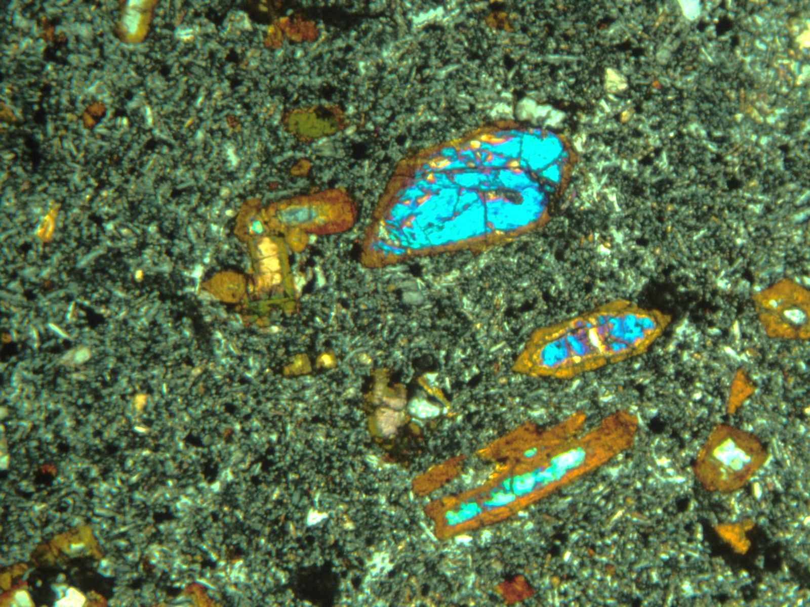
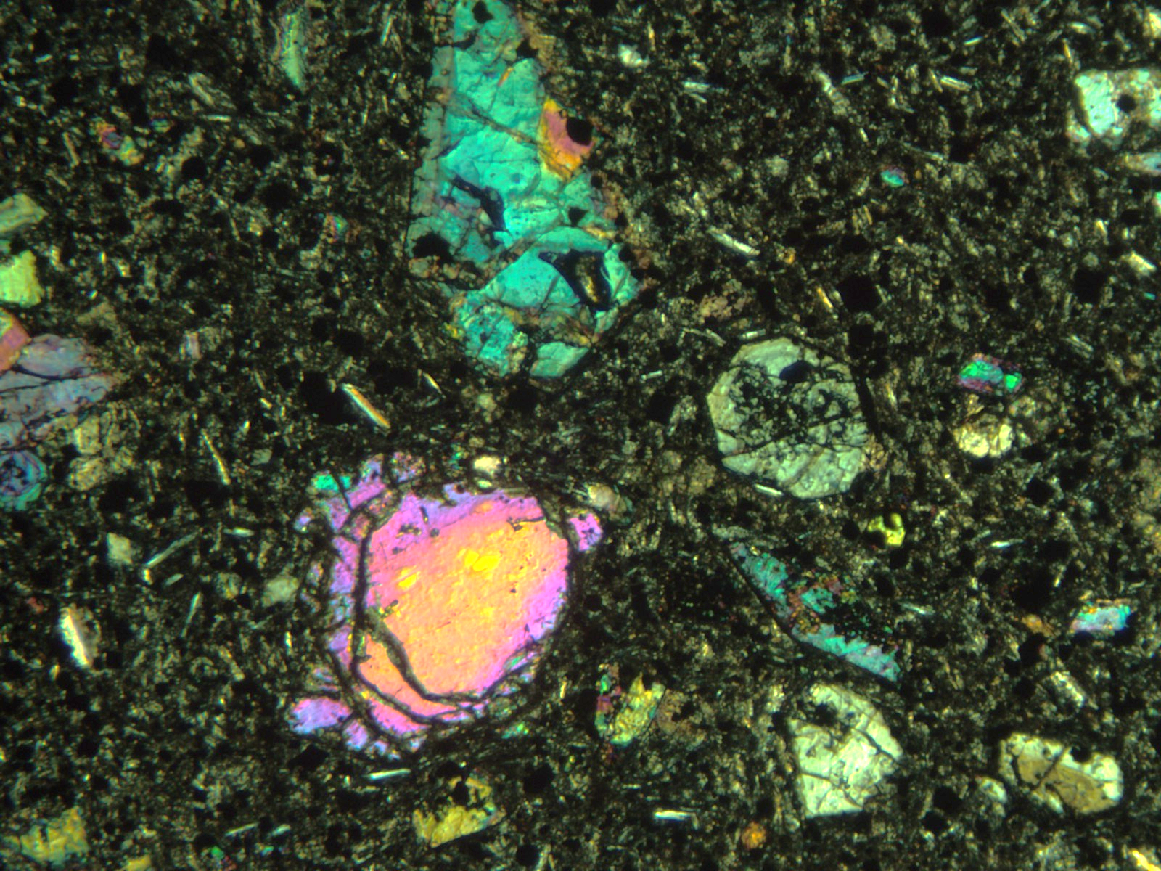
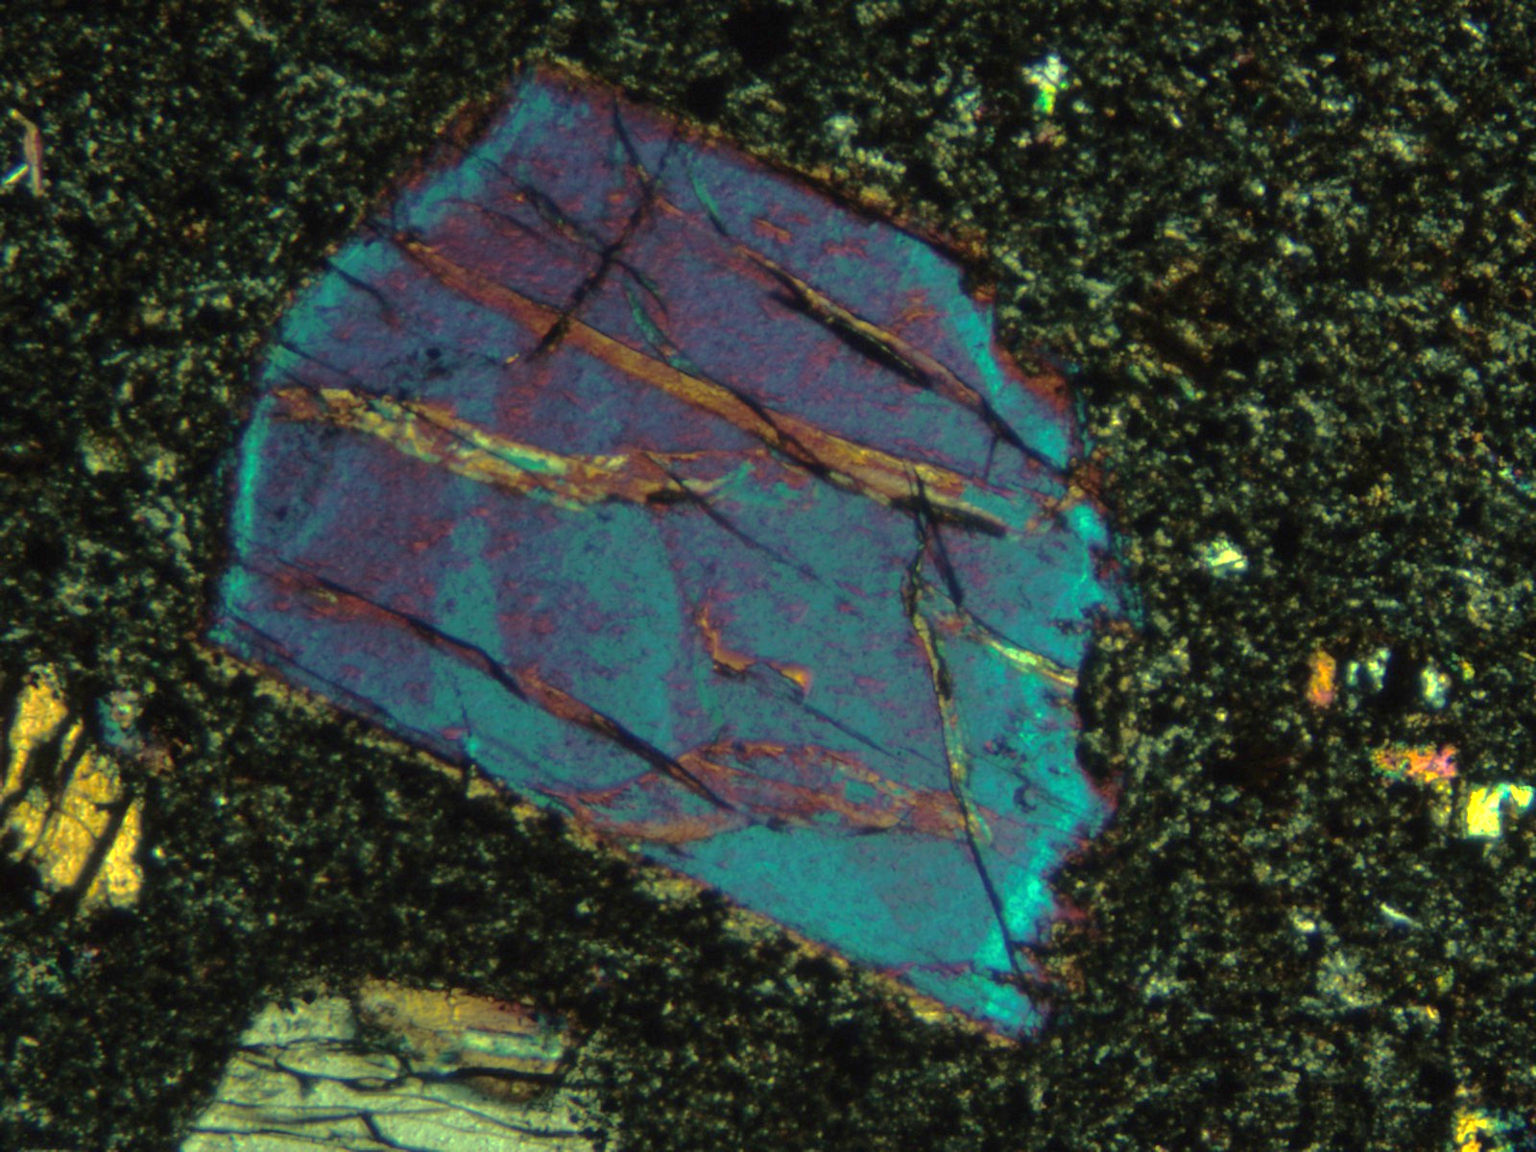
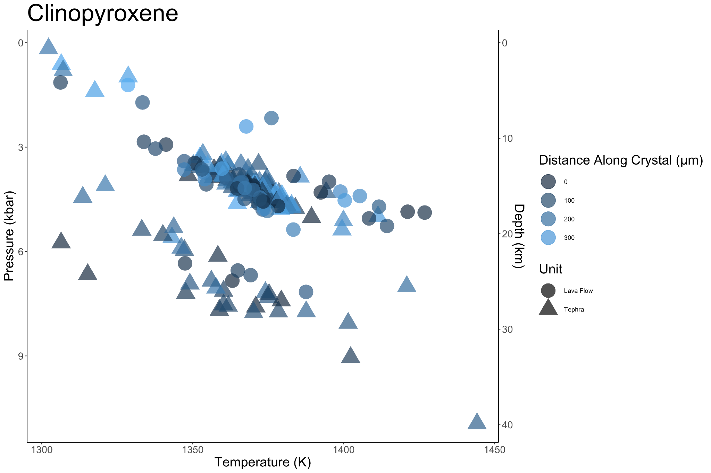
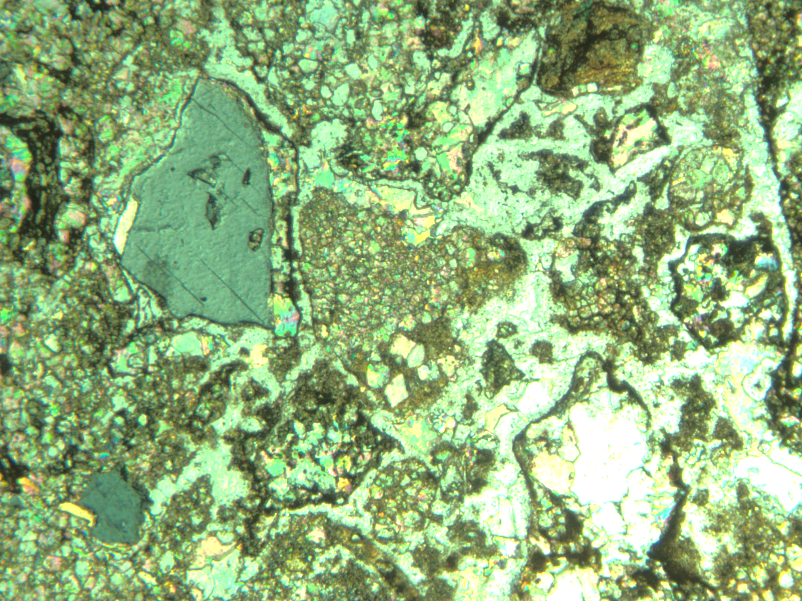
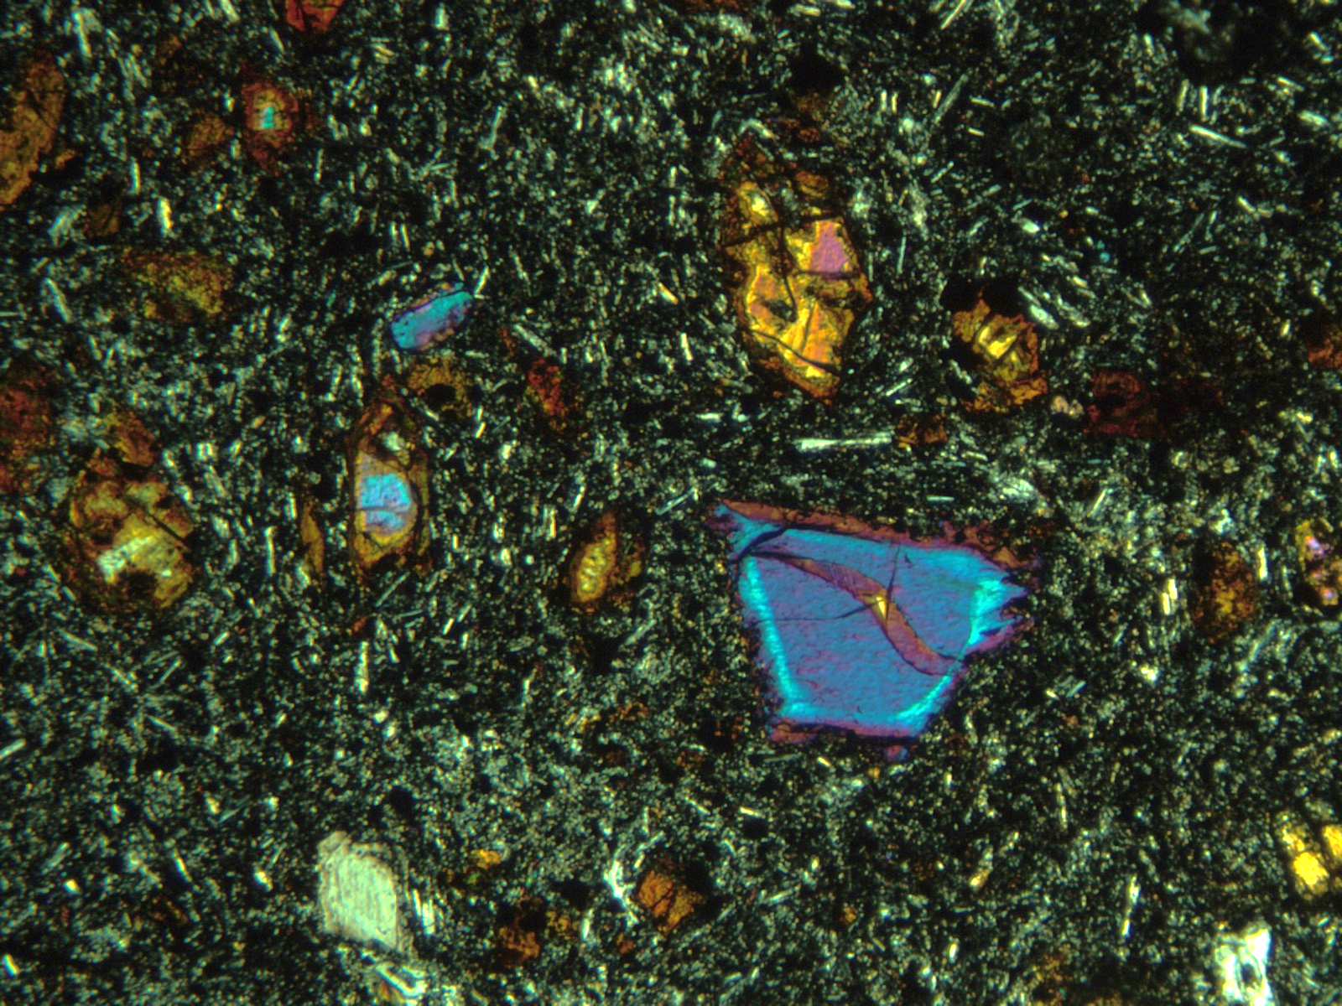
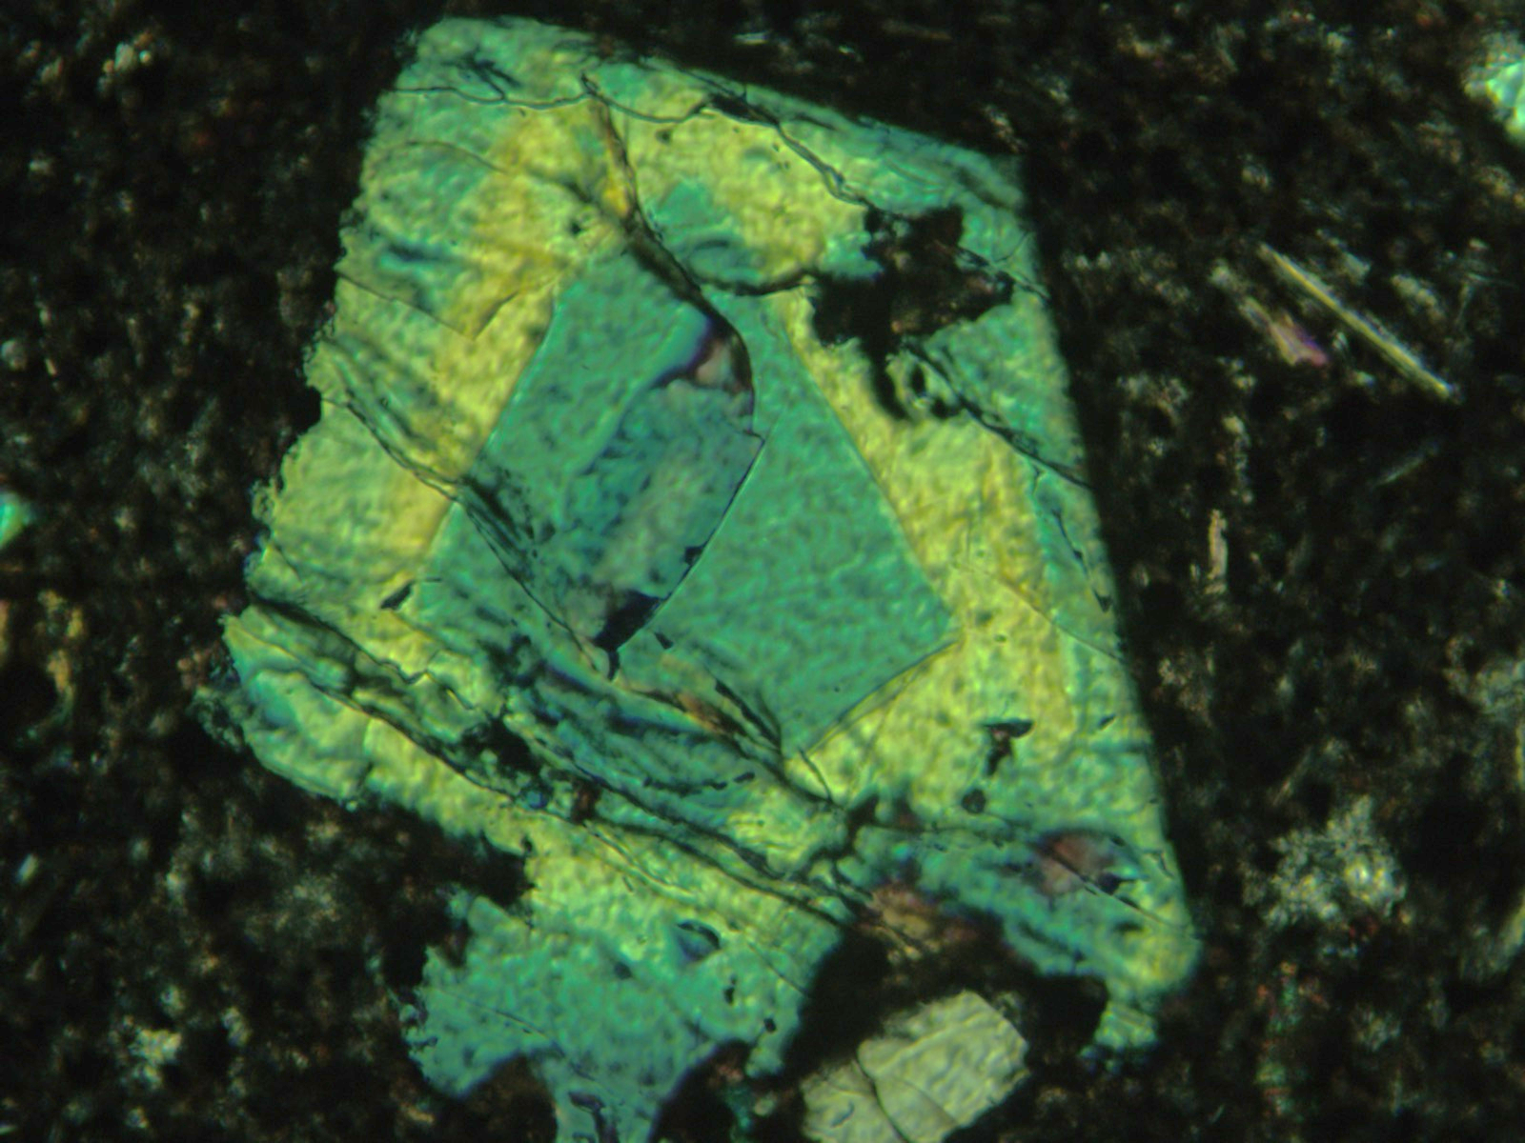
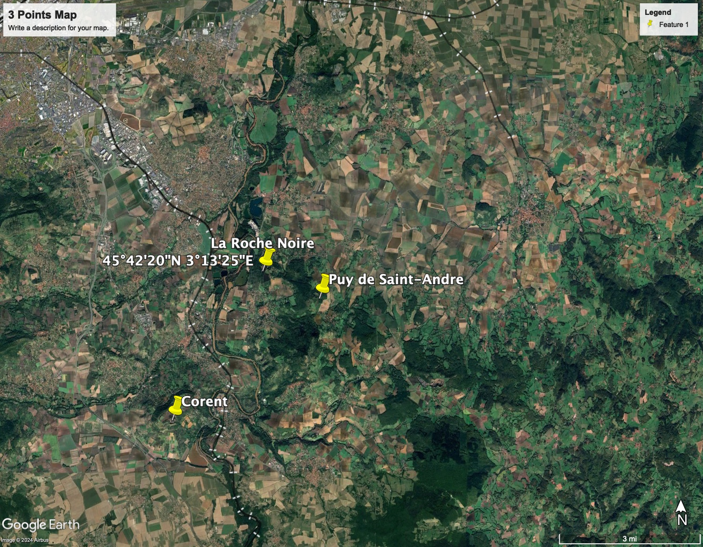
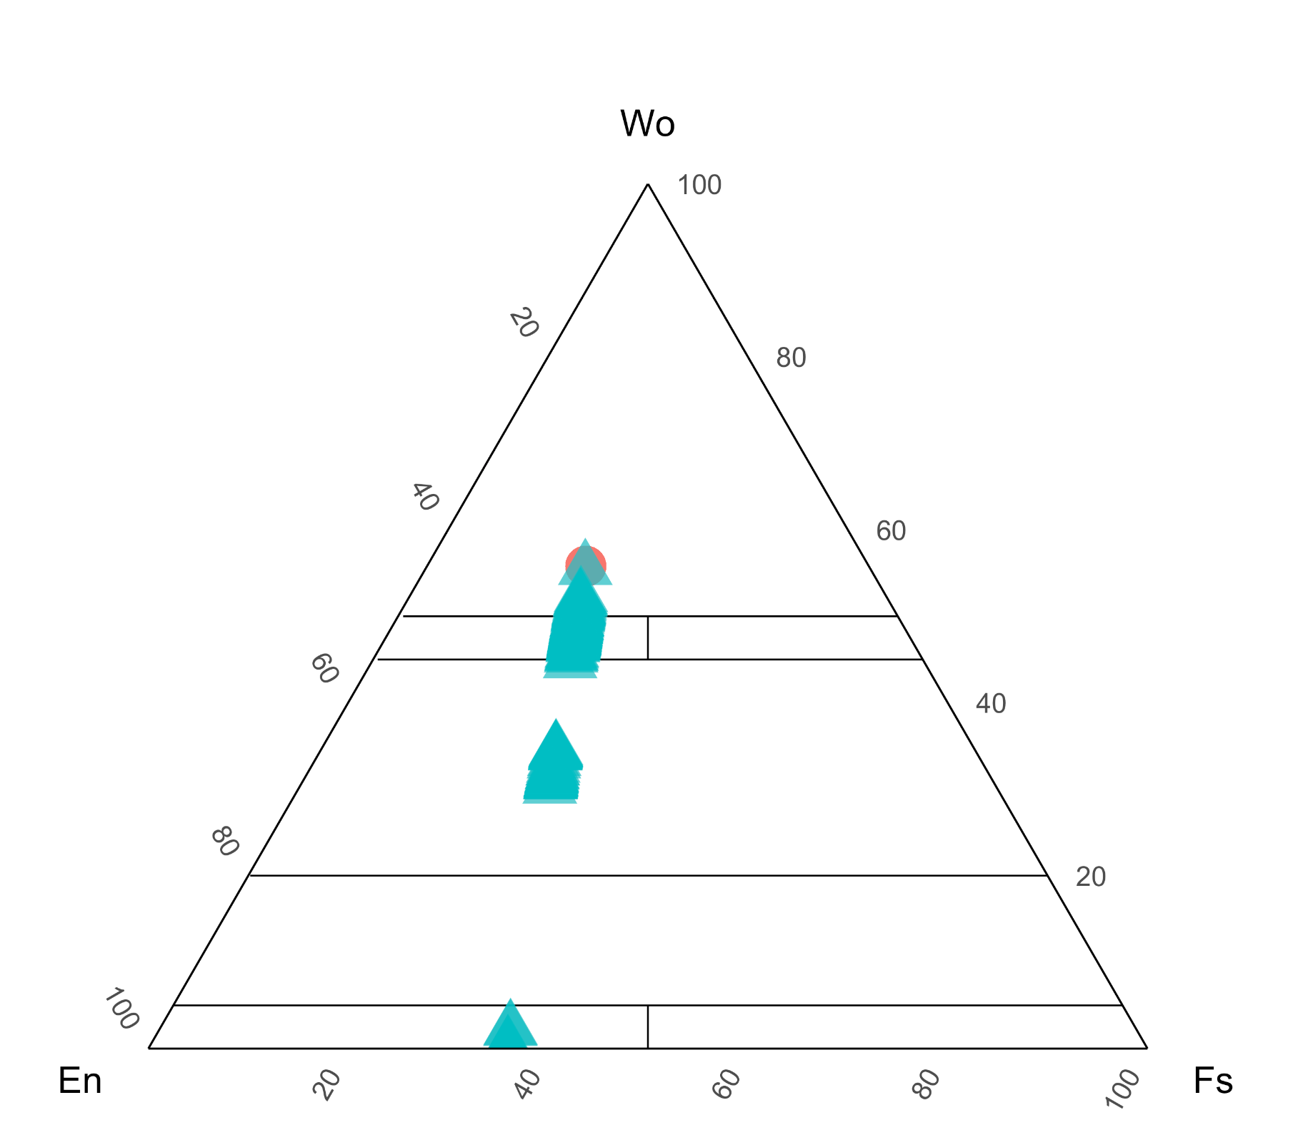
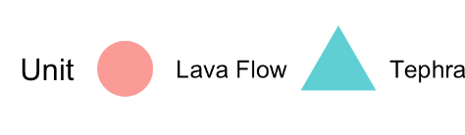
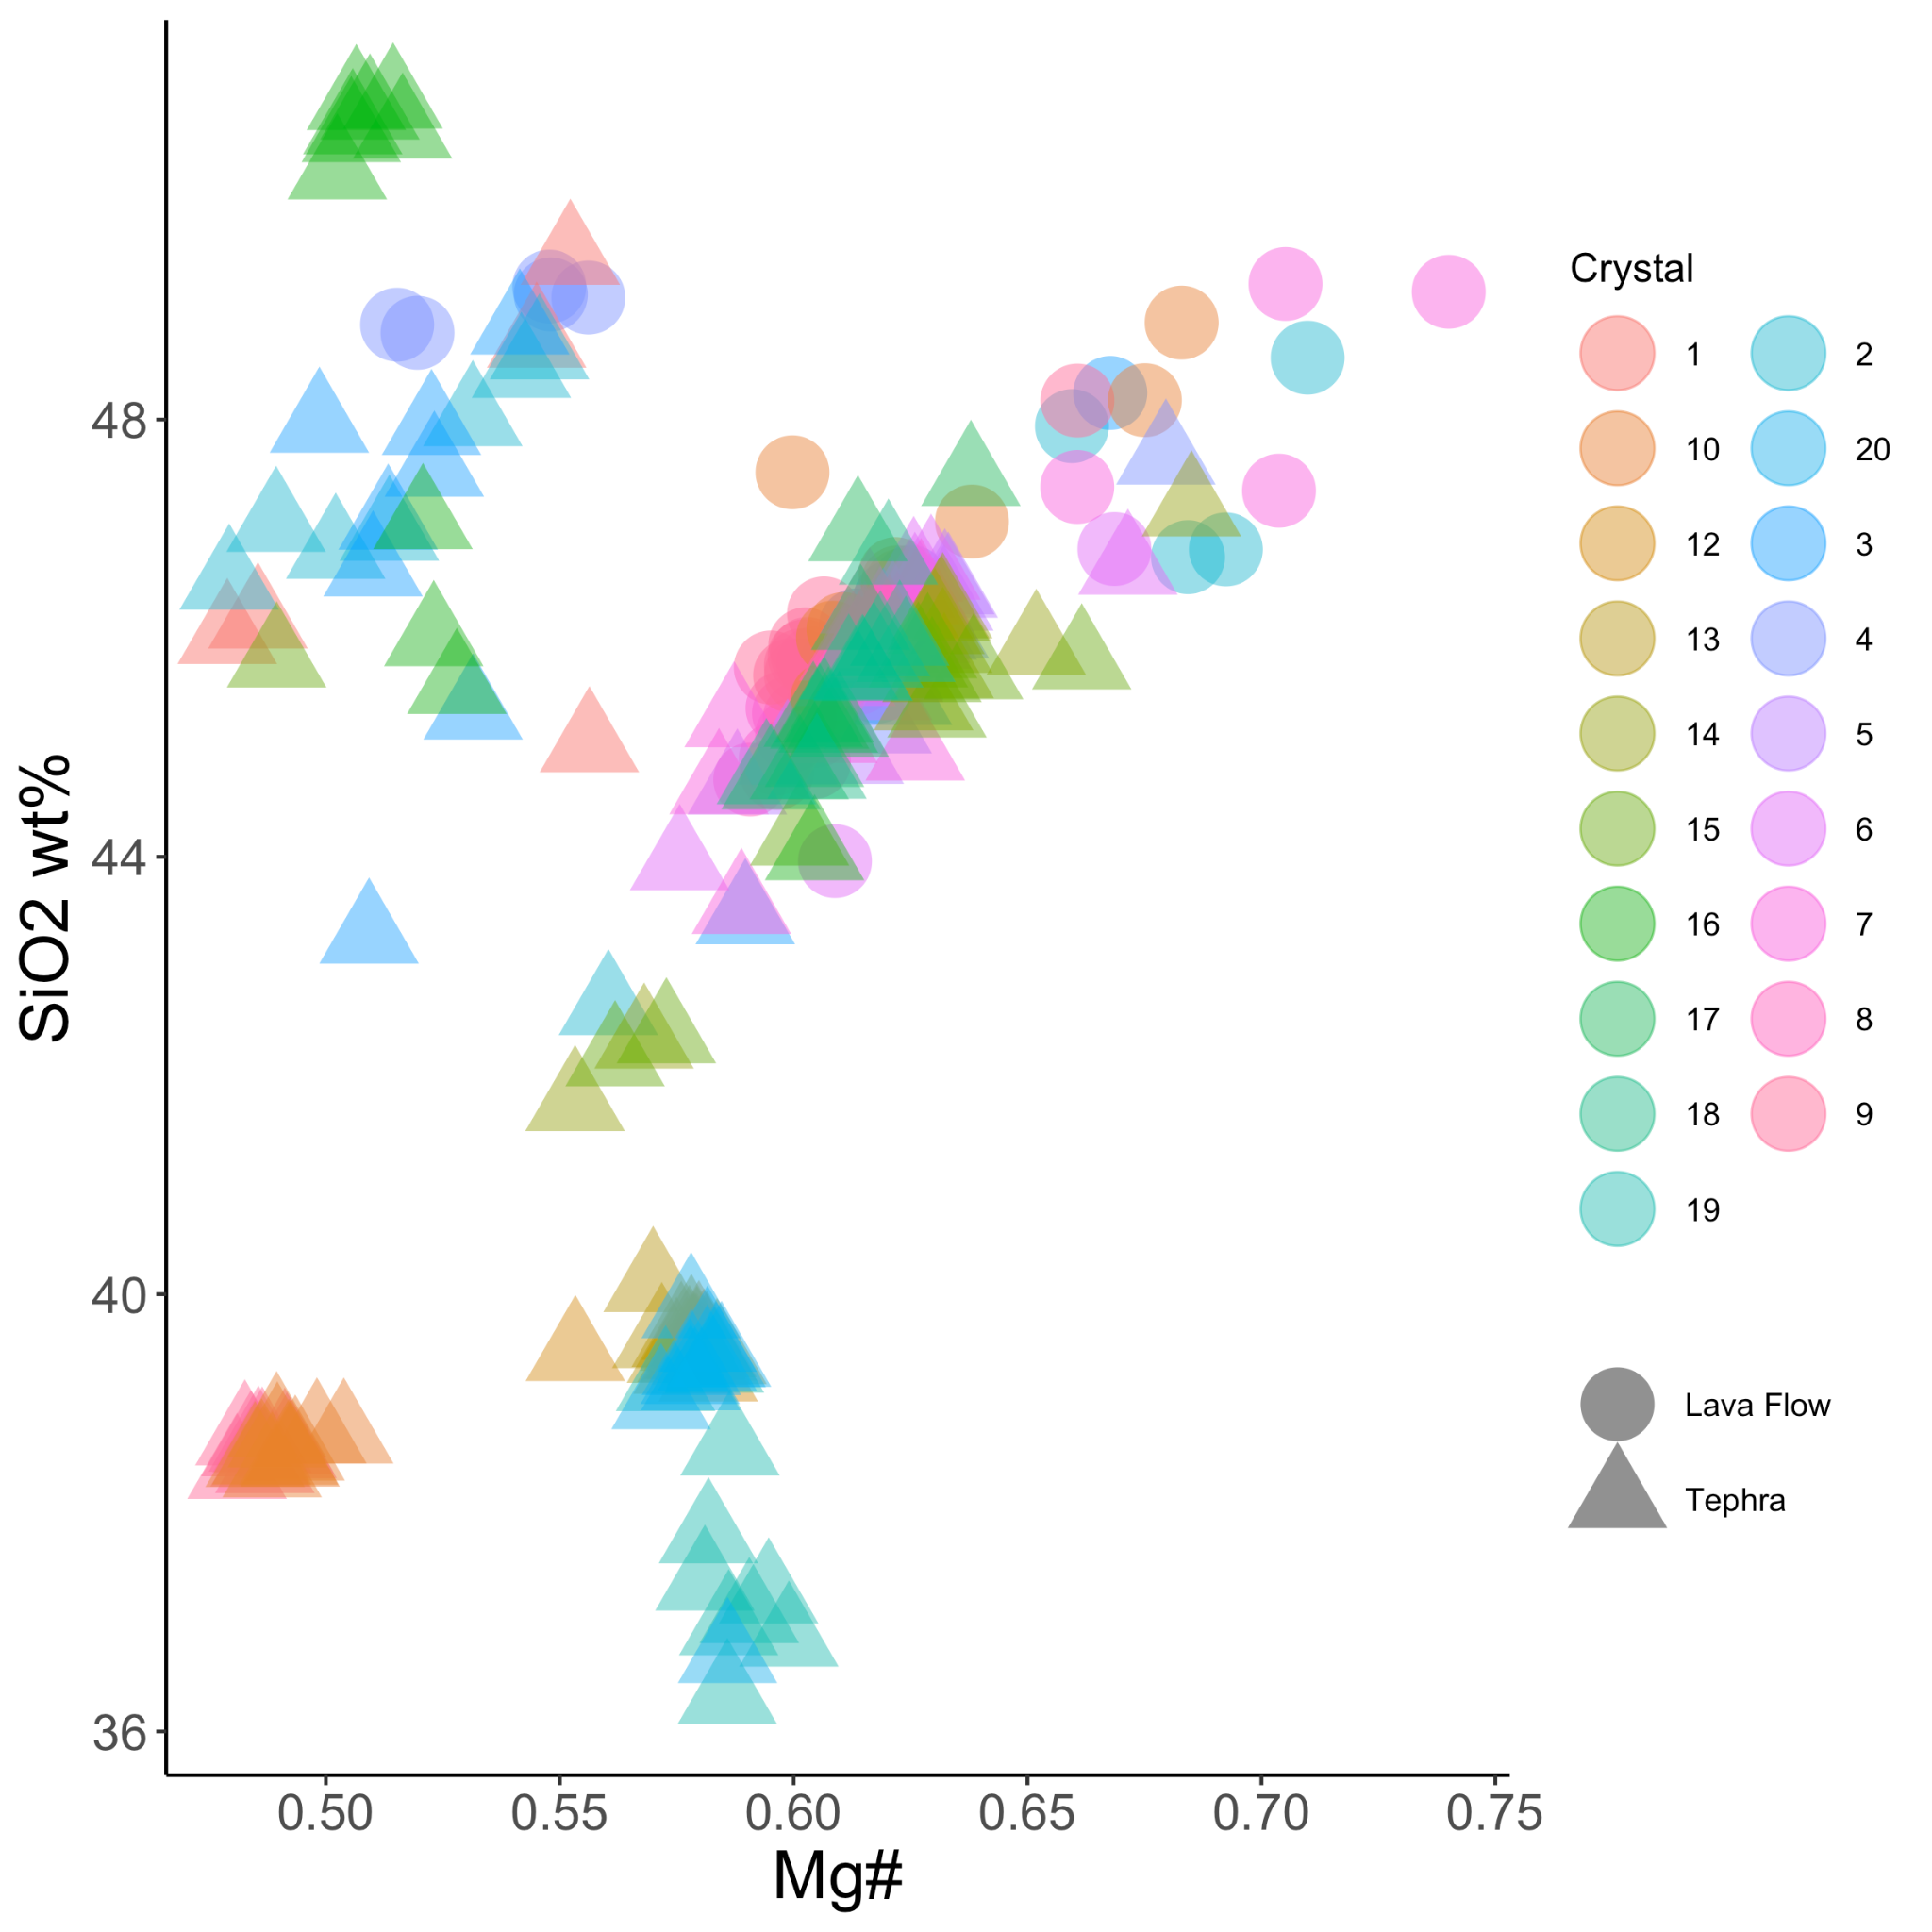
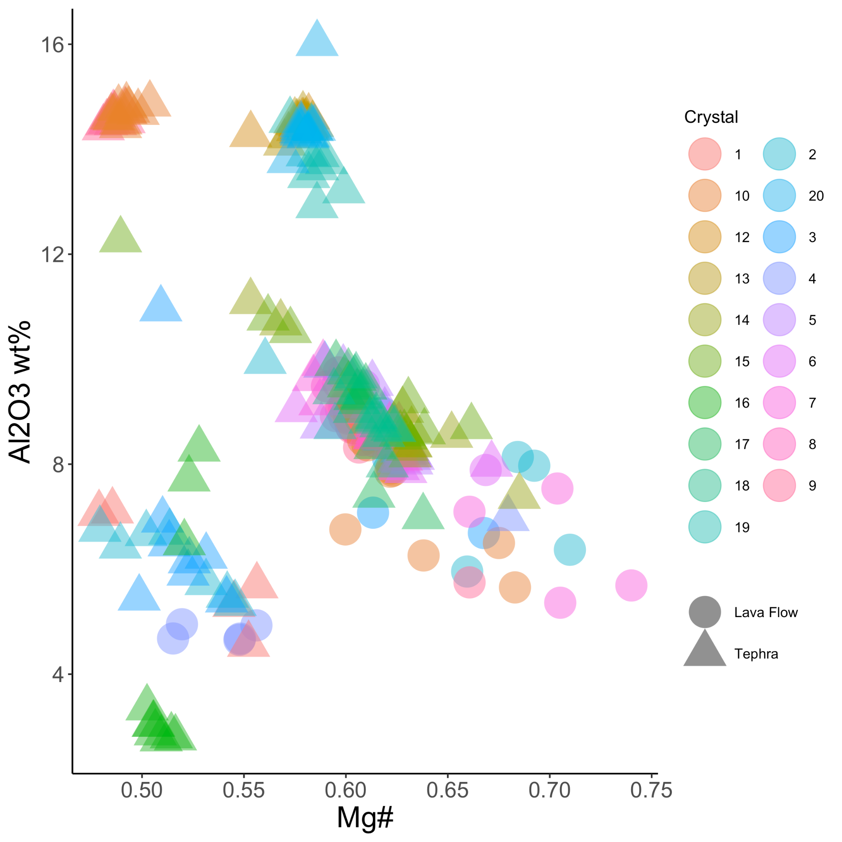
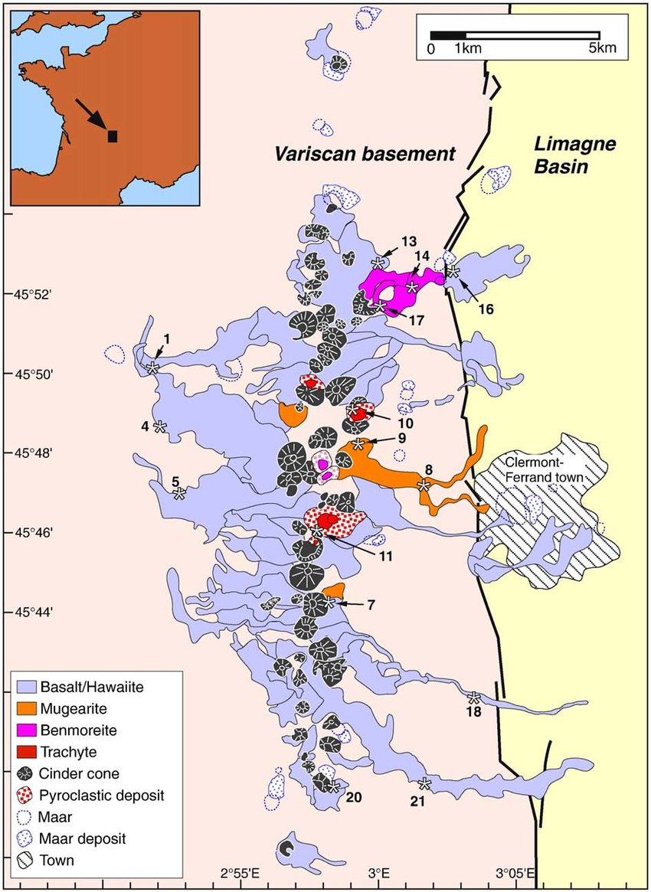
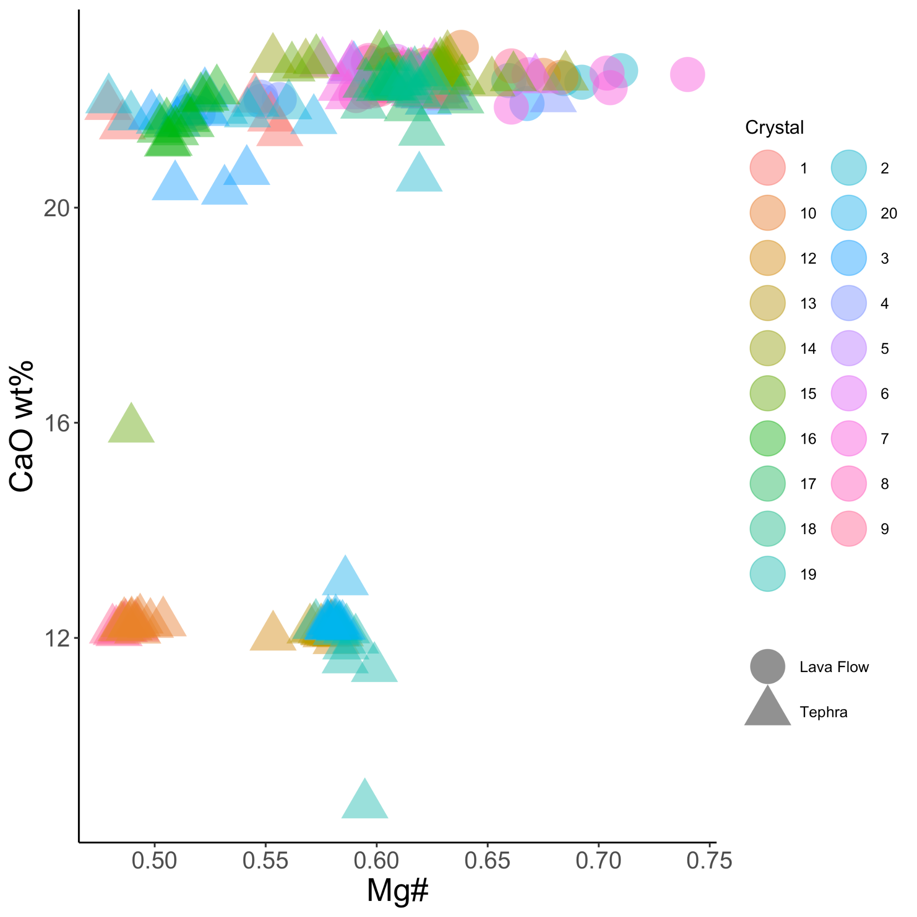
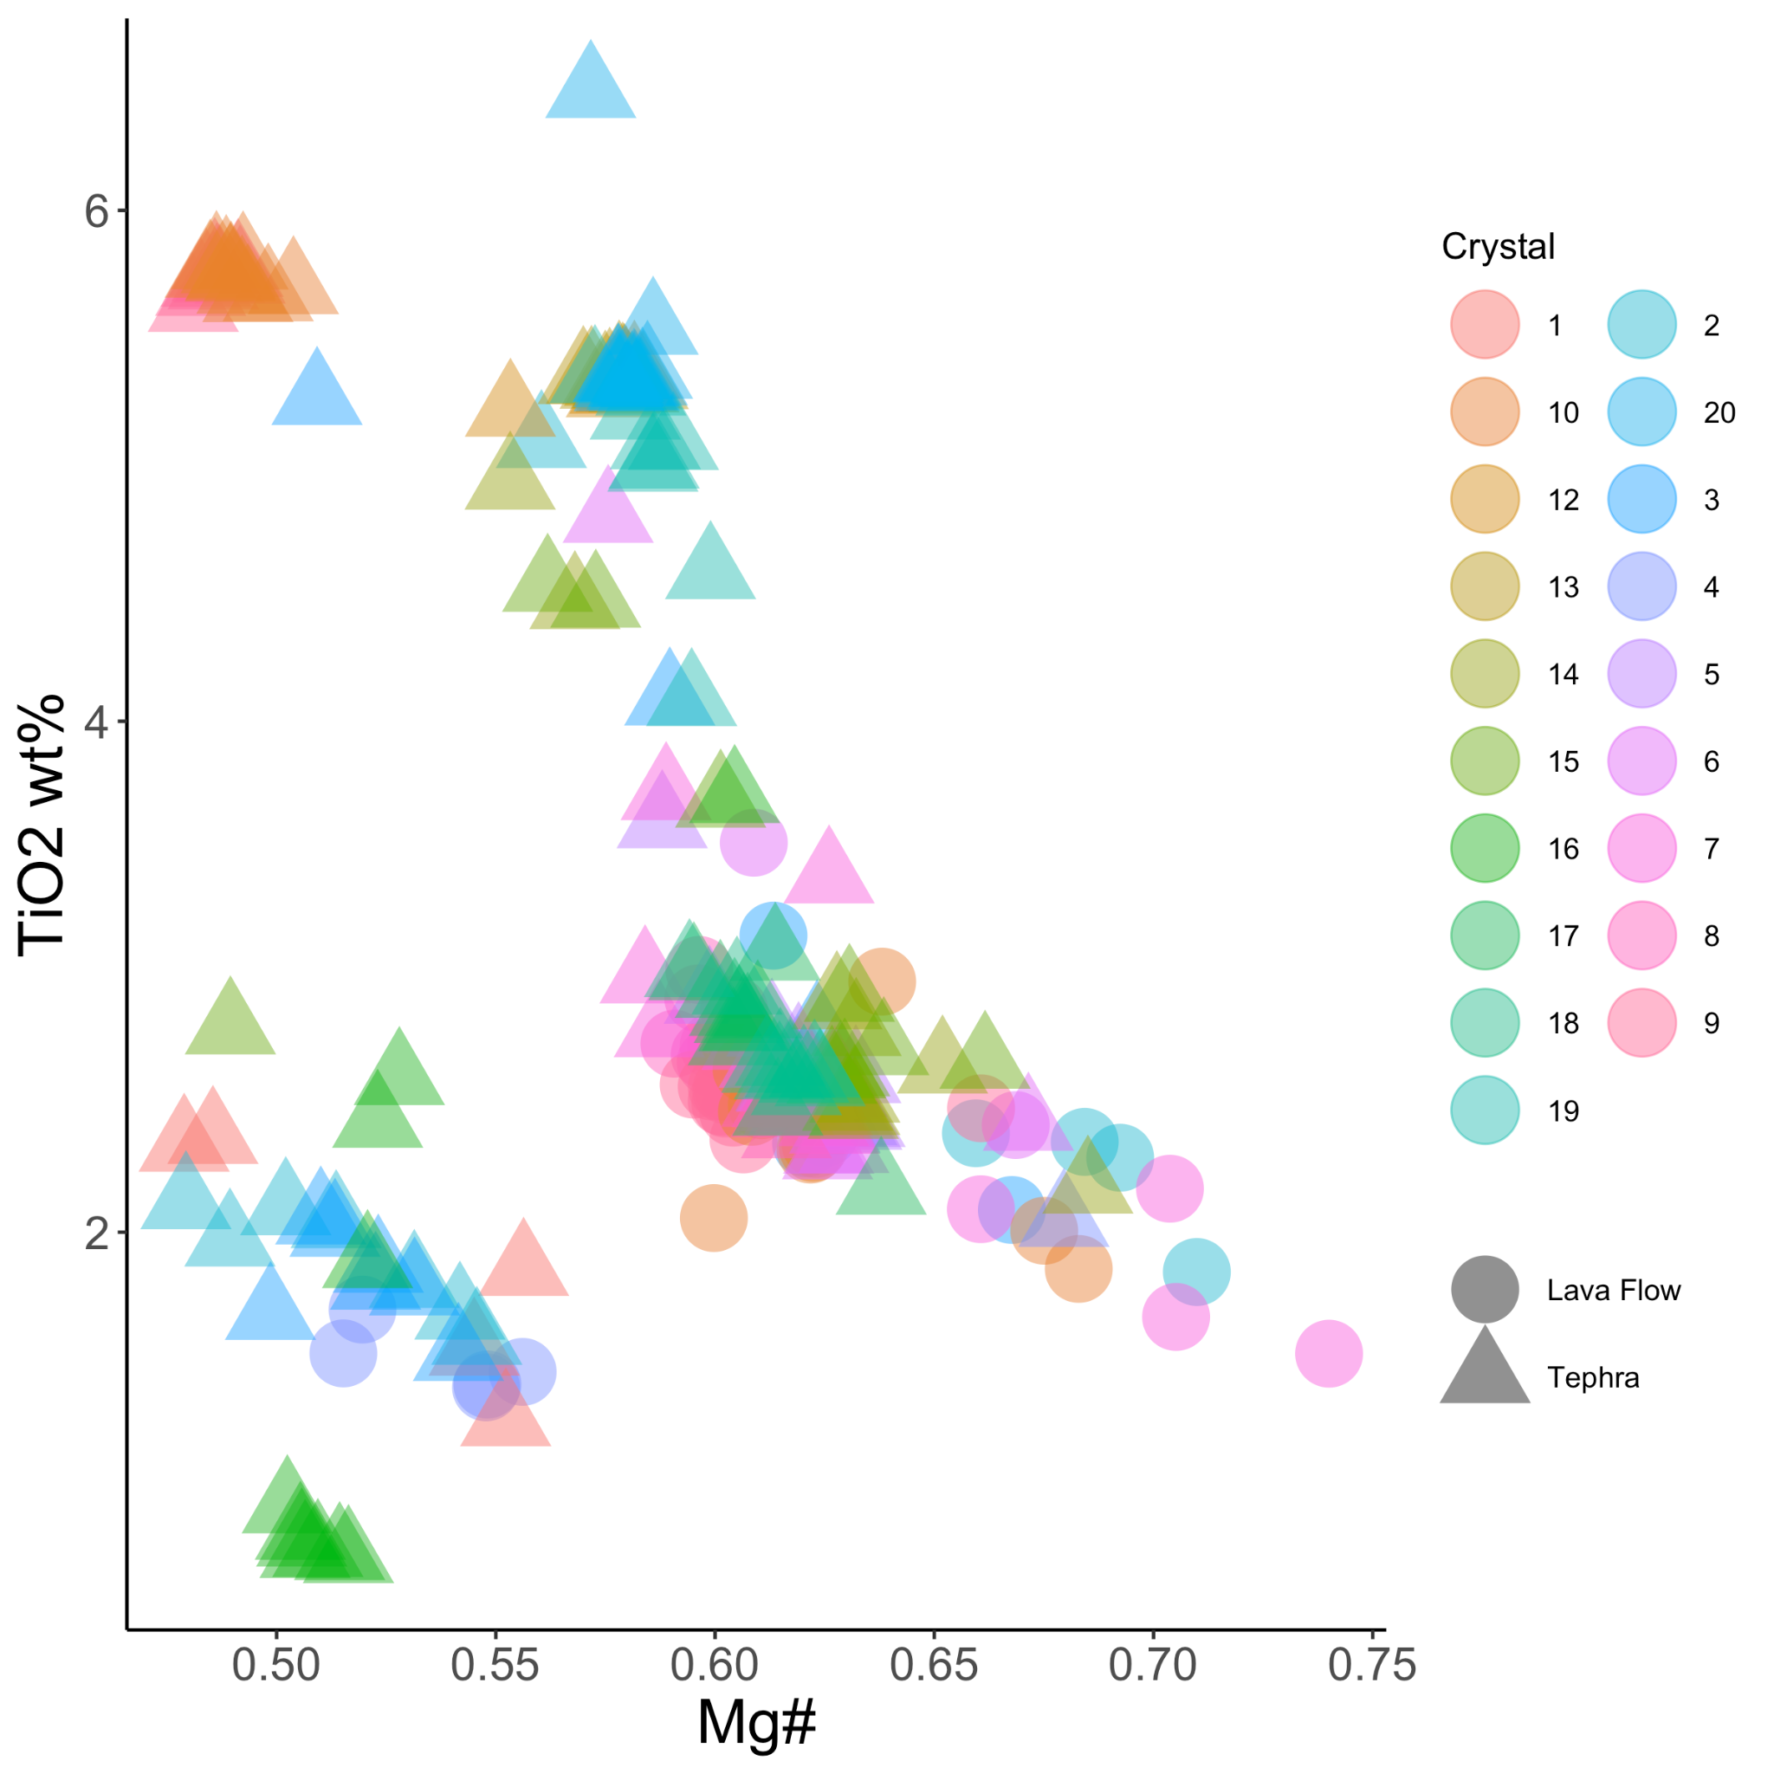
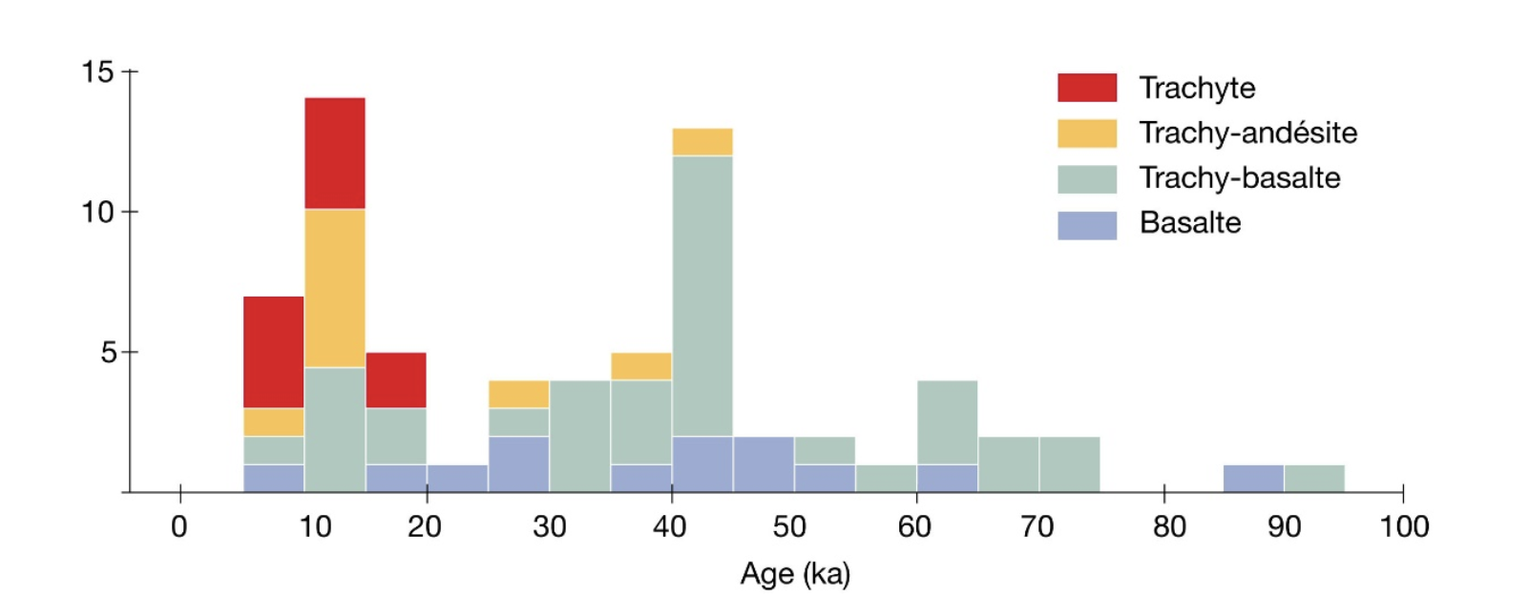
Magma Assembly During Continental Rifting:
Insights from the Limagne Graben and the Chaîne Des Puys
Jordan Christian¹, Martin Guitreau², Emma M. Burkett¹ and Julia G. Bryce¹
1. University of New Hampshire, Department of Earth Sciences, Durham, NH, USA
2. Université Clermont-Auvergne, Laboratoire Magmas et Volcans, Aubiere, France
Abstract
Approach
Thermobarometry
Though continental rifting is a key part of Earth’s tectonic processing, factors most influential in magma assembly, including magma source regions and the extensive magma networks that ultimately drive rifting, remain enigmatic. The westernmost graben in the European Cenozoic Rift System (ECRS), the Limagne Graben and the associated Chaîne Des Puys, are one such example where the reconstruction of the magmatic plumbing systems requires more clarity. Initiation of rifting is assumed to have started about 35 Ma, and magmatism has been active sporadically from 25 Ma down to approximately 5 ka. Magmatism started in the rift and migrated to the plateau des Dômes. ​Overall, lava geochemical compositions have evolved from undersaturated (basanite) for the oldest and/or those within the Limagne rift to saturated (basalt) for the least differentiated lavas of the Chaîne des Puys¹. Such changes in composition suggest progressive rifting manifests both source region changes, potentially increasingly complex and extensive volcanic plumbing systems or both. Here we report geochemical data from clinopyroxene and amphibole phenocrysts within Puy de Corent (3 Ma) to provide insights into sources, timing, and petrogenetic processes associated with magmatism during rifting in the Limagne Graben. We then compare these lavas to other lavas in the ECRS.
Samples collected from regional volcanoes, 45.4 - 45.7°N latitude
Roche Noire, Corent, and St. Andre, emplaced at 1, 3, and 16 Ma, respectively
Compare the pyroxenes and amphiboles within a tephra and lava from Corent
Spatially resolved elemental transects via EPMA
Complementary LA-ICP-MS elemental analysis
St. Andre
Corent 1a
Roche Noire
Figure 9: Modeled thermobarometric constraints of Corent clinopyroxene demonstrates comparable clinopyroxene formation conditions in lava and tephra as calculated by Thermobar⁶ using published thermodynamic data⁷.
Summary
Corent 2
Corent 3
Corent 4
Corent tephra contains amphibole with notably high TiO₂ contents (kaersutite-rich compositions), comparable to other ECRS products and interpreted as a contribution from the metasomatized European Subcontinental Lithospheric Mantle.
Corent lava and tephra clinopyroxene have comparable compositions: ~ 46% SiO₂ and ~22% CaO content.
Thermobarometric modeling suggests that clinopyroxene in both samples have comparable formation conditions at similar temperatures and pressure.
Figure 3. Mapped regions of the three puys (Google Earth Pro).
Figure 4. Photomicrographs of thick sections of samples from Roche Noire (1 Ma), St. Andre (16 Ma), and Corent samples (3 Ma).
Motivation and Background
Mineral Chemistry
Research Question:
Are there notable geochemical differences in tephra and lava flows that indicate distinctive magma assembly processes?
Geology & Volcanic History:
- Chaîne Des Puys is an important feature in the West European Rift System on the Limagne fault with linear alignment of volcanoes, cinder cones, maars¹
- Plateau des Dômes of
Hercynian age, Limagne rift of Eocene age²
- Products range in composition from basalt to trachyandesite across eruptive periods¹
- Graben formation and sedimentation near sea level before volcanism across the ECRS³
- Tephra emplaced at Puy de Corent prior to the erupted lava
amph
Acknowledgments and Works Cited
This work was supported by an International Research Opportunities Grant from the Hamel Center for Undergraduate Research, a research traineeship from NSF-180420, and the Karen Von Damm Research Grant from the UNH Earth Sciences Department. Our deepest thanks to the Laboratoire Magmas et Volcans at the Université Clermont-Auvergne (UCA), particularly Jean-Luc Devidal and Julie Mallens, for supporting Jordan’s summer research fellowship.
amph
Figure 5. (above) Compositional range of lava and tephra clinopyroxene and amphibole at Corent (with amphibole plotted for comparison with anhydrous clinopyroxene endmembers).
Figure 6a,b. (a) Mg#-SiO₂ and (b) Mg# - Al₂O₃ magma differentiation trends in lava and tephra mounts are recorded by Corent clinopyroxene and amphibole (circled).
Figure 1. Schematic geologic map of the study area.²
¹Merle, O., Boivin, P., Langlois, E., de Larouzière, F.-D., Michelin, Y., & Olive, C. (2023). Geosciences, 13(7), 198. 10.3390/geosciences13070198,
²Hamelin, C., Seitz, H.-M., Barrat, J.-A., Dosso, L., Maury, R. C., & Chaussidon, M. (2009a). Chemical Geology https://doi.org/10.1016 j.chemgeo.2009.06.005
³Mayer, B., Jung, S., Romer, R.L. et al. Contrib Mineral Petrol 167, 989 (2014). https://doi.org/10.1007/s00410-014-0989-3
⁴Martel, C, et al. (2013), Journal of Petrology, 54(6), 1071–1107, 10.1093/petrology/egt006.
⁵Costa, F., Shea, T., & Ubide, T. (2020). nature reviews Earth & environment, 1(4), 201–214. https://doi.org/10.1038/s43017-020-0038-x
⁶Wieser, P., Petrelli, M., Lubbers, J., Wieser, E., Ozaydin, S., Kent, A. and Till, C. (2022) “Thermobar: An open-source Python3 tool for thermobarometry and hygrometry”, Volcanica, 5(2), pp. 349–384. doi: 10.30909/vol.05.02.349384
⁷Putirka, K.D. Reviews in Mineralogy and Geochemistry 2008;; 69 (1): 61–120. doi: https://doi.org/10.2138/rmg.2008.69.3
⁸Jannot, S., Schiano, P. & Boivin, P. Contrib Mineral Petrol 149, 600–612 (2005). https://doi.org/10.1007/s00410-005-0670-y
⁹Faure, G. (2001). Origin of igneous rocks: The isotopic evidence. Springer.
¹⁰Mutch, E.J.F., Blundy, J.D., Tattitch, B.C. et al. Contrib Mineral Petrol 171, 85 (2016). https://doi.org/10.1007/s00410-016-1298-9
¹¹Ridolfi, F. (2021). AMP-TB2: Minerals, 11(3), 324. https://doi.org/10.3390/min11030324
Figure 7. CaO-Mg relationships in Corent tephra and lava flow pyroxene and amphibole illustrate distinctive cpx and amphibole compositions.
Figure 8. TiO₂ wt % versus Mg# for tephra and lava flow phenocrysts identify large ranges of Ti contents in amphibole and clinopyroxene in Chaîne des Puys Corent samples.
amph
amph
Figure 2. Magmatic products range in composition from basaltic to trachyte.¹

