Slide 1


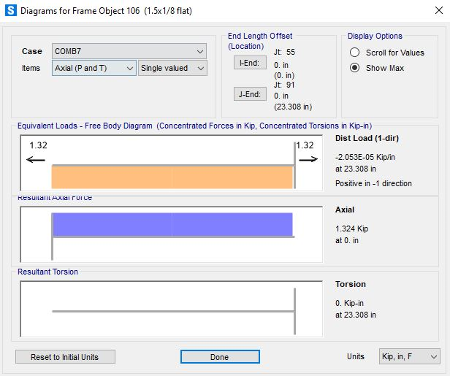
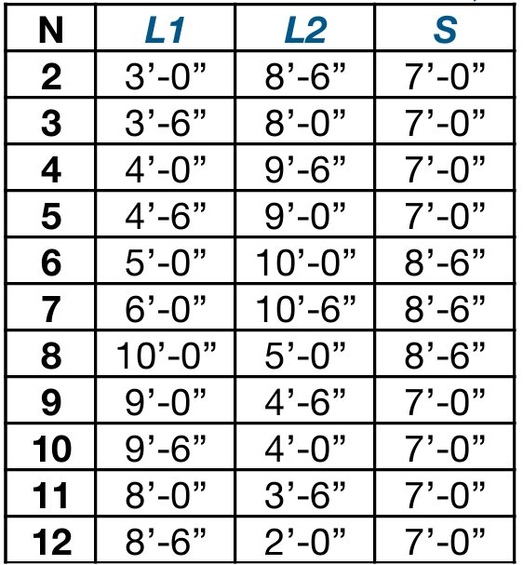
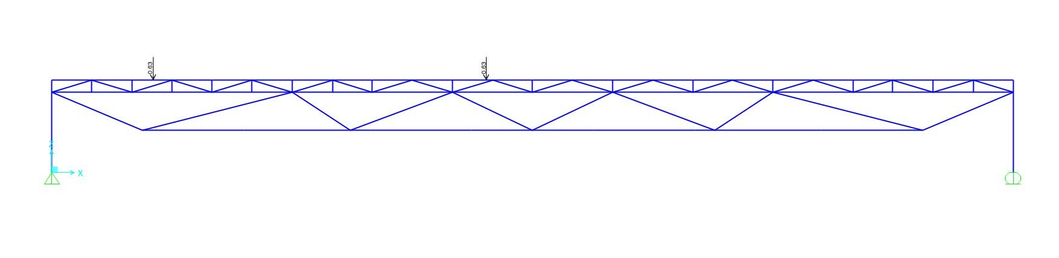
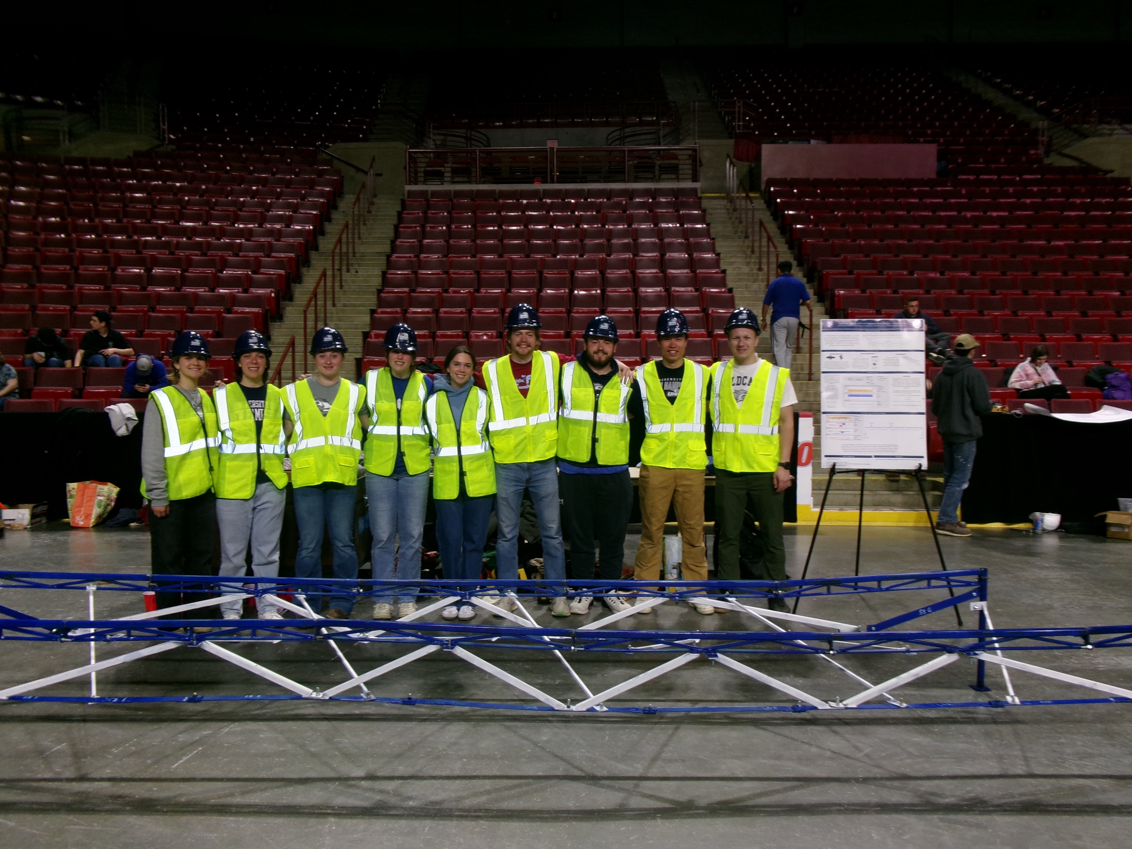
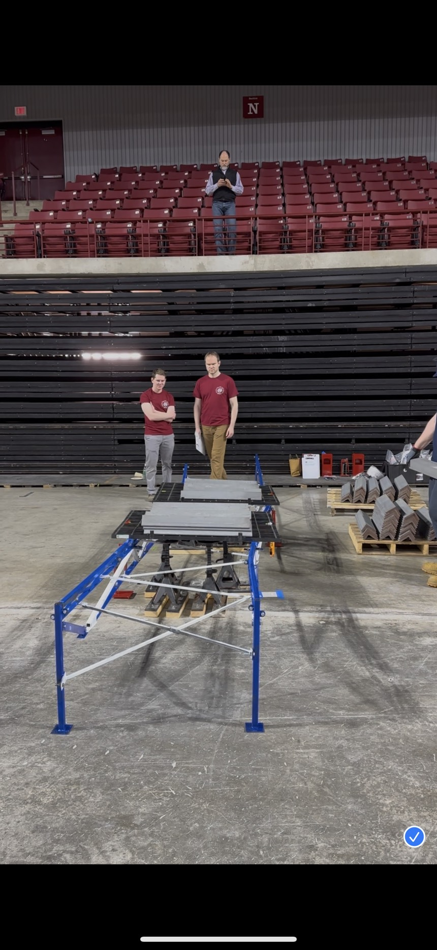
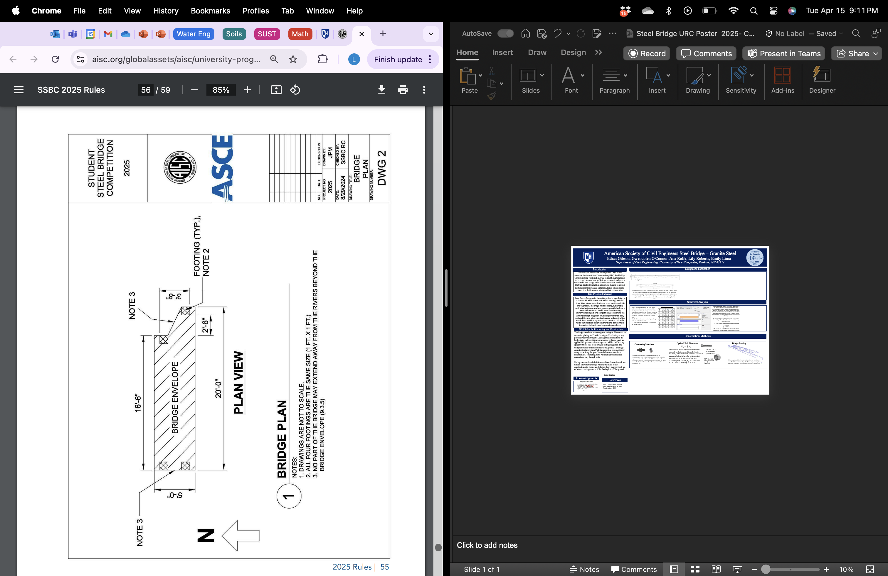
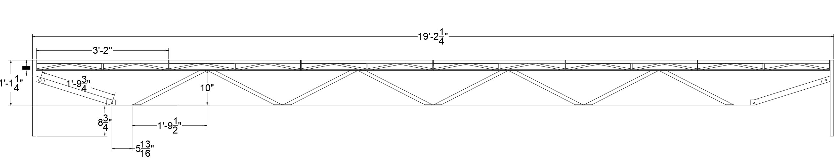
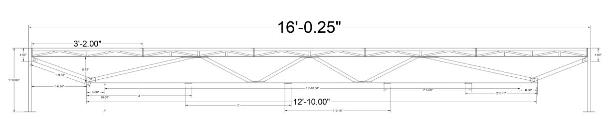
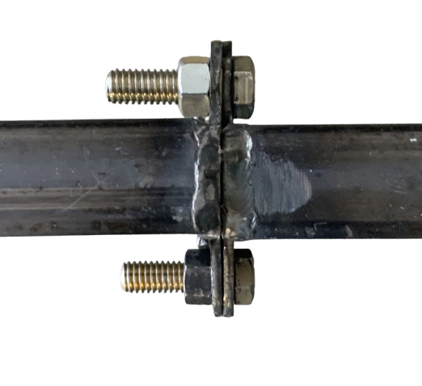
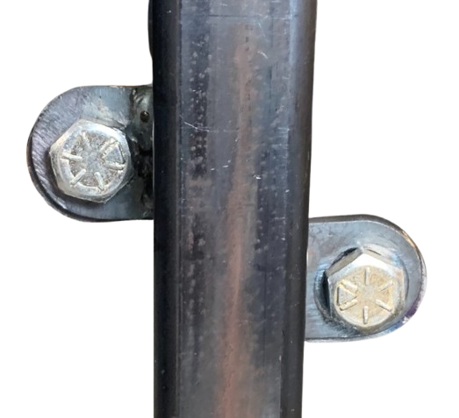
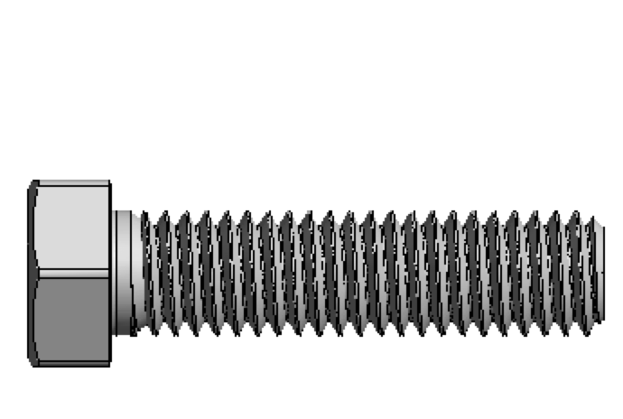
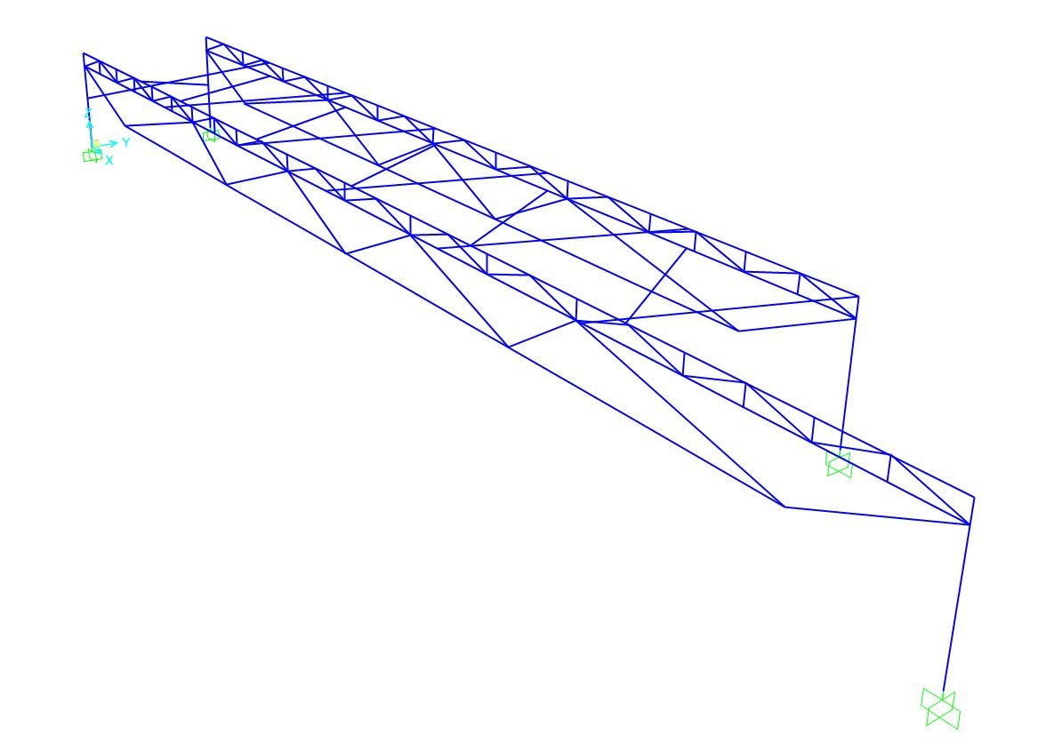
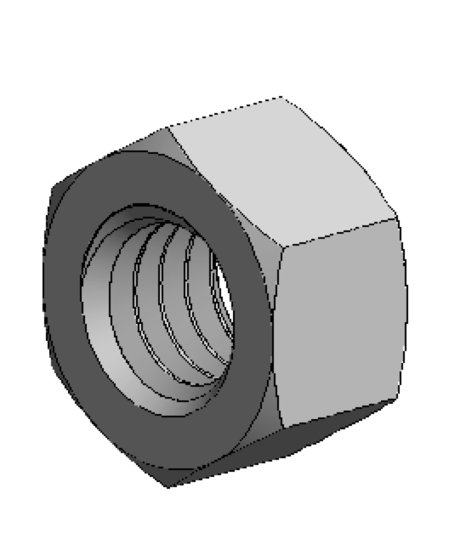


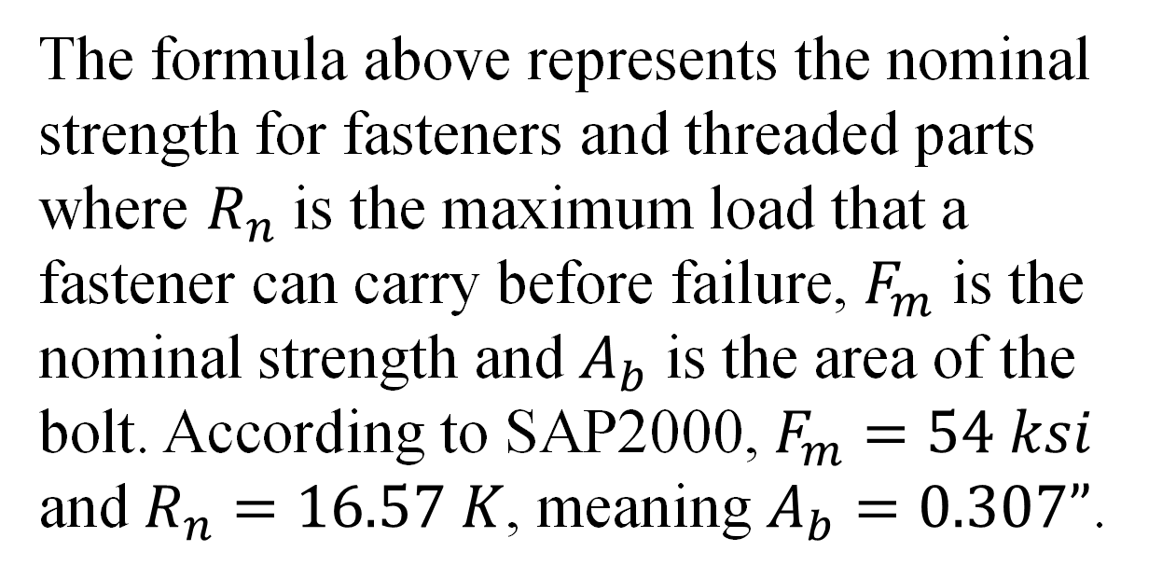
American Society of Civil Engineers Steel Bridge – Granite Steel
Ethan Gibson, Gwendolen O'Connor, Ana Rolfe, Lily Roberts, Emily Lima
Department of Civil Engineering, University of New Hampshire, Durham, NH 03824
Introduction
Structural Analysis
The American Society of Civil Engineers (ASCE) and American Institute of Steel Construction (AISC) Steel Bridge Competition is a yearly nation-wide competition challenging students to determine how to fabricate, construct, and erect a scale model steel bridge under timed construction conditions. The Steel Bridge Competition encourages students to extend their classroom knowledge a practical, hands-on design and construction that fosters creativity and fosters innovation.
Table 1 – Load Cases​
L1, L2 – Dimensions for positioning decking units for vertical load test
S – dimensions for positioning decking units for lateral load test
Before timed construction, the head judge rolls a die to determine the location of the decking units along the bridge for the lateral and vertical load tests. The possible results of the roll are found in table 1. Using SAP2000, our model was tested against each possible case. ​
To ensure appropriate member selection for each section of the bridge, a structural analysis was performed using SAP2000 to determine the demand on individual members. Based on these results, the required cross-sectional area necessary to safely support the applied loads was calculated. Structural sections were then selected to meet or exceed these minimum area requirements, ensuring both safety and efficiency.
An example of this calculation is provided below for the leftmost diagonal member of the bottom chord in the long span of the bridge.
1.5” x 0.25” Flat Bar Tensile Yielding Capacity Calculation
$$F_{y}=36 ksi$$
$$A_{g}=0.375 {in}^{2}$$
$$ΦP_{n}={Φ∗F}_{y}∗A_{g}=0.9∗36 ksi∗0.375 {in}^{2}=12.15 kips$$
Capacity = $12.15 kips$ > Demand from SAP2000 = $1.32 kips$
2025 Problem Statement
Story County Conservation is seeking a steel bridge design to connect trails within Peterson Park by spanning the South Skunk River, where a sandbar island hosts sensitive wildlife and vegetation. The bridge must be strong, sustainable, aesthetically pleasing, and able to accommodate both park users and maintenance vehicles while minimizing environmental impact. The competition will determine the winning concept, judged on structural performance, cost, sustainability, and adherence to clearance and construction restrictions. Participating teams must submit a 1:10 scale model that meets all design constraints and demonstrates innovation, inclusivity, and engineering excellence
Free Body Diagram
Competition Results
During the competition, the final bridge construction took 32 minutes and weighed 190 lbs. Full lateral loads were withstood, and the bridge was able to safely vertically load approximately 700 pounds. The load case chosen was number 5. The image below shows the bridge with the applied load, the bridge failed at the connections shown by the bucking in the top member.
A free body diagram is shown above for a single span that represents one of the decking support bridge stringers, with the same end to end length, with supports at appropriate locations to represent the piers. The load is from Case 7, listed above. Next to the free body diagram, the shear, moment, and deflection diagrams are shown. These correspond to the free body diagram constructed for a single beam. The peak magnitudes of shear, moment, and deflection are circled and shown.​
2025 Rules for Fabricating and Construction
The bridge must have two contiguous stringers. There must be access for placing 3’-6” wide decking and load safely at any point between the stringers. Decking should not deform the bridge in its built condition when vertical or lateral loads are applied. Bridge must only touch ground within 1’x1’ footing spaces with one side of the bridges footing staggered. The bridge cannot be tied or anchored to the ground. The bridge cannot extend more than 3’ off the ground or be wider than 5’ at any point along the span. Vertical clearance must be a minimum of 7” including bolts. Members cannot touch at connections only through bolts. Everything must be within the bridge envelope.
During construction six builders are allowed two of which are barges, allowing them to go withing the rivers of the construction site. Weight is added if any member, tool, nut or bolt touch the ground or if the footing lifts off the ground. Complete construction must be completed within 30 minutes.
Design and Fabrication
The bridge consists of two contiguous stringers. The 2D side view is shown above. (5) 38” members make up the shorter span of the bridge and (6) 38” members make up the long span of the bridge to meet the length requirements and minimize construction time. The dimensions of a single member are shown in figure 1. A height of 1’10” was chosen due to the deflection from the self-weight of the bridge.
SAP2000 was used to analyze the deflection that each span of the bridge would undergo after the load was applied. We also used the program to determine the amount of force in each connection so that we could design the connecting tabs efficiently.
Construction Methods
References
Connecting Members
Optimal Bolt Dimension
Bridge Bracing
Steel Construction Manual. American Institute of Steel Construction, 2023.
$$R_{n}=F_{m}A_{b}$$
Acknowledgements
Top View
The formula above represents the nominal strength for fasteners and threaded parts where $R_{n}$ is the maximum load that a fastener can carry before failure, $F_{m}$ is the nominal strength and $A_{b}$ is the area of the bolt. According to SAP2000, $F_{m}=54 ksi$ and $R_{n}=16.57 K$, meaning $A_{b}=0.307”$.
3/8”-16, 1 1/2”, fully threaded Grade 8 Bolt
Side View
A Special Thanks to:
Dr. Azam, Noah MacAdam, Dr. Han
Our Sponsors: ASCE, AISC, TFMoran, H.L. Turner, H&H, Atlantic Bridge and Engineers, Local 669 Sprinkler Fitters
All other supporters
To connect each member along the span, a series of alternating tabs were welded to the members. This created a sequence of tabs which allows the ability to join members quickly and securely. These alternating tabs allowed the shear force to be distributed across the bolt and joint interface to prevent tear out. ​
3/8”-16, High Strength Grade 8 Hex Nut
X-bracing is used for the intermediate bracing to enhance overall stiffness of the bridge. The X-bracing ensuring it can withstand horizontal forces without excessive deformation. ​

