Slide 1
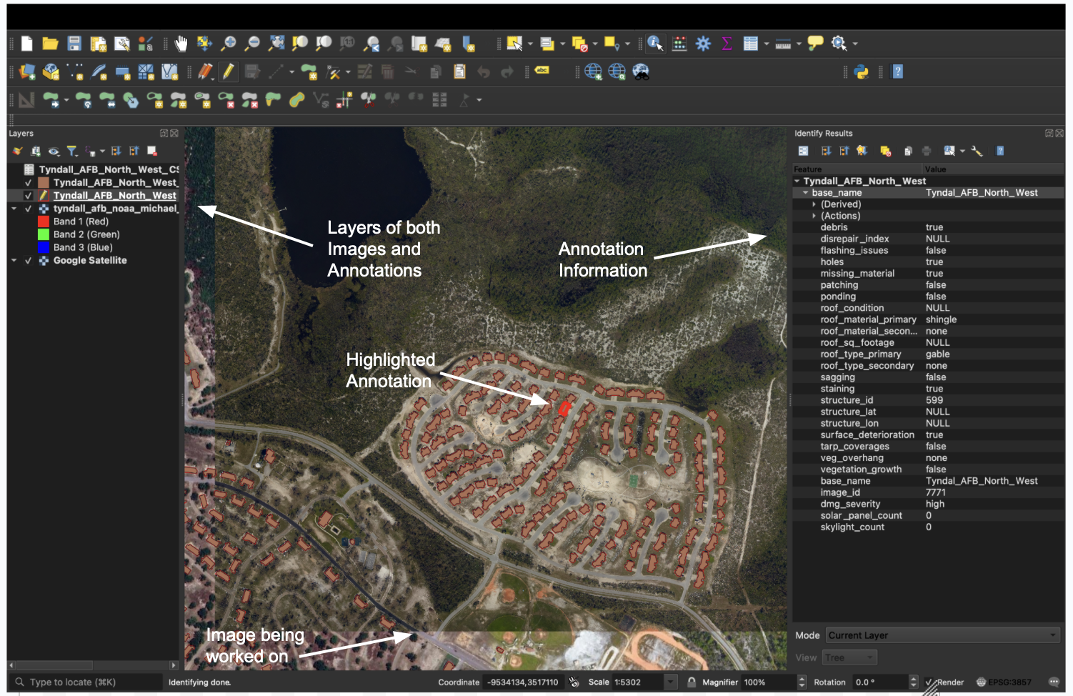
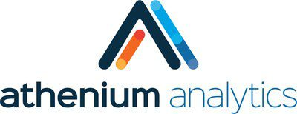
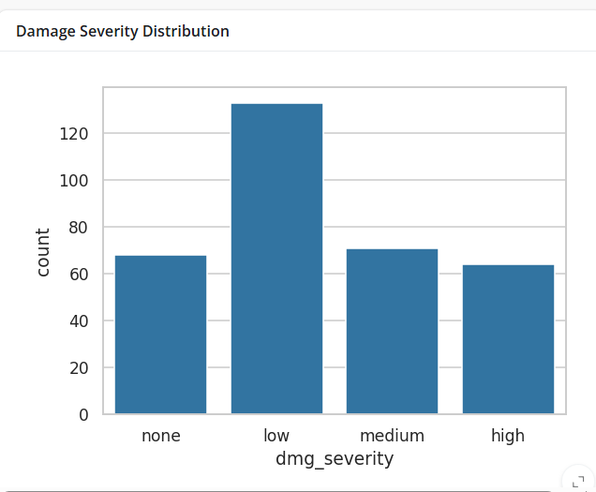
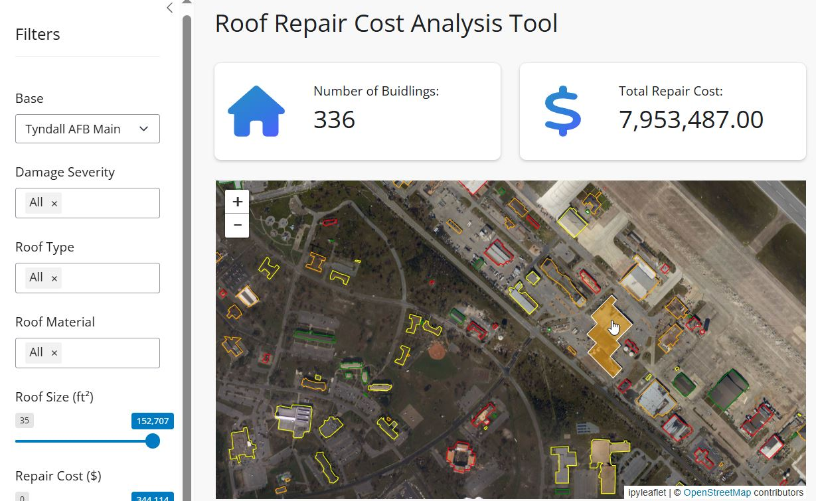
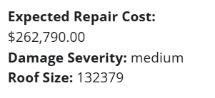
U.S. Military Housing Repair Cost Analysis Joshua Testa, Benjamin Weisberg, Aiden Landman, Cooper French, Thomas Byrne Project Advisor: Lisa Henry | Project Sponsor: Athenium
Introduction
Data Collection and Annotations (QGIS)
Testing & Results
With increase in yearly natural disasters, effective damage analysis of US military housing is an important concern many service members have. Athenium tasked us to develop an AI-driven webapp utilizing geographic imagery and data of roofing damage that provides a repair cost estimate and damage breakdown.
We aim to develop our application to provide visual, interactive, and efficient damage report software to help devise cost effective solutions to Military housing roof damage.
Implementation Tools
We utilized our sponsor meetings to get feedback on our progress. Our main areas of testing were speed and usability of the webapp. We also had a sponsor check annotations to make sure they were accurately annotated.
Our program was able to achieve fast load times after we compressed and stored satellite imagery on Athenium's server. Sponsors were happy with the usability of the webapp and filtering options.
To begin implementing our UI, we utilized QGIS, an open-source geographic information system enabling us to construct precise annotations for our interface. We manually assigned damage report data to individual roofs creating detailed annotations capturing the extent and nature of the damage.
An example of a QGIS file being worked on, with a highlighted annotation (center) and its information (right). ​
Requirements
User Interface
Functional Requirements
For the UI, we used a python-based web development framework called "Shiny". The annotated data was run through the cost analysis API and then loaded into an SQLite database. The number of buildings and total repair cost statistics are displayed at the top. There is also a table of annotation data, a damage severity distribution chart, and individual statistics are displayed when a building is clicked on. Users can filter all of this data based on damage severity, roof type, roof material, square footage of roof, and repair costs.
Satellite imagery of military housing needs to be analyzed. Each roof being assigned data (known as an "annotation")
A UI needs to be created that will display all completed annotations on a map with associated satellite imagery and provide a damage and repair cost analysis utilizing Athenium's AI model.
User must be able to filter data shown based on roof/damage features which will then be reflected in total damage/cost report.
Users must be able to click on specific annotations to see damage/cost analysis on specific buildings.
Here is a bar graph depicting a breakdown of damage within the annotation
Evaluations & Conclusions
We were able to successfully develop our interface with proper display of annotations and cost analysis. Not all features were implemented like filtering annotations on the map and having hosting the webapp with a URL.
However, we deem our application successful as we developed a dynamic user interface with full geo imagery and annotation loading in less than 15 seconds for all bases.
This is a screenshot of the current UI providing the completed annotation file (center) and several filters (left). With overall expenditure and other pertinent information
Features
Select base
Filter data (Update statistics
& Annotations on map
Click on annotation for more details
Graph with display options
Non-Functional Requirements
Future Directions
We want our UI to be visually appealing and easy to use. Also, fast load times of imagery and a usable resolution when fully zoomed in.
Next major steps include deploying our application to all users who have access to the link and improving the AI model to be more accurate with repair costs.

Slide 2
Abstract
Military housing infrastructure faces ongoing challenges due to environmental damage, aging structures, and inadequate maintenance assessments. These issues pose safety risks to service members and their families, requiring efficient and accurate damage analysis to support budget optimization and timely repairs. Our project addresses this need by leveraging satellite imagery, AI-powered computer vision, and cost estimation algorithms to evaluate roof damage across military bases. Using QGIS, we annotate satellite images to identify damage, which is then processed into structured datasets. These datasets are uploaded into an interactive web interface built with Shiny, allowing users to filter and analyze damage reports by severity, roof type, and repair costs. The system integrates Athenium’s gauge damage API to generate repair cost estimates with a 10% margin of error, providing actionable insights for decision-makers. By enhancing damage assessment efficiency, this project enables faster, data-driven repair planning for military housing. Future improvements will focus on deploying the application at scale and refining AI models for even greater accuracy in cost predictions.

