Slide 1

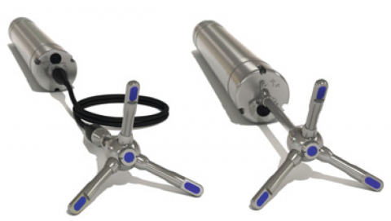
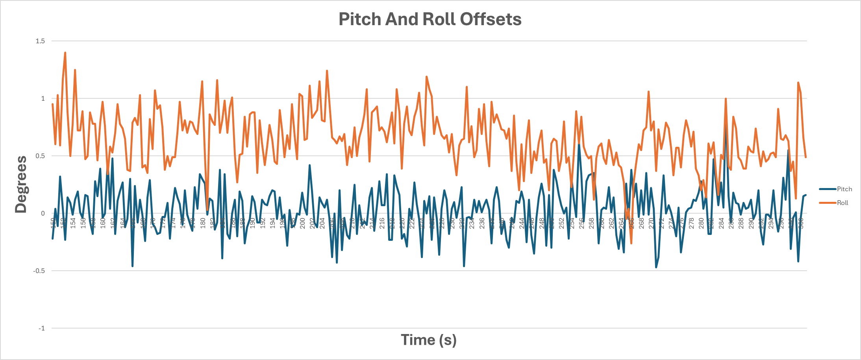
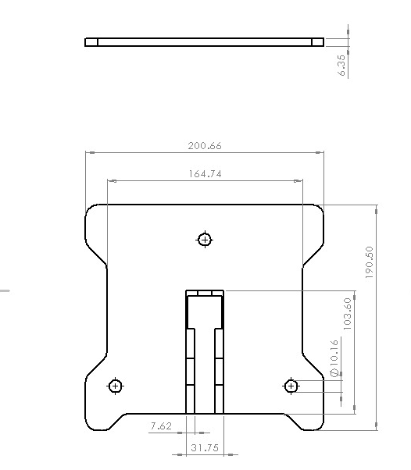
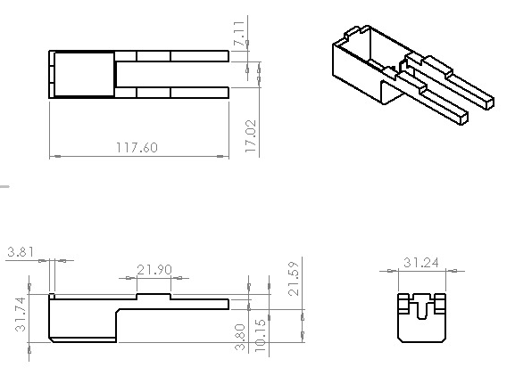
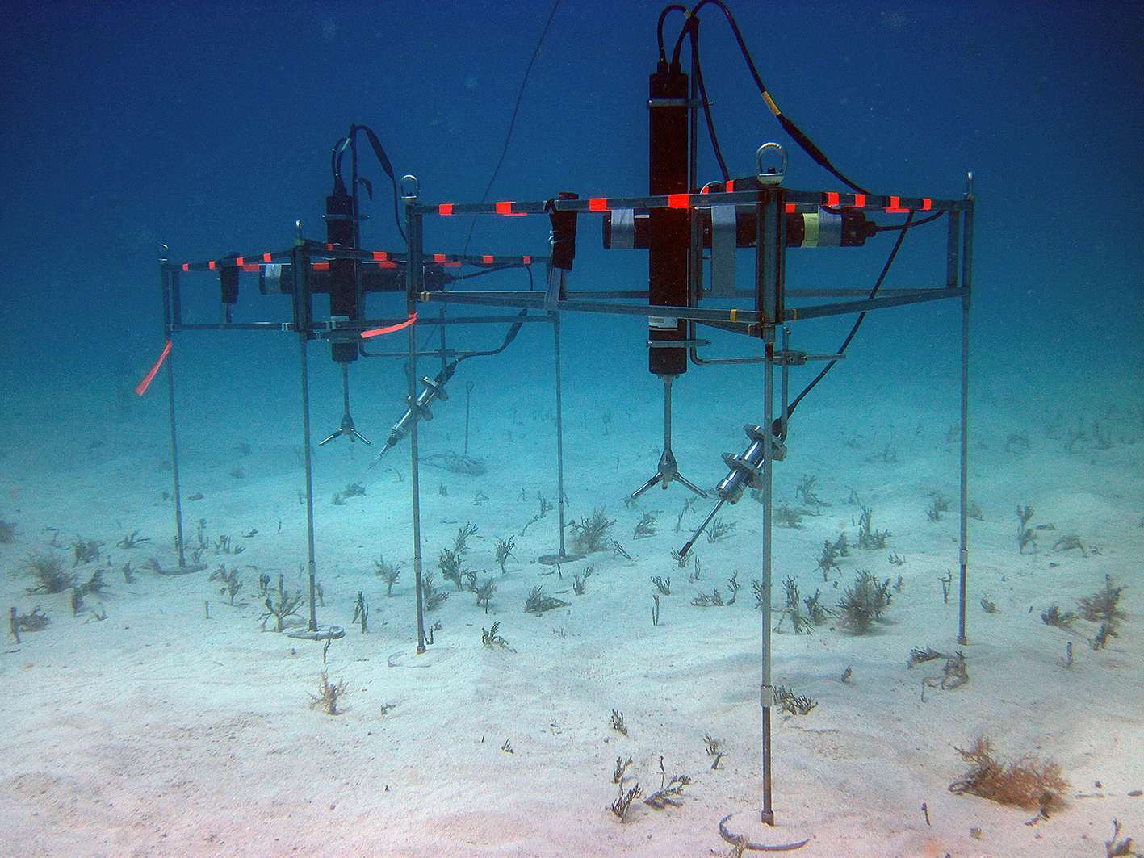
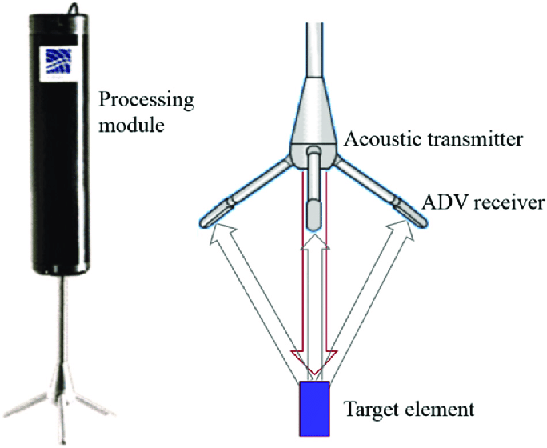
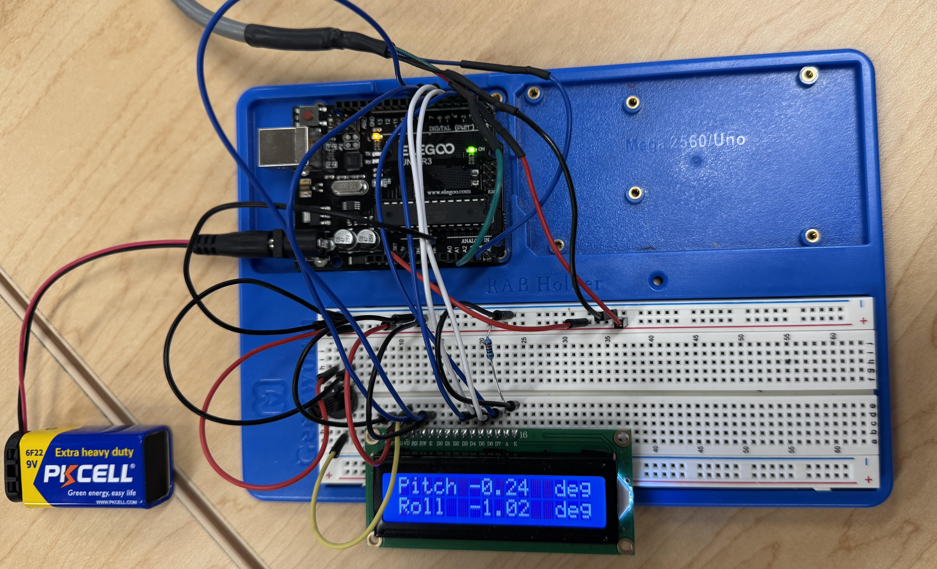
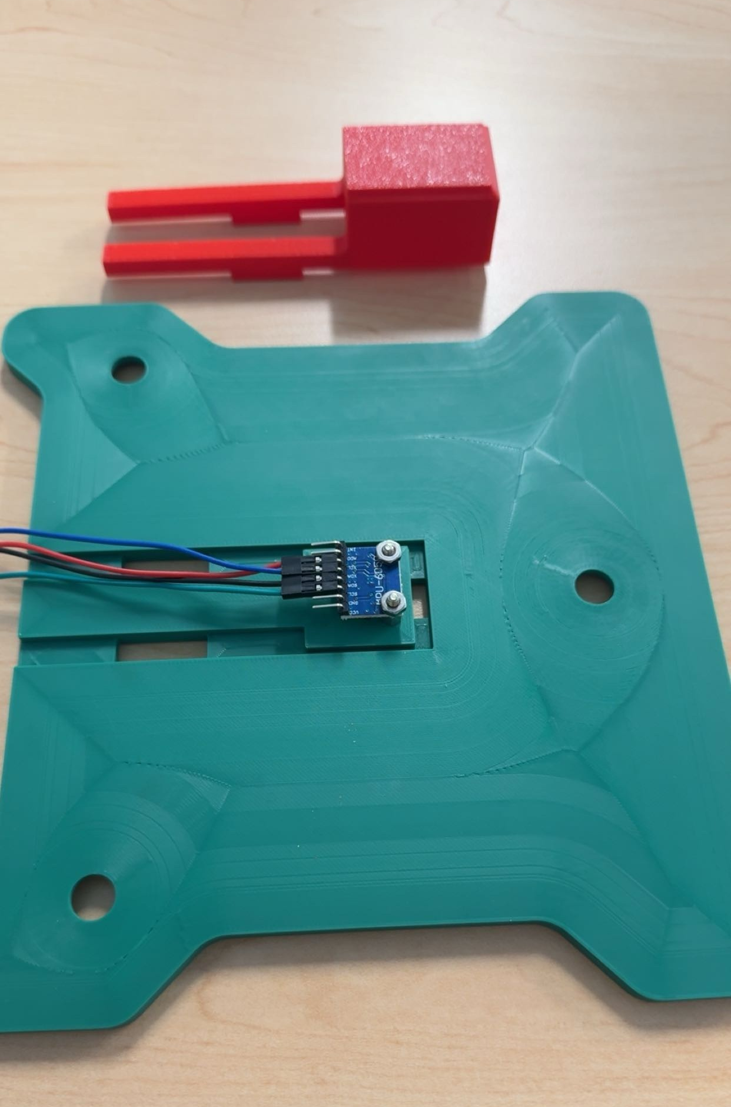
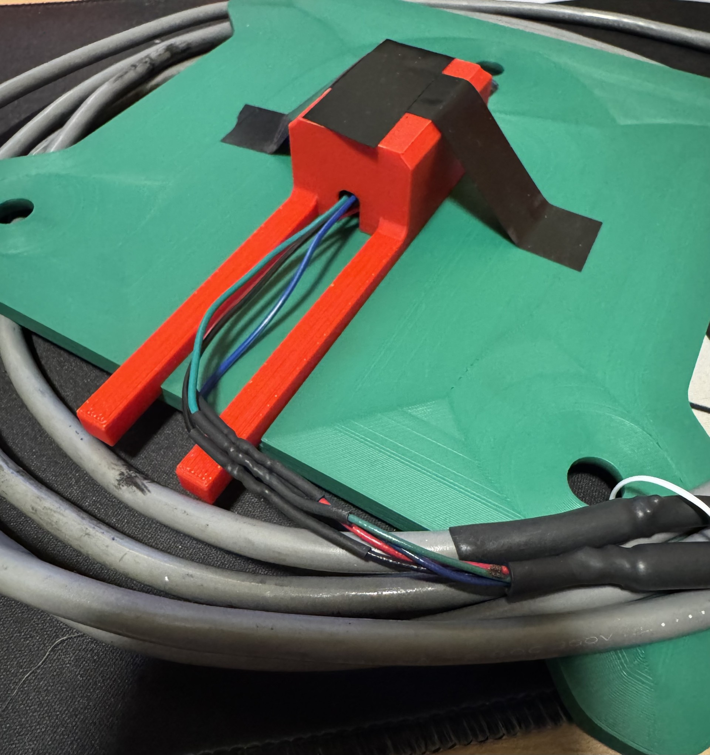
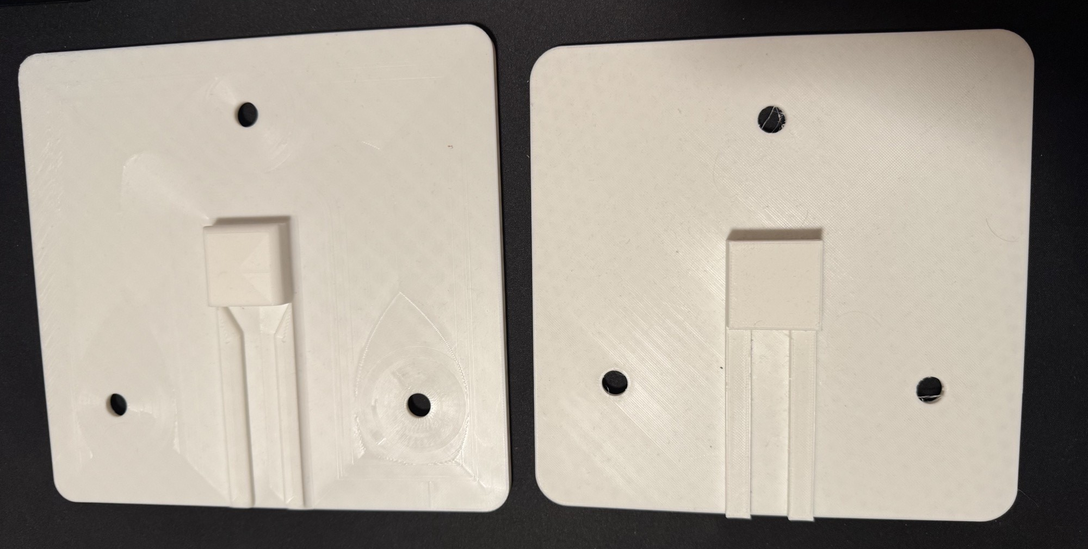
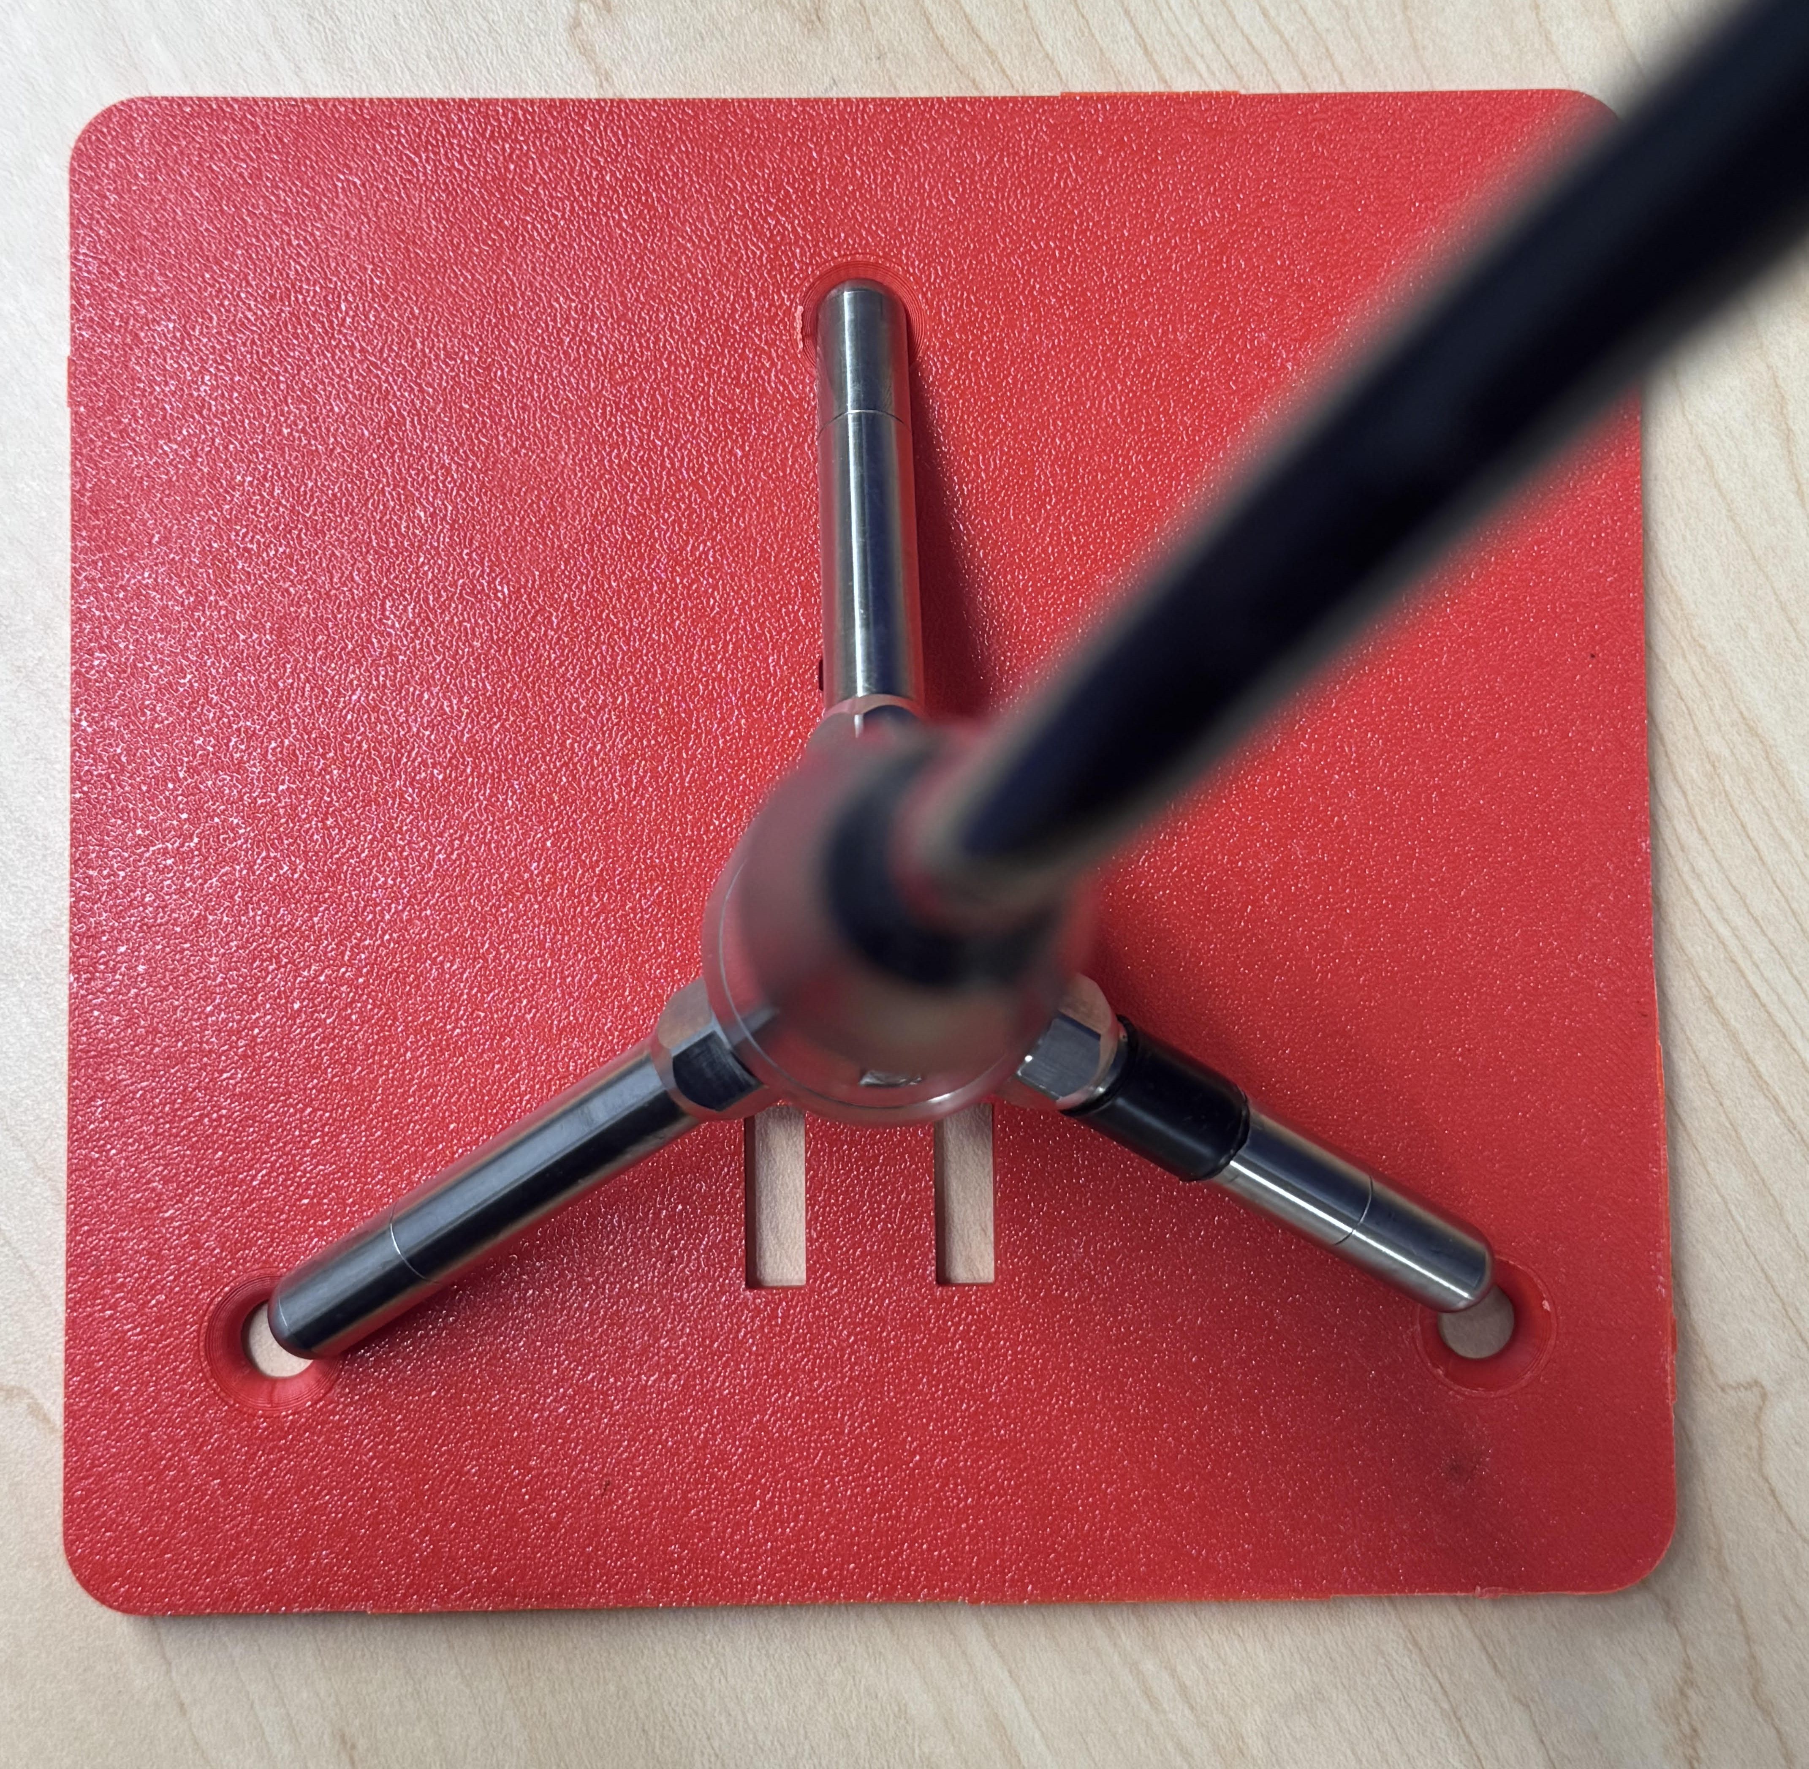
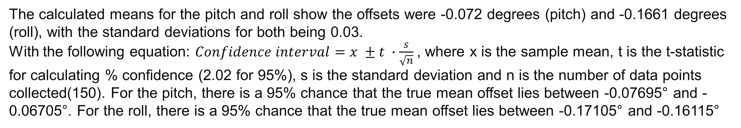
Tilt Sensor for Acoustic Doppler Velocimeter with Remote Head
Nortec Vector Probe
William Joyner
Department of Earth Science, University of New Hampshire
Overview
Design Process (SolidWorks)
Code and Offset Determination
Why is measuring and cataloging flow velocities in different bodies of water essential for marine studies?
Understanding Water Dynamics
Ecosystem Health and Biodiversity
Flood Forecasting and Management
Water Quality and Pollution Control
Water Resource Management
Whether it is a river or an ocean, water flows in every direction, some directions much stronger than others, but each direction is important. The Nortec Vector probe detects flow velocities in the vertical and horizontal directions simultaneously. But if it is not perfectly level, then the flow velocities in each direction will be calculated incorrectly thus skewing the data. The purpose of this project was to create a device that could be mounted on the three-pronged head of the vector probe and display its orientation to ensure accurate data collection. The Nortek Vector is a high-precision Acoustic Doppler Velocimeter (ADV) designed for measuring 3D water velocity in a small sampling volume. It's widely used in oceanographic and hydrodynamic research, particularly for studies involving small-scale turbulence, sediment transport, and boundary layer dynamics. Some of its applications include:
Turbulence studies in rivers, estuaries, and coastal areas
Sediment transport research
Wave orbital motion analysis
Boundary layer investigations
Low flow measurements in various aquatic environments
There were a total of 4 design iterations made (using SolidWorks) for this project with the detachable hood introduced in the third rendition The main issue had with the design process was getting the holes on the plate to match up with the three prongs on the vector probe (figure 10). Another early issue was not having enough housing space for the inner electronics of the project and not making it watertight. The larger, detachable hood was introduced to provide more space inside and gives easy access to the electronics. This was 3D printed with standard PLA filament. The other components used for this project were an Arduino microprocessor, display unit and a 9v battery (as shown in figure 6). In addition, the main component of the entire project was the MPU-6050 tilt sensor (as shown in figure 8). This sensor has a 3-axis gyroscope to measure rotation and a 3-axis accelerometer to measure linear acceleration/ tilt.
Within the hood, is the MPU 6050 tilt sensor, mounted with two screws and nuts. The orientation of the plate and the tilt sensor will not be the same then the offset between the sensor and plate needed to be taken into account. While using a digital level to keep the plate horizontal, the sensor was taking data of that orientation. Using that collected data, the mean offset could be calculated and accounted for in future measurements. Figure 9 shows the time series measurements during the calibration test With orange being the roll, and blue being the pitch with the pitch and roll offsets in degrees over a period (150s)
Figure 1: Nortec Vector Probe
Figure 9 shows the pitch and roll offsets with orange being the roll, and blue being the pitch.
Figure 4: SolidWorks drawing of the plate (mm)
Figure 5, SolidWorks drawing of the hood (mm)
The calculated means for the pitch and roll show the offsets were -0.072 degrees (pitch) and -0.1661 degrees (roll), with the standard deviations for both being 0.03.
With the following equation: $Confidence interval=x ±t ∙\frac{s}{\sqrt{n}}$, where x is the sample mean, t is the t-statistic for calculating % confidence (2.02 for 95%), s is the standard deviation and n is the number of data points collected(150). For the pitch, there is a 95% chance that the true mean offset lies between -0.07695° and -0.06705°. For the roll, there is a 95% chance that the true mean offset lies between -0.17105° and -0.16115°
Next Steps (Future Improvements)
Figure 2: Two vector probed deployed offshore
Figure 3: Schematic of Nortec Vector Probe
Prototypes
For future improvements to this project, I would like to design something that can safely attach to the probe so that someone does not need to continuously hold the plate while taking orientation measurements. I think the end goal of this project would be to design something that would stay on the device underwater and would be able to adjust the orientation remotely and be able to adapt to changing/ shifting landscapes in turbulent marine environments. The difficulty lies with designing an assembly that allows for moving parts and more electronic devices without leaving any openings for water to seep through, while still being aerodynamic to reduce drag in the water and being cost effective.
Figure 6: Arduino microprocessor (top), Display unit (bottom right) & 9v battery (bottom left)
The original two prototypes had no detachable hood and very little space for electronics and a large open space making it difficult to seal off to prevent water infiltration. If the third iteration (figure 10) had not had the holes for the probe prongs misaligned, it would have been the final product. In the third and fourth iterations, the hood part of the assembly was enlarged to ensure all electronics will have space and not be damaged. In addition, the opening for the cables to run from was greatly reduced making sealing the opening with hot glue or sealant much more plausible. Finally, with the introduction of a detachable hood, the possibility of water seeping in underneath increased. To minimize any possible water infiltration, a sort of moat was added for the hood to sit in, locking it in place and with the addition of sealant around the edges, making water infiltration highly unlikely.
Sources
Nortek. Vector (300 m). Nortek, n.d., https://www.nortekgroup.com/products/vector-300-m. Accessed 19 Apr. 2025.
Nortek. Vector (4000 m). Nortek, n.d., https://www.nortekgroup.com/products/vector-4000-m. Accessed 19 Apr. 2025
Forschungszentrum Küste, Universität Hannover. Nortek 3D Vector Specifications. n.d., https://www.fzk.uni-hannover.de/fileadmin/fzk/02-Das_FZK/03-Ausstattung/01-Der_GWK/01-Messtechnik/Messtechnik_Datenblaetter/Stroemungsmessgeraete/Nortek_3D_Vector/Nortek-3D-Vector_Spec..pdf. Accessed 19 Apr. 2025
EquipOcean. Nortek Vector Velocimeter. EquipOcean, n.d., https://www.equipocean.com/shop/nortek-vector-velocimeter-21. Accessed 19 Apr. 2025
Marine Institute for Sea and Coastal Laboratories (MISCLab), University of Maine. Nortek Vector User Manual. n.d., https://misclab.umeoce.maine.edu/ftp/instruments/Nortek%20Vector/Vector.pdf. Accessed 19 Apr. 2025
.
Figure 8: Final plate iteration with MPU-6050 tilt sensor installed
Figure 11: Final assembly with hood attached
Figure 7: Prototypes 1(right) and 2(left) for plate design with non-detachable hood
Figure 10: Third plate iteration with vector prongs slightly misaligned

