Slide 1
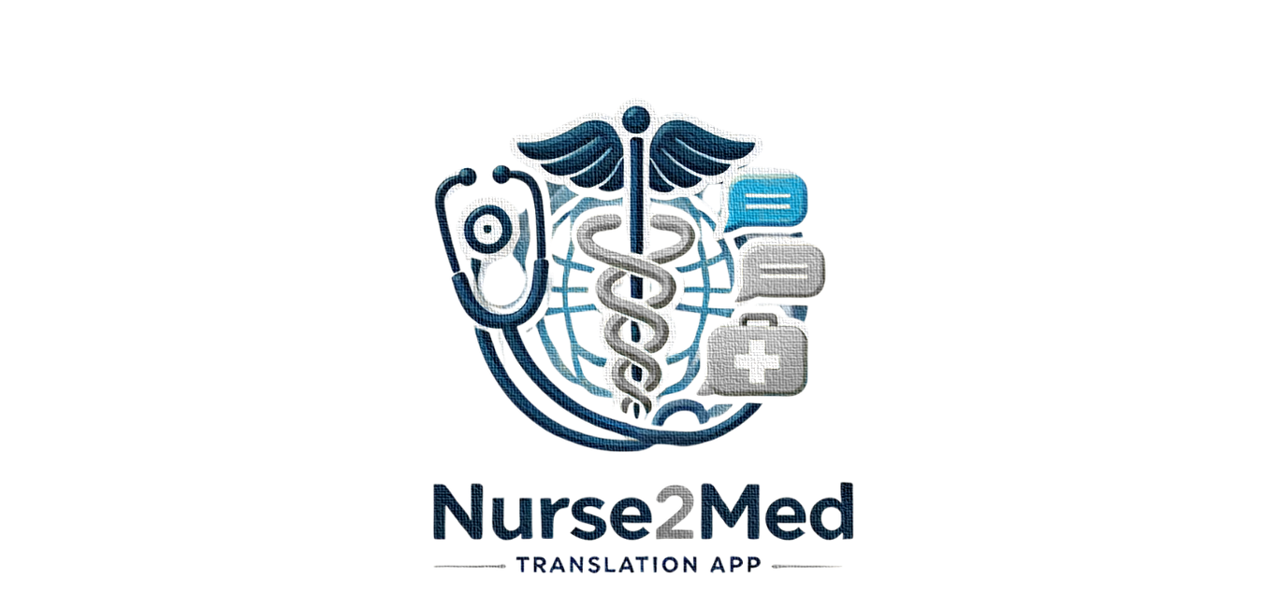

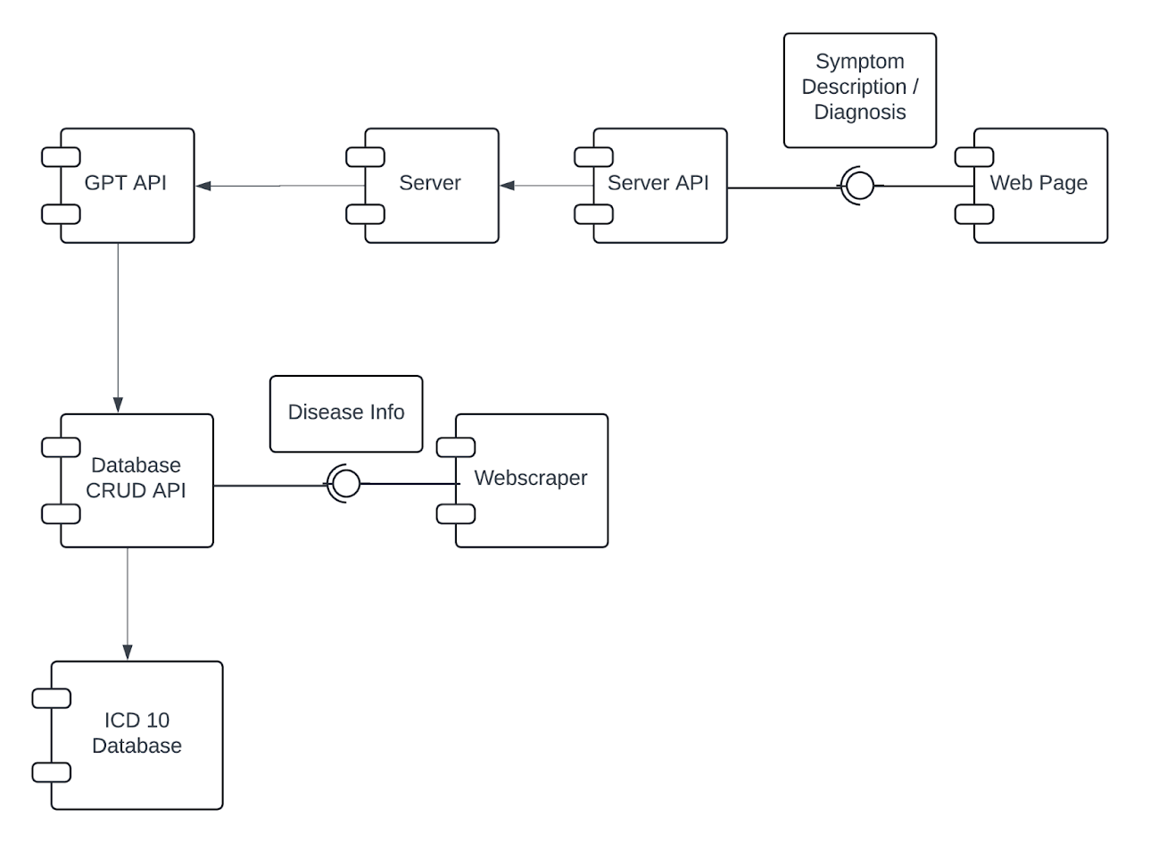
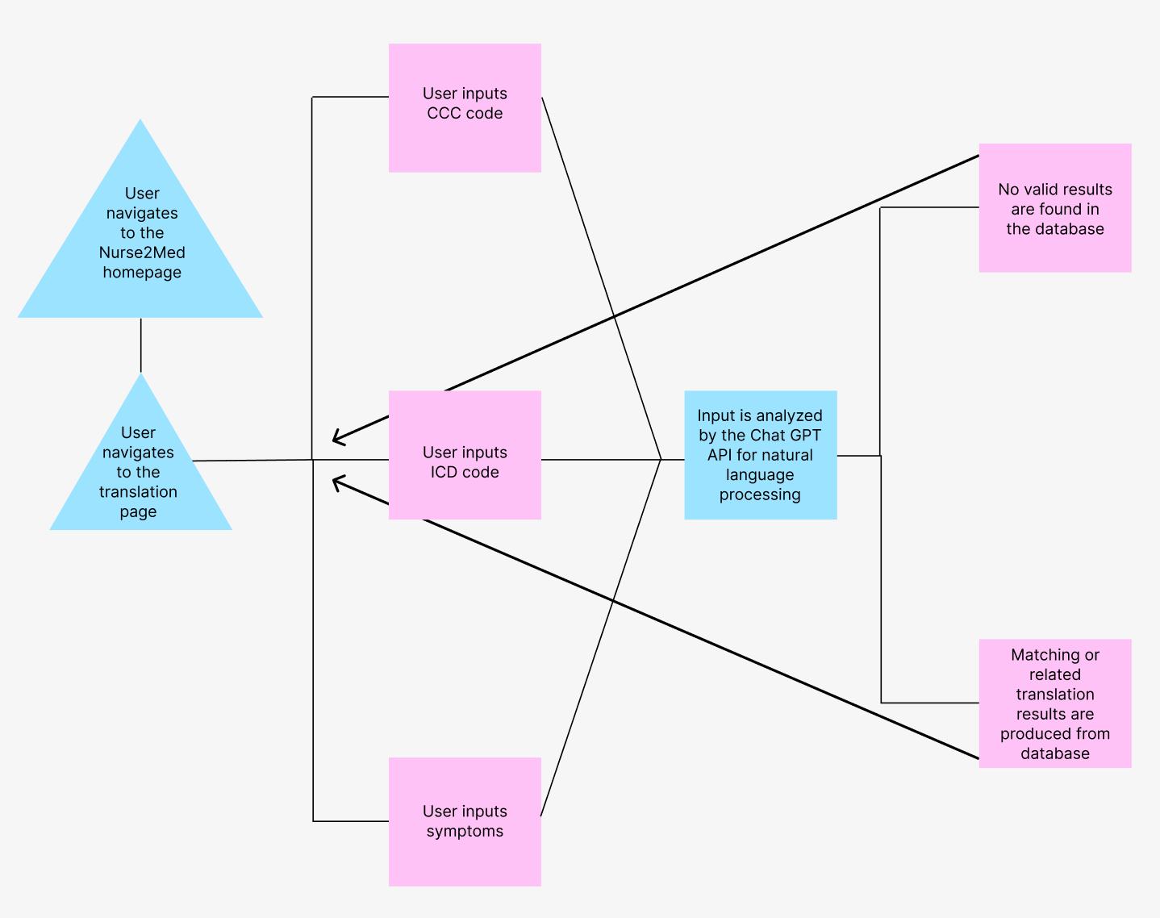
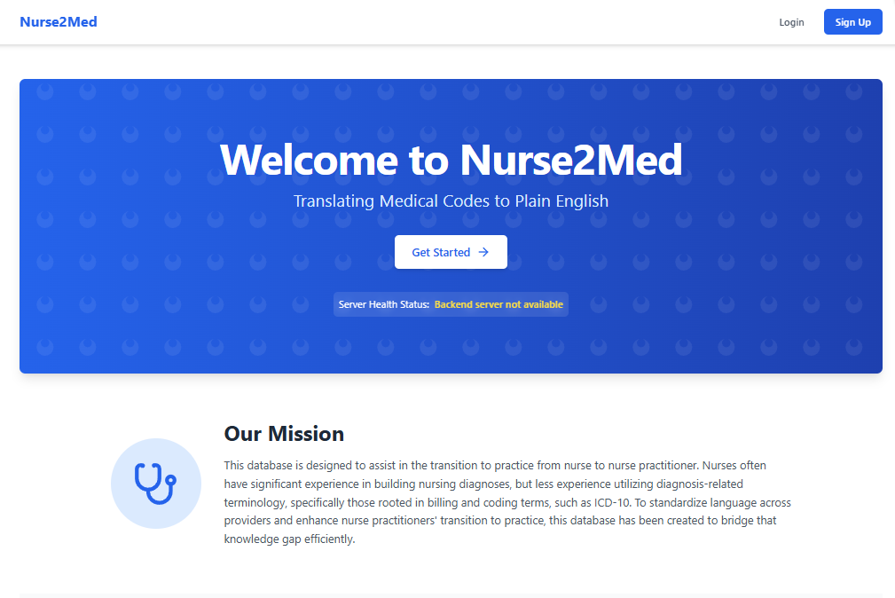
Nurse2Med
Rhy Fernands (Computer Science)
Andrew Butler (Computer Science)
Jon Doherty (Computer Science)
Justin Fournier (Information Technology)
Olivia Morel (Information Technology)
Sean Connors (CS: Cybersecurity)
Introduction
Product Design
Our interface has a simple structure that allows users to easily access the benefits of our tool. Users can navigate to the translation page, select the code they would like to request further information regarding, and our natural language processing model retrieves the relevant information from our database compiled of web scraped data to provide the
user with applicable translation information.
Nurses and Nurse Practitioners use different sets of standardized diagnosis codes, which can make it difficult for nursing students to make the transition during the nurse practitioner program. Nurse2Med is a web application which aims to make this process easier by providing a centralized learning location. The key features of this tool are the ability to 'translate' between the nursing and nurse practitioner set of codes: CCC (Clinical Care Classification) and ICD-10, with the additional ability to find codes by searching for key features such as symptoms.
Component Diagram
Activity Diagram
Requirements
Implementation & Testing
Evaluations + Conclusions
Our product requires the translation
of nursing terms into ICD-10 codes
and diagnoses through the integration
of natural language processing model.
It also requires database storage and retrieval abilities with data acquired
from a web scraping module. Non-functional requirements include
Scalability for concurrent users, data security and authentication, and a
user-friendly interface.
Nurse2med has 3 modules: a server, client, and webscraper. The server is deployed on the UNH network, meaning it is currently only available within the UNH network. The server is responsible for making the queries to the GPT-4 API, which is the backbone of our NLP-translation function. We also pass this query through our diagnosis code database, which is populated by our webscraper, and contains all the diagnosis codes and relevant information for both sets of diagnosis codes.
Unfortunately, our tool has not had the chance to be evaluated as we originally planned. The plan was to send out a satisfaction/quality of learning survey through our sponsor in the UNH nursing program, but this was not approved.
This survey would have included a pre- and post- use section. The pre-use section would ask the user to rate their ability/comfort with both code systems. Then, we would ask them to use our site for a specified amount of time, and rate their comfort again. In this way, we intend to see if our app is helpful to our users.
Testing has not been completed as much as we would have liked. Translation functionality has been verified as much as possible with our limited collective knowledge of nursing.
Sponsors: Clarissa Michalak, Kundai Andrew Midzi | Advisor: David Benedetto (Computer Science Department) | IT/CS 792, 2024-25

