Slide 1





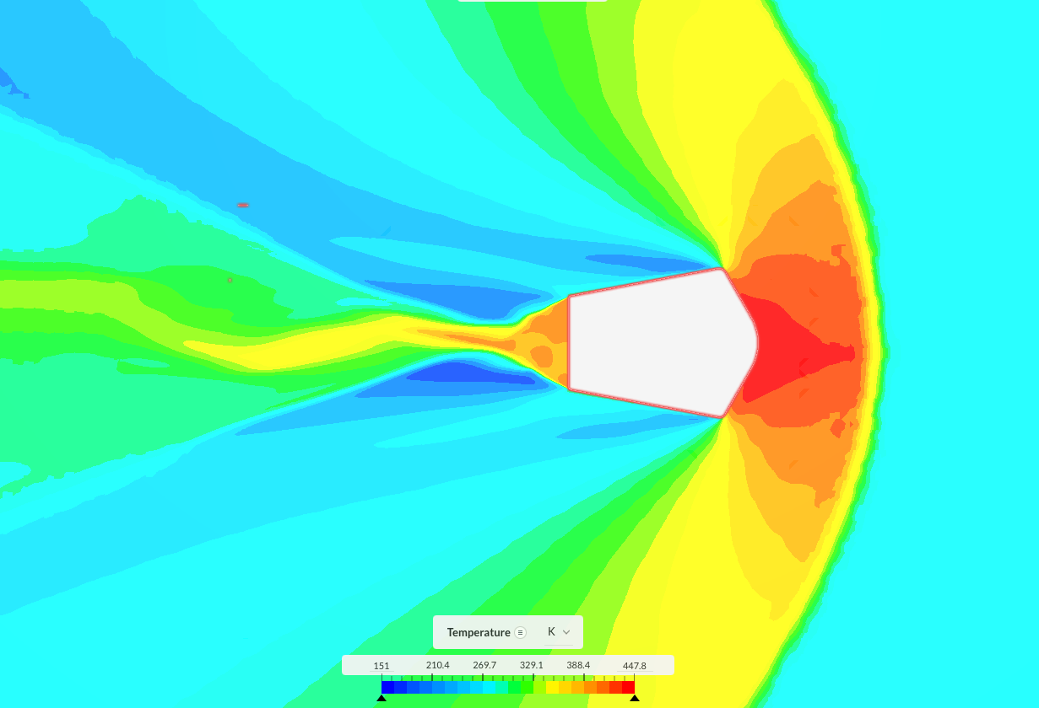
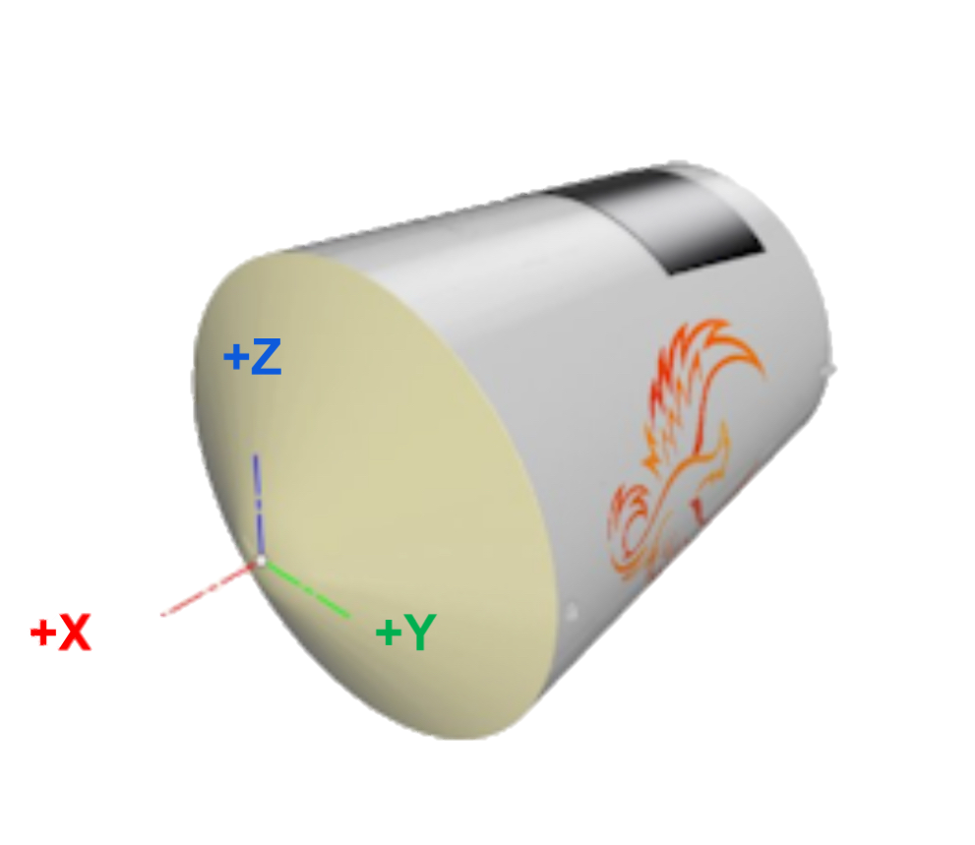
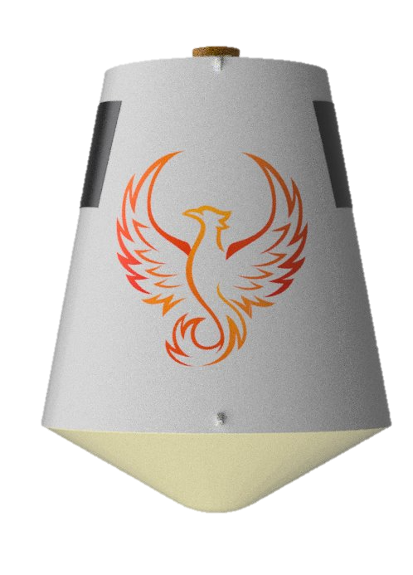

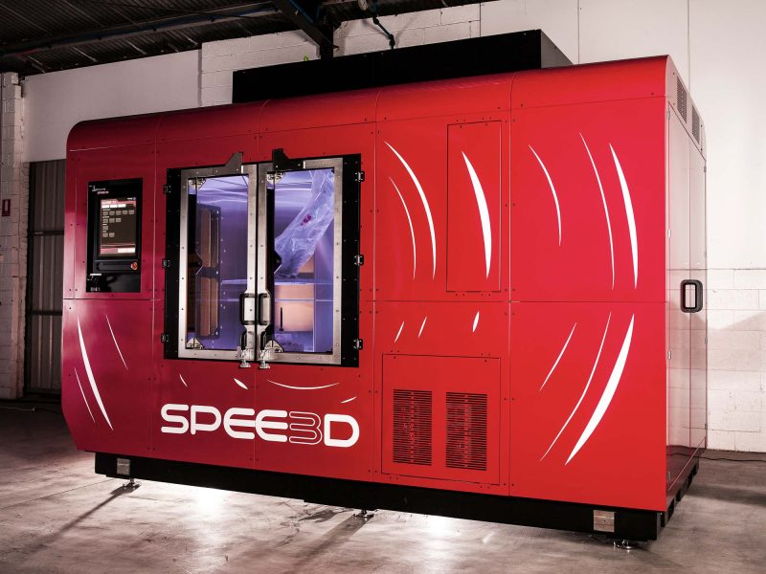
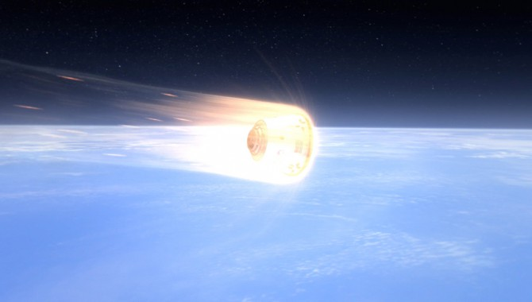















Investigating Multi-Layered Cold Spray Technology for
Spacecraft Thermal Protection Systems
Nick Olibrice
Project Advisor: John Roth
Department of Mechanical Engineering, University of New Hampshire, Durham, NH 03824
Project Overview & Objectives
Approach and Simulation
Conclusions
As spacecraft reusability becomes a top priority in modern spaceflight, developing advanced thermal protection systems (TPS) that are also reusable becomes critical. Traditional TPS solutions - such as ablative heat shields and brittle ceramic tiles - often suffer limited to no reuse and costly maintenance time.
This project evaluates the feasibility of using cold spray technology to fabricate layers of a thermal protection system for atmospheric reentry. Rather than aiming to design an optimized final system, the research focuses on:
Understanding the thermal environment during reentry
Evaluating material functional requirements for each layer
Determining whether cold spray is a viable fabrication method for any of these layers
Objectives:
Establish if multilayer cold spray can be used as a thermal protection system (TPS) on a reentry spacecraft.
TPS is to be designed for the -Y side of the Hermes Alpha during peak reentry heating.
Requirements:
The heat shield shall withstand $1.2 × {10}^{6}\frac{W}{m^{2}}$heat flux
Shall withstand 2500°C heating conditions
Shall be under ¼ total TPS mass (2.12 kg per side panel)
Industry collaborators supplied heat flux estimates at the nose, which were used to validate values obtained at the nose while obtaining side panel simulation data.
Conducted 2D axisymmetric computational fluid dynamics (CFD) simulation of capsule to capture hypersonic flow conditions using SimScale.
Simulated Mach 6 flow ~60 km altitude with adiabatic surface conditions.
CFD focused on side panel heat flux; after obtaining simulation data, values were scaled up for real expected mission heating conditions at Mach 12 flow.
Results informed material selection and feasibility assessment for cold spray integration.
Although the goal is to utilize cold spray for the entire TPS, additional non-cold spray layers are recommended due mainly to insulation requirements
Cold spray is most feasible for the substrate and intermediate metallic layer, especially in low-curvature regions like the capsule sides.
Preliminary cycle-count projections show acceptable performance for the metallic layers, but oxidation and micro cracking in the UHTC could limit service life.
Mass requirements prohibit the ability to increase non-insulation layer thicknesses to account for expected unwanted prices of pure ceramic insulation layer. A hybrid cold spray-insulation blanket layer is advised.
Preliminary results support the viability of a partially cold-sprayed TPS for the –Y side panel of the Hermes Alpha by utilizing proven ceramics used in similar applications, but the current ideal needed powders for cold spray deposition do not exist for commercial use.
This implies that current Cold Spray technology does not meet the requirements to develop the needed TPS mainly due to the lack of the existence or commercial availability of the required metallic-ceramic powders and would require the development of such powder(s) to properly integrate.
Cold Spray may be a viable solution if the following are done:
  Research efforts are made in developing a metal-ceramic composite powder than can survive deposition.
  The chosen insulation layer’s porosity does not affect its usefulness when depositing the other layers onto it.
This investigation establishes a foundation for further development and testing of cold spray-based TPS solutions in reentry applications.
Layering Strategy
Each TPS layer was assigned a specific role based on its location in the heat path and thermal environment. Considering the idea of a multi-layer approach, it was beneficial to define the functionality of each layer, based on the thermal environment being studied. This was done by using the initially provided values of heat flux and temperatures provided by industry collaborators.
Surface Layer: Withstand aerodynamic heating without melting or ablating and radiate absorbed heat outward.
Intermediate Layer: Spread and buffer thermal loads, provide structural support, and resist oxidation.
Insulation Layer: Block and slow heat conduction to the vehicle body.
Substrate Layer: Provide structural integrity and mechanical attachment of TPS to the spacecraft.
Generalized 4-Layer Approach
Idealized 4-Layer Approach
Preliminary 4-Layer Approach
UHTC Outer Layer:
  Material: Tantalum (Ta) - Zirconium DiBoride ($ZrB_{2})$ composite powder
  Thickness: $t_{1}=0.300 mm (≈1.18 × {10}^{−2} in)$
Refractory Metal Layer:
  Material: Tantalum – Tungsten (Ta-W) Alloy
  Thickness: $t_{2}= 0.050 mm (≈1.97 × {10}^{−3} in)$
Insulating Layer:
  Material: Alumina-Enhanced Thermal Barrier (AETB) Ceramic Tile
  Thickness: $t_{3} = 15.0 mm (0.591 in)$
Substrate Layer:
  Material: Aluminum Alloy
  Thickness: $t_{4}= 2.00 mm (7.87 × {10}^{−2} in)$
UHTC Outer Layer:
  Material: Silicon-Carbide (SiC) encapsulated in Nickel (Ni) and co-sprayed with Ta, coated with Ta
  Thickness: $t_{1}= 0.11 mm total (≈4.33 × {10}^{−3} in)$
Refractory Metal Layer:
  Material: 316L Stainless Steel
  Thickness: $t_{2}=0.100 mm (≈3.94 × {10}^{−3} in)$
Insulating Layer:
  Material: Ceramic Fiber Insulation Board (i.e Duraboard, Cerakwool)
  Thickness: $t_{3}= 7 mm (≈0.276 in)$
Substrate Layer:
  Material: Aluminum 6061-T6
  Thickness: $t_{4}=2 mm (7.87 × {10}^{−2} in)$
Future Work
Material Validation: Closer collaboration with SPE3D to investigate the use of ceramic-metallic powders, as mentioned, for this use-case.
Sample Fabrication: Manufacture multi-layered cold spray TPS using SPE3D’s machinery and test deposition on capsule-representative curvature.
Thermal Testing: Conduct thermal cycle testing on small-scale samples to assess durability of bonded and sprayed layers.
Aerodynamic Validation: Conduct wind tunnel tests to investigate the effects on drag from the TPS and determine if a finishing coat is required to prevent undesired aerodynamic effects.
Simulation Improvement: Refine simulations to be time-dependent at mission-specific flow conditions, including thermal load prediction.
Background
Traditional thermal protection systems utilize ablation to dissipate the thermal energy built up during atmospheric reentry. These systems face challenges with reusability and require time-intensive fabrication that results in an undesired increase in time between missions. Reentry bodies encounter temperatures exceeding 1500°C and dynamic mechanical stresses, necessitating multi-functional materials.
Cold Spray is a promising solid-state deposition method that accelerates powdered materials to high velocity and bonds them to a substrate without melting. Its low-thermal approach may make it suitable for:
Building high-temperature resistant layers without heat damage.
Enabling rapid, low-cost refurbishment between missions.
Customizing TPS systems for different mission profiles.
This project builds upon existing TPS architectures by integrating various layers with independent purposes while exploring whether cold spray is compatible with the temperature and structural requirements identified through aerodynamic and thermal simulation.
$$Ta−ZrB_{2}$$
$$Ta−W Alloy$$
$$AETB Ceramic Tile$$
$$Aluminum 6061−T6$$
Equations
$x_{oxide}=\sqrt{k_{p}t_{total}}$, $L=FS∙x_{oxide}$
$L=\frac{q^{′′}t}{ρC_{p}ΔT}$, $L_{mat}=FS∙L$
$δ=2\sqrt{\frac{k}{ρC_{p}}t}$, $L=FS∙δ$
$q_{rad}=εσT^{4}$, $q_{net}=(1−ε)q^{′′}$
Research Parameters
$$T_{surf,ideal}=2500 K$$
$$q_{ideal}^{′′}=1.1 × {10}^{6} W/{m^{2}}$$
$$T_{surf,side}=930 K$$
$$q_{side}^{′′}=3.7 × {10}^{4} W/{m^{2}}$$
$$t_{min}=0.05 mm$$
$$A=1 m^{2}$$
$$Ni−SiC/Ta$$
$$316L Stainless Steel$$
$$Cerakwool$$
$$Aluminum 6061−T6$$
$$t_{1}$$
$$t_{1}$$
$$t_{2}$$
$$t_{2}$$
Acknowledgements
$$t_{3}$$
$$t_{3}$$
Prof. John Roth, Space Phoenix, SPE3D, Victor Champagne
$$t_{4}$$
$$t_{4}$$
References
Challenges and Considerations
Cold Spray Material Compatibility: Some idealized materials, such as UHTCs, are brittle and may fracture on high-velocity impact if proper percentage of each material within the composite is not properly addressed.
Layer-to-Layer Interactions: The investigation of the layer-to-layer interaction was not considered for this study and would advise, at minimum, the addition of a thermal barrier coating interface that is designed to handle thermal expansion differences between layers to prevent delamination.
Thermal Cycling & Oxidation: Repeated reentry cycles increases likelihood of cracking and oxidation in exposed layers (outermost layer).
Modeling vs. Reality: While 2D CFD at lower flow velocity conditions provides valuable insights, full 3D transient simulations would provide higher fidelity for complex geometries.
Notes:
The generalized layer formulation was determined using the initially provided values of heat flux and temperature values at the nose of the vehicle during peak heating conditions.
The idealized material thickness was determined using the heat flux and temperature values provided by industry collaborators.
The final proposed material selection was determined using the heat flux and temperature values obtained from the CFD analysis. Explain a how I scaled values up for side panel heat flux and temp from Mach 6 to Mach 12
in-between approach columns, add equations for temp scaling and input temps for side panels for research

