Slide 1
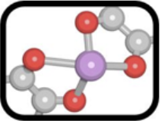
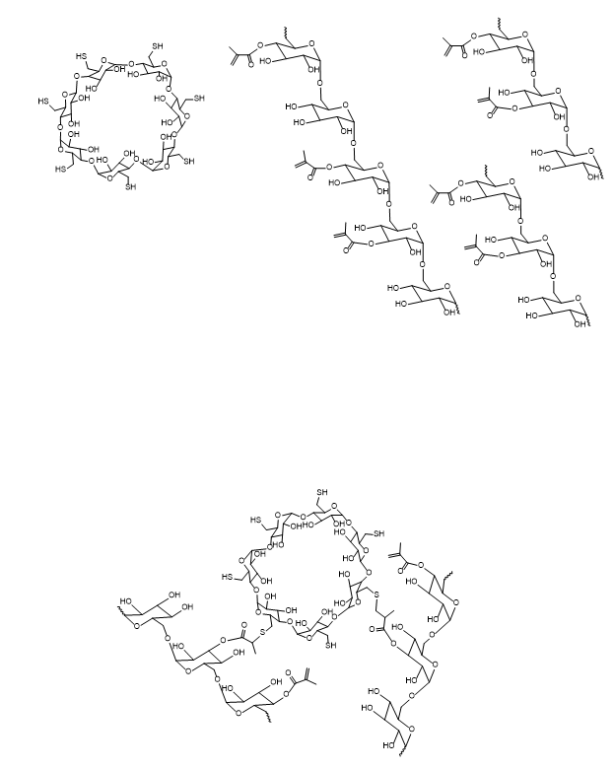
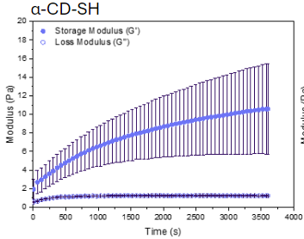
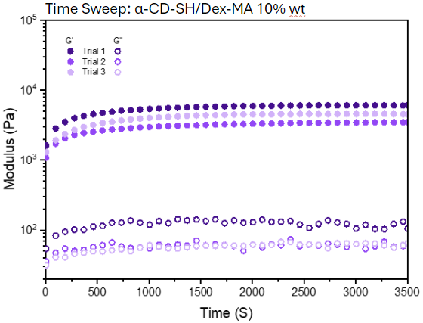
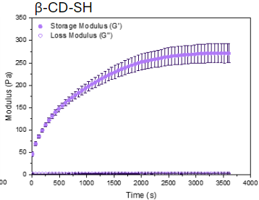
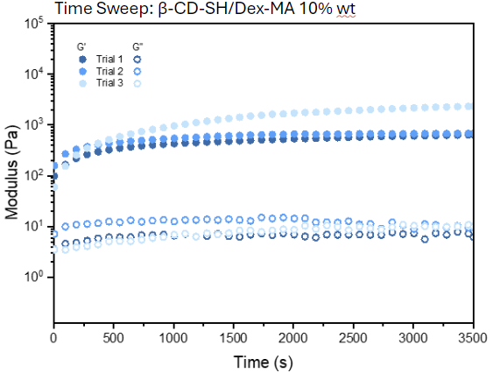
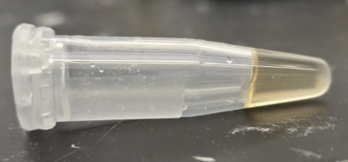
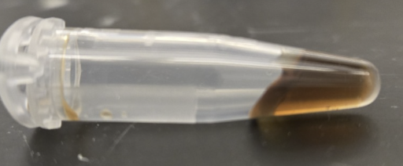
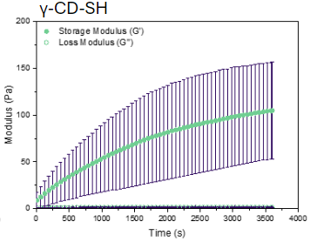
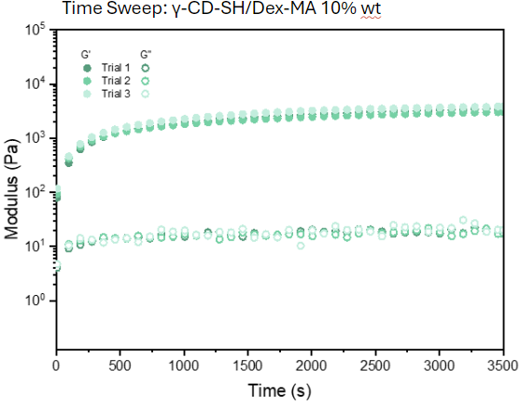
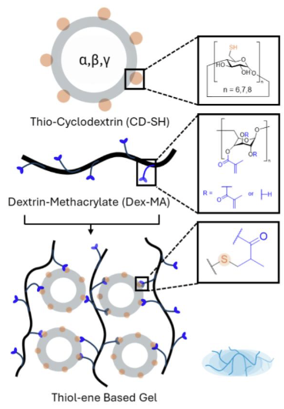
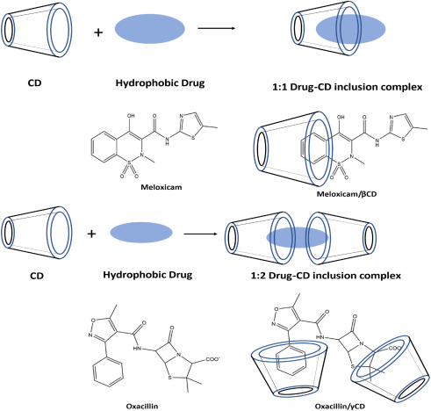
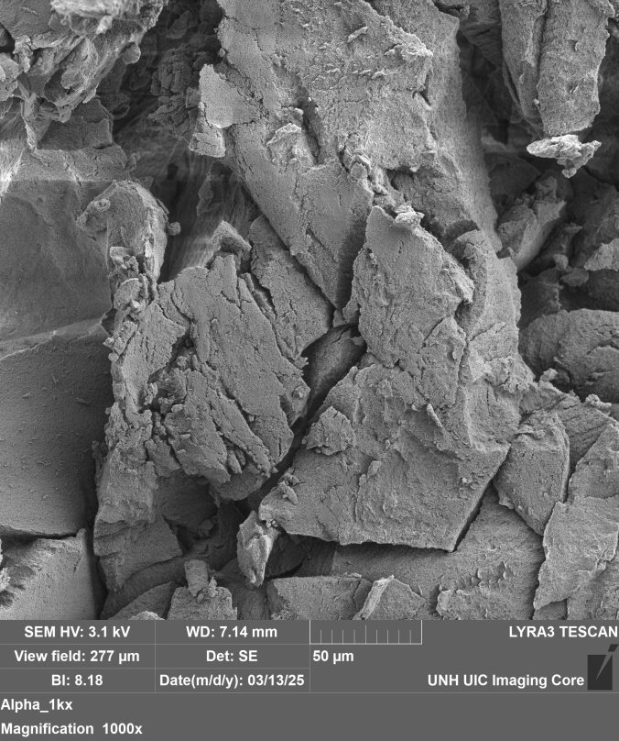
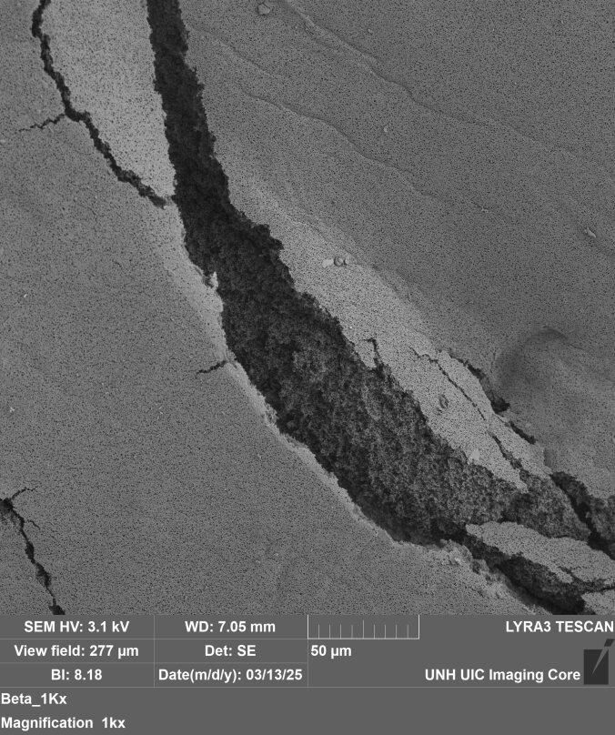
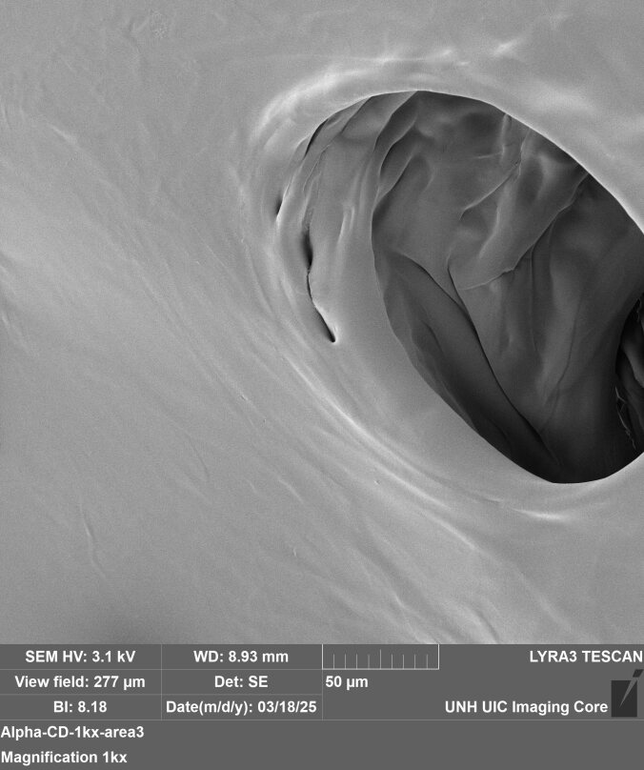
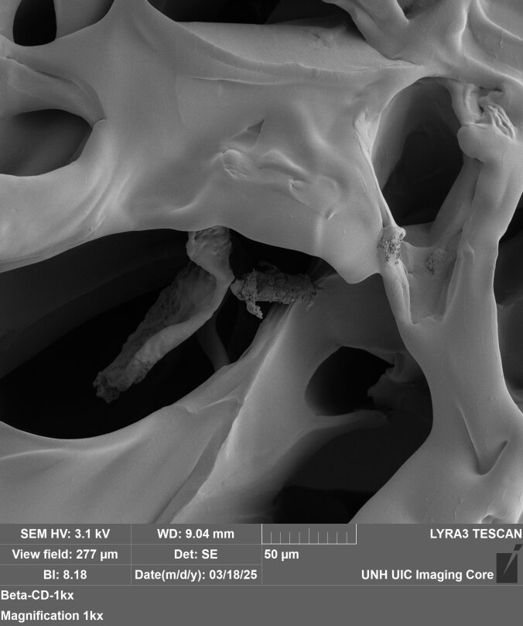
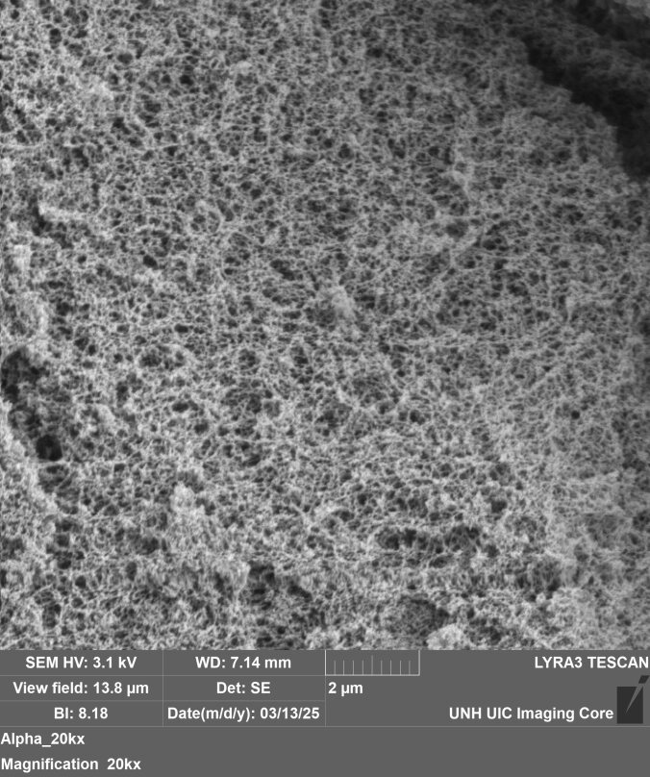
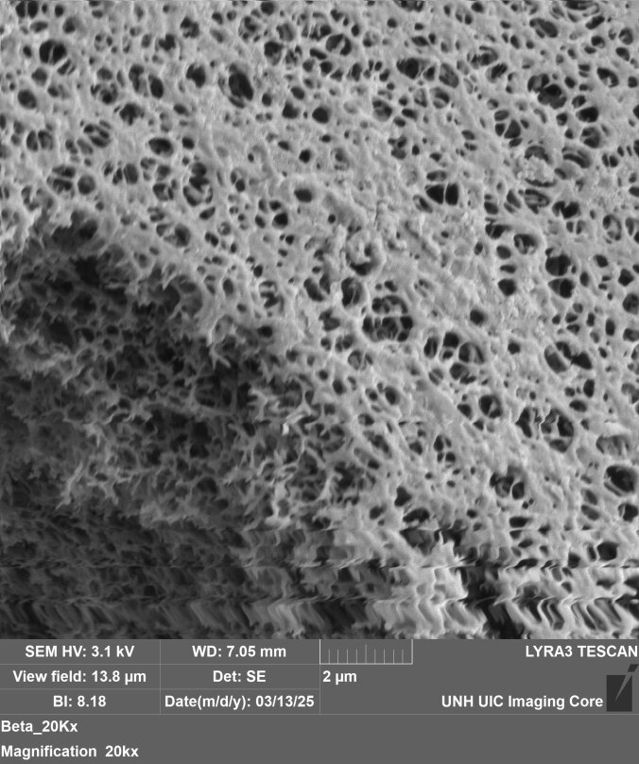
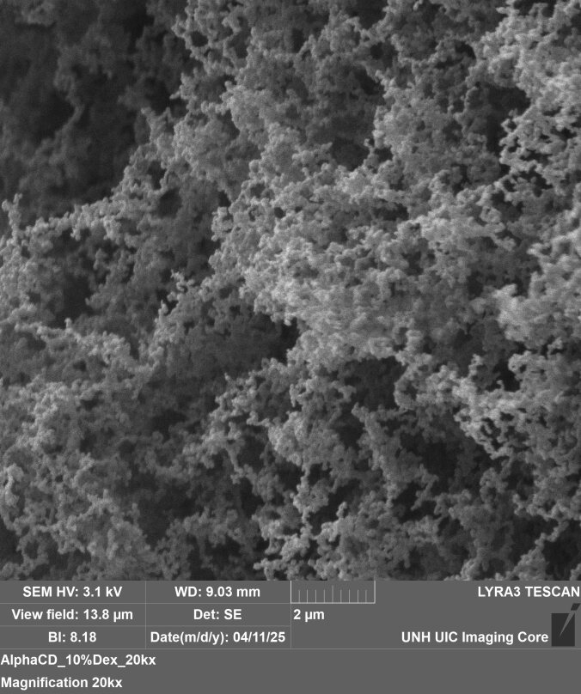
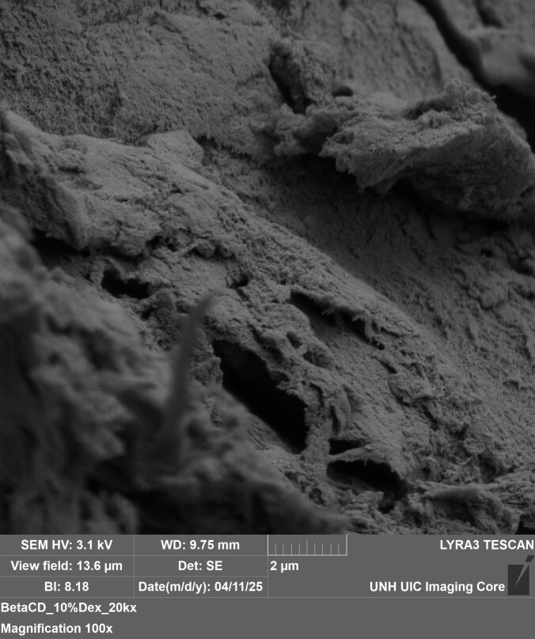
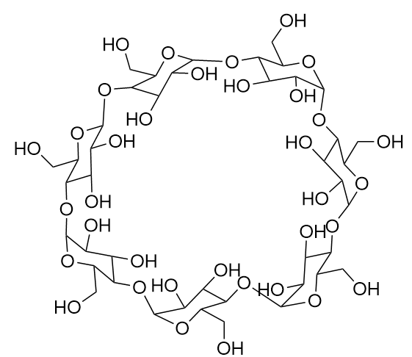
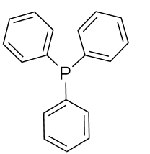
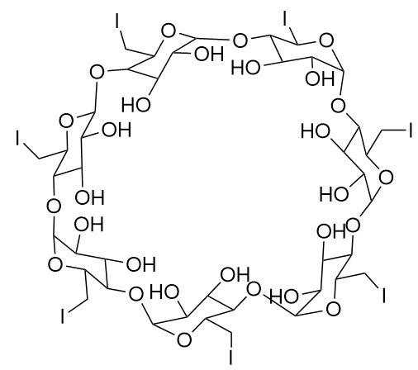
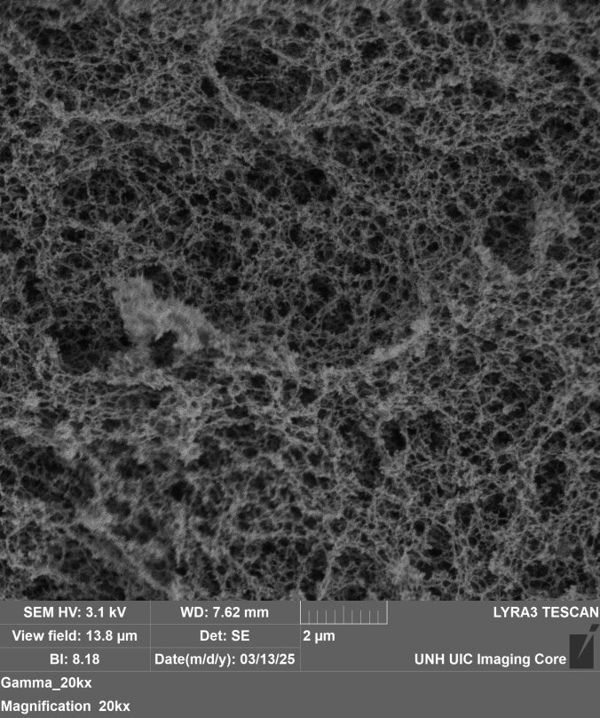
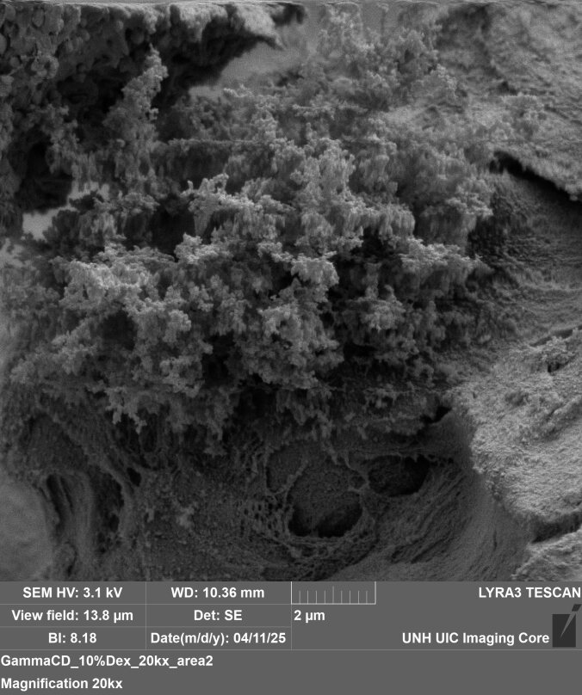
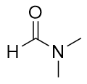
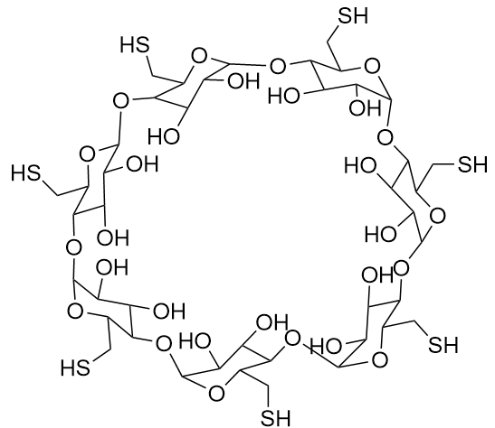
Tuning the Physical Structure and Mechanical Properties of Cyclodextrin-Dextran Hydrogels
Evan Kennedy, Patrick Strobel, Aylin Aykanat*, and Linqing Li**
Department of Chemical Engineering and Bioengineering, University of New Hampshire, Durham, NH, USA
*Aylin.aykanat@unh.edu ** Linqing.li@unh.edu
1: Introduction
3: Thio-Michael Addition
5: Rheology
Countless people need medication in their daily lives, and some require frequent trips to the hospital
Hydrogels offer convenience, able to provide a sustained release of drug over days or weeks
Many drugs are hydrophobic, making it difficult to load them into many hydrogels
Cyclodextrin has a hydrophobic pore, allowing drug loading
If the stiffness and crosslinking density of a hydrogel can be tuned, its release rate of a loaded drug can be tuned
Modulating the concentration of hydrogel constituents affects the gel’s stiffness and visible density
Vascularization is regulated by the structure of the environment, among other factors
Cyclodextrin-Dextran hydrogels may be lyophilized to yield a porous network relevant to endothelial cells
Gelation of CDSH-DexMA Hydrogel
50 mg/ml
100 mg/ml
1
2
1
6
7
3
7
6
5
4
2
4
86 kD DexMA chains, 70% methacrylation
3
5
6, 7, or 8-glucose rings (α, β, or γ CD), 100% thiolated
NaOH
1:1 -SH to -MA ratio
α:
Fast Gelling Time (<30 seconds)
β:
Cyclodextrin Inclusion Complexes for Drug Delivery¹
γ:
Overview of Material
4: SEM
Critical-Point Dried
Lyophilized
50 and 100 mg/ml CD-SH and DexMA. Rheology performed immediately after adding base and vortexing. Performed on NATO Lab rheometer.
Hydrogel diffusion rates are regulated by crosslinking density and stiffness
Higher concentrations of constituents form stiffer hydrogels
*Figure generated by Pat Strobel
50 mg/ml CD-SH and DexMA. Imaged on SEM at 1kx magnification after Ethanol Drying and Critical Point Drying. Alpha on left, Beta on right.
50 mg/ml CD-SH and DexMA. Imaged on SEM at 1kx magnification after Freezing and Lyophilization. Alpha on left, Beta on right.
7: Conclusions
2: Thiolation and Methacrylation
Porous matrices support cellular invasion
Lyophilized gels have pores on the scale of endothelial cells
Methacrylation of Linear Dextran²
Cyclodextrin-Dextran gels may be tuned in stiffness and structure
Lyophilized hydrogel pore systems may support vascularization in wound healing treatments
Stiffness and structure may be controlled to mediate cell adhesion, as well as the diffusion rates of…
5 wt% CD-SH and DexMA
10 wt% CD-SH and DexMA
Thiolation of Cyclodextrin
Drugs to be delivered
Toxins or pollutants to be absorbed
Next step: Load a CDSH-DexMA gel with a fluorescent molecule to visualize and quantify its drug-loading ability
PPhe₃, I₂
NaOMe,
MeOH
Acknowledgement
DMF, 90°C
Hydrogel diffusion rates are regulated by its crosslinking density and its stiffness
NH BioMade IIA 1757371 and EPS-1101245
CIBBR (P20GM113131) at NIH
UNH CHBE Department
Dr. Linqing Li’s Lab, UNH
Dr. Aylin Aykanat’s Lab, UNH
UNH Core facility and Instrumentation Center
References
Thiourea
NaOH, H2O
KHSO₄, H2O
Higher concentrations of constituents form denser hydrogels
1.
Saha, P. & Rafe, M. R. Cyclodextrin: A prospective nanocarrier for the delivery of antibacterial agents against bacteria that are resistant to antibiotics. Heliyon 9, e19287 (2023).
2. Bubli, S. Y. et al. Inducing an LCST in hydrophilic polysaccharides via engineered macromolecular hydrophobicity. Sci. Rep. 13, 14896 (2023).
DMF, 70°C
Reflux
50 mg/ml CD-SH and DexMA. Imaged on SEM at 20kx magnification after Ethanol Drying and Critical Point Drying. Alpha on left, Beta on right. Gamma on bottom.
100 mg/ml CD-SH and DexMA. Imaged on SEM at 20kx magnification after Ethanol Drying and Critical Point Drying. Alpha on left, Beta on right. Gamma on bottom.
Notes:
SEM – 20 um
Toxicity- 100 um
Gel- 100 um
Gel with cells- 50 um, 2D

