Slide 1
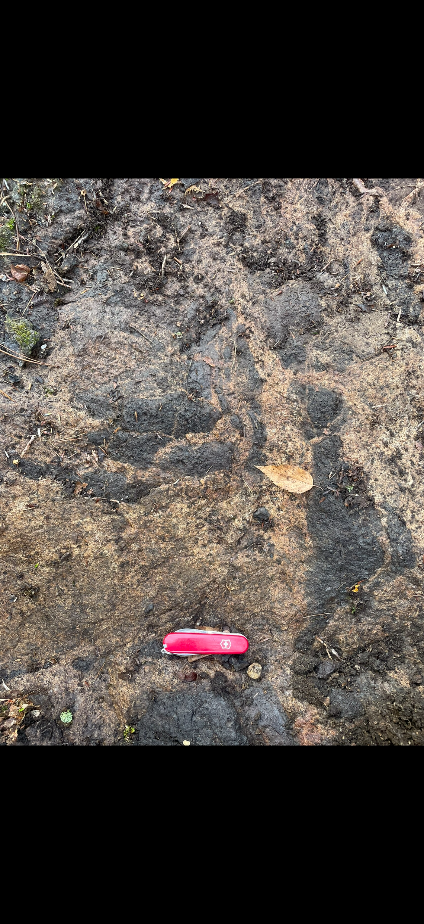
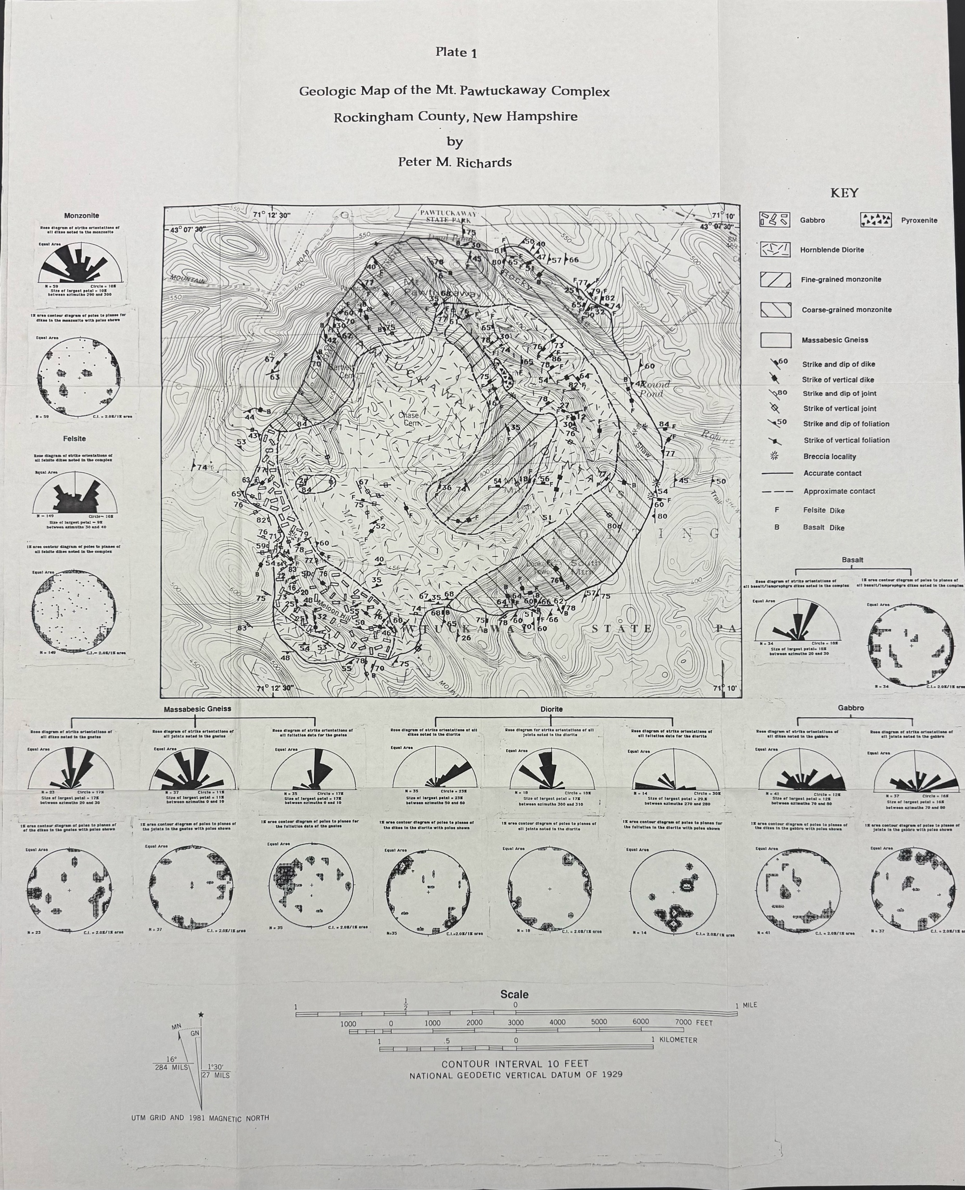
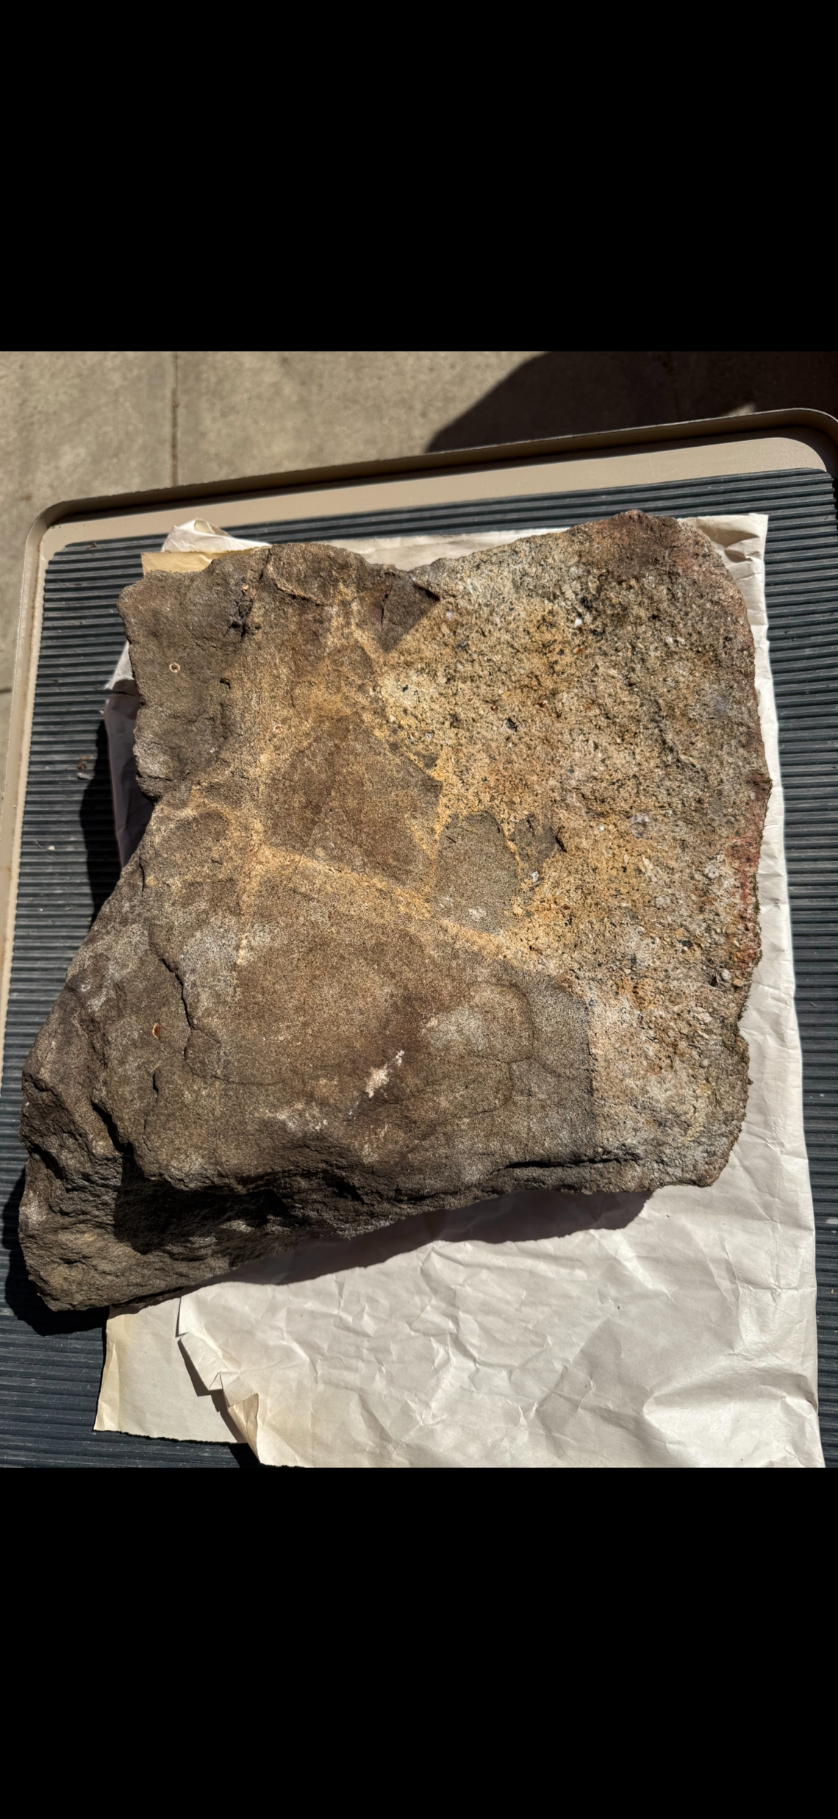
Magmatic Brecciation in the Pawtuckaway Ring Dike
Jacob Cossette jbc1046@usnh.edu Advisor: Jo Laird
Department of Earth Sciences, University of New Hampshire, Durham, NH
Introduction
Results
Conclusion
The Pawtuckaway ring dike is part of the White Mountain Magma Series and formed approximately 121Ma (Lower Cretaceous). In 1990 as a master's thesis, Peter Richards mapped the entire complex and distinguished four rock units, monzonite, pyroxenite, hornblende diorite, and gabbro. He noted nine breccia localities at or near the contact between the monzonite and the other bodies. At the end of his thesis, Richards proposes a model for the formation of Pawtuckaway using geophysical data. For this project I collected samples using Richard’s geologic map (noted below as Figure 1) and examined the texture and xenoliths within them to see if they support his model.
The texture and xenoliths within Samples 1, 2, and 3 supports Richard’s model for the formation of the Pawtuckaway ring dike complex. His model has the pyroxenite and gabbro bodies intruding at or around the same time, followed later by the hornblende diorite, and ending with the monzonite. The lack of pyroxenite and gabbro xenoliths in the same identified rock supports both the pyroxenite or the gabbro intruding around the same time. Additionally, the xenolith’s angularity and some being completely within the monzonite leads to the monzonite intruding later.
Figure 3: Angular xenoliths of gabbro within coarse-grained monzonite, scale bar is 10cm across
Figure 2: Angular pyroxenite xenoliths completely enveloped by monzonite, Swiss army knife is 8cm across
Figure 4: Sample 25PWT1 before cutting
Acknowledgments and References
The three samples taken from the field were designated 25PWT1, 25PWT2, and 25PWT3. Samples #1 and #2 were both taken within the same area of three breccia localities within the monzonite, while sample #3 was taken from the breccia locality near the contact of the pyroxenite and monzonite.
Both the photographs and samples show angular xenoliths of pyroxenite or gabbro encircled by monzonite. The texture of the monzonite is fine-grained in Figure 2, while it is coarse-grained in Figure 3 and in Samples 1 and 2. There was no pyroxenite found as xenoliths within the gabbro and monzonite localities I identified. Likewise, there was no gabbro xenoliths found within the pyroxenite and monzonite locality. Sample 1 has “fingers” of monzonite and sample 2 has monzonite intruding into the gabbro along breccia planes.
I would like to thank Professor Jo Laird for her continued assistance throughout this project. Additionally, I would like to thank Joe Piro for his help in the field and with sample collection. Finally, I would like to that the New Hampshire State Parks Department for allowing me to collect samples.
Richards, P. M. (1990). Nature of the Emplacement of the Mt. Pawtuckaway Complex, Rockingham County, New Hampshire (Masters Thesis, University of New Hampshire)
Figure 1: The geologic map created by Peter Richards
Methods
Collected three hand samples in the field using Richard’s geologic map
Cut those samples using rock saws at the UNH Earth Sciences Department
Shipped five 1cm wide wedges to Mineral Optics in Vermont to be professionally made into thin sections to be examined with a petrographic microscope

