Slide 1


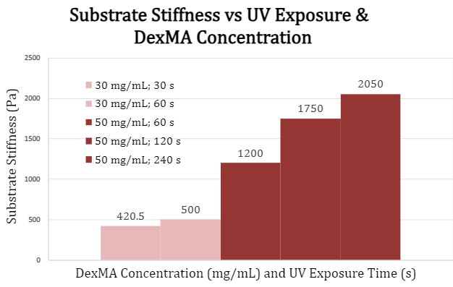
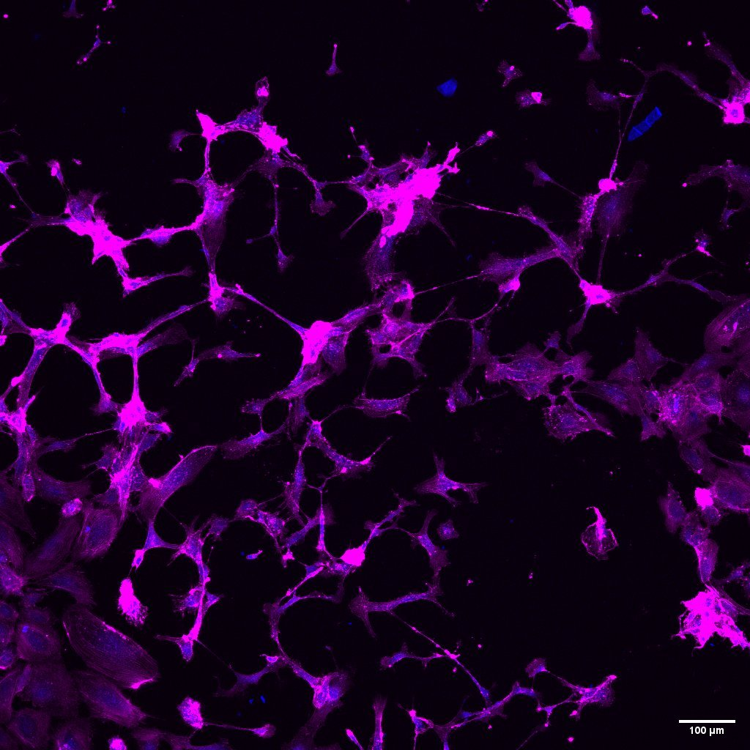
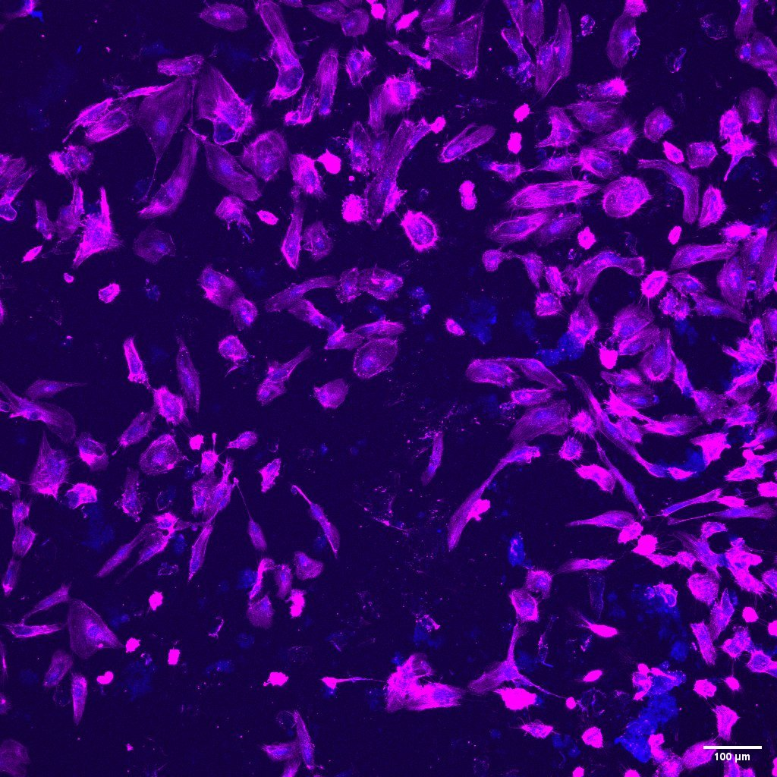
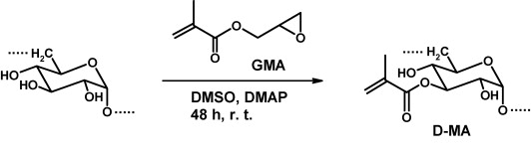
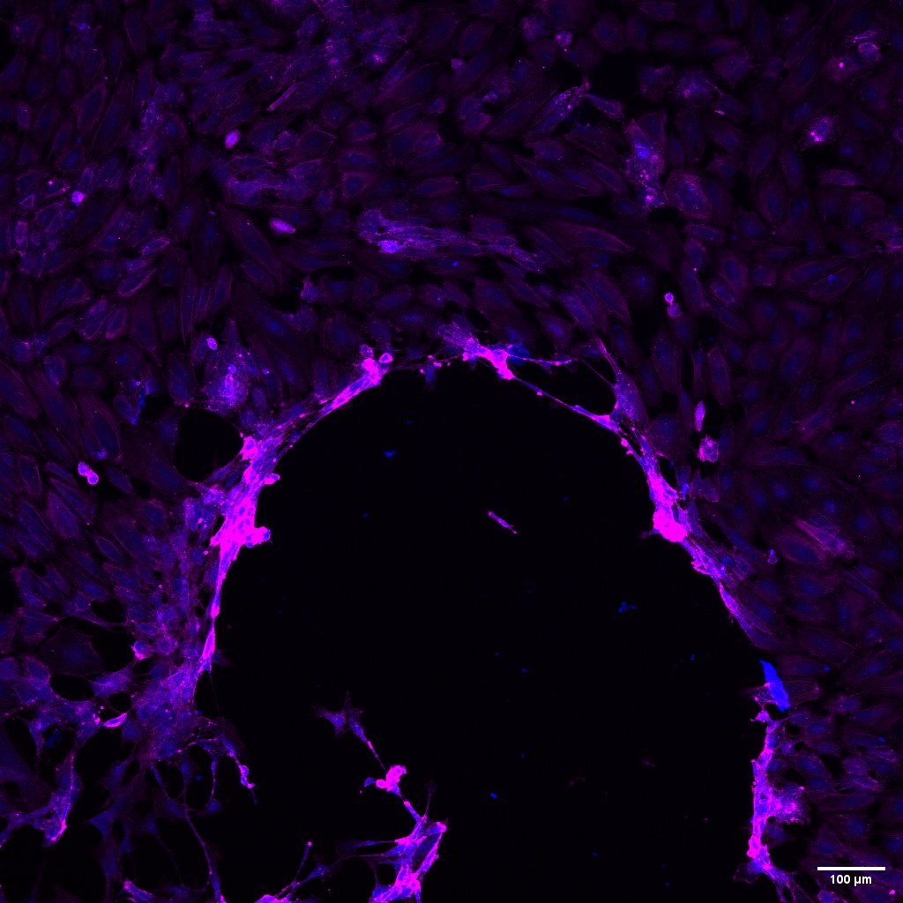
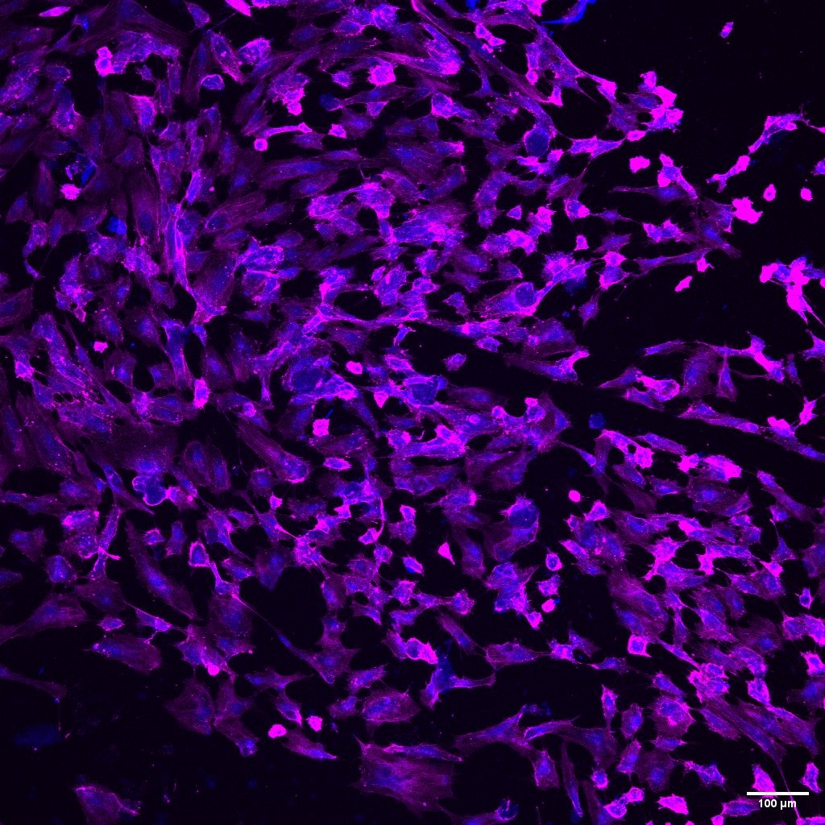
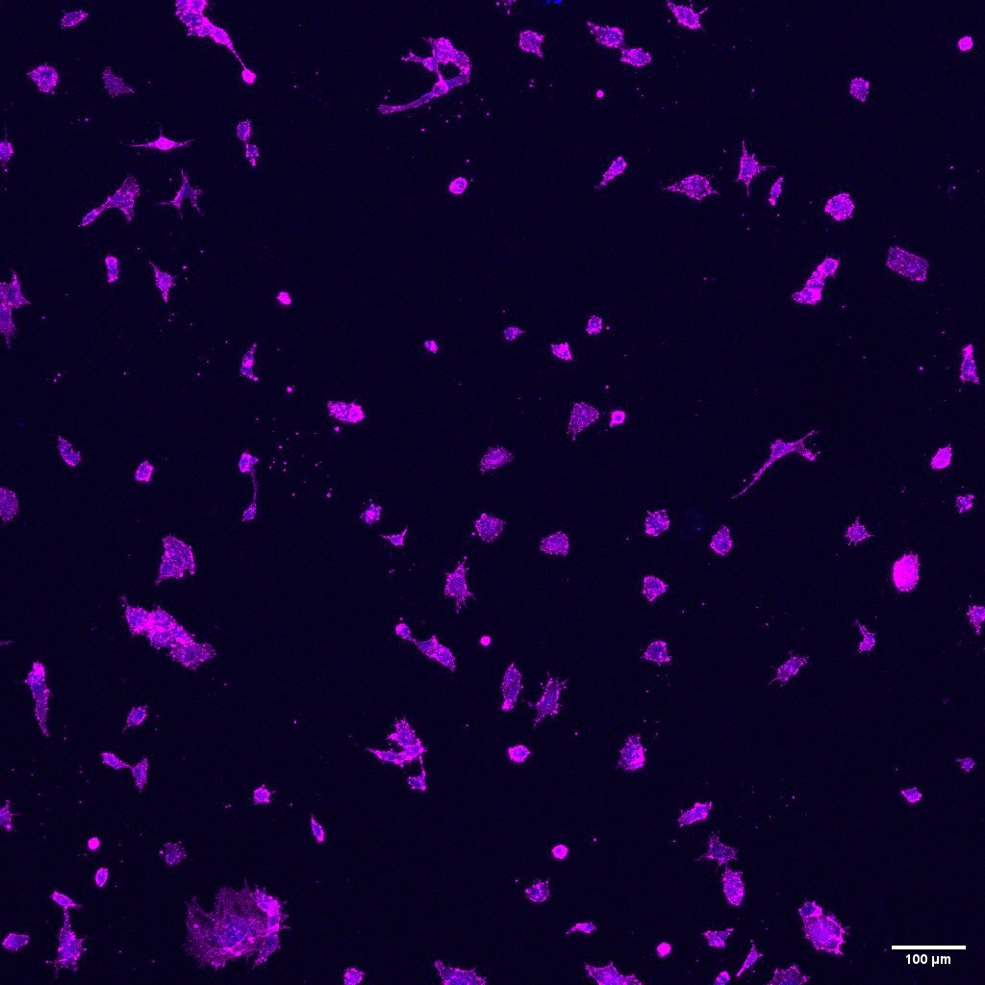
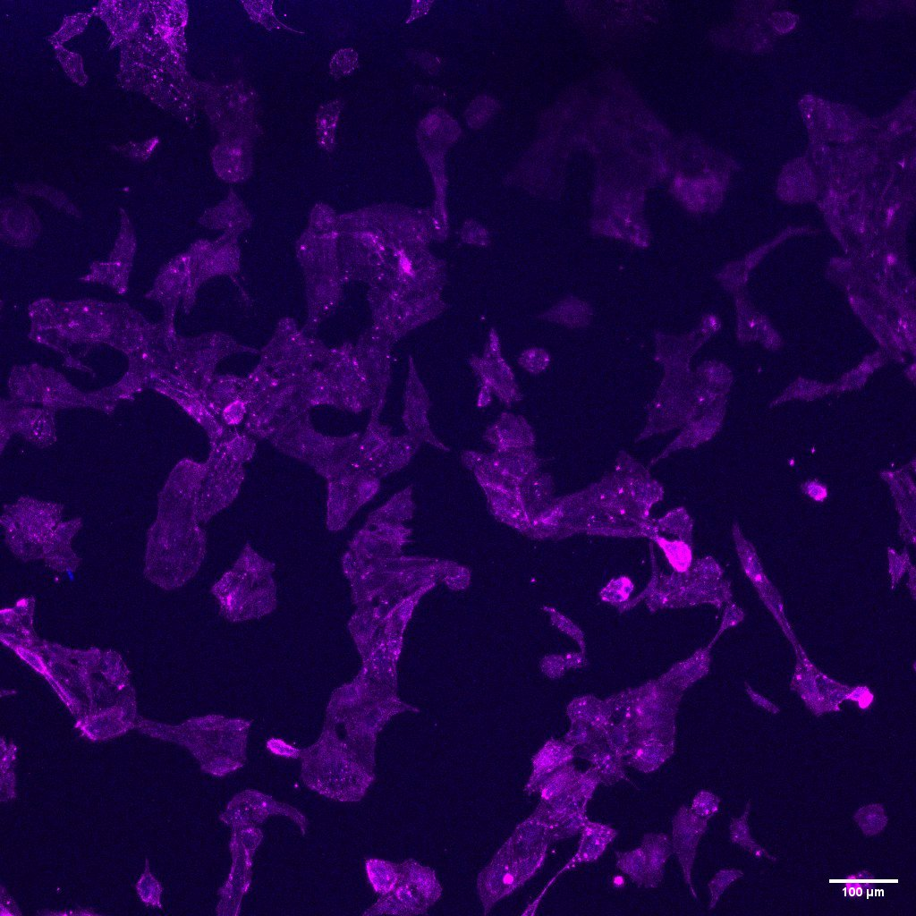
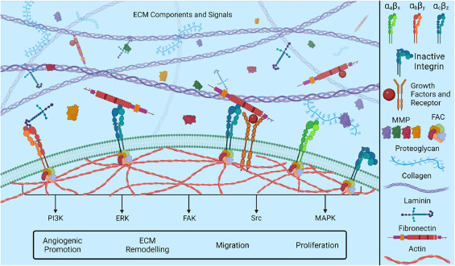
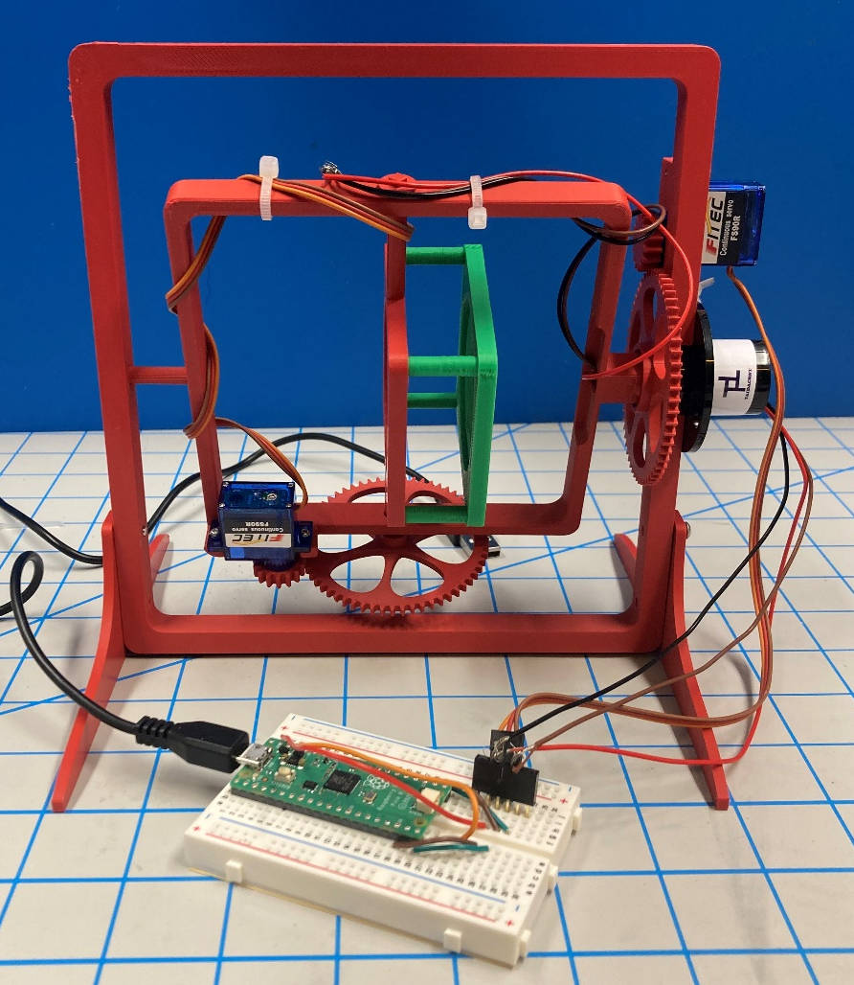
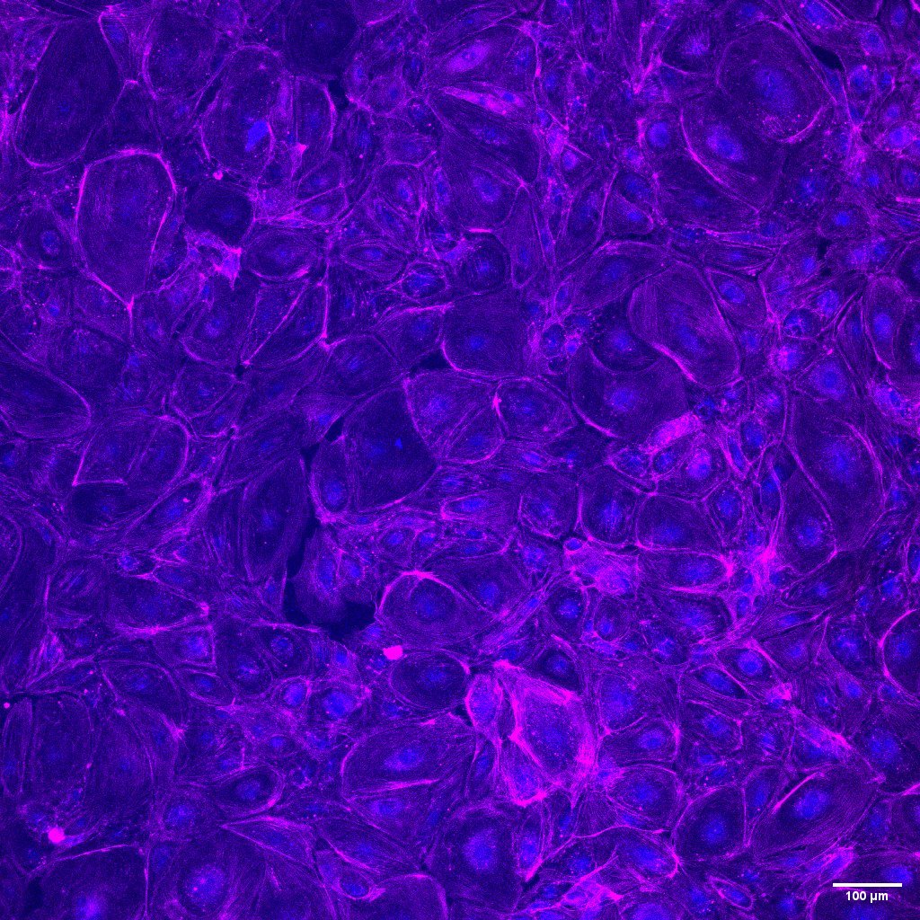
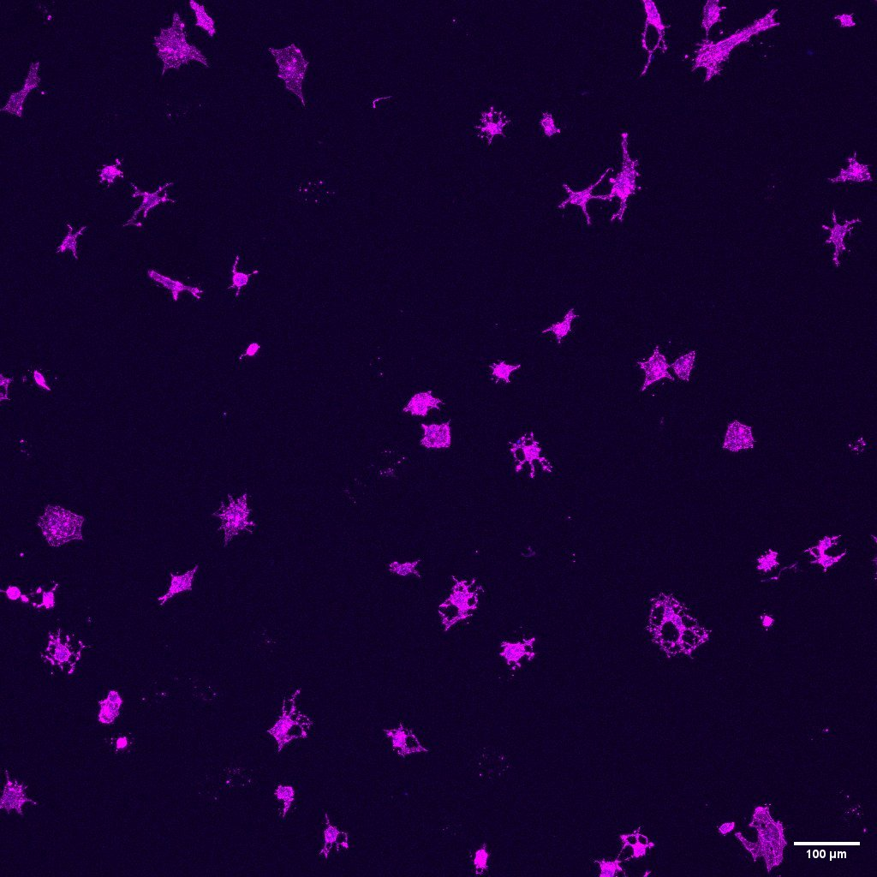



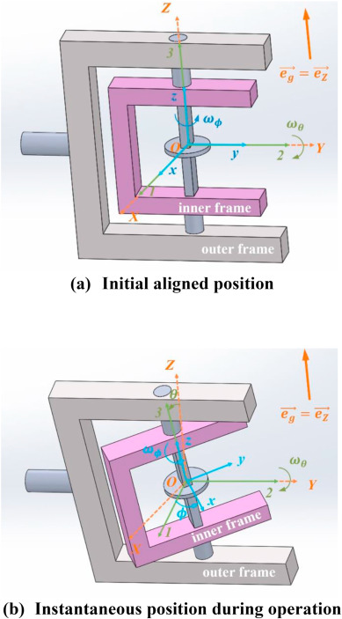
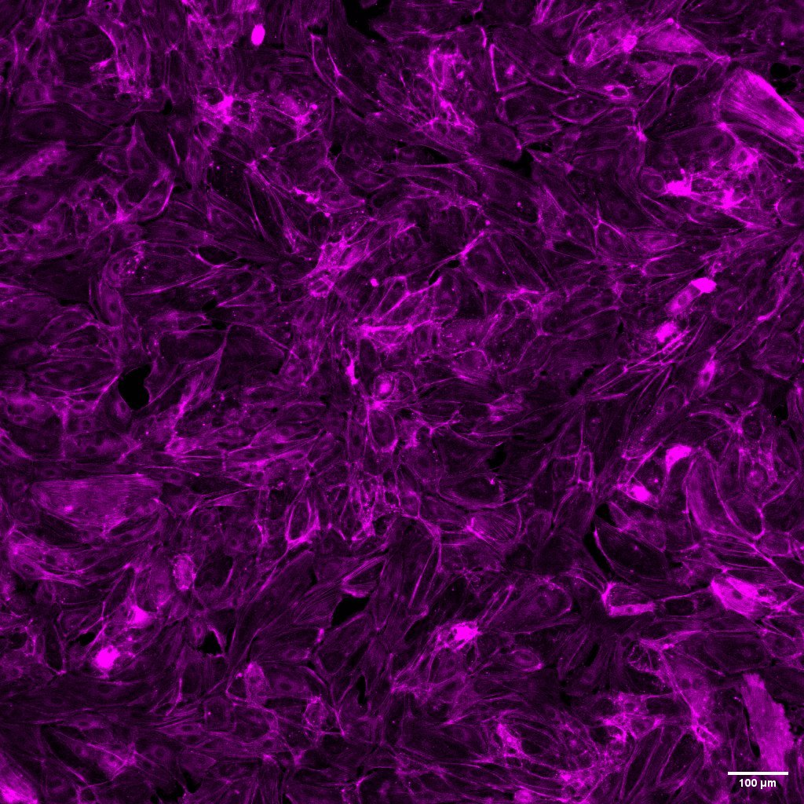
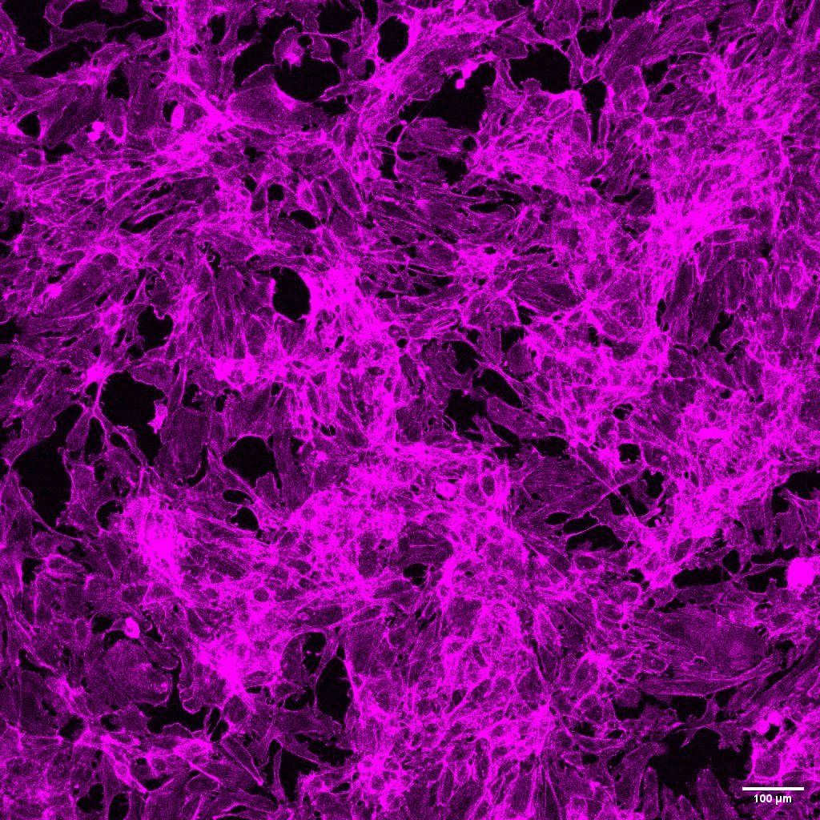
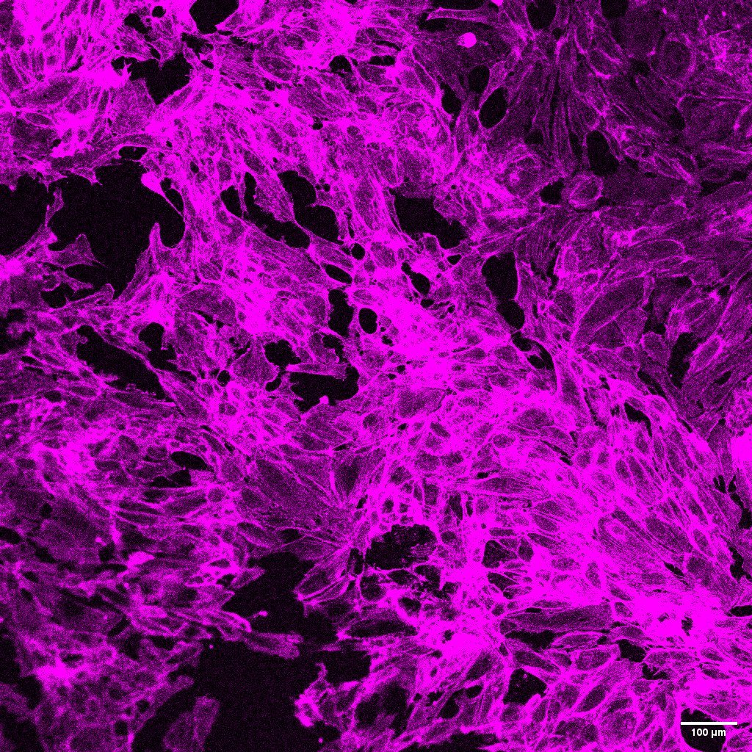
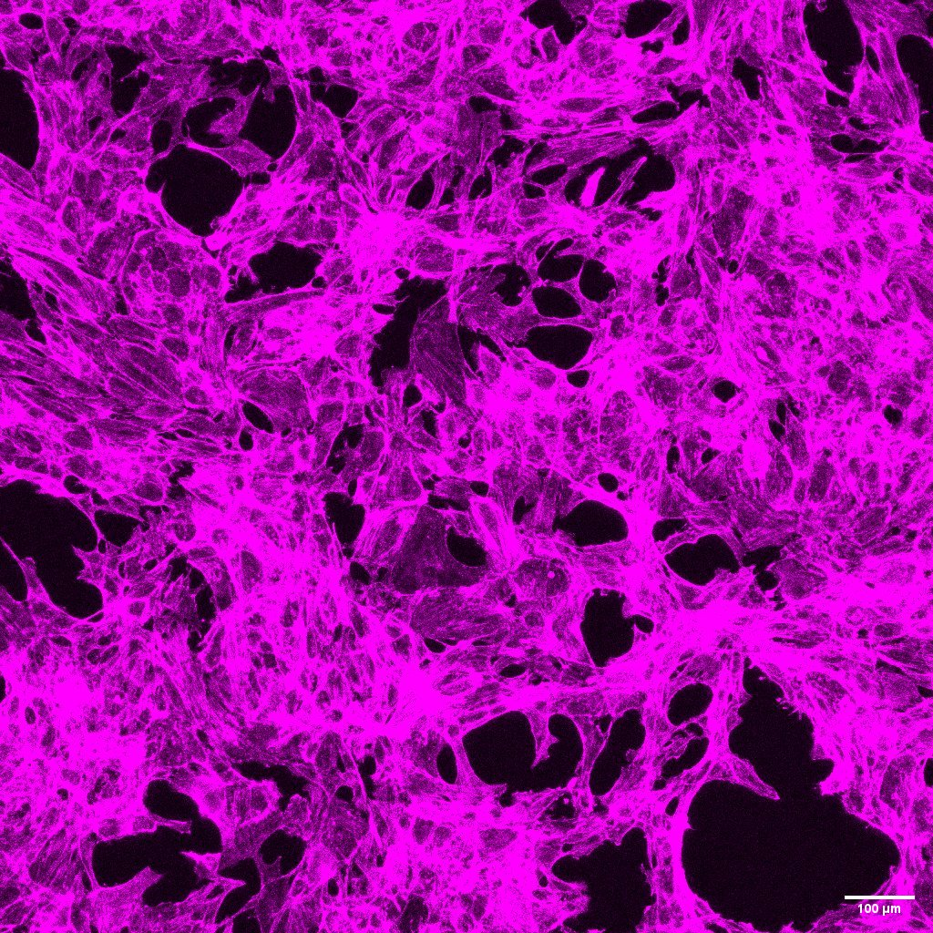
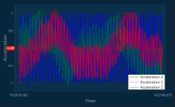
The Impact of Microgravity on Vascular Network Formation
Matthew Ryan, Haley Royce, Dr. Linqing Li
Department of Chemical Engineering and Bioengineering, University of New Hampshire
Introduction
Dextran Hydrogel Chemistry and Rheology
Microgravity Day 1 Results
To enhance quality of life for mission staff and long-term space exploration, it is essential to understand the effects of microgravity on molecular biology, the vascular system, and new blood vessel development.
Health issues arising from gravity differences include difficulty maintaining healthy blood pressure, significant loss of bone and muscle mass, and changes leading to vison problems, dehydration, and kidney stones.
This project aims to investigate the impact of microgravity on the regulation of endothelial cell behavior.
The polysaccharide dextran was methacrylated for photocrosslinking to increase mechanical stiffness.
Once methacrylate groups were added via glycidyl methacrylate, samples were lyophilized and resuspended in Medium 199 and Igracure Photoinitiator before UV crosslinking for up to 240 seconds.
Higher dextran concentration and longer UV exposure increased shear stiffness.
.25 FN
.5 FN
Preliminary results show increased stress on actin fibers and cell elongation in the microgravity environment.
The formation of ring-like structures shown in the bottom images suggests physiological changes to counteract the effects of altered mechanical forces.
.25 FN
.5 FN
Qualitative Analysis of Soft and Stiff Dextran Hydrogels
Conclusions and Future Work
RPM Fabrication
Due to the elevated temperature and humidity conditions required within the incubators for optimal cell growth, the motors experienced a failure after the initial 24-hour period.
As higher temperature and humidity resistant motors are integrated into the RPM assembly, cell studies will be repeated with varying levels of fibronectin concentrations at .1, .25, and .5 mg/mL.
Future experimental variables include the application of an alternative ECM coating, collagen, in addition to the incorporation of three-dimensional dextran hydrogels.
The 3D clinostat, known as a random positioning machine, or RPM, has been previously used to create a microgravity environment for mammalian cell culture.
The device was modeled on SolidWorks and 3D printed with a Bambu X1 Carbon Printer.
The RPM is made of two perpendicular frames that rotate independently of each other. Cell culture dishes are placed in the sample holder in the center of the inner frame.
Day 1 Soft
Day 1 Stiff
Day 1 Soft
Day 3 Soft
Day 3 Stiff
Cells do not attach directly to the dextran hydrogel.
Extra cellular matrix proteins shown above support cell adhesion and proliferation.
The hydrogels were coated in RDG, a peptide in fibronectin to improve cell attachment.
Soft and stiff 86kDa 70% DexMA hydrogels were prepared.
Soft gels: UV crosslinked for 60s, DexMA concentration of 30mg/mL
Stiff gels: UV crosslinked for 240s, DexMA concentration of 50mg/mL
These soft/stiff gels were used to determine hydrogel stiffness-dependent cell behavior.
Acknowledgements
Microgravity Validation
This research was supported by Haley Royce, Dr. Linqing Li, the Department of Chemical Engineering and Bioengineering, NH BioMade as funded by NSF Award #IIA 1757371 administered by NH EPSCoR at UNH, the NH Space Grant Consortium, and NASA Cooperative Agreement 80NSSC20M0051.
A WIT MOTION accelerometer was used to validate the microgravity environment.
As the RPM spins in various random, offsetting directions, the device continuously tracks the resulting accelerations, producing the acceleration over time graph below.
Results are shown below indicate that the average acceleration in the x, y, and z axes is effectively zero, confirming the microgravity environment.
Varying Fibronectin Concentrations
.25 FN, Day 1
.25 FN, Day 3
.5 FN, Day 1
.5 FN, Day 3
References
[1] Ingber, D. E. (2002). Mechanical Signaling and the Cellular Response to Extracellular Matrix in Angiogenesis and Cardiovascular Physiology. Circulation Research, 91(10), 877–887.
[2] Space Biology Program | Science Mission Directorate. (n.d.). Science.nasa.gov. https://science.nasa.gov/biological-physical/programs/space-biology
[3] Herranz, R., Anken, R., Boonstra, et al. (2013). Ground-Based Facilities for Simlation of Microgravity: Organism-Specific Recommendations for Their Use, and Recommended Terminology. Astrobiology, 13(1), 1–17.
[4] Bellis, S. L. (2011). Advantages of RGD peptides for directing cell association with biomaterials. Biomaterials, 32(18), 4205–4210.
-0.064137529 | 0.02590676 | -0.037969697
x | y | z
HUVEC (endothelial) cells were seeded on 86kDa 70% DexMA 30mg/mL 90s UV crosslinked gels coated with .25 and .5mg/mL fibronectin. This was performed under normal gravity as a control for comparison with the microgravity samples.

