Slide 1
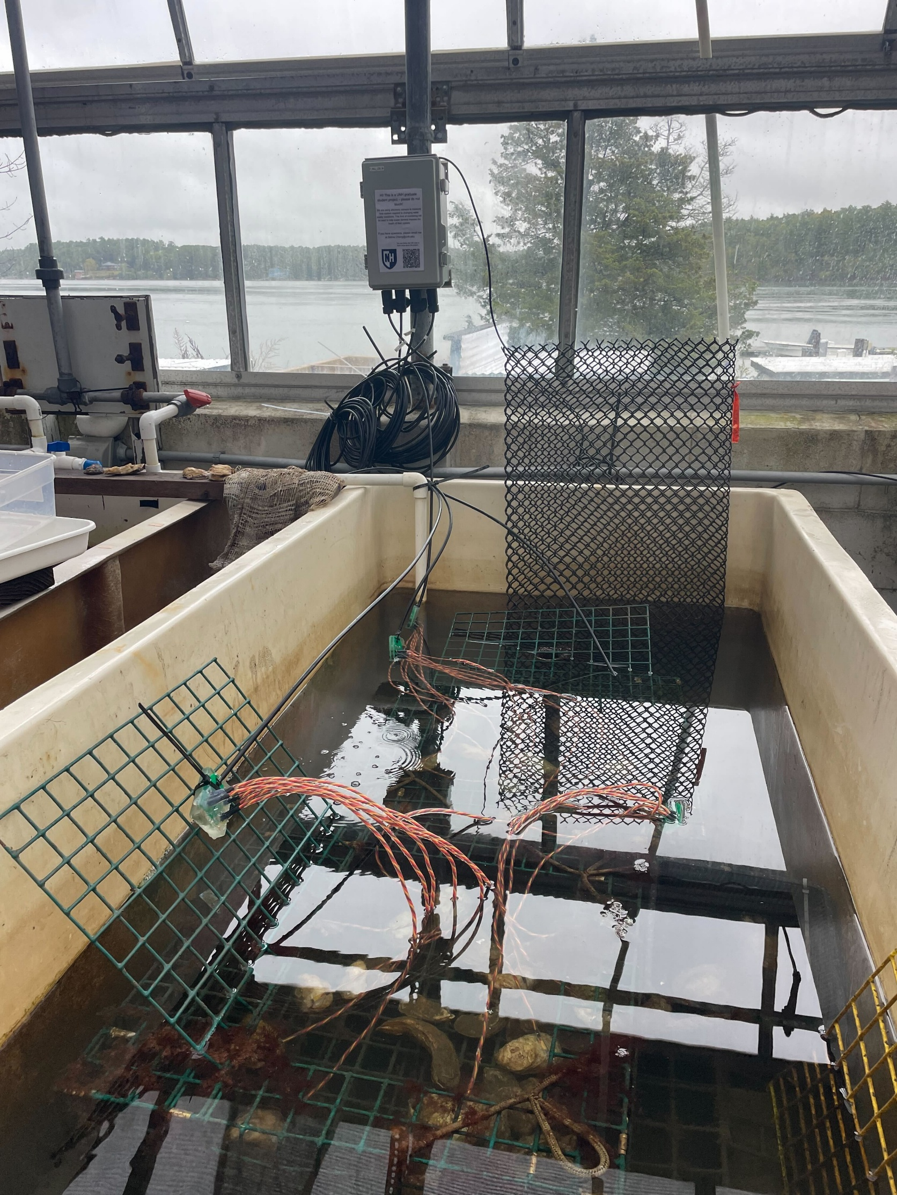
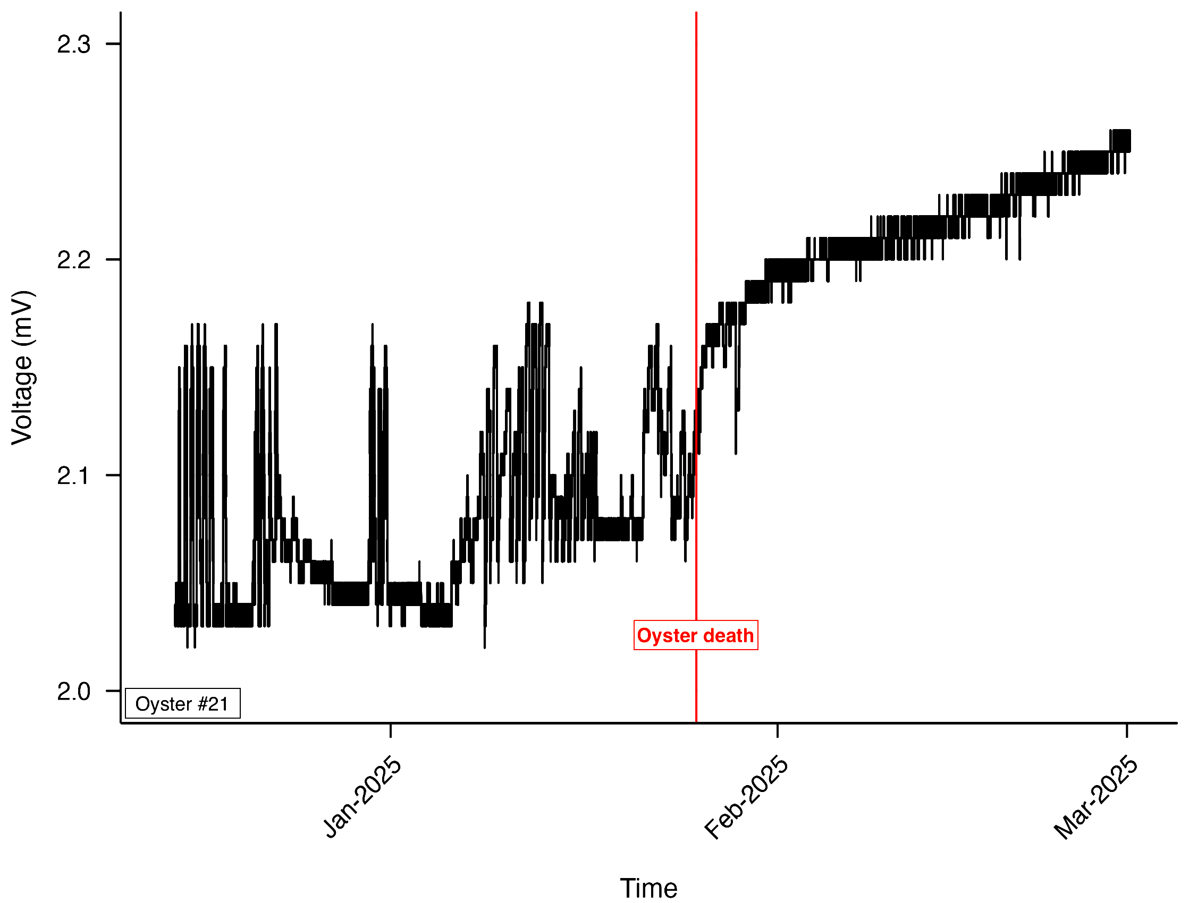
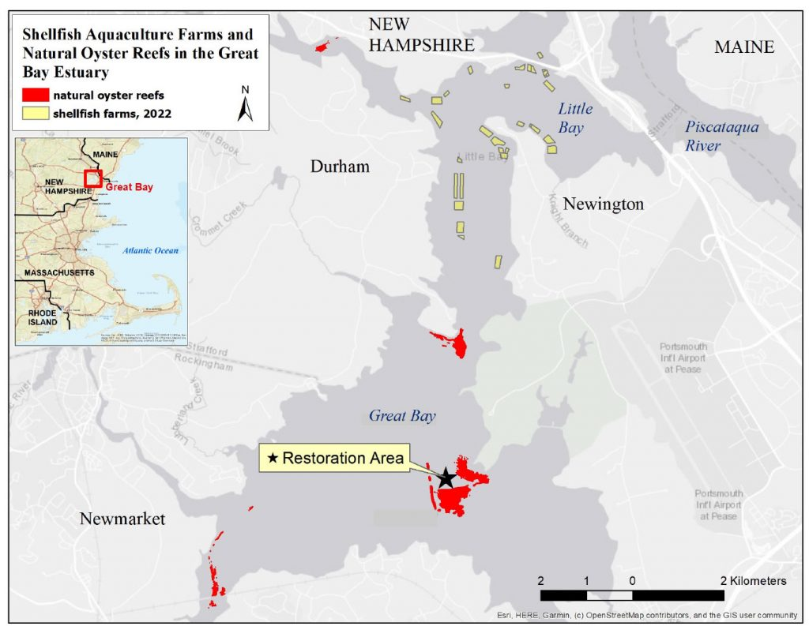
Real-Time, Wireless Monitoring of Oyster Behavior Internet-of-Things Integration for Remote Sensing Adam Hookway Department of Mechanical Engineering, University of New Hampshire
New Frontiers of Data
The OysterBoss System
Why Oysters?
Data collection has always been labor intensive and limited by cost and technology available.
As technology improves, researchers have had the opportunity to collect more specialized and typically enigmatic data relevant to their field of study.
Today, many investigators are paying large businesses thousands of dollars for specialized equipment, though expanded functionality and application come at a large cost if available.
To directly monitor oyster health, we created a system to measure oyster opening and closing (“gaping”) behavior in real-time using high frequency electronic sensors. This behavior is indicative of feeding, waste disposal, respiration, and responses to predation and other stressors.
Researchers at the University of New Hampshire are currently investigating the feasibility of ecosystem monitoring via behavioral data collected from oysters, clams, and other bivalves. By studying the filter-feeding tendencies, the researchers of the Quantitative Marine Ecology Lab hope to better evaluate water quality among other environmental areas of concern.
Functions: | Specialized Deployment:
Monitoring bivalve activity. Remote sensing. Real-Time monitoring. Onboard water quality monitoring. Power Independent. | Designed to monitor oyster farms, sometimes up to 300m offshore. LoRa radio transmitting allows for remote and power scarce deployment. Network-meshing provides reliable and redundant communication. Cellular service using LTE-M and NB IoT provides cheaper installment for single-system locations.
Internet of Things Integration
The Internet of Things is a network of interconnected sensors and collection arrays that allow for users to collect and send data over the internet. This allows for:
Live monitoring
Cloud based data storage
System reliability
Data from the comfort of home
Systems utilizing IOT functionality are more specialized and allow for simpler data harvesting than expensive alternatives. They are so accessible that they can be designed, built, and programed by the researchers themselves.
Progress
Oysters are a focus of restoration efforts and aquaculture operations in New Hampshire, with >50 acres of restored reefs and >100 acres of oyster farms. Oyster aquaculture has grown rapidly in the last decade, with a 550% increase in the value of oyster farms in New Hampshire from 2014-2024.
Firmware architecture and buoy system
are still under development. Successful
integration of sensors has allowed for
limited indoor data collection. Monitoring functionality has shown to provide practical data being process by UNH Graduate Student Selina Cheng under the direction of Dr. Easton White.
References
.
-Projects. NH Shellfish Farmers Initiative. (2022, March 5). https://nhsfi.com/projects/
-New Hampshire Sea Grant. (2025, April). Oysters. University of New Hampshire. https://seagrant.unh.edu/our-work/aquaculture/oysters

