Slide 1
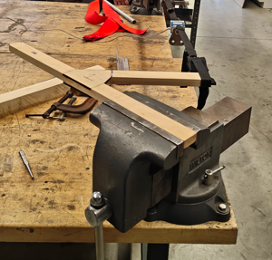
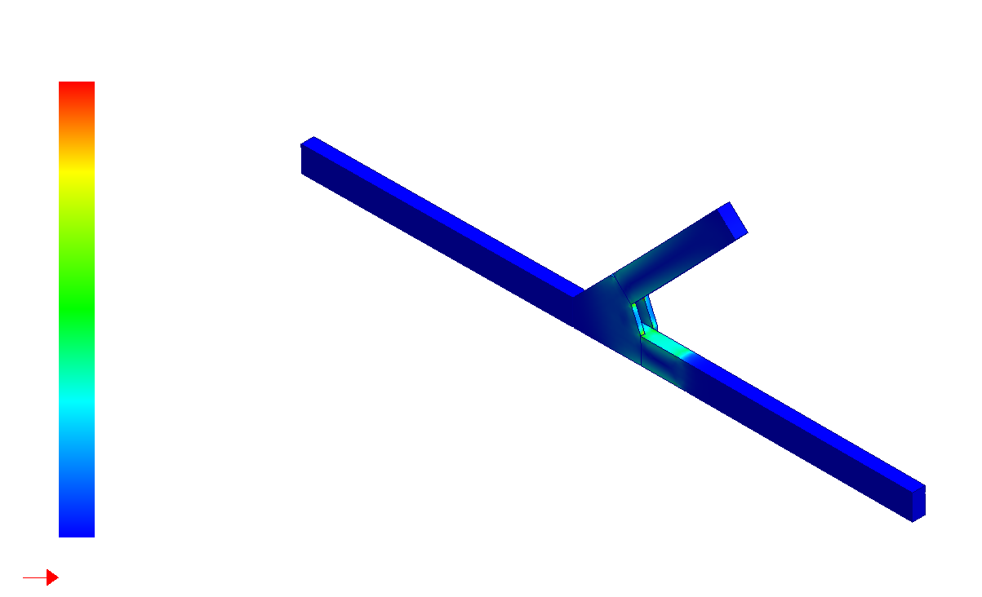
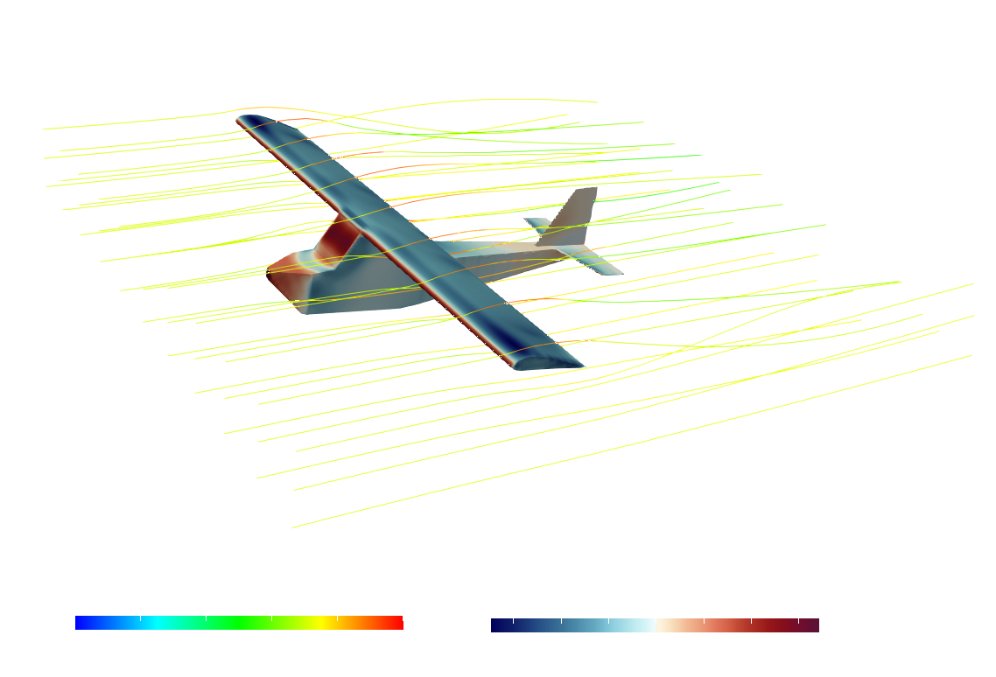
ULTRALIGHT PROJECT
Mechanical Engineering, University of New Hampshire, Durham, NH 03824
Marcus Herold, Seth Chartier, Philip Mather, Ethan Tillinghast, Brian Viscido
Faculty Advisor: Dr. Ivaylo Nedyalkov
Our Mission
Material Challenges
Driven by a commitment to innovation and sustainability, our undergraduate team combined hands-on engineering, modeling and experimentation, becoming the first in the world to successfully design, build, and fly a manned electric ultralight aircraft. As one of the last major modes of transportation to electrify, aviation is on the verge of transformation — and we aim to be at the forefront of that change.
Kevlar Rigging
King Post
Experimental
Computational
Wings rigged with 400lb Kevlar to transfer load from wing to frame.
Custom pulley design 8x multiplies forces to tension wings.
Major Constraints
Gusset Type | Breaking Force
 | Analytical (lbs) | Experimental (lbs)
45° Inset | 65.0 | 127.3
45° Outset | 57.2 | 167.7
90° Inset | 43.5 | 220.5
90° Outset | 47.5 | 136.6
Conclusions:
All experimental joints required a higher breaking force than SolidWorks predicted.
Inset and outset gussets proved to require comparable breaking forces
Adhere to all legal requirements.
254 lbs weight limit
24 knots maximum stall speed
55 knots max speed
Aircraft must take off under its own power.
Aircraft must not experience any structural damage at any point during flight.
All critical components rated to 2.5g load with 1.5 FOS.
Wings
Epler 1210 profile cut from foam and fiber glassed. Two aluminum spars for strength.
Empennage
Constructed from pine wood. Adhered together with glue, laser cut gussets and wood screws.
Weight Budget
Flight Plans
Landing Gear
Bungee design allows for smooth landing and adjustable tension.
Fuselage
Item | Weight (lbs)
Fuselage | 65
Wings | 70
Power System | 61
Empennage | 34
Miscellaneous | 22
Total | 252
Met weight constraint with 2lbs to spare.
Sky Haven Airport Rochester, NH
Wright-Brother’s style flight
Winds < 10 kts, <5 kts crosswind component, no precipitation, daylight
¾” cold-rolled steel welded in house.
Power System
20-kW Motor
111 Nominal Voltage Battery
VESC Speed Controller
Pilot
Analysis
Experimentation
Certified Pilot Zack Yeaton.
205 Flight Hours
Instrument Rated
Experience flying many aircraft styles including traditional and taildragger configurations.
Dynamic Thrust Testing
Data collected from a calibrated load cell to evaluate performance of various motor-prop configurations.
A range of speeds and power settings were used to characterize thrust output under dynamic operating conditions.
CFD Analysis
Varying angles of attack analyzed
In and out of ground effect flow
Covered and uncover fuselage
Conclusions
110 lbf of drag
450 lbf of lift
Acknowledgements
Advisor: Ivaylo Nedyalkov
TSC workers: Scott Campbell, Noah McAdam, Kevan Carpenter
CEPS Dean: Erin Bell
Department Chair: Christopher White
Professionals: Todd Scruton, Jeff Sullivan
Academic Provost: Cyndee Gruden
UNH Legal: Karyl Martin, Debbie Grotheer
Impact Load Analysis
Main landing gear designed to withstand 2.0 G landing
Energy balance used to calculate impact speed according to the FAA.
Wing Structural Testing
Wings loaded to 2.0 G’s to simulate worst-case in-flight conditions.
Observed no failure of Kevlar cords and no yielding or plastic deformation in aluminum spars.

