Slide 1

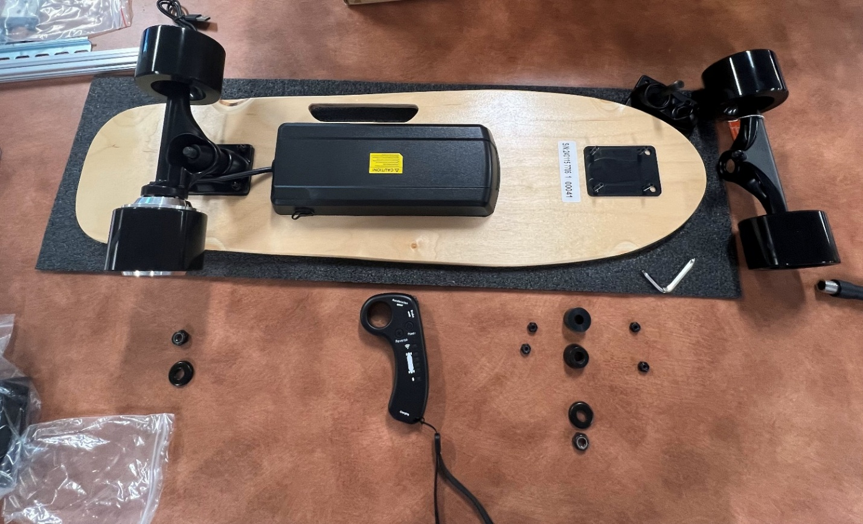
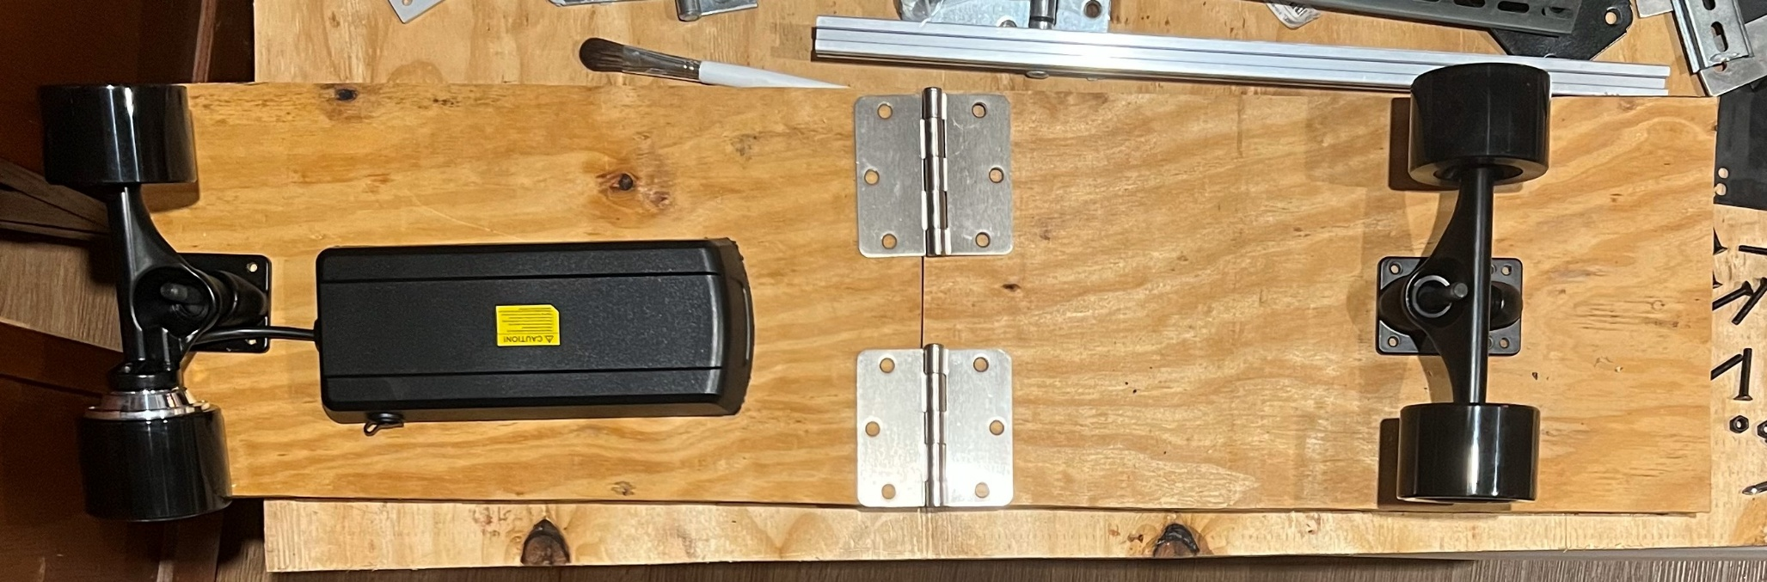
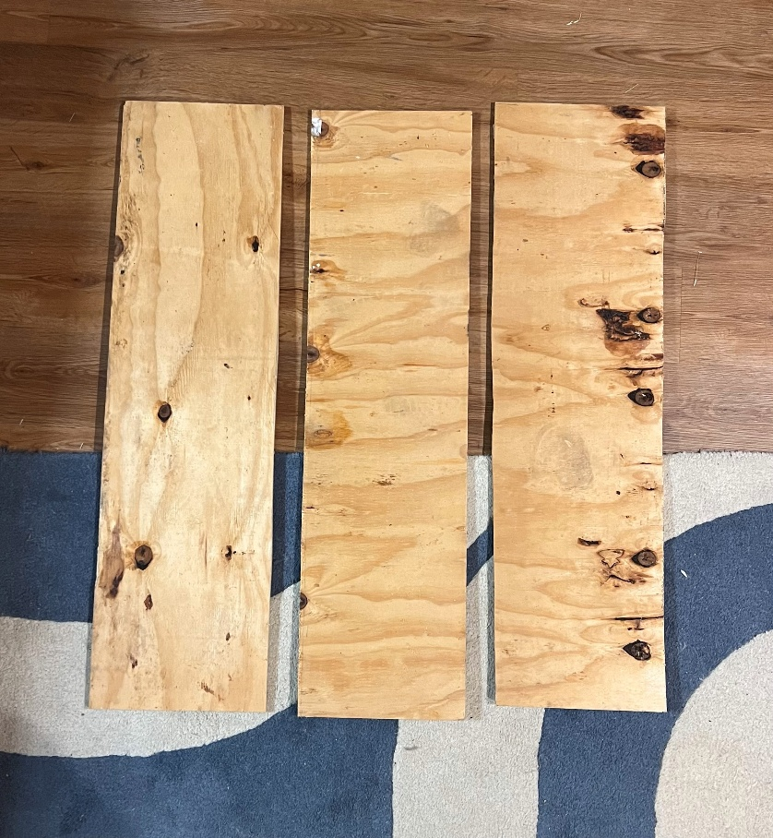
Trying to Navigate Campus in a More Compact Way
Martin MacLean
Advisor: Benjamin Mitchell
Department of Innovative Scholars University of New Hampshire
Background
Methods
Components of the Project
Background: Transportation on campus has always been an important part of a student’s life. With plenty of students either using an electric scooter, skateboard, normal skateboard, or even just walking.
Problem: The main issue with any option besides walking is what to do with your transportation after you’ve gotten to your destination, with people either needing to awkwardly carry it around or leave it outside to potentially be taken.
Solution: Now the solution to this would be to produce a form of transportation that could become easy to transfer or hold onto when not in use, thus the idea of an electric foldable skateboard was born.
The electronic components and wheels were taken from a cheap electric skateboard in order to save on cost and time when it comes to assembly
The board was fabricated by taking three thin boards of wood and adhering them together using liquid nail in order to have a strong and uniform board
After producing the board, it was cut horizontally down the middle, where hinges were screwed in to allow it to fold, and metal sleeves were fabricated and attached on the underside of the board to allow a metal bar to be placed when the board was in use to maintain strength and avoid the board folding when being used.
Here can be seen the original board that was taken apart to use its electronics for the board, the three, inch thick, individual pieces of wood used to assemble the board that would be used for the final product, and the draft of what the final product would look like. These images show the process that went into the construction for the foldable skateboard.
Original store-bought board
Draft of the final product
How Does it Compare?
Results
If compared to that of a normal store-bought skateboard, not much is lost in terms of speed for the board as its able to use the same power and wheels that were used on a fully produced electric skateboard.
Some speed was lost as the board needed to weigh more to support a human’s weight and some core strength is lost to be able to fold.
The finished result for the skateboard was 36 inches long by 9.75 inches wide when fully extended and about 17.5 inches long when folded in half. It was able to be folded in order to maintain a smaller profile, thus being able to be easier to carry and even be put into a backpack
The three boards that were glued together

