Slide 1
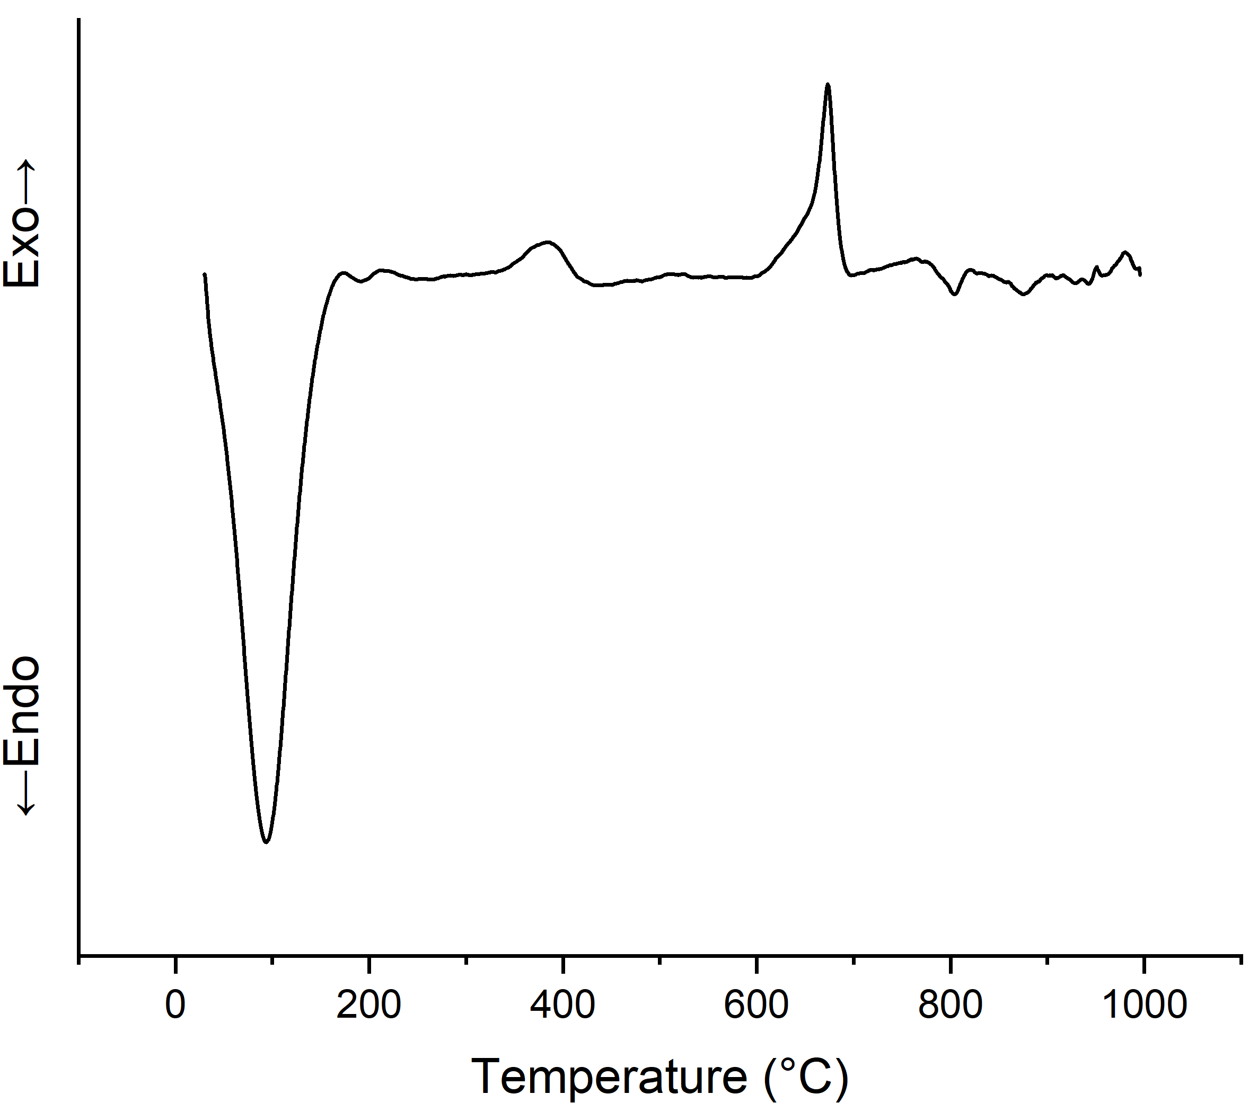
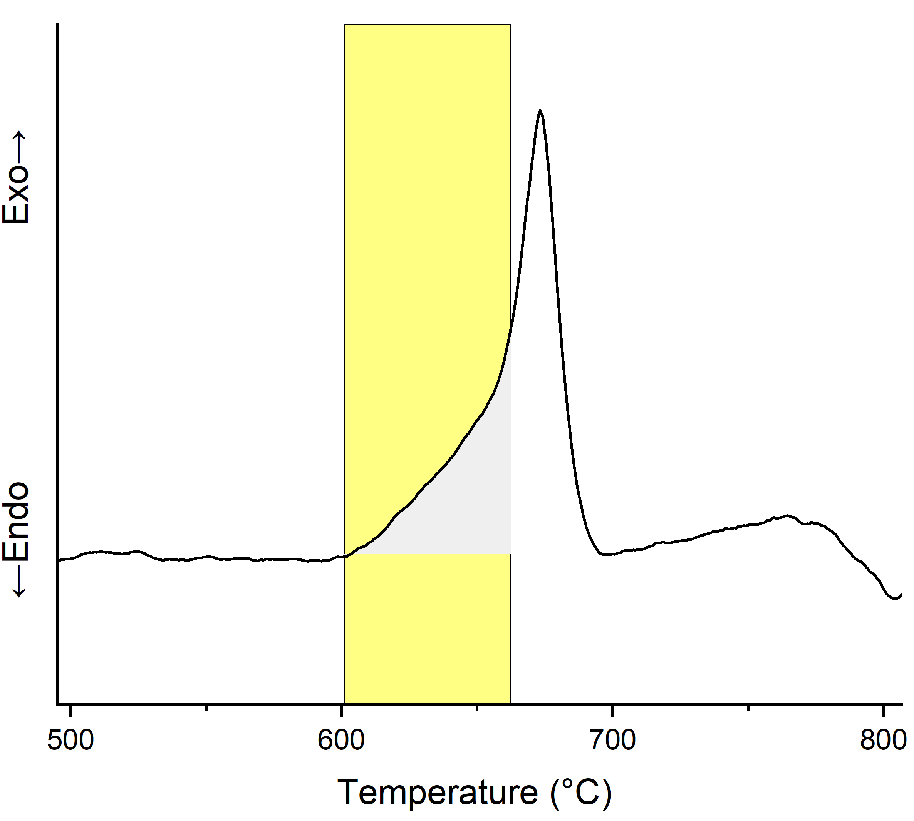
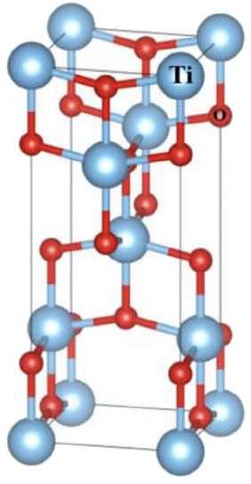
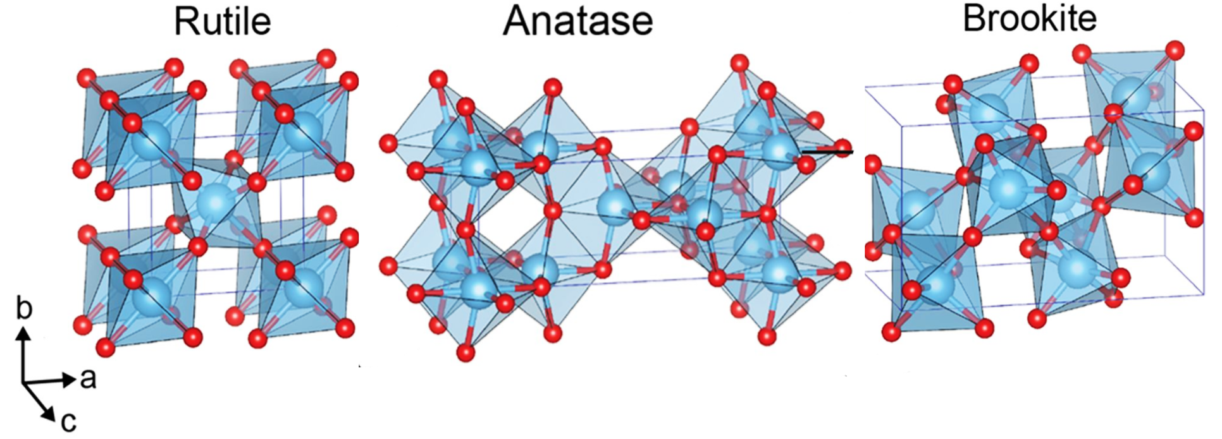
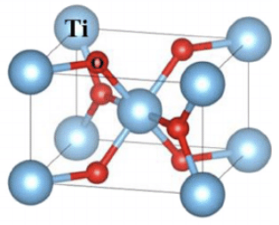
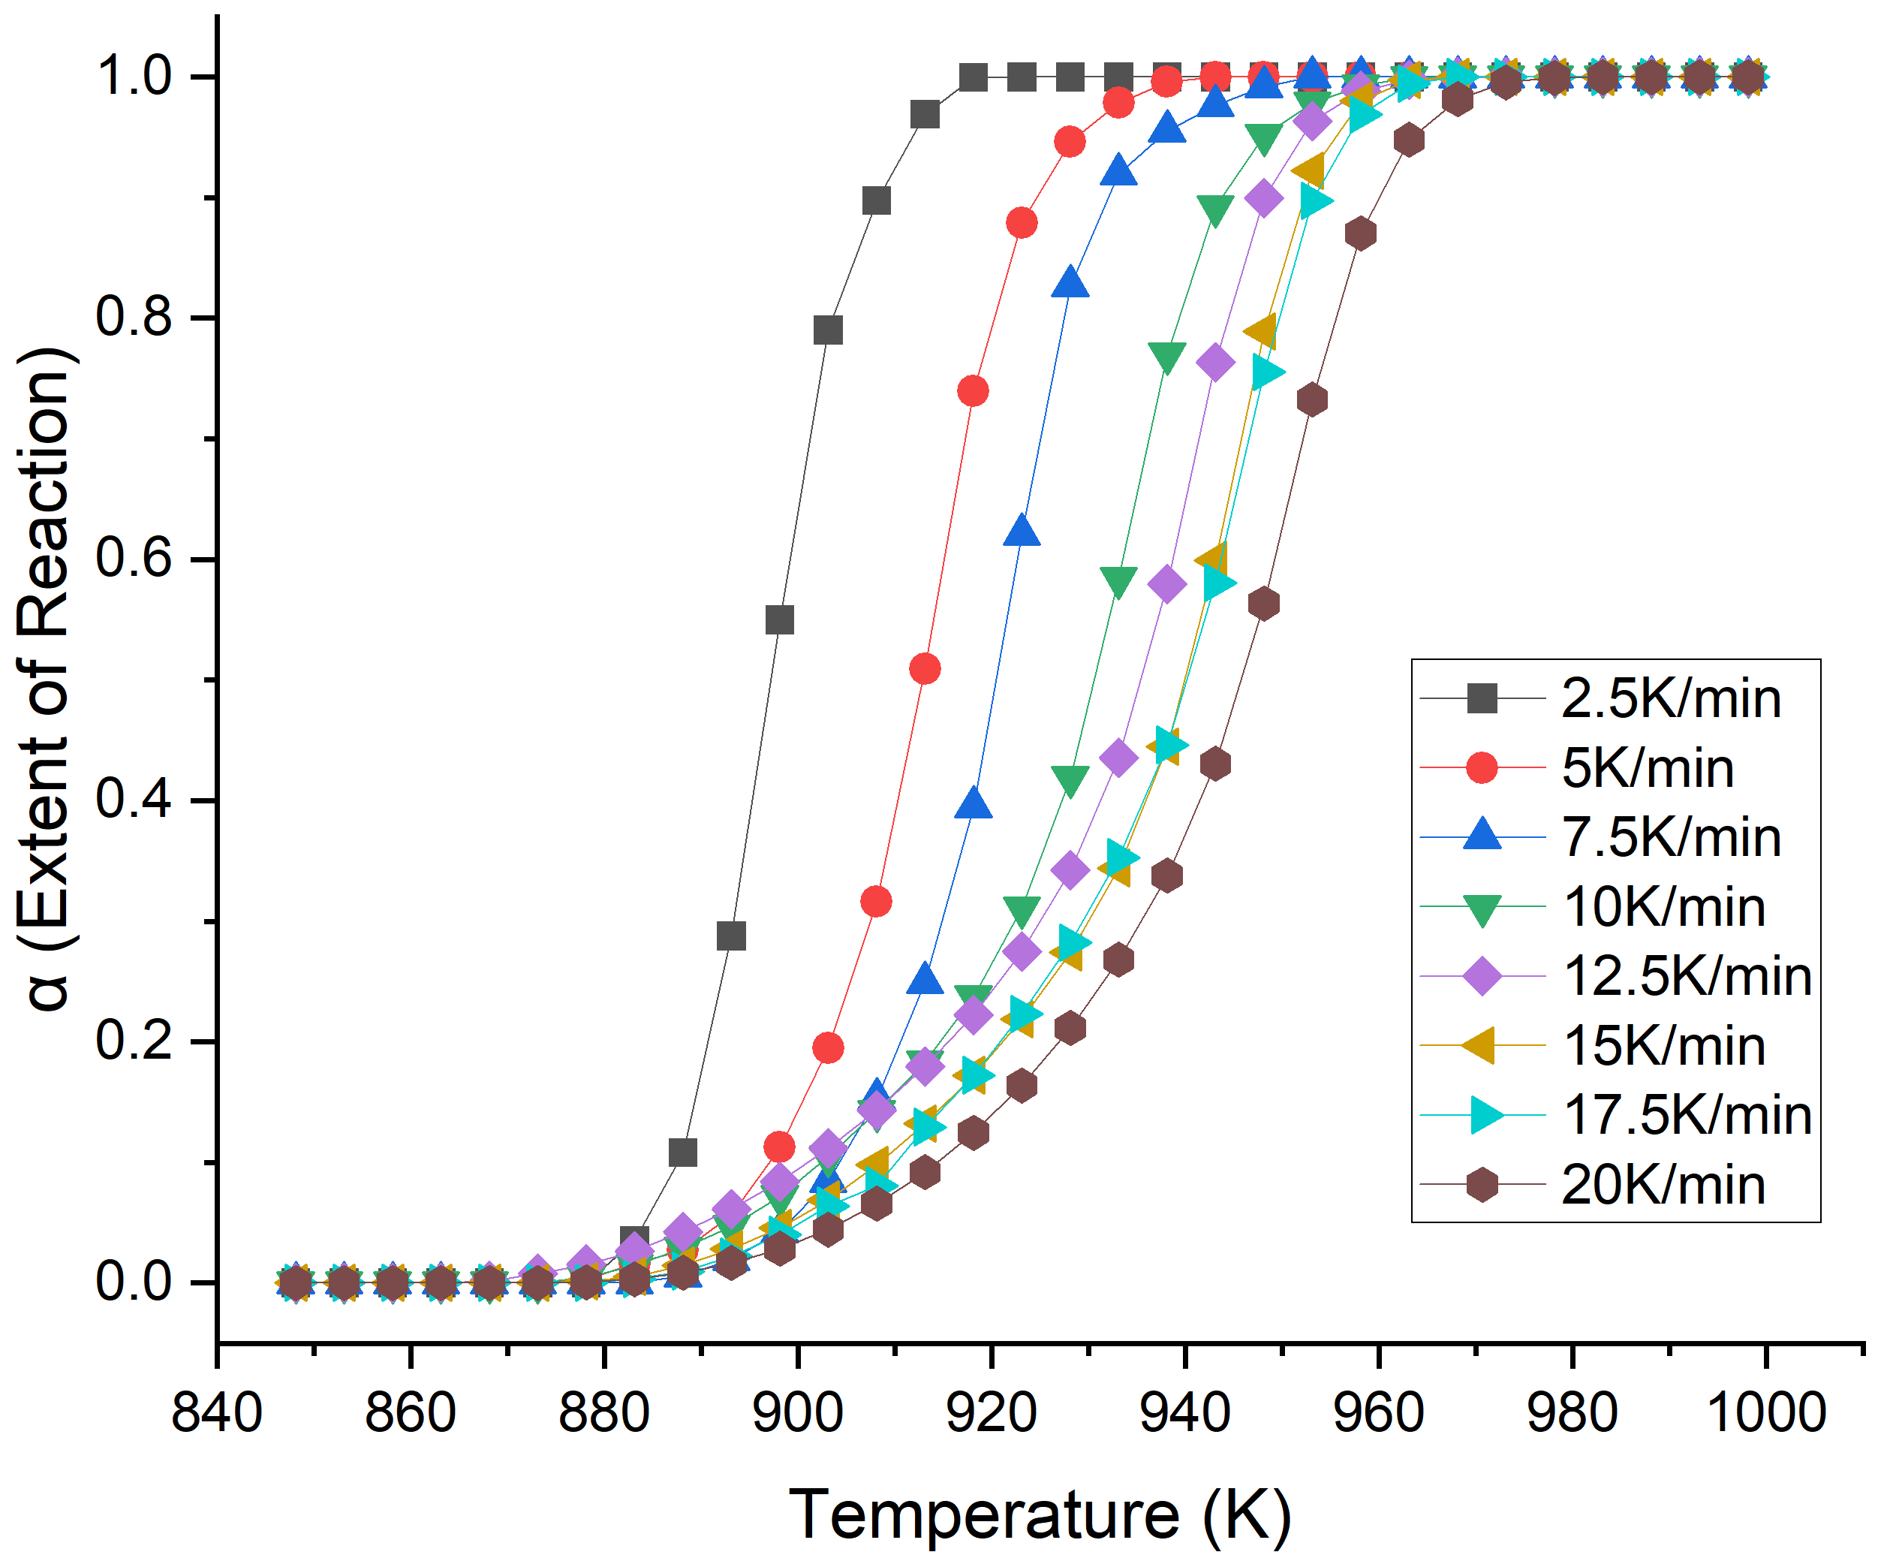
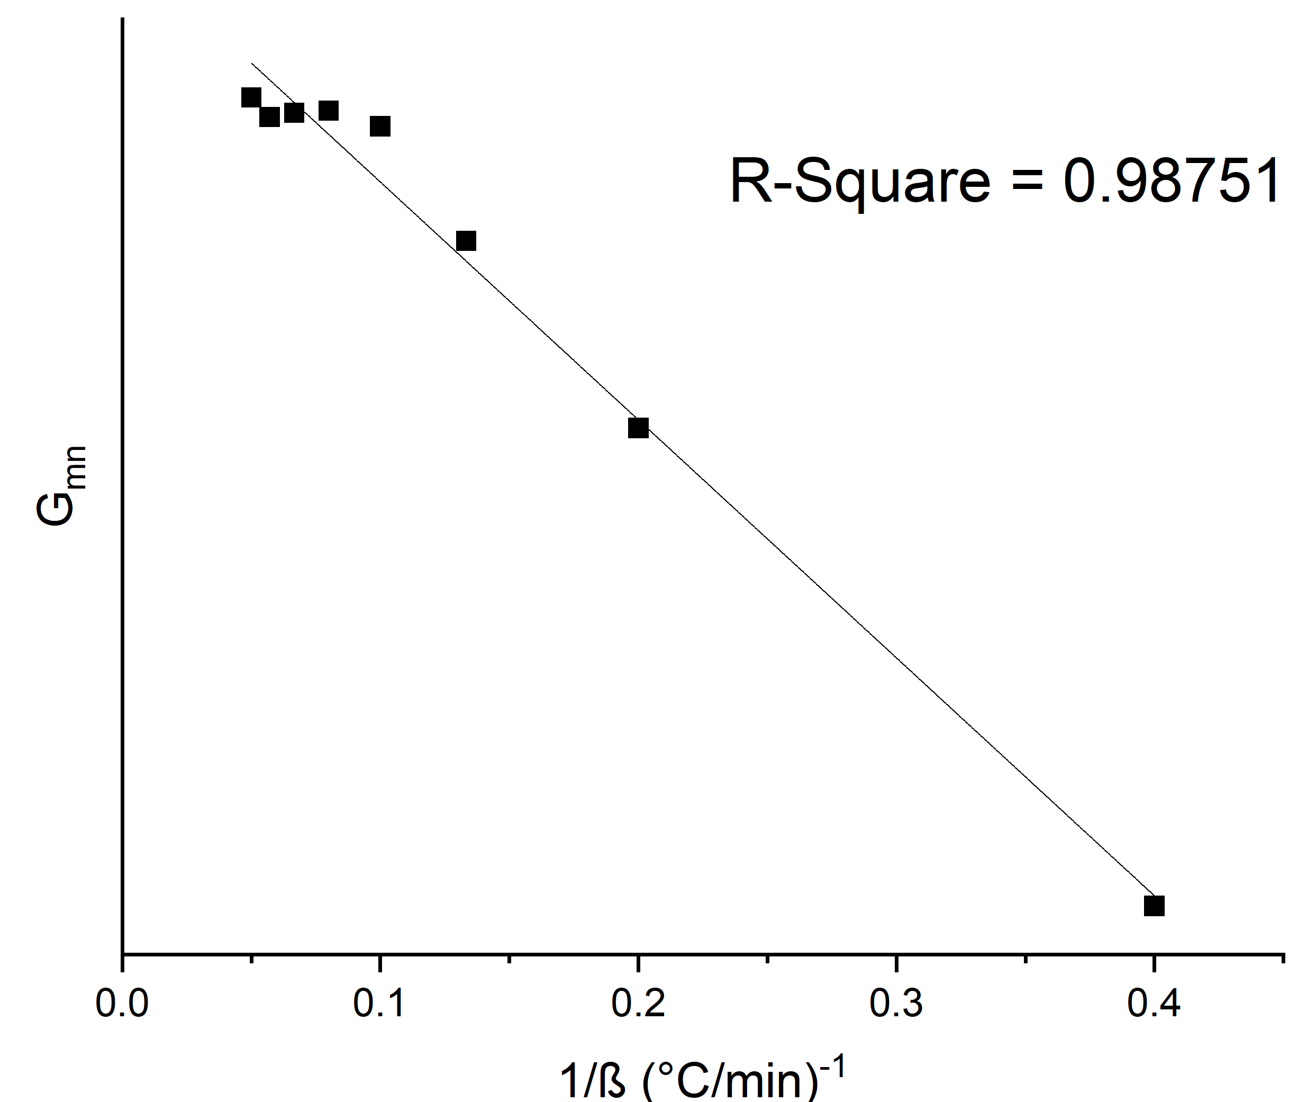
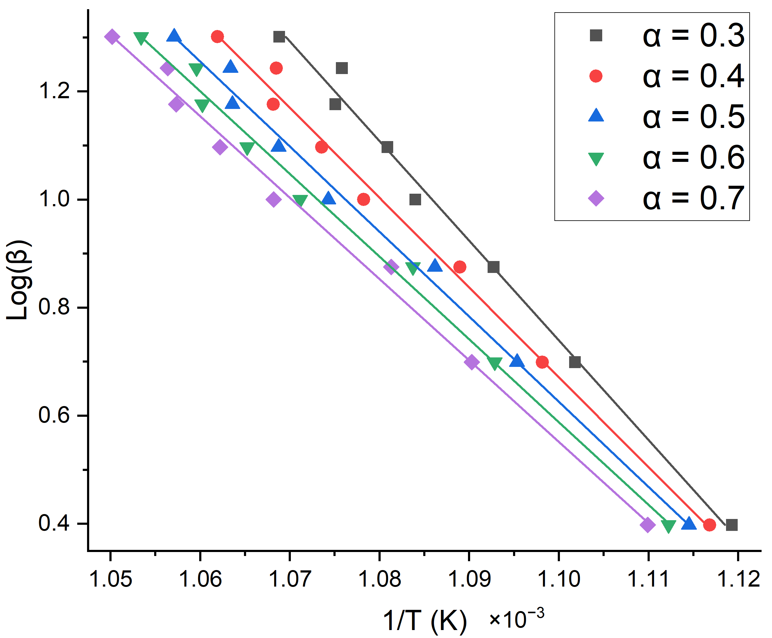
Kinetics of the Anatase - Rutile Transition William Steere, Seth Drahusz, and Dr. Nan Yi Department of Chemical Engineering and Bioengineering, University of New Hampshire, Durham, NH 03824
Introduction
Determining Extent of Reaction
Results
Titanium Dioxide (TiO₂) is a robust catalyst:
Cost-effective
High chemical stability
Versatile use in photo- and thermal-catalysis
Integration of exothermic transition peak
Average pre-exponential factor:
$$1.80×{10}^{15} (\min^{−1})$$
Kinetic Model: Avrami-Erofe’ev equation (n=1.5)
$$g\left(α\right)={\left[−ln⁡(1−α)\right]}^{\frac{2}{3}}$$
$$α=\frac{A(T)}{A_{Total}}$$
Average activation energy:
$$293.2{kJ}/{mol}$$
Anatase
Rutile
Phase transitions are transitions between internal morphologies^{[1]}
Elevated temperature instigates the Anatase-Rutile Transition (ART)
This study investigated the kinetics of the ART process to better understand TiO₂ catalysts
Kinetic Modeling
Arrhenius relationship
Avrami-Erofe’ev mechanism
Summary
Methodology
Anatase TiO₂ transitions to Rutile TiO₂ under elevated temperature conditions
Anatase-Rutile transition is an exothermic process
ART process follows a nucleation and nuclei growth mechanism
Potential error exists in early alpha values, incentivizing additional analysis
The kinetic mechanism provides insight into the applications of TiO₂
TiO₂ Support Synthesis^{[2,3]}
Sol-Gel synthesis using TTIP precursor
Differential Thermal Analysis (DTA)
Average sample weight: 20 mg
8 heating rates: 2.5 – 20 $\frac{℃}{min}$
Temperature scanning range: 25$℃ −$ 1000 $℃$
Activation Energy & Pre-exponential Factor
OFW relationship
E_{A} formula$:$
$$E_{a}=Slope×\left(\frac{−1.987}{−0.4567}\right)\left(\frac{4.184}{1000}\right)$$
Pre-factor A formula:
$$A=\frac{{10}^{Intercept}×1.987×g\left(α\right)}{E_{a}(cal./mol)}$$
Example calculation: $α=0.4$
$$E_{a}=−16495×\left(\frac{−1.987}{−0.4567}\right)\left(\frac{4.184}{1000}\right)=300.1\frac{kJ}{mol}$$
$$A=\frac{{10}^{18.82}×1.987×0.639}{71767}=1.2×{10}^{14} \min^{−1}$$
Acknowledgements
Data Evaluation
UNH Hamel Center for Undergraduate Research and Darcy Silver
Extent of Reaction $(α: 0.3−0.7)$
Temperature - $α$ relationship
Arrhenius Parameters^{[4]}
$g_{mn}=\int_{α_{m}}^{α_{n}}{{dα}/{f(α)}=\frac{1}{β}I_{mn}=\frac{A}{β}\int_{T_{m}}^{T_{n}}{e^{{{−E}_{a}}/{RT}}dT}}$
Ozawa-Flynn-Wall (OFW) method^{[4]}
$log\left(β\right)=log\left(\frac{AE}{Rg(α)}\right)−2.315−0.4567\left(\frac{E_{a}}{RT}\right)$
References
[1] Materials 2023, 16, 2731
[2] J. Mol. Catal. A, 2005, 225, 203-212
[3] J. Inorg. Organomet. Polym. 2020, 30, 4829–4846
[4] Ind. Eng. Chem. Res. 2008, 47, 7211–7218
Notes:
Activation energy significance speak more on
Extent of reaction equation

