Slide 1


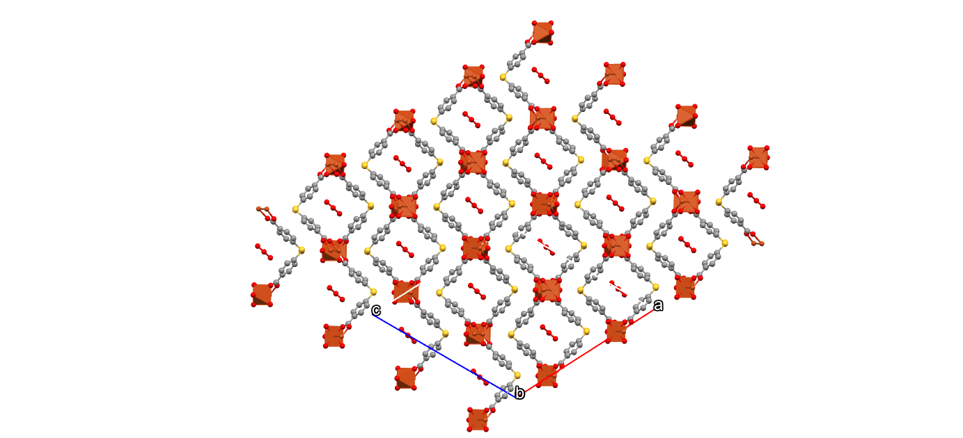
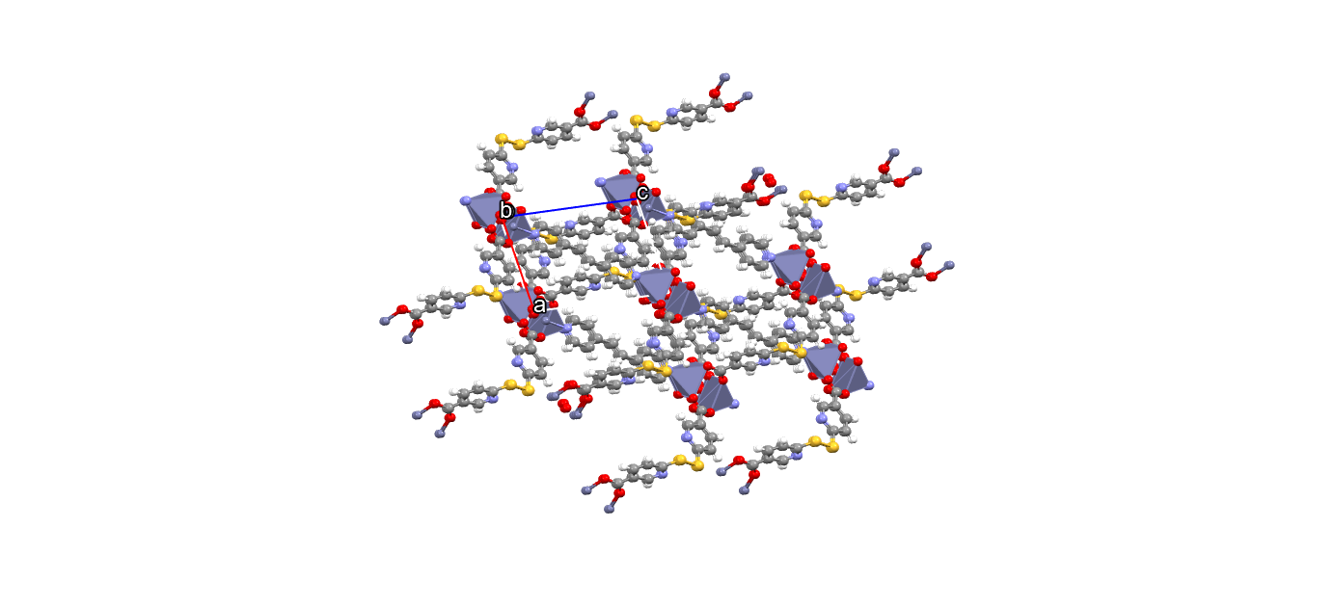
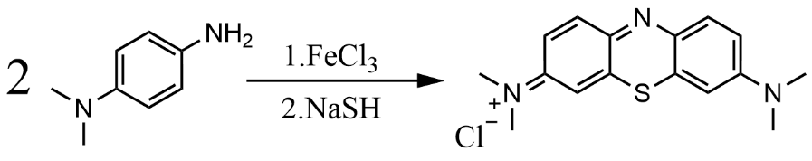
Development and Characterization of Hydrogen Sulfide
Releasing Frameworks for Therapeutic Remediation
Connor Foley*, Anthony Traficante, Aylin Aykanat
Department of Chemistry, University of New Hampshire, Durham, NH 03824
Introduction
Experimental Design
Result
Hydrogen sulfide, H₂S, has been discovered as the third biological gasotransmitter, possesses astounding antioxidant and anti-inflammatory properties.^{[1][2]} Metal organic frameworks (MOFs) consist of porous cells capable of being loaded with chemotherapeutics. Glutathione (GSH) is produced in the 1000-fold proximate to malignant cancerous cells, MOF’s containing disulfides can interact and break with the free thiol group in glutathione, acting as a trojan horse for drug delivery.
664nm
291nm
613nm
Fig.1, Beneficial and Noxious Effects of H₂S
Fig.2, UV-Vis of Methylene Blue
Fig,4 Mechanism of Disulfide Cleavage to produce H₂S
Fig. 11, Calibration Curve of H₂S Detection via Methylene Blue Formation
Experimental
[Cu₂((O₂CPHS)₂)₂(H₂O)₂]_{n}
[Zn₂(ddca)₂ (dpe)]_{n}·nH₂O
Future Work
[Cu₂((O₂CPhS)₂ )₂(H₂O)₂]_{n}: To a scintillation vial (40mL), Copper (II) Chloride (0.212g, 1.2mmol) was added alongside DMF (~8mL) and allowed to dissolve. In a separate scintillating vial (20mL), 4,4dithiobisbenzoic acid (0.356g, 1.2mmol) was dissolved in DMF (~8mL), then poured into the scintillating vial containing dissolved copper chloride and washed with additional DMF (8mL). Hydrochlroic acid (0.1M, 16mL) was added, the vial was capped and shaken for ~15 seconds, a white precipatate began to form. Solution was heated at 80°C for 22h, then purified via vacuum filteration and washed with DMF (3x30mL) and 95%
ethanol (3x20mL) to afford royal blue cubic crystals.
[ZnMOF): To a round bottom flask (50mL), Zinc Acetate (0.227g, 1.2mmol), 6,6 dithiodinicotinic acid (0.372g, 1.2mmol), 1,2 bis-(4-pyridyl) ethylene (0.221g, 1.2mmol), and DI water (70mL) were placed under sonication for ~30min, then placed in a teflon chamber and heated to 140°C in an
isothermal oven for 3d. Product was purified
via vacuum filteration and washed with
DI water (3x30mL) and 95% ethanol (3x30mL) to afford
brown crystals similar to iron oxide in color.
Methylene Blue Calibration Curve: A methylene
blue calibration curve was made in accordance with
the figure on the right. After equal addition of the
activator, precursor (DMPD N,N-dimethyl
-p-phenylenediamine) and corresponding diluted
NaSH stock, scintillating vials were placed on an
orbital shaker for ~20min then placed on
centrifuge for ~30min at 5000rpm.
Finally, UV-Vis absorbance was
taken at 675nm to quantifiably
detect methylene blue
generation and, in turn, H₂S
formation. This derived
calibration curve can be
used to detect H₂S
generation from disulfide
containing MOFs when
interacting with thiol
groups present in cysteine or
glutathione.
Due to the inconsistence present in the
calibration curve, it is theorized that
hydrogen sulfide generation occurs
rapidly and escapes from the vial
before interacting to form
methylene blue. If air free calibration
curve is proven inconsistent; fluorescence probes offer great quantization of H₂S
via fluorescent excitation and emission.^{[3]} Synthesis and characterization
Of 2-(maleimido)ethyl 4-pyrenylbutanoat (MEPB) probe will be conducted, then
used to quantified H₂S via fluorescent excitation. Although relatively new, this method offers both a higher LOQ and LOD, ^{[4]} essential for analysis of minute concentrations of H₂S.
Fig. 5, Synthetic Scheme of [Cu₂((O₂CPHS)₂)₂(H₂O)₂]_{n}
Fig. 8, Synthetic Scheme of [Zn₂(ddca)₂ (dpe)]_{n}·nH₂O
Fig. 12, Detection Scheme of H₂S via MEPB Excimer
Conclusion
After successful synthesis and characterization of several disulfide containing MOF’s and obtaining a methylene blue calibration curve with a sustainable R² = 0.9833, further refinement of the assay is needed to obtain a higher linear correlation factor >0.99. It is hypothesized that atmospheric oxygen may interfere with the calibration curve assay and an air free assay may prove more successful. Testing of disulfide containing MOFs, such as Zn(MOF) with GSH and cysteine have displayed values indicative of disulfide cleave and MOF degradation.
Acknowledgements
Fig. 6, PXRD of [Cu₂((O₂CPhS)₂)₂(H₂O)₂]_{n}
Fig. 9, PXRD of [Zn₂(ddca)₂ (dpe)]_{n}·nH₂O
I would like to give special thanks to the FEM group, Aylin Aykanat,, Anthony Traficante, Elise Hanley, Pat Strobel, Forde Kates, Lucas Laventure, Evan Kennedy, Eddie Gaffny Rebecca Lahousse, and my friends and family for their continuous support.
4,4 dithiobisbenzoic acid
6,6 dithiodinicotinic acid
References
[Cu₂((O₂CPhS)₂)₂(H₂O)₂]_{n}
[Zn₂(ddca)₂ (dpe)]_{n}·nH₂O
[1] Mandel, R. M.; Lotlikar, P. S.; Runčevski, T.; Lee, J.-H.; Woods, J. J.; Pitt, T. A.; Wilson, J. J.; Milner, P. J. Transdermal Hydrogen Sulfide Delivery Enabled by Open-Metal-Site Metal–Organic Frameworks. Journal of the American Chemical Society 2024, 146 (28), 18927–18937.
[2] Cirino, G.; Szabo, C.; Papapetropoulos, A. Physiological Roles of Hydrogen Sulfide in Mammalian Cells, Tissues and Organs. Physiological Reviews 2022, 103 (1)..
[3] (1)Pose, M.; Dillon, K. M.; Denicola, A.; Alvarez, B.; Matson, J. B.; Möller, M. N.; Cuevasanta, E. Fluorescent Detection of Hydrogen Sulfide (H2S) through the Formation of Pyrene Excimers Enhances H2S Quantification in Biochemical Systems. Journal of Biological Chemistry 2022, 298 (10), 102402–102402.
[4] Pose, M.; Dillon, K. M.; Denicola, A.; Alvarez, B.; Matson, J. B.; Möller, M. N.;
Cuevasanta, E. Fluorescent Detection of Hydrogen Sulfide (H2S) through the Formation of Pyrene Excimers Enhances H2S Quantification in Biochemical Systems. Journal of Biological Chemistry 2022, 298 (10), 102402–102402.
‌
Fig. 3, Methylene Blue Calibration Curve Assay
Fig. 7, IR of [Cu₂((O₂CPhS)₂)₂(H₂O)₂]_{n}
Fig. 10, IR of [Zn₂(ddca)₂ (dpe)]_{n}·nH₂O

