Slide 1


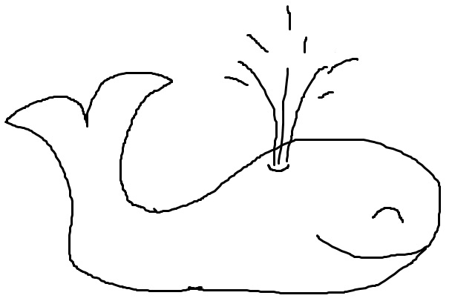
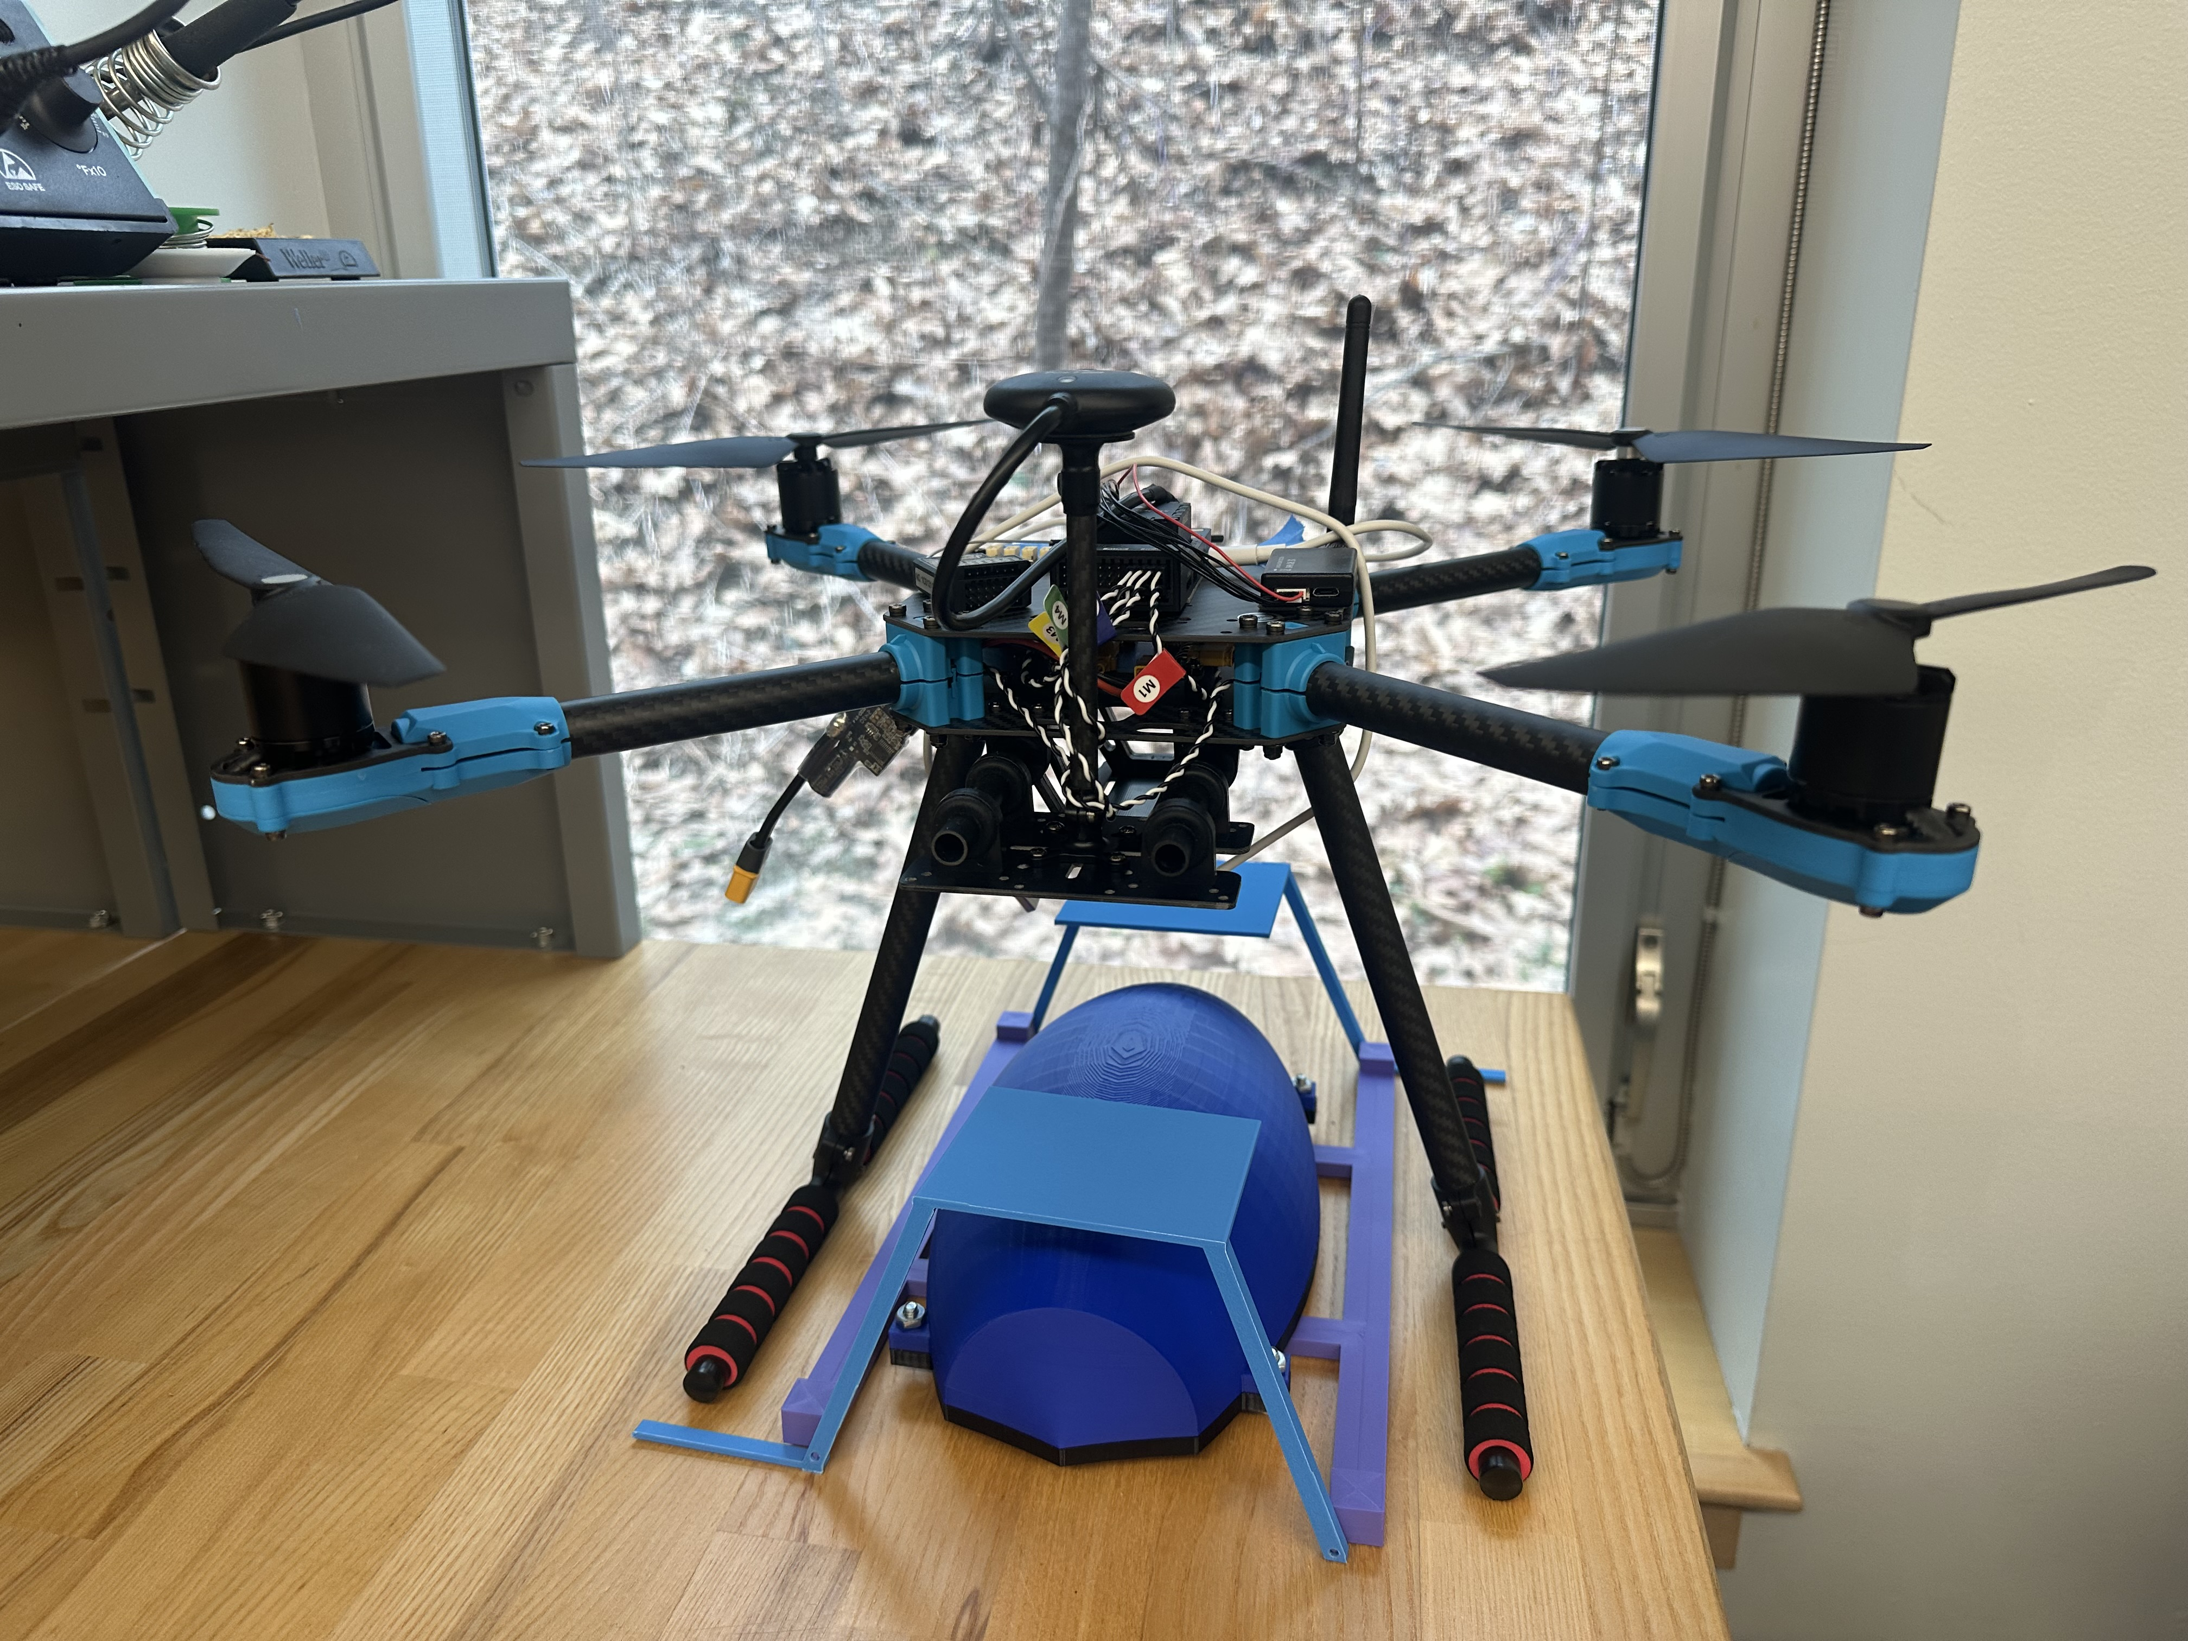
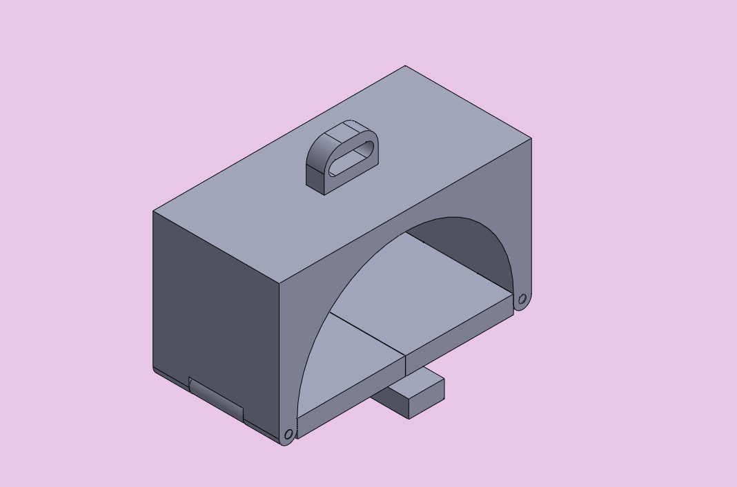
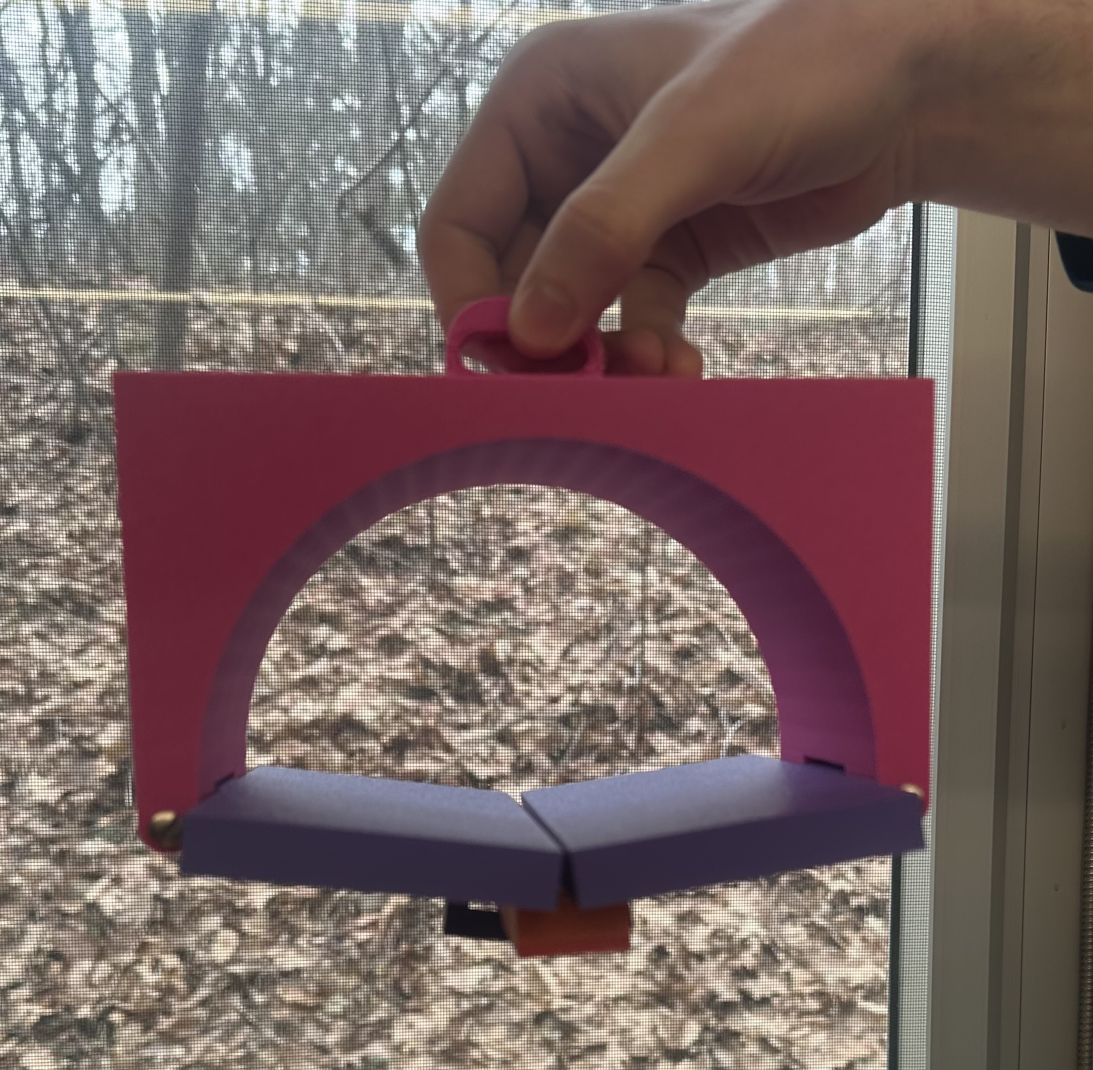
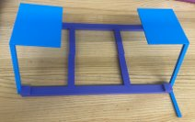
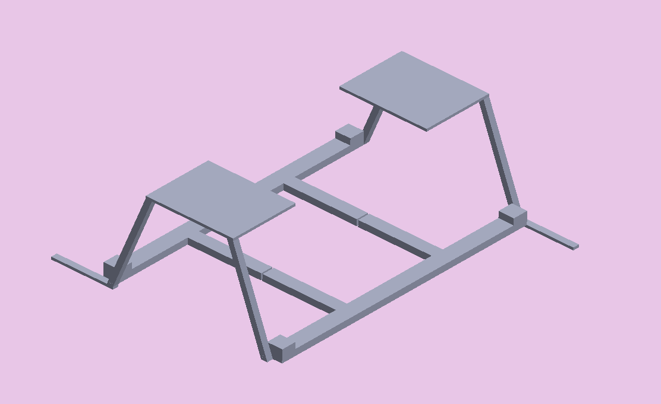
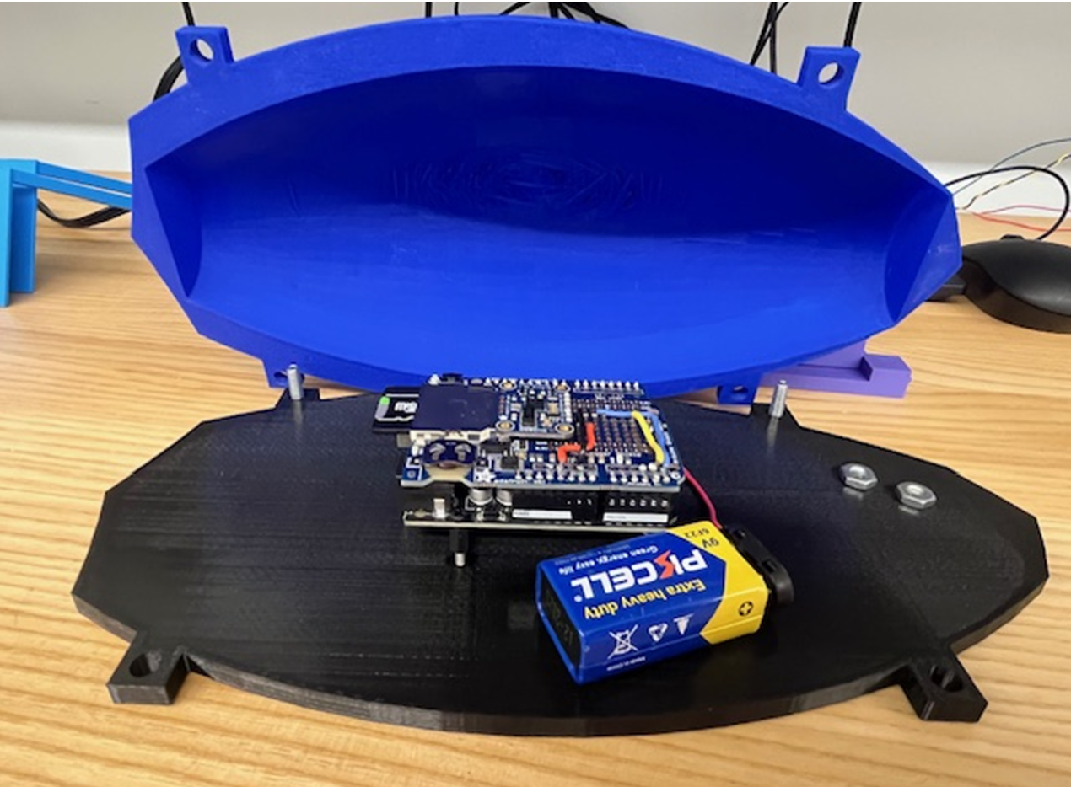
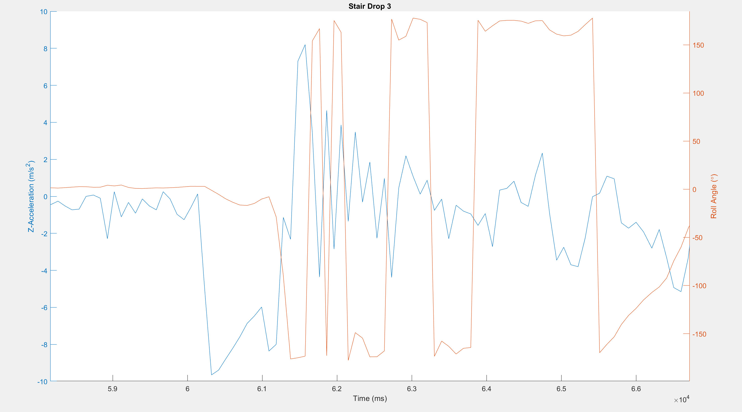
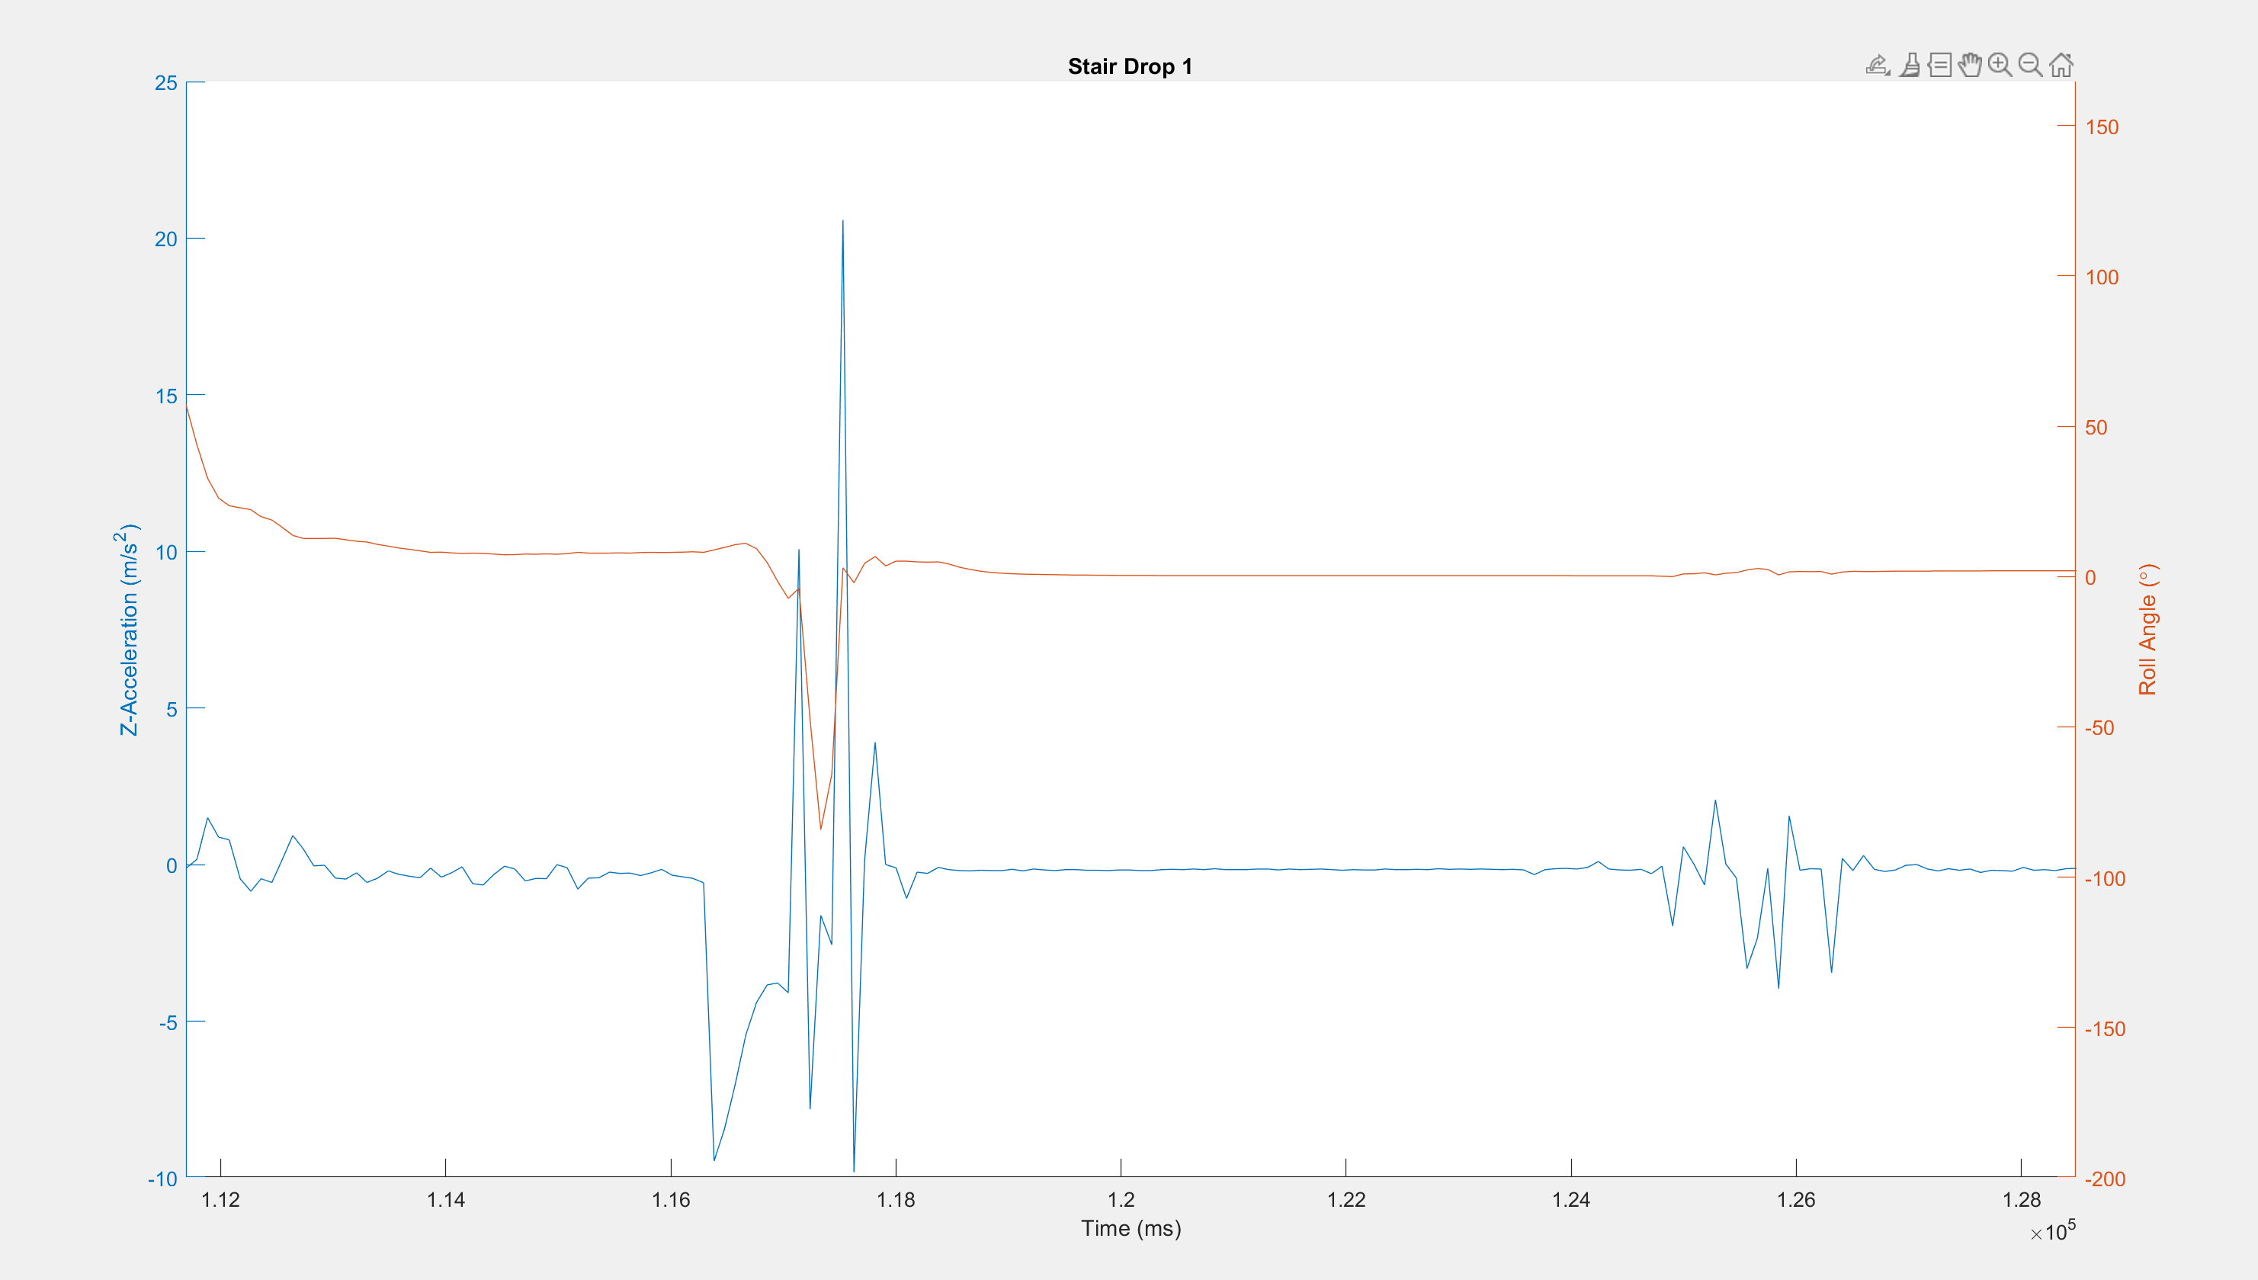
Safe Whale Tag (SWaT): Tag Deployment
Katelyn Otis, Brendan Wright
Department of Mechanical Engineering, University of New Hampshire, Durham, NH 03824
Introduction
Experimental Testing
We were tasked with developing a method to safely tag and track whales, with a focus on the tag deployment. Current methods such as harpoons and poles are not safe, can harm the whale, and cause added stress. These issues affect the data collected. Through literature reviews and comparing various deployment methods that have been tried previously, we determined that utilizing a UAV would be the safest and most effective way to deploy a tag onto the whale. With this now determined, we knew our objectives would be:
To determine if the Tag Model made falls in a way that works with this method
To design a way we would drop the tag from a UAV
This was an interdisciplinary project, completed alongside senior project groups and other underclassmen.
We began our analysis of how the tag fell by performing handheld drops from the top of a step stool to get a feel for the drops and not risk damaging the tag.
Quickly realized that only being able to visually see the behavior is not accurate enough for the situation
Decided to add an Arduino with an IMU to collect numerical data
We recognized that the data we were getting was not over a long enough drop, so we started using a stairwell to elevate the height.
These drops allowed us a longer drop (about 10ft) giving us better data to analyze
This height also better simulated the height from which we will drop the tag onto the whale
Figure 2: The first iteration of the dropping mechanism (both SOLIDWORKS and 3D printed)
Figure 3: The second iteration of the dropping mechanism (both SOLIDWORKS and 3D printed)
Figure 1: The UAV that will eventually be used to drop the housing and tracker onto the back of a whale.
Data Collection
Through initial drop tests, we determined:
The flat bottom design of the tag allows for air to easily be displaced evenly around the housing
As the weight of the tracker is also resting on the base, we believe that this helps with the stable falls that we witnessed
The design of the tracker's suction method does allow for variation in falling as well
The housing that we used to test our drops was not the same mass as the final product. However, it had the same weight ratio between the base and the cover.
We decided that to accurately get data from our drop tests we would want to use an Arduino with an inertial measurement unit (IMU) attached to it.
With assistance from a CS student, we worked to program an Arduino to measure values of roll and acceleration in the Z direction
This originally displayed data in a numbered list, and with the help of a graduate student, we learned and utilized MATLAB to create a program that would visually represent our data in a graph.
The first data set we uploaded was not easy to read or determine where the fall was represented
We changed to be more cautious when dropping the tag to get more consistent data
Figure 4: The tracker utilized to collect our data. It is an IMU attached to an Arduino.
Figure 5: The first attempt at using a graph to analyze our data
Results
Acknowledgements
Our Advisors: May-Win Thein, Matthew Florence
Other Students: Aidan Boucher, Emma Galbraith, Hannah Arnholt, Maggie Enderle, Trevor Pettigrew, Murray Mckay, Tiarnan Burke-Smith, and the rest of the SWaT Team
After performing various tests and analysis of those tests, we came to determine:
The housing designed by the senior project group consistently dropped with the bottom staying horizontal to the surface
Any rotation along the X-axis was determined to be human error (the housing would stick to our hand)
We have analyzed the data to learn that the spike is where the drop occurs, and the graph shown is focused into that point
Data and analysis was relayed to the senior design team so they could be aware of any improvements that needed to be made
Wind was not a factor in our measurements as we were testing in an indoor environment
No rotation along the Y-axis
Communication is crucial to success when working in a group as big as ours
Figure 6: The results of the first test summed up in acceleration across the Z-axis and roll. This was achieved using MATLAB.
References
Quaglia, Sofia. "How Do Whales Hear Their Songs and Other Sounds if They Don't Have Ears?" Discover Magazine, 27 Dec. 2023, https://www.discovermagazine.com/planet-earth/how-do-whales-hear-their-songs-and-other-sounds-if-they-dont-have-ears.
Yirka, Bob. “Marine Biologists Use Drones to Affix Suction Cup Tags to Whales to Prevent Upsetting Them”, Physics.Org, https://phys.org/news/2023-04-marine-biologists-drones-affix-suction.html
Abrams, Michael. "Using Drones to Tag Whales." ASME, American Society of Mechanical Engineers, 13 July 2023, https://www.asme.org/topics-resources/content/using-drones-to-tag-whales.
"Using Drones and Tags to Study Rice’s Whales." NOAA Fisheries, National Oceanic and Atmospheric Administration, 6 Nov. 2024, https://www.fisheries.noaa.gov/feature-story/using-drones-and-tags-study-rices-whales.

