Slide 1


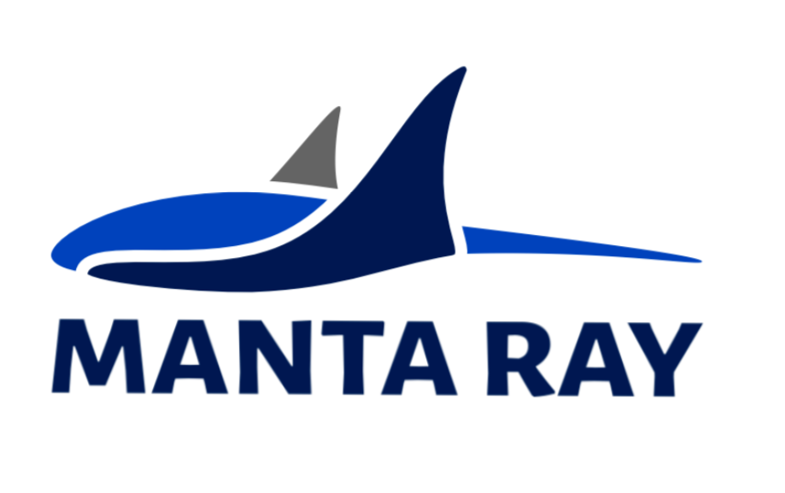


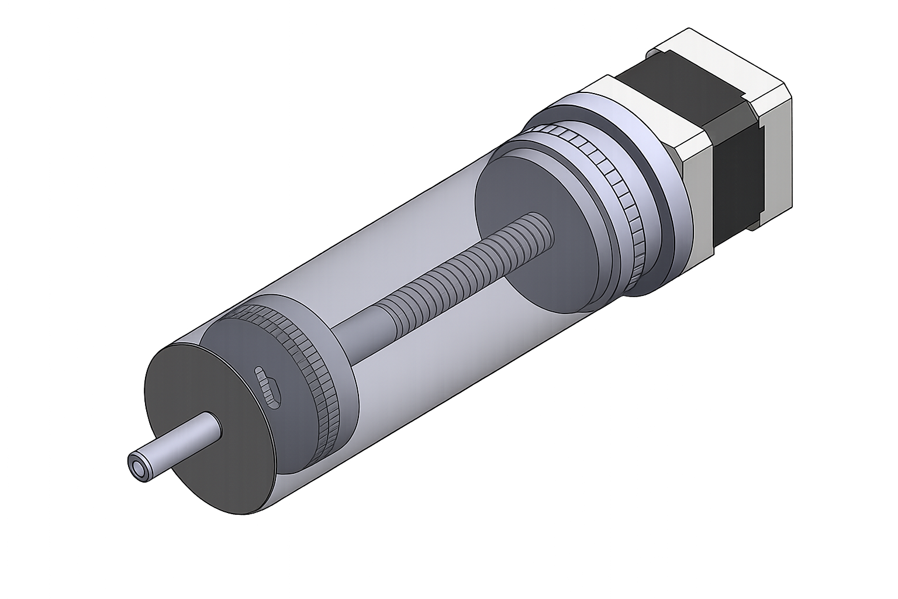
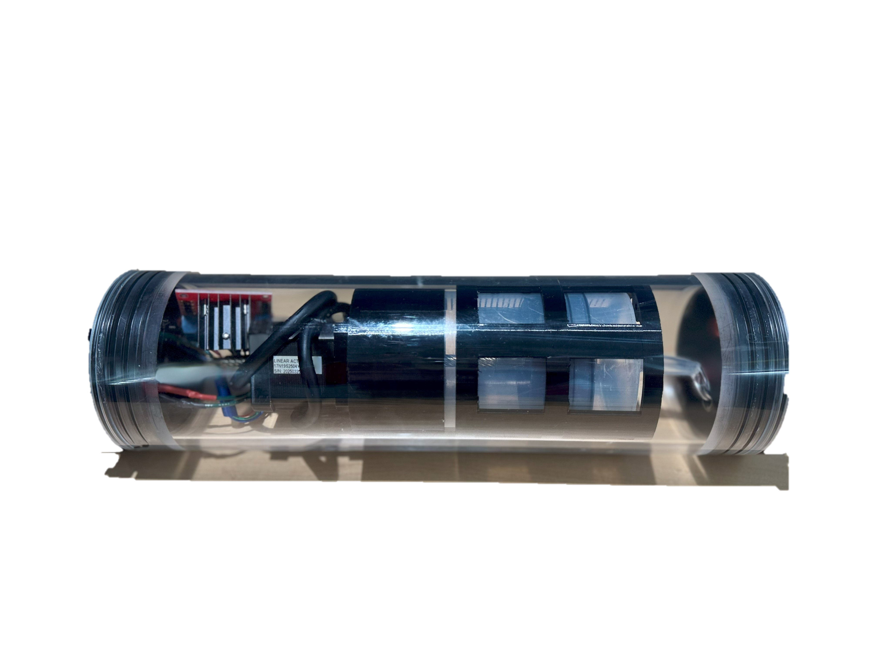
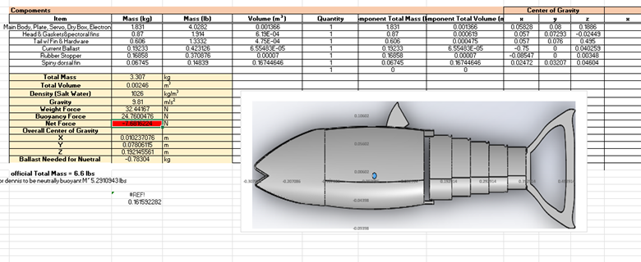
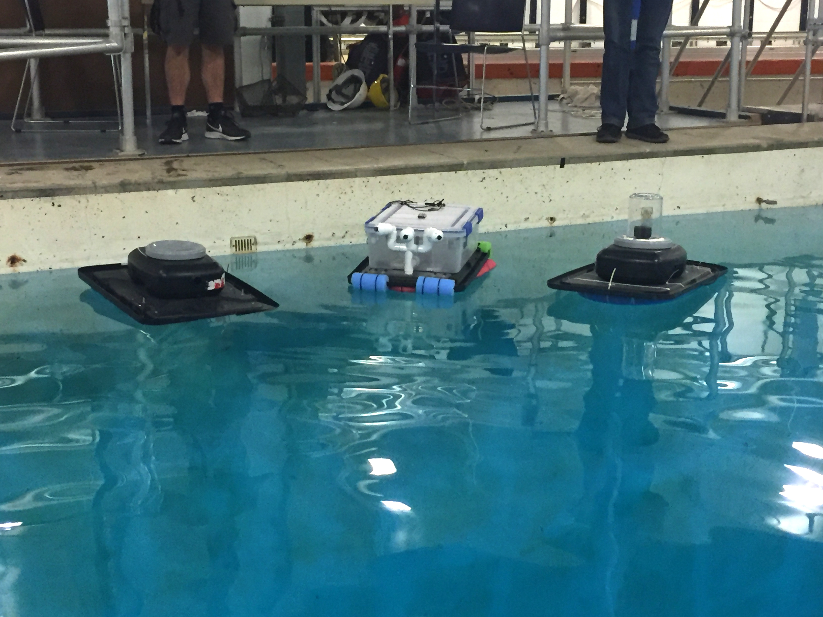
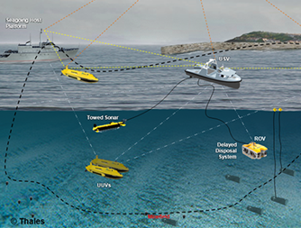
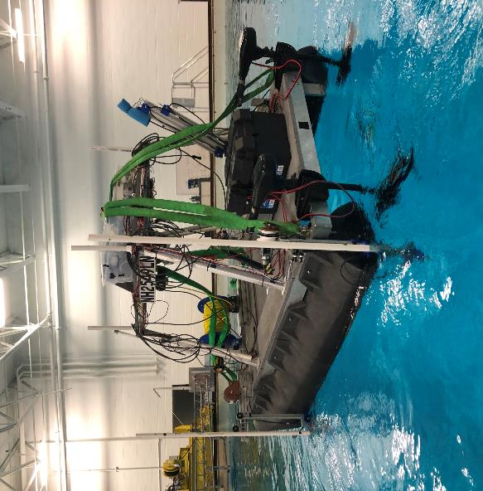
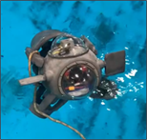
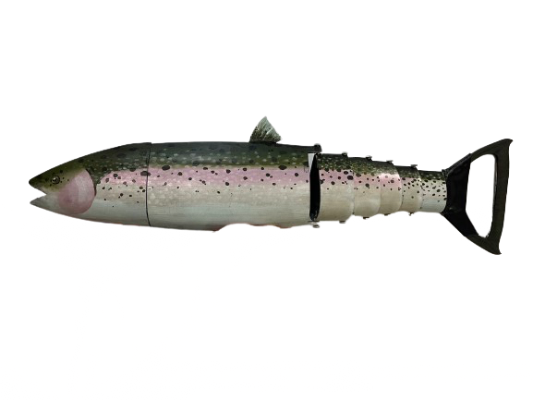
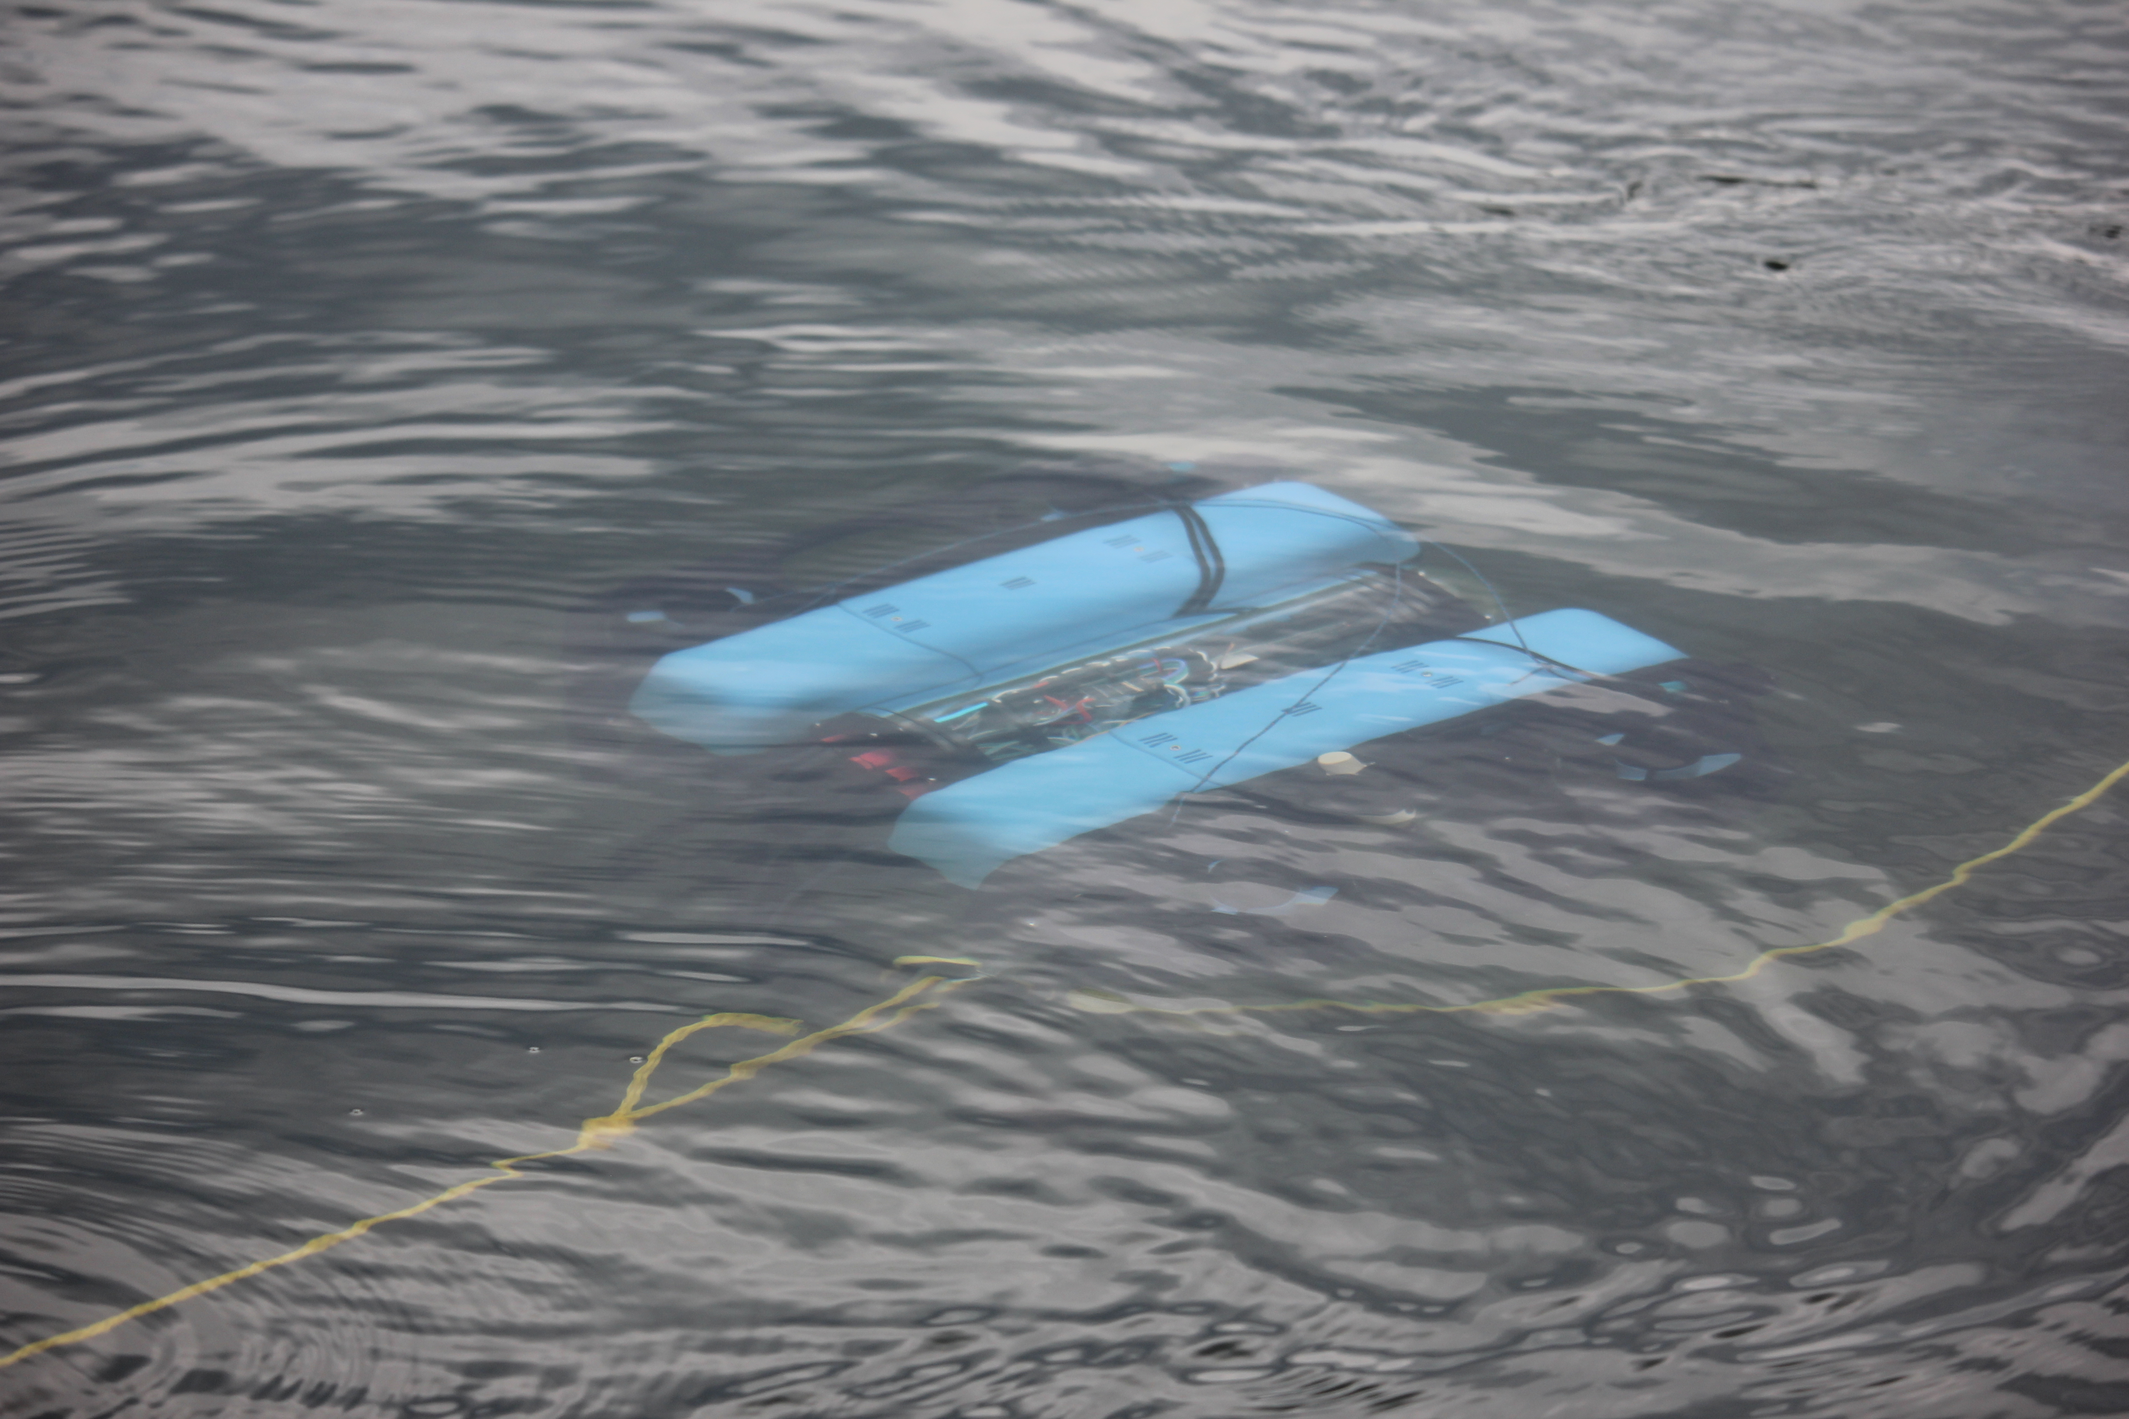
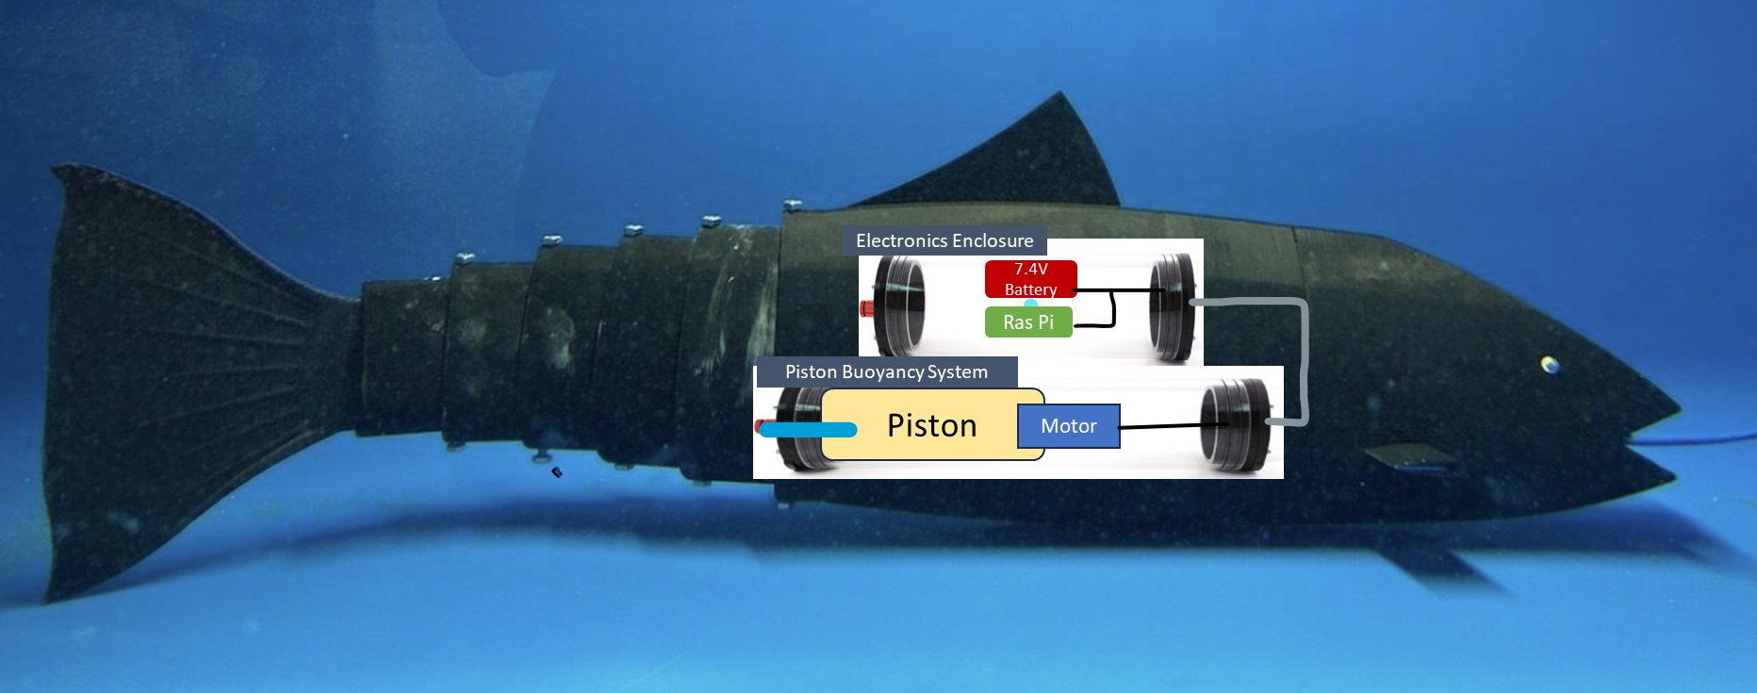
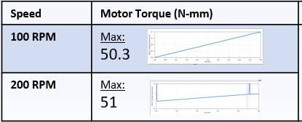
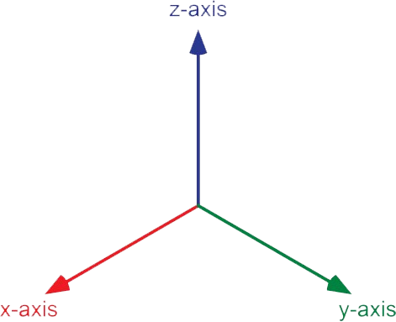
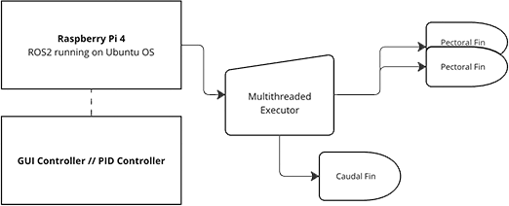
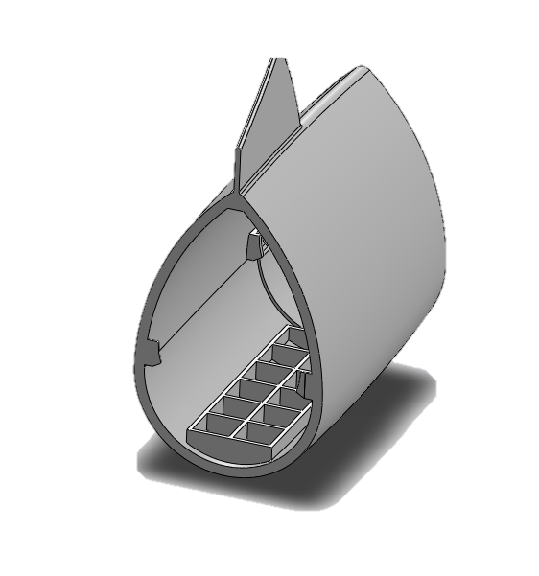
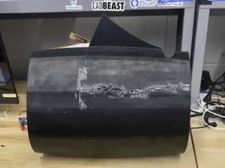
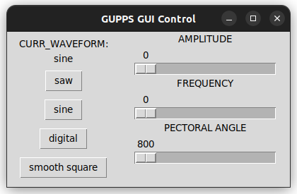

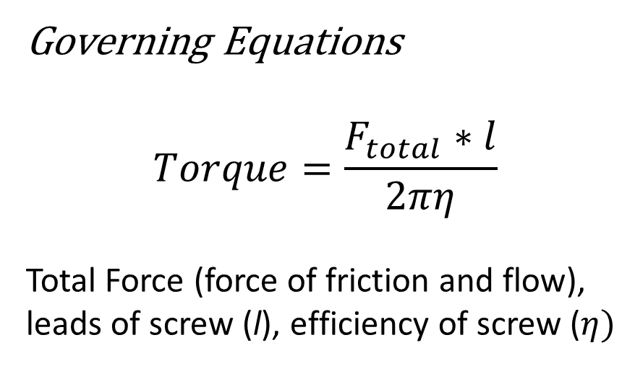

Marine and Naval Technological Advancements for Robotic AutonomY (MANTA RAY)
Ghost Uncrewed Performance Platform Submersible (GUPPS)
Project Advisors: Dr. May-Win Thein, Dr. Yuri Rzhanov, Dr. Elizabeth Fairchild
Graduate Advisors: Margaret Enderle, Hannah Arnholt, Derrek Perham, Jack Groeneveld-Meijer, Alex Cook, and Nick Custer
Team Members: Kelly Anderson (ME), Brian Ferrara (ME), Seth Rossman (CE), Caden Giordani, and Jonah Stevens
MANTA RAY Mission
Buoyancy System
Operational Analysis
Team MANTA RAY is an interdisciplinary project dedicated to creating, maintaining, and expanding a network of marine robots for seafloor mapping and underwater perception. The network began as just the autonomous surface vehicle (ASV) and unpiloted underwater vehicle (UUV) but has expanded to include a prototype of the ASV, known as TUPPS, and two kinds of remotely operated vehicles, the Ghost Uncrewed Performance Platform Submersible (GUPPS) and KRILL, in addition to the Safe Whale Tagging (SWaT) device designed for safe and non-invasive whale tracking/observation. With these systems, students work to improve communication between vehicles, develop autonomous behaviors and algorithms, and upgrade existing mechanical systems to improve precision and performance.
To enable depth control, the team developed a piston-based buoyancy system that allows the ROV to descend and remain submerged before surfacing. This helps collect data at various depths.
Current State Buoyancy
When the buoyancy system is not activated, GUPPS remains positively buoyant with the help of strategically placed foam. The foam ensures that GUPPS will return to surface when the buoyancy system expels all its water. Knowing the center of mass allowed us to properly ballast the fish to ensure stability.
Stepper Motor Function
Using SolidWorks, we were able to estimate the necessary torque we would need from our motor.
Design
Piston Design
The piston-driven system was inspired by RC submarine buoyancy systems. The system is controlled via stepper motor and lead screw assembly moving a rubber stopper to vary internal water volume and thus density.
Waterproof Enclosures
Buoyancy enclosure
200mL piston
Stepper motor with lead screw
Motor Driver to send signals to operate driver
Electronic enclosure
Raspberry Pi
7.4 V Li-Po batteries for pectoral fins, buoyancy piston, and rear tail motor
Figure 3: Diagram of the buoyancy & electronics enclosures
Key Components
Motor: NEMA 17 with lead screw
Driver: L298N motor driver
Electronics: Raspberry Pi, 7.4V li-Po battery
Features/Benefits
Holding tray to secure piston preventing any movement
Custom motor mounting to attach motor to piston
Regulated water intake/discharge
Ideal for small robotic platforms and battery powered
Does not rely on external air sources
Governing Equations
$$F_{weight}=m∗g$$
$$F_{buoyancy }= V_{tot}∗ρ∗g$$
$$F_{tot}=F_{w}−F_{b}$$
Mass (m), gravity (g), total Volume ($V_{tot}$), density ($ρ$),
Figure 4: CAD prototype of buoyancy system
TUPPS
ASV
Figure 9: Buoyancy data sheet
KRILL
UUV
Figure 5: Buoyancy system enclosure
GUPPS
Governing Equations
$$Torque=\frac{F_{total}∗l}{2πη}$$
Total Force (force of friction and flow), leads of screw (l), efficiency of screw ($η)$
GUPPS Mission
GUPPS is designed to unobtrusively investigate underwater environments using a biomimetic robotic fish. Ultimately, GUPPS will be deployed in the University of New Hampshire’s AquaFort testbed to study fish behavior in realistic environments. Previous years have worked to enable the fish swim on a 2D plane propelled by a rear tail servo motor. This year’s goals is to develop an active buoyancy system to allow the fish to dive 10 feet and return to the surface. The team also aims to design a ballasting system to maintain balance during surge, yaw, and pitch motion
Figure 10: Torque simulation results
ROS2 Subsystem Integration
Future Work
The future goal for GUPPS is to develop a fleet of fish that can work together autonomously. Control of each system can generally be achieved with the use of a Raspberry Pi
Now that GUPPS can swim on a 3D plane, code must be developed by future CS teams to integrate the system with pressure sensors and other subsystems to become autonomous. Pressure sensors can be used to provide feedback on depth and autonomously control buoyancy. The buoyancy system can be further optimized to reduce size and improve efficiency.
Finally, the goal is to create a fleet of five fish that can work together autonomously on missions.
Body Redesign with Ballasting
Enlarge Hull:
To integrate the buoyancy and electronics systems, the body, head, and tail were enlarged to house the two separate enclosures.
Figure 1: Upscaled Body Figure 2: Grid system along the belly of the fish body
Grid System:
A slotted grid system runs along the belly of the fish to hold weighted pellets in place. The downward force from the weights ensures the fish maintains an upright orientation during motion.
Figure 6: Coordinate system
Figure 7: Subsystem diagram
Acknowledgements
GUPPS is comprised of multiple subsystems governed by a MultiThreaded Executor allowing near-perfectly synchronized movement. These systems include a servo-based caudal fin, two servo-based pectoral fins, and the proposed buoyancy system.
Movement in the x-axis and y-axis is easily handled via a manipulation of amplitude and angle in the caudal fin. Z-change is possible via the equation
$$Pitch ∇°=arcsine\left(\frac{Desired ∆Z}{∆X}\right)$$
More rapid z-axis change is possible via the proposed buoyancy system.
Commands for both the buoyancy system and pectoral/caudal fins are sent over the ROS2 robotics framework and are generated via a GUI publisher or PID controller.
This work was funded in part by New Hampshire Sea Grant's Workforce Development Project E/WFD-2, pursuant to National Oceanic and Atmospheric Administration Award No. NA22OAR4170124. Additional funding was supplied by NEEC grants #N00174-17-1-0002 & #N00174-20-1-0006.
Special thanks to Dr. Martin Renken,, and Thai Tran from NUWC Keyport. As well as UNH staff members John Ahern, Scott Campbell, and Karin Whiting, and Wendy Goldstein, as well as the Olson Center and UNH Makerspace. And finally, a thanks to Aquafort members Micheal Doherty, Erich Berghahn, and Michael Coogan.
References
RC Shipyard. (n.d.). RC shipyard tech – R/C ship building techniques and technology. https://www.rcshipyard.com/tech/
Unknown Creator. (n.d.). RC submarine buoyancy system LEGO [Video]. Bing. https://www.bing.com/videos/riverview/relatedvideo?&q=rc+submarine+buoyancy+system+lego&&mid=EADD503E8BF7B69D71C2EADD503E8BF7B69D71C2&&FORM=VRDGAR
Figure 8: GUI control panel

