Slide 1
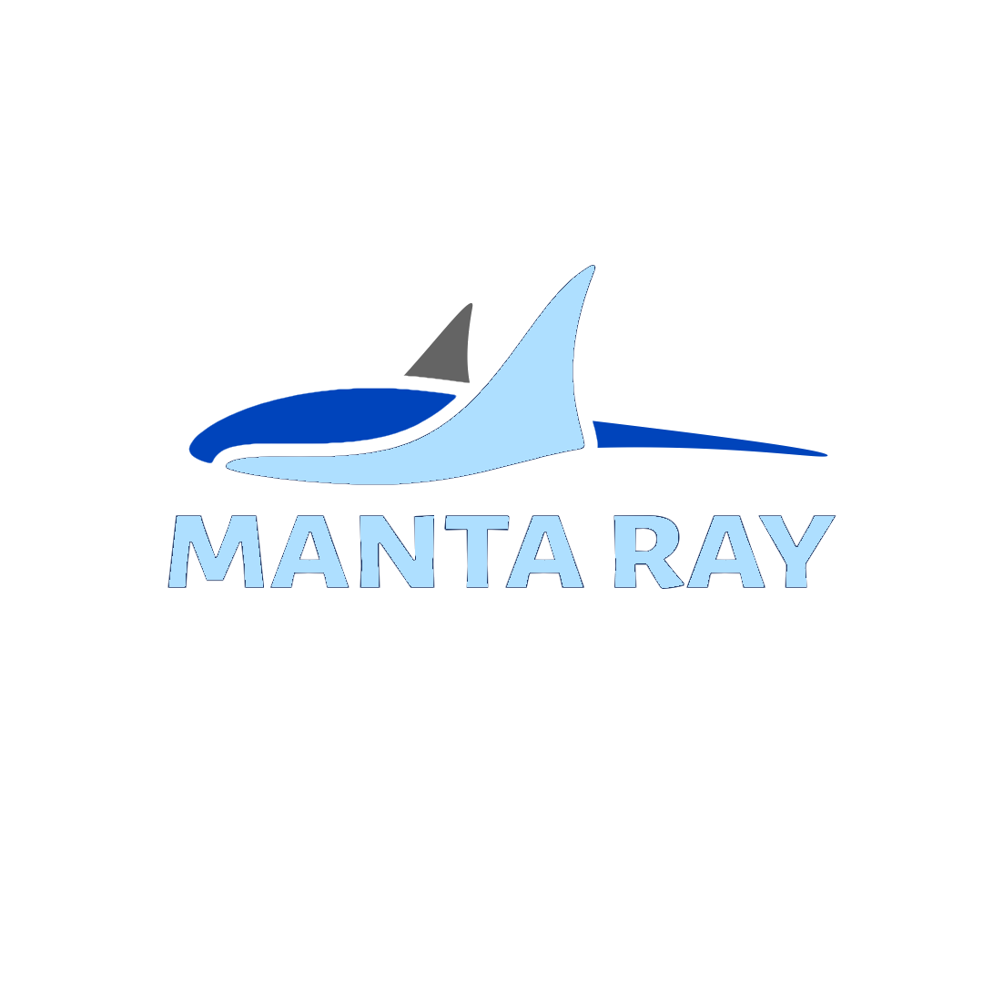




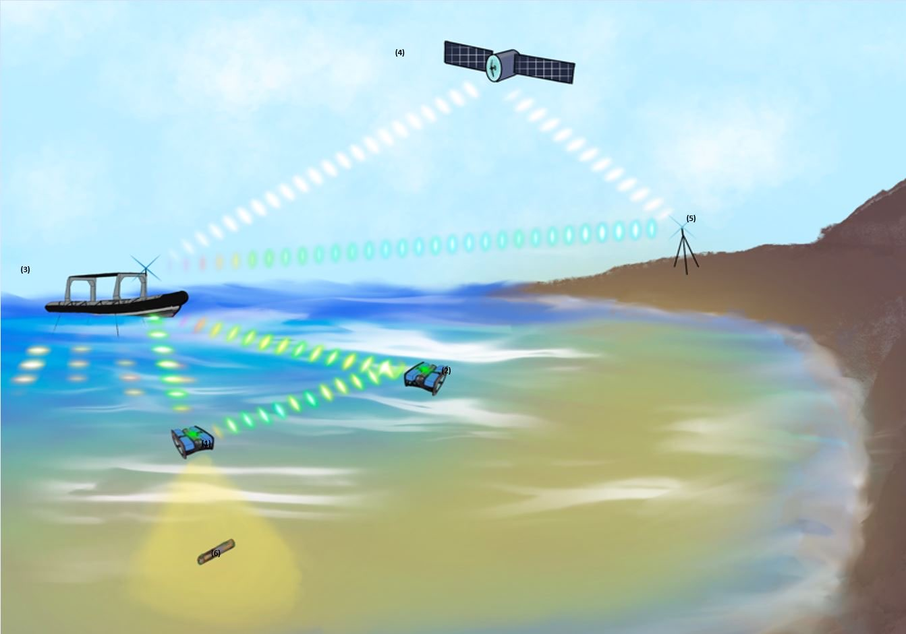
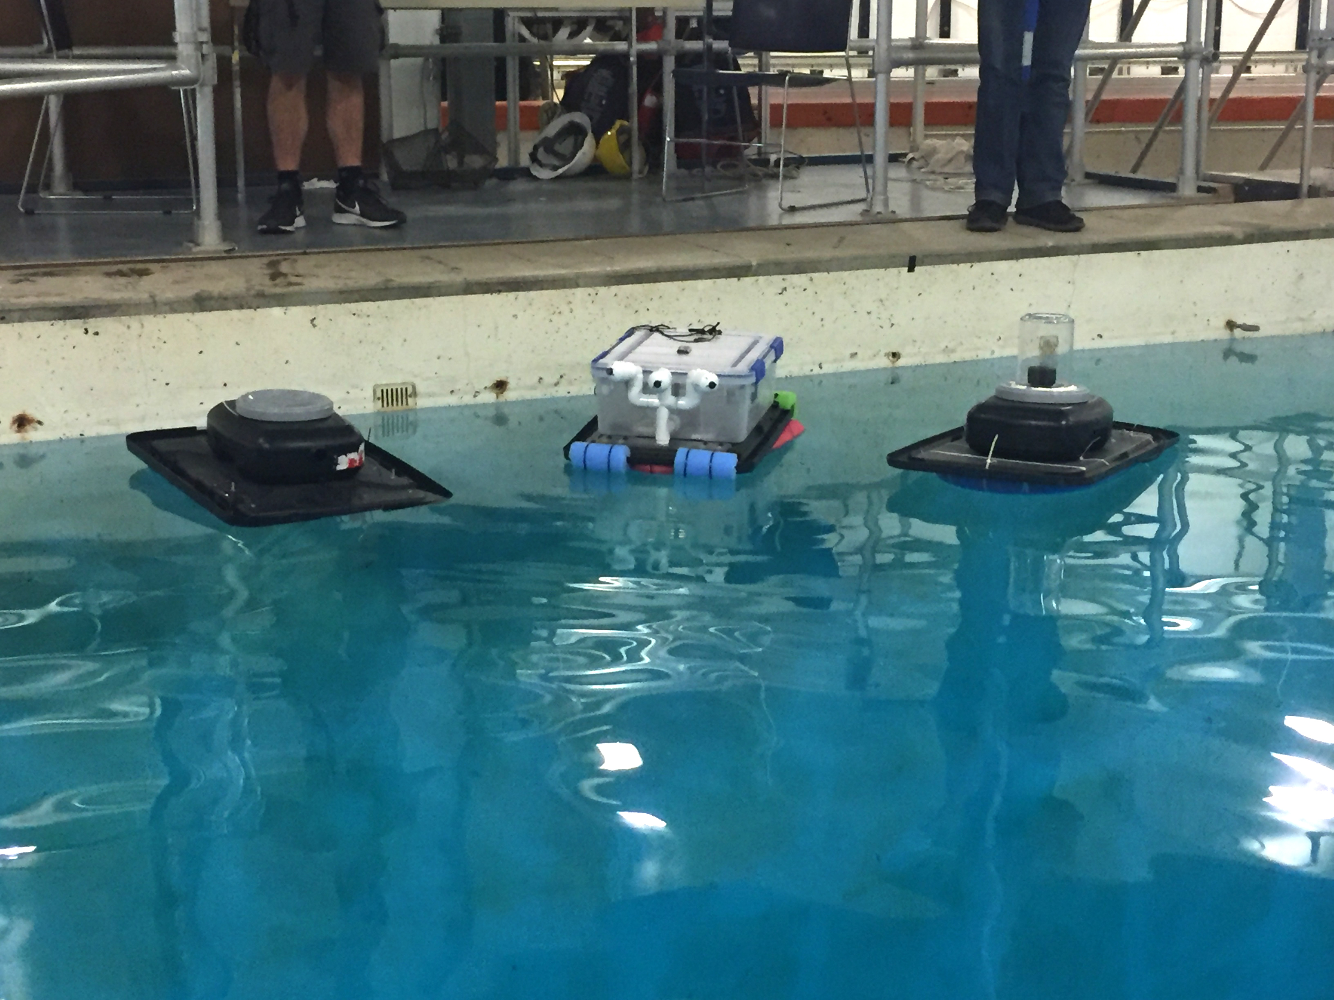
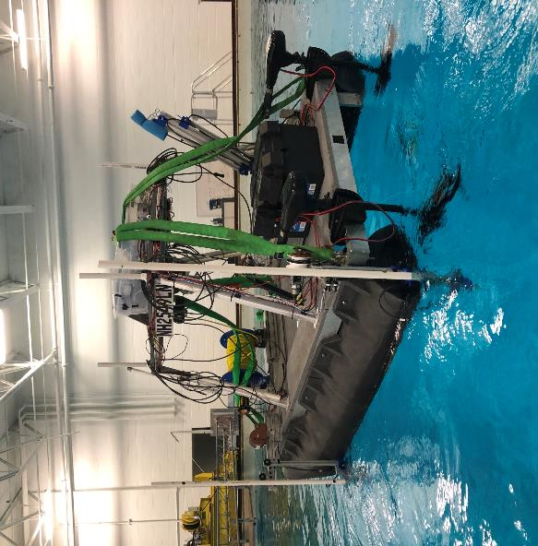
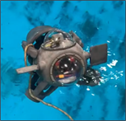
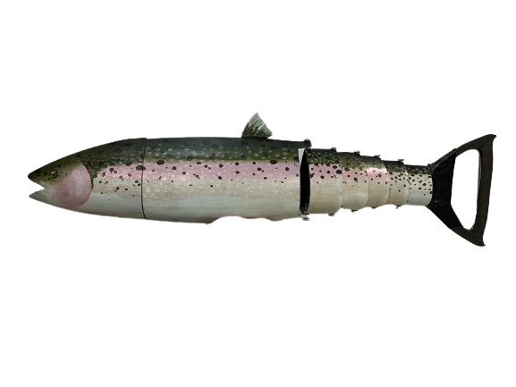
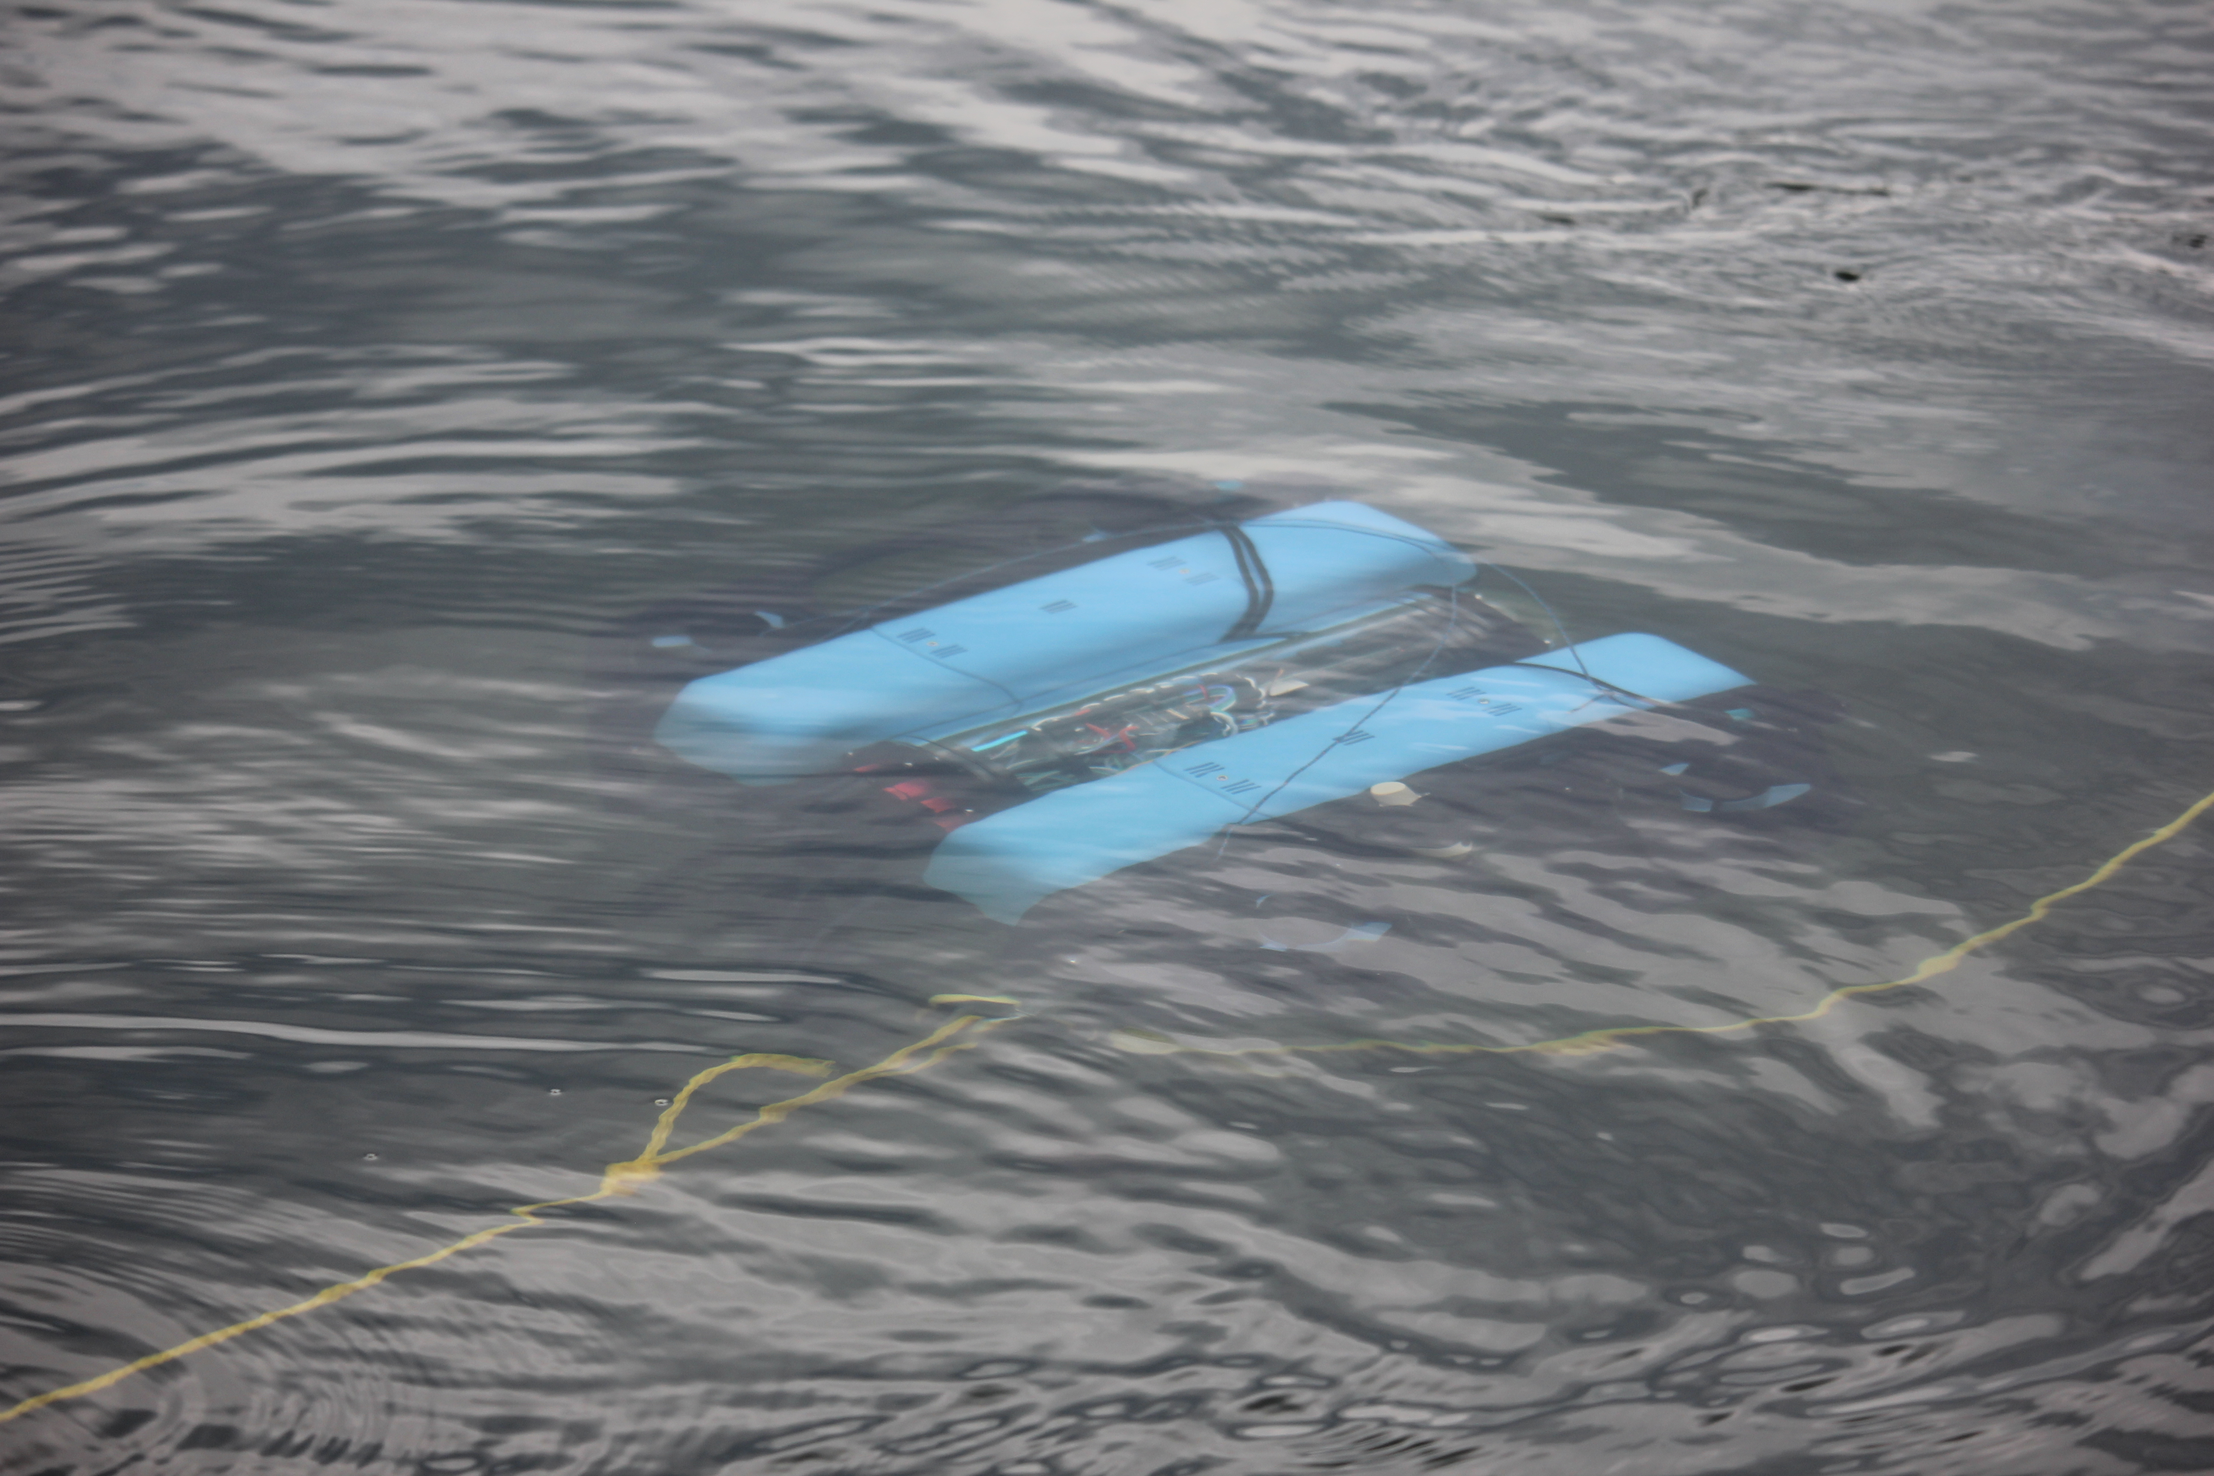



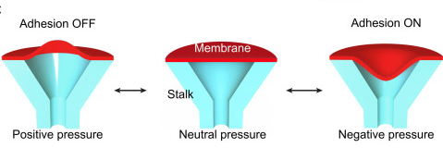
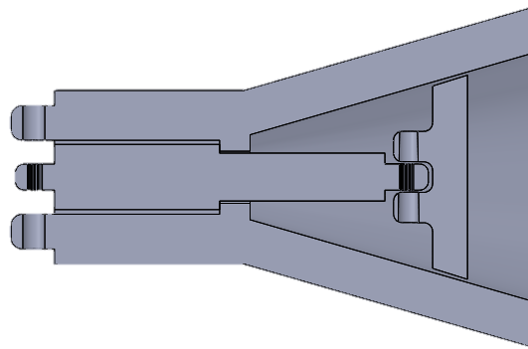
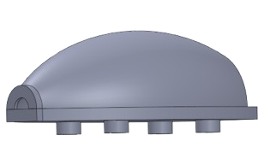
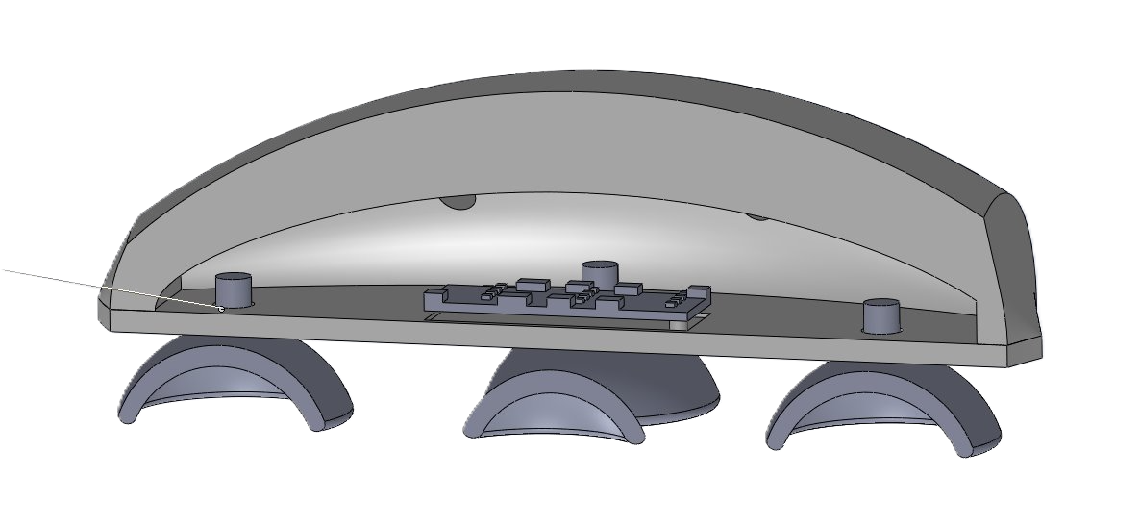
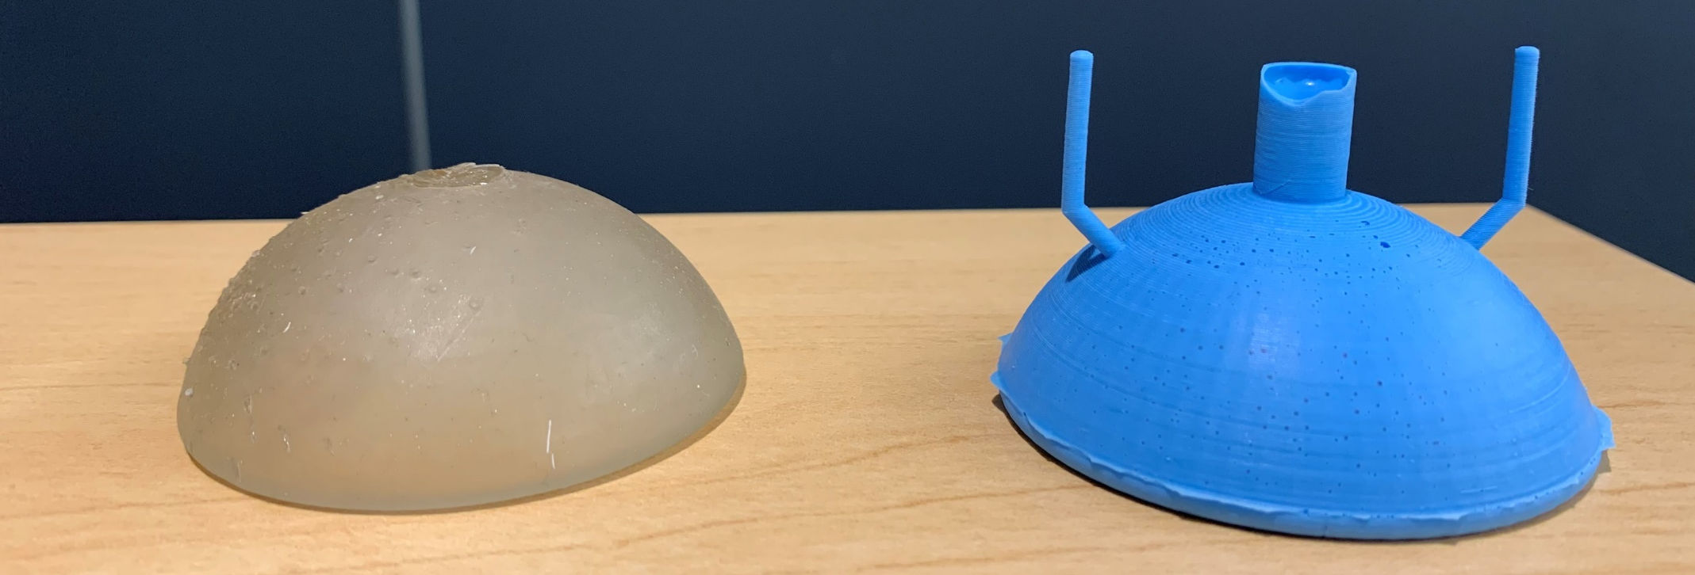
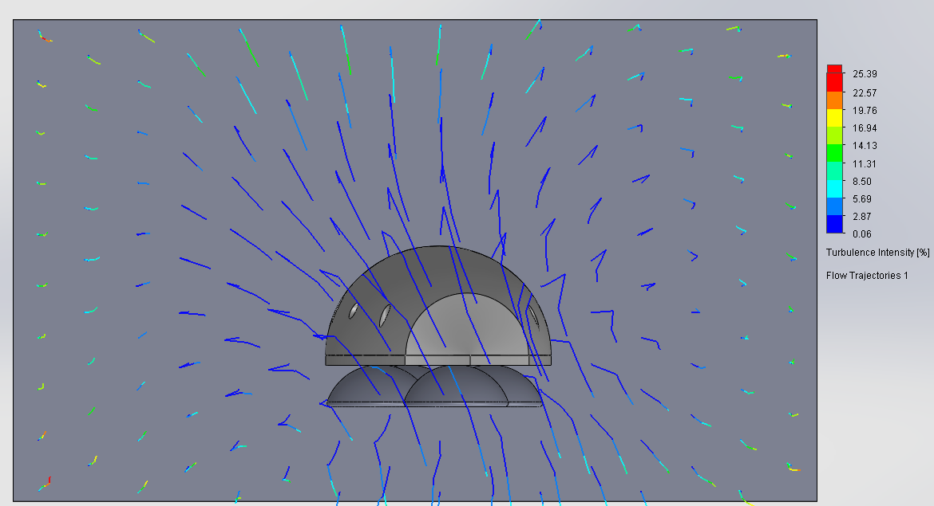
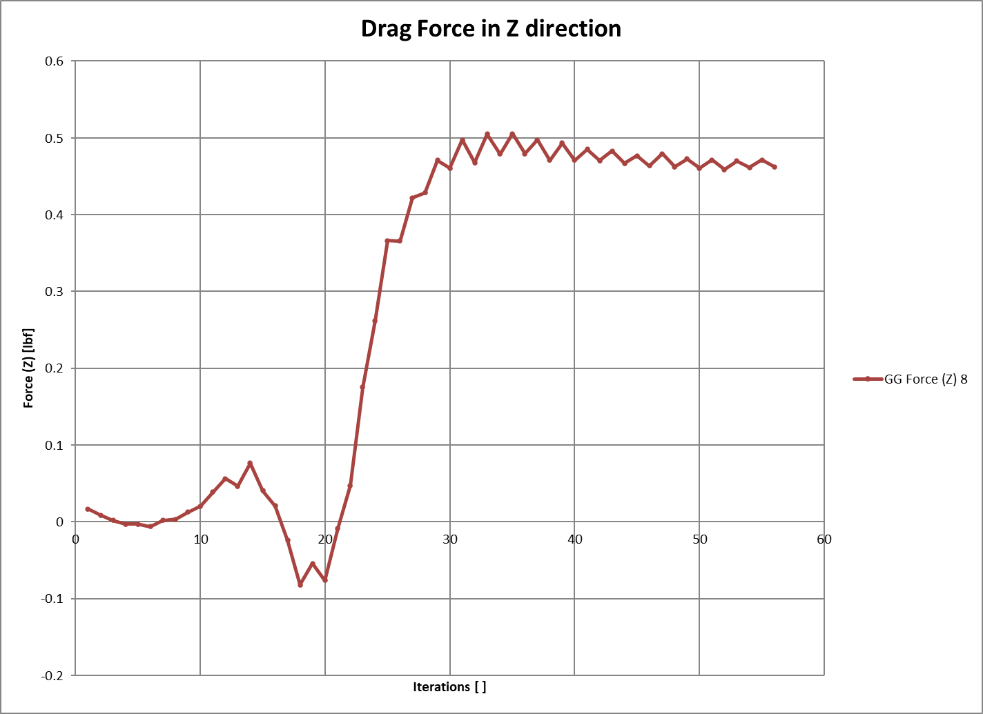
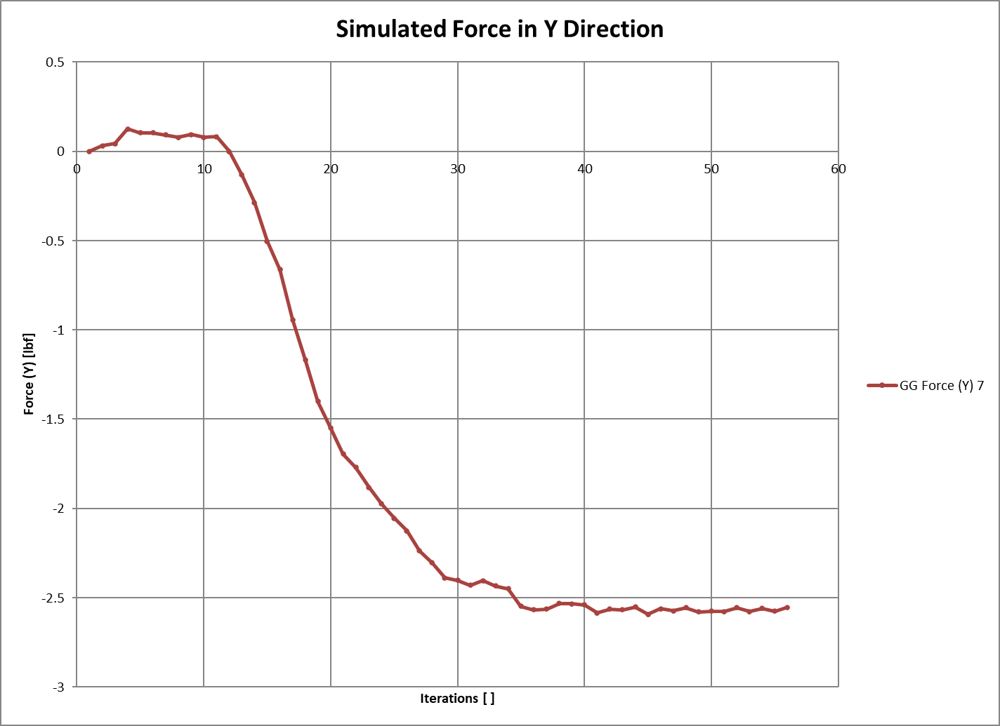
SWaT: Safe Whale Tag​
Advisors: Dr. May-Win Thein, Dr. Elizabeth Fairchild, Dr. Yuri Rhzanov
Aidan Boucher ³, Tiarnan Burke-Smith ¹, Paxton Dionne ², Murray McKay ⁴, Trevor Pettigrew ¹, Aden Taif ¹​
Alexander Watkins ², Nicolas Zerbinopolous ², Emma Galbraith ^{3,5}, Katelyn Otis ¹, Brendan Wright ¹ ​
1:UNH Department of Mechanical Engineering, 2: UNH Department of Electrical and Computer Engineering, 3: UNH Department of Computer Science, 4: UNH Department of Ocean Engineering,
5: UNH Sustainability Institute​, University of New Hampshire, Durham, NH 03824
MANTA RAY Misson Statement
Introduction
Team MANTA RAY is an interdisciplinary project dedicated to creating, maintaining, and expanding a network of marine robots for seafloor mapping and underwater perception. The network began as just the Autonomous Surface Vehicle (ASV) and Uncrewed Underwater Vehicle (UUV) but has expanded to include a prototype of the ASV, named TUPPS, and two kinds of remotely operated vehicles, the Ghost Unpiloted Performance Platform Submersible (GUPPS) and KRILL, in addition to the Safe Whale Tagging (SWaT) device designed for safe and non-invasive whale tracking/observation. With these systems, students work to develop improve communication between vehicles, develop autonomous behaviors and algorithms, and upgrade existing mechanical systems to improve precision and performance.
TUPPS
ASV
KRILL
UUV
GUPPS
Figure 1: MANTA RAY Mission
Figure 1: Various whale tag configurations (Russel D. et. al. (2019))
Figure 2: In–situ invasive whale tags. Left: Humpback Whale, Right: Orca (Russel D. et. al. (2019))
Housing Design
Traditional Adhesion Design
Mechanical Adhesion Method
Requirements
Waterproof
Hydrodynamic
Minimal Weight
22% Decrease in Drag
Lower Profile
Figure 9: Membrane suction method (Frey S.T. (2022))
Figure 6: Possible suction cup designs (Beach A. et. al. (2023))
Figure 3: First Housing Model
Figure 4: Prototype Housing Model
Figure 5: Model Simulations
Figure 6: Observed Force Charts
Figure8: Left: Resin Suction Cup, Right: Silicone Suction cup
Figure 10: First model of mechanical adhesion method
Tests and Results
Conclusions
Acknowledgements
Table 1 shows the shear force withstood by the silicone suction cup before detaching from the 80-grit whale skin. In addition to these results, the resin cup was tested in the same method. It withstood over 20lbs of shear force before material failure occurred.
Trial | Shear Force [lbf]
1 | 16.3
2 | 16.6
3 | 16.3
Avg. | 16.4
Table 2 shows average removal force required for the standalone mechanical adhesion cup to be removed from various skin roughness. On average, when the device received power throughout the test it held stronger. This is something that future iterations of this project must consider.
Grit | Continuous Power Shear Force [lbf] | Non-continuous Power Shear Force [lbf]
80 | 7.2 | 7.2
220 | 9.0 | 6.9
320 | 14.3 | 6.8
Our work has successfully created a basis on which future teams can compare their creations to quantify the performance of future designs. The resin cup performed superior to the silicone cup in shear force but was not resilient enough to withstand multiple tests. While the actuator cup was not able to adhere as well as the silicone cup, its ability to detach itself when prompted is desirable. These methods prove that comparable alternatives are possible, and further research into materials and methods could produce superior whale tags.
This work was funded in part by New Hampshire Sea Grant's Workforce Development Project E/WFD-3, pursuant to National Oceanic and Atmospheric Administration Award No. NA24OARX417C0037.
Thank you to Dr. Karl Brommer and Dr. Kaelyn Gamel for their assistance with this project.
References
​Beach, A., Harris, C., Wang, Y., & West, R. (2023). Making a Better Suction Cup. University of Michigan.
​Frey, S. T. (2022). Octopus-inspired adhesive skins for intelligent and rapidly switchable underwater adhesion. Retrieved from ScienceAdvances: https://www.science.org/doi/full/10.1126/sciadv.abq1905
Russel D. Andrews, R. W.-P.-J. (2019). Best practice guidelines for cetacean tagging. IWC Journal of Cetacean Research and Management, 27-66.

