Slide 1

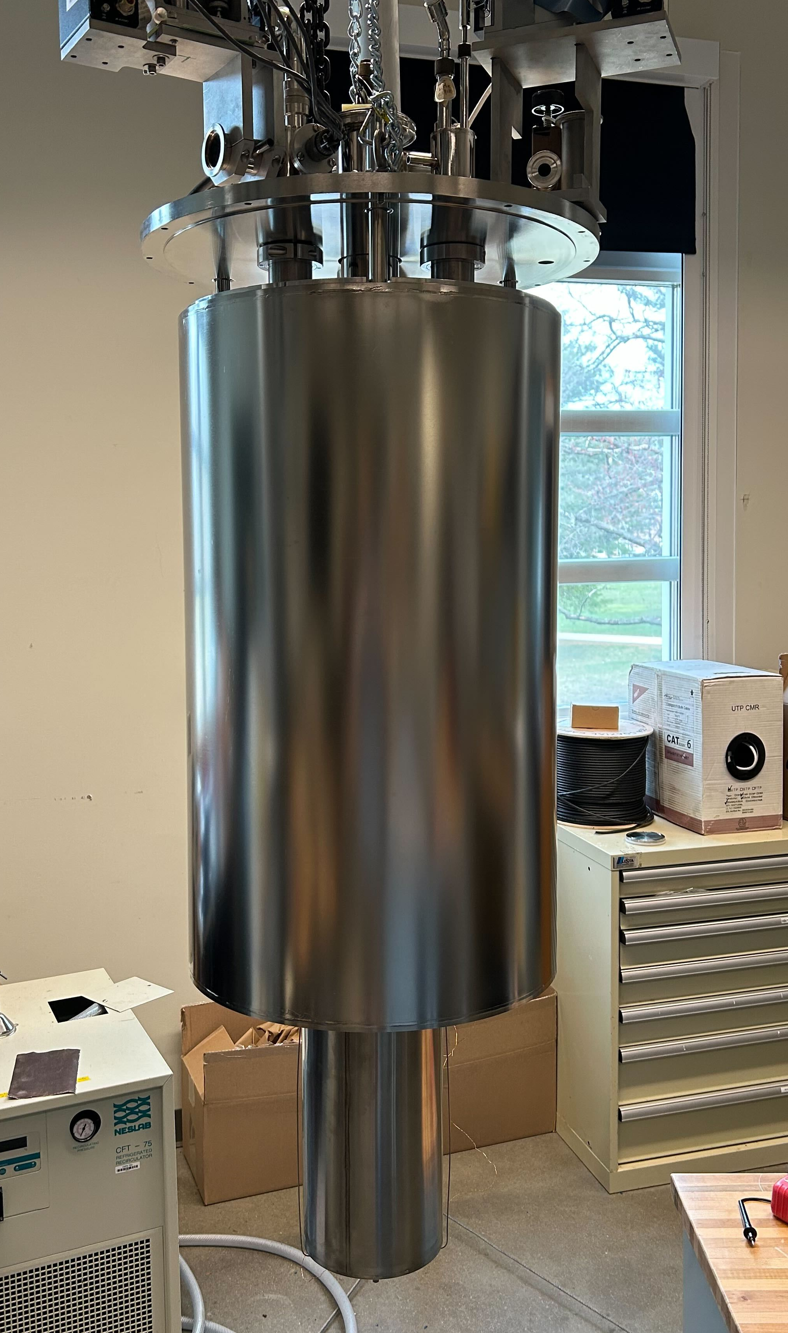
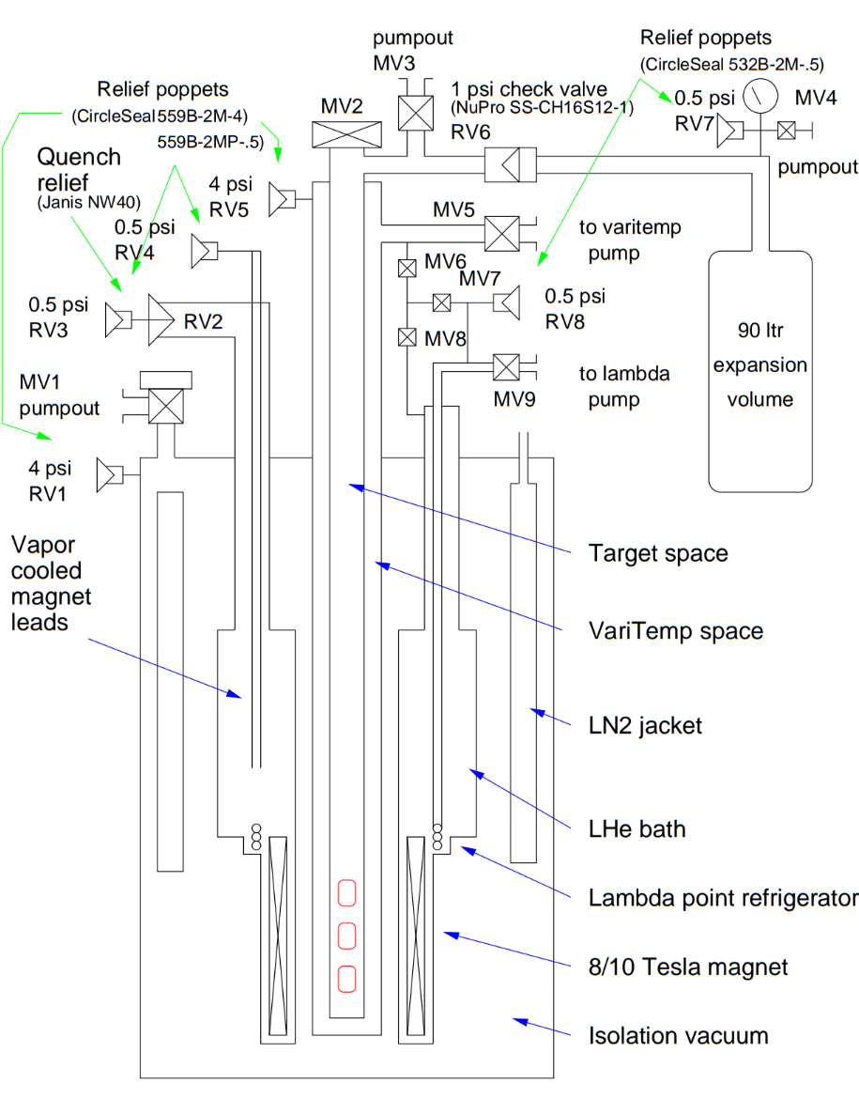
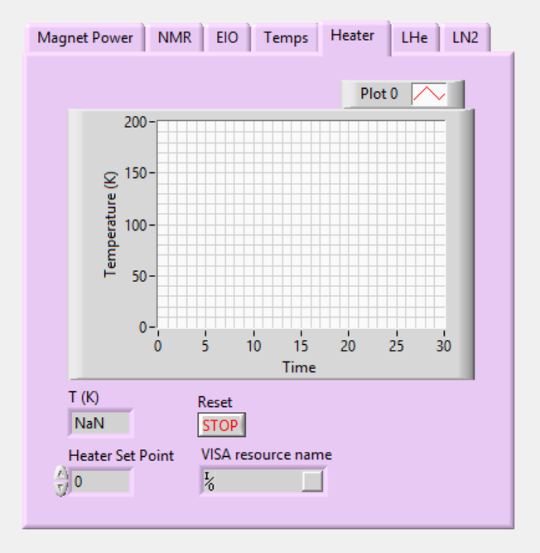
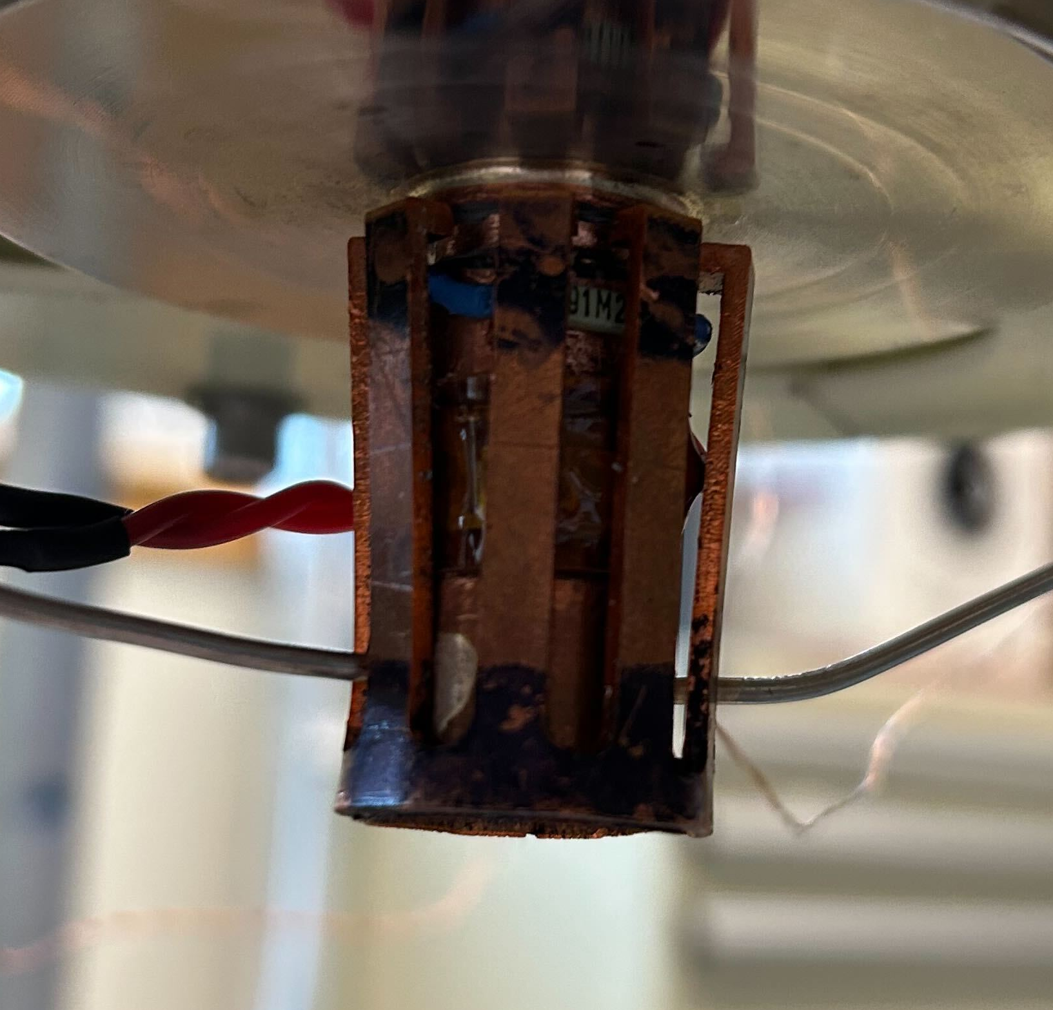
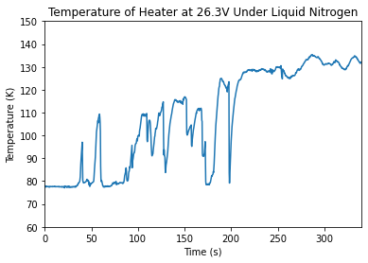
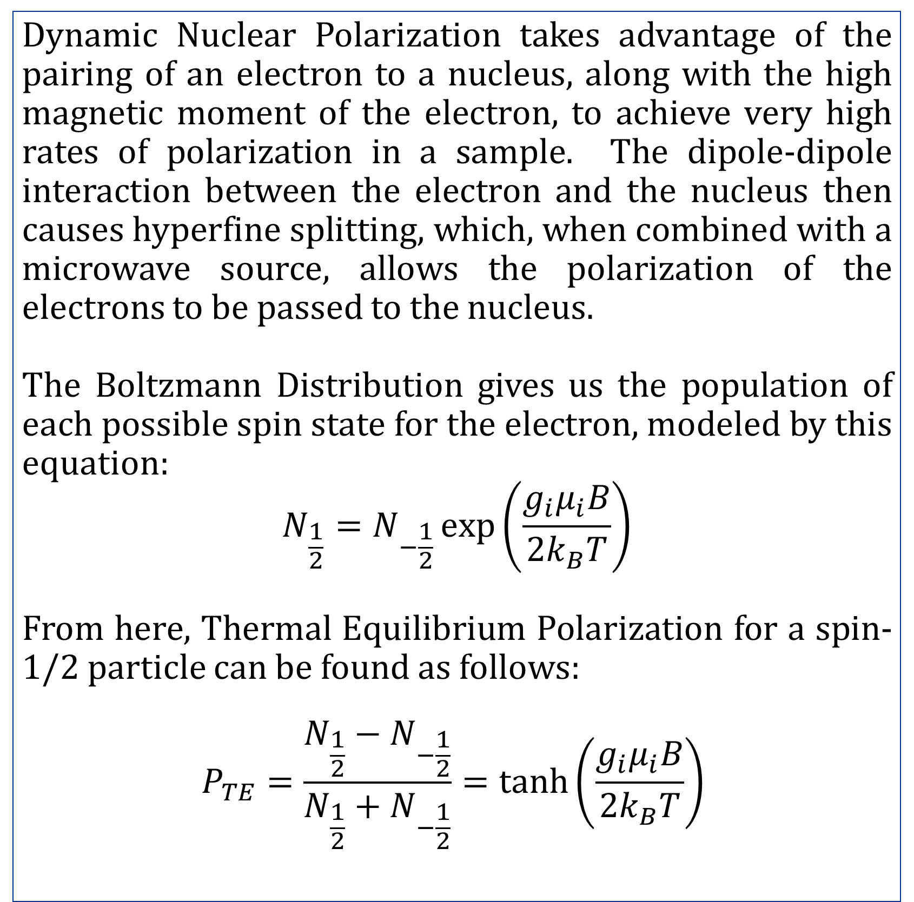
Setup and Installation of an 8T Magnet and 1.5K Cryostat System for Dynamic Nuclear Polarization
Author: Matthew Breton Advisor: Nathaly Santiesteban
Department of Physics and Astronomy, University of New Hampshire
Introduction
Cryostat
Progress
Magnets and cryostats, when combined, can be utilized in experimental nuclear physics to polarize target materials. The cryostat was originally used at the Thomas Jefferson National Accelerator Facility (J-Lab) in Newport News, Virginia, but it was not working when it was brought to UNH. This system, along with an extended interaction oscillator (EIO) microwave generator and a target stick, will allow us to enhance the polarization of target material with a technique called Dynamic Nuclear Polarization (DNP).
Diagram of Cryostat
Cryostat Outside of Shell
A lot of progress has been made so far. We first pulled the magnet out of its shell, and catalogued all the connections, taking note of what needed to be replaced. After that, we began to replace these connections and replace the heater element at the bottom with our own design.
Our next step was designing our Data Acquisition system (DAQ) using LabVIEW. This involves learning how to communicate with all the instruments involved with measuring temperature, monitoring liquid levels, controlling power, and controlling the heater. This is still a work in progress, as we have run into connectivity issues with older instruments.
Methodology
Dynamic Nuclear Polarization takes advantage of the pairing of an electron to a nucleus, along with the high magnetic moment of the electron, to achieve very high rates of polarization in a sample. The dipole-dipole interaction between the electron and the nucleus then causes hyperfine splitting, which, when combined with a microwave source, allows the polarization of the electrons to be passed to the nucleus.
The Boltzmann Distribution gives us the population of each possible spin state for the electron, modeled by this equation:
$$N_{\frac{1}{2}}=N_{−\frac{1}{2}}\exp\left(\frac{g_{i}μ_{i}B}{{2k}_{B}T}\right)$$
From here, Thermal Equilibrium Polarization for a spin-1/2 particle can be found as follows:
$$P_{TE}=\frac{{N_{\frac{1}{2}}−N}_{−\frac{1}{2}}}{N_{\frac{1}{2}}+N_{−\frac{1}{2}}}=\tanh\left(\frac{g_{i}μ_{i}B}{2k_{B}T}\right)$$
Chart #1 Sub-Title Here
Chart #2 Sub-Title Here
Diagram (left) and Image (right) of the cryostat
The magnet has a superconducting solenoid that can create a magnetic field of over 8T when cooled to 4.2 K.
The LHe bath and lambda point refrigerator allow the target space to reach temperatures of 4.2 K and below.
Isolation vacuum and nitrogen vacuum keep the inside of the cryostat insulated.
Current front panel design in LabVIEW featuring heater control
Further Work & Conclusion
Application
Heater Element
To get to a point where we can test the cryostat, there are a few tasks that still need to be done:
Design heater control
Put the magnet back in the shell
Connect EIO and NMR systems
Once our system is operational, the goal is to use it in the medical industry, polarizing carbon that will be passed through a patient’s body, and studied after it exits.
With the previous equations, we can now calculate the polarization we can reach. The magnet is able to reach magnetic fields of 8 T and temperatures of 4.2 K. With these numbers, we can reach electron polarization of 98.8%. If we were instead trying to directly polarize the proton, we would only have a polarization of 0.389%.
References
Acknowledgements
HDice collaboration
D.G. Crabb, W. Meyer, SOLID POLARIZED TARGETS FOR NUCLEAR AND PARTICLE PHYSICS EXPERIMENTS, Annual Review of Nuclear and Particle Sciences, 1997.
Thank you to Dr. Nathaly Santiesteban, Dr. David Ruth, Olaiya Olokunboyo, Alexandra Antar, and Evan Menard, and the rest of UNH nuclear physics.
Photo of Heater Element and graph of Calibration under liquid nitrogen
The heater element allows us to control the temperature of the target space by heating up the helium vapor as it enters.

