Slide 1

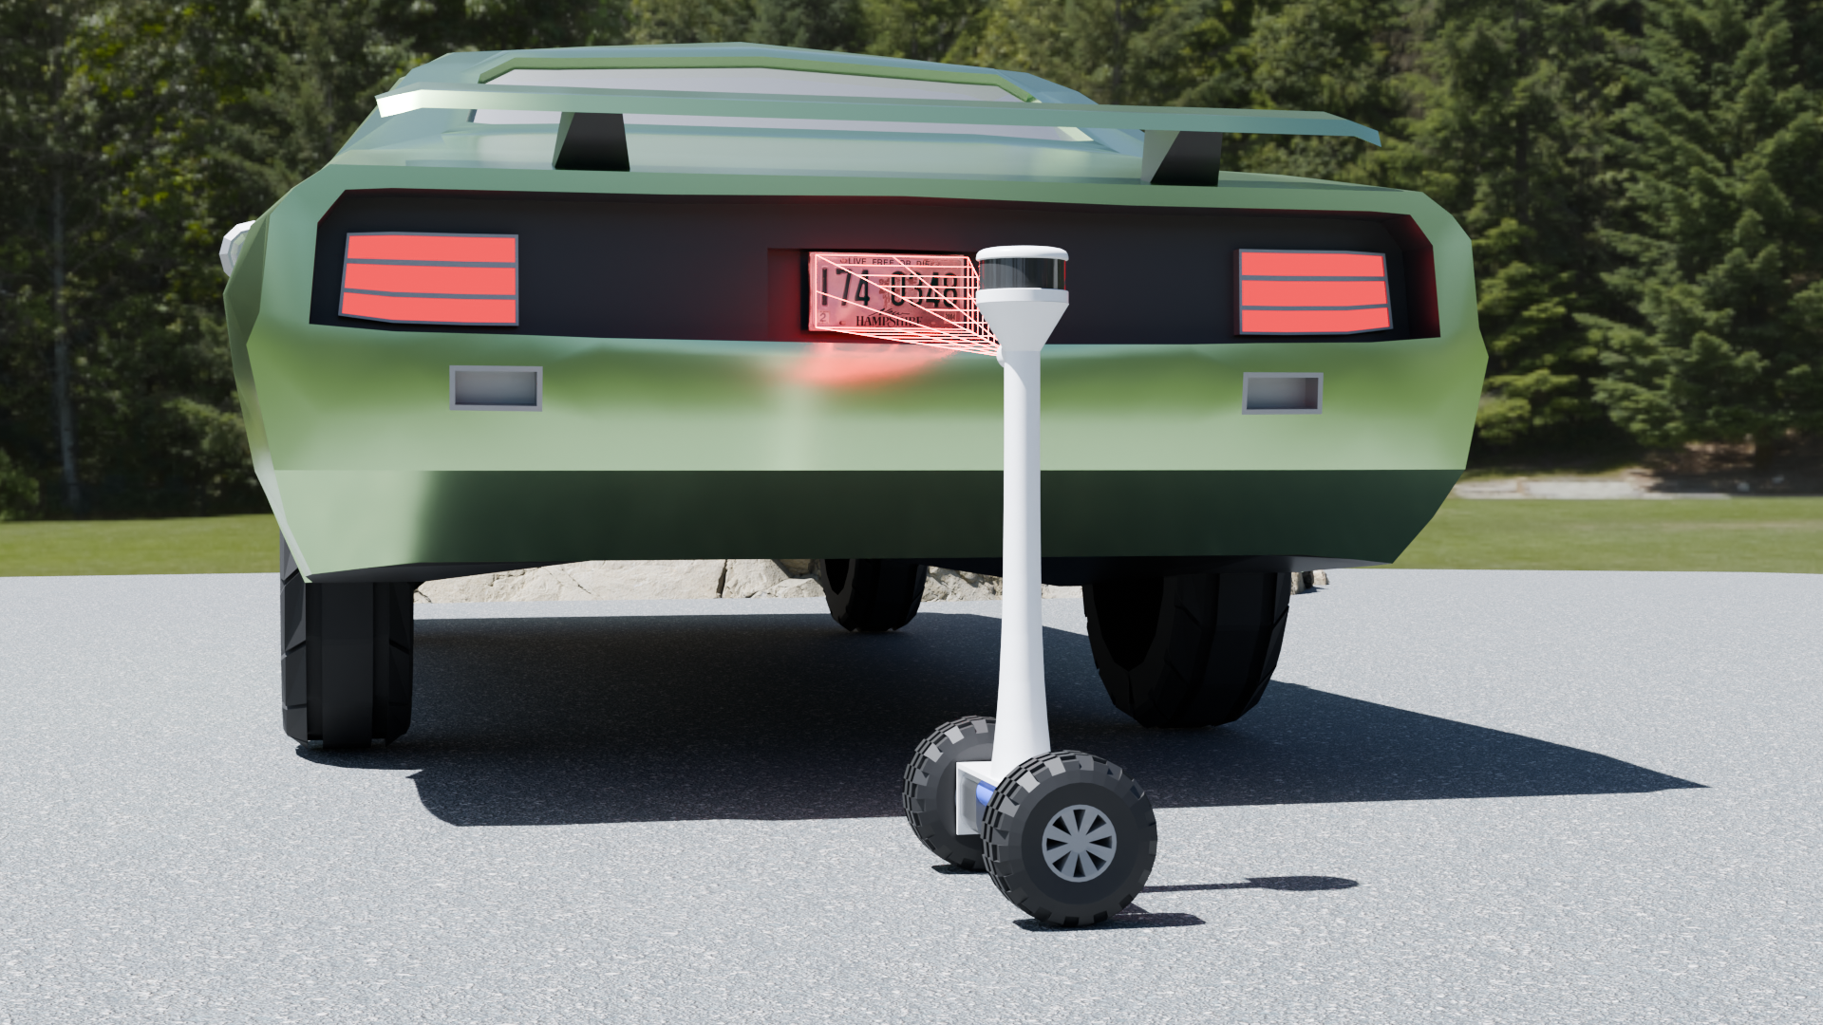
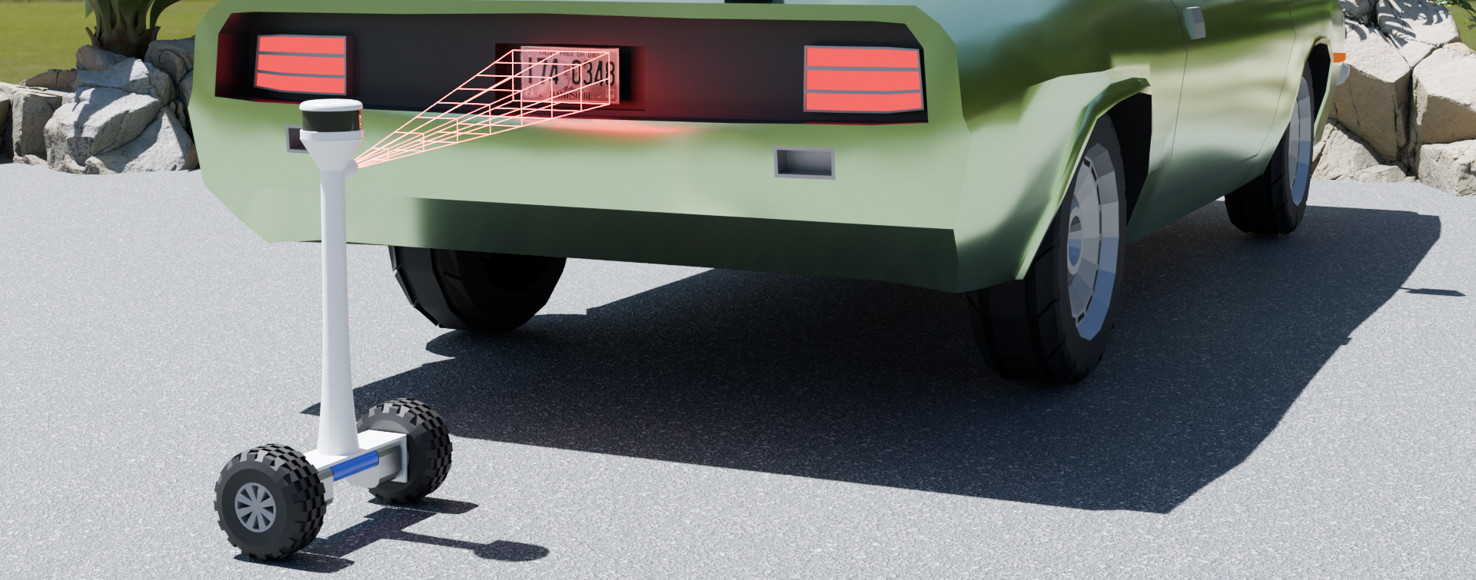
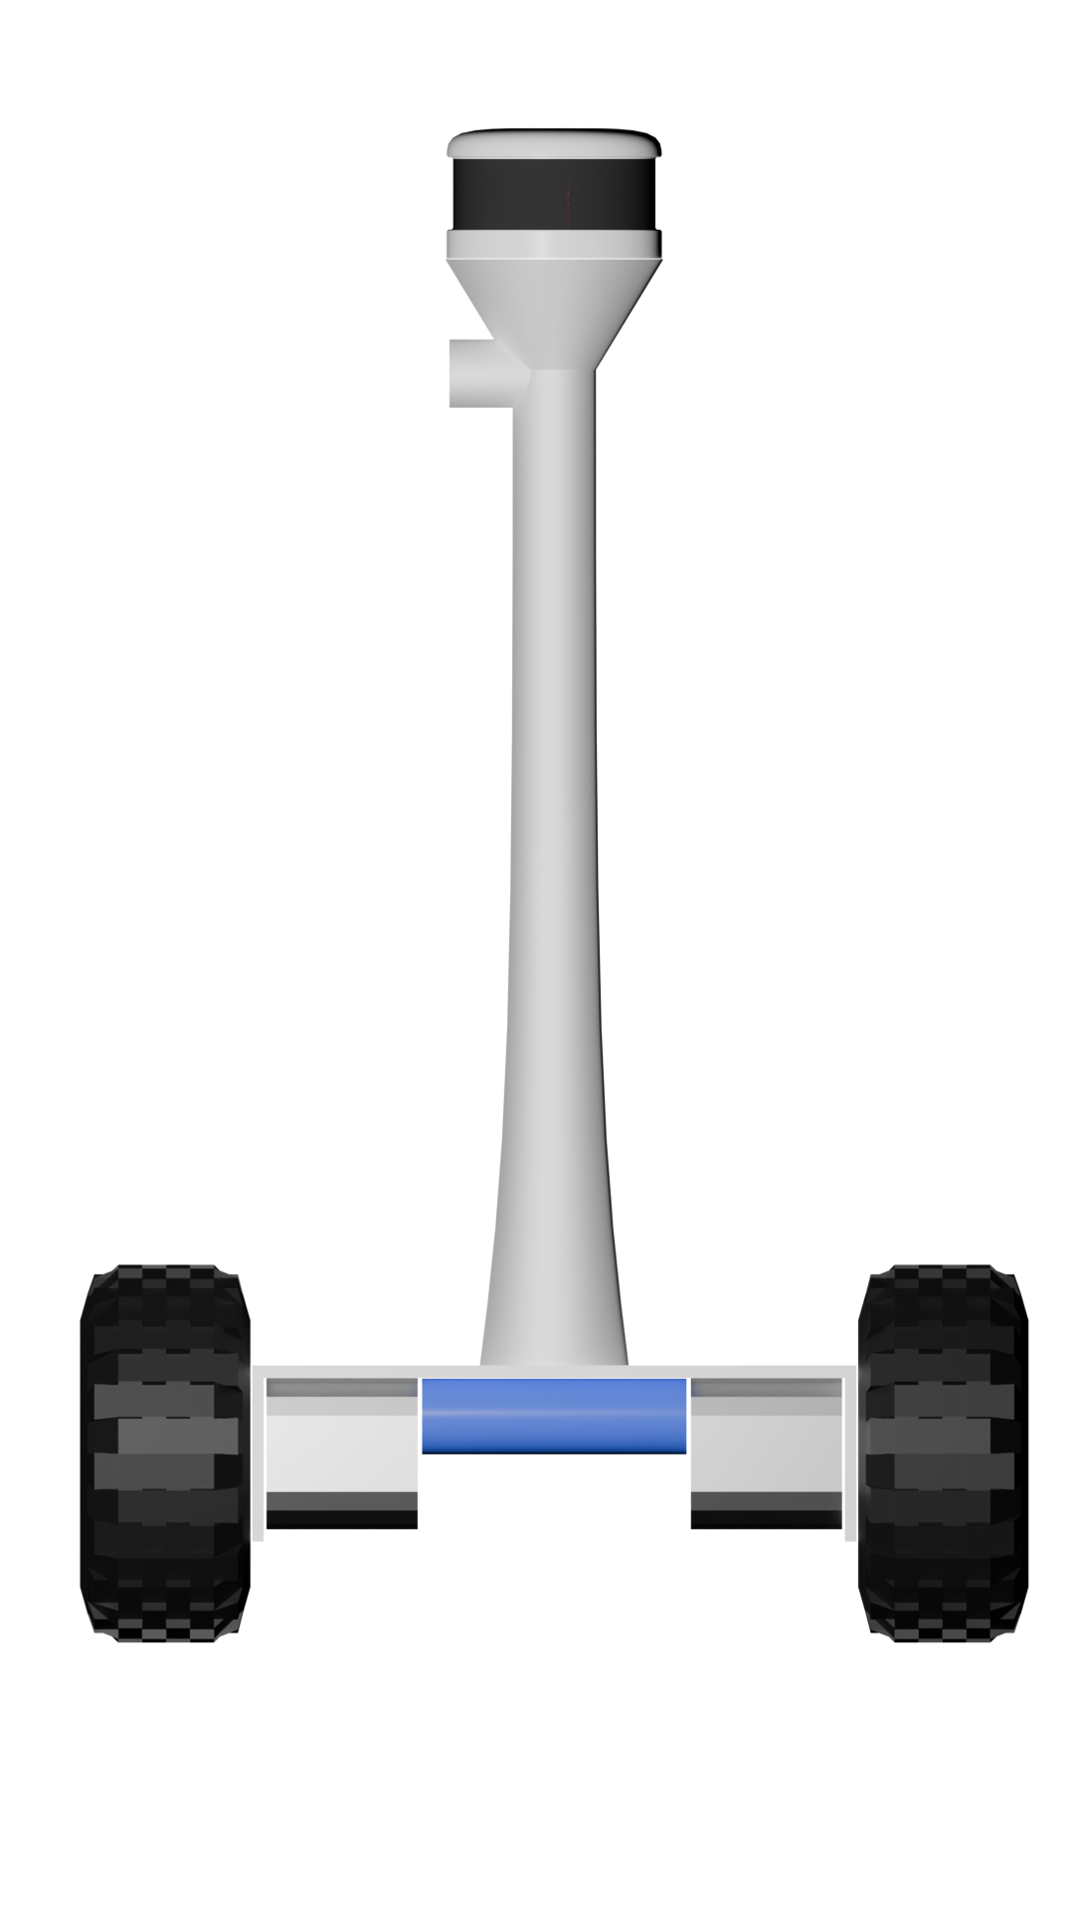
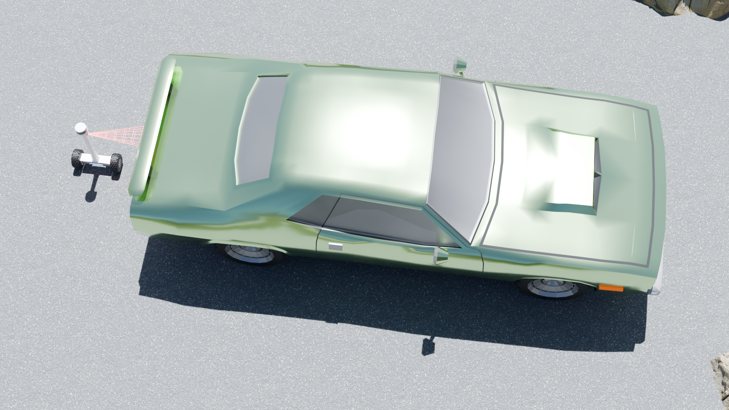
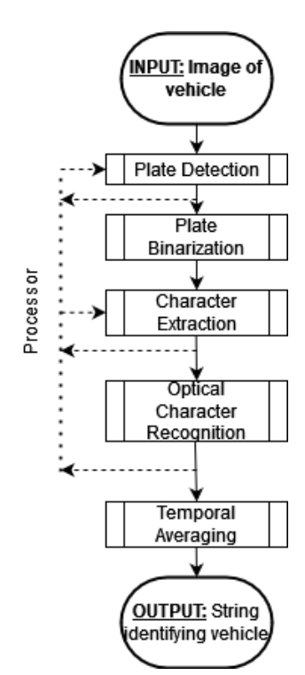
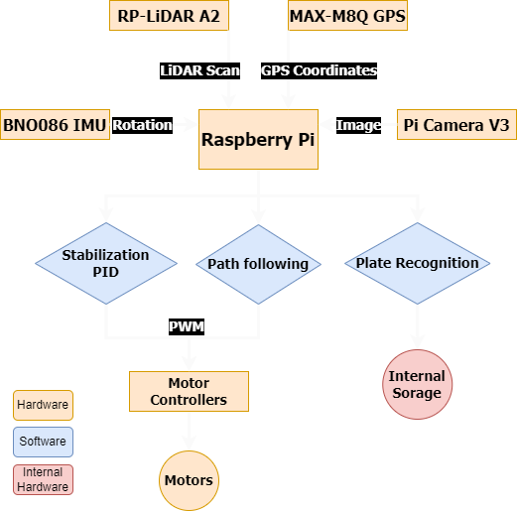
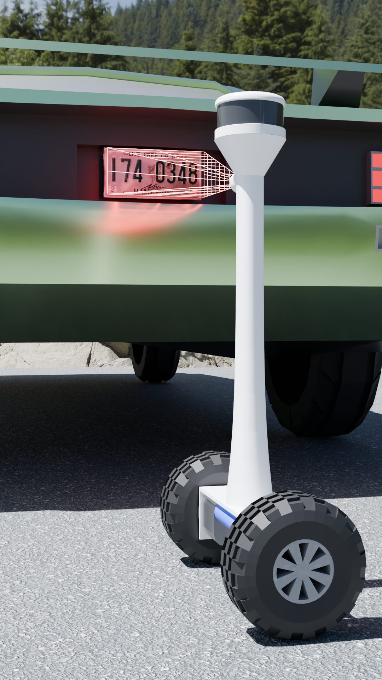
Development of an Automated Self-Balancing Robot
for Parking Pass Enforcement
Ryan Baer, UNH Computer Engineering Senior
Bryan Strawn, UNH Electrical Engineering Senior
M.D. Shaad Mahmud, Project Advisor
Introduction
Expected Results
Conclusions
Problem: How do we design and implement a system that allows a parking lot to be monitored in a safe, efficient, reliable way? What is the viability of a low-cost, low-profile autonomous robot working with machine vision, GPS, and LiDar to sweep through
a parking lot and consistently check permit status while keeping in mind the safety of pedestrians and personal property.
Background: Poor parking enforcement can cascade into a number negative effects on the surrounding area. These can include chaotic parking conditions, build up of traffic, lack of accessibility for the handicapped, loss of business to the area, and the slowdown or stoppage of emergency vehicles
Develop a two-wheel self-balancing robot(2-WSBR) for autonomous parking lot navigation.
Outfit this robot such that it can efficiently navigate through a predefined path while capturing relevant data points
Realize a Raspberry Pi 5 Single Board Computer (SBC) to work with a gyroscope, GPS, and LiDAR to allow for the operation of a 2-WSBR.
Formulate a system in which a series of GPS points can be interpreted and traversed by a 2-WSBR as a predetermined path.
Realize a system in which an SBC can input an image, detect a license plate, and interpret said image as a string to be processed in an accurate and consistent way.
Process a License Plate# as a String that can be compared to a database and allow for the flagging of unauthorized or unexpected vehicles.
Implement a LiDAR unit in such a way so as to detect and avoid obstacles as well as identify the occupancy status of a parking space.
This project is the outcome of the combination and integration of various leading technologies from multiple fields to create a robot that does not yet exist in this fashion.
The robot has the capability to stabilize on 2 wheels making it very versatile and mobile while also being small. The robot can also self navigate a path using its GPS and LiDAR modules.
Objectives: Mesh low cost components together to create a self-balancing obstacle avoiding robot that can perform a route throught a parking lot, checking for parking violations.
Artist Rendition
Figure 1: Concept in Action (Angle 1)
Background
Figure 3: Concept of Robot
Parking lot permitting is essential in areas with limited parking Spaces.
In some areas access needs to be restricted to designated individuals.
  Ie: reserving parking spaces for faculty on a college campus, as a professor that cannot park cannot teach.
Traditionally, enforcement of these permits involves personnel patrolling the lot.
  On foot or in vehicles, they have to manually to scan license plates and issue tickets to unauthorized vehicles.
  This is a time consuming process that costs a lot in man hours.
Figure 4: Concept of Action from Above
References
[1] Hau-Shiue Juang and Kai-Yew Lum. “Design and control of a two-
wheel self-balancing robot using the arduino microcontroller board”. In:
2013 10th IEEE International Conference on Control and Automation
(ICCA). 2013.
Figure 3: Optical Character Reader
Figure 4: Flow of Components
Areas for Further Study
Figure 2: Concept in Action (Figure 2)
Utilizing advanced algorithms such as deep learning-based OCR.
Enhancing license plate recognition under various lighting conditions or when plates are partially obscured.
Refine LiDAR integration with Raspberry Pi for:
Real-time obstacle detection.
Exploring advanced LiDAR models for precise navigation.
Investigate sophisticated path-planning algorithms using GPS for:
Multi-point navigation.
Effective obstacle avoidance in complex environments like parking lots.
Contribute to efficient autonomous systems for:
Parking enforcement.
Delivery.
Surveillance.
Impact
Can assist and multiply the power of parking/security enforcement
Detects how long a vehicle has been parked in a specific spot
Detects if a vehicle has a valid parking pass.
Implementing a multi-robot system would greatly improve accuracy for times of vehicle admittance and exit.
Contact Information
Ryan Baer: Senior Computer Engineer, rlb1072@usnh.edu
Bryan Strawn: Senior Electrical Engineer, bryan.strawn@unh.edu
MD Shaad Mahmud: ECE Project Advisor, MDShaad.Mahmud@unh.edu
Research Objectives
Improve and optimize on existing stationary applications such as the NH EZ-PASS system fir a more dynamic license plate reading system.
Improve upon existing bulky and expensive systems with a more lightweight agile system.
Improve upon existing dynamic LPR systems, such as the SMP Robotics S5.3ALPR
Introduce a novel system solution that integrates advanced sensors, including LiDAR and GPS to create a robust design for autonomous navigation in dynamic environments.

Slide 2
Development of an Automated Self-Balancing Robot
for Parking Pass Enforcement
Ryan Baer, UNH Computer Engineering Senior
Bryan Strawn, UNH Electrical Engineering Senior
M.D. Shaad Mahmud, Project Advisor
Introduction
Expected Results
Conclusions
Problem: How do we design and implement a system that allows a parking lot to be monitored in a safe, efficient, reliable way? What is the viability of a low-cost, low-profile autonomous robot working with machine vision, GPS, and LiDar to sweep through
a parking lot and consistently check permit status while keeping in mind the safety of pedestrians and personal property.
Background: Poor parking enforcement can cascade into a number negative effects on the surrounding area. These can include chaotic parking conditions, build up of traffic, lack of accessibility for the handicapped, loss of business to the area, and the slowdown or stoppage of emergency vehicles
Develop a two-wheel self-balancing robot(2-WSBR) for autonomous parking lot navigation.
Outfit this robot such that it can efficiently navigate through a predefined path while capturing relevant data points
Realize a Raspberry Pi 5 Single Board Computer (SBC) to work with a gyroscope, GPS, and LiDAR to allow for the operation of a 2-WSBR.
Formulate a system in which a series of GPS points can be interpreted and traversed by a 2-WSBR as a predetermined path.
Realize a system in which an SBC can input an image, detect a license plate, and interpret said image as a string to be processed in an accurate and consistent way.
Process a License Plate# as a String that can be compared to a database and allow for the flagging of unauthorized or unexpected vehicles.
Implement a LiDAR unit in such a way so as to detect and avoid obstacles as well as identify the occupancy status of a parking space.
This project is the outcome of the combination and integration of various leading technologies from multiple fields to create a robot that does not yet exist in this fashion.
The robot has the capability to stabilize on 2 wheels making it very versatile and mobile while also being small. The robot can also self navigate a path using its GPS and LiDAR modules.
Objectives: Mesh low cost components together to create a self-balancing obstacle avoiding robot that can perform a route throught a parking lot, checking for parking violations.
LiDAR
Processor, GPS, Gyroscope Assembly
Figure 1: Concept in Action (Rear Angle)
Camera
Background
Wheels/Motor Hub
Power
Plant
Parking lot permitting is essential in areas with limited parking Spaces.
In some areas access needs to be restricted to designated individuals.
  Ie: reserving parking spaces for faculty on a college campus, as a professor that cannot park cannot teach.
Traditionally, enforcement of these permits involves personnel patrolling the lot.
  On foot or in vehicles, they have to manually to scan license plates and issue tickets to unauthorized vehicles.
  This is a time consuming process that costs a lot in man hours.
Artist Rendition
Figure 3: Robot Concept Diagram
Figure 3: Optical Character Reader
Figure 4: Flow of Components
Areas for Further Study
Figure 4: Concept of Action from Above
Figure 2: Concept in Action (Close-Up)
Utilizing advanced algorithms such as deep learning-based OCR.
Enhancing license plate recognition under various lighting conditions or when plates are partially obscured.
Refine LiDAR integration with Raspberry Pi for:
Real-time obstacle detection.
Exploring advanced LiDAR models for precise navigation.
Investigate sophisticated path-planning algorithms using GPS for:
Multi-point navigation.
Effective obstacle avoidance in complex environments like parking lots.
Contribute to efficient autonomous systems for:
Parking enforcement.
Delivery.
Surveillance.
Impact
Can assist and multiply the power of parking/security enforcement
Detects how long a vehicle has been parked in a specific spot
Detects if a vehicle has a valid parking pass.
Implementing a multi-robot system would greatly improve accuracy for times of vehicle admittance and exit.
References
[1] Hau-Shiue Juang and Kai-Yew Lum. “Design and control of a two-
wheel self-balancing robot using the arduino microcontroller board”. In:
2013 10th IEEE International Conference on Control and Automation
(ICCA). 2013.
Research Objectives
Improve and optimize on existing stationary applications such as the NH EZ-PASS system fir a more dynamic license plate reading system.
Improve upon existing bulky and expensive systems with a more lightweight agile system.
Improve upon existing dynamic LPR systems, such as the SMP Robotics S5.3ALPR
Introduce a novel system solution that integrates advanced sensors, including LiDAR and GPS to create a robust design for autonomous navigation in dynamic environments.
Contact Information
Ryan Baer: Senior Computer Engineer, rlb1072@usnh.edu
Bryan Strawn: Senior Electrical Engineer, bryan.strawn@unh.edu
MD Shaad Mahmud: ECE Project Advisor, MDShaad.Mahmud@unh.edu

Slide 3
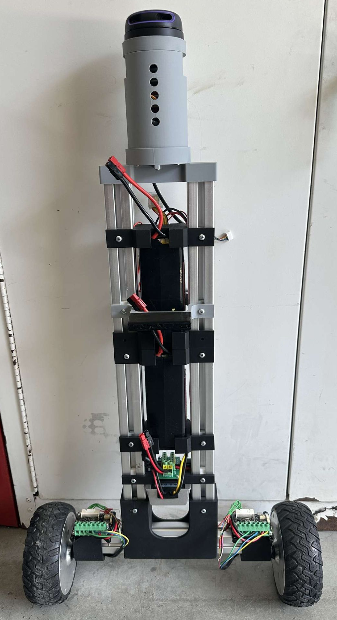
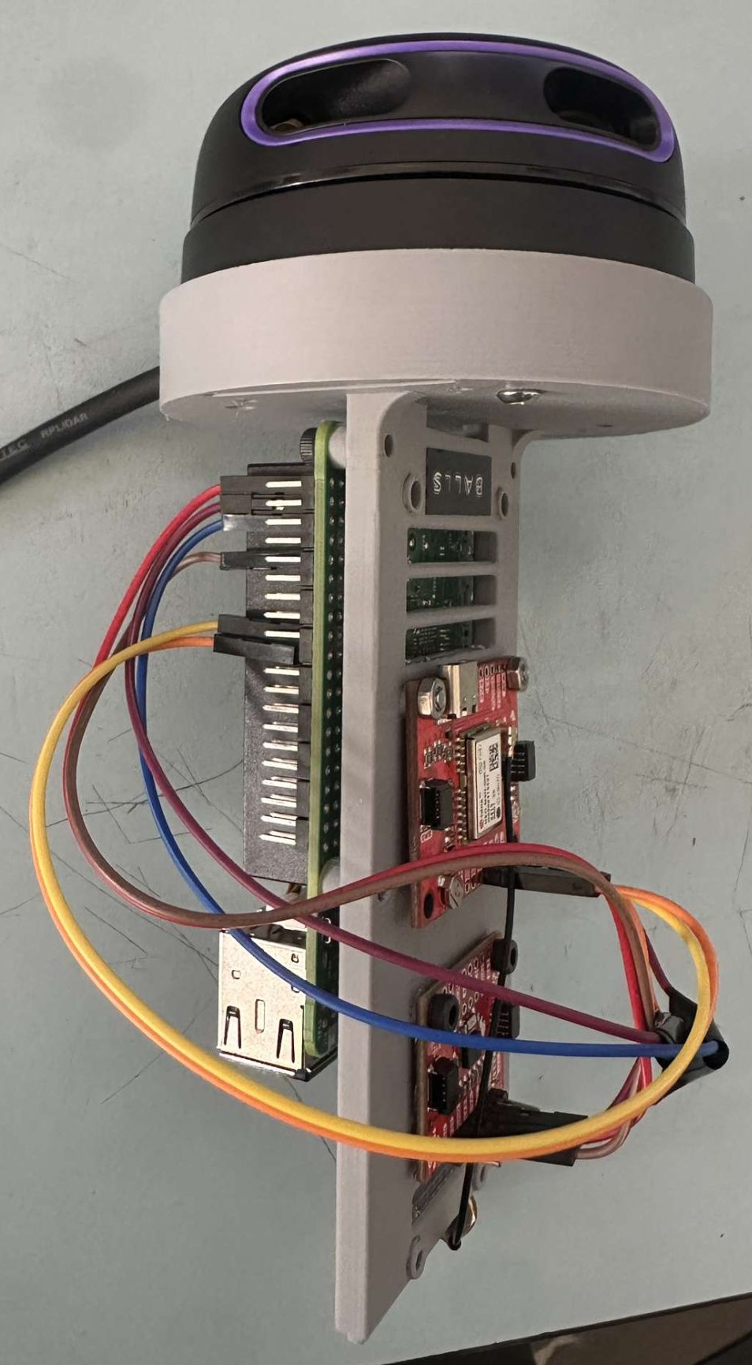
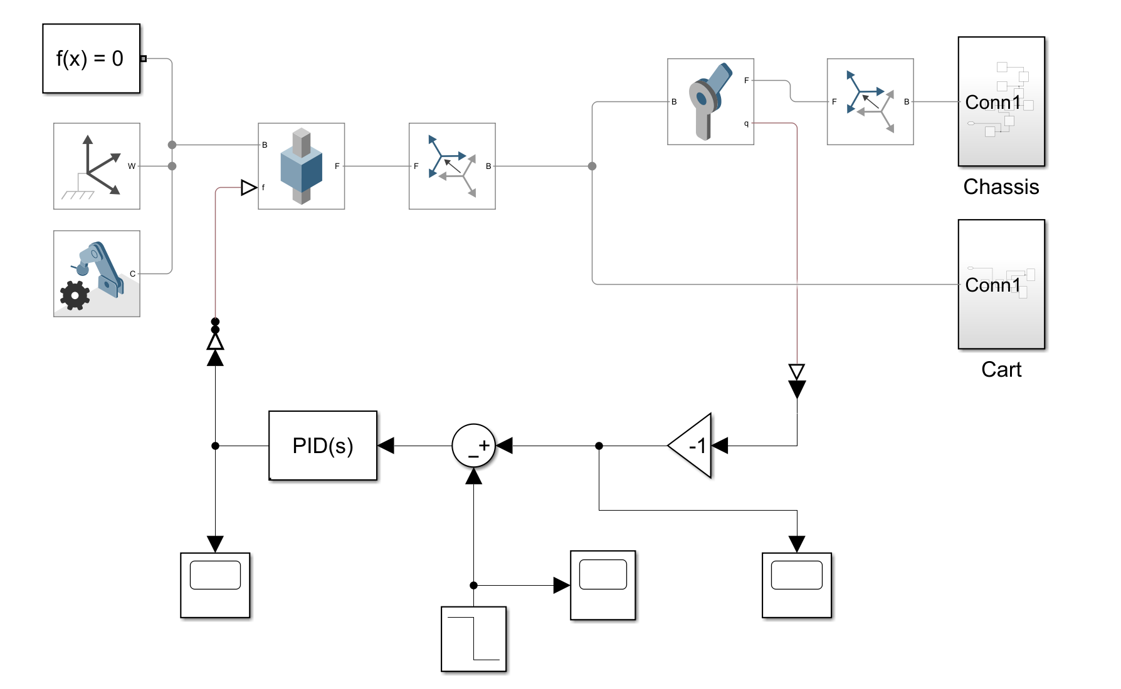
Development of an Automated Self-Balancing Robot
for Parking Pass Enforcement
Ryan Baer, UNH Computer Engineering Senior
Bryan Strawn, UNH Electrical Engineering Senior
M.D. Shaad Mahmud, Project Advisor
Introduction
Results
Conclusions
Problem: How do we design and implement a system that allows a parking lot to be monitored in a safe, efficient, reliable way? What is the viability of a low-cost, low-profile autonomous robot working with machine vision, GPS, and LiDar to sweep through
a parking lot and consistently check permit status while keeping in mind the safety of pedestrians and personal property.
Background: Poor parking enforcement can cascade into a number negative effects on the surrounding area. These can include chaotic parking conditions, build up of traffic, lack of accessibility for the handicapped, loss of business to the area, and the slowdown or stoppage of emergency vehicles
Developed a 2 wheeled balancing robot from scratch
All major parts were 3D printed and custom designed for the project
Raspberry Pi 5 used as processor to process data from BNO086 IMU, NEO-M9N GPS, and RP-LiDAR A2
PID Loops utilized to maintain balance and for locomotion
Used simulated Simulink models for accurate controller tuning before implementation on physical model
Data from NEO-M9N allowing the bot to know where it is located and where it needs to go
This project is the outcome of the combination and integration of various leading technologies from multiple fields to create a robot that does not yet exist in this fashion.
The robot has the capability to stabilize on 2 wheels making it very versatile and mobile while also being small. The robot can also self navigate a path using its GPS and LiDAR modules.
Objectives: Mesh low cost components together to create a self-balancing obstacle avoiding robot that can perform a route through a parking lot, checking for parking violations.
LiDAR
Processor, GPS, Gyroscope Assembly
Figure 1: Rear View – Concept in Action
Camera
Background
Wheels/Motor Hub
Power
Plant
In areas with constrained parking availability, effective permit enforcement is essential.
To maintain proper use, access to certain parking areas must be restricted to permitted or authorized individuals.
  For example: reserving parking spaces for faculty on a college campus, as a professor that cannot park cannot teach.
Traditionally, parking permit enforcement relies on personnel patrolling the lot, either on foot or in vehicles. They must manually scan license plates and issue citations to unauthorized vehicles—a time-consuming process that incurs significant labor costs.
Enforcement frequency is often limited by staff availability.
Coverage may vary depending on time of day or personnel schedules.
Artist Rendition
Figure 4: Closed-Loop Control Diagram (Simulink Model)
Figure 5: Labeled Robot Diagram
Figure 3: Data Processing Center
Areas for Further Study
Figure 2: Operational
Concept – Ground View
Train custom object detection models to detect vehicle types, parking lines, or pedestrian zones.
  Ex) YOLOv8
Implement adaptive LQR control for improved balancing and stability under dynamic conditions (e.g., slopes, uneven pavement).
Develop robust SLAM (Simultaneous Localization and Mapping) for autonomous mapping of parking lots without pre-defined GPS waypoints.
Explore machine learning for terrain classification, allowing dynamic speed adjustment based on ground surface or weather conditions.
Incorporate solar or regenerative charging options for improved sustainability in parking lot environments.
Design a fail-safe return-to-base protocol using GPS + LiDAR to safely navigate back when battery is low or signal is lost.
Investigate coordination strategies for multiple self-balancing robots to collaboratively map, monitor, or enforce large parking areas.
Impact
Can assist and multiply the power of parking/security enforcement
Detects how long a vehicle has been parked in a specific spot
Detects if a vehicle has a valid parking pass.
Implementing a multi-robot system would greatly improve accuracy for times of vehicle admittance and exit.
Figure 6: Digital Prototype
Figure 7: Overhead Action Concept
References
[1] Hau-Shiue Juang and Kai-Yew Lum. “Design and control of a two-
wheel self-balancing robot using the arduino microcontroller board”. In:
2013 10th IEEE International Conference on Control and Automation
(ICCA). 2013.
Research Objectives
Improve and optimize on existing stationary applications such as the NH EZ-PASS system for a more dynamic license plate reading system.
Improve upon existing bulky and expensive systems with a more lightweight, agile system.
Improve upon existing dynamic LPR systems, such as the SMP Robotics S5.3ALPR
Introduce a novel system solution that integrates advanced sensors, including LiDAR and GPS, to create a robust design for autonomous navigation in dynamic environments.
Contact Information
Ryan Baer: Senior Computer Engineer, rlb1072@usnh.edu
Bryan Strawn: Senior Electrical Engineer, bryan.strawn@unh.edu
MD Shaad Mahmud: ECE Project Advisor, MDShaad.Mahmud@unh.edu

