Slide 1


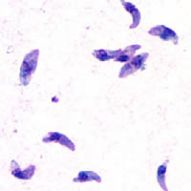
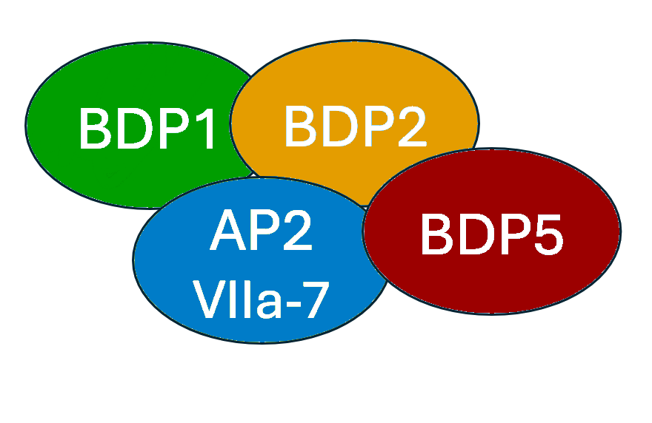
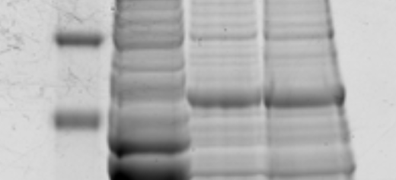
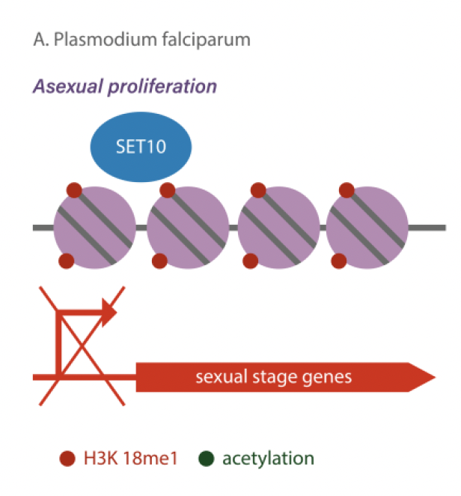
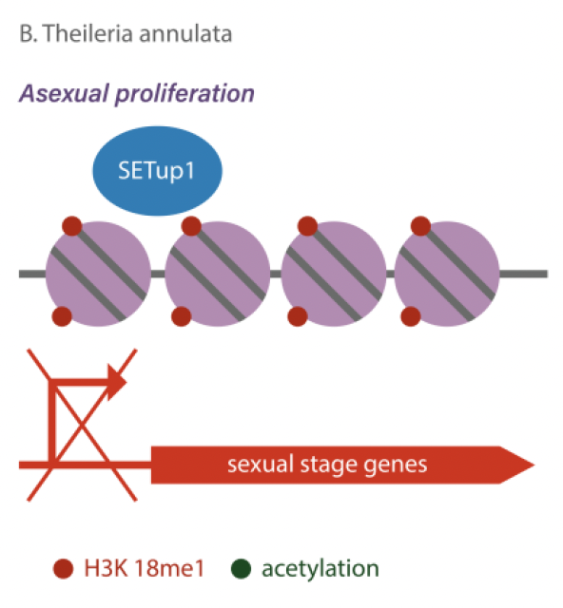
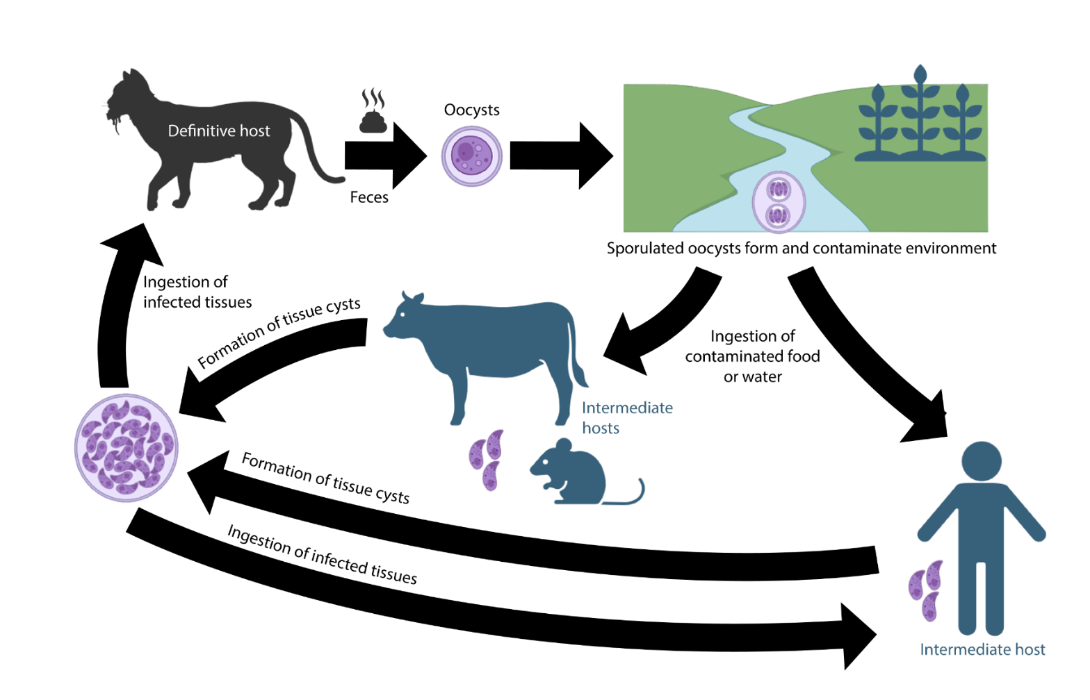
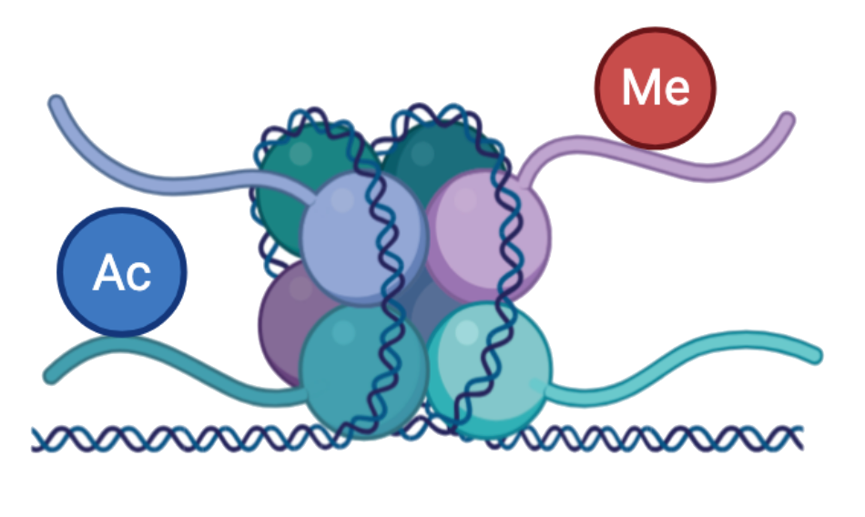
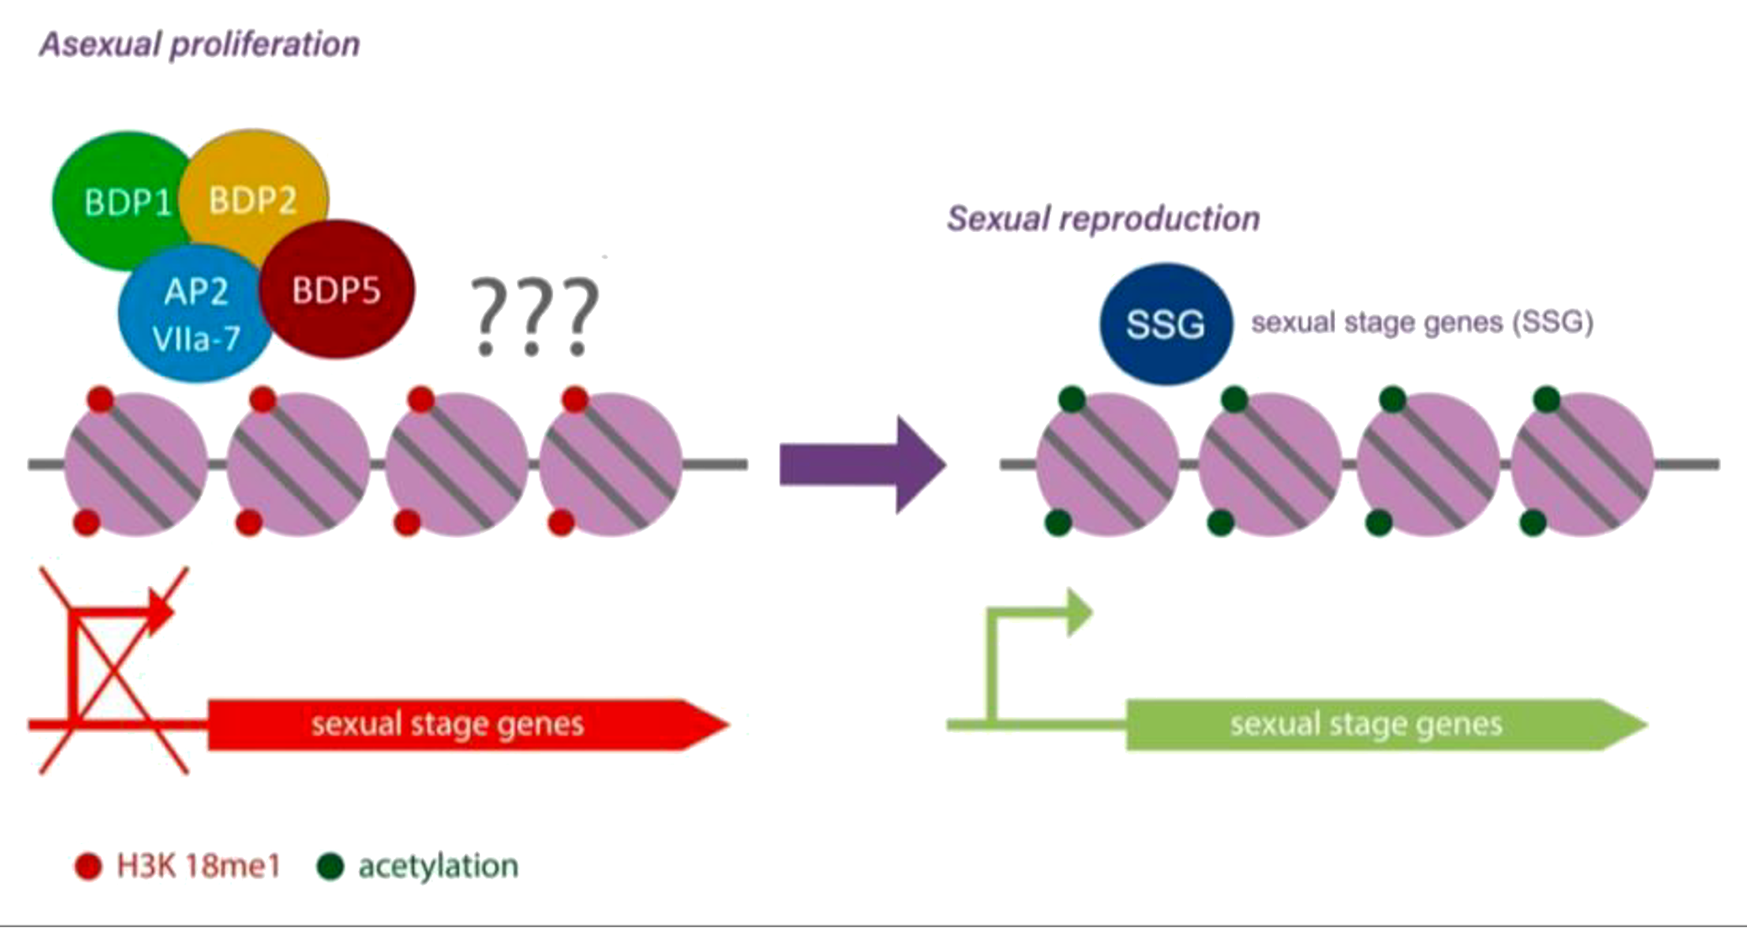
Assessing the Histone Methyltransferase Activity of the SET Domain of AP2VIIa-7 in Toxoplasma gondii
Ria Varki, Kendall Reidenbach, and Dr. Vicki Jeffers
Department of Molecular, Cellular and Biomedical Sciences, University of New Hampshire, Durham, NH 03824
Toxoplasma gondii
Bromodomain Complex: BDP1 Knockdown Results in Upregulation of Sexual Stage Genes
Determining APIIVa-7 SET Domain Methyltransferase Activity
An apicomplexan parasite that infects approximately a third of the world's population
Pregnant and immunocompromised populations are at high risk for disease complications
No cure for chronic infections
Regulation of gene expression helps T. gondii maintain infection in the host
Aim 1. Evaluate the histone methyltransferase activity of the AP2VIIa-7 SET domain.
Put AP2VIIa-7 SET domain into BL21 E. coli cells
Express protein, and confirm with SDS-PAGE gels
→ Proteins are separated by size
Isolate protein and check purification on an SDS-PAGE gel
→ Band at 55kDa
Use Methyltransferase Assay to confirm methylation
BDP1 is essential to T. gondii
→Loss of TgBDP1 results in massive gene
dysregulation
→ Upregulation of several sexual stage genes
AP2VIIa-7 is not essential for asexual proliferation
→ Contains SET, PHD zinc finger, and AP2 domain
→ Loss of AP2VIIa-7 results in decreased proliferation
Figure 4. Predicted BDP complex
Ladder
Flow Through
Without
Urea
Urea
Figure 1. Stained T. gondii tachyzoites
SET Domains in Other Apicomplexans Repress Sexual Stage Genes During Asexual Proliferation
62 kDa
55 kDa
Understanding how T. gondii controls gene expression can aid in the discovery of new drug targets
49 kDa
Figure 7. SDS-PAGE gel displaying the localization of the protein
Histone Modifications help T. gondii switch between life cycle stages
Aim 2. Determine how the loss of AP2VIIa-7 impacts histone methylation in T. gondii.
Extracting nuclear lysate from parasites
Performing Western Blots
→ Proteins are separated by size and visualized with antibodies
Sexual Replication
Control -IAA +IAA
RH AP2VIIa-7 - AP2VIIa-7
17 kDa
Figure 5. The role of histone methylation in suppressing sexual stage genes during asexual replication in P. falciparum and Th. annulata. Adapted from (2)
H3K18me1
Figure 8. Western Blots displaying changes in H3K18me1 methylation during AP2VIIa-7 knockdown
H3K18 – associated with sexual gene repression in other apicomplexans
P. falciparum – causative agent of malaria
Th. annulata – tick-transmitted parasite that causes tropical theileriosis
Summary and Future Directions
Asexual Replication
Studying AP2VIIa-7 and its role in T. gondii
SET domain is a predicted methyltransferase and might be recruited by BDP1 to repress sexual stage genes in asexually dividing T. gondii
Western blots were performed to see what histone residues AP2VIIa-7 SET domain might be methylating
The recombinant SET domain is being purified to test its methyltransferase capabilities
Future experiments
→ Potentially testing inhibitory compounds on AP2VIIa-7 SET domain
→ Testing other domains of AP2VIIa-7 for interaction with DNA/histones
→ Quantify histone methylation levels at sexual stage genes
Knowing AP2VIIa-7 function gives us further insight into the BDP complex which could support the notion of them being future drug targets for disease
Hypothesis
Figure 2. The life cycle of T. gondii and known routes of transmission to humans. Taken from (2)
AP2VIIa-7 methylates H3K18 and regulates sexual stage gene expression.
Histone Modifications:
Post-translation modifications to histone proteins
→ Examples:
acetylation, methylation
Alters chromatin structure affecting gene expression
Acknowledgments
Figure 3. Histone with methylation and acetylation mark
Undergraduate Research Award courtesy of the Hamel Research Center
Supported by UNH CIBBR
Logan Brown and Krisztina Varga, UNH Molecular, Cellular & Biomedical Science
Current and previous members of the Jeffers Lab
Bromodomain proteins (BDP) – binds acetylated lysine residues on histones and recruit transcriptional machinery
SET domain – A region in some proteins that typically has methyltransferase activity
References
Fleck, K., McNutt, S., Chu, F., & Jeffers, V. (2022, January 1). An apicomplexan bromodomain, TGBDP1 associates with diverse epigenetic factors to regulate essential transcriptional processes in Toxoplasma gondii. bioRxiv. Retrieved April 2, 2023, from https://www.biorxiv.org/content/10.1101/2022.12.24.521857v1
Reidenbach K, Jeffers V. Epigenetic Regulation of Sexual Development in the Eukaryotic Pathogen Toxoplasma gondii. Poster presented at: College of Integrated Biomedical and Bioengineering Research (CIBBR) Retreat; 2024 Sep 15; Memorial Union Building.
Cheeseman K, Jannot G, Lourenço N, Villares M, Berthelet J, Calegari-Silva T, et al. Dynamic methylation of histone H3K18 in differentiating Theileria parasites. Nat Commun. 2021 May 28;12(1):3221.
Musabyimana JP, Musa S, Manti J, Distler U, Tenzer S, Ngwa CJ, et al. Plasmodium falciparum SET10 is a histone H3 lysine K18 methyltransferase that participates in a chromatin modulation network crucial for intraerythrocytic development [Internet]. bioRxiv; 2024 [cited 2024 Sep 17]. p. 2024.07.05.602231. Available from: https://www.biorxiv.org/content/10.1101/2024.07.05.602231v1
Figure 6. Hypothesized role for AP2VIIa-7 in suppression of sexual differentiation in T. gondii. Adapted from (5).

