Slide 1







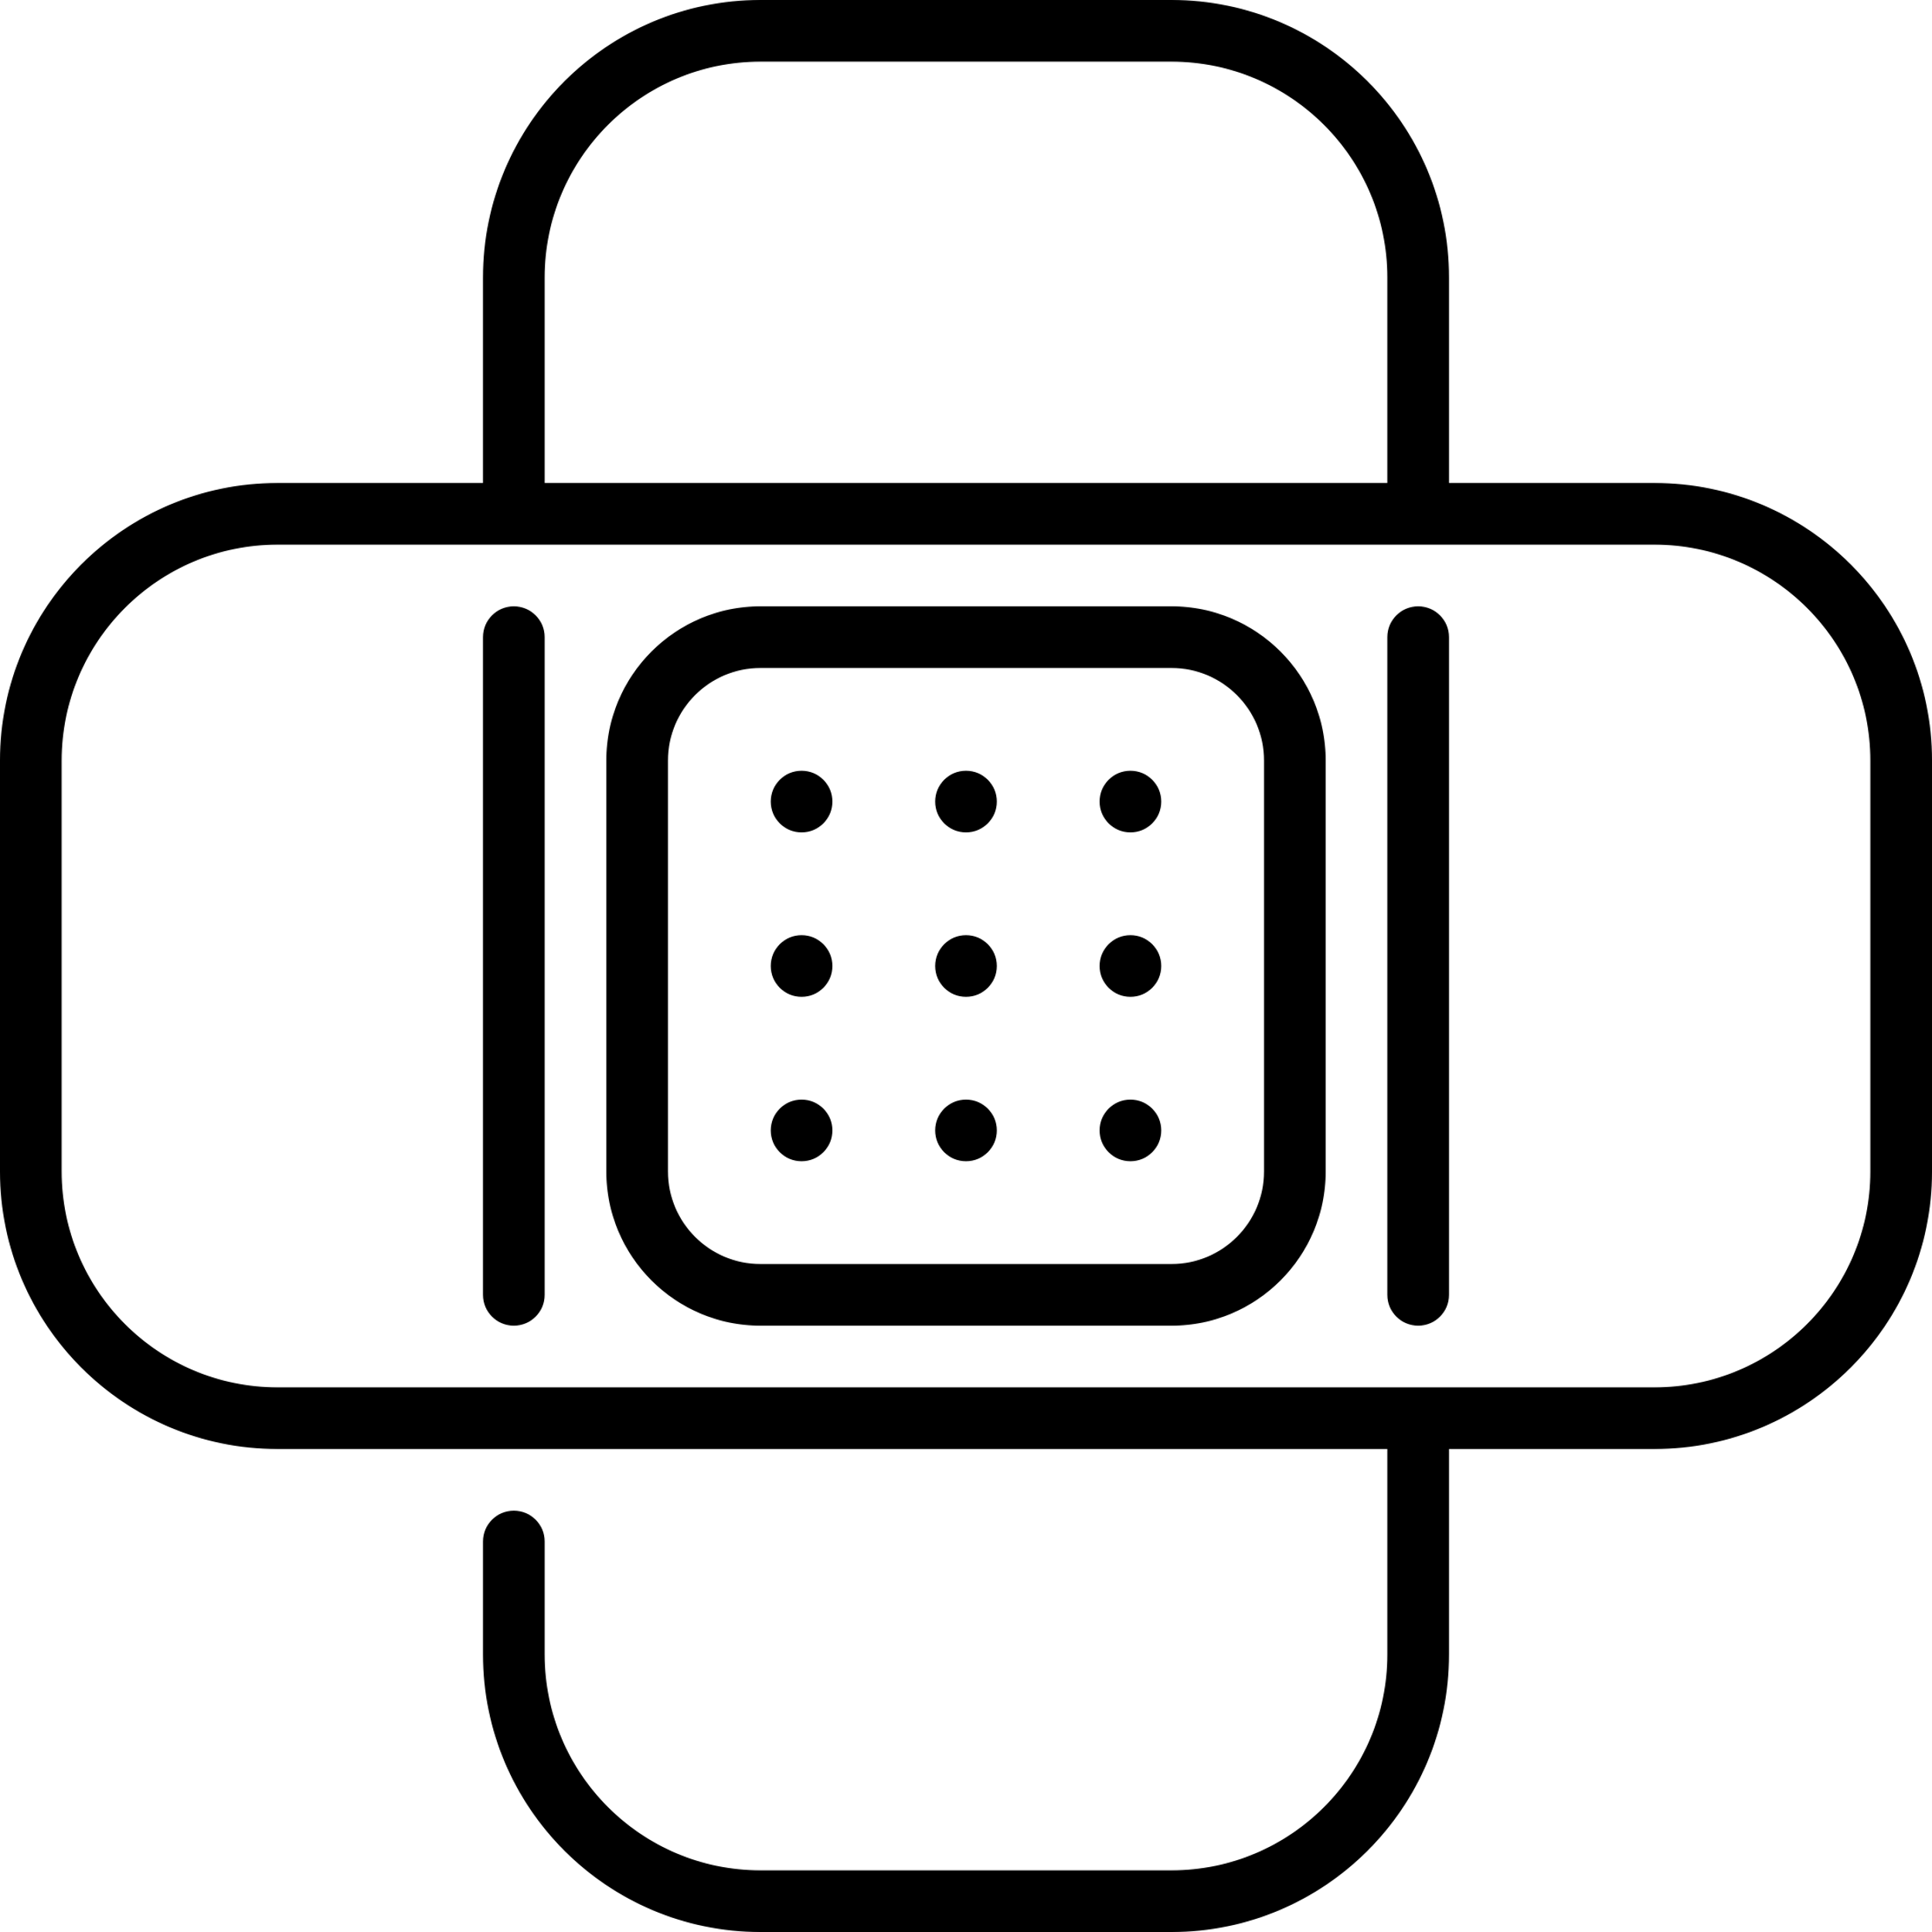







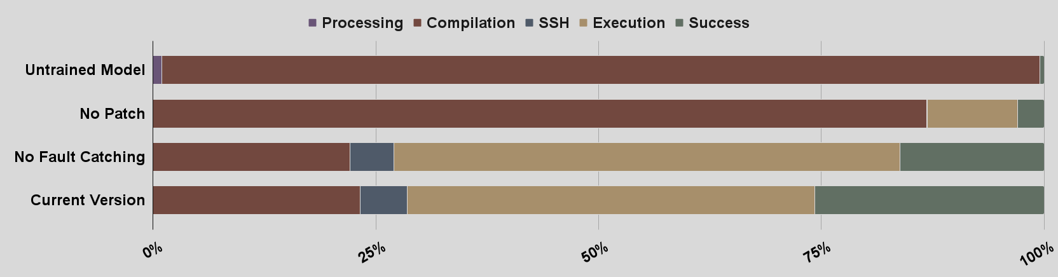
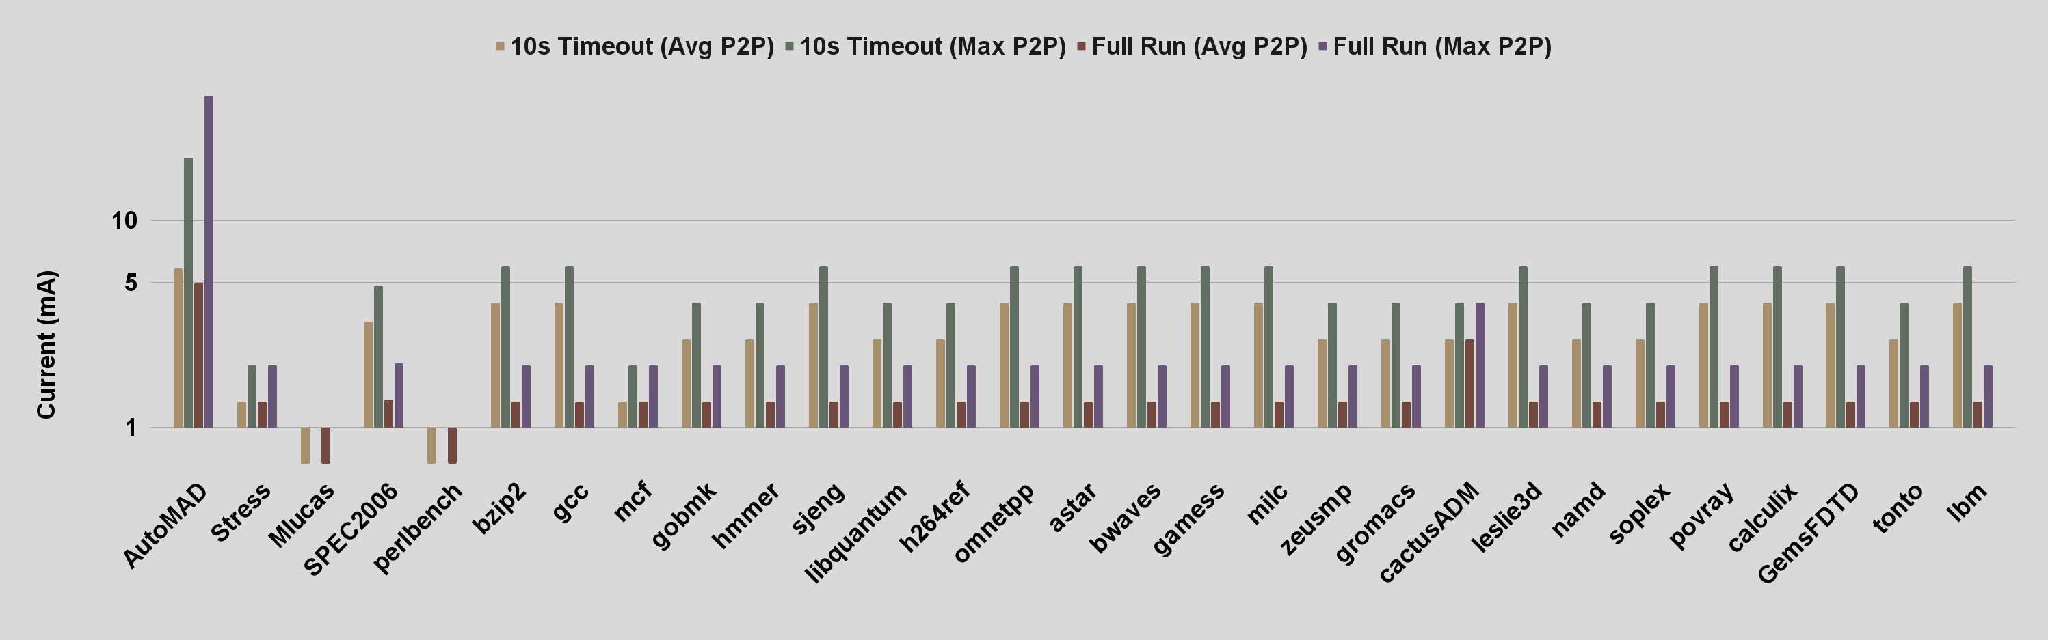
AutoMAD: Leveraging Large Language Models for Automated Microarchitectural Attack Discovery
Skylar Gagnon cng1022@usnh.edu
Advised by Prof. Dean Sullivan
Department of Electrical and Computer Engineering, University of New Hampshire, Durham, NH
Introduction
AutoMAD Framework
Implementation: The Classifier
Problem
Securing processors needs to be efficient and effective
Current Limitations
Manual Efforts
  Requires extensive reverse engineering
  Struggles to find undocumented features
  Method behind most novel discoveries
Architectural Fuzzing
  Struggles to discover novel attacks
  Can cover a large search space
  Mostly automatic process
Goal
Develop a novel architectural fuzzer capable of discovering microarchitectural attacks on ARM systems
AutoMAD
Classifier
Code Target: fault injection attack
Cause: Rapid oscillations in power which disrupts the voltage regulator
How to Monitor (Machine Specific):
Nvidia Jetson AGX Orin comes with a INA3221 power monitor
Samples current on the CPU and CV combined rail
How to Analyze:
Calculates average peak-to-peak, flags snippet if within the top-n
Generator
Configuration
Custom LLM
Snippet
Preprocess
Compile
SSH
Patch
Logger
DUT
Monitor
Snippet
Stats
Malicious Snippets
Update Log
Results
Analyze
SSH
Execute
Results
Run Log
Figure 1: AutoMAD Block Diagram
Generator
Purpose: Create malicious code snippets written in ARM assembly
How: A custom trained Large Language Model (LLM) generates code
Classifier
Purpose: Classify snippets as malicious or benign and collect run statistics
How:
During each processing stage a flag is set in the event a failure occurs
The monitor thread records hardware events during snippet execution
The measurements are analyzed to determine if the snippet is malicious
Snippet, measurements, and flags are then passed to the Logger
Logger
Purpose: Save run statistics and potentially malicious snippets
How: Parses Classifier results and updates relevant files
Experimental Setup:
GPU: Nvidia RTX A2000 12GB
DUT: ARMv8 Cortex-A78AE , Ubuntu 20.04.6, Kernel 5.10.104-tegra
Fuzzing Time: 12h
Version Comparison:
Motivation
Rise of cloud computing and shared hardware scenarios
Hardware is complex, undocumented, and closed-source
Lack of system security research on ARM processors
Growth of ARM market share in multiple sectors
Figure 2: Percent of snippets failed at each stage of classification
BACKGROUND
Peak-to-Peak Comparison:
Implementation: The Generator
Work | Arch | Open-Source? | Blackbox? | Guided?
IntroSpectre [1] | RISC-V | ✘ | ✘ | ✓
Revizor [2] | x86 | ✓ | ✓ | ✘
SpecDoctor [3] | RISC-V | ✓ | ✘ | ✓
Transynther [4] | x86 | ✓ | ✓ | ✘
Zenbleed [5] | x86 | ✘ | ✓ | ✓
AutoMAD | ARM | ✓ | ✓ | ✓
Methodology: Three Stage Training Approach
Stage | Goal | Train Algo | Time
1 | Familiarize model to ARM assembly | SFT | 2d
2 | Reward successful compilation + execution | PPO | 14d
3 | Reward high peak-to-peak current | ODPO | 5d
Figure 3: Maximum and average peak-to-peak currents during code runtime
Partial Responses
Conclusions
References
Base Model: Qwen2-0.5B-Instruct [6] | Trained Model: AutoMAD-RL-3
@loca8 main2 proc *loca1 int_main 0x40000000 3,3 *loca2 asm( #0x40000001 0x60 ) 10 *loca3 asm( #0x40000002 0x70 ) 20 ARM assembly can't directly perform this type of attack due to the limitations of the hardware and software. . . | stp x29, x30, [sp, -16]! mov x29, sp str wzr, [sp, 48] ldrsw x1, [sp, 44] add x0, x1, 1 cmp x0, 15 bhi BRANCH3
The AutoMAD framework proves to be a promising method of discovering microarchitectural attacks
Future Work
Expand AutoMAD to x86 systems
Expand to discover more types of attacks
[1] M. Ghaniyoun, K. Barber, Y. Zhang, and R. Teodorescu, “IntroSpectre: A pre-silicon framework for discovery and analysis of transient execution vulnerabilities,” in 2021 ACM/IEEE 48th Annual International Symposium on Computer Architecture (ISCA). IEEE, 2021, pp. 874–887.
[2] O. Oleksenko, C. Fetzer, B. Kopf, and M. Silberstein, “Revizor: Testing black-box CPUs against speculation contracts,” in Proceedings of the 27th ACM International Conference on Architectural Support for Programming Languages and Operating Systems, 2022, pp. 226–239.
[3] J. Hur, S. Song, S. Kim, and B. Lee, “Specdoctor: Differential fuzz testing to find transient execution vulnerabilities,” in Proceedings of the 2022 ACM SIGSAC Conference on Computer and Communications Security, 2022, pp. 1473–1487.
[4] D. Moghimi, M. Lipp, B. Sunar, and M. Schwarz, “Medusa: Microarchitectural data leakage via automated attack synthesis,” in 29th USENIX Security Symposium (USENIX Security 20), 2020, pp. 1427–1444.
[5] T. Ormandy, “Zenbleed,” 2023.
[6] A. Yang, B. Yang, B. Hui, B. Zheng, B. Yu, C. Zhou, C. Li, C. Li, D. Liu, F. Huang et al., “Qwen2 technical report,” arXiv preprint arXiv:2407.10671, 2024.

