Slide 1
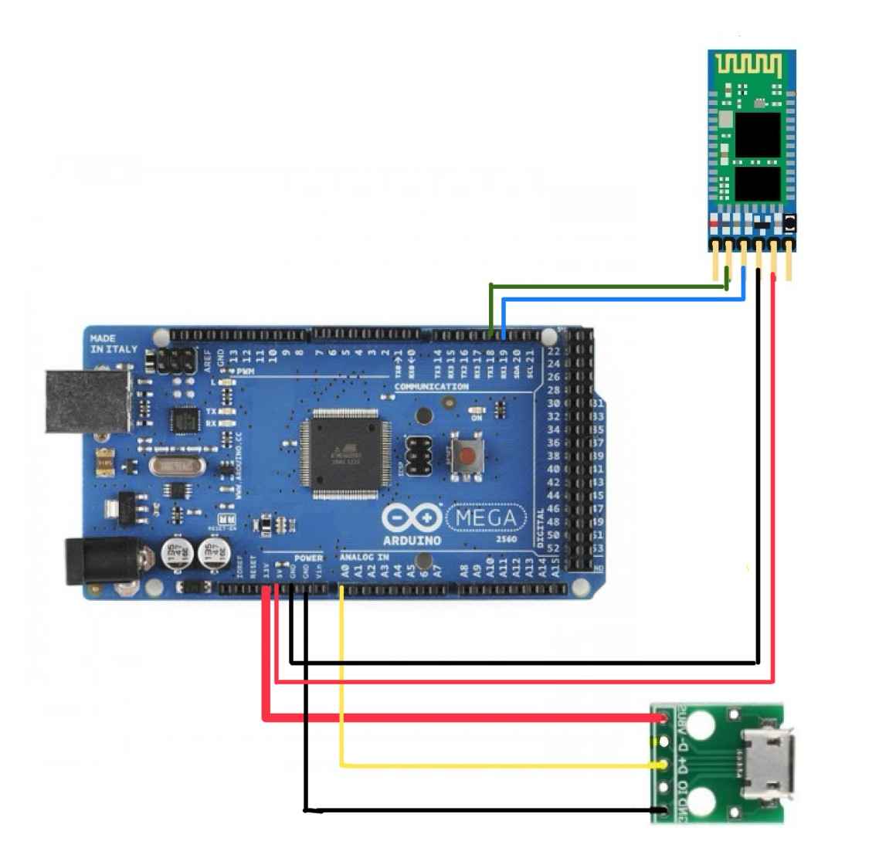
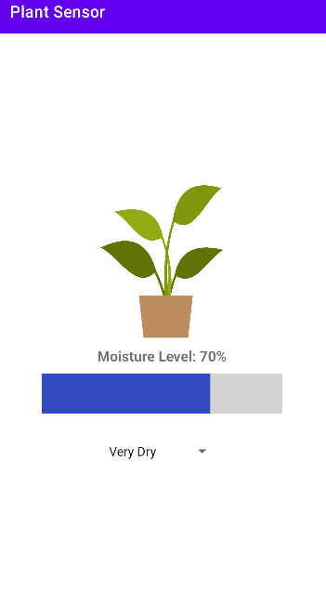
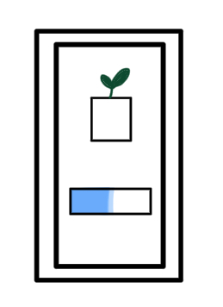
PlantaSanté: Real-Time Plant Health
Taylor Porter, Leighton Menter, Innovation Scholars, University of New Hampshire
background
Hardware
Conclusions
House plants are notoriously difficult to care for. While there are apps out right now that try to address this problem, but they require a fair amount of prior-knowledge of the needs of your plant, which most average people don’t have. Additionally, they don’t give you any updates about your plant, just preset reminders to water it.
Our app helps to combat some of the uncertainty that comes with plant health in real-time, without having to know all the ins and outs of your plant.
The center of our device is an Arduino MEGA which is connected to both a PlantMate soil moisture sensor and an HC-05 Bluetooth module. The soil moisture sensor reads in raw values and converts them to a percent value before sending them via the Bluetooth connection to be processed by the app.
Taking care of plants shouldn’t have to be so difficult. This app can help those looking to care for plants in their personal lives or be adapted for monitoring plant health in greenhouses.
While it doesn’t eliminate all complications when caring for plants, this app can help to identify what may have contributed to a plant’s poor health and help avoid common issues such as overwatering.
Future Plans
objectives
In the future, we’re hoping to make the device into a self-contained unit that would make it easier to use, as well as expand it with more sensors for humidity and levels of sunlight. We’d also like to explore compatibility with Apple devices and a predictive aspect based on the past sensor data.
Our objective going in was to create a device that could monitor the water levels of a plant’s soil and send that data in real-time to an app that can notify the user with specific information about their plant’s health. We wanted to create something that was easy to use and didn’t require a lot of research into a specific plant’s needs.
software
Using Android Studio, we developed an app that could receive Bluetooth data from the device and process it into a percentage which then displays accordingly on the app. We have a few set percent ranges based on the water needs of the plant, and programmed the app to send push notifications whenever the percent read in from the device leaves this ideal range.
Acknowledgements
UNH InterOperability Lab
Instructors: Kyle Ouellette and Dean Sullivan

