Slide 1

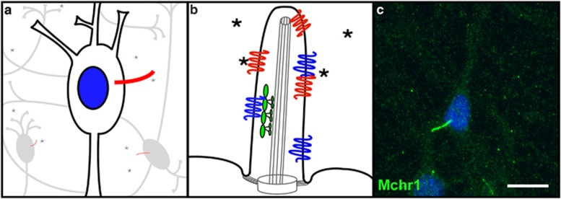
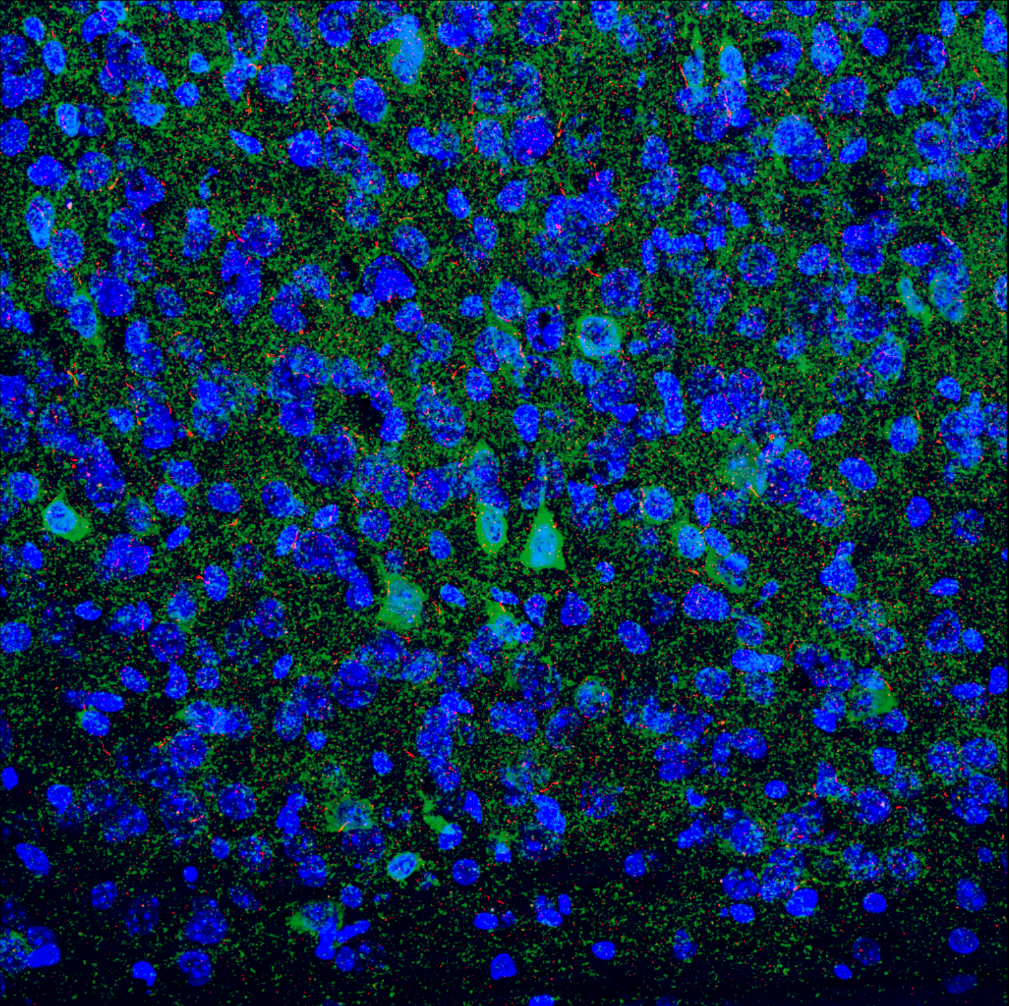
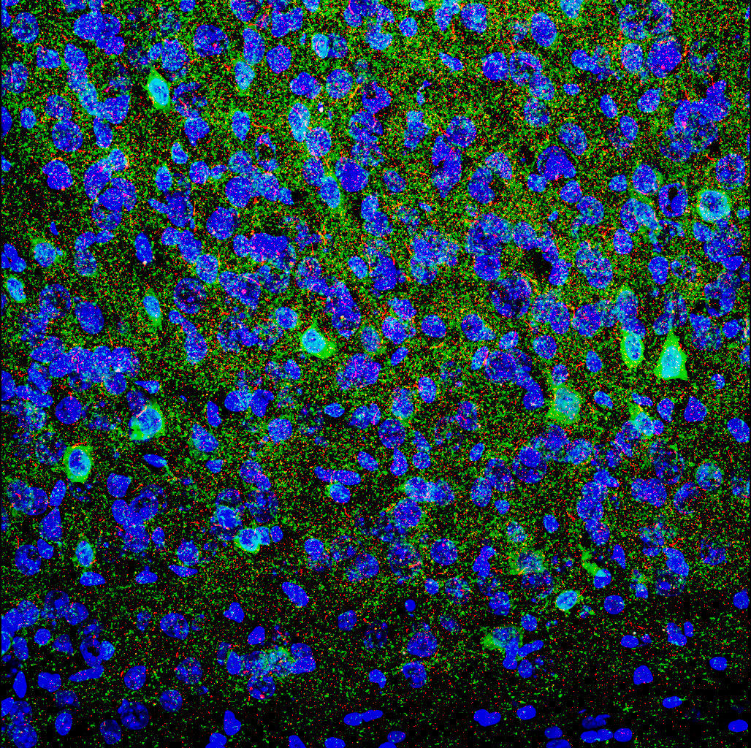
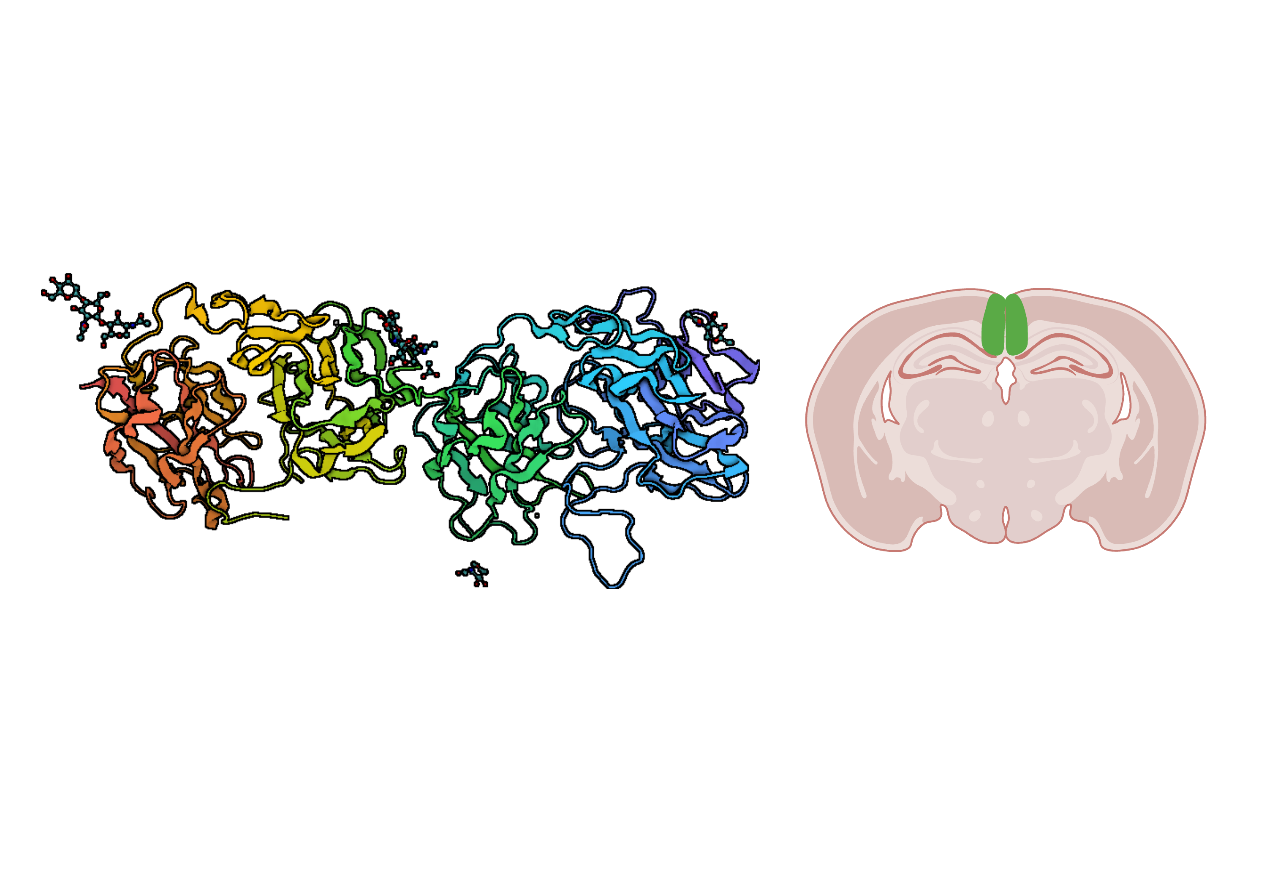
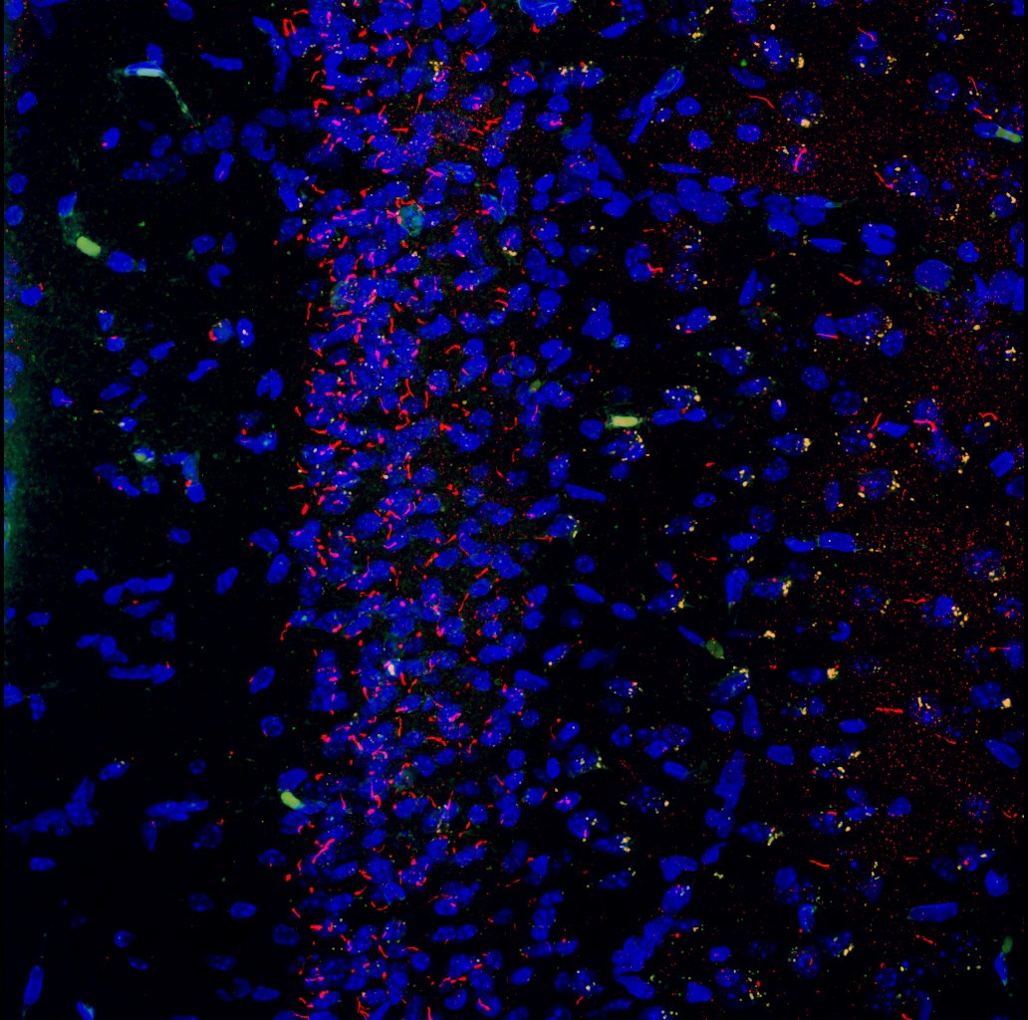
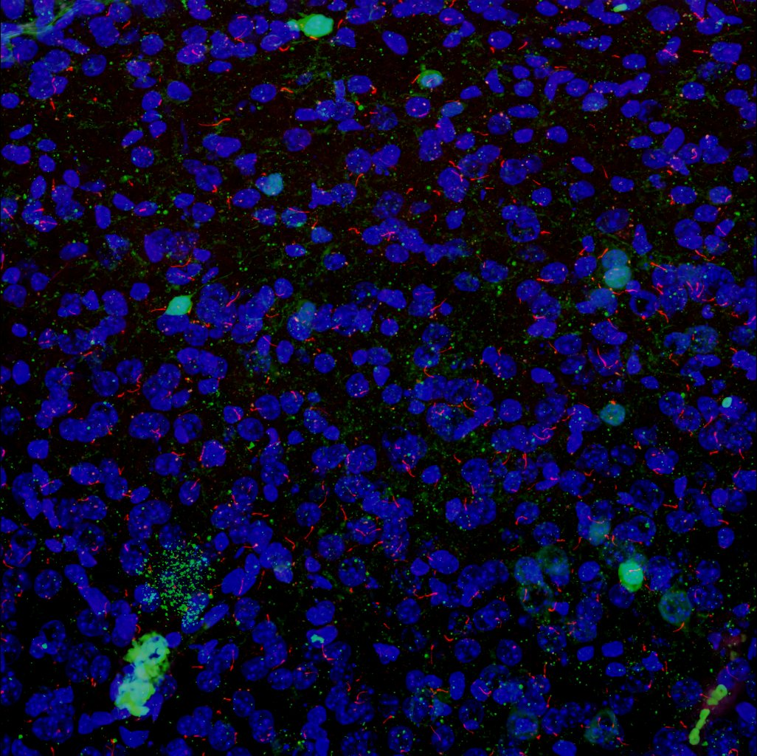
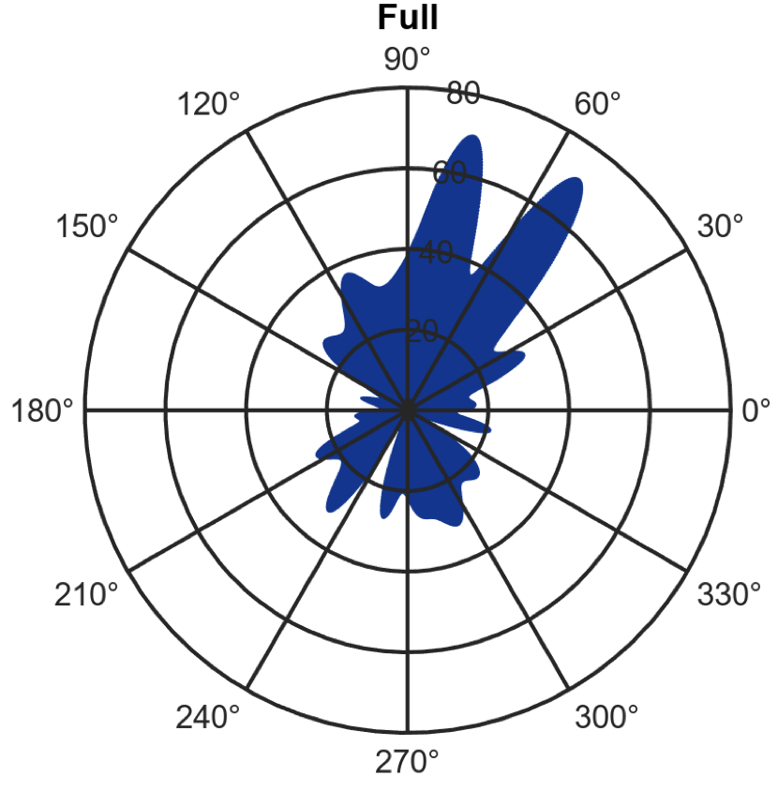
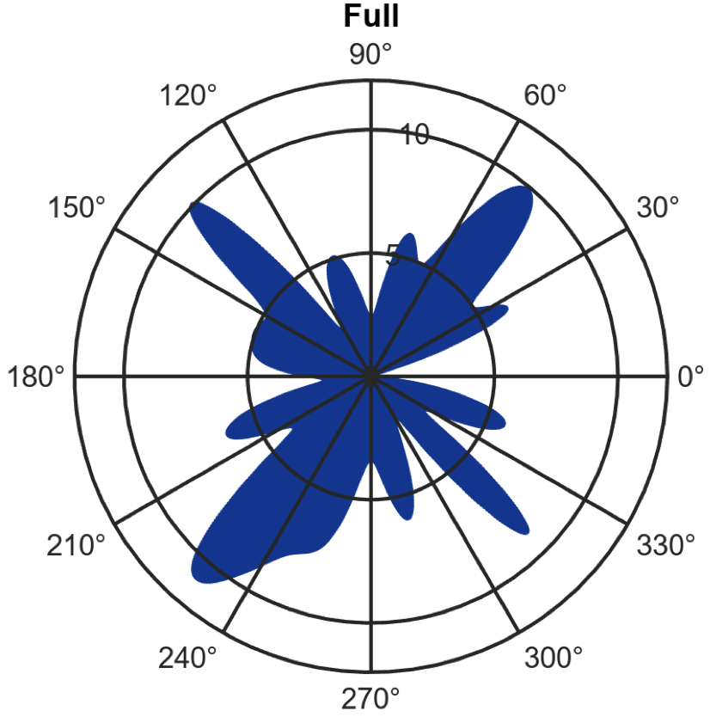
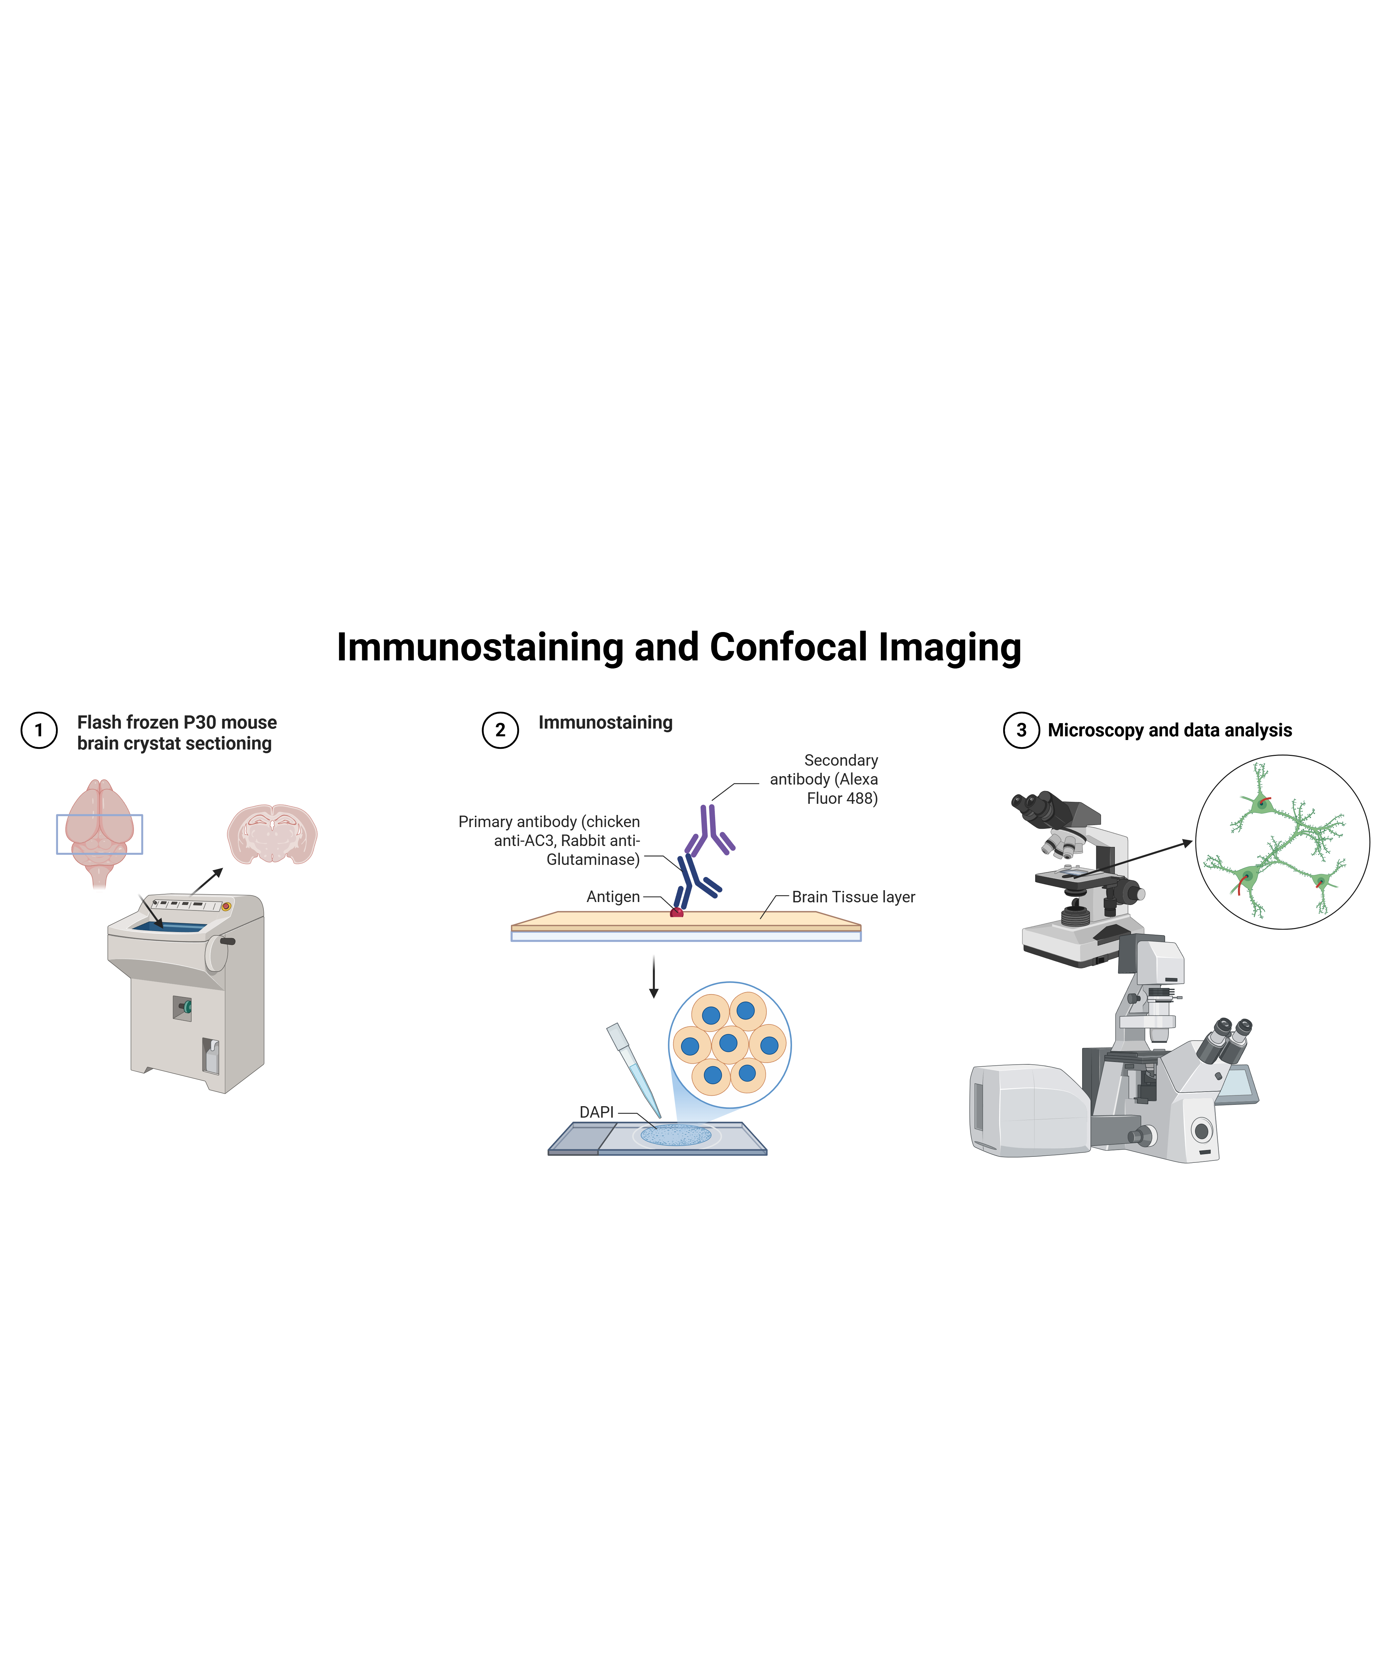
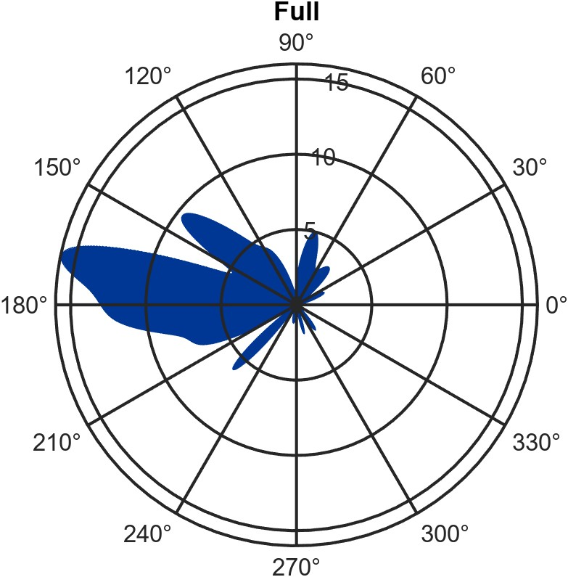
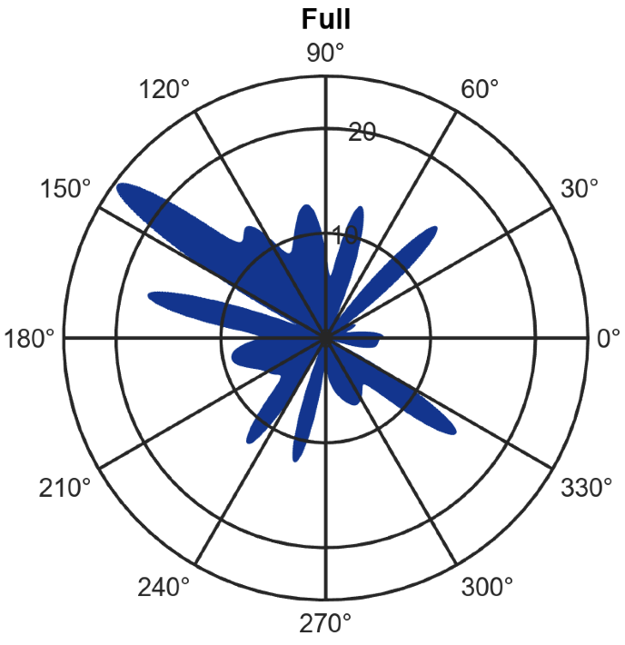


Impact of Reelin on Cilia Dynamics in the Cingulate Cortex
Kevin Jiang¹, Sumaya Akter², Liyan Qiu², Mark Lyon³, Mitsuharu Hattori⁴, and Xuanmao Chen^{2,*}
¹Department of Chemical Engineering and Bioengineering, ²Department of Molecular, Cellular, and Biomedical Sciences, ³Department of Mathematics and Statistics, UNH, ⁴Graduate School Department of Biomedical Sciences, Nagoya City University
Introduction
Cilia Length in the Cingulate Cortex
Cilia Directionality of Non-laminated Interneurons
Primary cilia are solitary, microtubule-based structures that are present on nearly every cell type in the human body, including neurons
Primary cilia is known to modulate embryonic neurodevelopment but little is known about its role in postnatal (after birth) neurodevelopment
Defective formation of primary cilia is implicated in the pathogenesis of developmental disorders, collectively termed ciliopathies
Reelin is a large extracellular matrix glycoprotein that critical for neuronal migration and cortical lamination
Reelin’s role in guiding laminar neuronal organization is well characterized but its role in primary cilia dynamics in the postnatal development is unclear
This work investigates whether Reelin influences cilia length and directionality in the mouse cingulate cortex
Figure 1: Schematic and image of neuronal primary cilia [1]
Figure 3: Average Cilia Length in the Cingulate Cortex
Cilia Directionality in the Cingulate Cortex
Figure 7: Confocal images of interneurons in wildtype (left) and reelin knockout (right) mice
Figure 2: Schematic two repeated units of Reelin and location of mouse cingulate cortex
Methodology
Figure 8: Cilia directionality of non-laminated interneurons in wildtype (left) and reelin knockout (right) mice
Tissue Preparation
P30 C57BL/6 WT mice (control) and reelin delete mice (experimental) brain samples are collected
Flash-frozen brains cryostat-sectioned into 30 um coronal slices
Immunostaining
Slices were PBS washed and blocked in blocking buffer for 2 hours
Incubated in primary antibodies (chicken anti-AC3, rabbit anti-glutaminase) overnight at 4 °C
Incubated in secondary antibody next day for 1.5 hours at 25 °C
Washed with PBS and mounted with DAPI
Imaging and Analysis
Confocal microscopy for image acquisition
ImageJ for image processing
    Angle tool measured alignment relative to external capsule
    Freehand line tool measured length from axoneme base to tip
Alignment data exported as csv into MATLAB for polar plot
Figure 4: Confocal images of wildtype (left) and reelin knockout (right) mice cingulate cortex
Conclusions and Significance
Reelin impacts cilia elongation and directionality in the cingulate cortex
The disruption of proper lamination in the cingulate cortex by deleting reelin reveals a previously unrecognized role of reelin in postnatal cortical lamination
Reelin has no impact on non-laminated interneurons suggesting that reelin’s role in cilia regulation is distinct from its known functions in neuronal migration
References and Acknowledgments
This study was supported by the National Institutes of Health (K01AG054729, P20GM113131-7006, R15MH126317-01 and R15MH125305-01 to X.C.), by University of New Hampshire CoRE PRP awards and Cole Neuroscience and Behavioral Faculty Research awards to X.C., and by a URA award from the University of New Hampshire Hamel Center for Undergraduate Research to K.J..
A strong thank you to Dr. Xuanmao Chen, Dr. Liyan Qiu, and PhD candidate Sumaya Akter for their mentorship and support
Figure 5: Cilia directionality in wildtype (left) and reelin knockout (right) mice cingulate cortex
Cilia Length of Non-laminated Interneurons
Figure 6: Average cilia length of non-laminated interneurons

