Slide 1


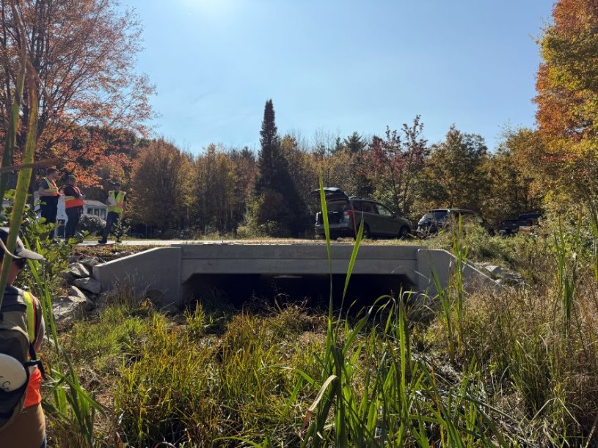
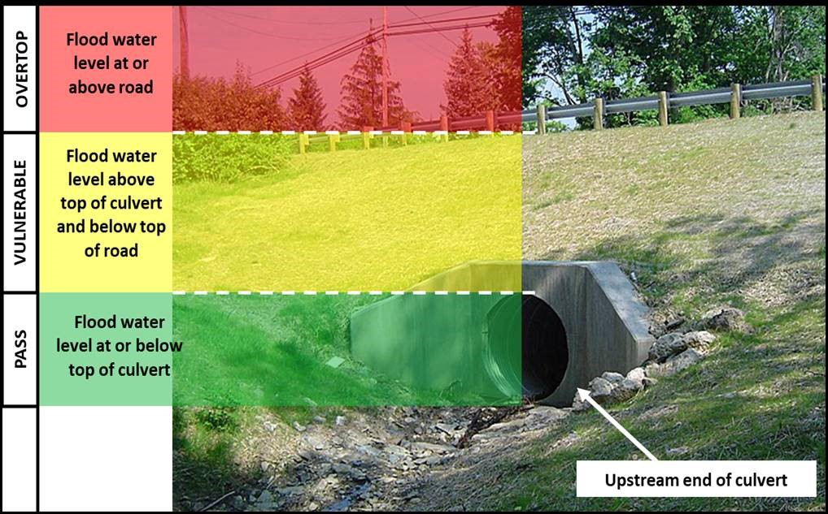
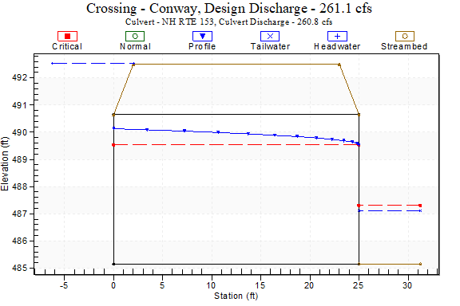
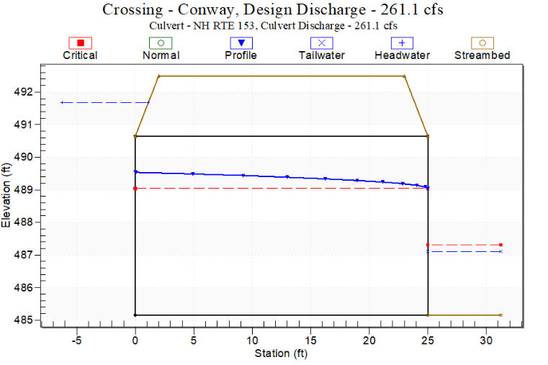
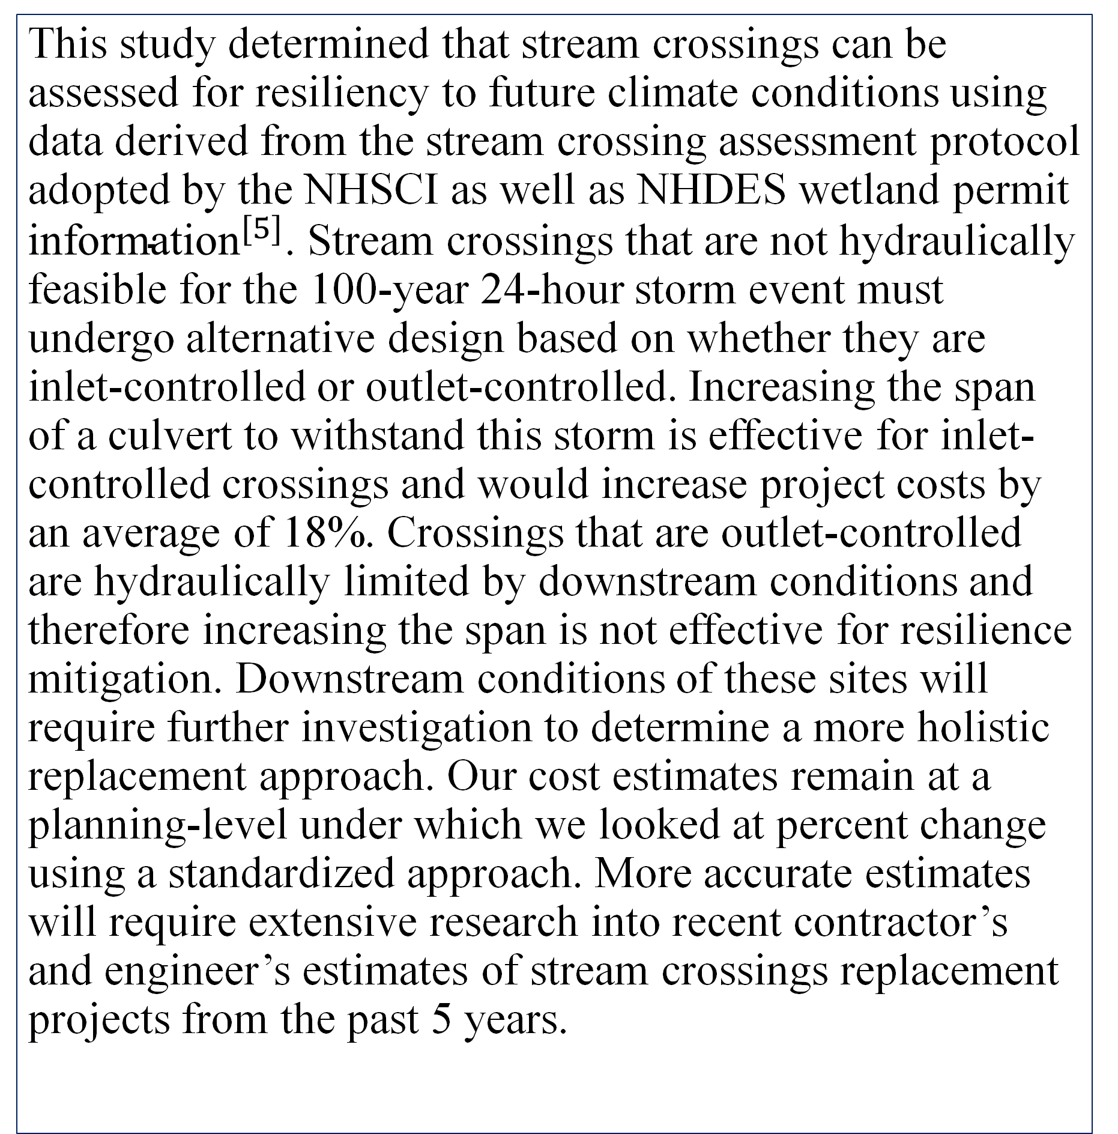


Climate Resilient Stream Crossings: Are We There Yet?
Ian Roessler, Patrick Jackson & Corum Nichols
University of New Hampshire, Department of Civil & Environmental Engineering
Introduction
Stream Crossings
Results
There has been increasing frequency and intensity of storm events in the Northeastern United States from 1958-2021, with a 60% increase in 100-year storms over this ${\text{period}}^{[1]}$. These storms have caused costly road washouts and closures, impacting public safety and transportation as well as environmental ${\text{health}}^{[2]}$. The study was conducted to assess the climate resiliency of Tier 3 culvert stream crossings across New Hampshire that have been approved for replacement within the past five years (2019-2024). For the scope of this study climate resiliency is defined as a stream crossing’s ability to prevent roadway overtopping for a 100-year 24-hour storm event in the year 2100. For stream crossings that overtopped the roadway during the future storms, their span was increased until flooding was mitigated. Additionally, a planning-level cost analysis was conducted to determine the increase in cost for alternative design to ensure a resilient future for NH.
Precast Concrete Box Culvert
Hydraulic Performance Rankings
50% of the culverts were non-resilient and required upsizing under future flows.
Eight of the NHDOT culverts overtopped under future flows (four under inlet control)
These four culverts were upsized by 1.0-1.5 ft for alternative resilient design
Three municipal culverts overtopped under future flows (all under inlet control)
These three culverts were upsized by 1.0-4.5 ft for alternative resilient design
The average cost increase of alternative design was estimated at 9.95% per foot of span increase.
Figure 1: Concord Site Stream Crossing
Figure 2: New Hampshire Stream Crossing Initiative Performance ${\text{Rating} }^{[5]}$
HY-8 Hydraulic Models
Model Conclusions
This study determined that stream crossings can be assessed for resiliency to future climate conditions using data derived from the stream crossing assessment protocol adopted by the NHSCI as well as NHDES wetland permit ${\text{information}}^{[5]}$. Stream crossings that are not hydraulically feasible for the 100-year 24-hour storm event must undergo alternative design based on whether they are inlet-controlled or outlet-controlled. Increasing the span of a culvert to withstand this storm is effective for inlet-controlled crossings and would increase project costs by an average of 18%. Crossings that are outlet-controlled are hydraulically limited by downstream conditions and therefore increasing the span is not effective for resilience mitigation. Downstream conditions of these sites will require further investigation to determine a more holistic replacement approach. Our cost estimates remain at a planning-level under which we looked at percent change using a standardized approach. More accurate estimates will require extensive research into recent contractor’s and engineer’s estimates of stream crossings replacement projects from the past 5 years.
Head Water
Methodology
-Water Overtops Road
Head Water
Ten New Hampshire Department of Transportation (NHDOT)-owned, and ten municipally-owned stream crossings were randomly selected and studied. The Federal Highway Administration’s (FHWA) HY-8 modeling software was used to assess the hydraulic performance of each crossing.
Input data for the hydraulic models (contributing watershed areas, 100-yr peak discharges, culvert dimensions, embedment depths, and topographical elevations) were gathered for each site from wetland permit applications, Stream Stats, and NHGRANIT.
To account for the effects of climate change by the year 2100 the inlet flowrates for each crossing were increased by 15% in the models. This decision was driven by meetings with professional engineers and the New Hampshire Coastal Flood risk Guidelines (NHCFRG) which suggest a 15% increase in precipitation when estimating for a 100-year storm past the year ${\text{2050}}^{[3]}$.
Each crossing was determined to be resilient or non-resilient based on hydraulic performance. A cost analysis using the NHDOT’s bridge repair replacement cost ${\text{estimator}}^{[4]}$ was conducted for the non-resilient stream crossings under inlet control to quantify the cost increase as a result of resilient alternative design.
Figure 3: Non-Resilient Longitudinal Profile (As-Designed)
Figure 4: Resilient Longitudinal Profile (Alternative Design)
Model Assessments and Costing
Model Summaries
Cost Assessment
Site | Hydraulic Performance | Vulnerability | Inlet or Outlet Control | Length (ft) | Original Span | Alternative Design/ Span Increase (ft) | Original Cost | New Cost
NHDOT Stream Crossings
Wakefield |  | Pass | Inlet | 40 | 7 | 0 | $252,000 | $252,000
Acworth |  | Pass | Inlet | 34 | 6 | 0 | $183,600 | $182,600
Alton |  | Overtops | Inlet | 70 | 6 | 1 | $420,000 | $490,000
Auburn |  | Overtops | Inlet | 45 | 9 | 1.5 | $364,500 | $425,250
Conway |  | Overtops | Inlet | 25 | 5 | 1 | $112,500 | $135,000
Eaton |  | Overtops | Outlet | 36 | 8 | N/A | $259,200 | $259,000
Hancock |  | Overtops | Outlet | 60 | 8 | N/A | $432,000 | $432,000
Jefferson |  | Overtops | Inlet | 45 | 20 | 1 | $900,000 | $945,000
Springfield |  | Overtops | Outlet | 82 | 20 | N/A | $984,000 | $984,000
Meredith |  | Overtops | Outlet | 30 | 4 | N/A | $72,000 | $72,000
Municipal Stream Crossings
Concord |  | Pass | Outlet | 70 | 16 | N/A | $560,000 | $560,000
Errol |  | Pass | Outlet | 44 | 20 | N/A | $440,000 | $440,000
Newington |  | Pass | Inlet | 38 | 11 | 0 | $209,000 | $209,000
Fremont |  | Pass | Outlet | 30 | 22 | N/A | $330,000 | $330,000
Bedford |  | Overtops | Inlet | 35 | 10 | 4.5 | $304,500 | $304,500
Derry |  | Pass | Inlet | 44 | 14 | 0 | $308,000 | $308,000
Hanover |  | Overtops | Inlet | 48 | 7.6 | 1 | $206,400 | $206,400
Groton |  | Vulnerable | Outlet | 28 | 23 | N/A | $322,000 | $322,000
Lempster |  | Pass | Outlet | 36 | 12 | N/A | $216,000 | $216,000
South Hampton |  | Overtops | Outlet | 50 | 8 | 12.5 | $312,500 | $312,500
Acknowledgements
Thank you to our project sponsors Polly Crocker and Karl Benedict of the NHDES and NHDOT, our UNH faculty advisors Dr. Jennifer Jacobs and Dr. Weiwei Mo, and to professional engineers Joel Ballestero, Nick Messina, and Tim Mallet!
References
Figure 5: Derived Model Characteristics & Costs
Figure 6: Cost Increase Per Project
Available upon request.
Notes:
Add current cost, proposed cost, and percent increase, remove bar chart
Discuss in Methodology why the outlet-controlled culverts are N/A for span increase (span redesign is ineffective, need slip lining etc.)
Show % of crossings that pass, are vulnerable, and overtop

