Slide 1

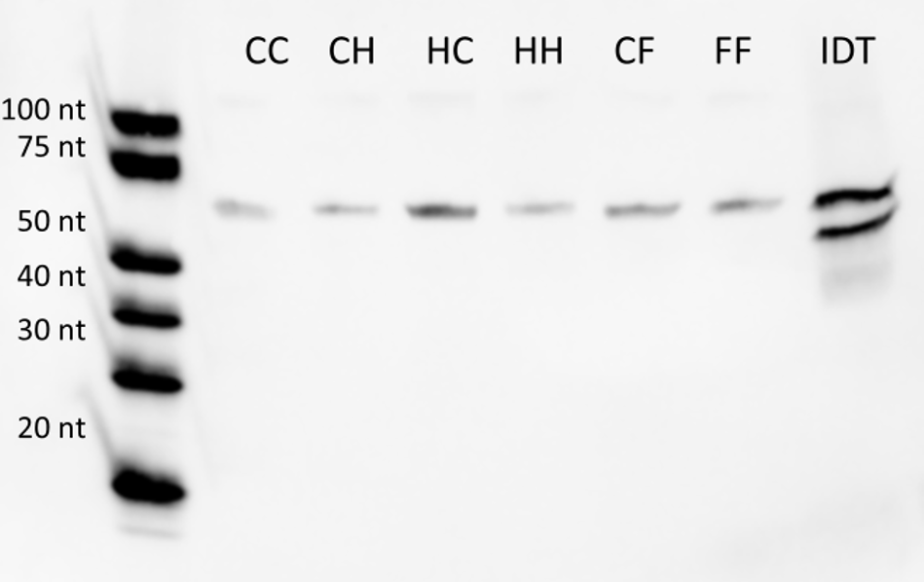
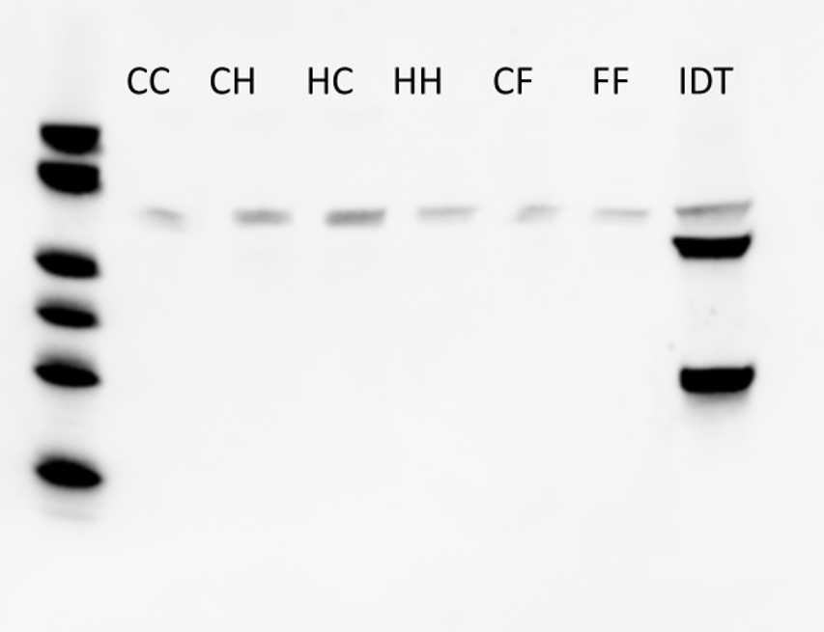
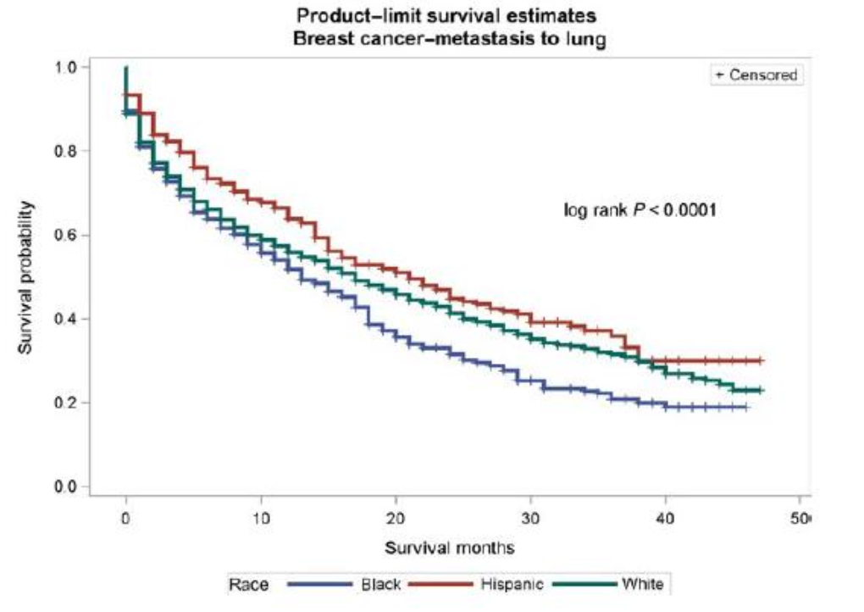
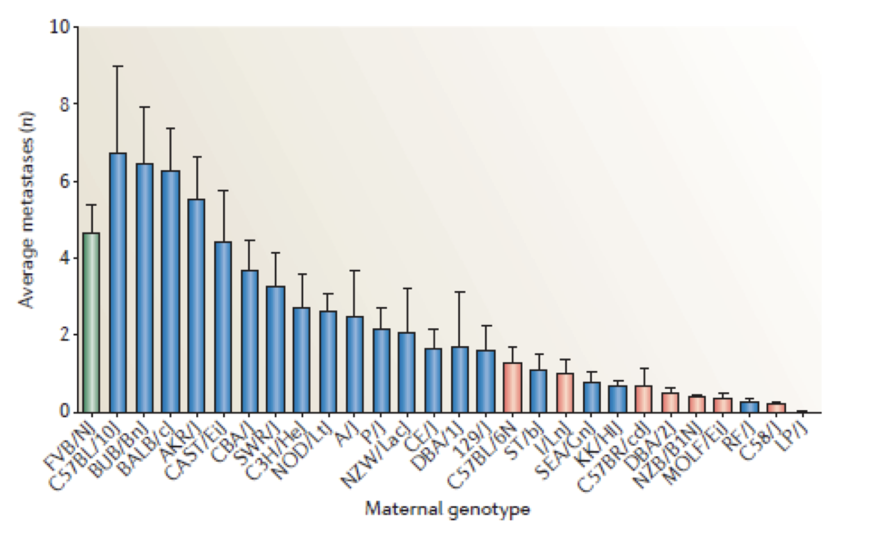
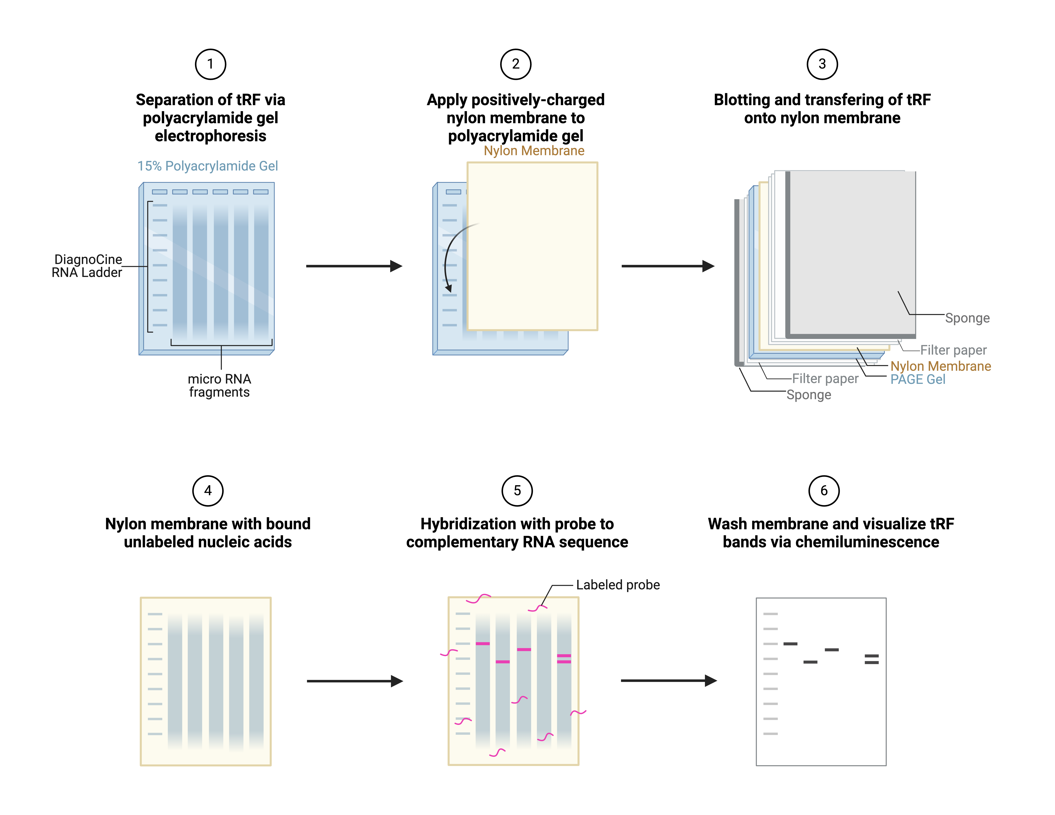
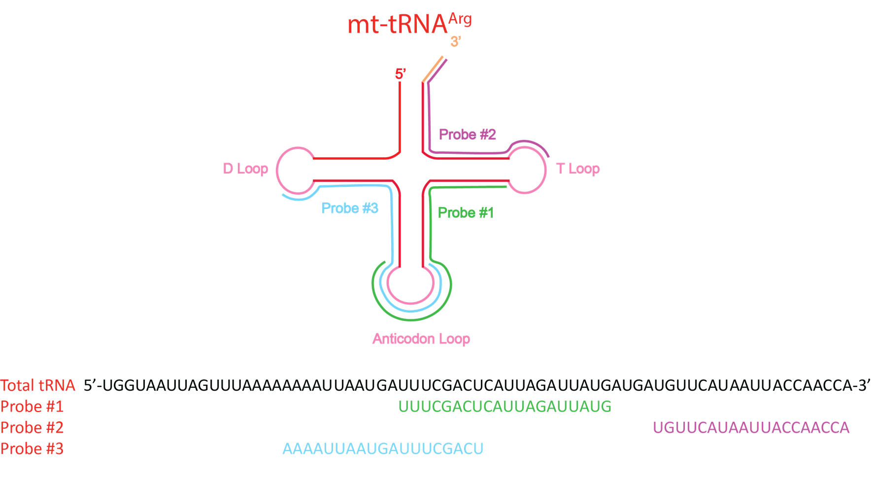
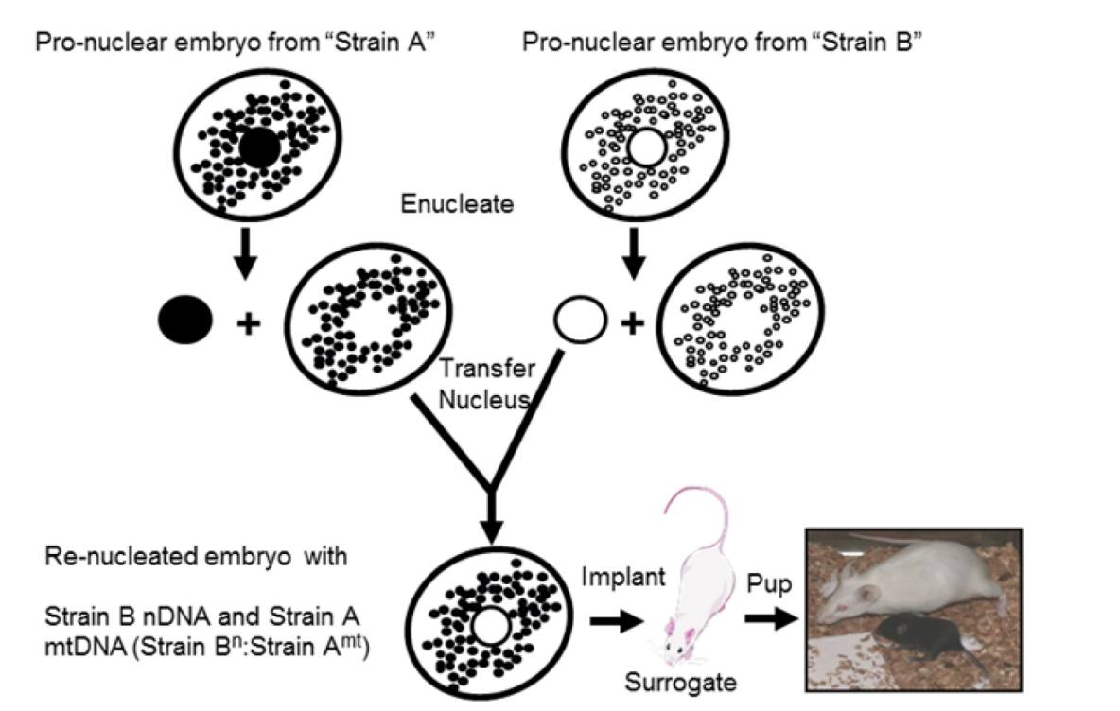
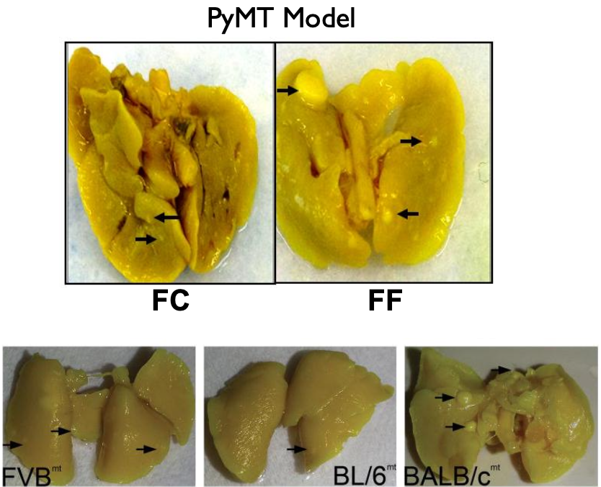

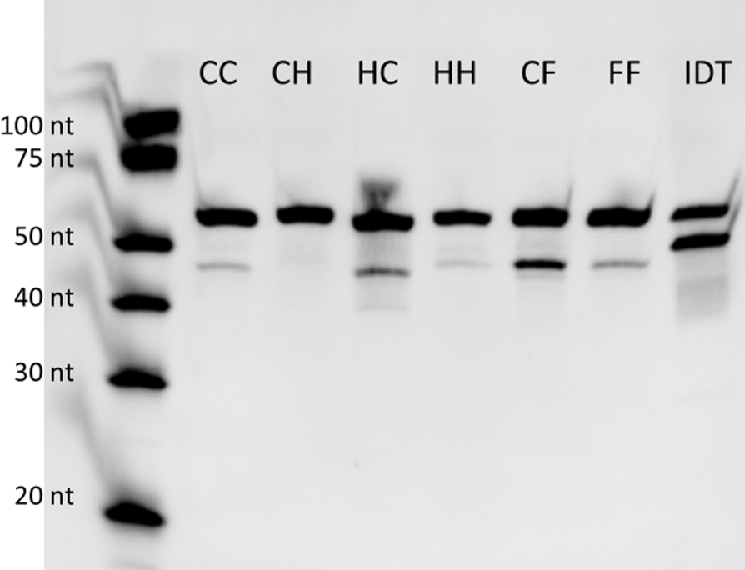
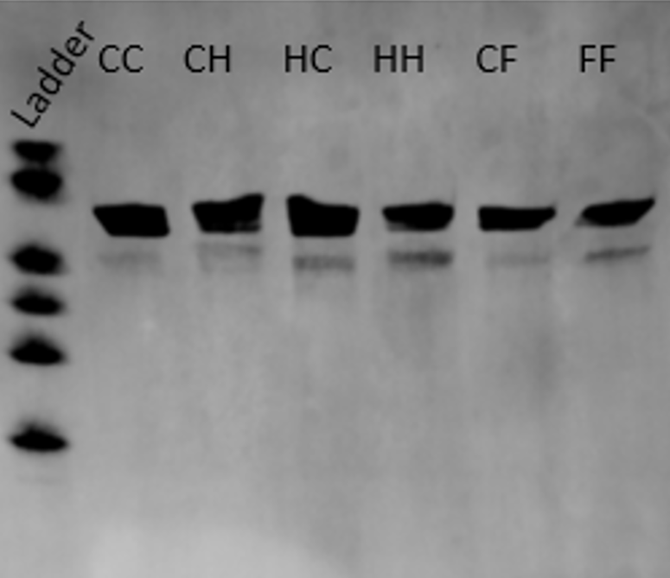

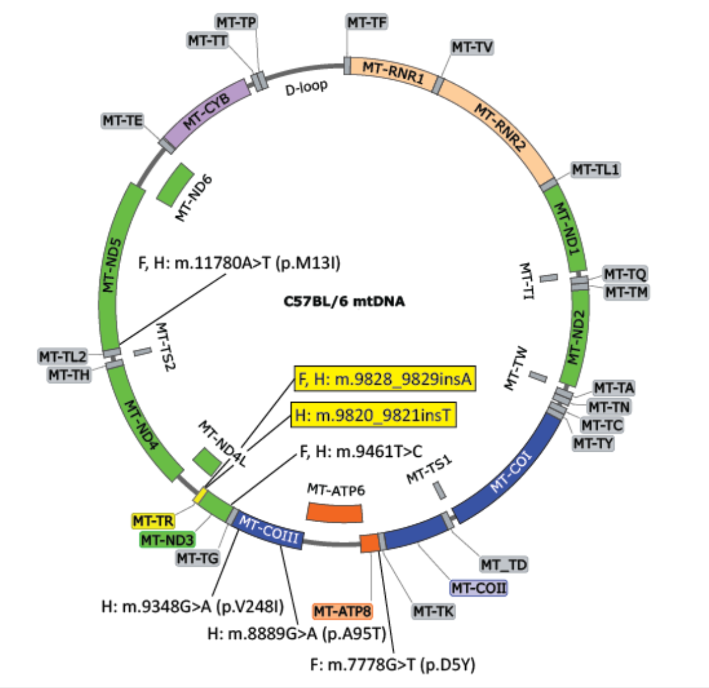
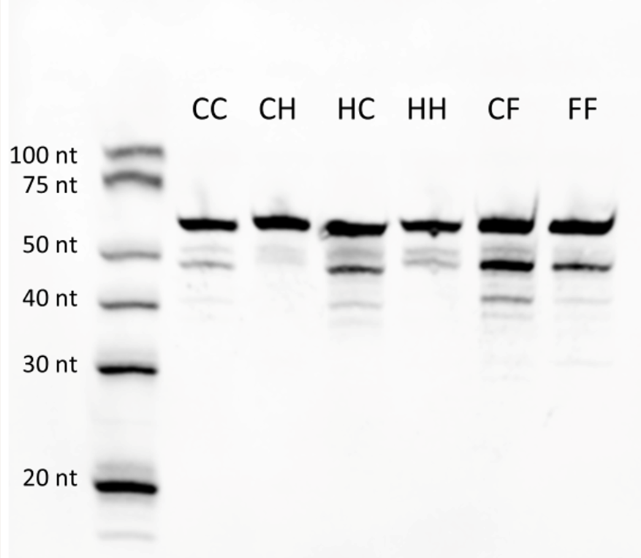
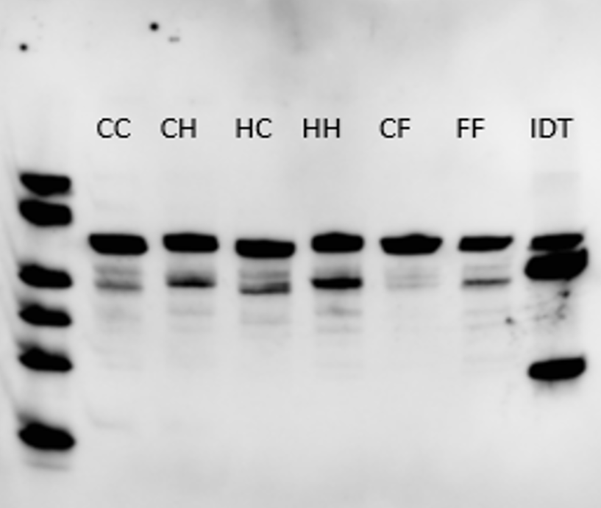
Role of Mitochondrial tRNA Fragments in Metastasis
Kevin Jiang¹, Sydney Quijano², Katy Swancutt², Danny Welch^{2,*}
¹Department of Chemical Engineering and Bioengineering, UNH, ²Department of Cancer Biology, KU School of Medicine
  The Overarching Question
  Hypothesis and Research Questions
Lung Northern Blot Results
Metastasis is the spread and growth of cancer cells to secondary sites away from primary tumor
Why is metastasis worse for some compared to others?
tRNA fragments derived from MT-TR polymorphisms affect metastatic burden
  Do mitochondrial tRNA fragments exist?
  If they do exist, are they variably expressed in different tissues?
  Methodology
RNA extraction from mouse tissue
Figure 7: Female lung probes 1 (left) and 3 (right)
Conclusion
Figure 1: Survival estimate of breast cancer-metastasis to the lung based on race [1]
Confirmed the presence of mitochondrial tRNA arginine fragments
tRNA arginine and its fragments are variably expressed in different tissues among MNX mice
The expression of tRNA arginine and its fragments seem to be influenced by biological sex
  Background
Northern blotting and visualization
Probe positions corresponding to tRNA arginine sections
Unanswered Questions
Where and how are these tRNA fragments produced?
Are these fragments tumor-derived or stromal-derived?
What do they interact with and how do they interact?
Do mitochondrial tRFs alter metastasis?
Figure 2: Average metastases vs. maternal genotype [2]
Acknowledgements
Male genotype was kept constant and maternal genotype was varied
Maternal genetic background influenced severity of metastasis
Mitochondria is maternally inherited
Mentors:
Danny Welch, PhD
Katy Swancutt, DVM, PhD
Lab Members:
Sydney Quijiano, B.S
Md Islam Atiqul, PhD
Parker B. Francis Fellowship
Melanie Bassham
Navneet Dhillon, PhD
Nancy Stewart, DO
PBF Fellows
Nawal Basra
Trevor Bell
Kian Fogarty
Nora Gerami
NFCR and Metavivor for their support
Liver Northern Blot Results
References
Figure 3: Creation of mitochondrial exchange mice and number of metastases based on mitochondrial genotype
[1] T. Akinyemiju, S. Sakhuja, J. Waterbor, M. Pisu, and S. F. Altekruse, “Racial/ethnic disparities in de novo metastases sites and survival outcomes for patients with primary breast, colorectal, and prostate cancer,” Cancer Medicine, vol. 7, no. 4, pp. 1183–1193, Feb. 2018, doi: https://doi.org/10.1002/cam4.1322.
[2] K. W. Hunter, R. Amin, S. Deasy, N.-H. Ha, and L. Wakefield, “Genetic insights into the morass of metastatic heterogeneity,” Nature reviews. Cancer, vol. 18, no. 4, pp. 211–223, Apr. 2018, doi: https://doi.org/10.1038/nrc.2017.126.
[3] A. D. Scheid, T. C. Beadnell, and D. R. Welch, “The second genome: Effects of the mitochondrial genome on cancer progression,” Advances in Cancer Research, pp. 63–105, Jan. 2019, doi: https://doi.org/10.1016/bs.acr.2019.01.001.
Metastatic burden is influenced by mitochondrial genotype
Single nucleotide polymorphisms in mitochondria genome influence metastatic outcome among mice
Comparison of mtDNA among mice strain drew attention to a specific polymorphic region
MT-TR encodes for tRNA arginine
tRNA can degrade into tRFs to act as growth factors to influence metastasis
Figure 5: Male liver (left) vs. female liver (right): probe 1
Figure 4: SNPs in MT-TR across mice strains based on C57BL/6 wildtype mitochondrial genome [3]
Figure 6: Male liver (left) vs. female liver (right): probe 3

