Slide 1



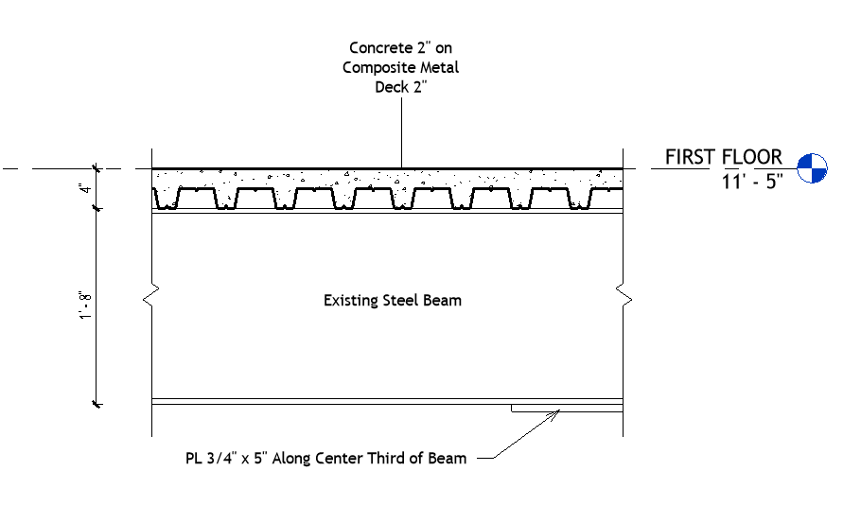
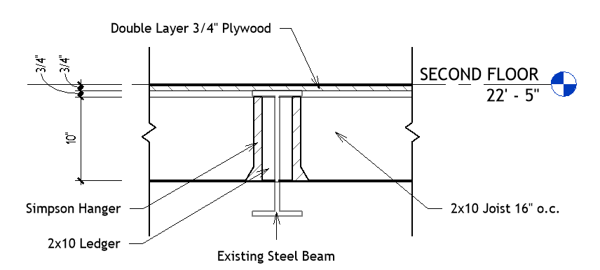
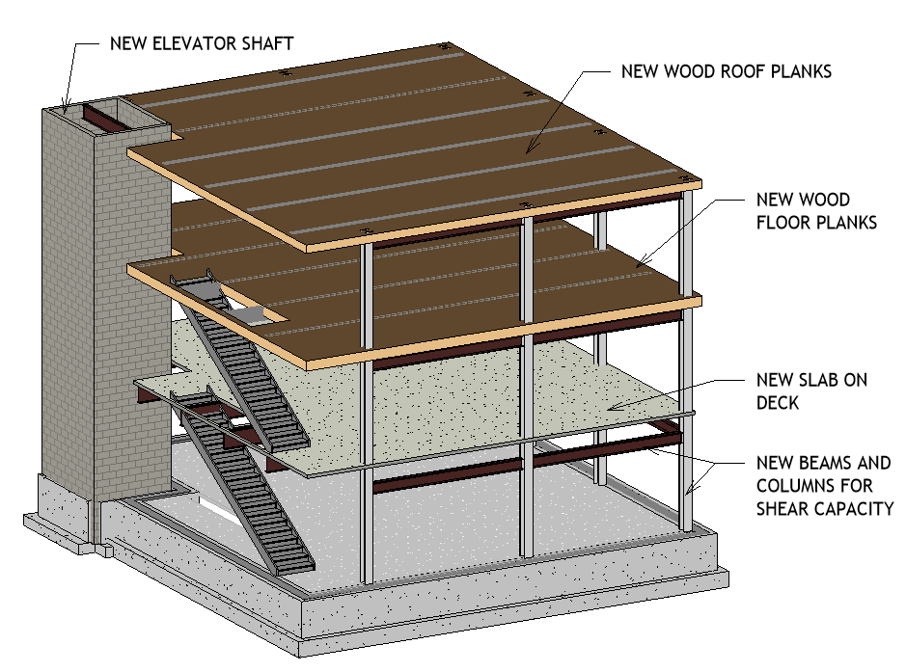
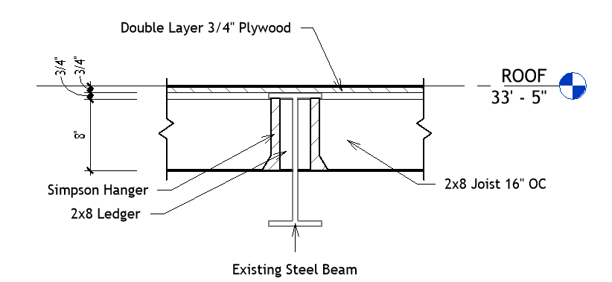
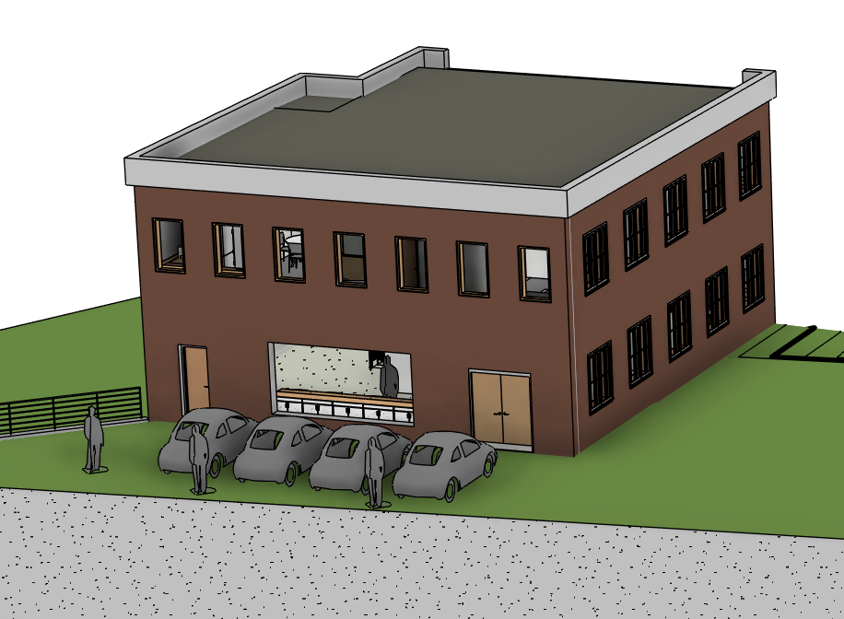
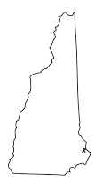
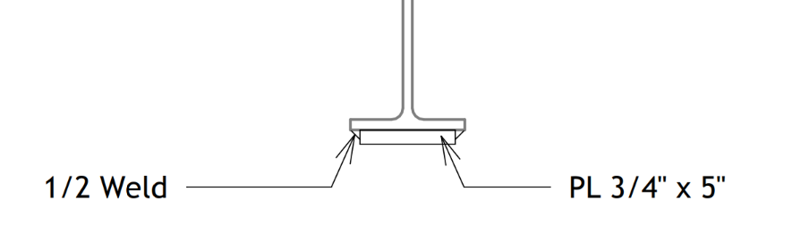
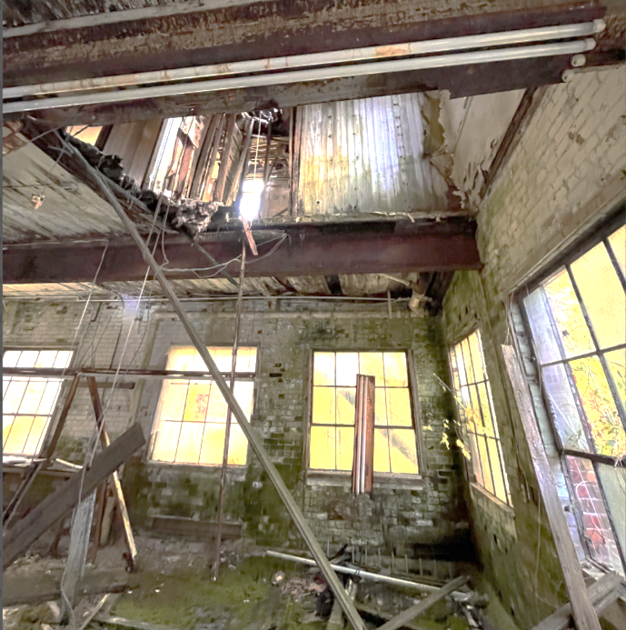
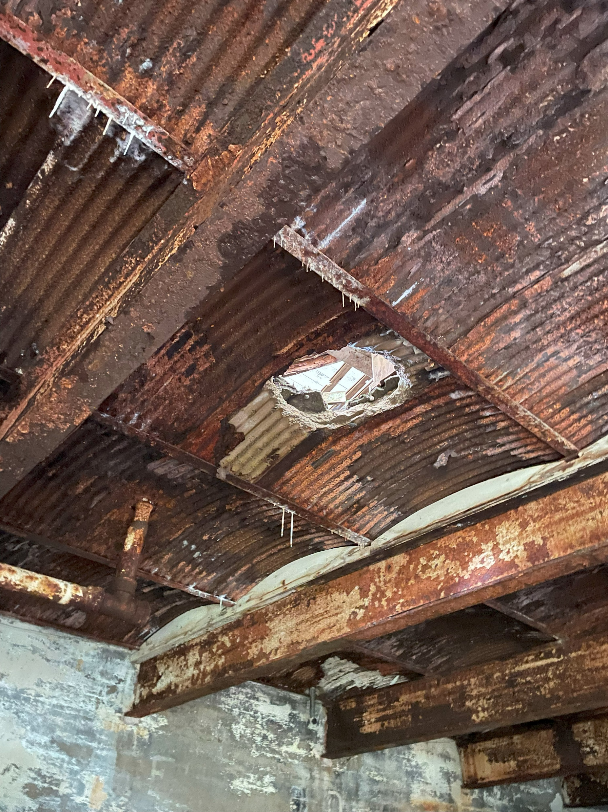
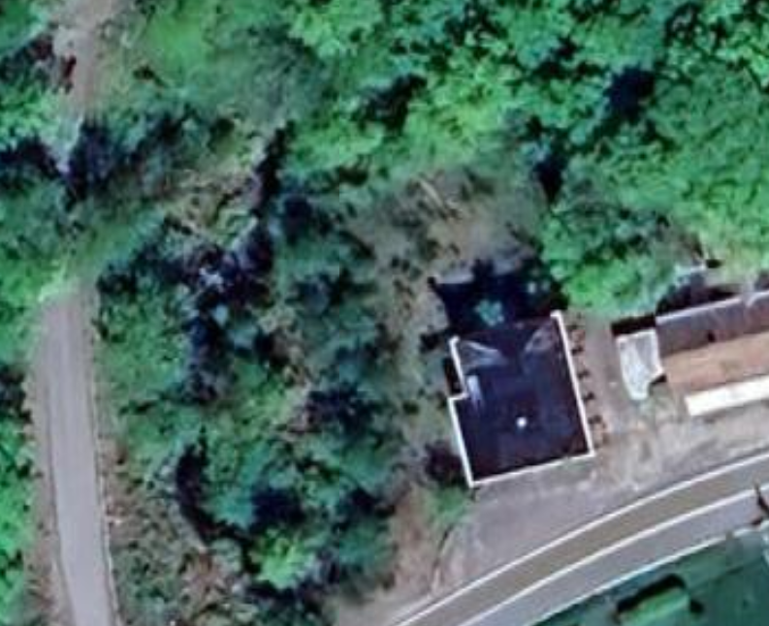
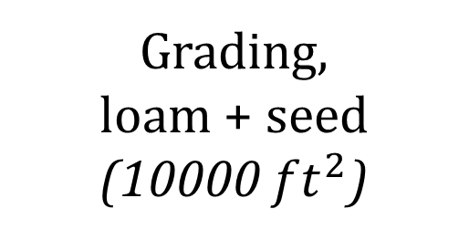
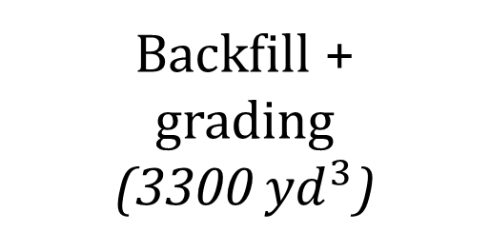

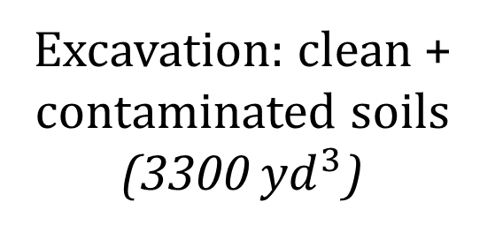
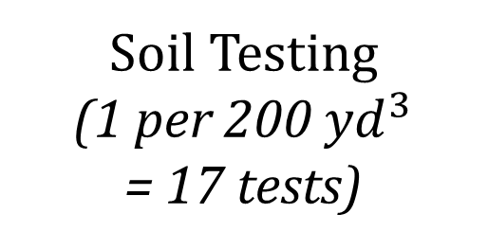
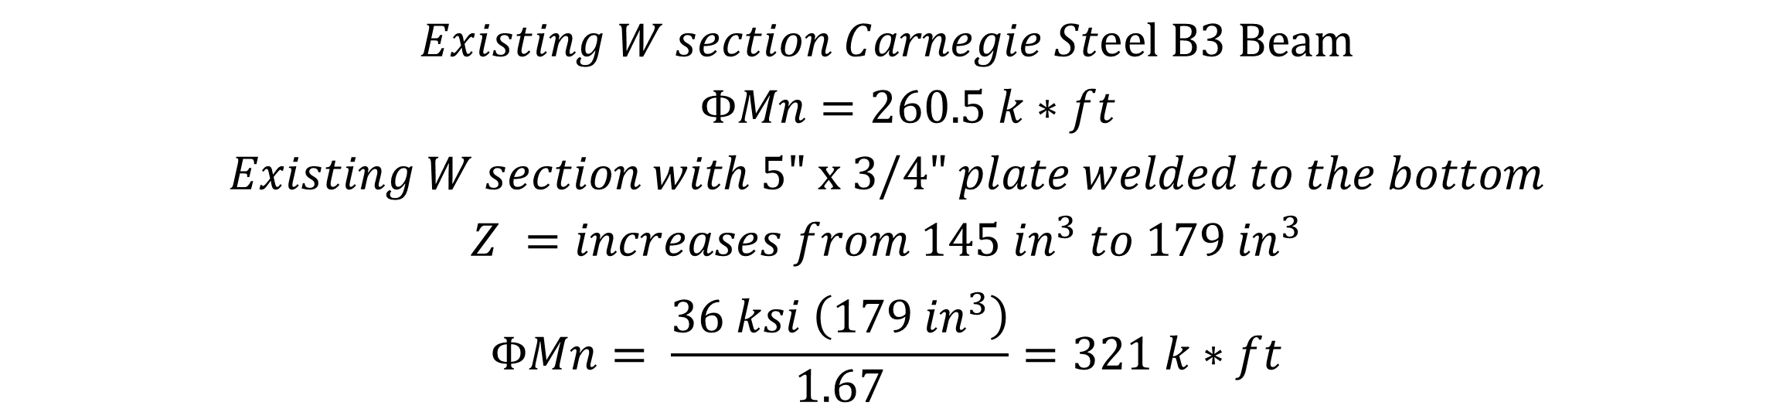
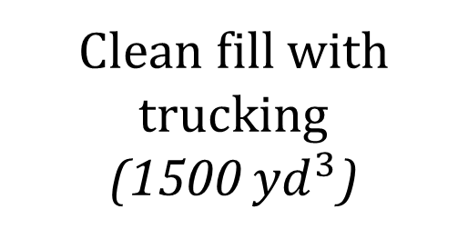
Electrosonics Building Renovation and Remediation
Dennis Chase | Jayleigh Genest | Paige Hornbeck | Mason Pillsbury | Jacob Ritchie
Civil and Environmental Engineering, University of New Hampshire, Durham, NH 03824
Introduction
Decision Matrix
Structural Details
Background: The Town of Chesterfield, with the Chesterfield Revitalization Group, and the New Hampshire Department of Environmental Services, requests a redevelopment of the former Electrosonics building and property on NH Route 9A to be redeveloped. The building is experiencing severe structural deterioration after being abandoned for 30 years and has a variety of contamination concerns after a history of industrial use.
Goal: Provide the town with a recommendation for the building usage with a proposed structural design to restore the existing building, along with a site remediation plan to address contamination concerns. The scope includes site visit observations, a code review of the existing structure, proposed alternative design development plans, structural renovation calculations, calculated cost estimates, and environmental remediation schematics.
Consideration | Elderly Housing | Café / Apartment | Pub / Function Room
Usage / Parking Needs | 3 | 2 | 1
Town Interest / Benefit | 1 | 2 | 3
On-Site Wastewater Treatment System | 2 | 3 | 1
Economic Viability | 1 | 3 | 2
Total | 7 | 10 | 7
In the table above the highest score indicates the most preferred. The image was AI generated using Canva Magic Media, producing an example of the envisioned interior design.
Design
Cost Estimate
Sample Floor Plan
Sample Structural Plan
Item | Estimated Cost
Environmental | $615,000
Demolition/Cosmetic | $196,000
Structural | $703,000
Site/Interior | $919,000
Total | $2,433,000
3D model of the existing site
$$Existing W section Carnegie Steel B3 Beam$$
$$ΦMn=260.5 k∗ft$$
$$Existing W section with 5\text{"} \text{x} \text{3/4" }plate welded to the bottom$$
$$Z =increases from 145 {in}^{3} to 179 {in}^{3}$$
$$ΦMn= \frac{36 ksi \left(179 {in}^{3}\right)}{1.67}=321 k∗ft$$
Modeled 3D Structure
Existing Conditions
Reinforcement to strengthen the existing steel beams
Environmental Remediation
Acknowledgements
The building has had multiple prior usages resulting in significant quantities of electroplating metals and solvents being discharged into the ground and multiple fuel oil spills. The surrounding soils and ground water are contaminated with cVOCs, RCRA metals, and petroleum. Below outlines the recommended remediation process.
Sydni Clark: Project Sponsor, Weston & Sampson
Alissa Reitter: Project Sponsor, Weston & Sampson
Lisa Damiano: Faculty Advisor
Kenneth Flesher: Faculty Advisor
Soil Testing
(1 per 200 ${yd}^{3}$
= 17 tests)
Excavation: clean + contaminated soils
(3300 ${yd}^{3}$)
On-site soil
staging (10 dumpsters)
References
The structure has extreme deterioration, including corroded metal decking, rotting wood framing, and toxic organic growth on the brick masonry. Testing found bulk moisture, asbestos, lead paint, and PCBs within the building. The site has severely limited space, posing challenges for site expansion.
AISC 16th Edition Steel Construction Manuel
ASCE 7-16 Minimum Design Loads for Buildings and Other Structures
2021 International Building Code
Phase II Environmental Site Assessment and Hazardous Materials Inventory (2013) by Ransom Consulting
Transportation and landfill disposal
(1500 ${yd}^{3}$)
Clean fill with
trucking
(1500 ${yd}^{3}$)
Backfill +
grading
(3300 ${yd}^{3}$)
Grading,
loam + seed
(10000 ${ft}^{2}$)
Google Earth image with marked areas of concern proposed for excavation

