Slide 1


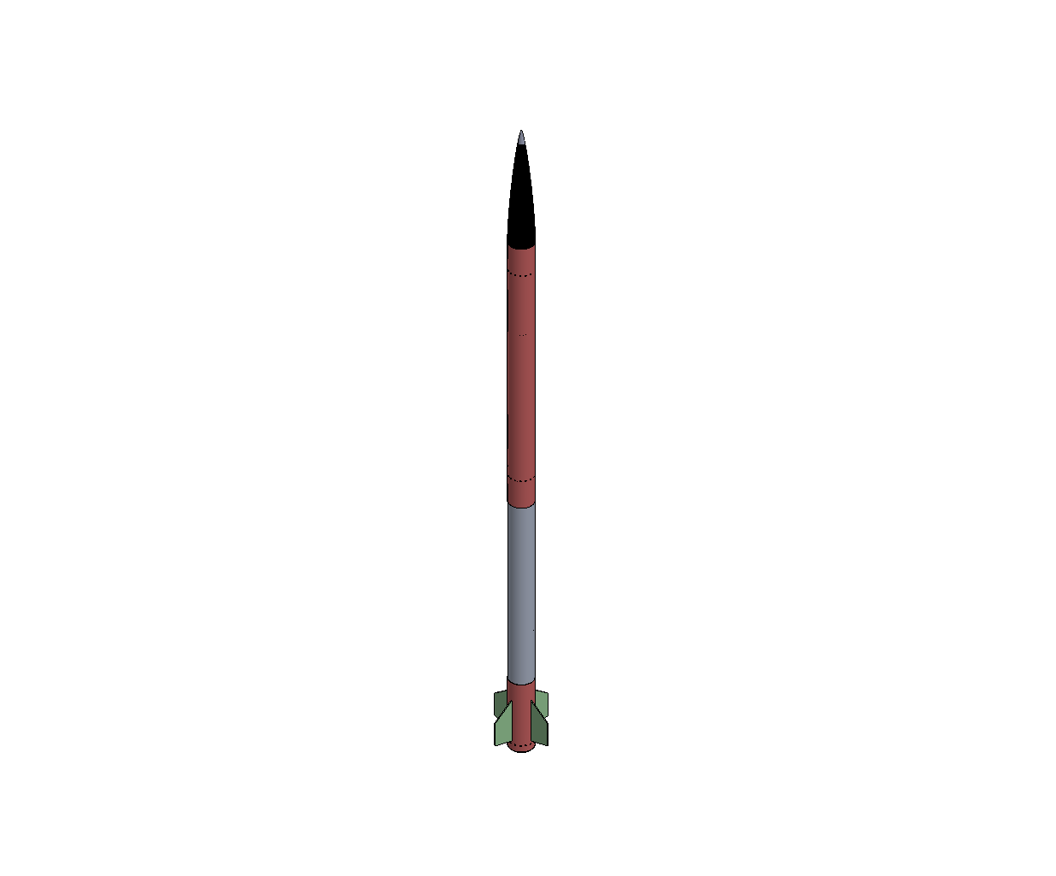
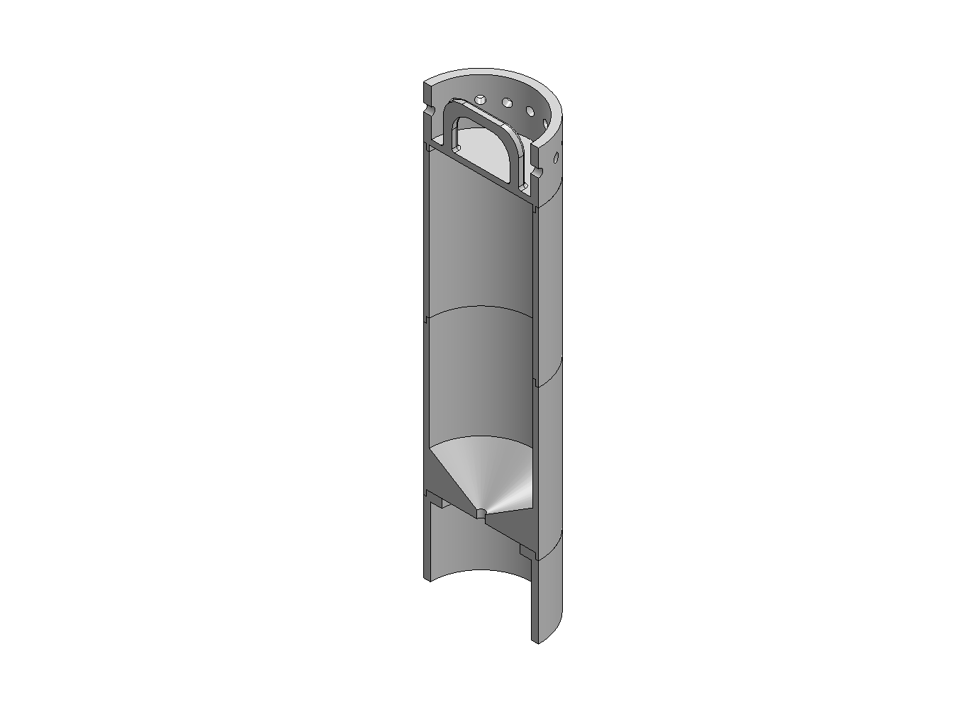
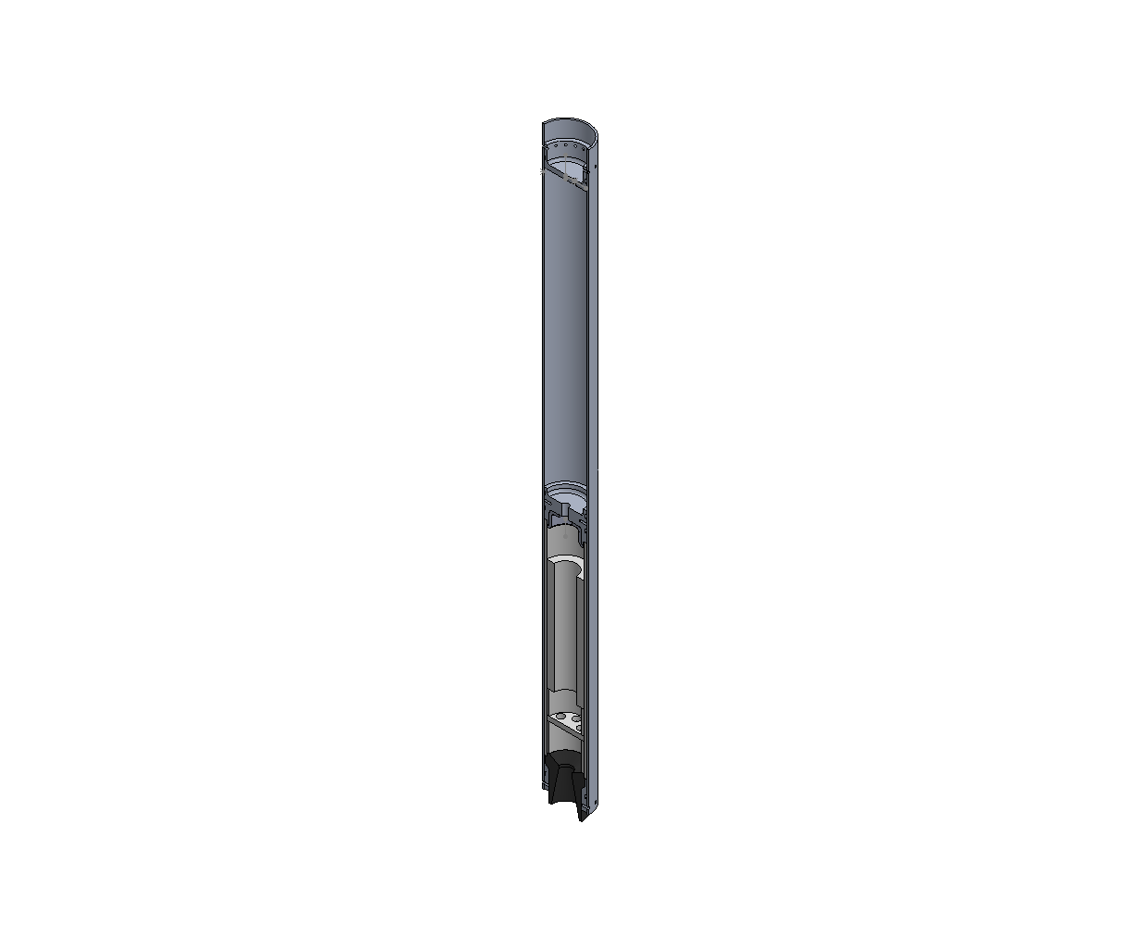
UNH SEDS: EPOCH II
High Powered Hybrid Rocket
Anthony Bilodeau, Douglas Coulter, Randall O'Neil, Michael Paradis, Nathan Pfirman, Brendon Saranich,
Jackson Scheele, & Matthew Wharton
Department of Mechanical Engineering, University of New Hampshire
Project overview
manufacturing
Design, Build, & Test Hybrid Rocket
Reach 10,000 ft Apogee
Compete at FAR-OUT Competition
Meet all safety requirements, UNH, FAR
Deployable Water Ballast
Non-pressurized water tank,
set to be released at a certain
altitude, activated by pyro valve.
Avionics
Ground Station
  Pad Systems
  Control Station
Guidance & Navigation
  Flight Computer
  LORA Tracker
Recovery
Dual-Deploy Tender Descender
  Drogue Chute at Apogee
  Main Chute at 1000 ft
Propulsion
Static Vent
Insulation – Phenolic & CHAMBERSAFE
Fuel Pouring Techniques
Payload
Water Ballast
  Deployable: Runs off independent electronics system
Cameras
  3 Runcam Split 4 V2
Administration & logistics
Attended Spacevision 2024 in Denver, CO
Worked with New Hampshire Space Grant Consortium
25 engineers, computer scientists, and physicists collaborated to achieve goals
Reworked model of operations to allow for localization of club, moved launch site from CA to ME, test site in NH
Recovery
Avionics
Design estimates & bill of materials
Design Estimates
Total Mass | 35.468 kg | 78.03 lb
Total Length | 3.124 m | 123 in
Launch Velocity | 30.5 m/s
Total Impulse | 9741.126 Ns
Thrust to Weight Ratio | 12.019
Materials
G12 Fiberglass | 6061-T6-Al | Alloy Steel
4340 Steel | Isomolded Graphite | Galvanized Steel
Payload
Testing & Next steps
Static Fire
  Scheduled for Late April
Recovery Testing
  Parachute Folding
Payload: Testing pyro valves
Launch in September 2025
Propulsion
manufacturing
Frame
Nosecone
  Tested multiple designs for performance: x^{1/2}
  Fiberglass sheet/epoxy layering technique to form nosecone
Fins
Airframe
  3D printed drill jigs for bolt circles for precision in boring into frame, for seamless integration with subsystems
acknowledgements
The authors would like to thank Kevan Carpenter, Noah MacAdam, and Scott Campbell of the Technical Service Center, Dr. James Clemmons of the UNH Physics Department , Dr. Antoinette Galvin of the New Hampshire Space Grant Consortium, and Matthew Clarke and Joey Cote of the Memorial Union and Student Activities
Hybrid Rocket Engine
Nitrous Oxide is injected via swirl injector
into solid paraffin fuel grain in combustion
chamber and then escapes via graphite nozzle.

