Slide 1
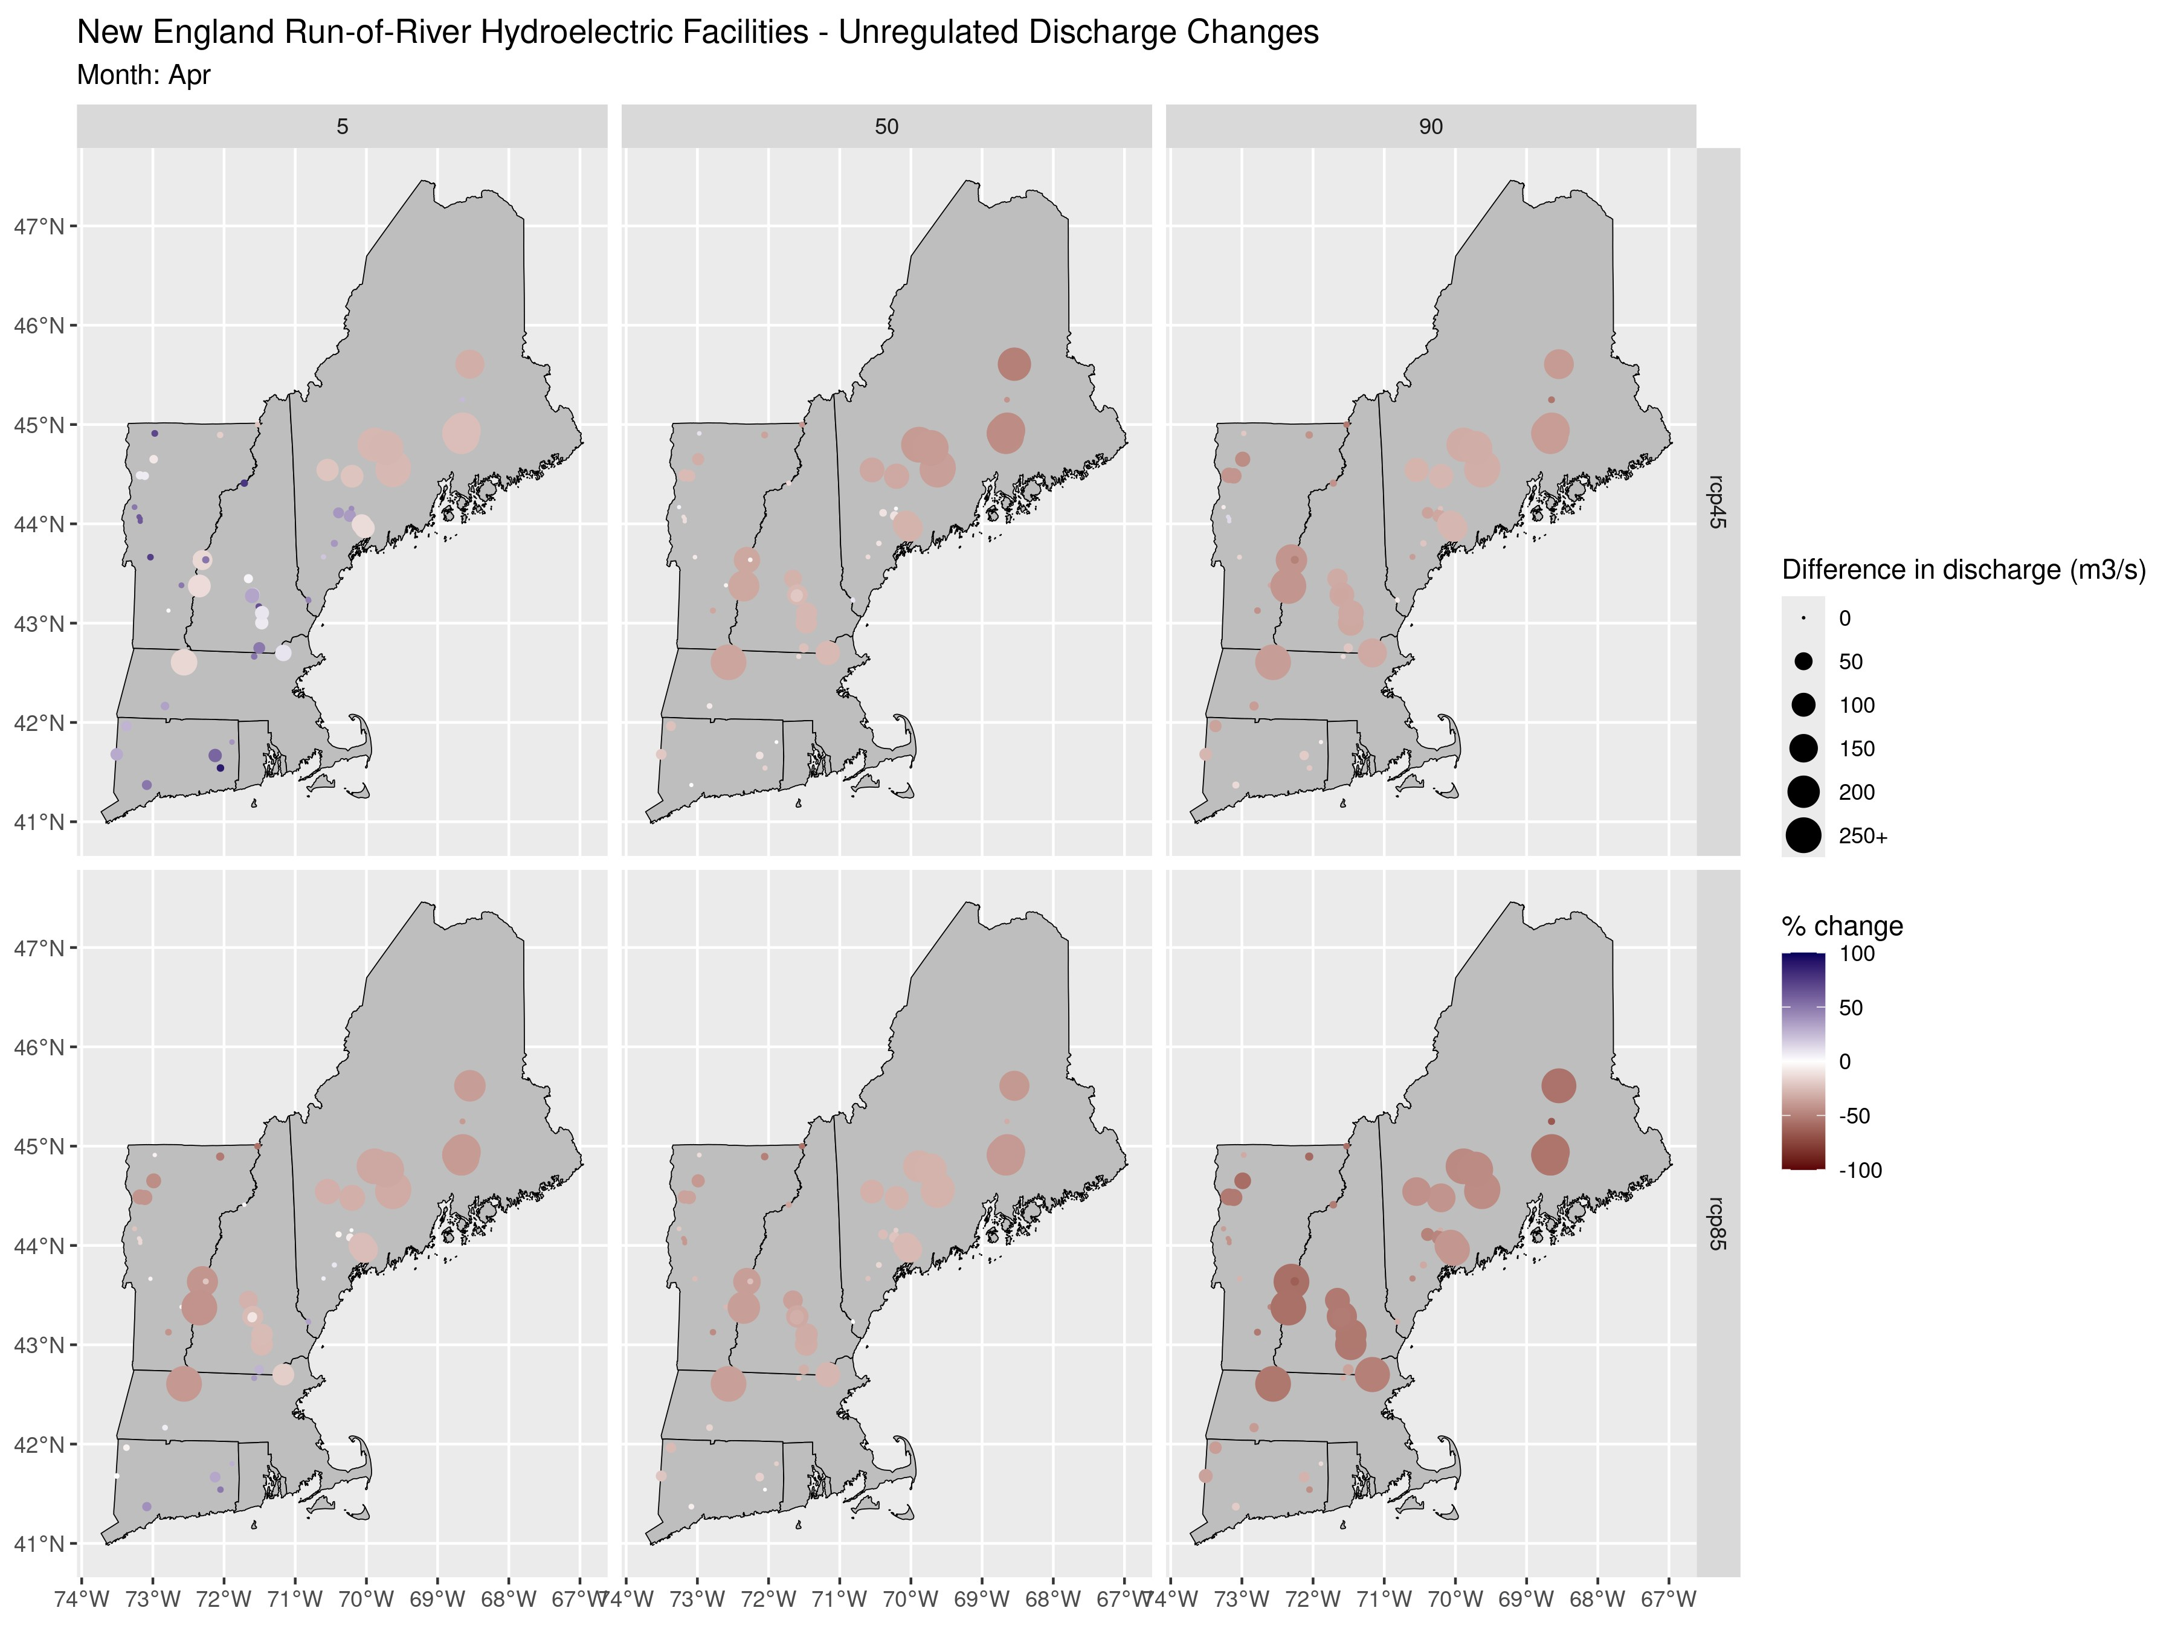
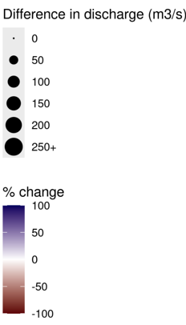
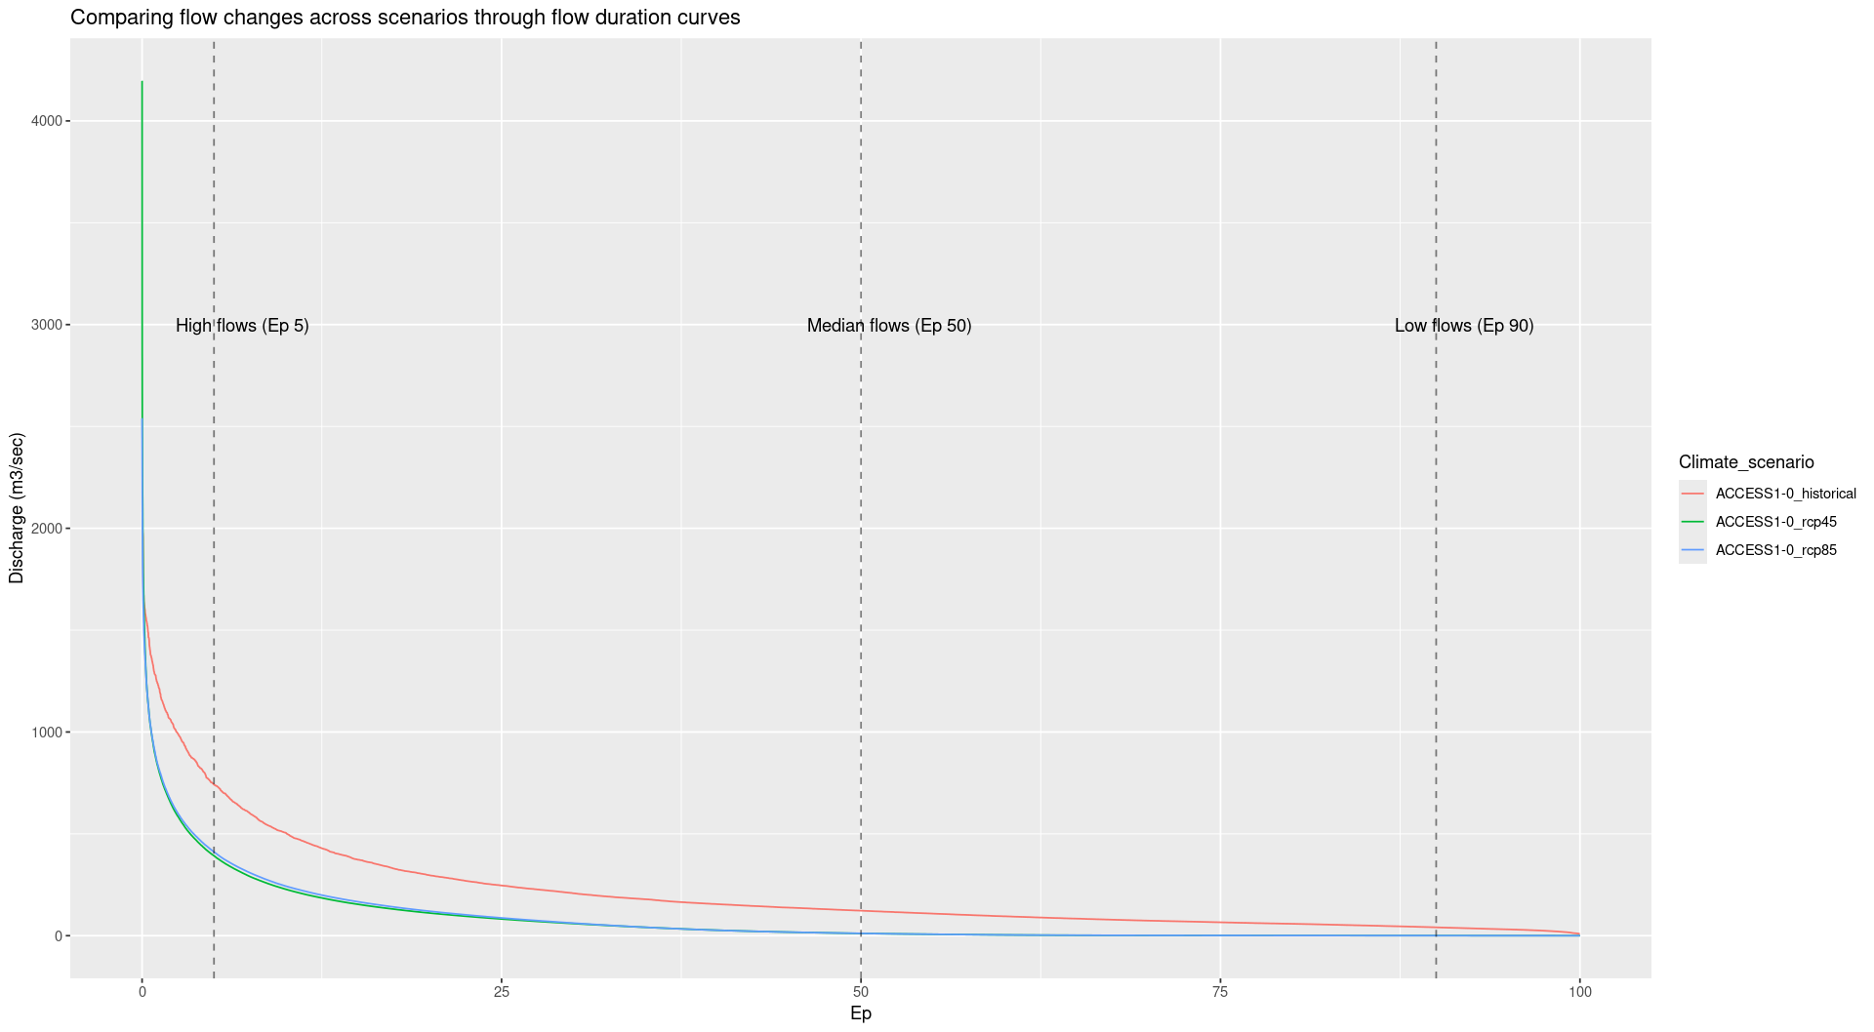
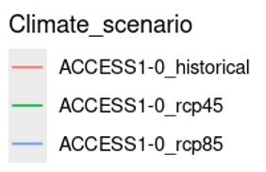
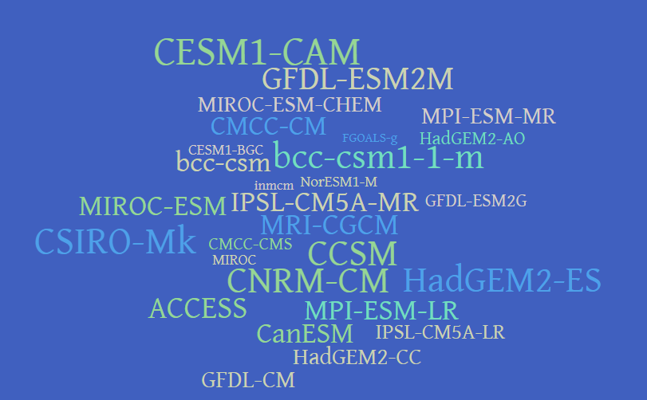
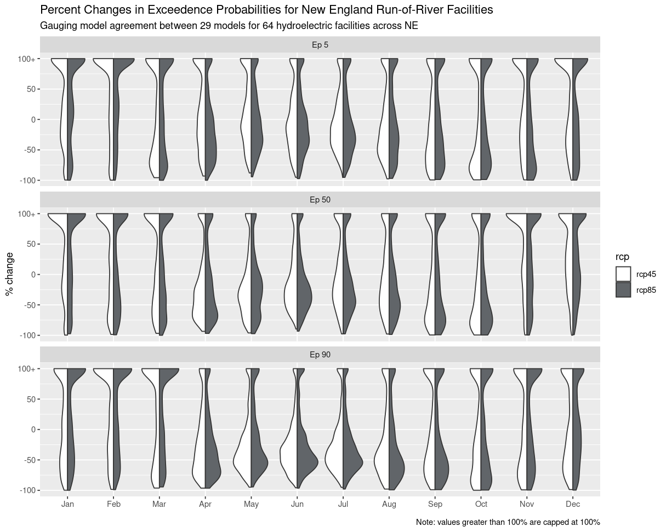
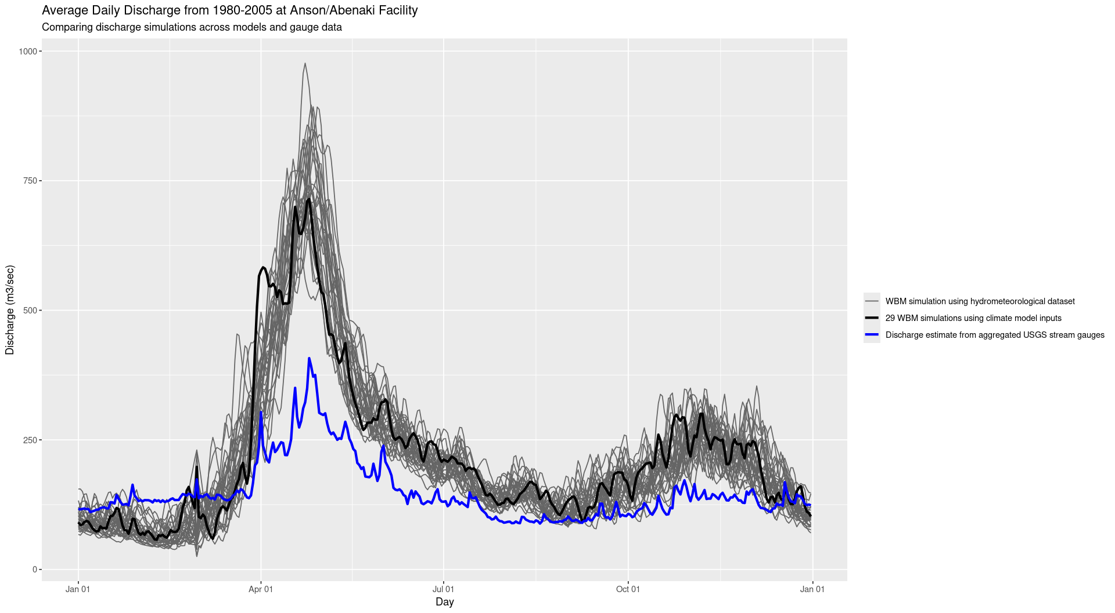
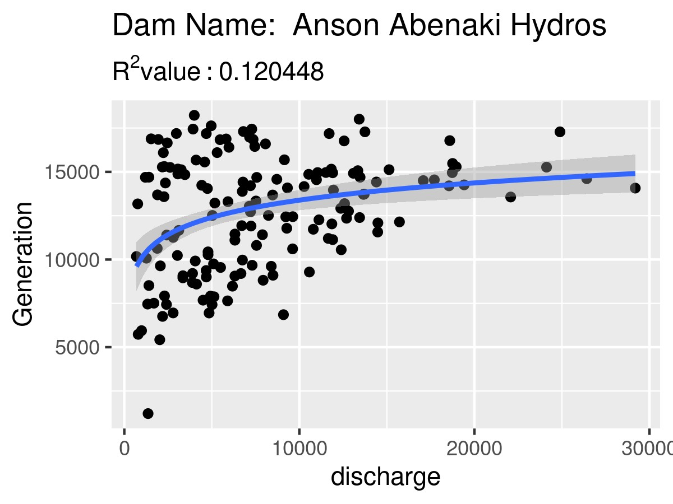
The Future of Hydropower in New England Becker Gibson Advisor: Danielle Grogan, PhD Water Systems Analysis Group, University of New Hampshire, Durham, NH 03824
Introduction
Results
Conclusions
Hydrological regimes are expected to change in response to a changing climate
Dryer summers and wetter winters are expected, with an earlier spring peak in flows
As of 2022, hydropower in New England generates roughly 10%¹ of its electricity, with many facilities in the process of undergoing relicensing
How could different changes in seasonal flows impact hydroelectric power production in New England?
Despite variability between individual models, there is high potential for significant change along seasonal patterns
Dryer summers may lead to less hydroelectric generation potential, which could add stress to a high-demand time on the electrical grid
Increased flows during winter months may lead to increased hydroelectric generation potential, however, significant increases in the highest flows raises concerns over flooding events
Methods
Water Balance Model² was used to simulate discharge for the New England region using the Localized Constructed Analogs³ climate ensemble
29 climate models and two warming scenarios: high and moderate
Examined 1980-2005 and 2033-2063
Compared the 5, 50, and 90% exceedance between the historical and future simulations for 64 sites listed as run-of-river on hydroreform.org⁴
Aggregated gauge data using dataRetrieval⁵ package by month for 9 sites from 2001-2012 and compared to monthly power generation data from the Energy Information Administration⁶
Model output using the Livneh⁷ hydrometeorological dataset was then compared to the power data
Significant reductions in general flow predicted from April-August for the New England region
Potential for significant increases during winter months across high-flow scenarios
2 greenhouse gas concentration scenarios
29 Climate Models
1 hydrological model
% difference between historical and future
Future Work
RCP 45
RCP 85
WBM
}
Rerun water model using updated climate simulations⁸
Calibrate model for individual sites
Expand sites for power generation/discharge comparison by better gauging individual sites
Work with hydropower operators to obtain more precise power generation data to validate models of changes to power generation potential under different climate scenarios
HOWEVER
LOCA1 regional climate ensemble
Historical Discharge Values
1980 - 2005
Projected Discharge Values
2033-2063
Models disagree on direction of change from August – December, possibly due to model limitations around precise freeze/thaw events
Stronger agreement in positive change from January – March
Stronger agreement in negative change from April - July
Acknowledgements
Supported by the National Science Foundation REU program,, Award #2244092 and the U.S. Department of Energy, Office of Science, Biological and Environmental Research Program, Earth and Environmental Systems Modeling, MultiSector Dynamics under Cooperative Agreement DE-SC0022141.
Any opinions, findings, and conclusions or recommendations expressed in this material are those of the author(s) and do not necessarily reflect the views of the US Department of Energy.
Expressing variation between models is an ongoing question in the research community, how should we weight model agreement vs. low probability but high-risk events?
References
1.Miller, N., Simonelli, J. & Stark, G. The future role of hydropower in the Northeastern United States: May 2020-May 2022 (2022). doi:10.2172/1864718
2.Grogan, D. S. et al. Water balance model (WBM) V.1.0.0: A scalable gridded global hydrologic model with water-tracking functionality. Geoscientific Model Development 15, 7287–7323 (2022).
3.Pierce, D. W., Cayan, D. R. & Thrasher, B. L. Statistical downscaling using localized constructed analogs (LOCA)*. Journal of Hydrometeorology 15, 2558–2585 (2014).
4.National map of hydropower dams. Hydropower Reform Coalition Available at: https://hydroreform.org/on-your-river/. (Accessed: 16th December 2024) .
5. DeCicco L, et al. dataRetrieval: R packages for discovering and retrieving water data available from U.S. federal hydrologic web services. (2025). doi:10.5066/P9X4L3GE.
6.Electricity Data Browser Available at: https://www.eia.gov/electricity/data/browser/. (Accessed: 16th December 2024).
7.Livneh, B. et al. A spatially comprehensive, hydrometeorological data set for Mexico, the U.S., and southern Canada 1950–2013. Scientific Data 2, (2015).
8.Pierce, D. W., Cayan, D. R., Feldman, D. R. & Risser, M. D. Future increases in North American extreme precipitation in CMIP6 downscaled with Loca. Journal of Hydrometeorology 24, 951–975 (2023).
9 sites were well-gauged, allowing for model validation
Actual discharge and power data were correlated
This does not account for shut-downs or no-market days, specific data from hydropower operators is needed
Model output needs to be calibrated for each site

