Slide 1
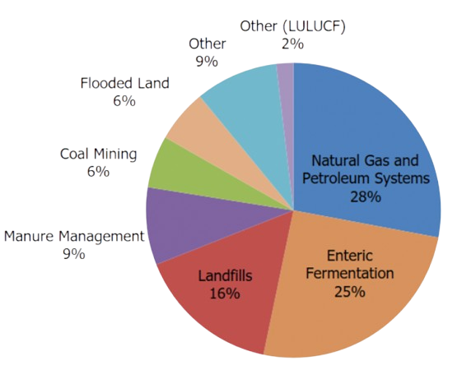
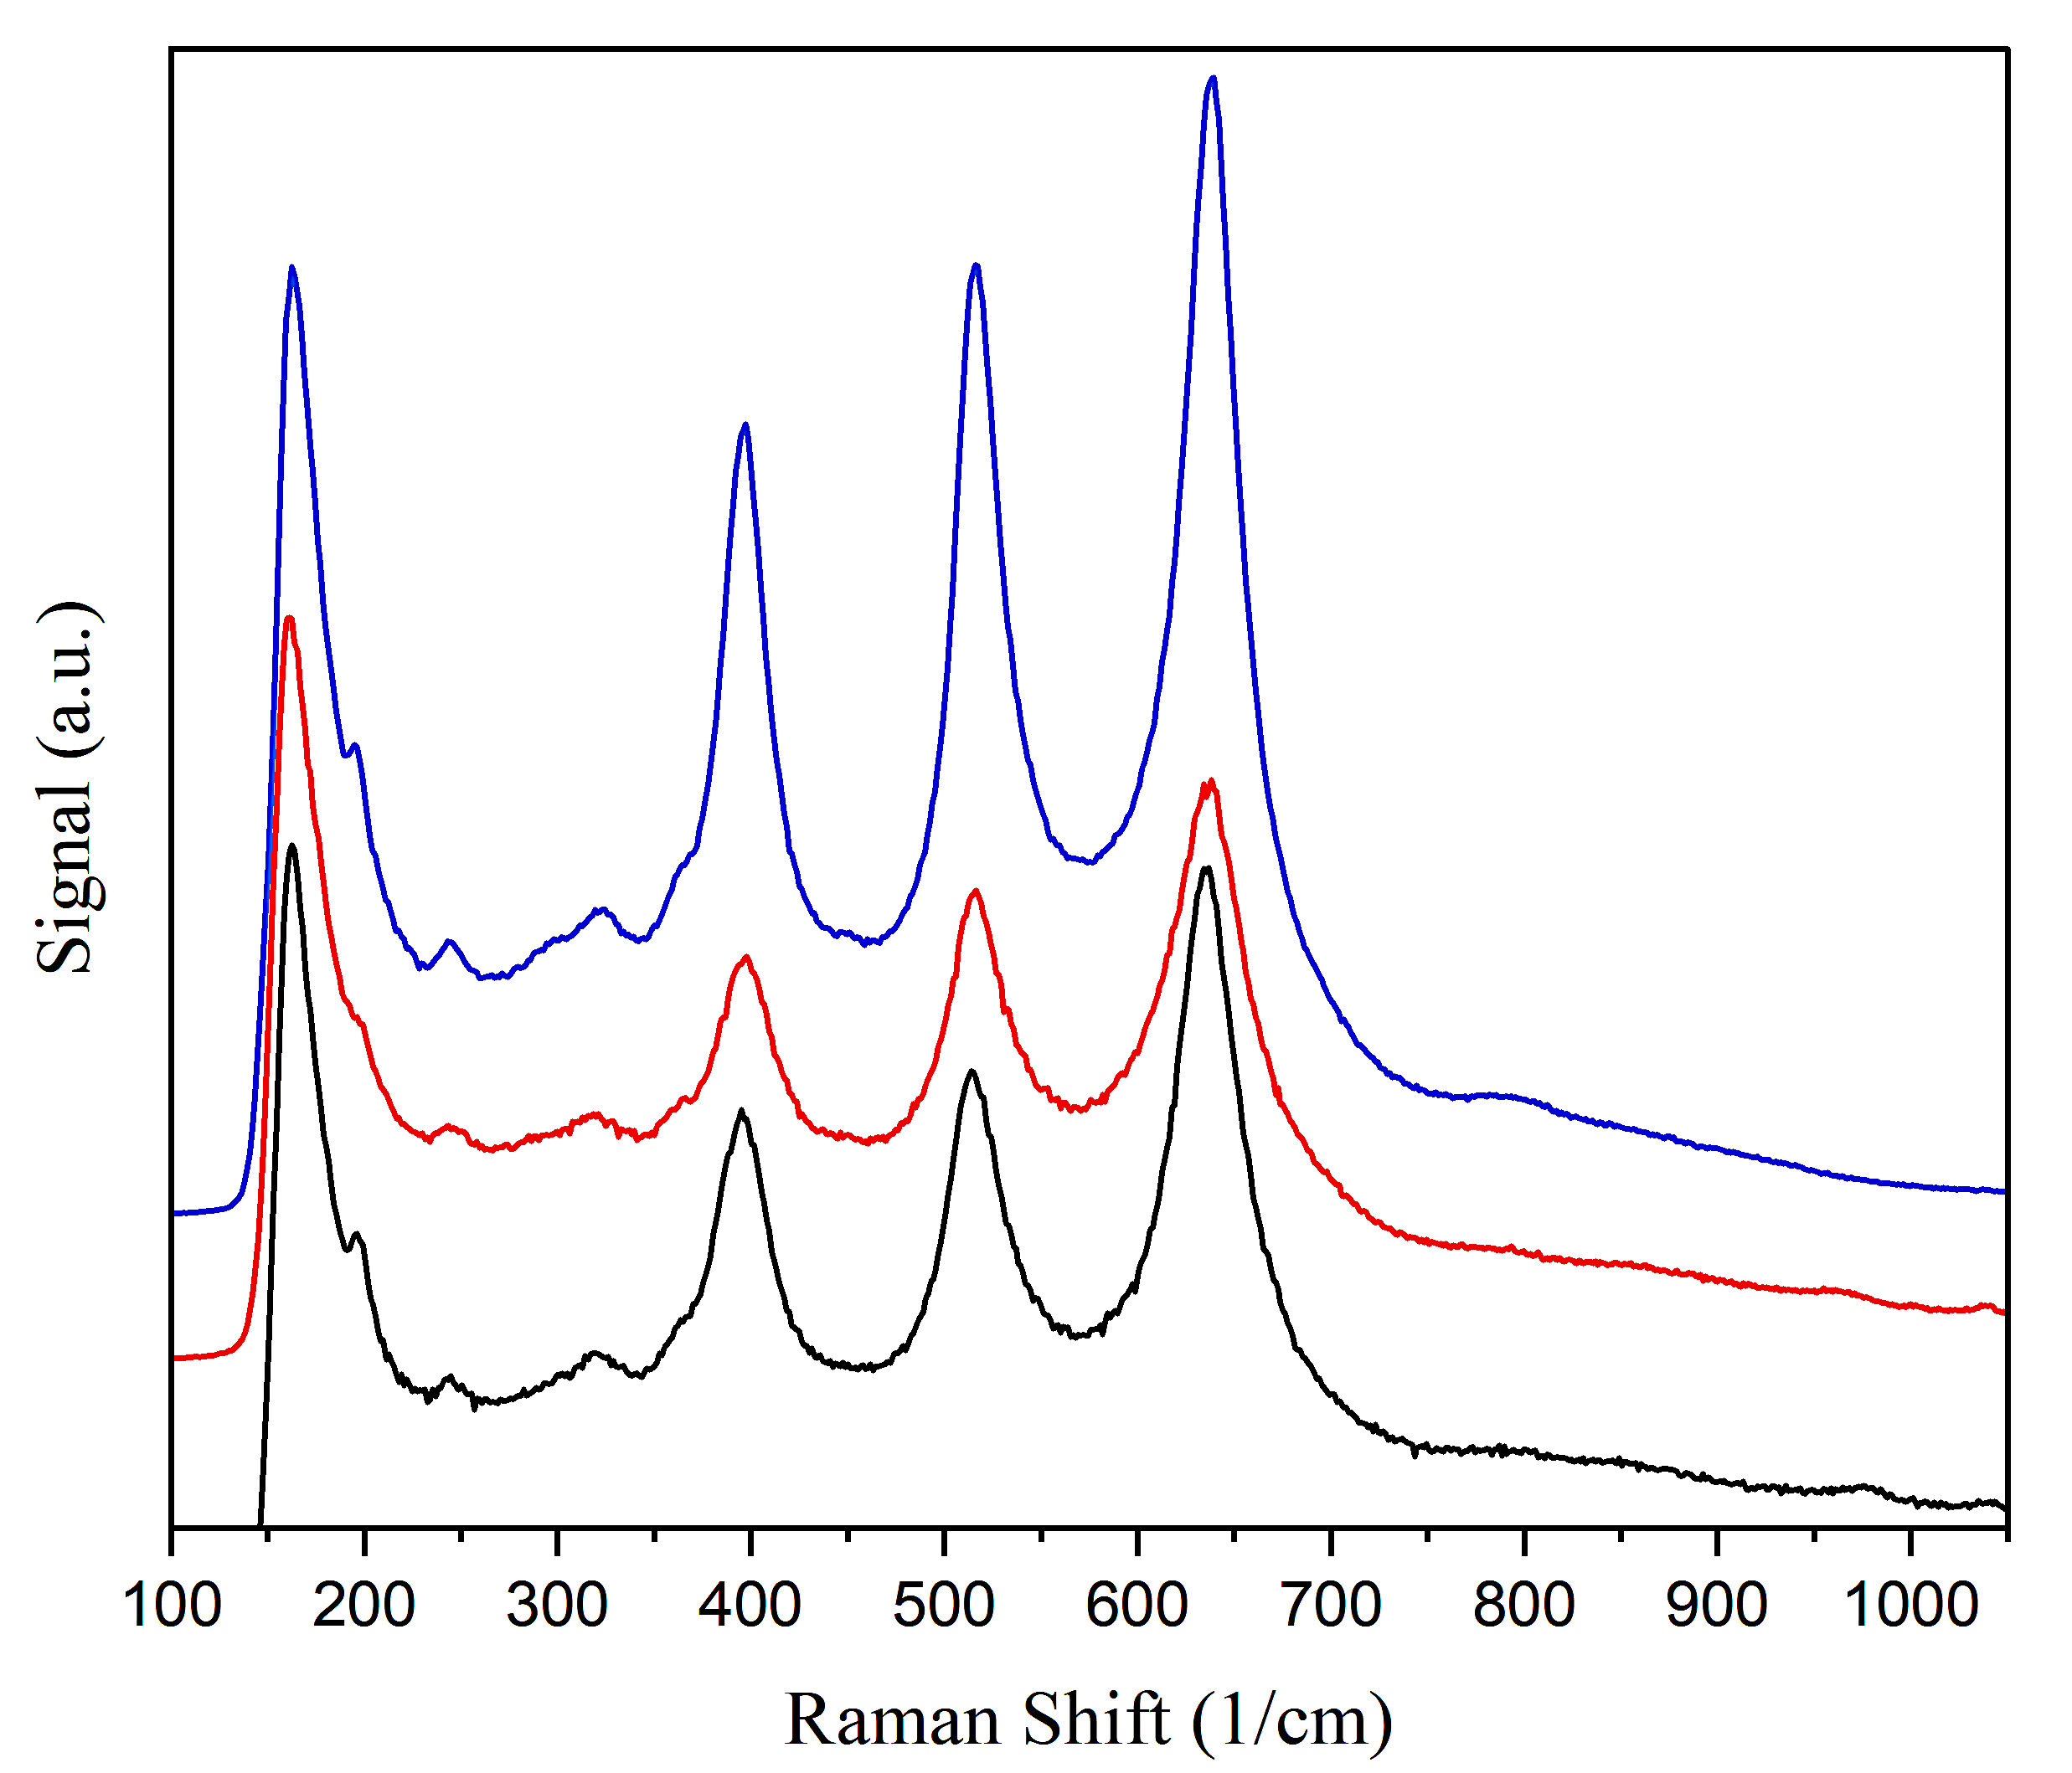
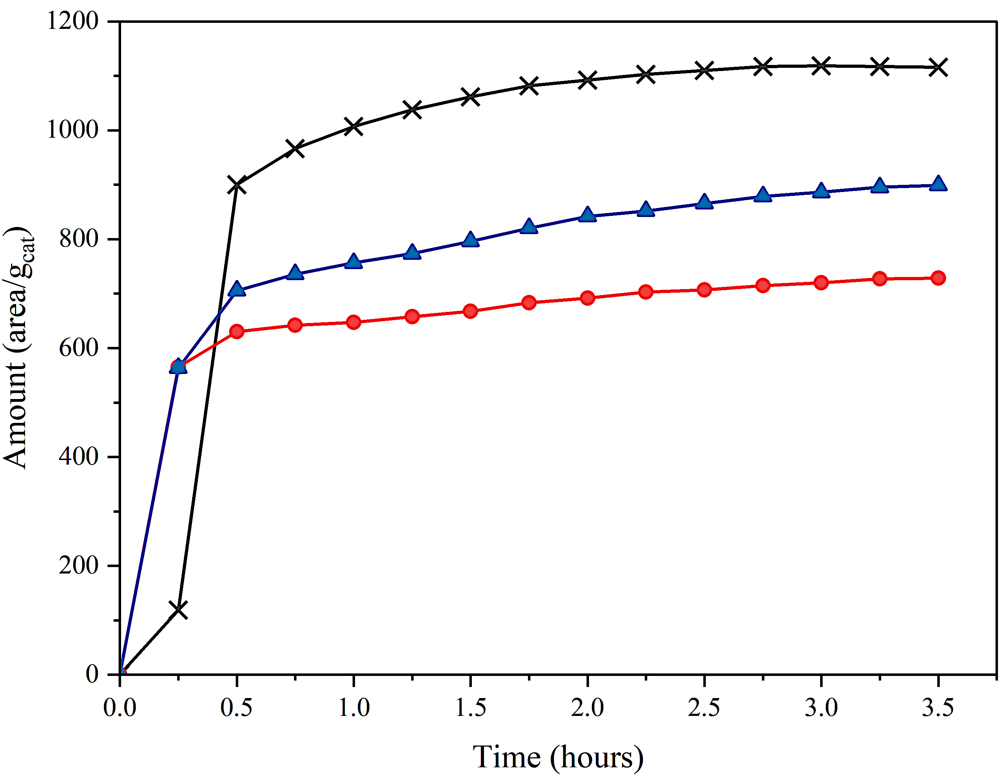
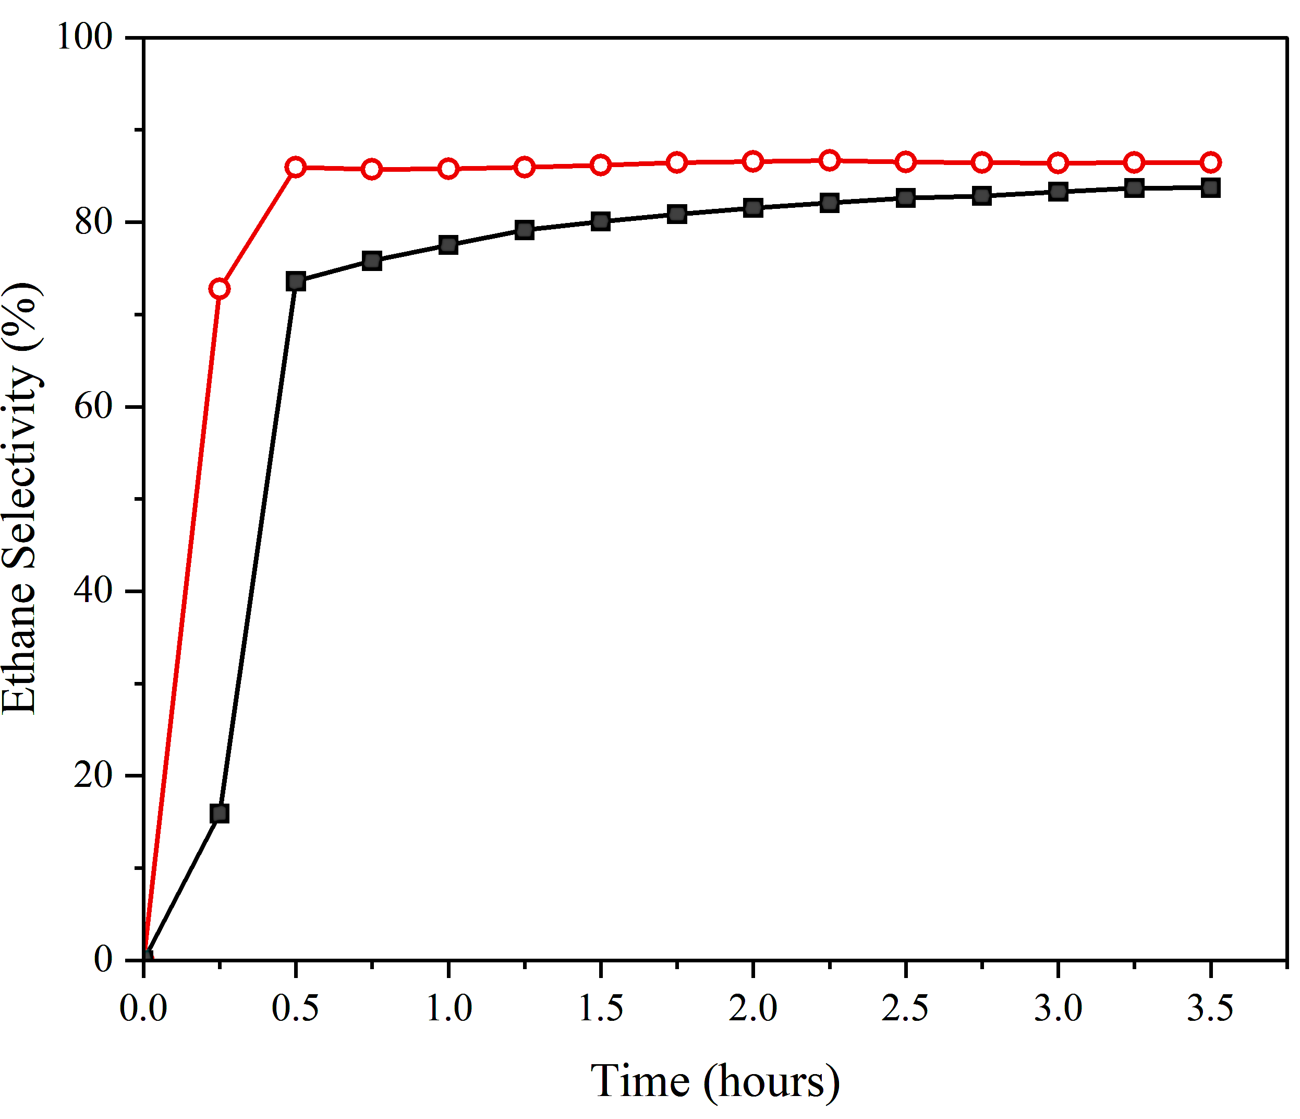
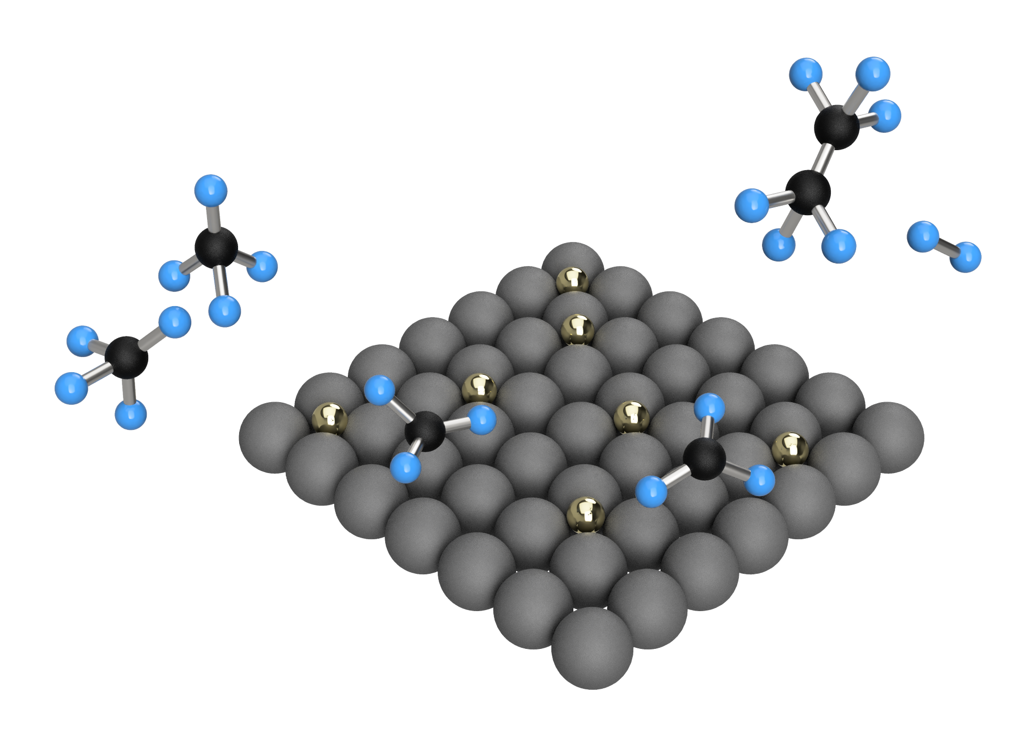
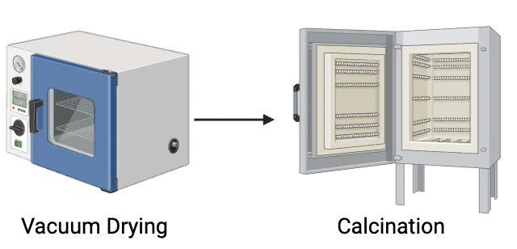
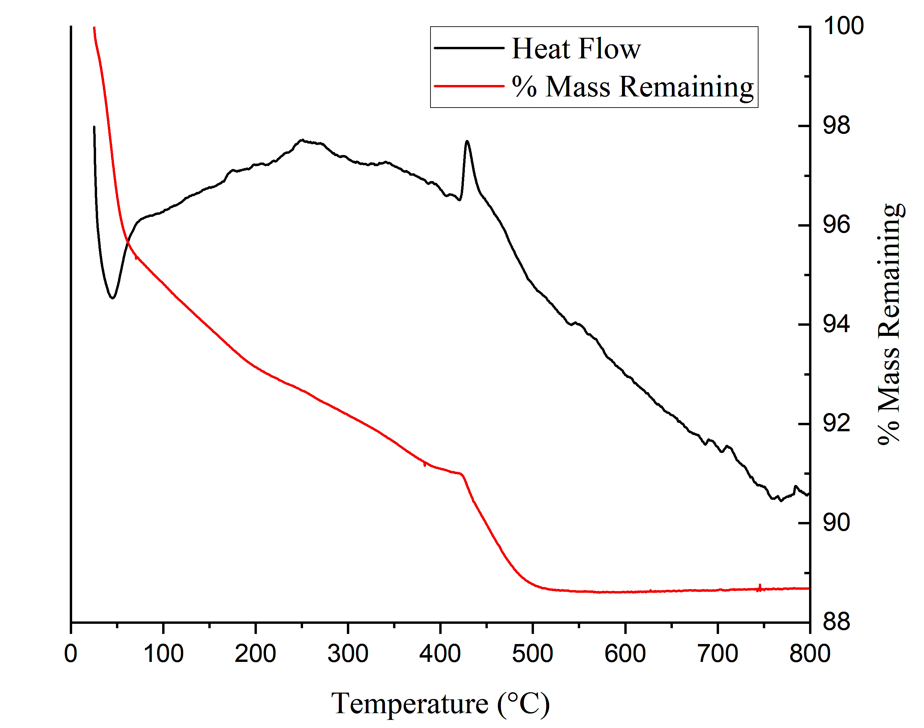
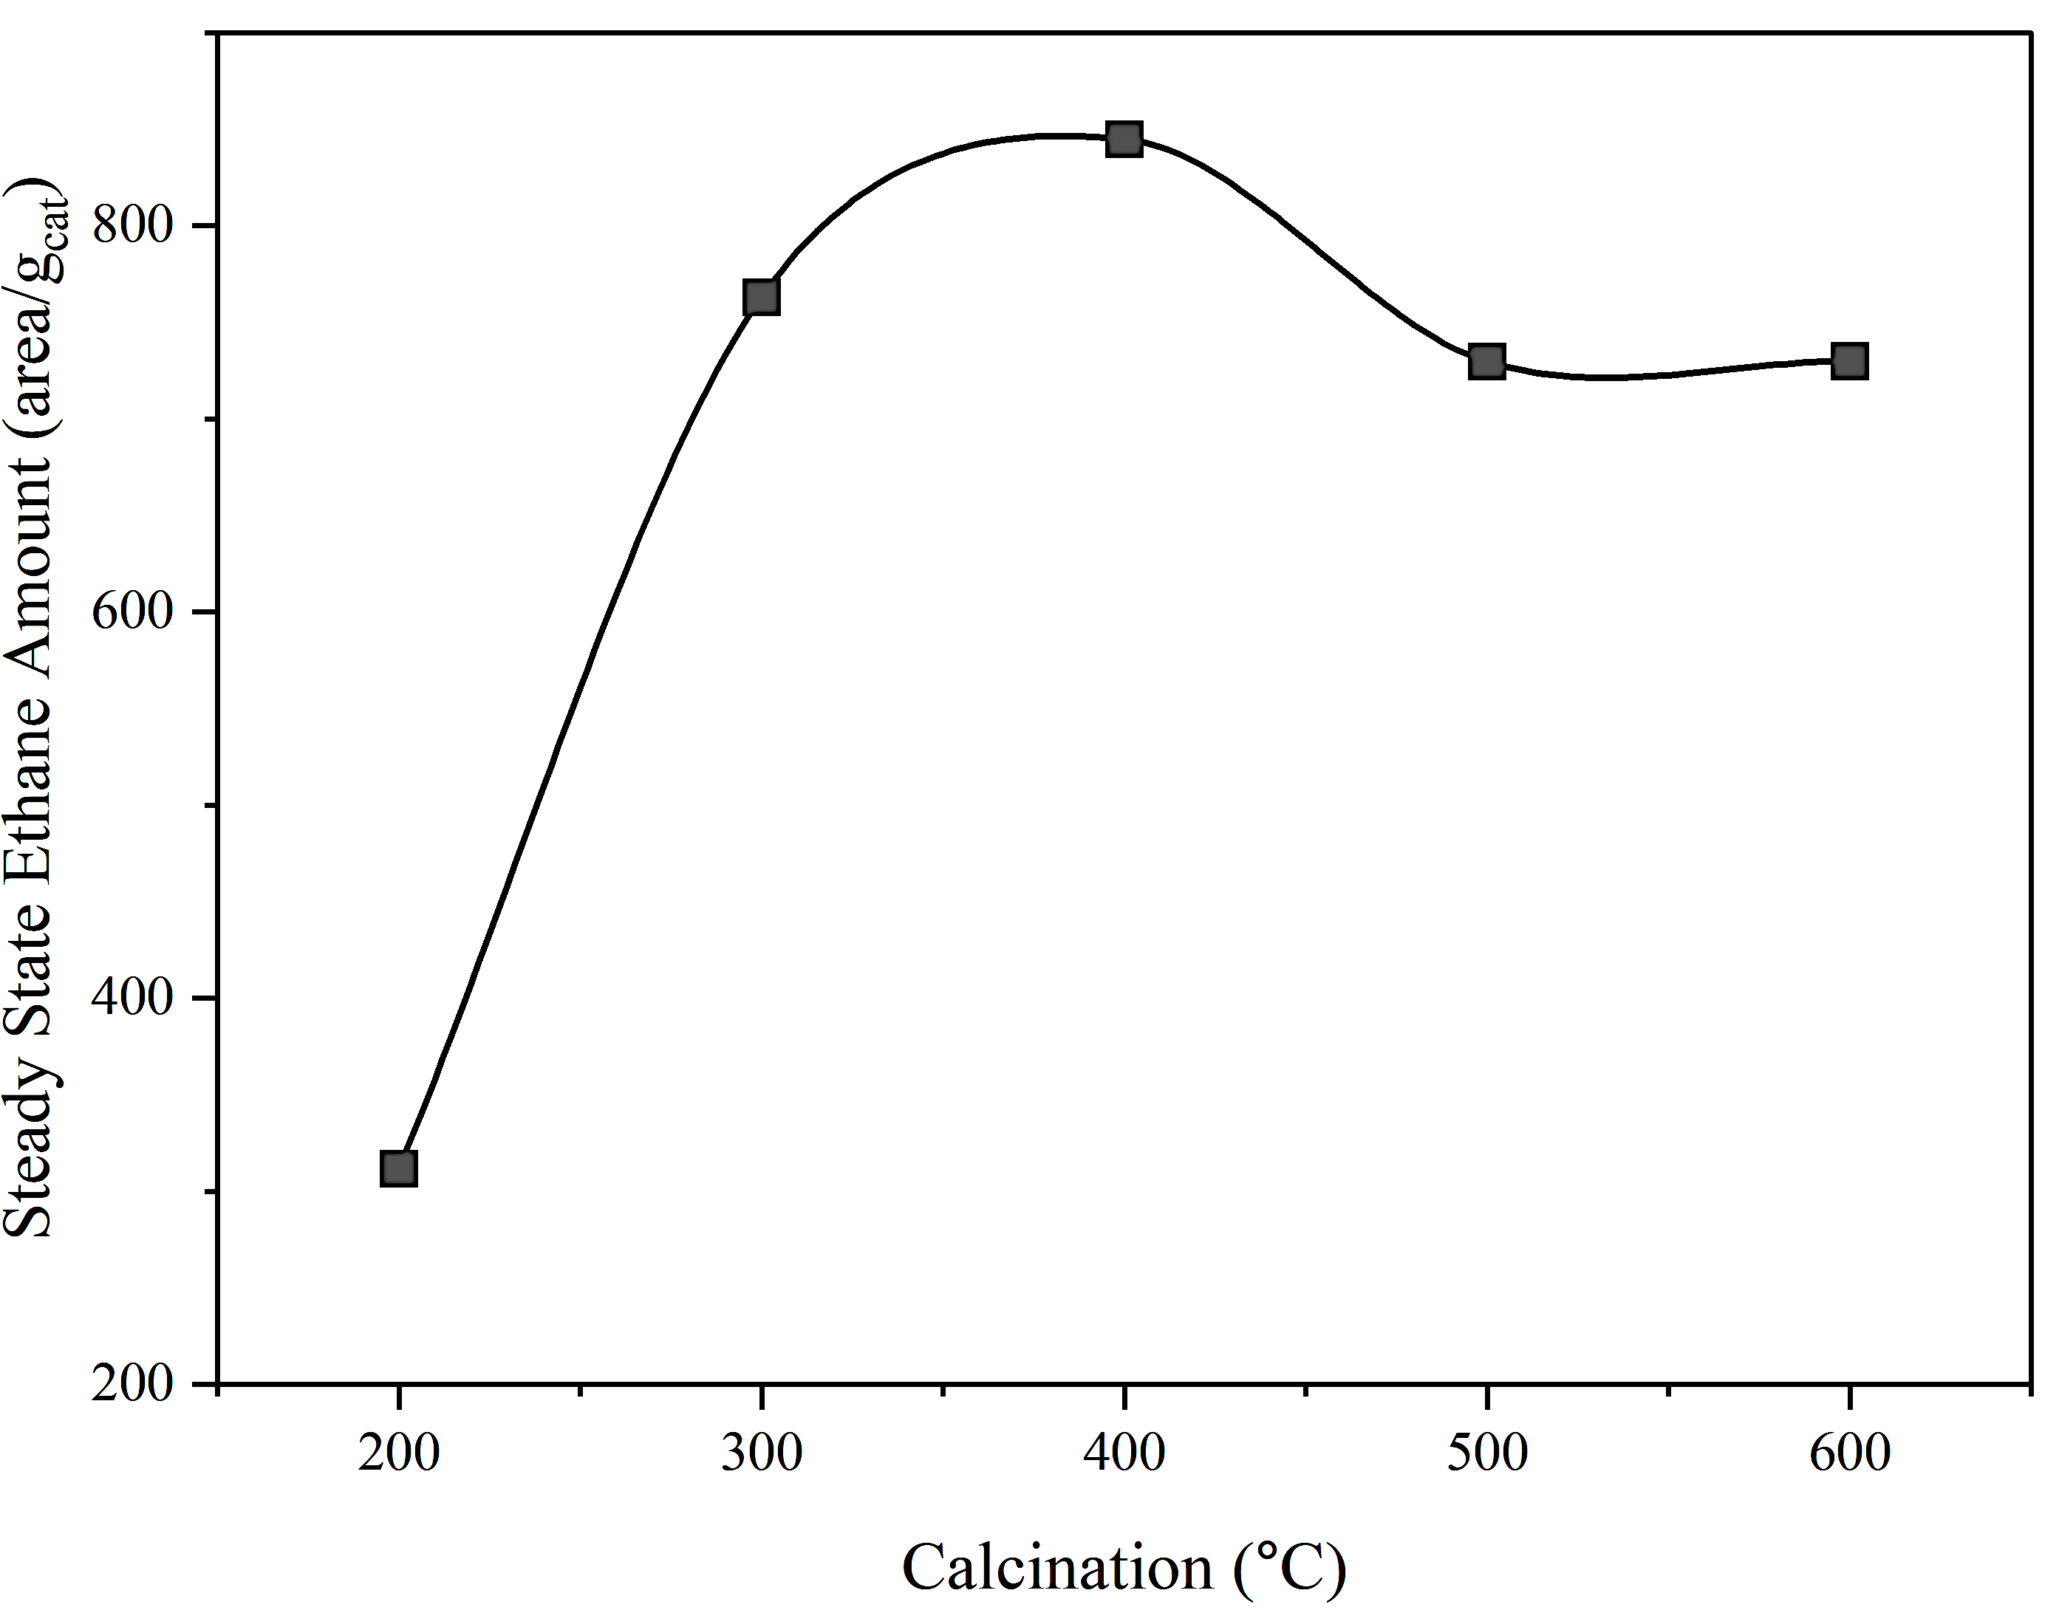
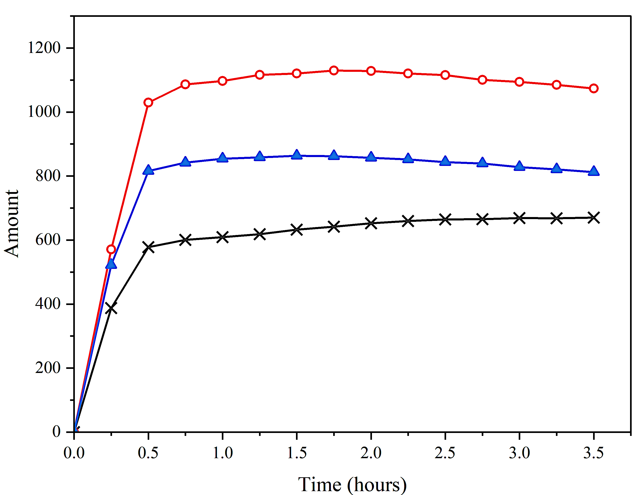
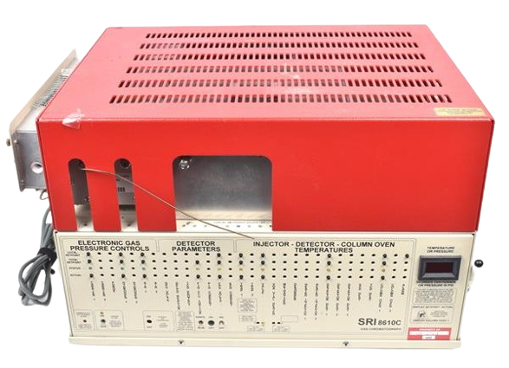
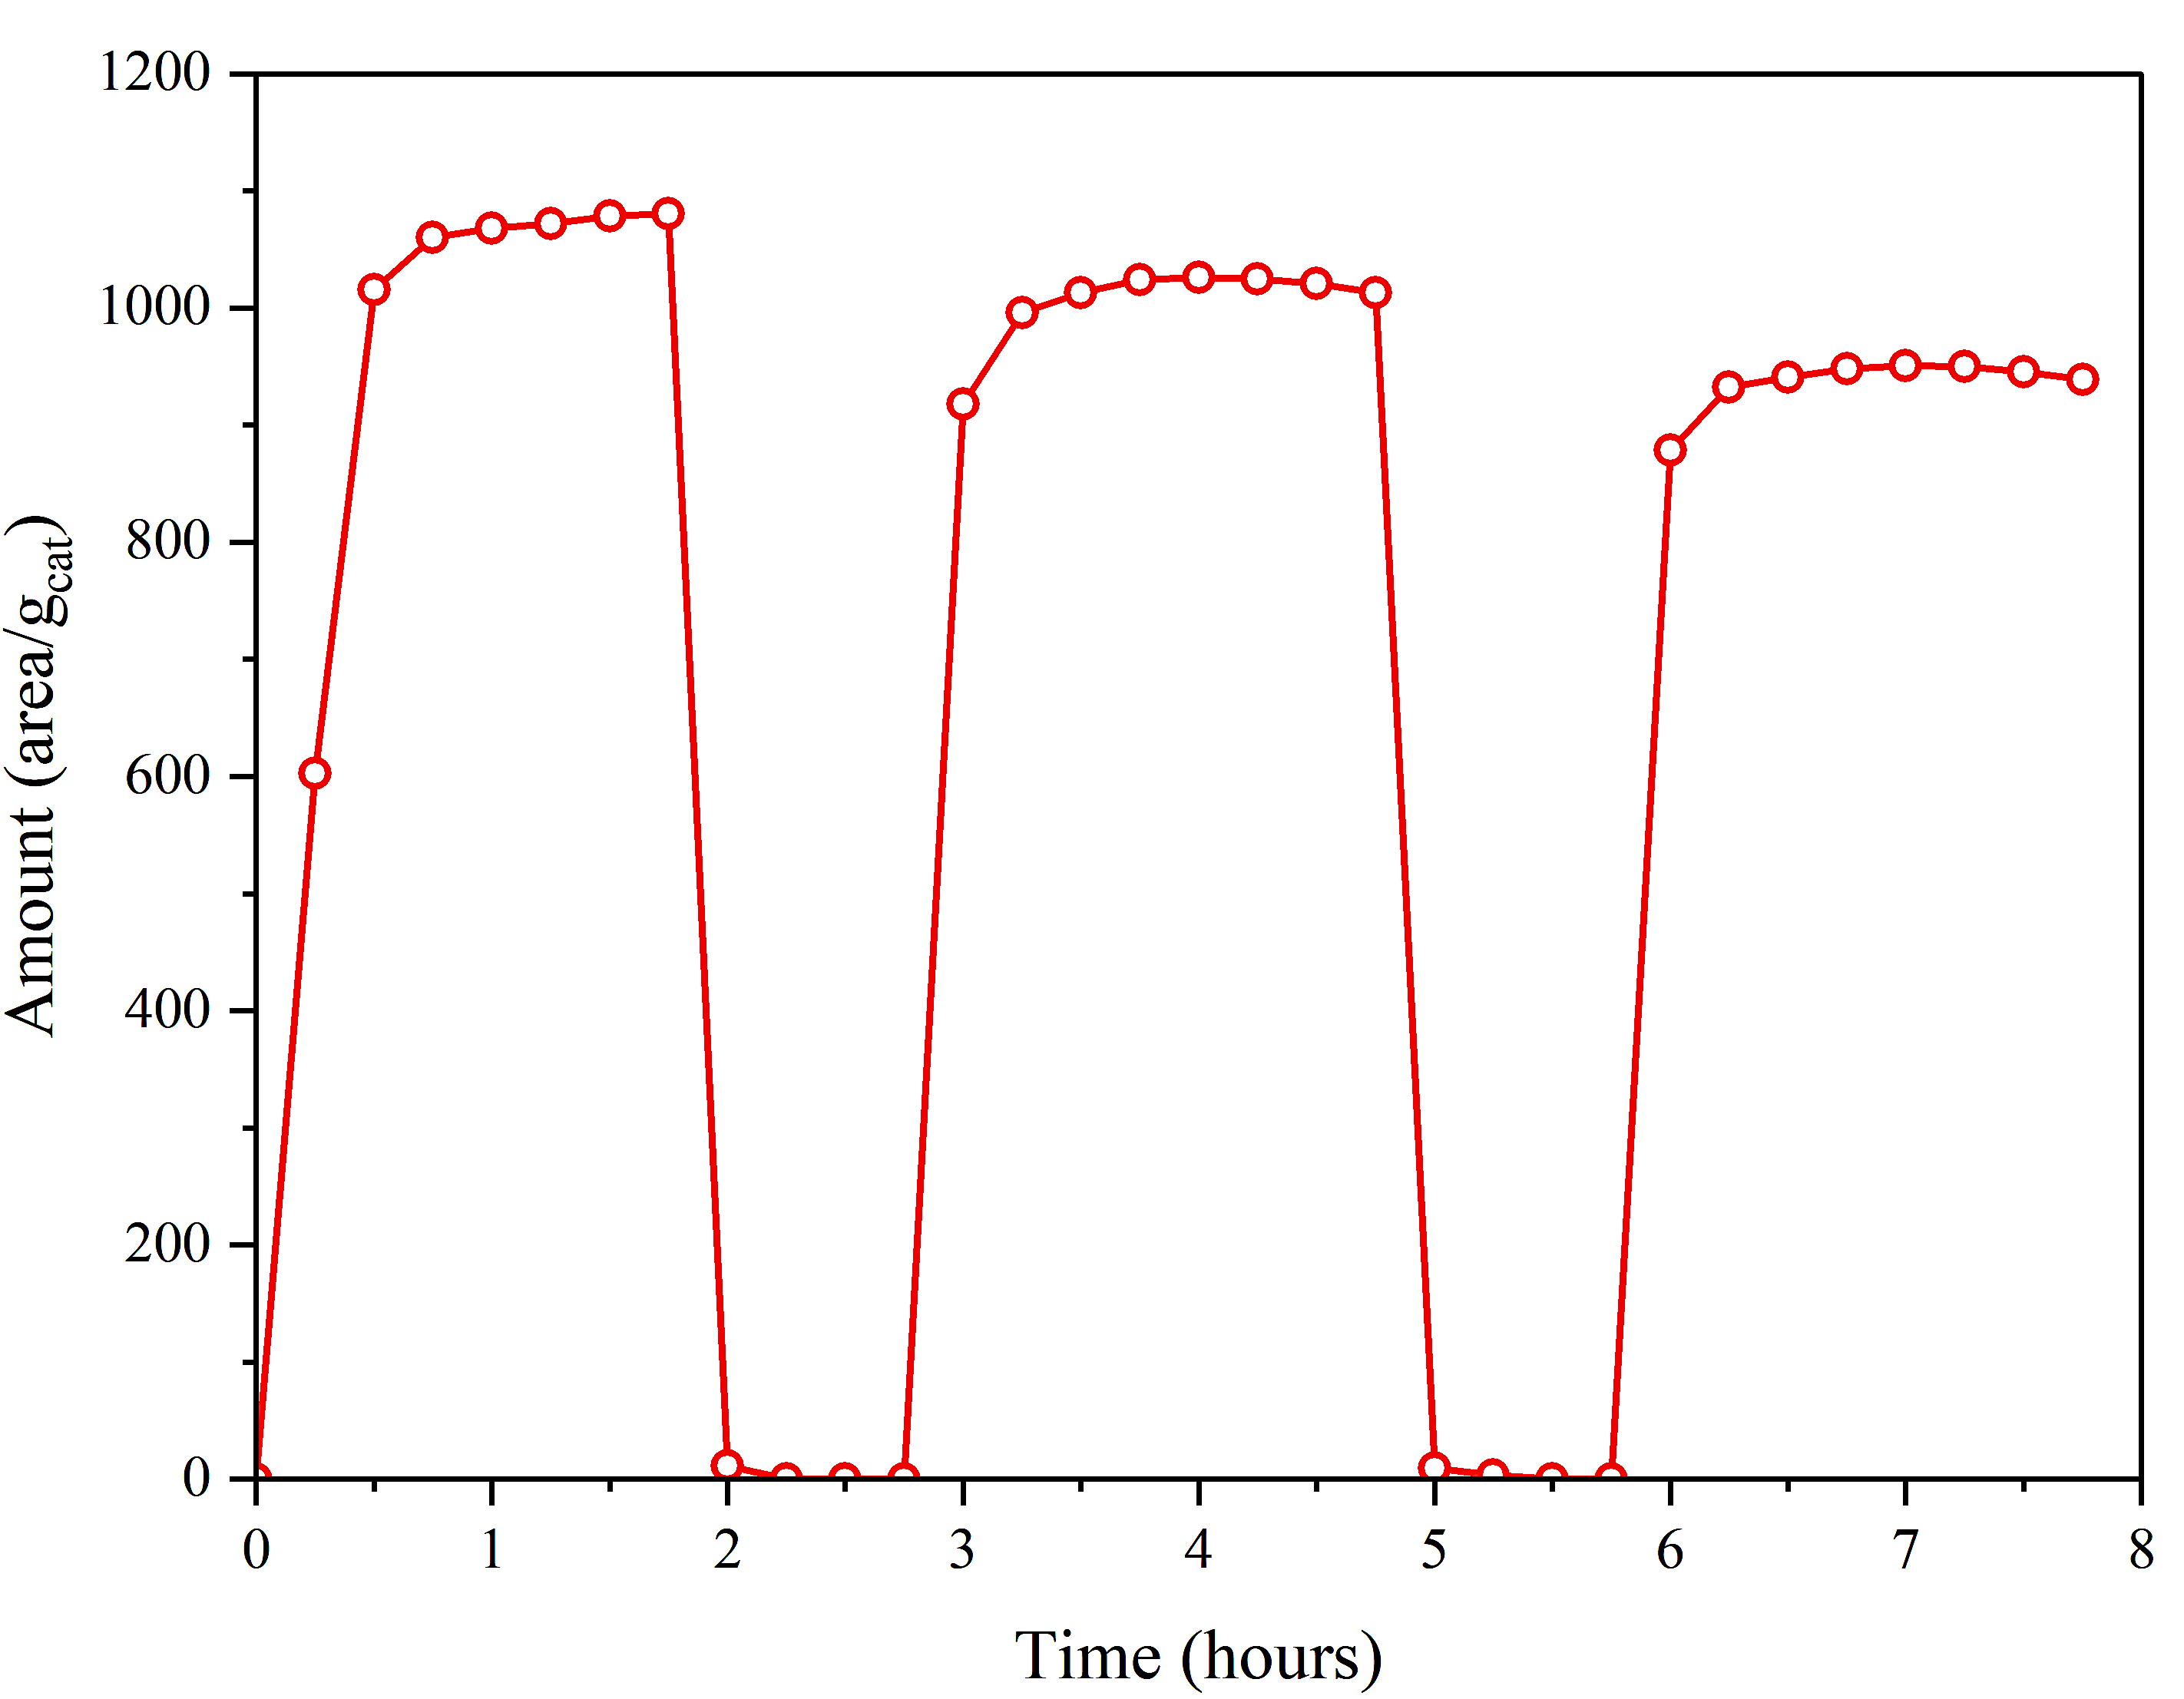
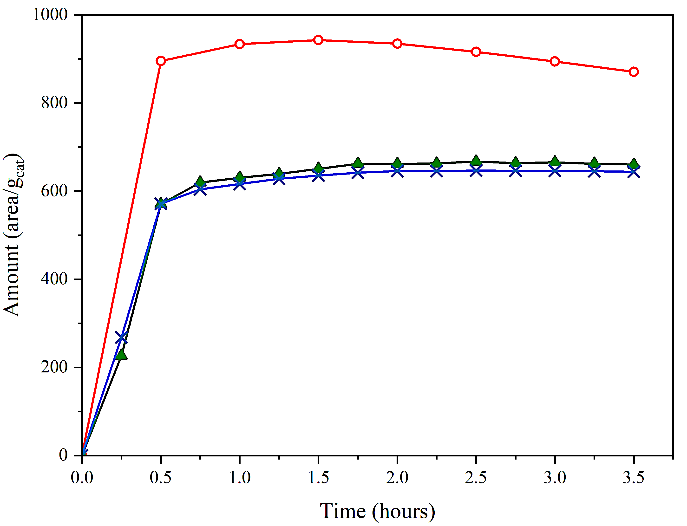
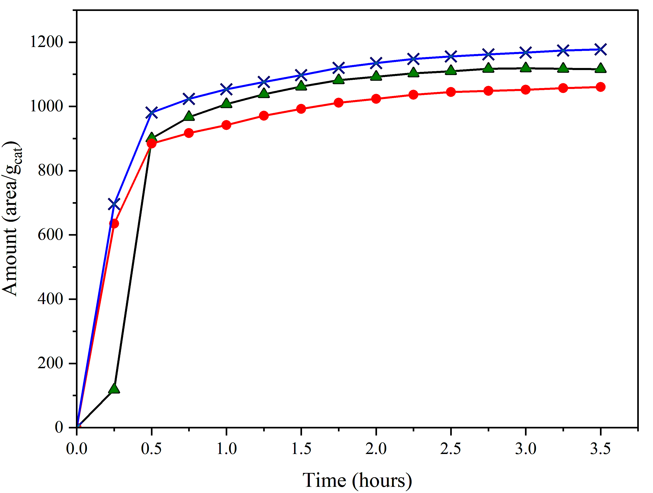
Photocatalytic Methane Conversion over Heteropoly Acid Based Catalysts
Jack Sullivan and Dr. Nan Yi
Department of Chemical Engineering and Bioengineering, University of New Hampshire, Durham, NH 03824
Introduction
How Does HPA and TiO₂ Effect Activity?
Methane (CH₄) is an abundant greenhouse gas
Ethane (C₂H₆) and Hydrogen are higher value fuels
Photocatalysis can overcome large energy inputs associated with thermal conversion
US Methane Emissions
Raman Spectra of Au-HPA-TiO₂, HPA-TiO₂, and TiO₂
Ethane Yield vs. TiO₂ Supports
Role of HPA
Sol-Gel
(0.5)Au-HPA-TiO₂
Anatase
(0.5)Au-TiO₂
Visible
UV
P25
Gold
TiO₂
Gold facilitates C-H bond cleavage
Heteropoly Acid (HPA) promotes photocatalytic performance
HPA-TiO₂
Heteropoly Acid
Au-HPA-TiO₂
Non-Oxidative Methane-Ethane Conversion
Sol-Gel TiO₂ Contains Anatase and Rutile Phases
Sol-Gel TiO₂ Exhibits Superior Ethane Production
HPA Increases Ethane Selectivity
Catalyst Synthesis
Activity Optimization of Au-HPA-TiO₂ Catalyst
Gold Loading | Calcination Temperatures | TiO₂ Support
HAuCl₄
Thermogravimetric Analysis of (5)Au-HPA-TiO₂
Effect of Calcination Temperature
Effect of Gold Loadings
0.5 wt. %
₂
1 wt. %
Wet Impregnation Method of Au-HPA-TiO₂
Endo Exo
Amount (area/g_{cat})
Activity Testing
0.25 wt. %
Photocatalytic activity testing
h$υ$
CH₄ (10%)
He (90%)
Au- HPA-TiO₂
CH₄
C₂H₆ CO₂
Room Temperature
Light ON/OFF Test
Regenerative Studies
Advantages of a Flow Reactor:
Allows for continuous methane conversion
Mitigate overoxidation through decreased contact time
Lamp ON | OFF
(0.5)Au-(10)HPA-TiO₂
(0.5)Au-TiO₂
Summary
Light Off
Light Off
Initial
Regeneration 2
Photocatalytic methane conversion makes sustainable methane transformation feasible
The synergy between heteropoly acid and gold enables the production of ethane and hydrogen at moderate conditions
Brookite phase TiO₂ may facilitate methane conversion
Regeneration 1
Initial
Regeneration 2
Acknowledgments
Regeneration 1
UNH Hamel Center for Undergraduate Research, Seth Drahusz, and Darcy Silver
References
[1] Overview of Greenhouse Gases. EPA, 2024
[2] Nat. Rev. Mater. 2022, 7 (8), 617–632.
[3] Nat. Energy 2020, 5 (7), 511–519.
(0.5)Au-HPA-TiO₂

