Slide 1
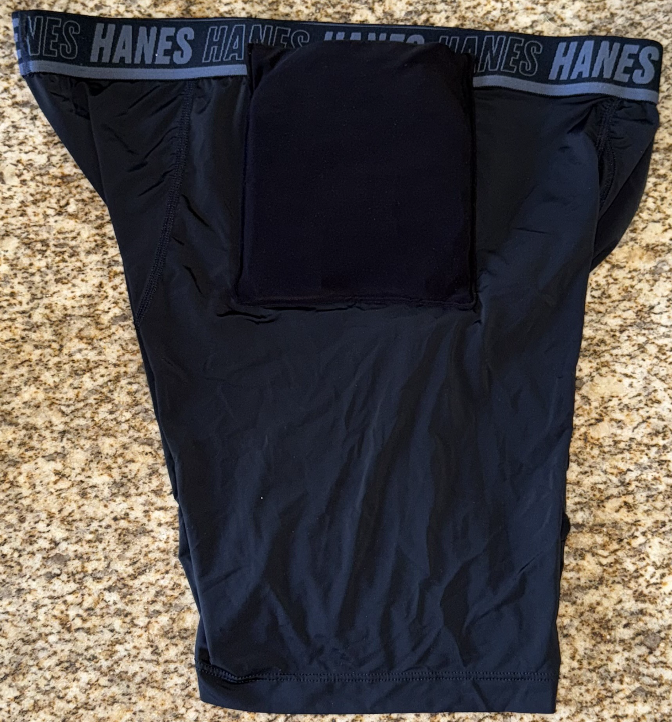
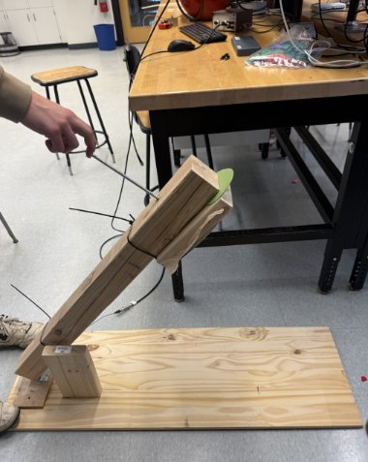
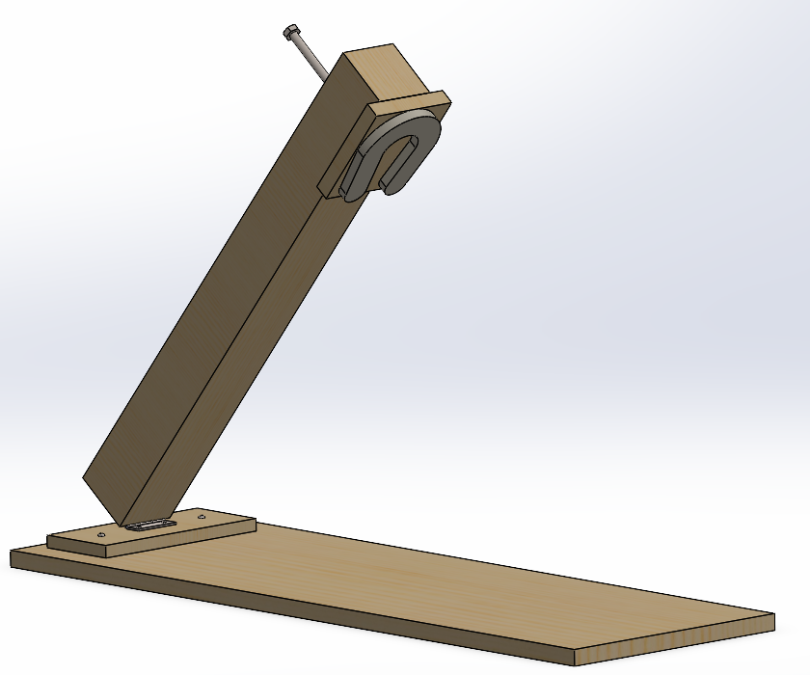
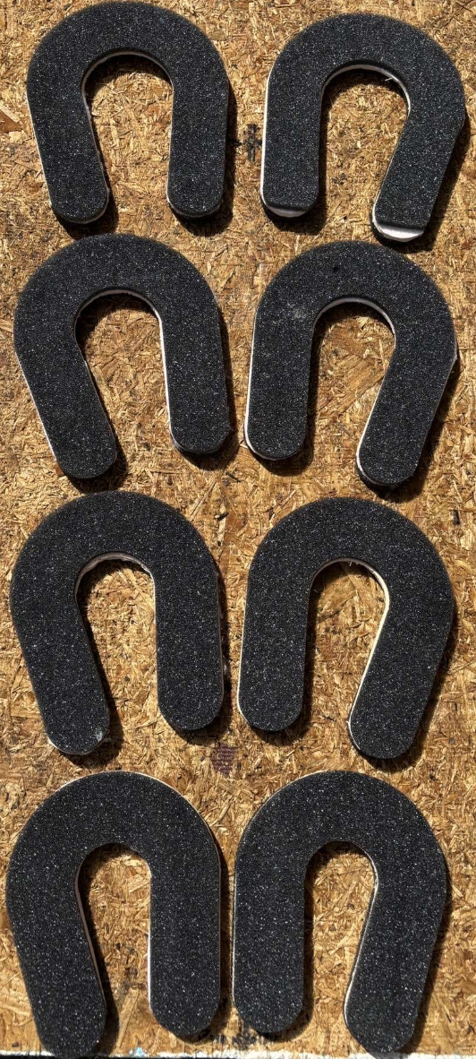
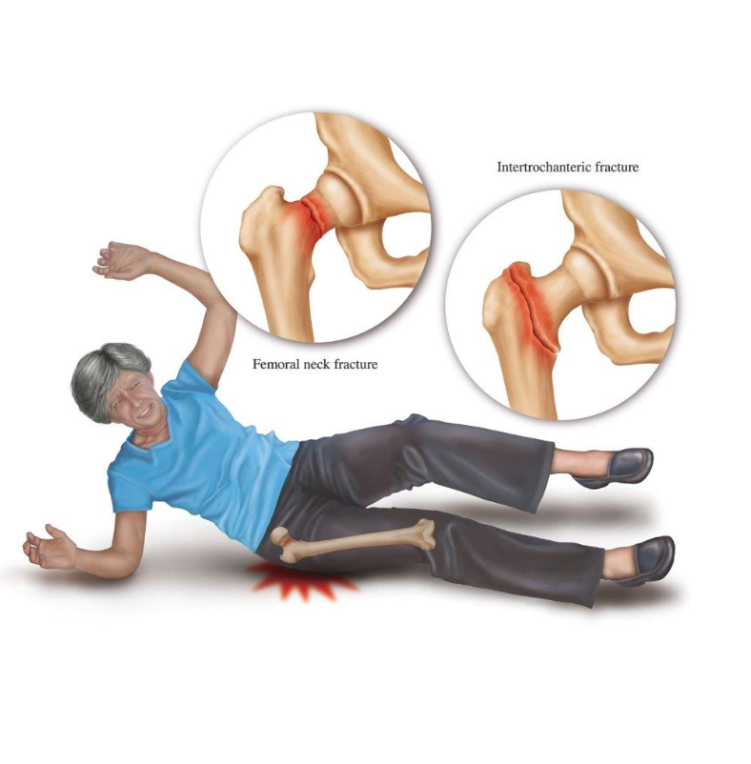
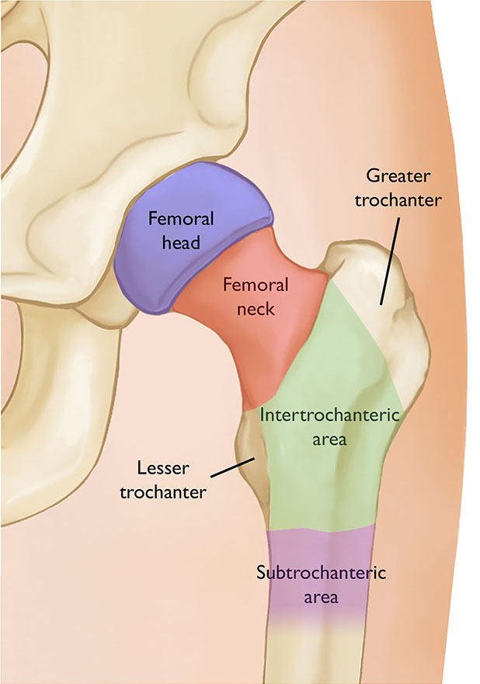
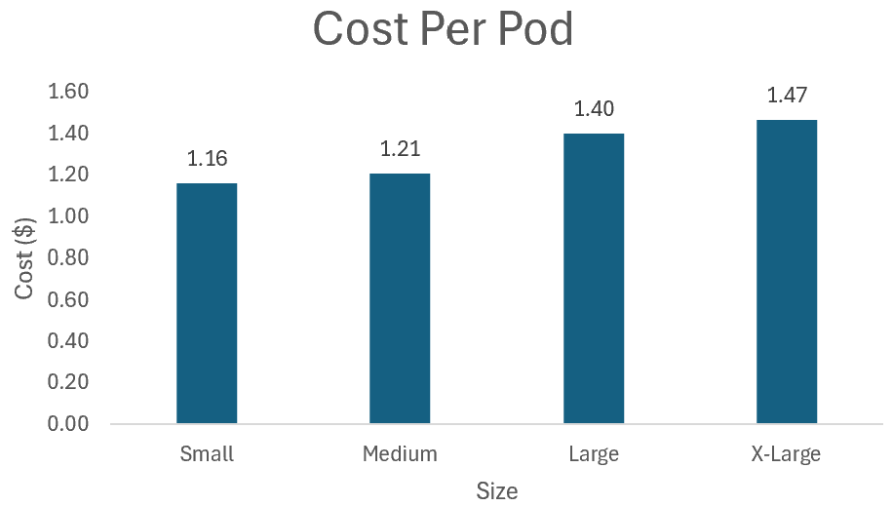
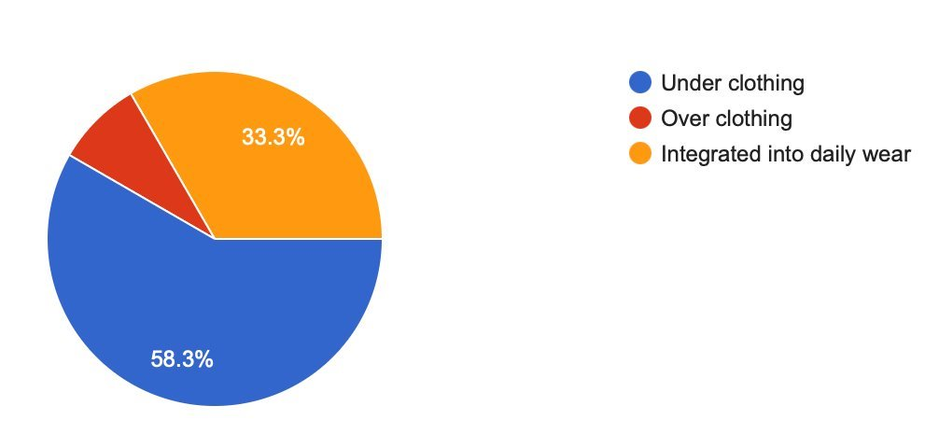
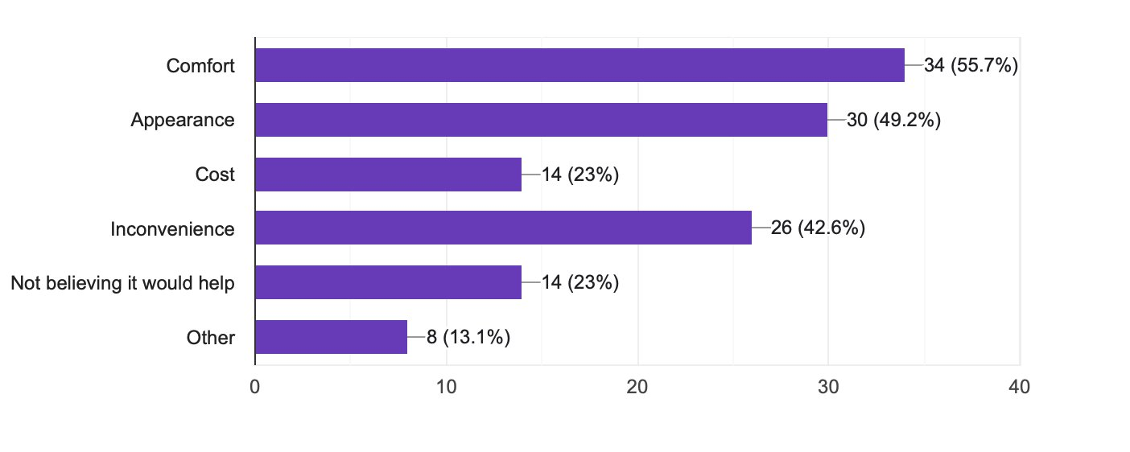
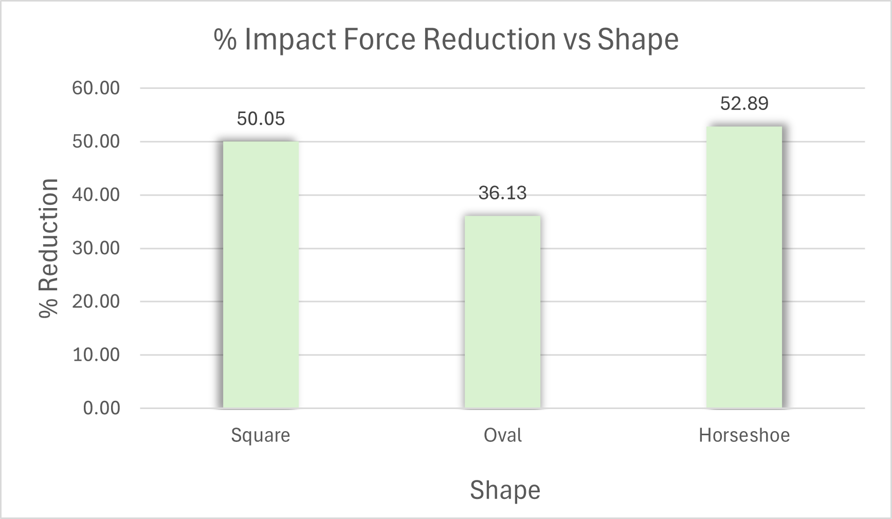
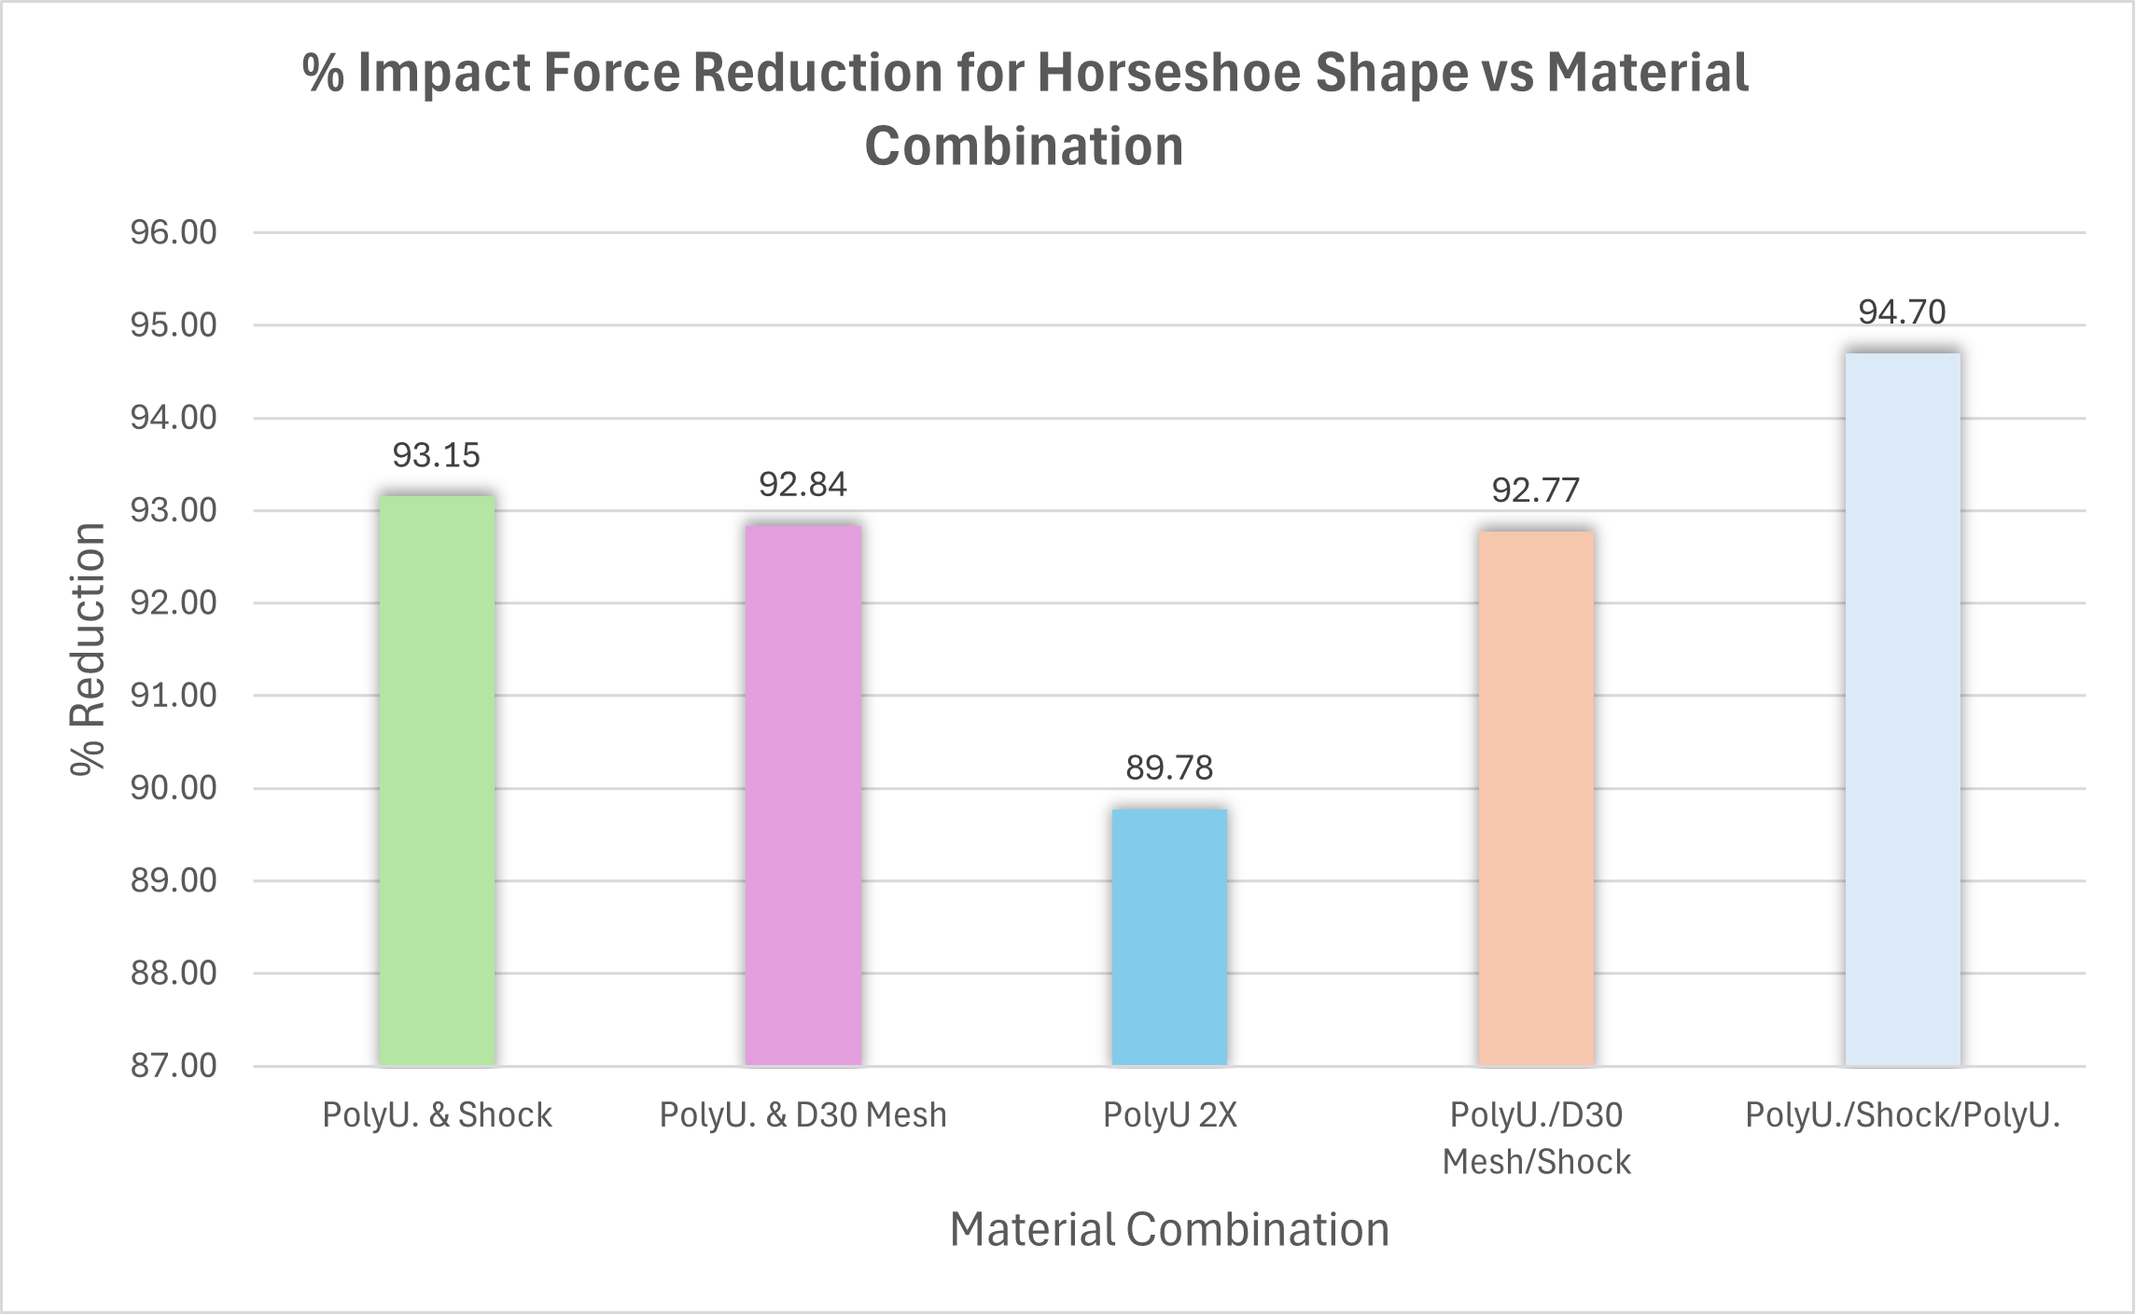
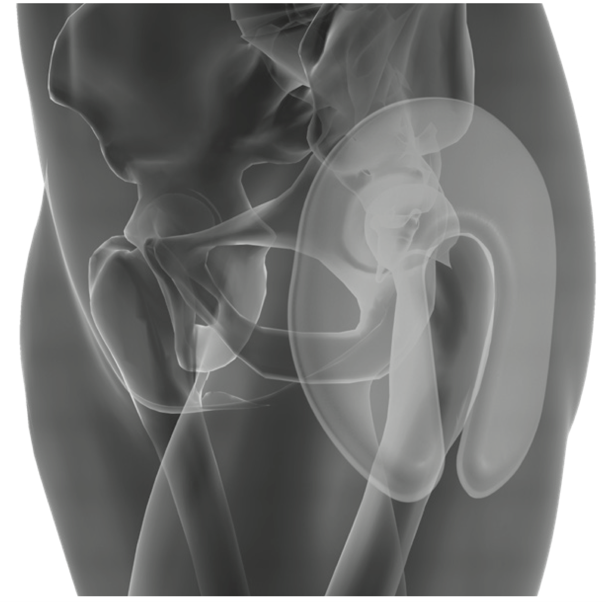
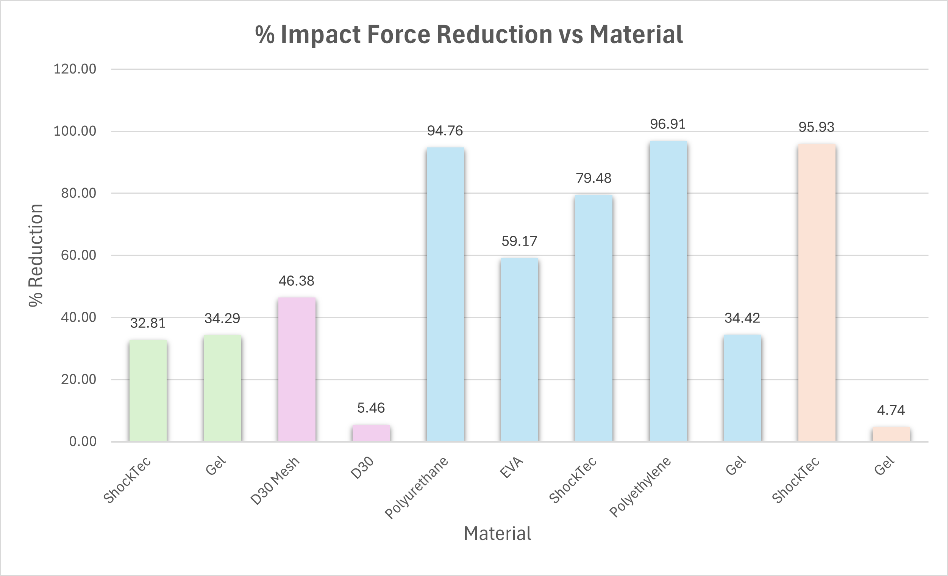
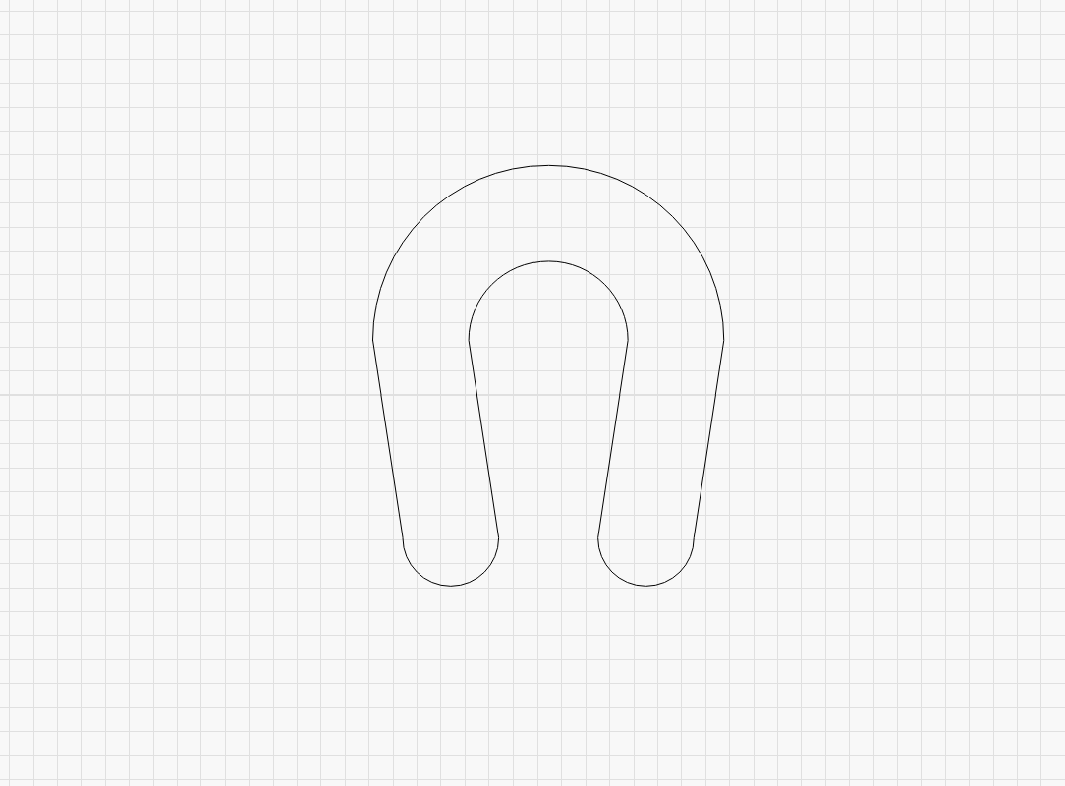
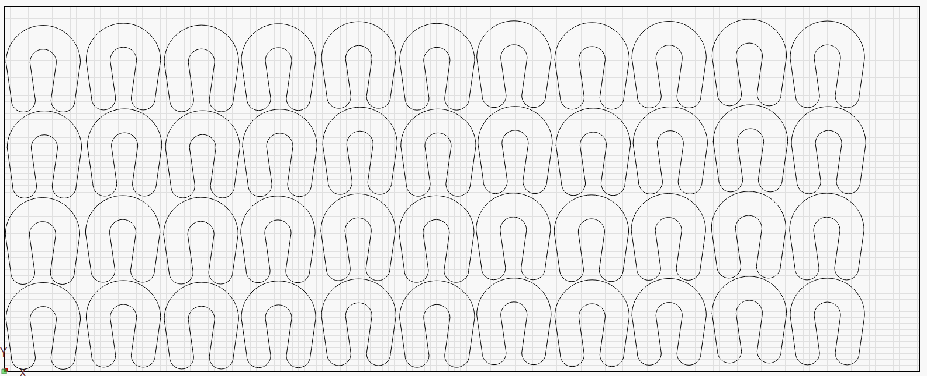
Hip Protector Joe D'Ambruoso, Owen Larouco, Nick Mazzie, Colin McCarthy Advisors: Professor Ivaylo Nedyalkov, Corky Newcomb University of New Hampshire Department of Mechanical Engineering
Project Overview
Materials, Testing, and Analysis
Prototype
Hip fractures due to falls are a leading cause of injury in individuals over the age of 65. Current solutions on the market are inadequate, often due to bulkiness, ineffectiveness, and being uncomfortable. This project aims to develop a hip protection device using optimized geometry and impact force reduction materials. Our horseshoe shaped pod disperses impact force off the bone to surrounding muscles and fat. This reduces direct force on the bone to ensure a safer outcome in the event of a fall. Our custom undergarment allows the user to insert and remove the protective pod whenever and wherever they feel. This product combines effectiveness, cost-efficiency, and comfort to ensure the user's needs are met.
Materials
Analysis
Our primary performance metric is impact force reduction. To calculate this, we measured the striking force from our testing apparatus without any foam or gel in the impact zone. This was our control test. We converted our accelerometer output of millivolts to acceleration using the sensor sensitivity and then factored in the mass to find our impact force. We then placed identically sized squares of our different materials in the impact zone, calculated the force with the different foam and gels, and then compared it to the control to find impact force reduction.
Polyurethane | Polyethylene
EVA Foam | SHOCKtec® Gel
D30® Aero | SHOCKtec® Air2Gel
D30® Mesh
Testing
We created a realistic testing apparatus that closely simulates the motion and the impact force of a sideways fall. We have a 3-foot lever arm that is hinged at the bottom to a base plate. The arm has an impact block, and when the system is released, it falls and strikes the bottom platform. We have an accelerometer (Endevco 256-10) attached to the top of the arm to record our data.
Fall Statistics and Root Causes
Nearly 1 million adults are hospitalized each year due to hip injuries.
Over 300,000 reported hip fractures occur annually in adults aged 65 and older.
30% of falls in the elderly population happen sideways, possessing the highest risk to the hip.
More than 90% of hip fractures results from sideways falls, making lateral protection essential.
Most hip fractures occur in the femoral neck or intertrochanteric area.
Femur Diameter
Femoral Head Width
Our final design consists of 4 different sized custom undergarments. Each pair has pockets sewed on to the side to hold the corresponding pod size in place on the user’s hip. The pod itself is 0.625 inches thick consisting of 2 layers of polyurethane foam and 1 layer of SHOCKtec® Air2Gel that is glued together by a spray adhesive.
Size | Femoral Head Width (mm) | Femur Diameter (mm)
Small | 44 | 26
Medium | 50 | 31
Large | 58 | 36
X-Large | 66 | 41
The femur acts as a leverage point during a fall, exposing these vulnerable areas. These findings directly informed our design approach. By understanding how and where these injuries occur, we were able to design our product that specifically protects the lateral hip. We focused on coverage of the femoral neck and intertrochanteric area – the areas most susceptible to fracture.
Testing Results
​
Key Takeaways
Polyurethane & SHOCKtec® Air2Gel overall best materials​
Polyethylene foam deforms under large impact forces
This will not work for our product
Horseshoe is best overall shape
3-layer combination of Polyurethane & SHOCKtec® Air2Gel yields best results of 94.7% reduction​
3-layer combination is 23% better than 2-layer combination of Polyurethane & SHOCKtec® Air2Gel​
Survey Results
Business Plan
How would you prefer a hip protection device to be worn?
What are your biggest concerns with a hip protection device?
Manufacturing
Our current prototype utilizes common off-the-shelf underwear, modified by hand-sewing custom pockets on each side, which house the foam pods. While effective for our early-stage development, this method of manufacturing is neither cost-effective nor scalable. For commercial production, we would plan to outsource manufacturing elsewhere. This would enable us to efficiently produce our custom undergarment and pods, ultimately optimizing both cost and production time.
Note: Labeled values (e.g. ".125") represent test sample thickness in inches
".125"
".375"
".625"
".400"
".525"
Cost Calculations and Selling
To calculate the cost per pod, we used the area of our foam sheets and arranged our different pod designs to see how many can be manufactured per sheet. We then figured out an estimate for the cost of glue due to the surface area of the pods and the total glue spray area. Our current sales strategy is to sell our pod and undergarment in a package as well as having them both available individually when replacements are needed.
Everybody wants something different
People are most concerned about comfort and appearance
If our product is effective, the cost is not an issue
75
Survey
Responses
".500"
Requirements
Unique Selling Points
Removable pod
Horseshoe shape
Affordable
Minimally invasive
Discrete
94.7% Impact force reduction
Must weigh less than 1.5 pounds
Must withstand impact force of 3000 N
Must reduce impact force by 50%
Must be machine washable
Foam pod must be usable for more than 1 fall
Must be thinner than 1"
".250"
".375"
".125"
".150"
Conclusion
Our research has shown the need for a new and improved product in the hip protection market. Our product combines effectiveness, comfortability, and discreteness. Through our hip protection pods, we aim to provide the elderly community with a safer and more independent lifestyle.
References
Contacts
More Info
Advisors: Ivaylo Nedyalkov
Corky Newcomb
Support: Riverwoods Retirement Community
CEPS Makerspace
Great Bay Marine
Laser cutting setup

