Slide 1
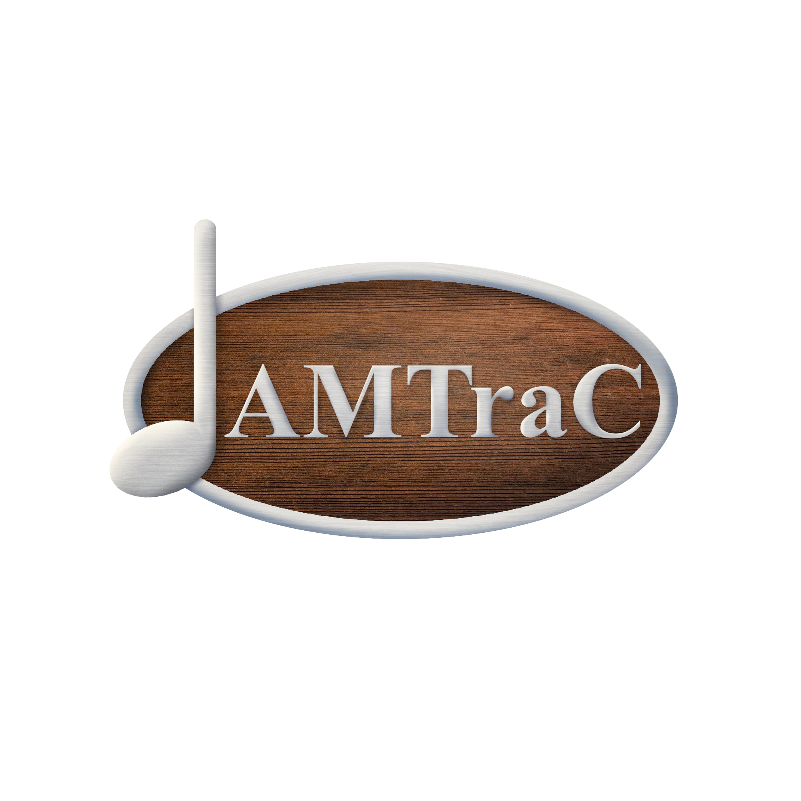
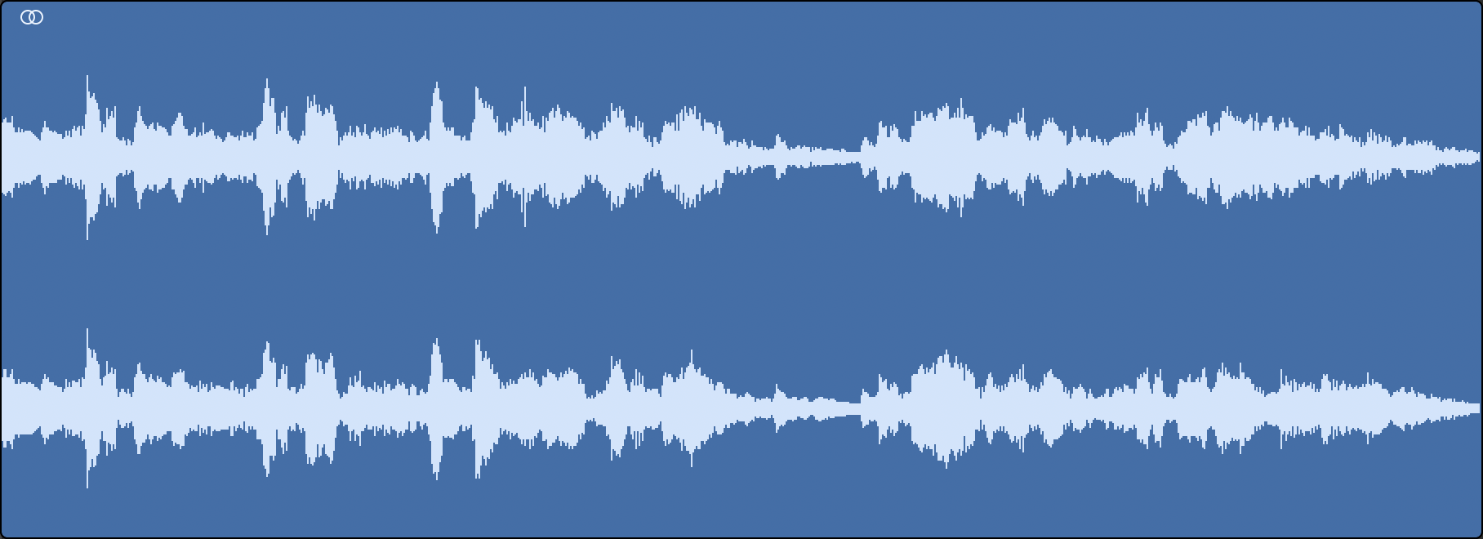
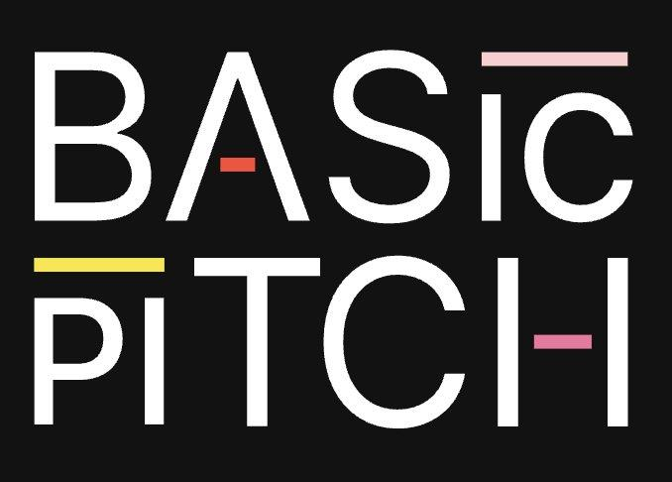
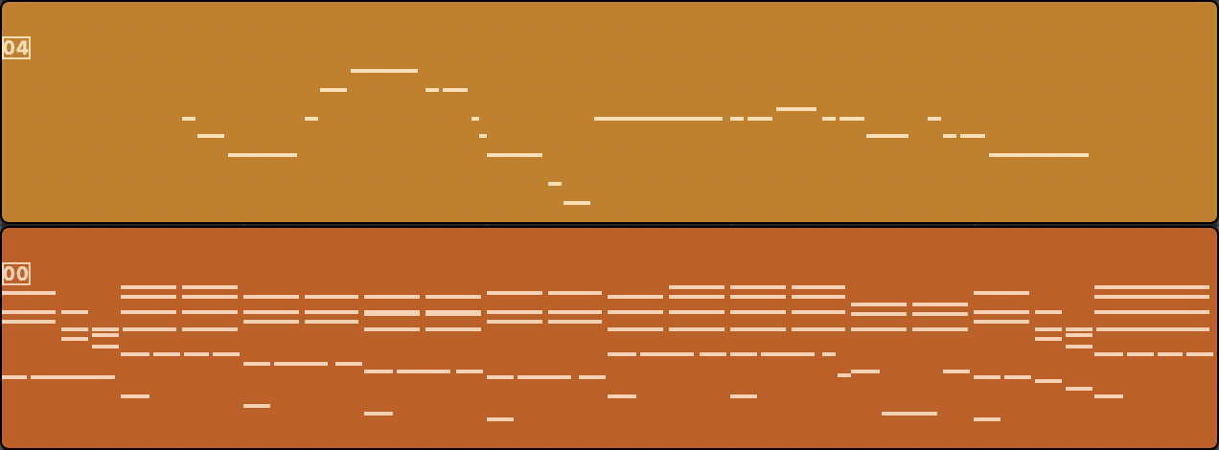
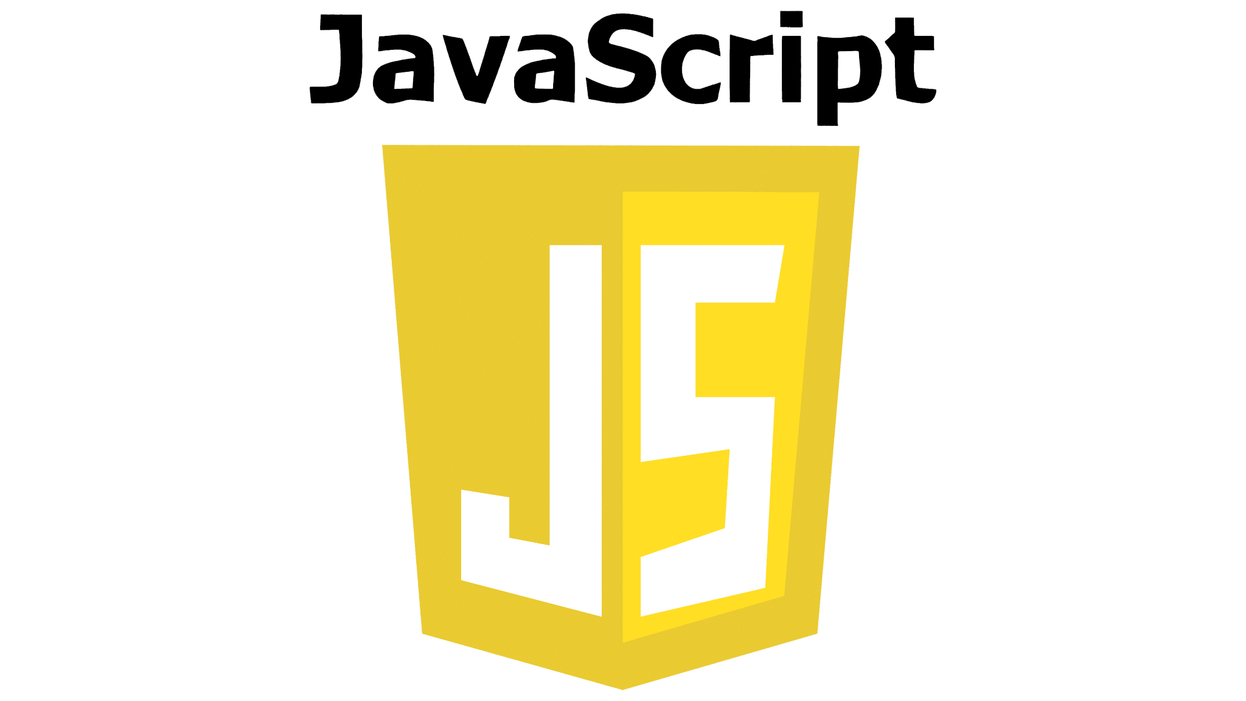
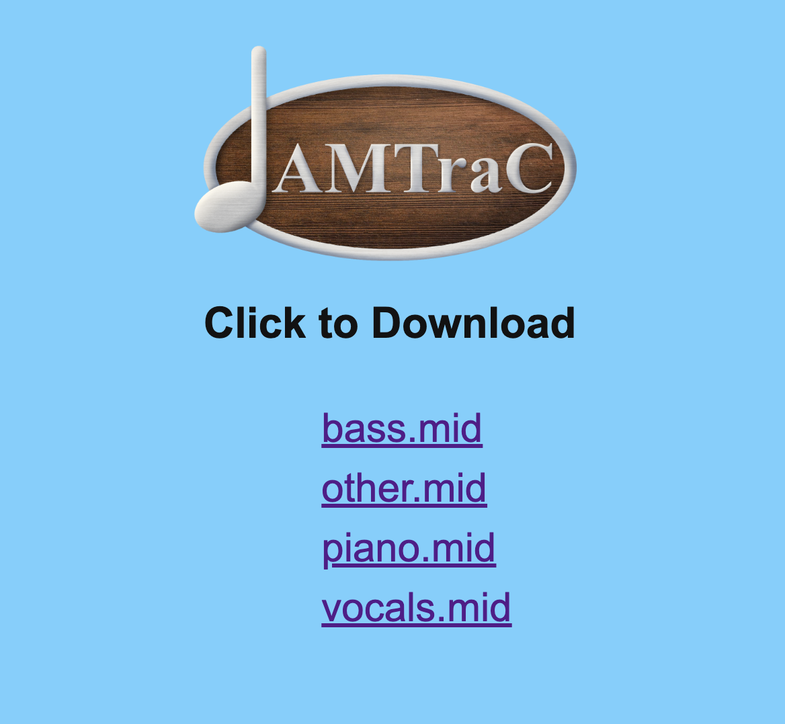
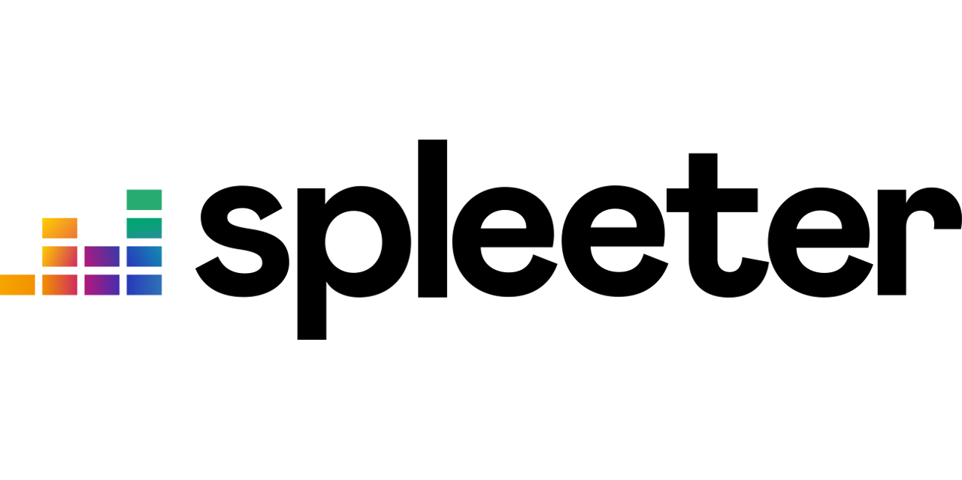
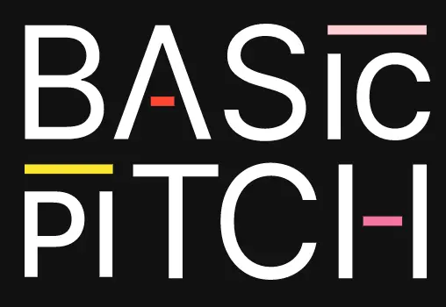
Audio to MIDI Transcription Creator Kestutis Biskis, Eamonn Brady, Evan Houle Innovation Scholars, University of New Hampshire, Durham, NH 03824
Abtract
Process
Through the use of AMTraC anyone can create sheet music from an audio recording. This can be used to transcribe recording sessions or to learn parts easier than playing by ear. Other software is expensive or doesn’t separate each instrument into its own file and transcribe.
Through our user interface, a file can be uploaded to the flask backend to be processed. First, it is split into individual instrument tracks using Spleeter. The individual tracks are then each run through Basic Pitch to obtain MIDI transcriptions of each part. The transcriptions are returned to the user and can be opened in a notation editor such as MuseScore or Noteflight to easily obtain sheet music.
Spleeter
Spleeter is an open source Python library developed by Deezer. It is a stem splitter that uses machine learning to separate audio files into separate tracks containing each individual instrument. It provides access to pretrained models for various instrumentations.
What’s Next
Stem splitting technology is still very flawed. It is difficult to get enough training data because a lot of music is copyrighted. Also it is difficult to perfectly transcribe music from imperfect recordings. Imperfections can come from human error such as playing out of tune and time, or from poor recording quality.
Basic Pitch
Basic Pitch is an open source Automatic Music Transcription (AMT) software developed by Spotify’s Audio Intelligence Lab. It takes an audio recording of a single instrument and transcribes it into MIDI data, which can be read by a computer as sheet music.
Front End
Challenges
In music, the overtone series can cause extra notes to be heard from a single pitch due to overlapping frequencies. To avoid this, we set a maximum frequency limit. During testing, we also found that very short notes were introducing phantom notes into the sheet music—notes that weren’t actually part of the original song. To fix this, we enforced a minimum note length of 200 milliseconds.
Back End

