Slide 1



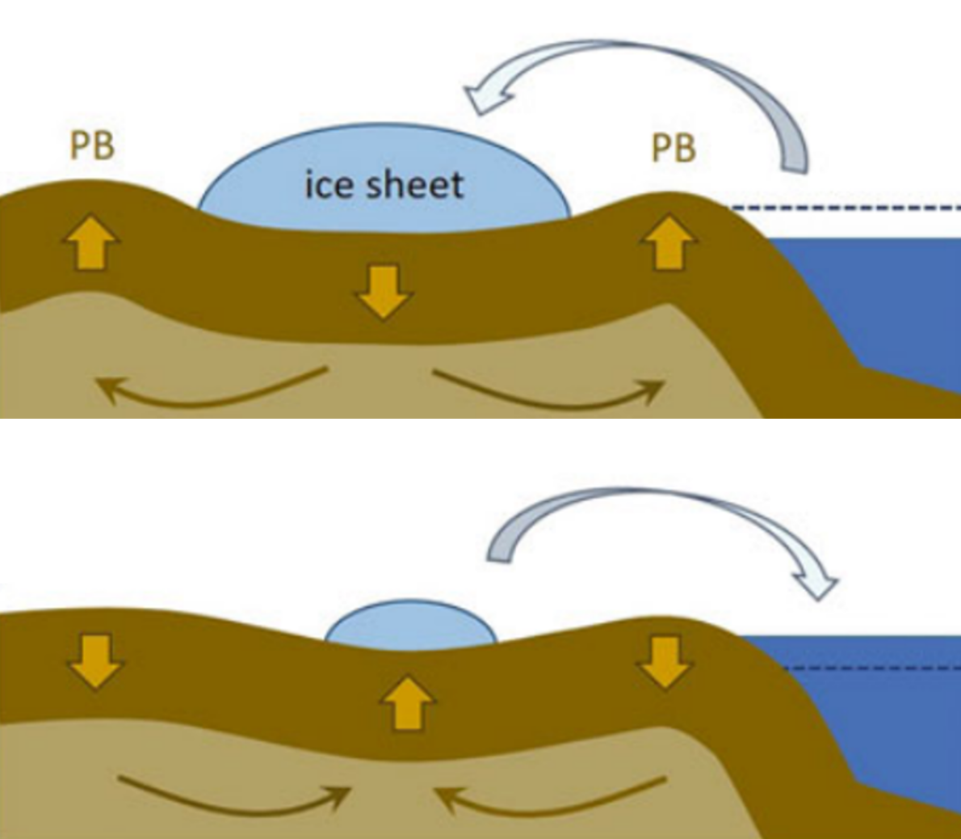
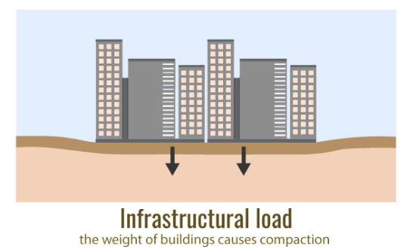
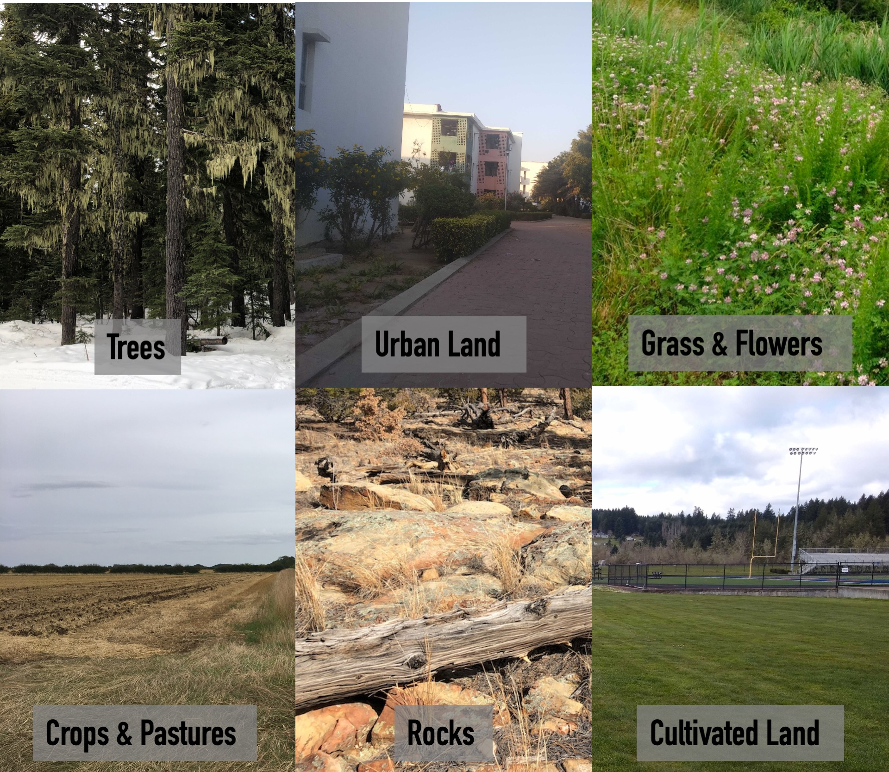
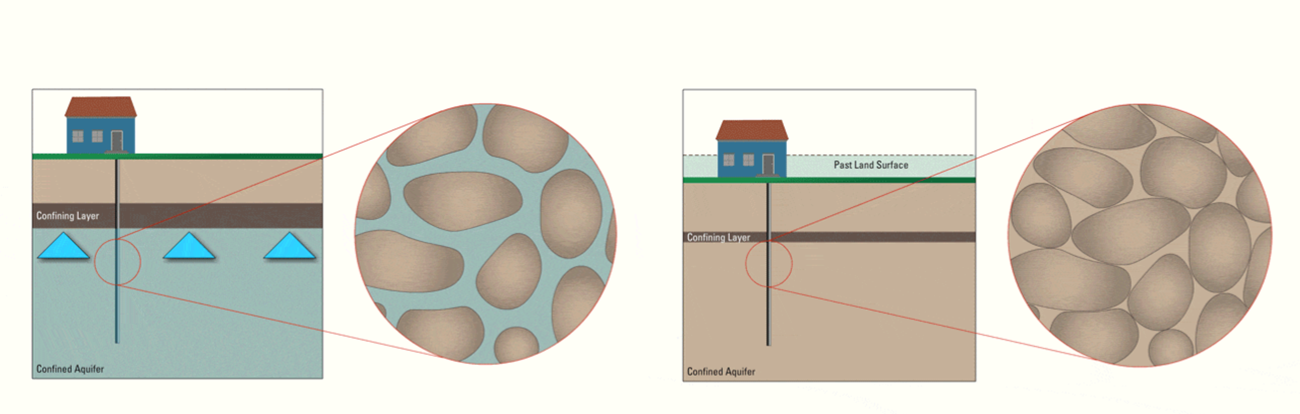
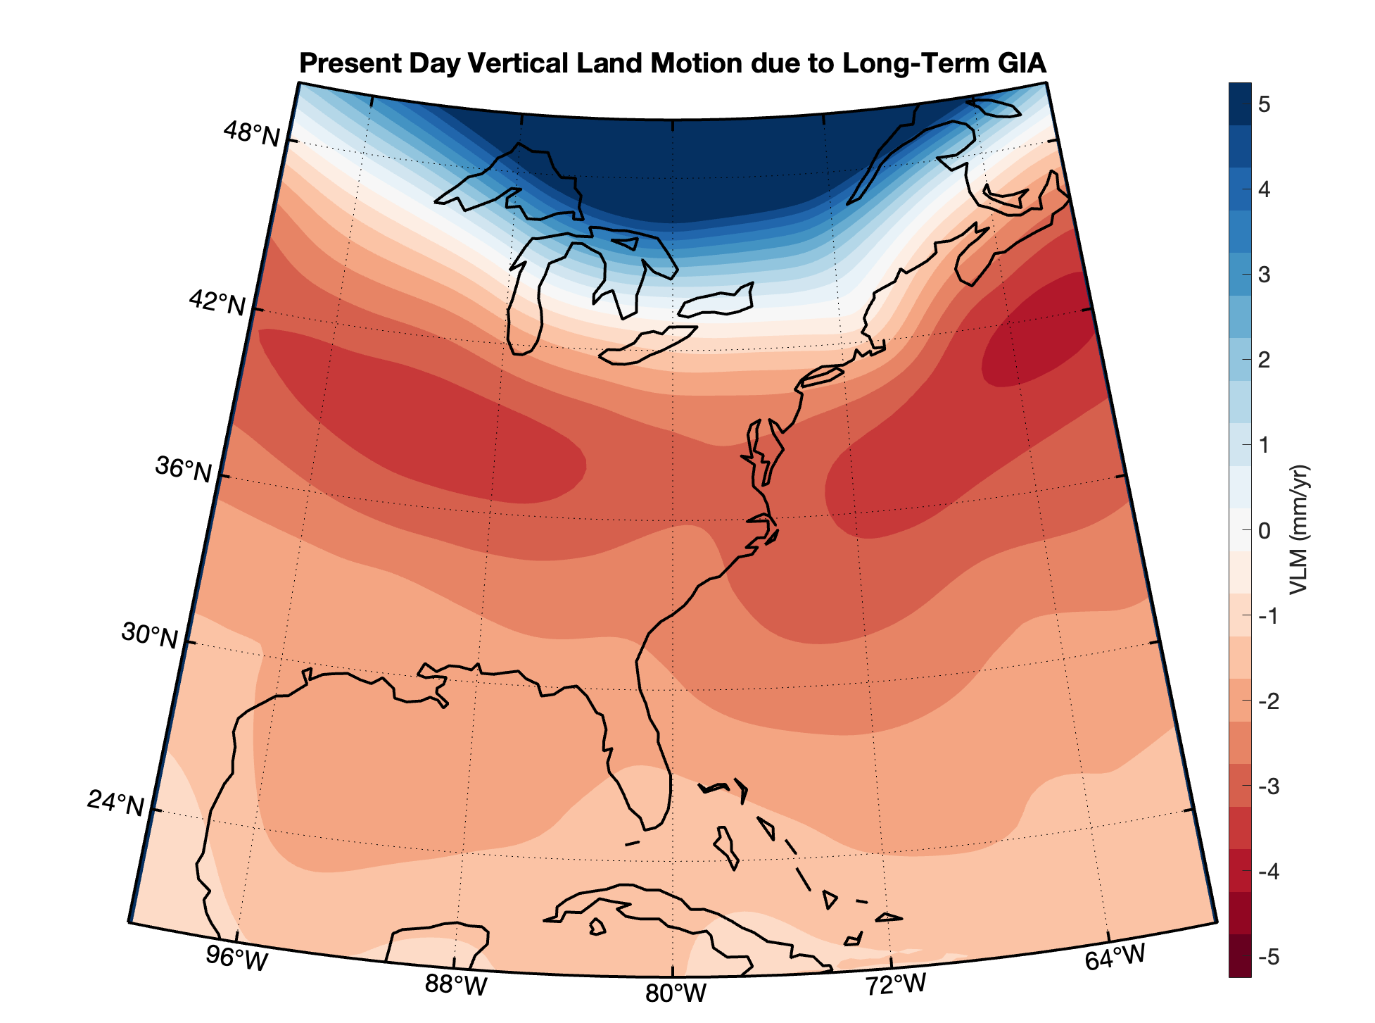
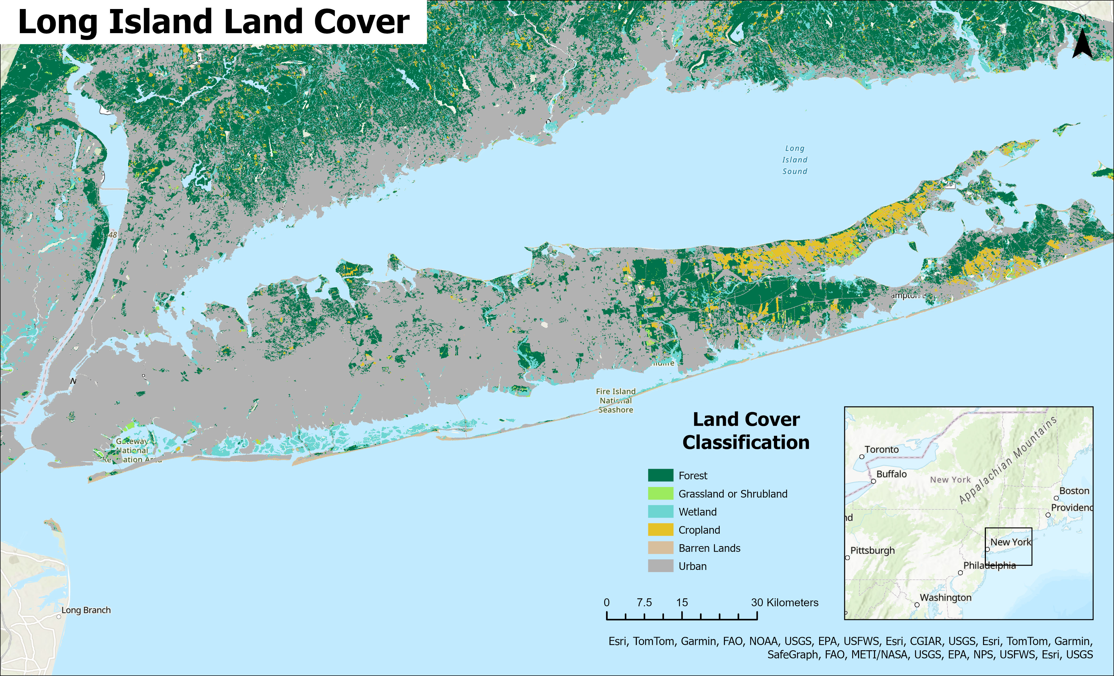
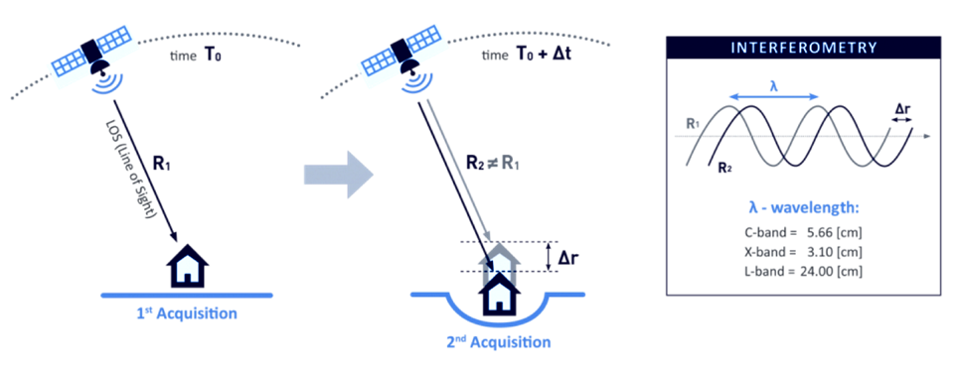
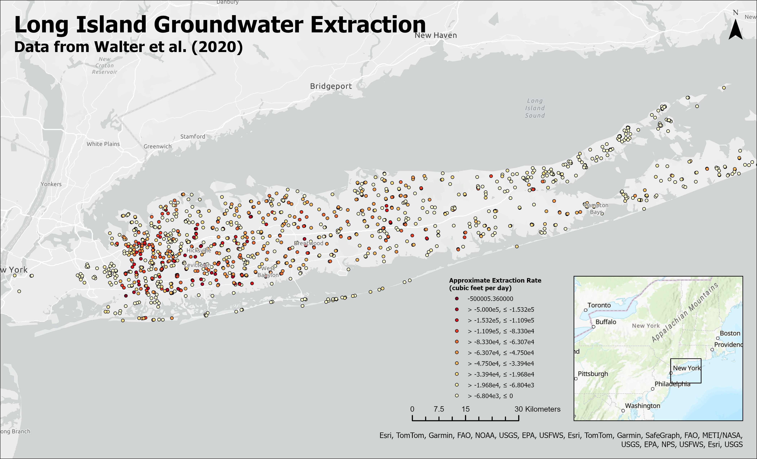
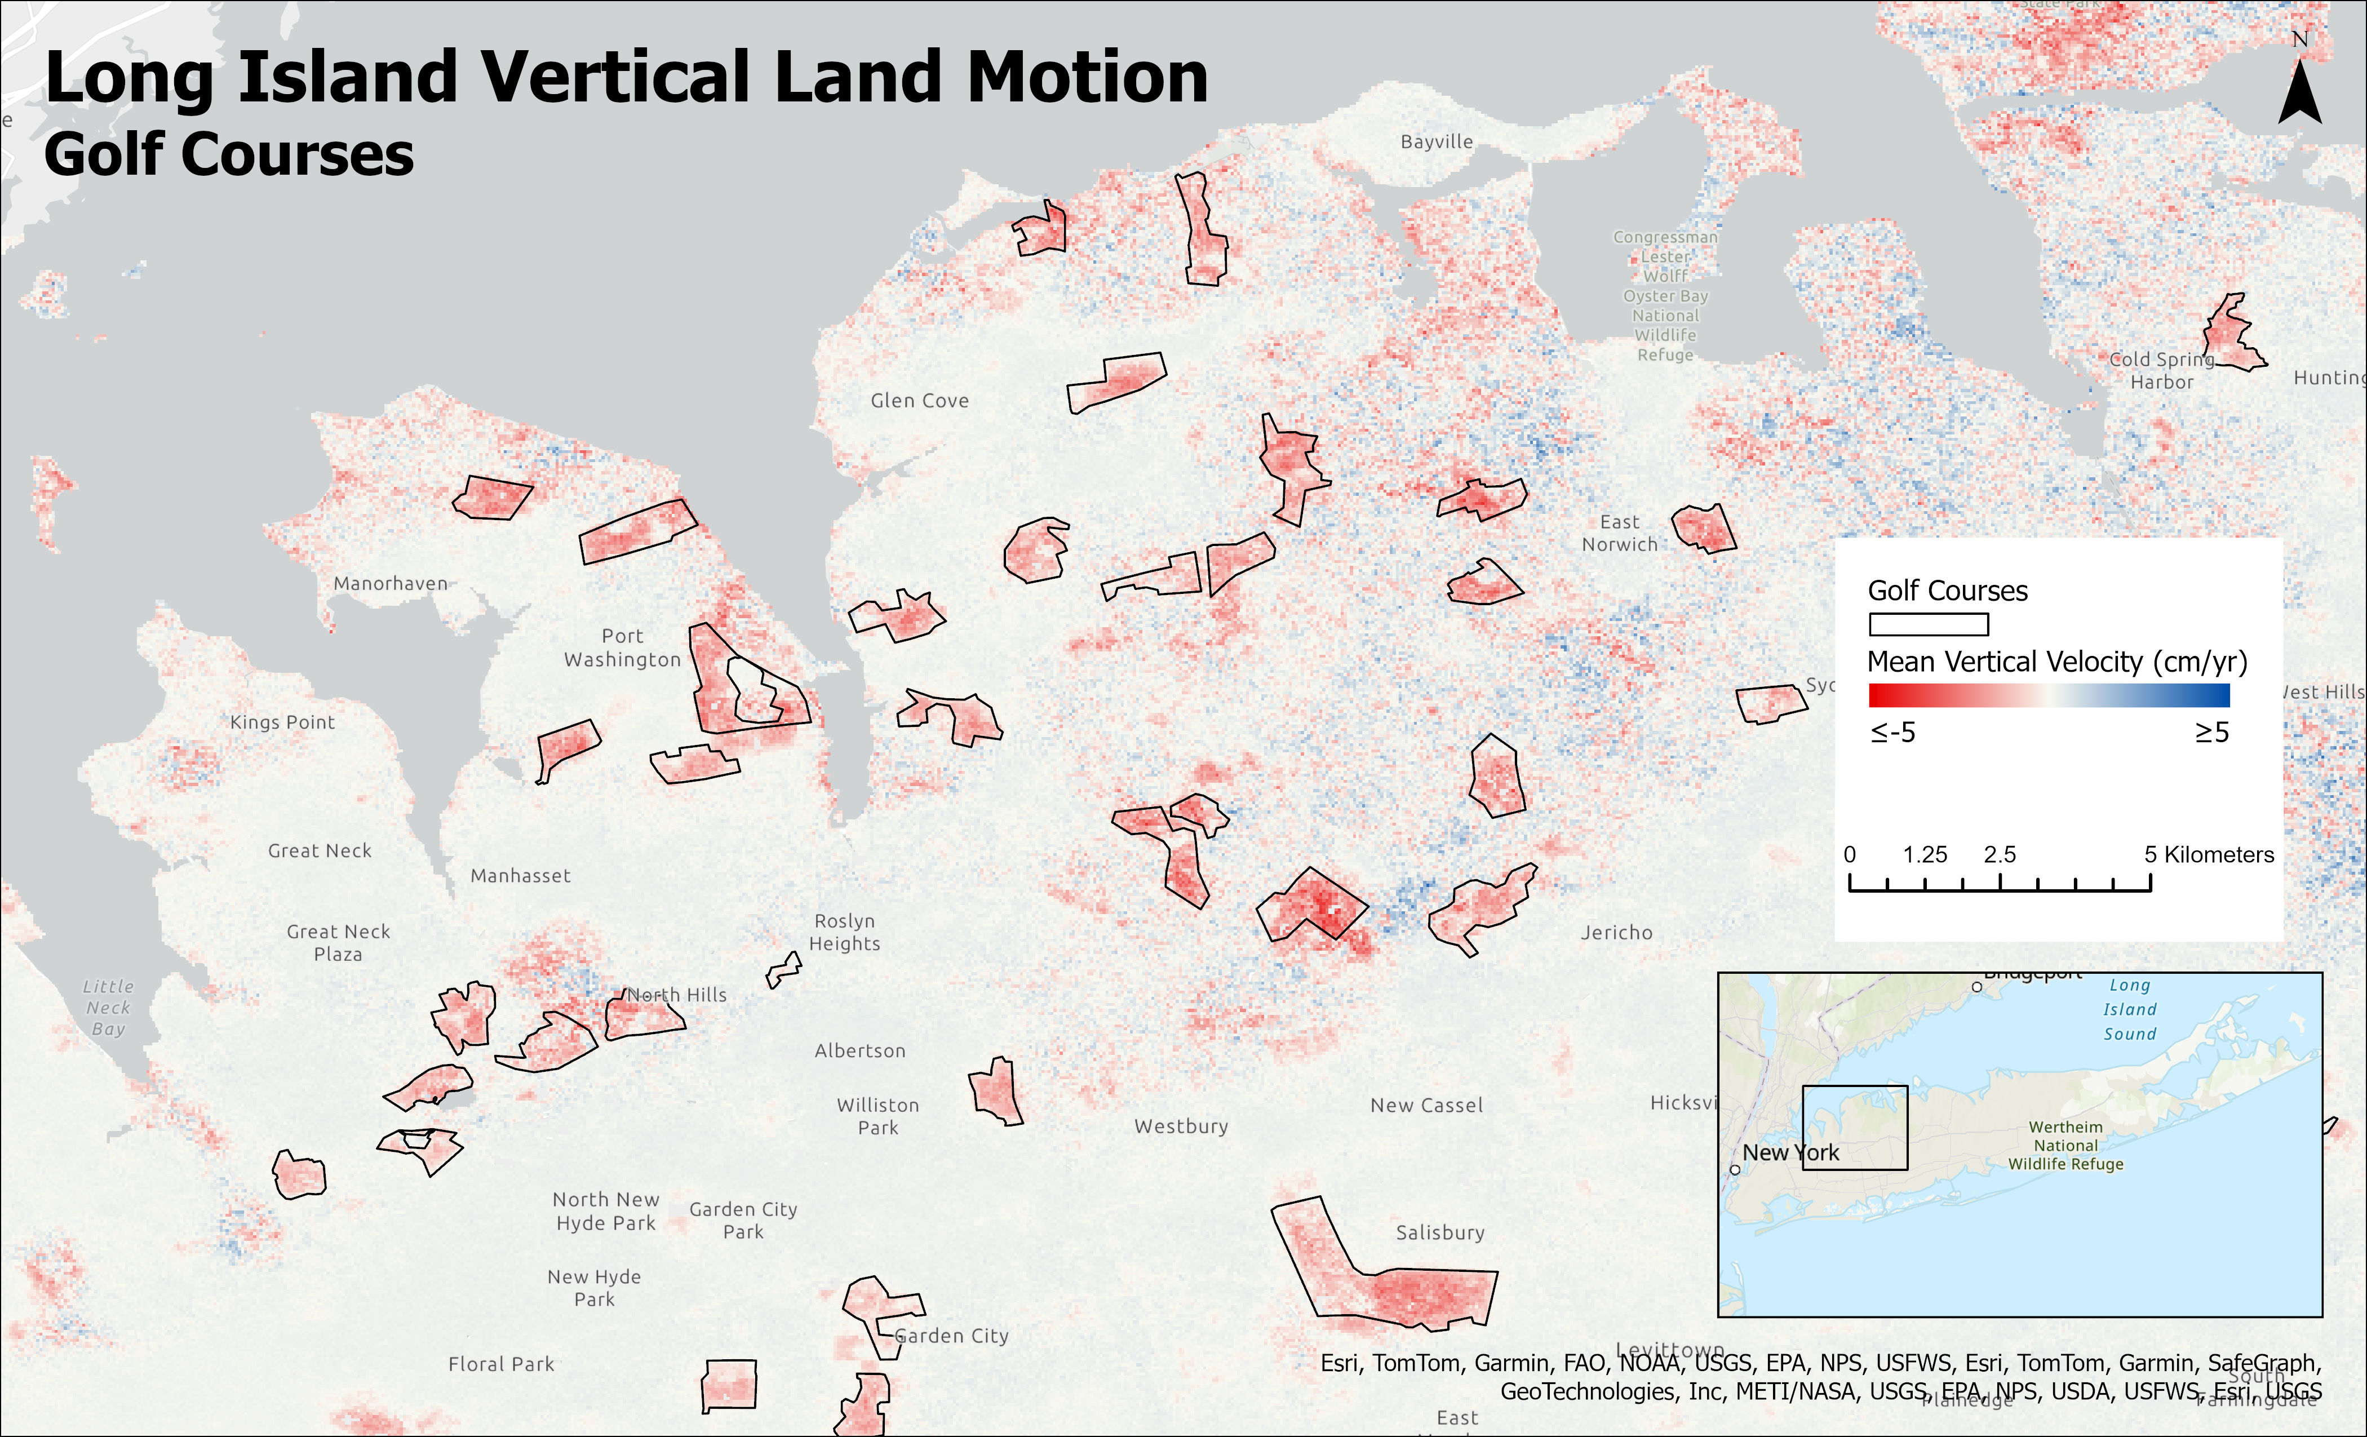
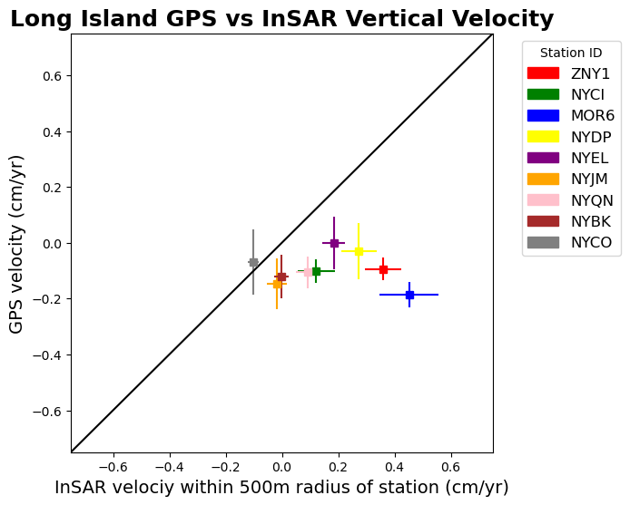
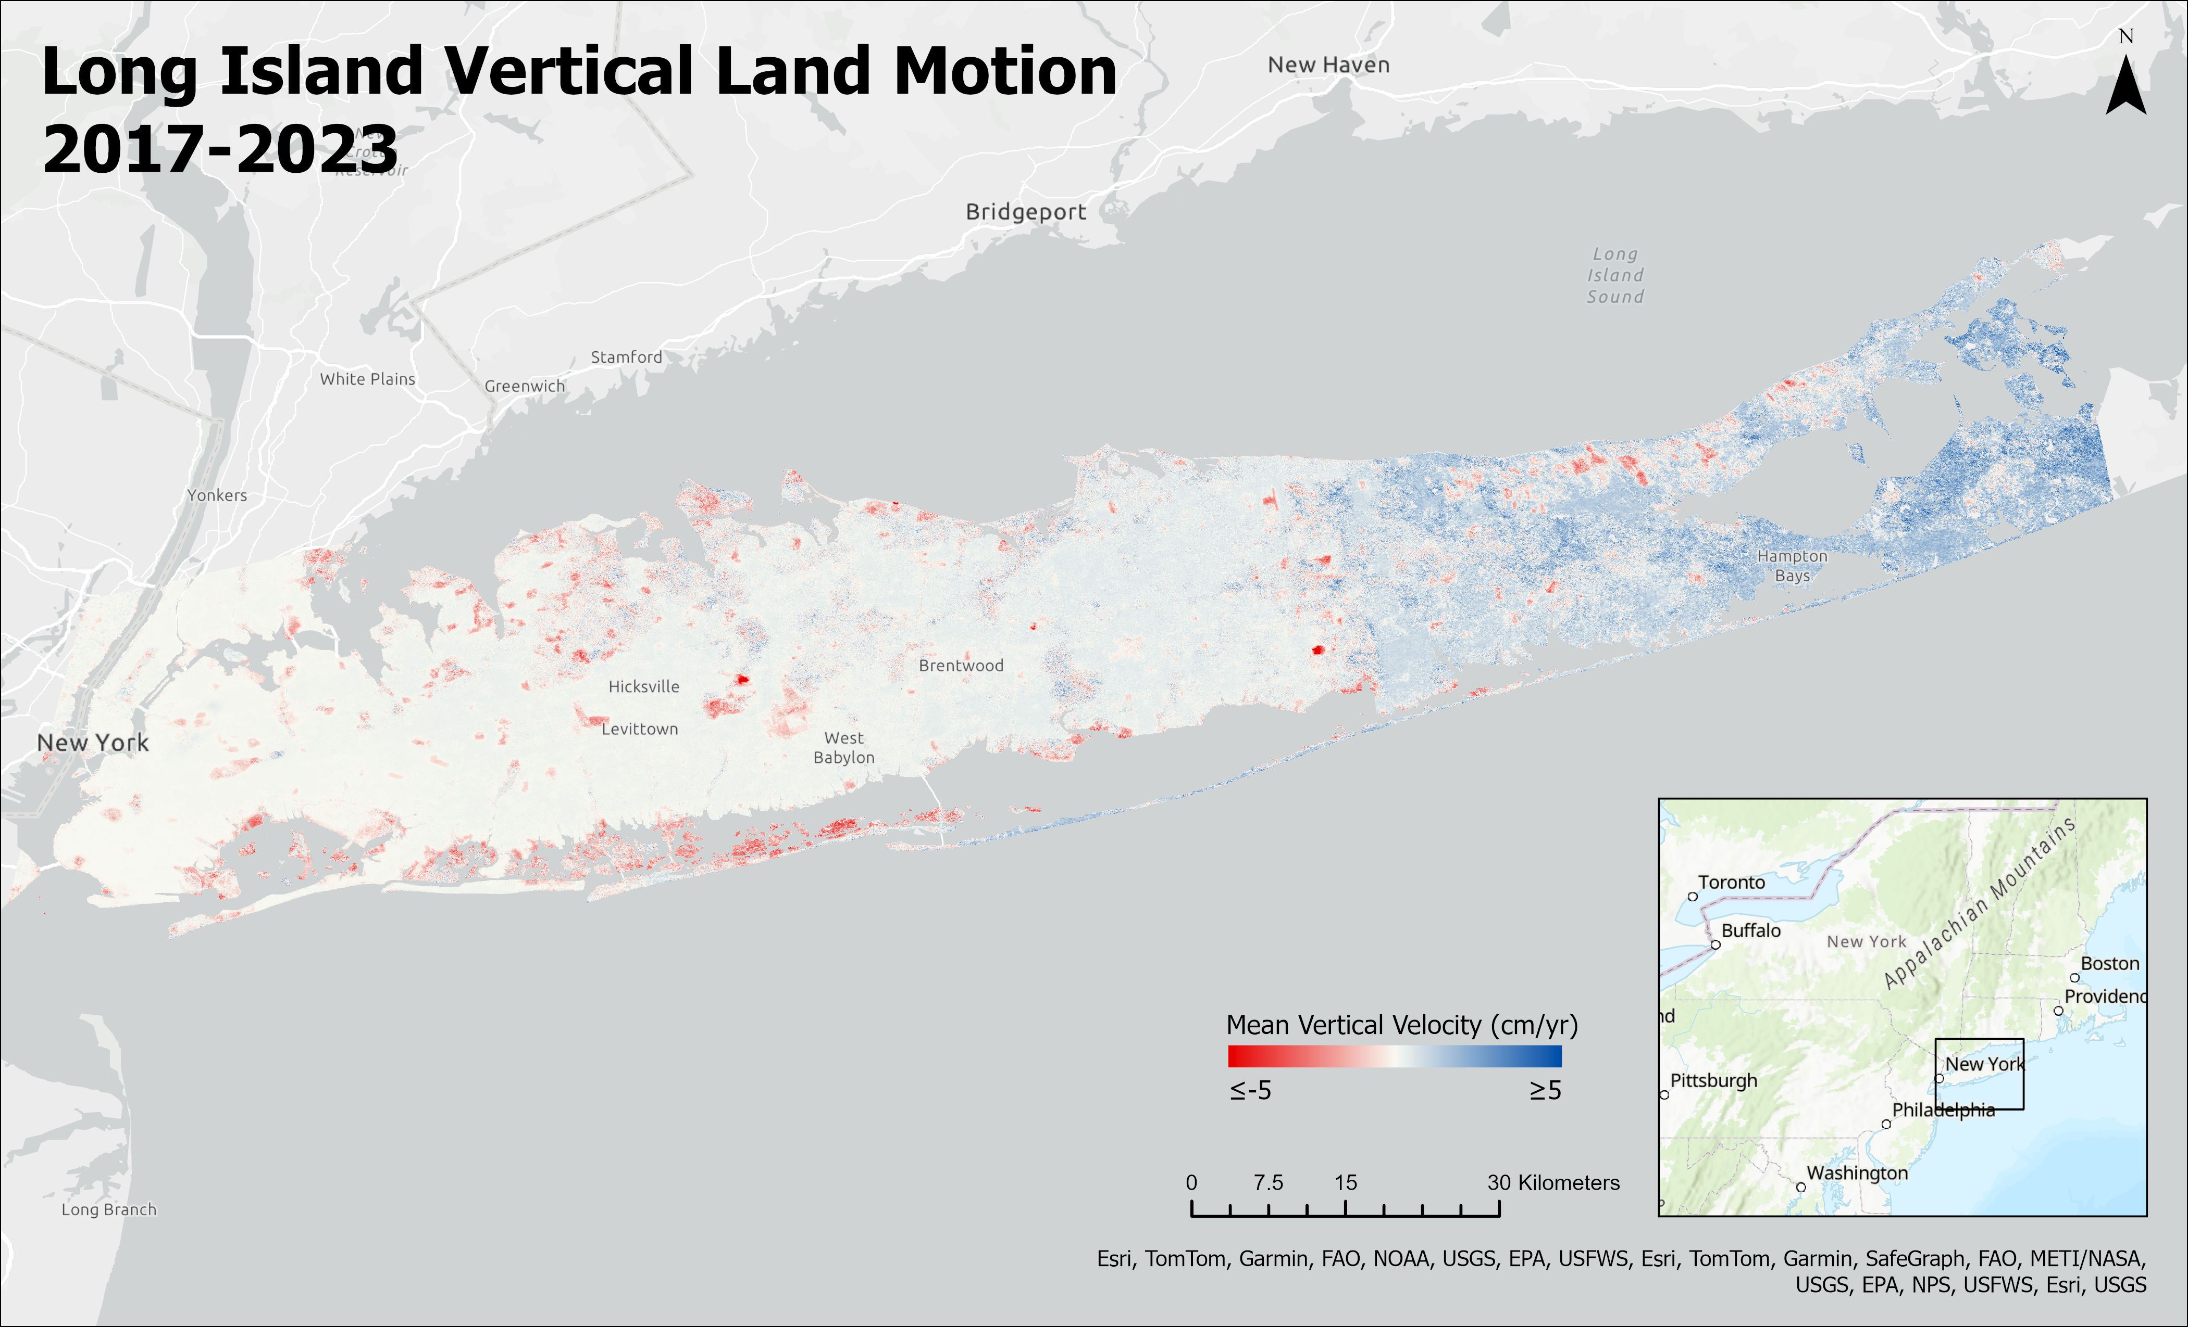
Evaluating the Causes of Land Subsidence on the U.S. Mid-Atlantic Coast Measured with InSAR
Jordan DiPrima¹, Dominick Ciruzzi², J. Matthew Davis¹, Sophie Coulson¹
¹Department of Earth Sciences, University of New Hampshire, Durham, NH ²Department of Geology, William & Mary, Williamsburg, VA
Introduction
Hypotheses
What is Land Subsidence?
1. Glacial Isostatic Adjustment
2. Groundwater Extraction & Hydrogeology
3. Infrastructure Loading
4. Land Cover
Land subsidence is the sinking or settling of land caused by natural processes or anthropogenic influence.
Can occur rapidly or over long timescales
Natural causes include tectonics, glacial isostatic adjustment, and thawing of permafrost
Anthropogenic causes include groundwater extraction, mining, fracking, and infrastructure loading.
Before Extraction
After Extraction
Why Study Land Subsidence?
Land Subsidence Can…
Increase the effects of sea level rise
Damage infrastructure and ecosystems
Decrease groundwater storage capacity
Glacial isostatic adjustment (GIA) is the viscoelastic response of the Earth to the redistribution of ice and meltwater loads [4]. At present day, areas formerly beneath ice sheets are uplifting. Areas that formerly surrounded ice sheets are subsiding. Image Source: [5]
Extraction of water from deep aquifers can cause land subsidence as pore fluid pressure decreases and hydrogeologic units compact beneath the load above them [6]. The is especially true in clay hydrogeologic units.
Image Source: [7]
Parsons et al., modeled Earth deformation caused by the mass of infrastructure in New York City (2023) [8]. Long Island may be experiencing residual deformation in the form of subsidence. Alternatively, subsidence may be occurring under the weight of Long Island’s own infrastructure. Image Source: [9]
Long Island is comprised of 10 land cover types. There may be a relationship between subsidence and land cover type, as each land cover type has different characteristic surficial materials, ecosystems, and human activity.
Image Source: [10]
Methods
Interferometric Synthetic Aperture Radar (InSAR) [1]
A satellite sends electromagnetic signals to the Earth’s surface and measures the reflected signal.
When two passes are made, the reflected signals can be differenced to create an image called an interferogram.
A process called phase unwrapping, converts interferograms into vertical land motion maps.
Analysis
Conclusions
US East Coast Vertical Land Motion due to
Three identified regions of subsidence:
  Region 1: golf courses
  Region 2: wetlands, groundwater extraction
  Region 3: farms
The maximum subsidence rate, -19.3 cm/yr, occurs at a landfill.
Wetland, cropland, and urban land cover types have the most subsidence.
The three identified regions of subsidence are underlain by clays
Groundwater extraction locations are associated with some but not all subsidence. Further analysis is necessary to characterize the spatial characteristics of aquifer compressibility.
The accepted cause of subsidence is soil compaction due to foot and vehicle traffic, heavy machinery, agricultural processes, redistribution of surficial materials, and changes in moisture.
Golf courses unexpectedly displayed consistent subsidence, likely due to the aeration process used to promote growth of turfgrass. This process results in a net loss of surficial material over time.
Uplift on the eastern side of the island may be an error due to the satellite’s inability to penetrate dense vegetation. Alternatively, it may be justified by modern-day GIA due to melting of the Greenland ice sheet and Arctic glaciers, which produces the opposite effect of long-term GIA.
The discrepancy between GPS and InSAR vertical velocity in figure 7 suggests that further refinement of InSAR data is necessary.
Long-Term GIA
Long Island
Figure 1. A schematic diagram of InSAR data collection. Two passes at times T₀ and T₀ + Δt are shown. Their respective reflected signals, R₁ and R₂, have a phase difference of Δr. [2]
Alaska Satellite Facility – OpenSARLab
A cloud-hosted JupyterHub with a library of open-source Python scripts made for InSAR data processing and analysis.
Analysis
Comparison to 9 Nevada Geodetic Lab GPS stations
Comparison to published InSAR data from the work of Ohenhen et al. (2023)
Qualitative analysis using aerial images from ArcGIS Pro’s ‘Imagery Hybrid’ Basemap and Google Earth Pro
Figure 3. Modern day vertical land motion (VLM) from long-term GIA. The ground surface is uplifting where the Laurentide Ice Sheet used to persist. Subsidence is occurring elsewhere due to the collapse of the peripheral bulge that formerly surrounded the ice sheet. Roughly 1 mm/yr of subsidence on Long Island is attributed to long-term GIA. Data Source: [11], Image courtesy of Sophie Coulson.
Figure 4. Land cover classification on Long Island. The ten land cover types present have been reclassified into five categories. Urban land cover exists mostly in the west but makes up a large portion of the east. Croplands are concentrated on the North Fork and wetlands are concentrated in the southwest. These three land cover types correspond to the subsidence trends in figure 2 .
Results
Region 1
Region 3
Figure 7. Comparison of GPS and InSAR vertical velocities. InSAR data tends to measure greater vertical velocities than GPS stations. Data Source [14]
Acknowledgements & References
I would like to thank NASA’s Student Airborne Research Program and NASA Early Career Research for supporting this project. I am especially grateful to my advisors Dominick Ciruzzi, Sophie Coulson, and Matt Davis their guidance and unwavering support.
Region 2
[1] Bürgmann et al. (2000). Synthetic Aperture Radar Interferometry to Measure Earth’s Surface Topography and Its Deformation. Annual Review of Earth and Planetary Sciences, 28(1), 169–209. https://doi.org/10.1146/annurev.earth.28.1.169
[2] InSAR at a Glance. (n.d.). TRE ALTAMIRA - A CLS Group Company. from https://site.tre-altamira.com/insar/
[3] Ohenhen, L. O. et al. (2024). Slowly but surely: Exposure of communities and infrastructure to subsidence on the US east coast. PNAS Nexus, 3(1), pgad426. https://doi.org/10.1093/pnasnexus/pgad426
[4] Wake, L. M. et al. (2016). Glacial Isostatic Adjustment (GIA) in Greenland: A Review. Current Climate Change Reports, 2(3), 101–111. https://doi.org/10.1007/s40641-016-0040-z
[5] Whitehouse, P. et al. (2021). Glacial Isostatic Adjustment. In A. Fowler & F. Ng (Eds.), Glaciers and Ice Sheets in the Climate System: The Karthaus Summer School Lecture Notes (pp. 383–413). Springer International Publishing. https://doi.org/10.1007/978-3-030-42584-5_15
[6] Sun, H. et al. (1999). Land subsidence due to groundwater withdrawal: Potential damage of subsidence and sea level rise in southern New Jersey, USA. Environmental Geology, 37(4), 290–296. https://doi.org/10.1007/s002540050386
[7] Virginia and West Virginia Water Science Center. (2022). Aquifer compaction and land subsidence. U.S. Geological Survey. https://www.usgs.gov/media/images/aquifer-compaction-and-land-subsidence
[8] Parsons, T. et al. (2023). The Weight of New York City: Possible Contributions to Subsidence From Anthropogenic Sources. Earth’s Future, 11(5), e2022EF003465. https://doi.org/10.1029/2022EF003465
[9] What Causes Land Subsidence? (n.d.). The Earth Observatory of Singapore. Retrieved April 15, 2025, from https://prod.earthobservatory.sg
[10] Land Cover Science . (n.d.). The GLOBE Program. Retrieved April 17, 2025, from https://observer.globe.gov/do-globe-observer/land-cover/science
[11] Austermann, J. et al. (2021). The effect of lateral variations in Earth structure on Last Interglacial sea level. Geophysical Journal International, 227(3), 1938–1960. https://doi.org/10.1093/gji/ggab289
[12] Commission for Environmental Cooperation (CEC). 2023. "2020 Land Cover of North America at 30 Meters". North American Land Change Monitoring System. Ed. 1.0, Raster digital data [30-m]. Available at http://www.cec.org/north-american-environmental-atlas/land-cover-30m-2020/
[13] Walter, D. A., et al. (2020). Simulation of groundwater flow in the regional aquifer system on Long Island, New York, for pumping and recharge conditions in 2005–15. In Scientific Investigations Report (Nos. 2020–5091). U.S. Geological Survey. https://doi.org/10.3133/sir20205091
[14] Blewitt, G. et al. (2018). Harnessing the GPS Data Explosion for Interdisciplinary Science. Eos. http://eos.org/science-updates/harnessing-the-gps-data-explosion-for-interdisciplinary-science
Figure 5. Groundwater extraction sites on Long Island. Color indicates extraction rates in ft³/day. Long Island relies heavily on its four major aquifers for drinking water. Groundwater extraction is most concentrated on the western side of the island. Extraction in or near wetlands causes the most subsidence because their composition is most compressible. Data Source: [13]
Figure 6. Zoom-in of Region 1 (figure 2) overlain by polygons representing the locations of golf courses. This unexpected correspondence between golf courses and subsidence was found to exist throughout the rest of Long Island. In total, 100 of 131 golf courses are subsiding.
Figure 2. Vertical land motion on Long Island, NY in cm/yr with a red-blue color ramp stretched over values ranging between -5 cm/yr and 5 cm/yr. The full data range is (-19.3 cm/yr, 8.73 cm/yr). The overall trend is a west-east gradient from near-zero values to uplift. The three main subsidence trends are circled and labeled.

