Slide 1


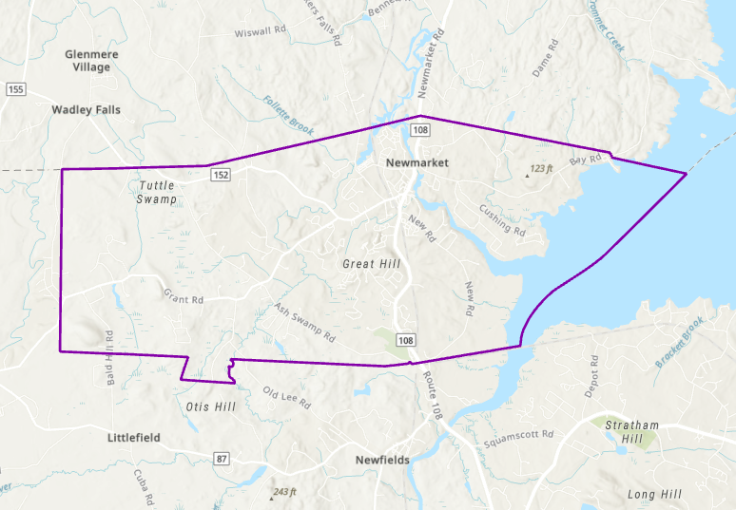

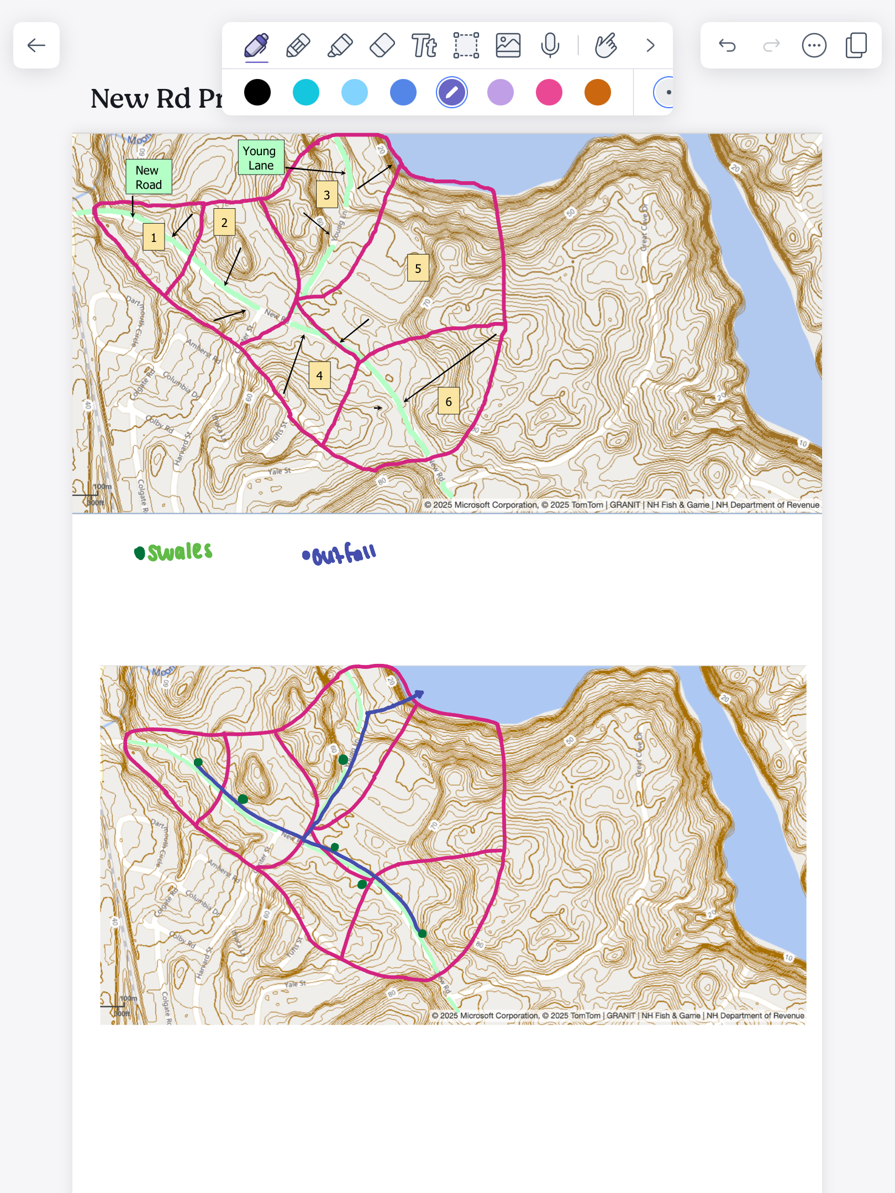
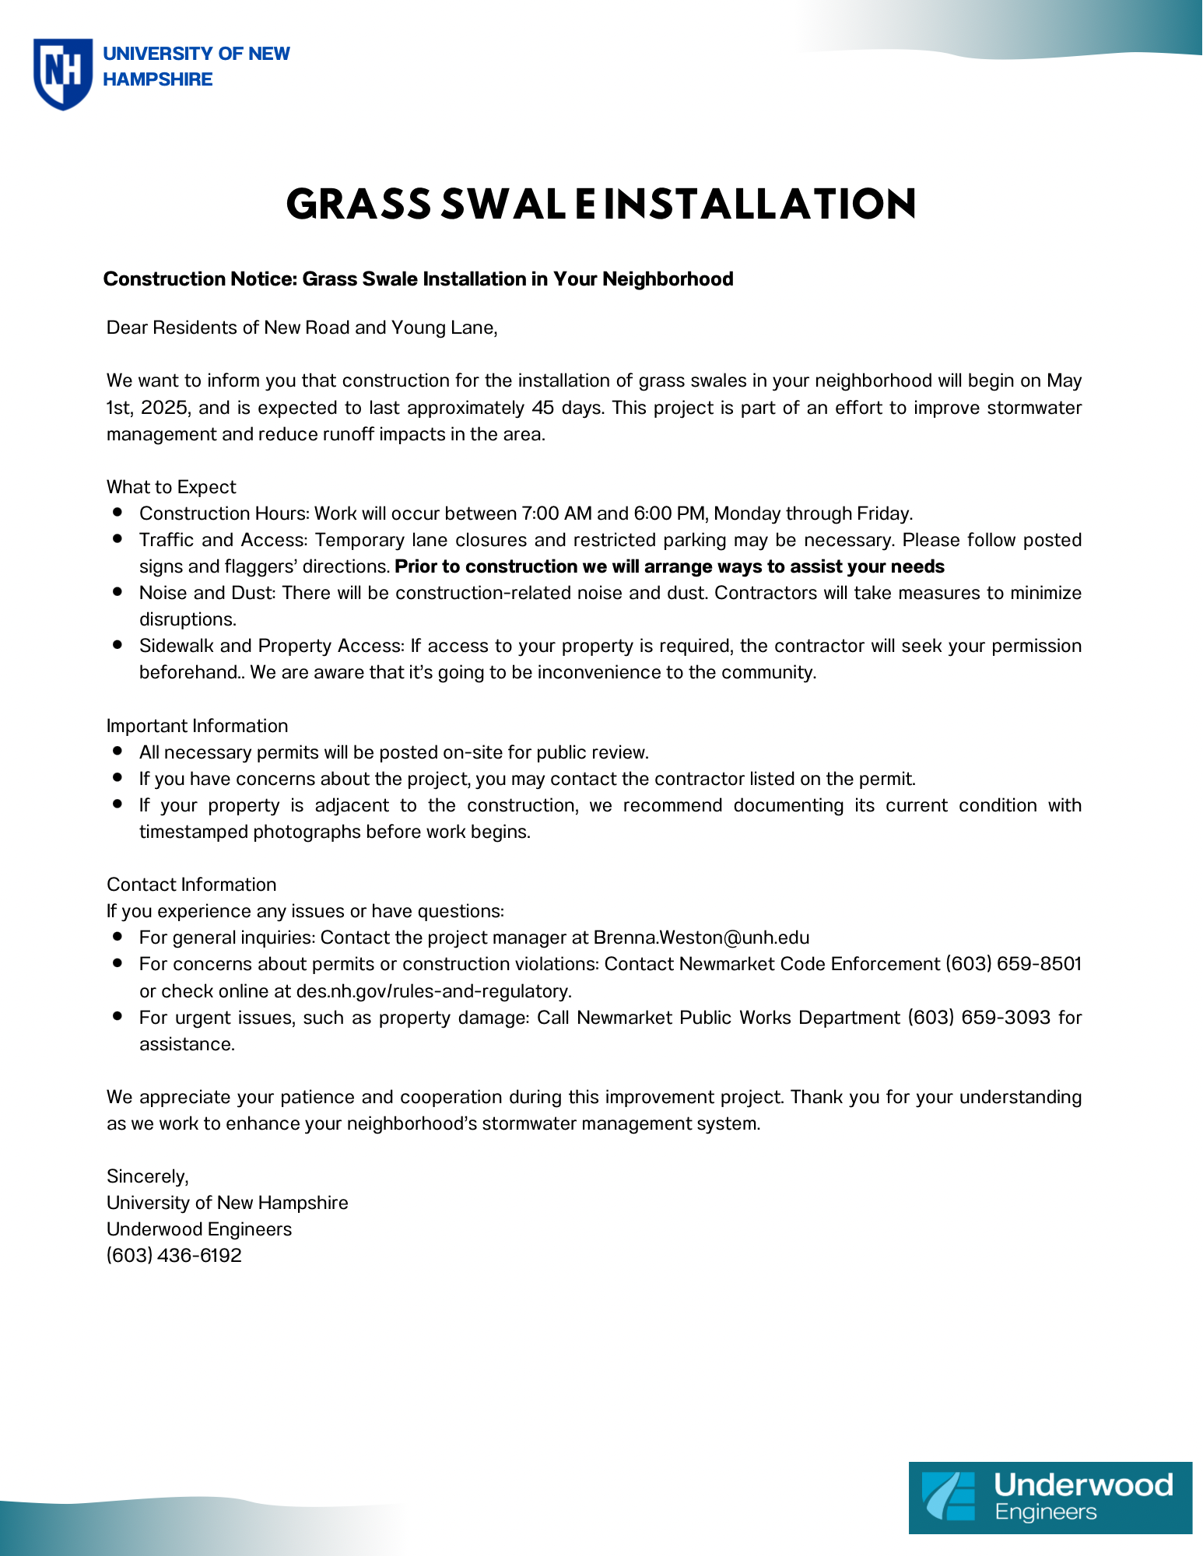
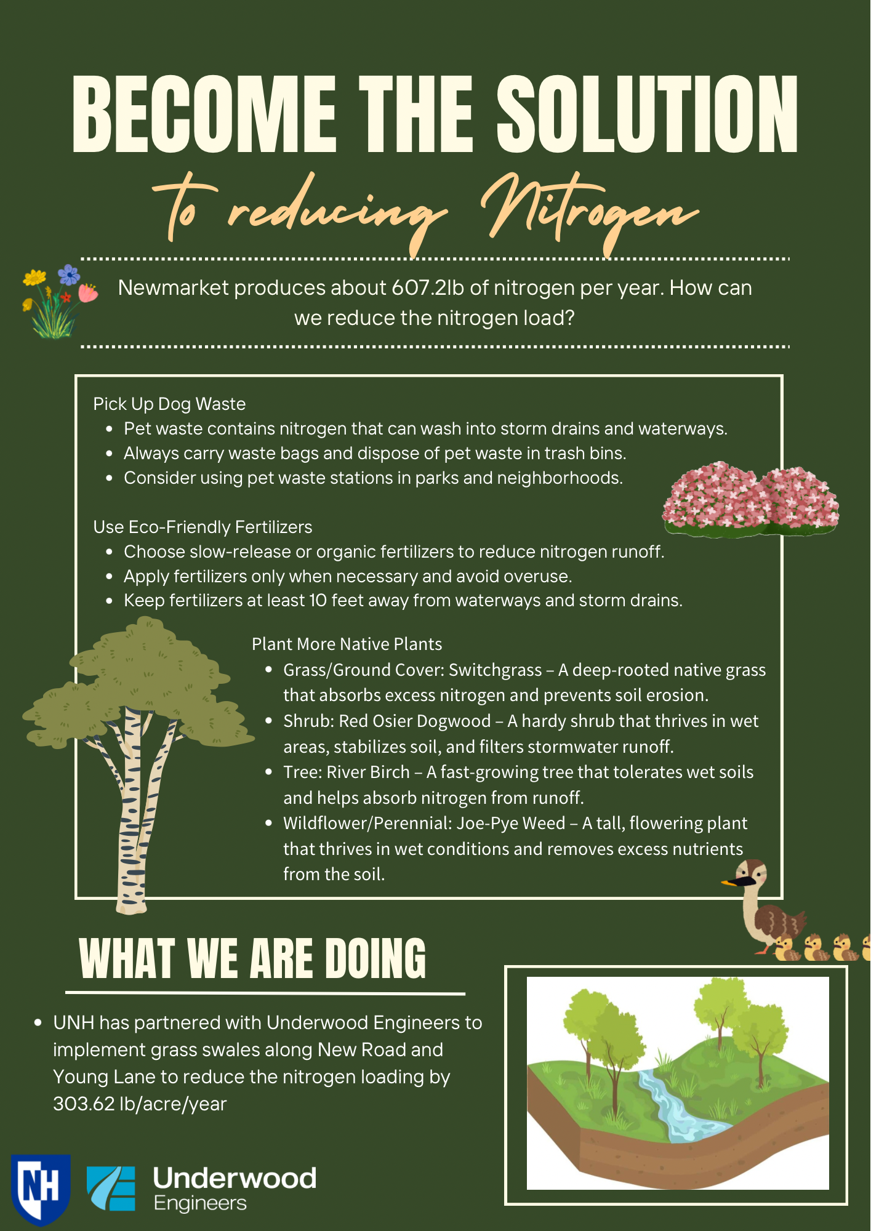
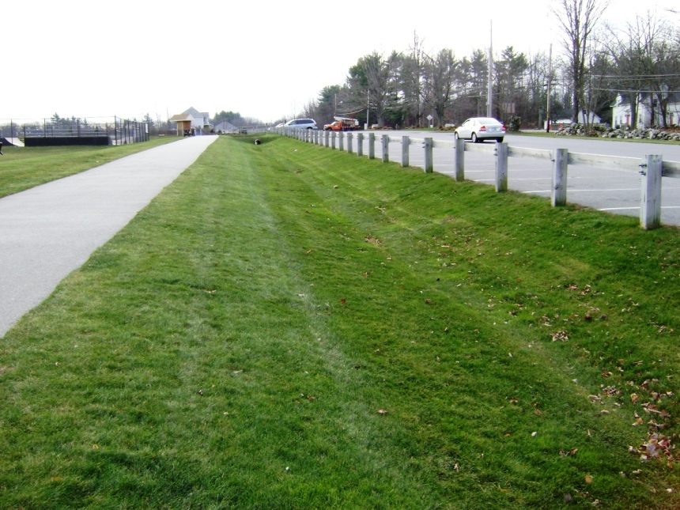
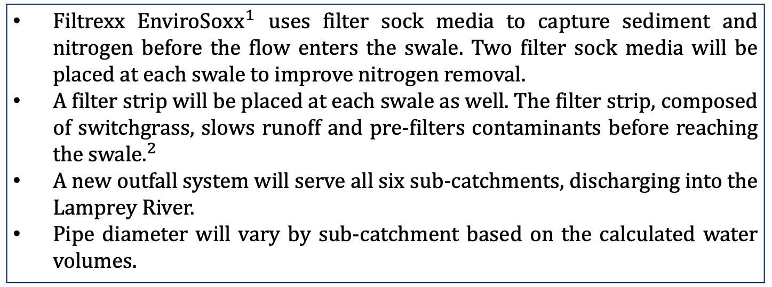
New Road Stormwater Treatment and Lamprey River Outfall – Newmarket, NH
By: Brenna Weston (Project Manager), Adarsh Bimali, Cole Capobianco, and Kelsey Purnomo
Department of Civil and Environmental Engineering, University of New Hampshire, Durham, NH 03824
Filtrexx. EnviroSoxx Pollutant Removal. Filtrexx, . Accessed 17 Apr. 2025.
Introduction
Project Location- Swale and Outfall Placement
Grass Swale and Outfall Design
The Mother’s Day Flood of 2006 brought record-breaking rainfall to Newmarket, NH, causing severe flooding along New Road due to the overflow from Moonlight Brook and the Lamprey River.
The flood increased stormwater runoff and nitrogen pollution, fueling eutrophication in the Great Bay Estuary (GBE).
The UNH Engineering Team evaluated three Best Management Practices (BMPs) to mitigate stormwater runoff and nitrogen pollution near Moonlight Brook and the Lamprey River. One BMP was selected, and a new outfall system was designed on town-owned land along New Road and Young Lane to manage runoff.
Project Area with Sub-Catchments
Outfall and Swale Placement
Filtrexx EnviroSox$x^{1}$ uses filter sock media to capture sediment and nitrogen before the flow enters the swale. Two filter sock media will be placed at each swale to improve nitrogen removal.
A filter strip will be placed at each swale as well. The filter strip, composed of switchgrass, slows runoff and pre-filters contaminants before reaching the swale$.^{2}$
A new outfall system will serve all six sub-catchments, discharging into the Lamprey River.
Pipe diameter will vary by sub-catchment based on the calculated water volumes.
Newmarket, NH
Legend:
Legend:
Project area
Project area
Sub-catchments
Swale placement
New Rd. and Young Ln.
New Rd. and Young Ln.
Contours
Outfall
Water flow directions
Public Outreach
Project Area
Grass Swale Design
Swale Cross Section View
Grass Swale
Methodology
Three BMPs were evaluated during the 2024 Fall semester:
  Rain gardens,
  Grass swales, and
  Tree box filters.
The BMPs were designed to manage flow for a 10-year, 24-hour storm.
The BMP size and cost estimations were based on the project area, which was split into six sub-catchments.
Each alternative was assessed using a decision matrix that ranked performance based on cost, nitrogen removal, flood protection, operation and maintenance (O&M), and long-term sustainability.
Rain gardens achieved the highest nitrogen removal efficiency (32%) but required an area of 30,000 ft² and cost $730,000.
Grass swales achieved a nitrogen removal of 13%. 19 swales were estimated for efficient flood management, coming in at a total cost of $790,000.
Tree box filters had the lowest nitrogen removal (3%). 88 filters were required for the project area, costing about $975,000.
While rain gardens performed best in nitrogen removal, spatial constraints made grass swales a practical choice.
Grass swales were selected for implementation due to their cost-effectiveness, adequate treatment performance, and ease of implementation.
Peak flows for each sub-catchment were estimated using the Rational Method.
Swale and pipe sizing were determined using Manning's Equation.
Due to limitations of town-owned land, the grass swale design includes one grass swale placed in each of the six sub-catchments.
Enhancements were made in the 2025 Spring semester to improve the efficiency of the swale and lower the total construction cost.
Project Status
Cost and Nitrogen Removal
The total construction cost for the swale is approximately $440,000.
The estimated lifetime O&M costs are approximately $7,500.
The revised design improves nitrogen removal to 50% efficiency, at a cost of approximately $1450 per pound removed.
The selected BMP complies with NHDES permit, Municipal Separate Storm Sewer Systems (MS4) permit, and Army Corps of Engineers regulations, supporting long-term environmental compliance and protection of the Great Bay Estuary.
Cost Estimate and Nitrogen Removal of Each BMP
Cost Estimate and Nitrogen Removal Comparison for Grass Swale
Acknowledgments
Project Sponsor: Ben Dreyer, PE (Underwood Engineers)
UNH Faculty Advisor: Julie Paprocki, PE
References
1. Filtrexx. EnviroSoxx Pollutant Removal. Filtrexx, https://filtrexx.com/application/files/3816/4787/6242/4.1_Filtrexx_EnviroSoxx_Pollutant_Removal.pdf
2. United States Environmental Protection Agency. BMP Vegetated Filter Strip. November 2021, www.epa.gov/system/files/documents/2021-11/bmp-vegetated-filter-strip.pdf.

Slide 2

This poster template provided courtesy of
UNH ESRC Poster Printing Services
Trust us to make your poster look GREAT!
Website: http://posters.unh.edu
Poster Guide: http://goo.gl/1E7TJY
DELETE THIS SLIDE BEFORE PRINTING

