Slide 1
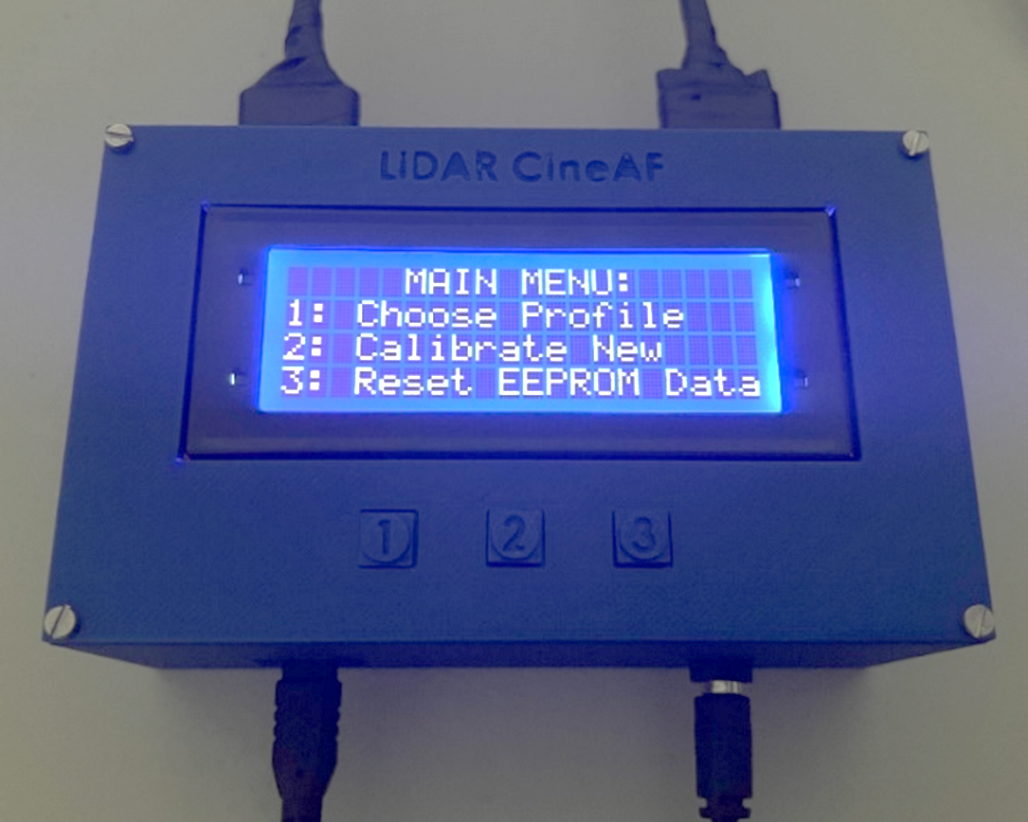
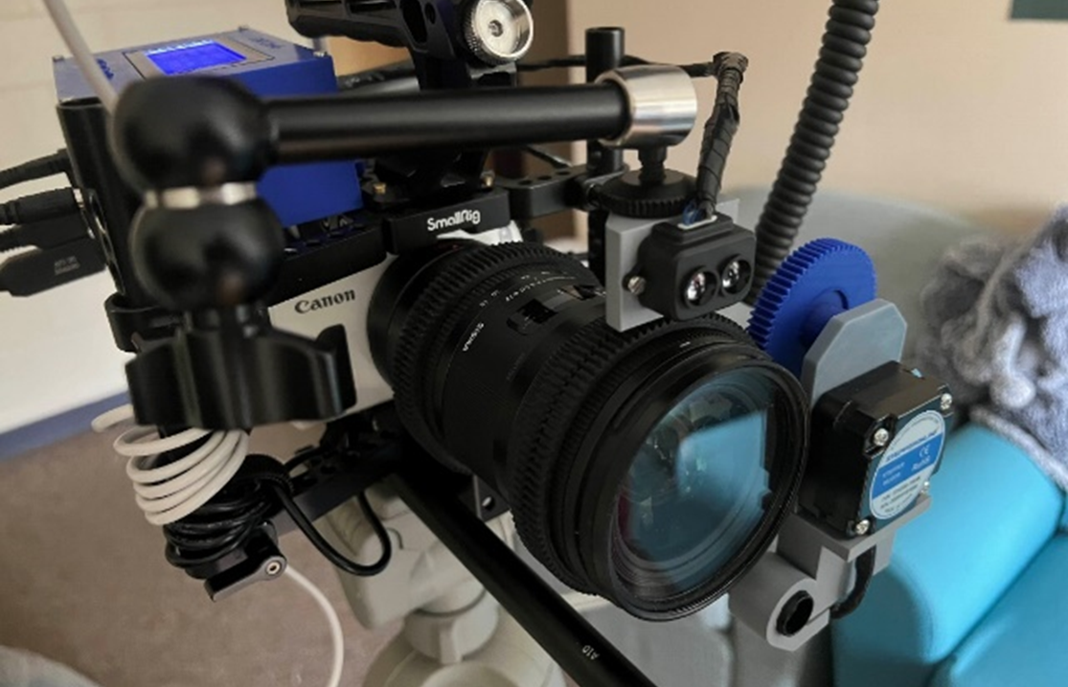
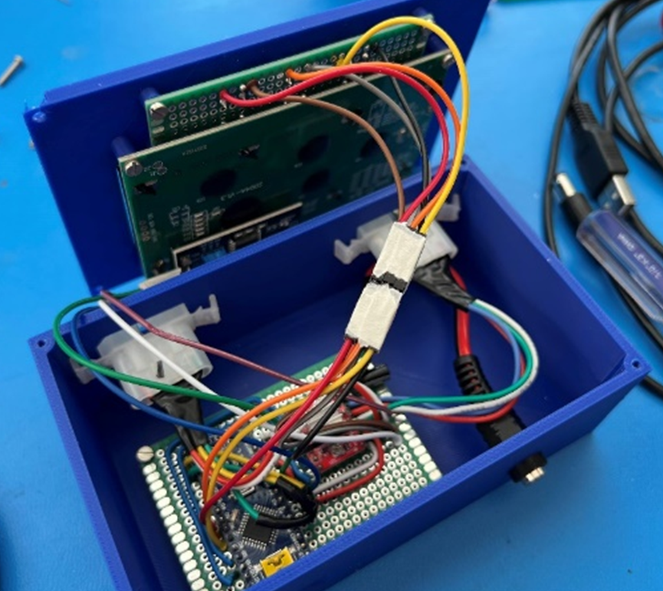
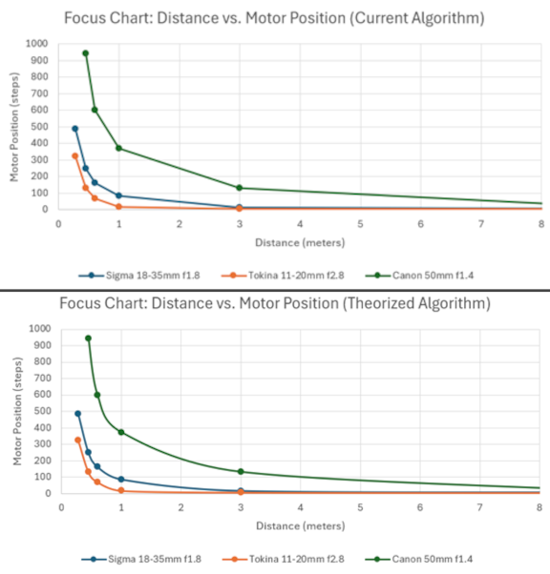
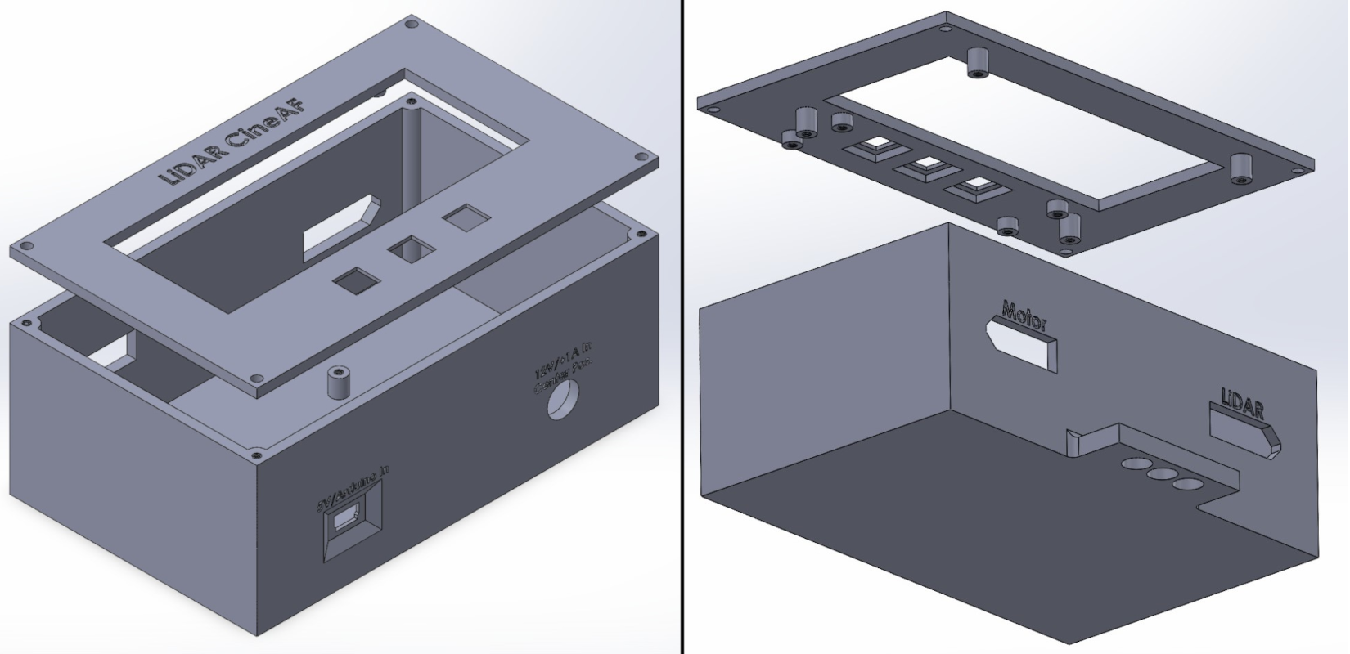
Low-Cost LiDAR Lens Autofocus System for Cinema Cameras Nolan K. Juneau (nkj1006@usnh.edu) Faculty Advisor: Dr. Richard Messner, Ph.D Department of Electrical and Computer Engineering, University of New Hampshire
Introduction
Software Design
Results
Goal: Design and build a functional, low-cost autofocusing system for cinema cameras using inexpensive LiDAR technology that can be adapted to any cinema camera rig.
Motivation: Professional cinema cameras (unlike many consumer cameras) do not have in-built autofocusing, requiring a dedicated camera crew member to manually “pull focus”. LiDAR-based autofocus systems do exist but are prohibitively expensive for independent filmmakers. Consumer microcontroller/electronics hardware and 3D-printing technology can achieve similar performance for a fraction of the cost.
Requirements:
Allows for autofocus capability for all lenses with a manual focus ring
Designed as a mountable, self-contained unit with user control:
Main case should be no larger than 150mm x 150mm x 75mm
Be powered entirely by 5V USB power for ease of portability
Total material cost of the system should not exceed $100
Programmed via ArduinoIDE in C++ (~700 lines total)
“Calibration sequence” determines focus curve for any given lens:
Sets motor position for focus at four distances (0.6m, 1m, 3m, & infinity) and extrapolates focus “curve”
Stores three “focus calibration profiles” via Arduino’s internal nonvolatile EEPROM memory
Reset function clears all saved EEPROM calibration data
Effectively keeps subjects in focus for wide/medium lens focal lengths (<50mm):
Maximum Range of 9m (29.53ft)
Three “calibration profiles” means settings are saved for multiple lens/camera setups, even when powered off
Control box and LiDAR sensor block mounts to cinema camera rig using standardized ¼-20 screw mounts
Focus motor attaches to standardized 15mm mounting rods to interface with focus ring via 0.8 Mod gear
Total materials cost of only $71.69 per unit
While in “focus mode”, live distance feed from TF-Luna is listed on screen
TFMPlus Arduino library used for TF-Luna serial communication
AccelStepper Arduino library used for speed-ramped stepper motor control
LiquidCrystal_I2C Arduino library used for LCD display communication
Hardware Design
Circuit Design & Block Diagram
Future Advancements
Distance Sensor: TF-Luna LiDAR Sensor:
Single-beam distance detection, maximum range of 9m (29.53ft)
Connected to Arduino Nano via Serial protocol
Mounted to camera via 3D-printed mount to ¼-20 screw thread
Microcontroller: Arduino NANO
Stepper Motor: NEMA-17 (17HS08-1004S) with 5-1 gear reduction:
Controlled via A4988 stepper motor driver board
600mA current input requires separate 12VDC power supply, achieved via USB to 12V barrel jack step-up cable (center-positive)
3D-printed case designed in SolidWorks:
Measures 5.12”W x 3.15”L x 1.97”H
4x20 LCD display for GUI & live distance feed (using I2C protocol):
Three push-buttons for GUI control
Two 4-pin Molex connectors to connect motor and LiDAR sensor
Arduino NANO, A4988 driver, and DC power inputs soldered to 5x7cm perfboard for permanent mounting/wiring
GUI buttons soldered to 2x8cm perfboard
Wire connections between Arduino and LCD screen/buttons can be disconnected for servicing/troubleshooting
Powered via dual-output USB battery bank for 5V and 12V circuits
Curve extrapolation algorithm can be smoothed for more accurate, “natural” focusing
Increase single-beam distance for use with telephoto lenses
Single-beam LiDAR is limiting, can be expanded using LiDAR arrays:
Incorporate face/body tracking and selective subject focusing via image processing
Microsoft Kinect LiDAR arrays are easily sourced and highly capable for motion tracking
Sensor Block
Motor Block
Subject
TF-Luna
LiDAR
Sensor
Focus Ring Control
Electronics can be simplified to a single PCB using an STM32 IC to vastly reduce size:
Merge internals, LiDAR sensor, and motor assembly
Could be run off a rechargeable Li-ion internal battery
Machine body from aluminum via CNC to greatly increase resiliency
Distance
Stepper Motor
Distance
Data
(Serial)
Control Box
Motor
Signal
Motor Position Instructions
+12V
Barrel
Jack
Power
References
+5V
USB
Power
Arduino NANO
Microcontroller
A4988 Stepper Motor Driver
TFMini-Plus Arduino Library for the Benewake TFMini-Plus LiDAR Sensor https://github.com/budryerson/TFMini-Plus
LiquidCrystal_I2C Arduino Library for I2C LCD Displays
https://github.com/johnrickman/LiquidCrystal_I2C
AccelStepper Arduino Library for Stepper Motors with Acceleration/Deceleration Support
https://github.com/waspinator/AccelStepper
Tenney, Matthew. “Microsoft Kinect – Hardware.” Geospatial Modeling & Visualization, Geospatial Modeling & Visualization, 5 July 2012, https://gmv.cast.uark.edu/scanning/hardware/microsoft-kinect-resourceshardware/
I2C
Screen
Data
Open/Closed Switch Data
LCD
Screen
Push Buttons

