Slide 1
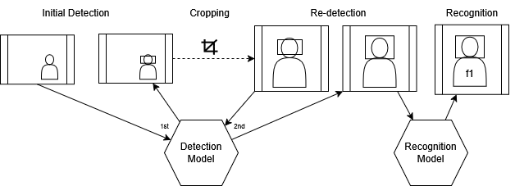
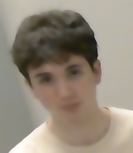
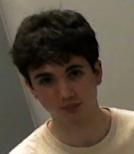
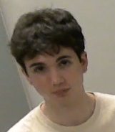
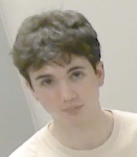
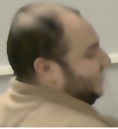
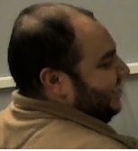
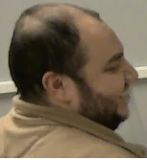
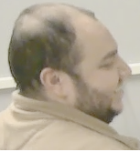
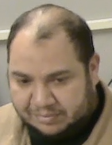
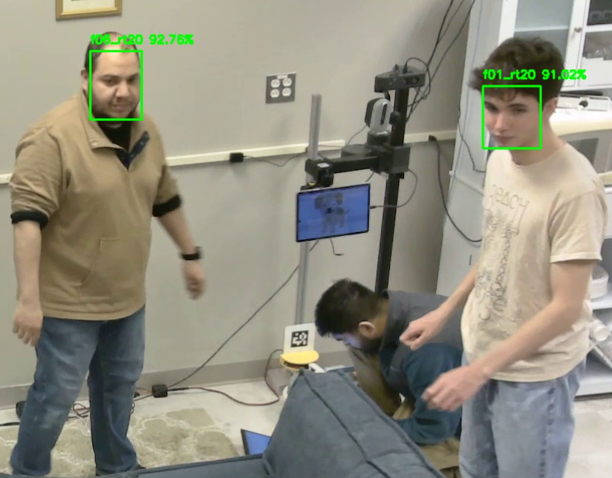
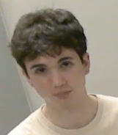
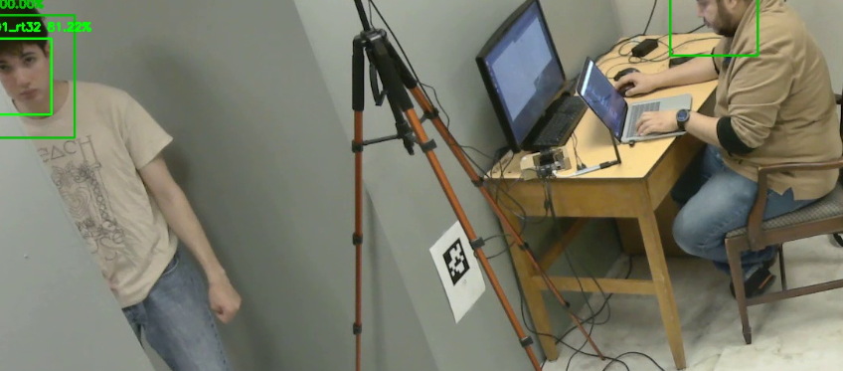
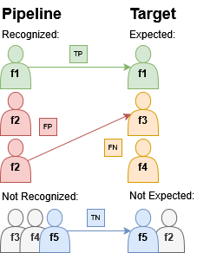
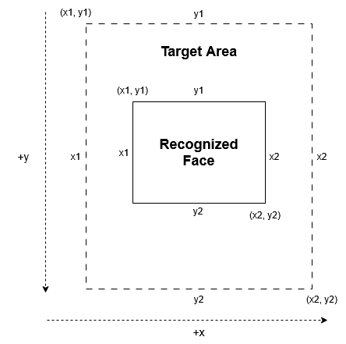
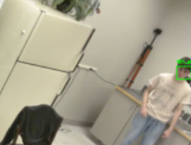
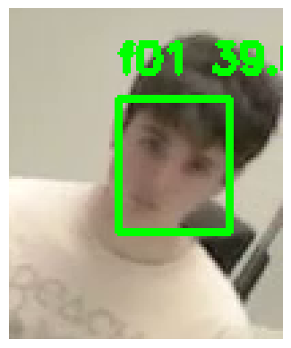
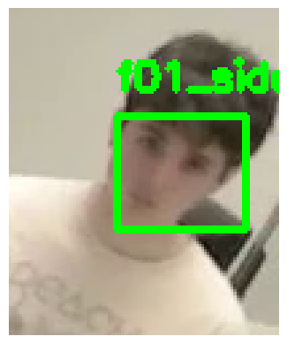
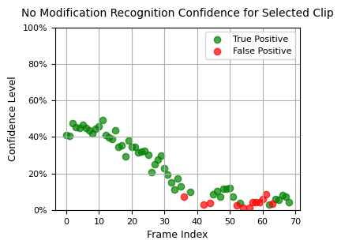
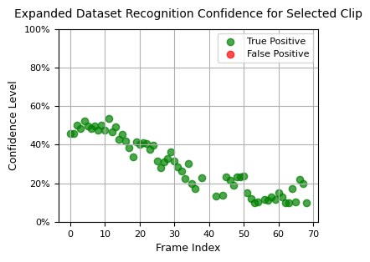
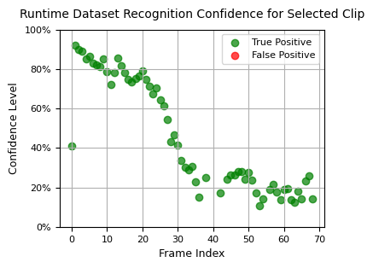
Design and Analysis of Facial Recognition Algorithms for Home Monitoring Nathaniel F. Bernich Advisor: Momotaz Begum, Department of Computer Science
Introduction
Modifications
Results (cont.)
The Cognitive Assistance Research Lab (CARL) is implementing facial recognition systems to monitor patients with Alzheimer’s Dementia in their homes, which may be challenging for existing technologies. My project aims to evaluate and improve the performance of facial recognition algorithms in a home environment to aid in this application.
Fig. 3: Modified pipeline with re-detection after cropping
Cropping and re-detection:
The area around each detected face is cropped, and another face detection on the cropped area adjusts the bounding box. A similar strategy where the bounding box is simply translated onto the cropped area was also tested.
Research Questions
Expanded Dataset:
For all faces in the dataset that the recognition algorithm matches against, several variations are created. Variations include gamma adjustment, gaussian blur, and other preprocessing steps to better match lower quality face images found in the footage.
Fig. 8: Results for each modification across all testing footage
Which aspects of footage (camera angle, subject position, etc.) in a home environment pose the greatest challenges to “out-of-the-box” facial recognition pipelines?
How can performance of these pipelines be evaluated?
What modifications can be made to the pipelines to improve them for this use case?
Data across all frames indicates that expanding the dataset and sampling additional faces from the footage is superior. Confidence levels highlight how closely faces are matched against the runtime dataset. Remaining failures tend to involve a failure of face detection prior to recognition.
Fig. 4: Partial expanded dataset
ORIGINAL DATASET
ORIGINAL DATASET
Runtime Dataset:
During the runtime of the pipeline, recognized faces that match faces in the original dataset with high confidence are added to a “runtime dataset”. The runtime dataset better reflects how faces appear in the footage and is checked in later frames.
Baselines
Conf:
75.56%
Conf:
65.49%
I used footage from the research team’s Olson Center lab, designed to mimic a studio apartment.
The footage intends to stress anticipated weak areas of facial recognition.
I used existing deep learning models as a basis for my implementation and tested several modifications.
RUNTIME DATASET
RUNTIME DATASET
Conf:
92.76%
Conf:
91.02%
Fig. 5: The runtime dataset built from sampling previous frames matches the footage better
Fig. 9: Targets (dark green) with overlayed recognition bounding boxes (light green), if a face was detected. Detection fails for some faces, in which case recognition always fails.
Methodology
Results
Conclusion
Fig. 1 (left): Sample frame analysis
A basic recognition pipeline performs well for most frames in the sample footage. However, when the resolution or angle of a face is substandard, misrecognition is common.
Performance improvements to facial recognition can be attained through rather simple algorithms, showing promise for applications in a home environment
The most effective improvements rely on adapting datasets to better match the inevitably poorer quality of real footage encountered in this setting
These strategies appear to increase correct recognitions while avoiding additional false positives, as desired
Occasional failure of face detection remains a challenge to consider
Fig. 2 (below): Face bounding box matching against a target area
Re-detection showed early promise, but did not significantly improve results overall. In cases where it did, the bounding box appeared to change noticeably after re-detection. The cropping modification did not produce better results than the baseline, indicating that it is the bounding box, not the area of the frame sent to recognition, that is relevant.
Fig. 6: Bounding box adjustment from re-detection
Expanded datasets were sufficient to eliminate many misrecognitions in the sample footage. Runtime datasets produced similarly favorable results. Furthermore, runtime datasets raised confidence for nearly all recognitions, especially those involving higher quality footage.
My evaluation algorithm matches recognized faces to targets areas where they are expected, and records:
True Positives: Expected faces that are recognized
False Positives: Unexpected faces that are recognized
False Negatives: Expected faces that aren’t recognized
True Negatives: Unexpected faces that aren’t recognized
With these values across all frames, I calculate:
Precision: what proportion of found faces are expected
Recall: what proportion of expected faces are found
Acknowledgements
I would like to thank Prof. Momotaz Begum for her guidance during my project, and her research team for helping to facilitate my learning.
Resources
InsightFace Face Analysis Library: https://insightface.ai/
Baseline models: https://github.com/deepinsight/insightface/tree/master/model_zoo
Fig. 7: Confidence over time under several modifications, in a sample clip with progressively lower quality faces

