Slide 1

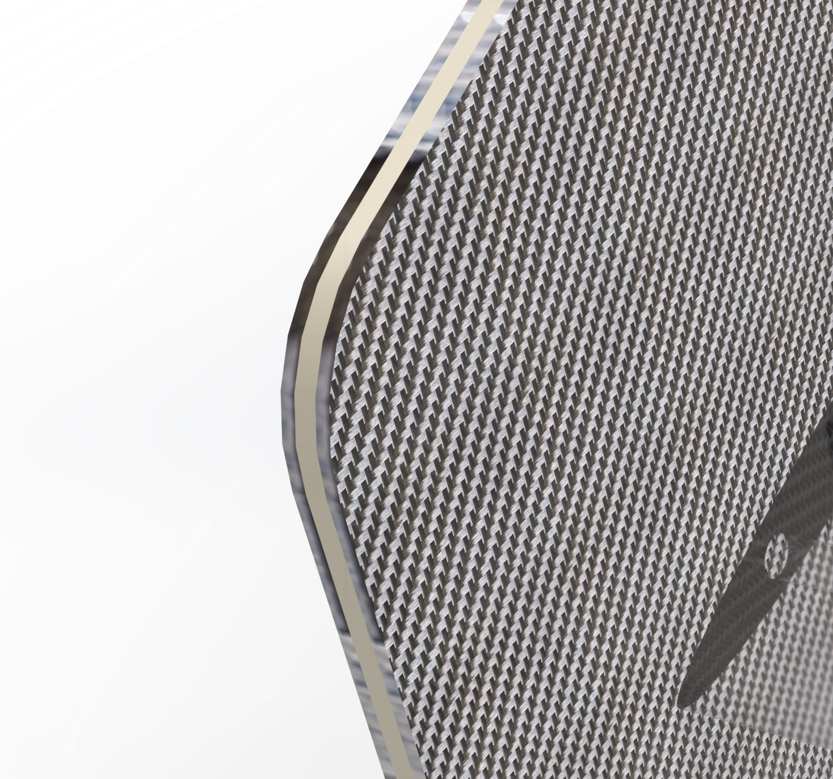
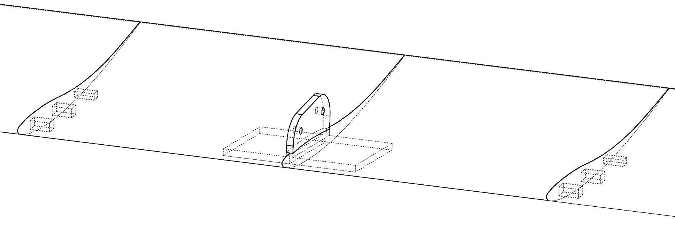
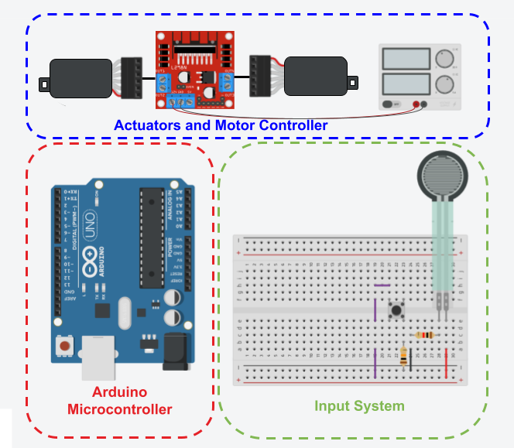
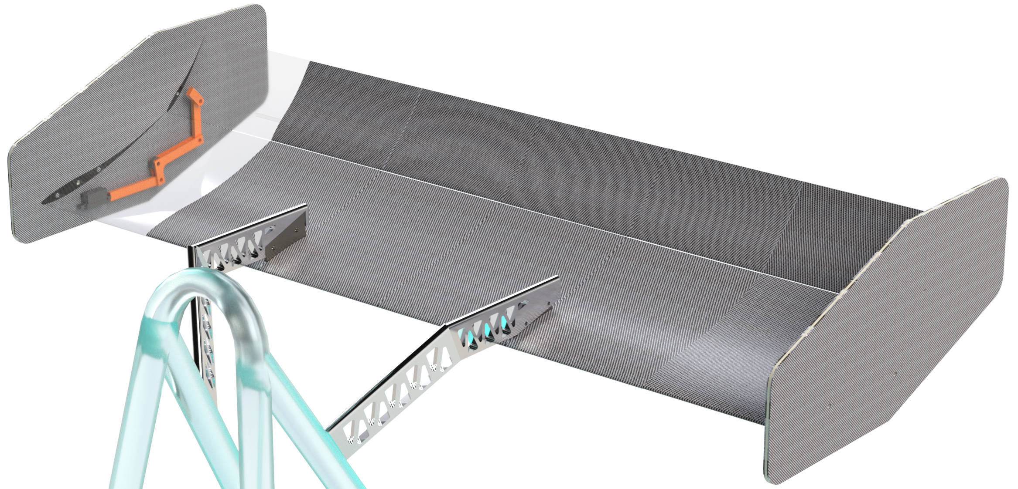
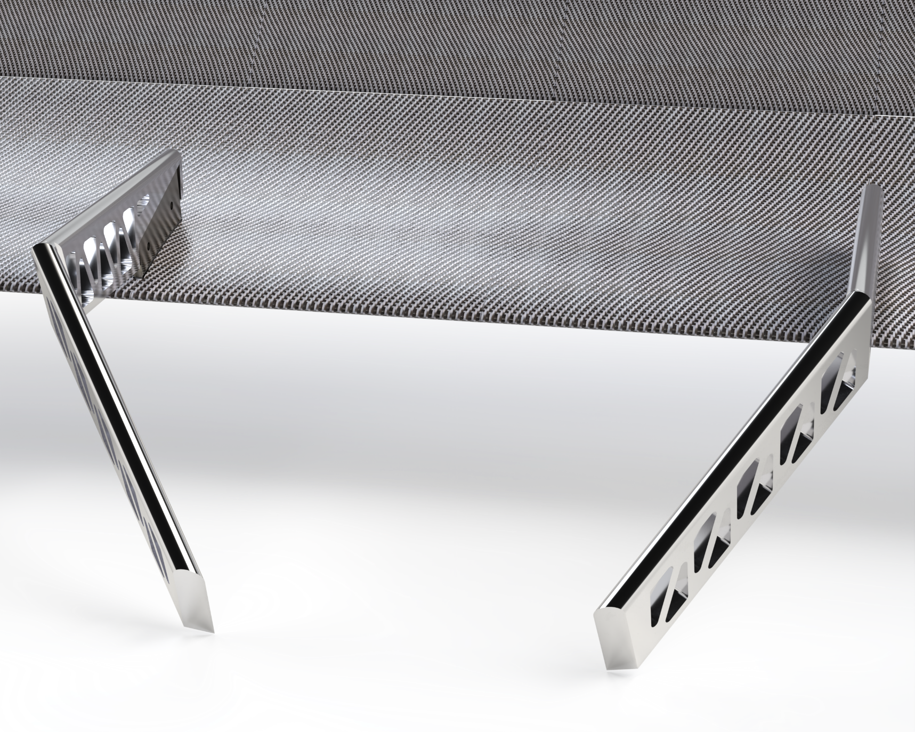
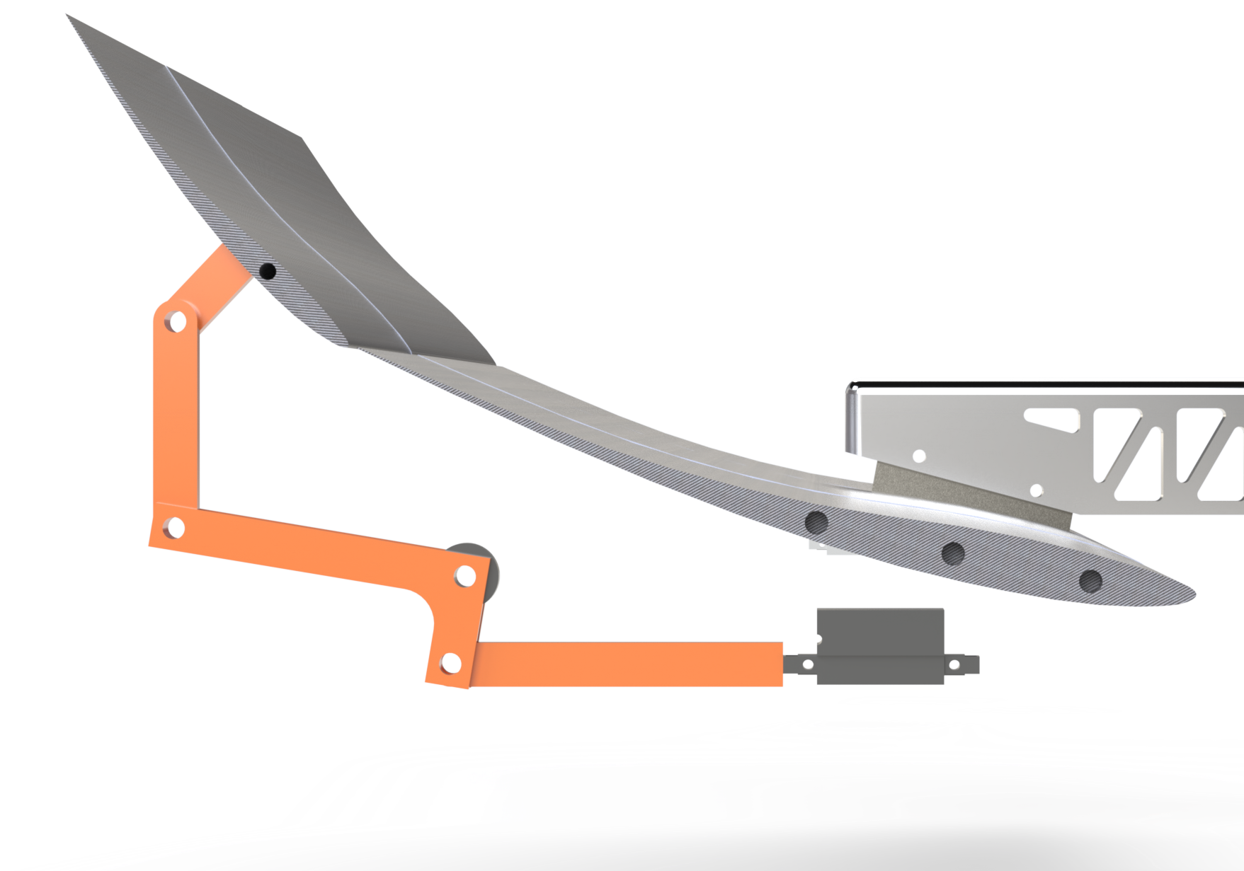
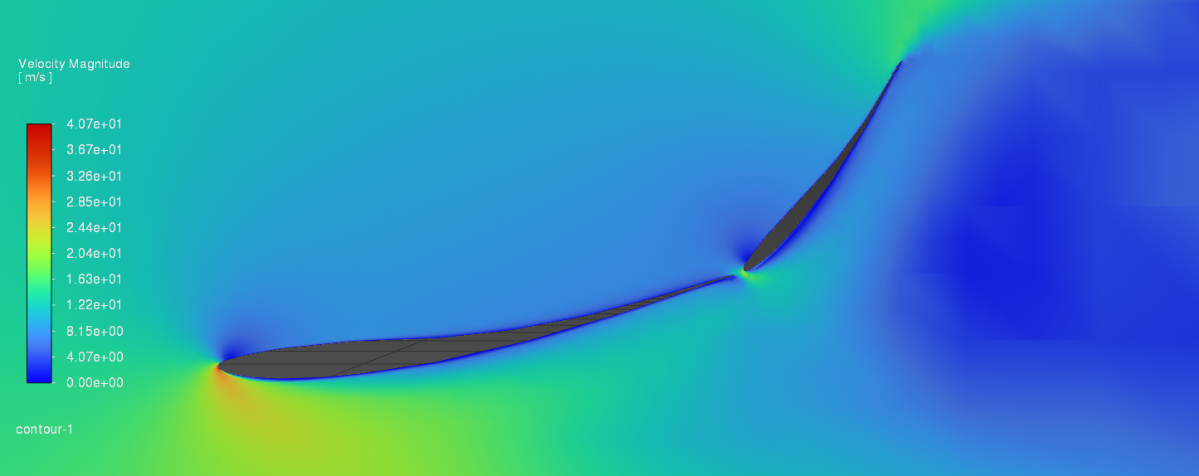
Active Aero and Drag Reduction System for the UNH FSAE Car
Josh Beaulieu, Thomas Trumble, Jackson Weber, Colby Wheeler
Department of Mechanical Engineering, University of New Hampshire, Durham, NH 03824
Team Aero
Introduction
Control System
UNH’s Formula SAE team competes in high-performance racing but has lacked aerodynamic components due to limited resources. Team Aero was created to showcase active aerodynamics with a two-wing system: a fixed lower wing and an upper wing that adjusts based on driver input. This project boosts performance and sets the stage for future UNH aero development.
Arduino-based control system that manages the actuation of the linkage system:
Pressure sensor increases actuator actuation distance with higher applied pressure.
Override button forces zero actuator extension regardless of pressure input.
Actuator potentiometer outputs to the Arduino.
Analysis and Optimization
Researched slow-speed, high-downforce wing profiles. All sims were conducted at FSAE car speed (35mph).
Final Stationary Wing: 10 degrees, 250mm chord, 55% thickness, has the ideal C_{L}/C_{D} ratio.
Final Actuated Wing: 125mm chord is ideal with a 3-degree resting angle. Chose 125mm since it was the shortest chord we could realistically manufacture.
End Plates
Wing Construction
Profiles @13 degrees AoA, 18 in. chord
Airfoil | C_{D} | C_{L} | C_{L}/C_{D}
e423 | 0.24 | -1.17 | -4.96
goe225 | 0.19 | -1.05 | -5.44
goe431 | 0.19 | -1.04 | -5.55
goe233 | 0.20 | -1.11 | -5.60
s1223 | 0.14 | -0.31 | -2.20
2 mm Carbon Fiber plates on each end.
3 mm Divinycell H80 core.
Set-in bearing for actuated wing to rotate in.
3D-Printed each wing in 6 PLA sections.
Dowels and aluminum brackets used to align each wing section.
Adhesive bonding used to attach parts.
Carbon fiber + epoxy used to wrap each wing.
Conclusions & Future Work
Moving forward, we plan to document and transfer our research, design methodologies, and fabrication techniques to the UNH FSAE team. This will enable future teams to:
Refine and optimize the current wing design for enhanced performance.
Develop improved control systems with more precise actuation and driver feedback.
Enhance structural materials and manufacturing techniques to improve strength-to-weight ratio and aerodynamic efficiency.
Expand aerodynamic testing, including on-track validation and advanced CFD simulations with full-vehicle integration.
Integrate the wing into the future UNH FSAE Michigan competition vehicles.
Acknowledgements
We would like to thank Professors May-Win Thein, Juan Carlos Cuevas Bautista, and Ivaylo Nedyalkov, as well as Scott Campbell. We would also like to thank the UNH Parents Association.
Gooseneck Mounts
Mechanical Linkage System
Material: 6061 Aluminum.
Weight: 2.2 lbs.
Factor of Safety: 9.6 at 35 mph.
Material: Components 3D-printed from ABS.
Actuator travel distance: ~5.8 mm.
Angle adjustment: 3° to 50° in 0.29s.
References
[1] Airfoil Tools. “Airfoil Details: GOE233.” Accessed Jan 7, 2025. http://airfoiltools.com/airfoil/details?airfoil=goe233-il
[2] Autodesk Inc. “Circuits on Tinkercad. “ Accessed Apr 3, 2025
https://www.tinkercad.com/circuits

