Slide 1



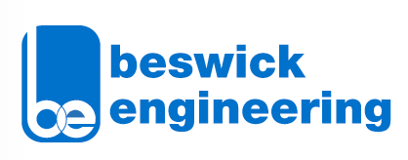
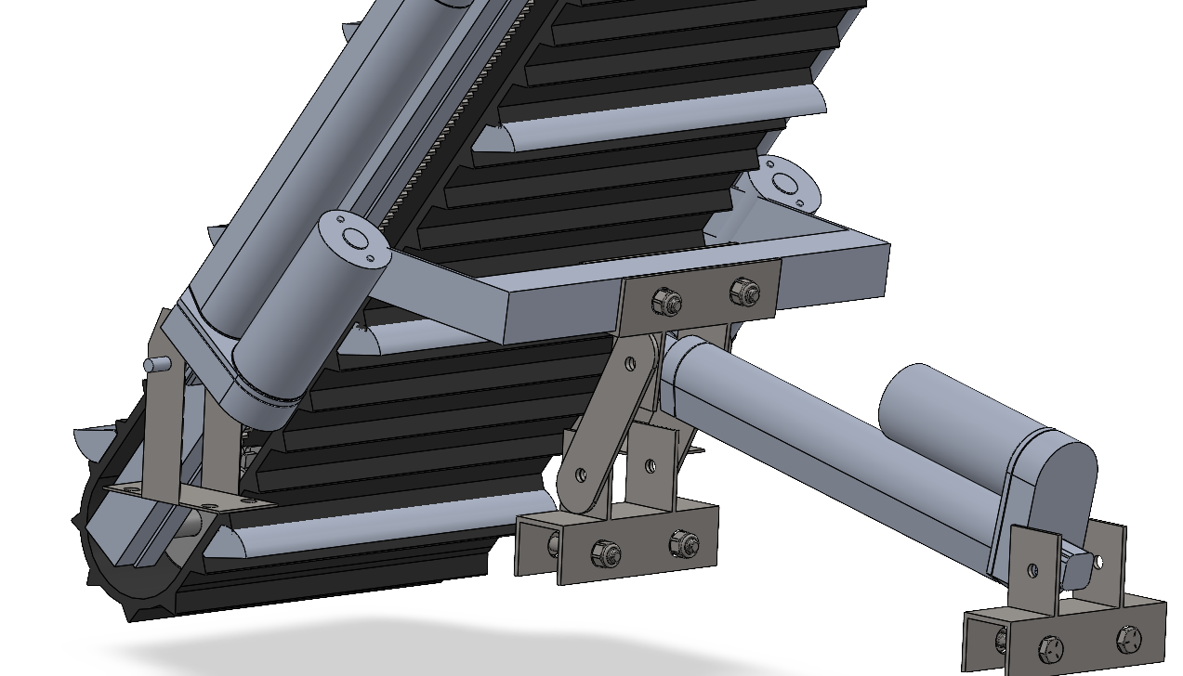
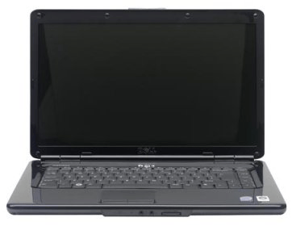
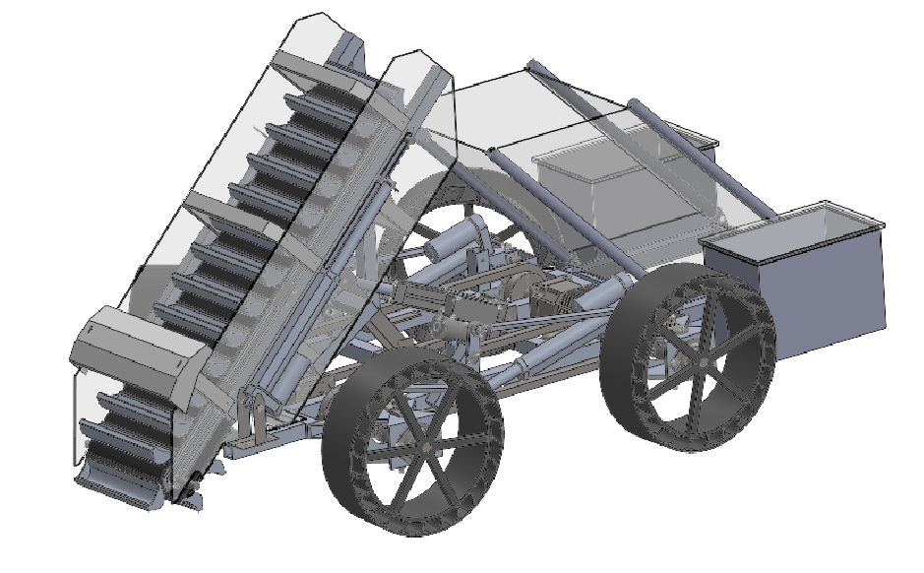
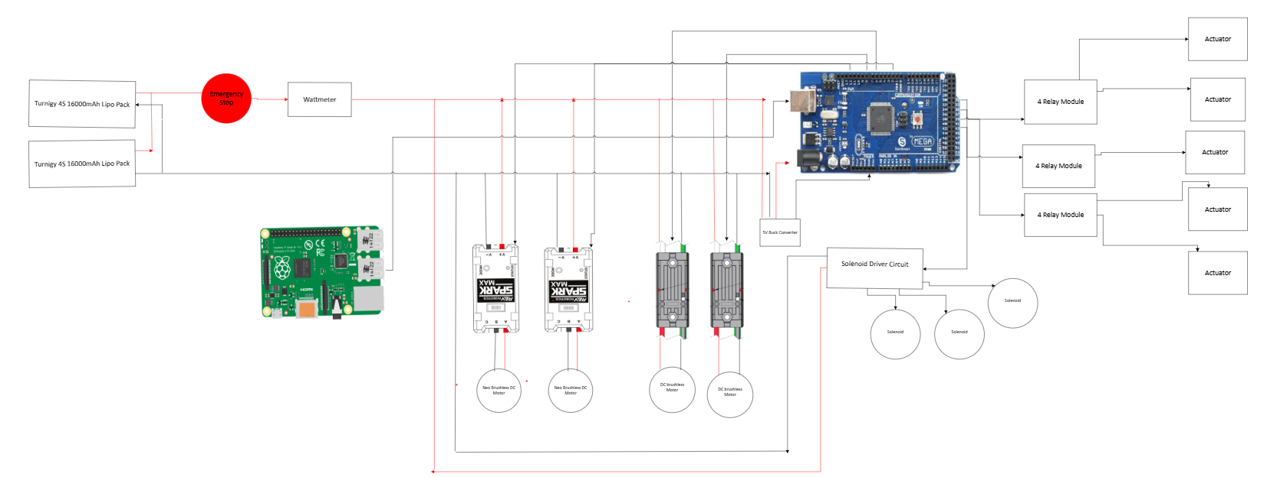
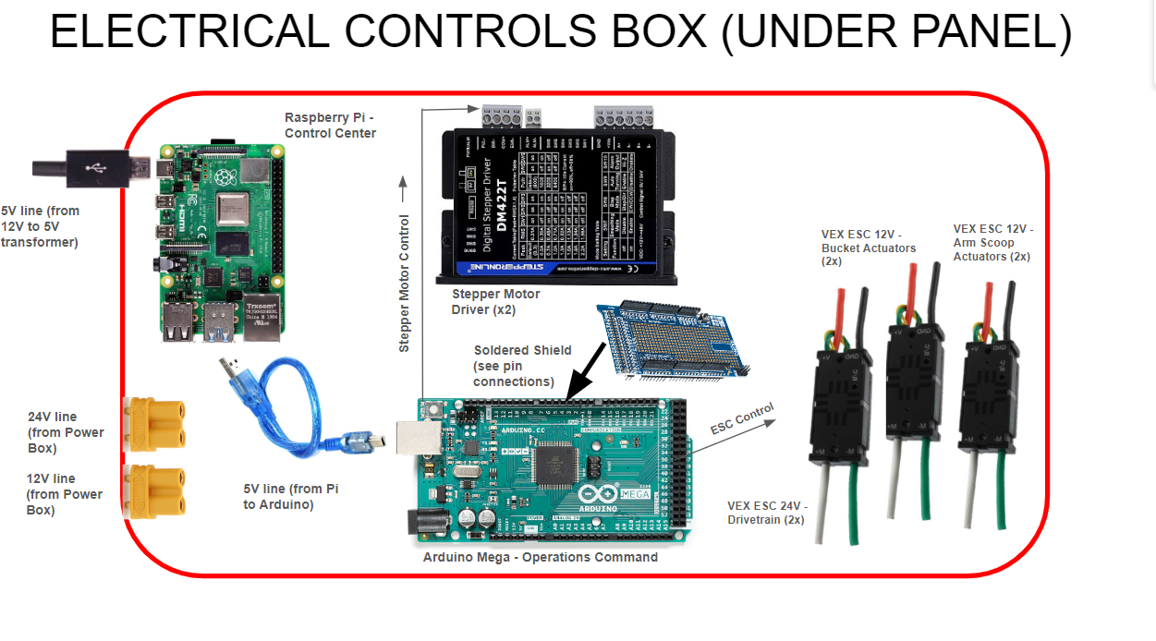
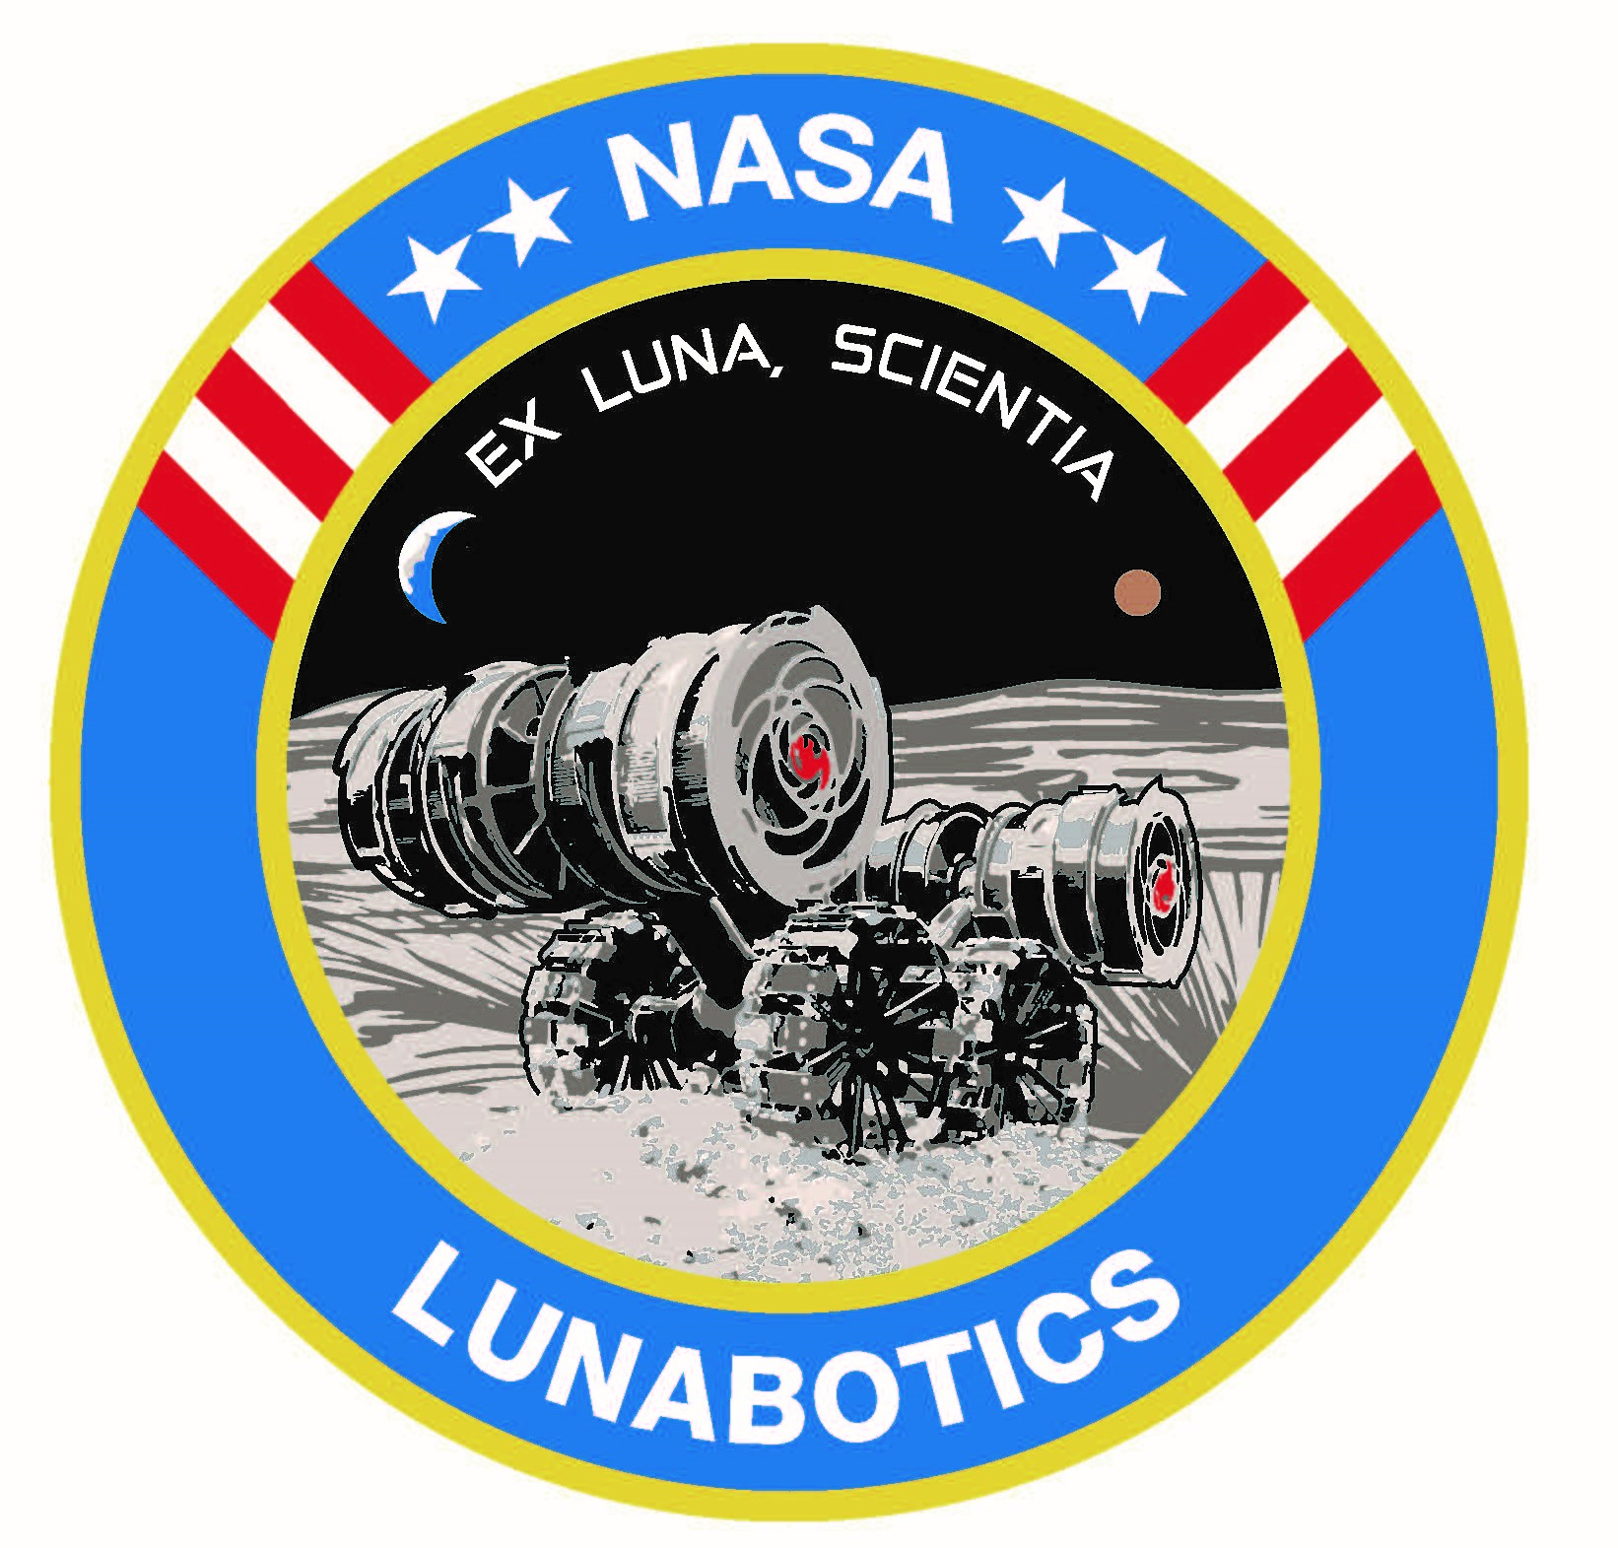
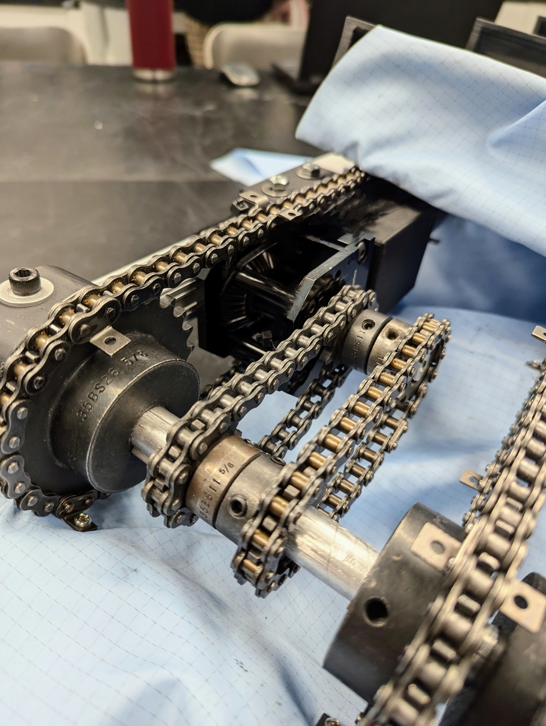
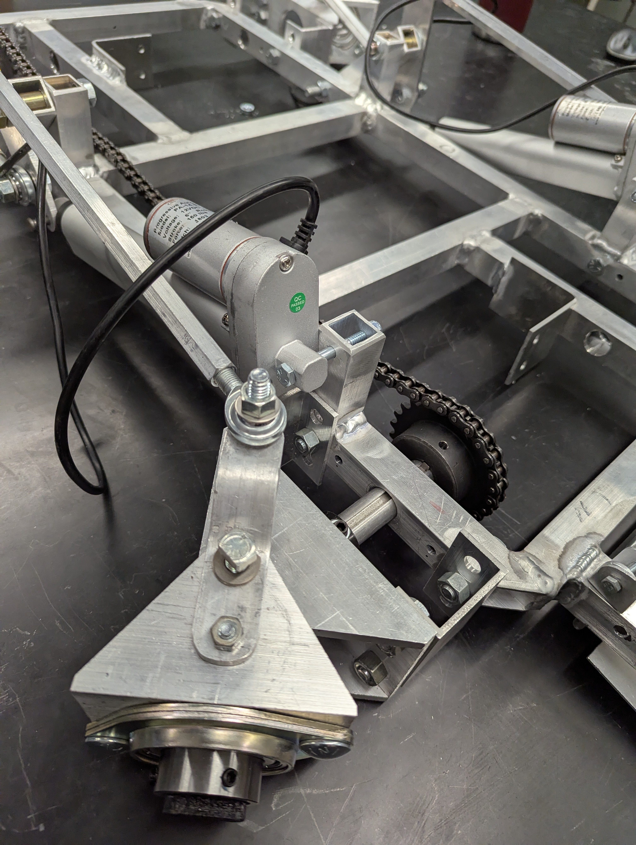
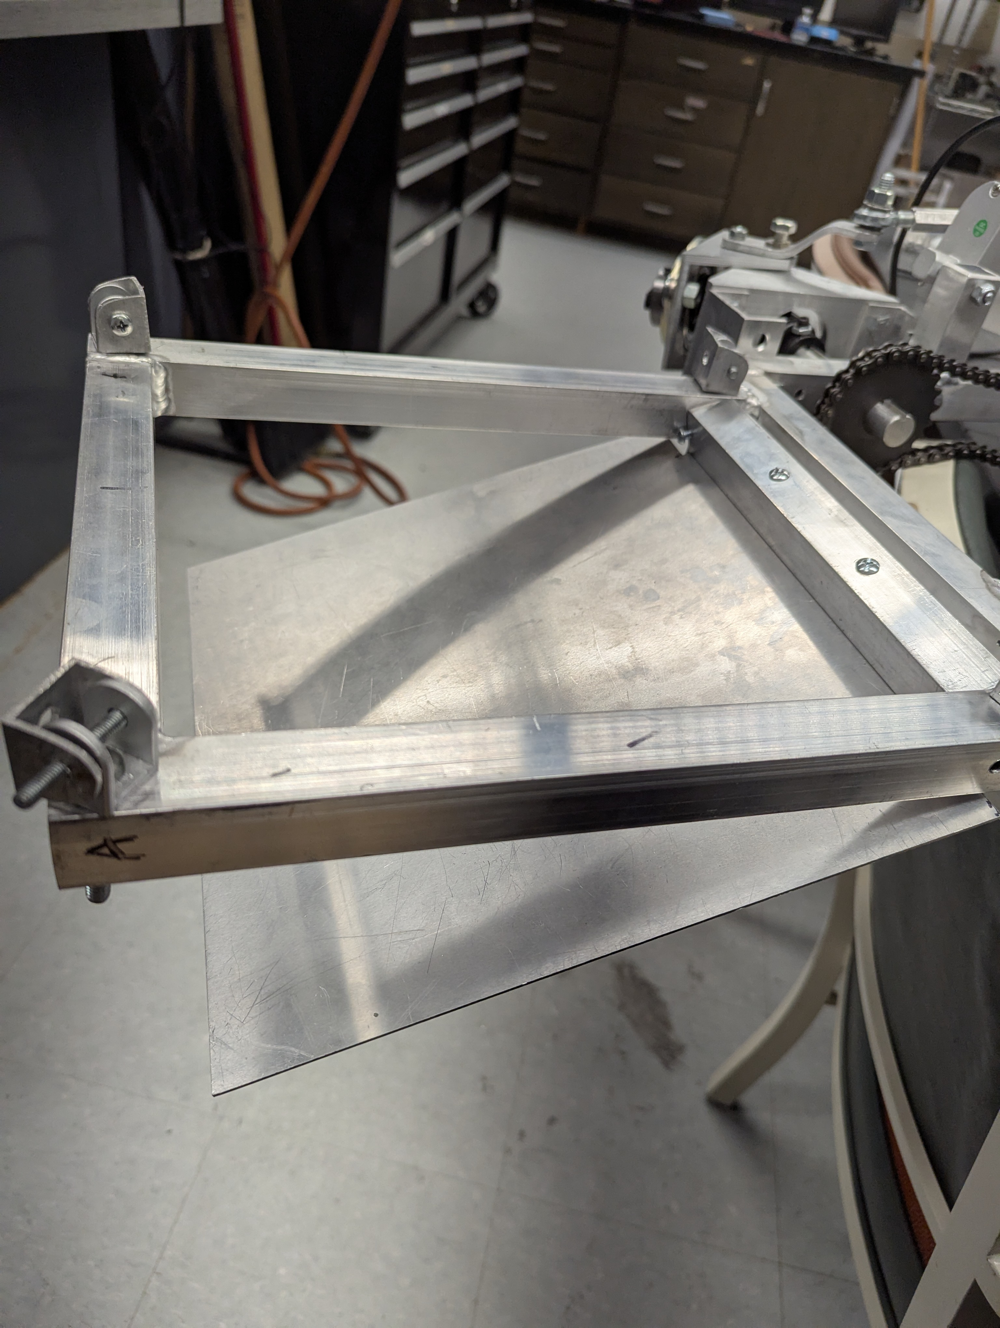
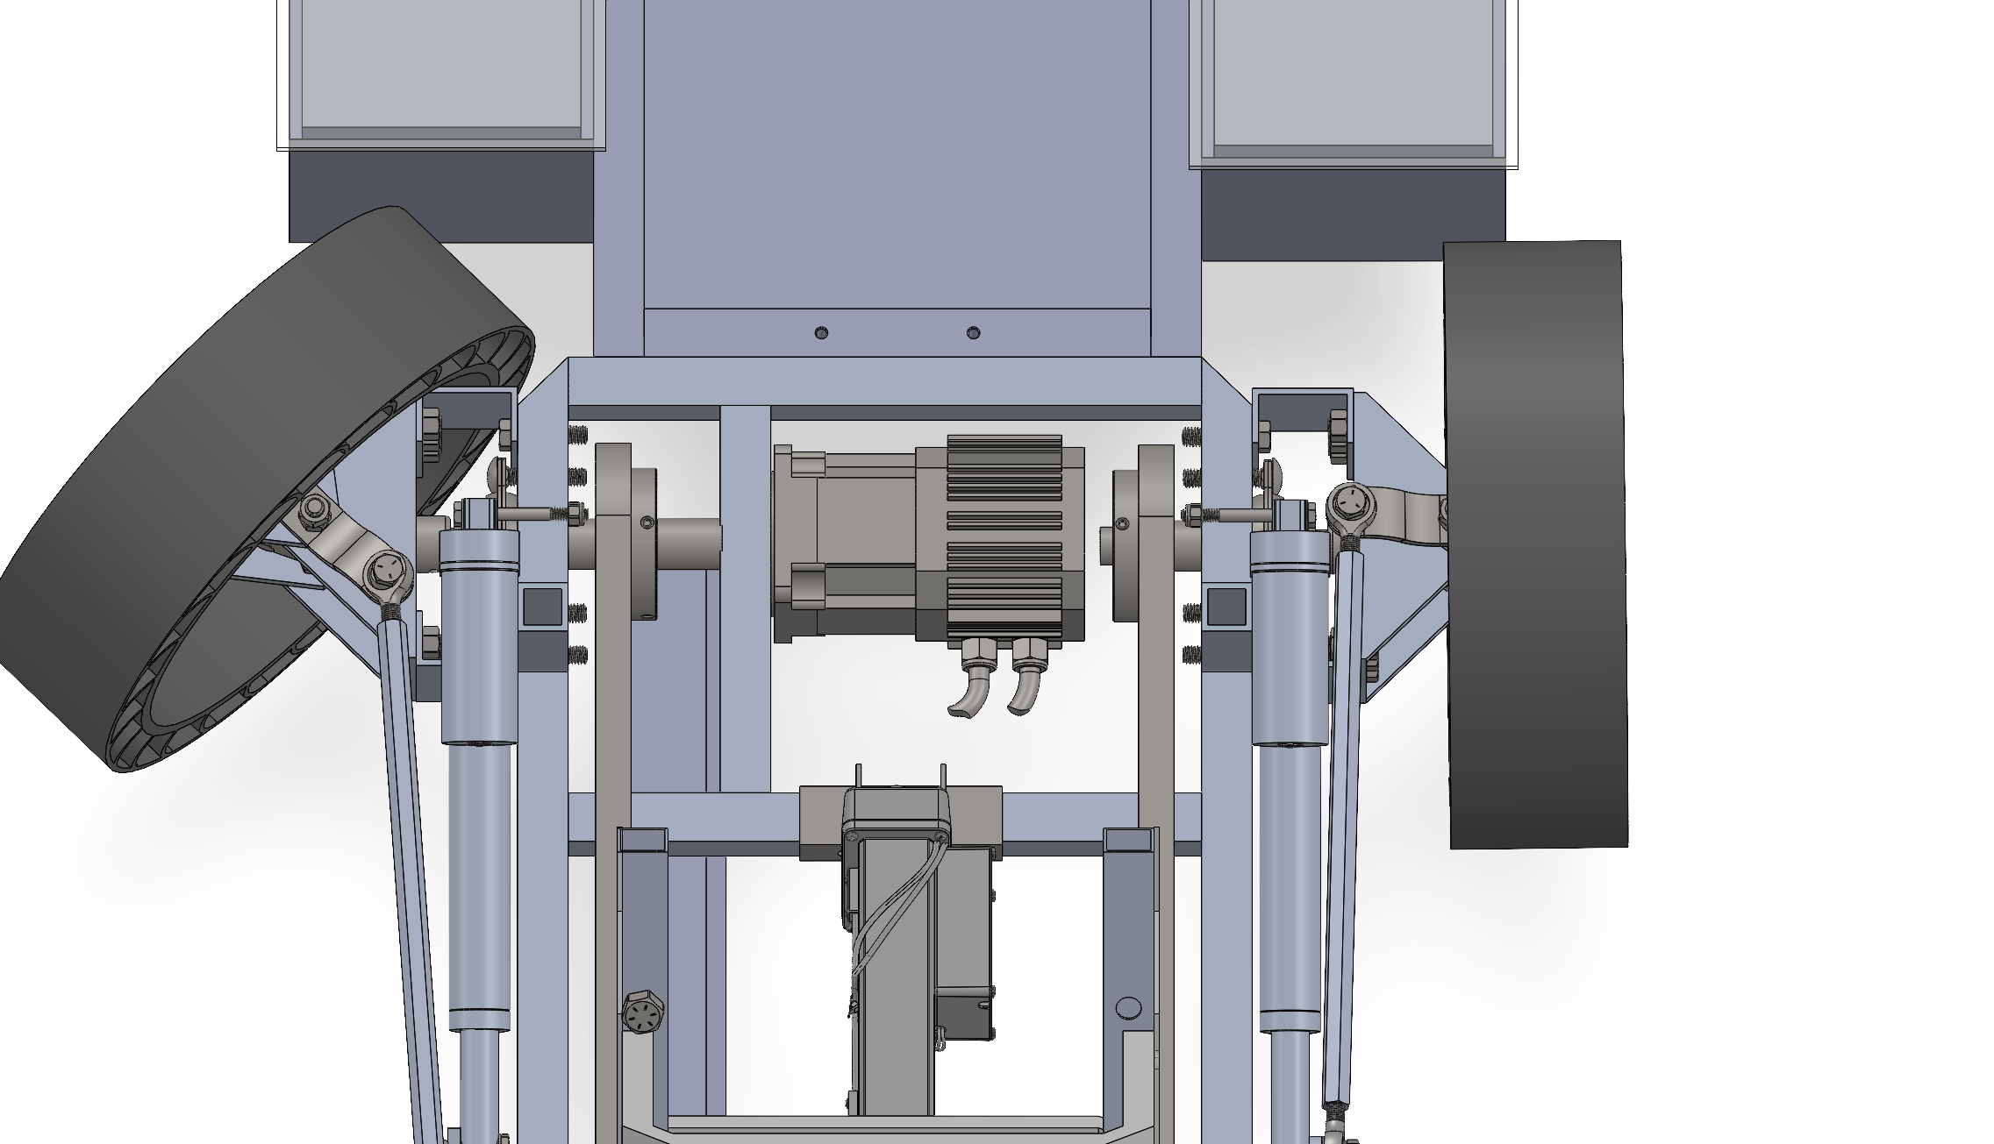
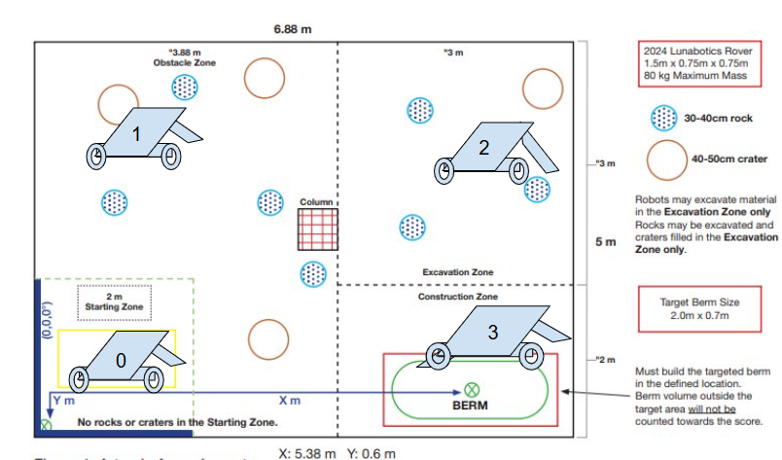
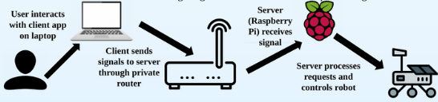
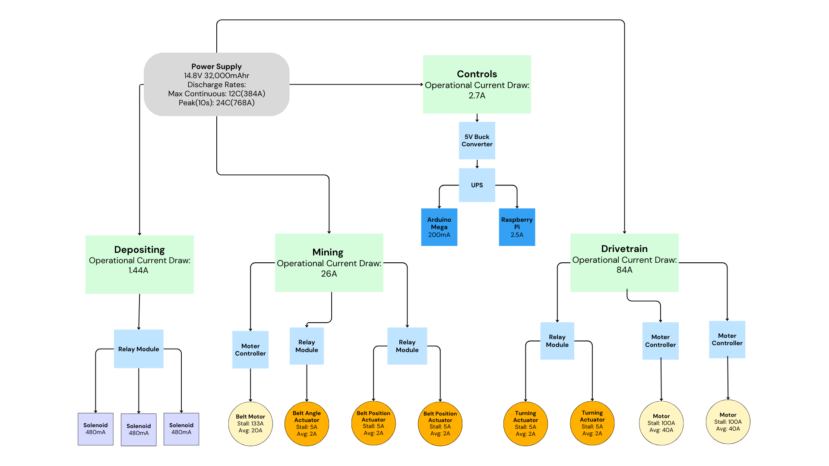
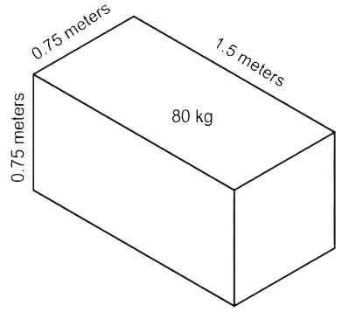
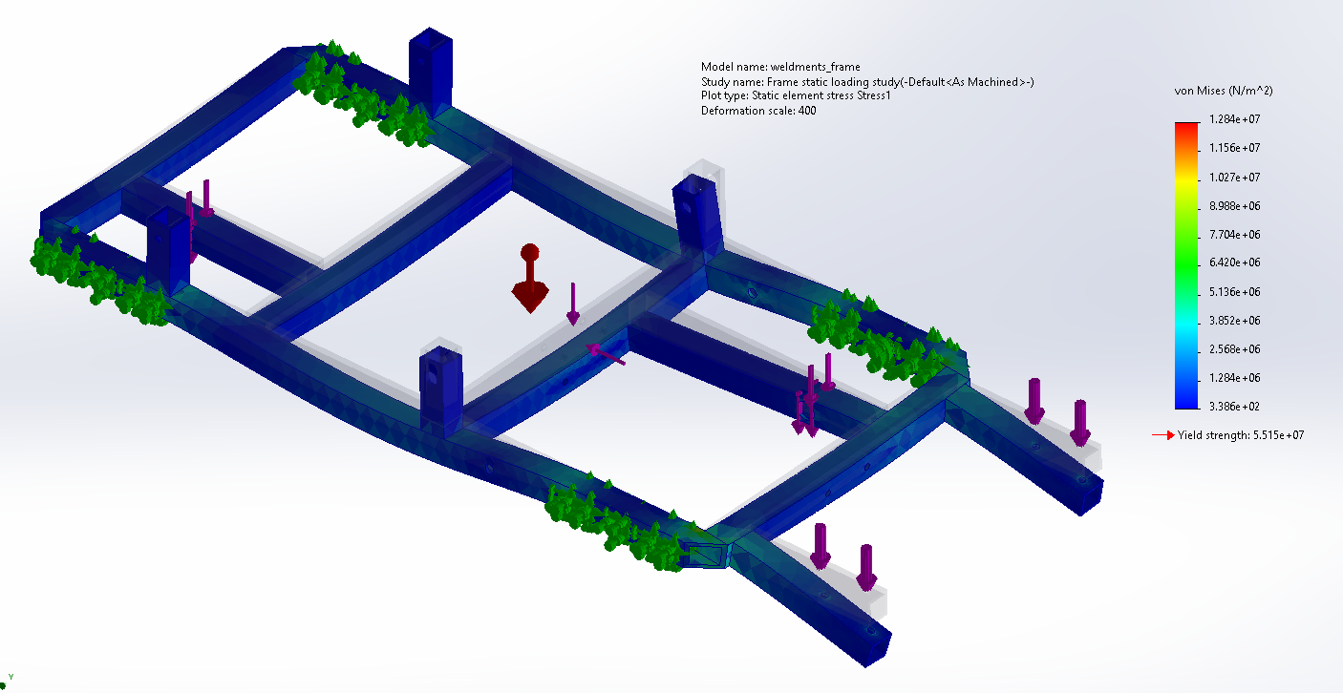
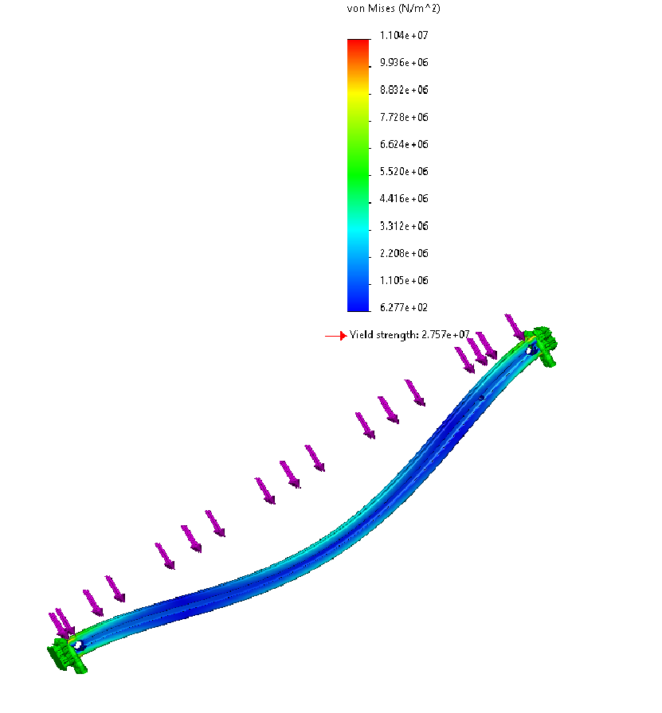
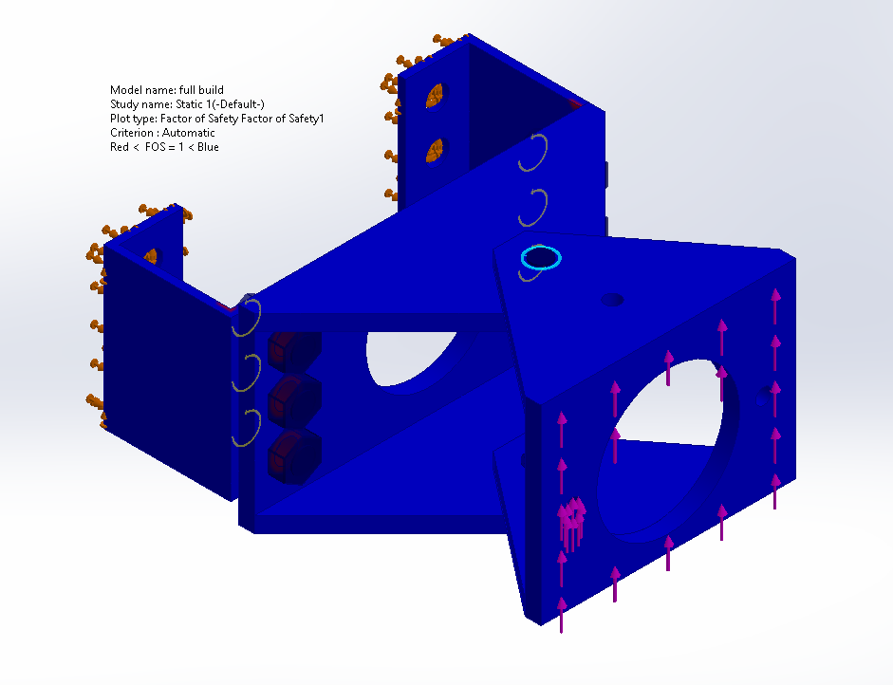
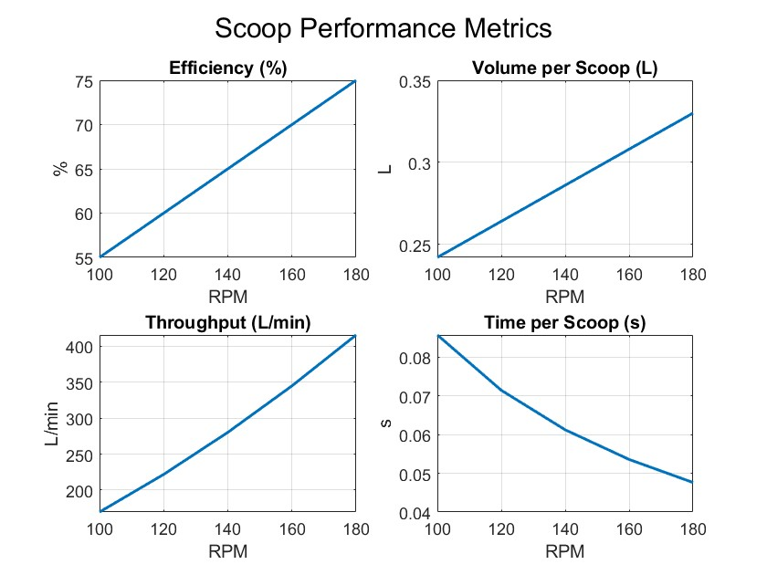
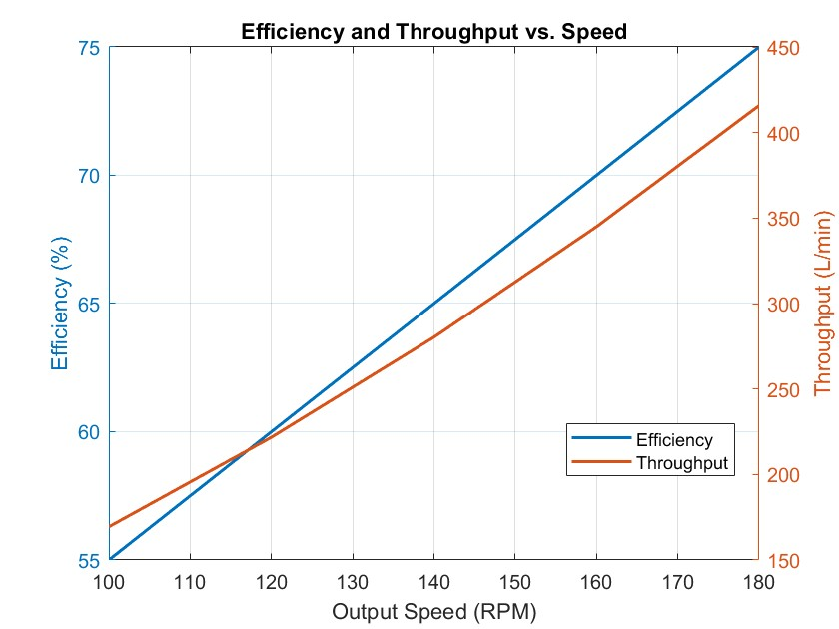

UNH LunaCats | NASA Robotic Mining Team
Kyle Auger, Emerald Bell, Alan Chen, Riley Ducharme, Jack Radzelovage,
Erica Graham, Dan Lavoie, Jackson Wozniak
Advisors: Professor May-Win Thein, ChanLing Beswick
University of New Hampshire Department of Mechanical Engineering
Project Overview
Electrical/Control Boxes
Control: Software and Hardware
NASA Lunabotics Competition
(University of Central Florida, Kennedy Space Center)
National college-level lunar rover mining competition held in Florida, hosted by Caterpillar with a $10,000 prize pool.
Interdisciplinary design teams bring robots to compete in a lunar simulant (BP-1 and LHS-1 sandpit) arena.
As part of NASA’s Artemis mission, teams are given material and performance specifications, NASA challenges each team in their knowledge of systems engineering and design.
Robotic Mining Belt
Houses Arduino and Raspberry Pi for motor controls, which draw power from the 16V LIPO battery pack. These systems communicate with actuators & motors using electric speed controllers.
Systems Controls & Operation
The robot is controlled via a client-server system in which a laptop is connected to an onboard Raspberry Pi through an external router.
Raspberry Pi communicates with Arduino to send motion commands to different parts of the robot through remote operation.
LiDAR and autonomous run cycles are team goals, granting extra competition points.
Mining system consisting of collective scoops designed for continuous lunar regolith excavation for berm construction. Consists of linear actuators for translational and rotational motion for a highly mobile subsystem.
Competition Scoring
Competition points are earned based on performance in several categories which includes berm volume normalized to power consumption and weight. Dust mitigation is another critical factor in scoring.
Software Design
Mechanical Analysis
Competition Strategy
Client
The client is run on a local computer using Python, which is connected to the robot via a boosted router setup.
The client was designed for ease of use. The client should be easy to launch and set up, with intuitive driving controls.
Server
The server is run on a Raspberry Pi located on the robot, which sends commands to the Arduino which controls the individual elements of the robot.
The server was designed with consistency in mind. It runs for long driving sessions without crashing and quickly receives and passes on input commands.
Team Performance & Operation Strategy
Strategy is to recoup any lost points in the power and weight categories by designating parts of the robot as “dust-free” features and protecting them from regolith.
Extra points are earned by mining and constructing larger berms or by mining and constructing without kicking up any dust.
Depositing & Berm Construction
Material is collected in the fabric container and deposited through a drop hatch located at the rear. The storage container is primarily constructed from fabric to minimize weight while maintaining functionality.
Rover Frame
Welded Al 6061 frame designed to support the load and bear weight of our lunar robot. The mounting considerations and the drivetrain system influenced its design.
Drivetrain & Locomotion
A chain-driven motor system utilizes individual motor control for arena navigation. All-wheel steering allows for no-slip turns and dust mitigation.
Server-Client Router Connection Scheme
Electrical Analysis
Voltage regulators step down the battery for our on-board controls.
Use separate power sources for the motor and control systems to prevent loss of control.
Metrics & Project Requirements
Material Analysis
Mechanical Systems Design
Competition Requirements
Must function in a lunar environment (no air-filled tires, pneumatics, etc.)
Must have an emergency kill switch
Must provide its own onboard power
Team Metrics
Robot must mine and displace 0.13
cubic meters of material in 15 minutes
to qualify for finals
Material must be displaced in 4 trips
from the mining area to the dumping area
Weight budget created to ensure robot
did not exceed 176lbs (80kg)
Movement performance tests allow for informed modification of the current drivetrain
Vehicle fits within dimension specs
FEA & Material Selection
Mining, Depositing, and Frame Design
An enclosed mining belt was favored over a scoop design for maximum efficiency and dust mitigation.
Mining Belt Design
The enclosed mining belt rotates via a 12V DC motor in addition with a 90° gearbox turning a shaft using a 28:1 gear ratio to meet torque requirements.
FEA & Material Selection
The mining belt was optimized using FEA to reduce weight and increase mining strength.
Torque and load analysis in SolidWorks aided in our design choices for the steering system.
Material strength analysis led us to choose strength-to-weight efficient Aluminum 6061-T6 for the robot’s frame, and subsystems.
STEM Engagement (Outreach)
Community & ARTEMIS
Students were invited to learn about robotics and NASA’s STEM Gateway Competitions.
ORHSR events were held with our team.
UNH open house and admitted students day to show incoming students what the CEPS Program has for hands on experience
Acknowledgments
Professor May-Win Thein Project Advisor
Beswick Eng, ChanLing Beswick Business Sponsor
NASA Lunabotics Department, CAT Competition Hosts
CEPS and ME Dept Grant & Funding

